Slide 1
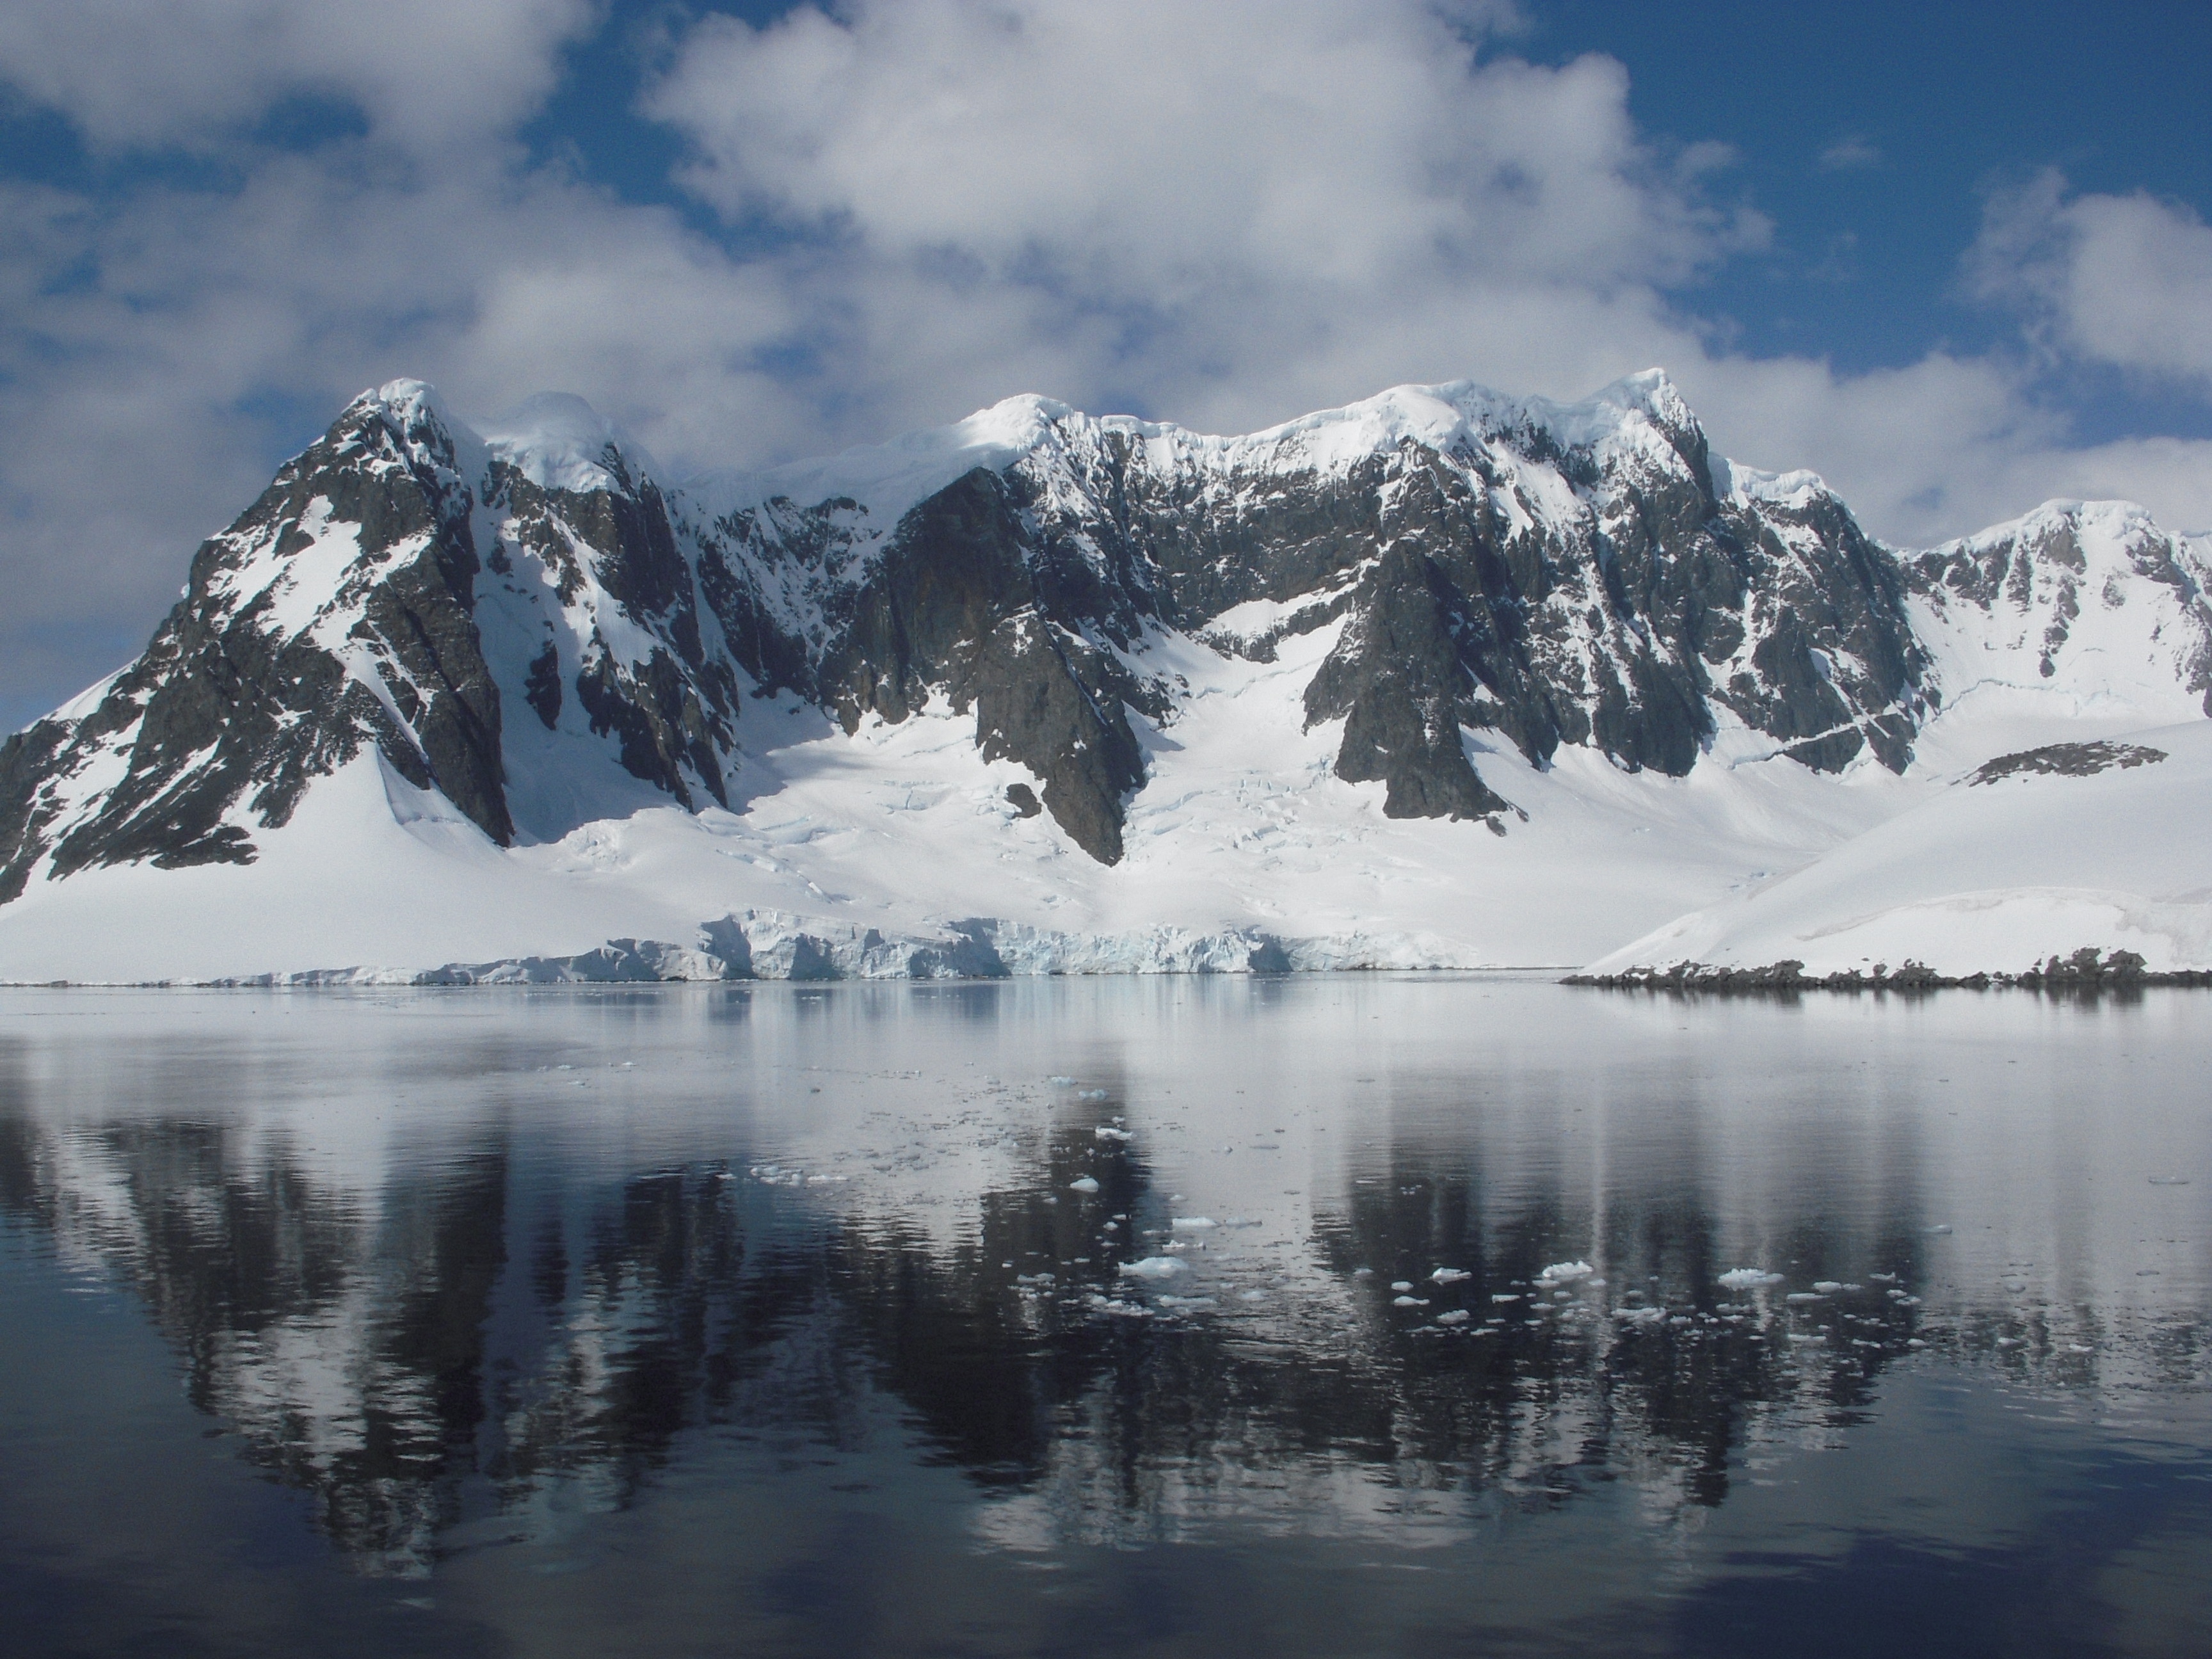



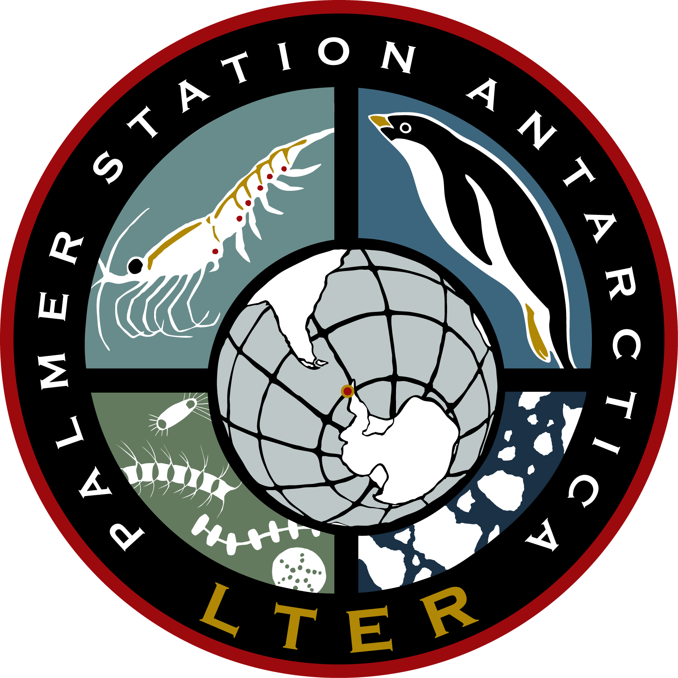


September 28, 2011, LTER Planning Meeting
Satellite Driven Studies of Climate Mediated Changes in Antarctic Food Webs
Poster #267 Broad Scale Remote Sensing
Poster #268 Local Field Effort/Remote Sensing
Matthew Oliver, Megan Cimino, Andrew Irwin, William Fraser, Josh Kohut, Oscar Schofield, Mark Moline, et al.

Slide 2
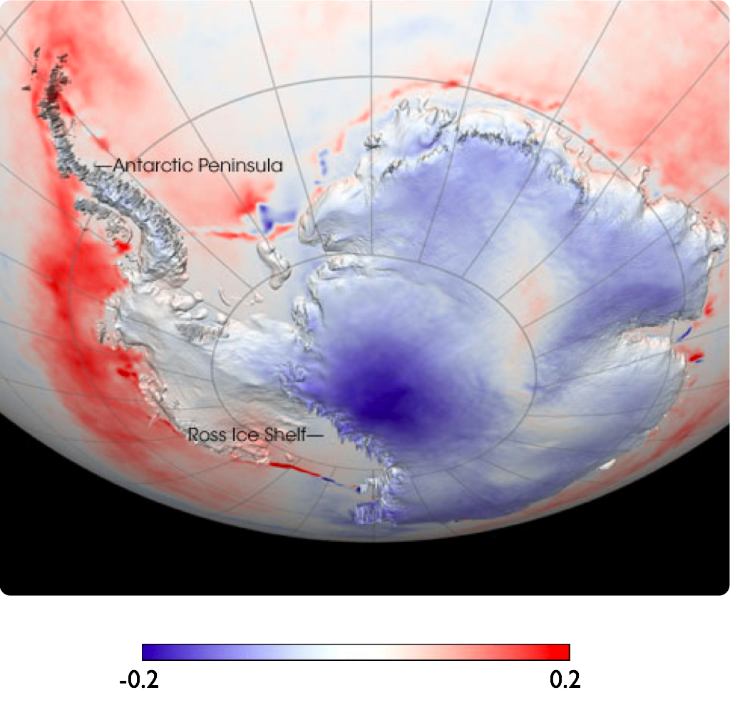
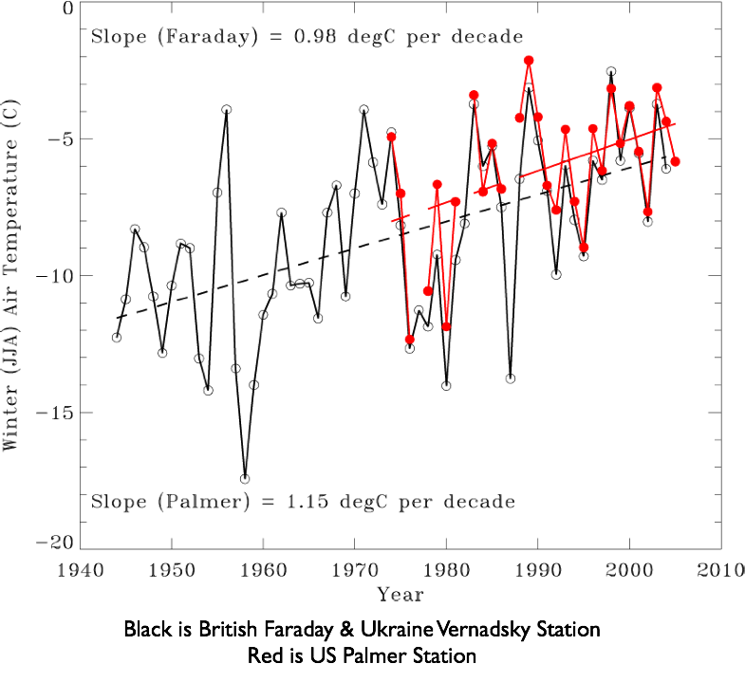
Background
  West Antarctic Peninsula (WAP) is the undergoing the fastest winter warming on Earth (Vaughan et al. 2003)
    Mean winter air temperature increased by 6°C since 1950
Temperature Anomaly

Slide 3
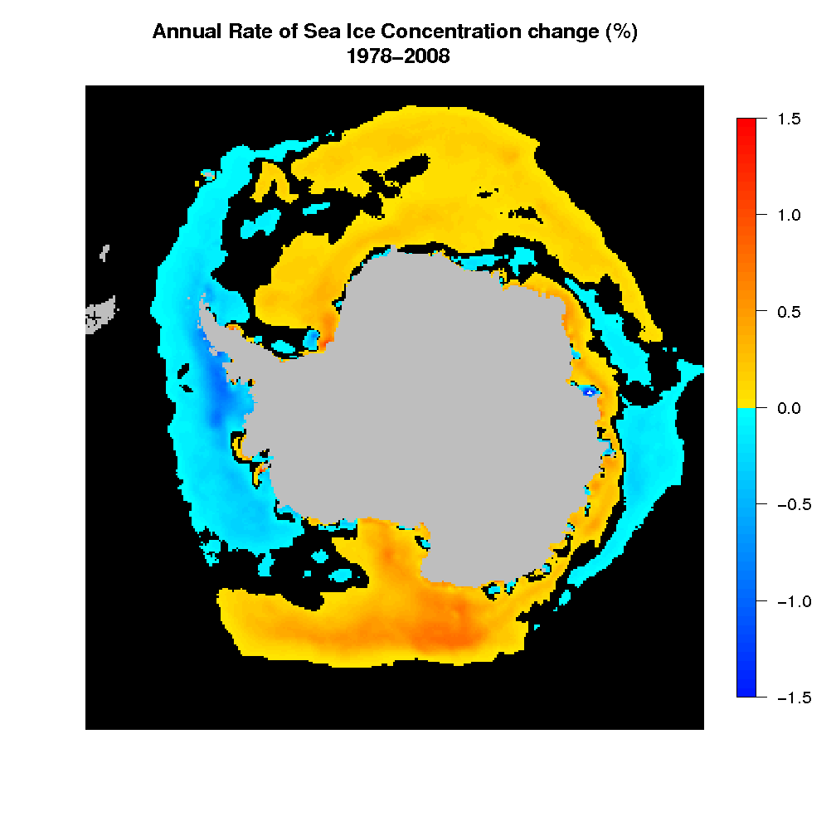
Also a Large Change in Sea Ice Concentrations

Slide 4
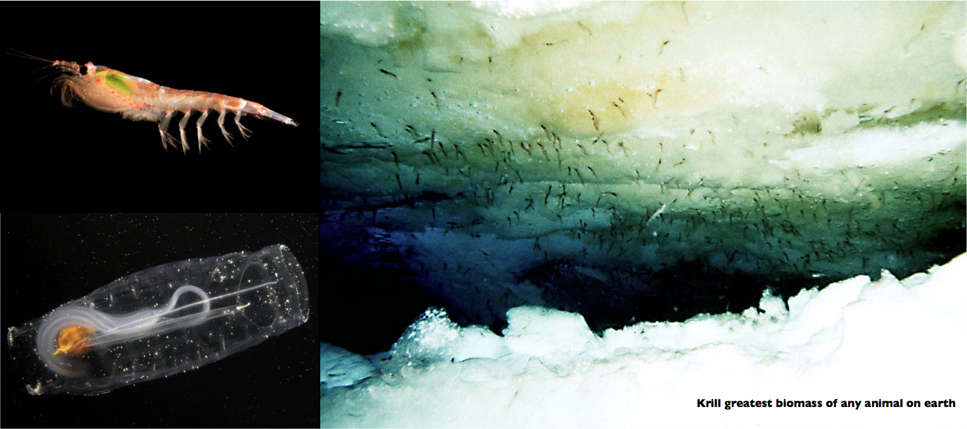
Background
These changes alter the base of the food chain

Slide 5
Background
From Loeb et al., 1997
100
10
6
Krill:Salp
Ice Index
1
4
0.1
0.01
2
0.001
80
82
84
86
88
90
92
94
96
100
Year
10
2
Krill:Salp
R
= 0.56
1
0.1
0.01
0.001
2
4
6
100
Ice Index
10
2
Krill:Salp
R
= 0.63
1
0.1
0.01
0.001
-4
-2
0
Mean Air Temperature (°C)

Slide 6
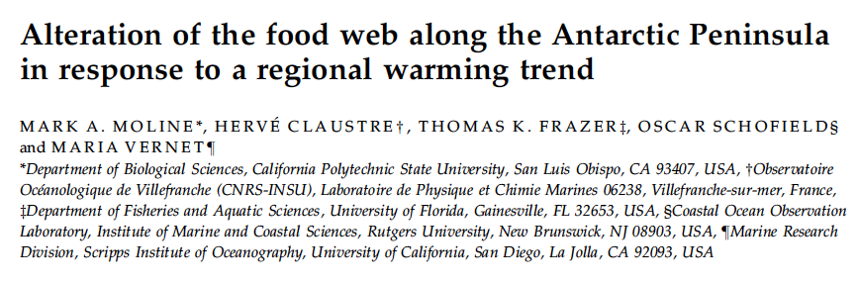
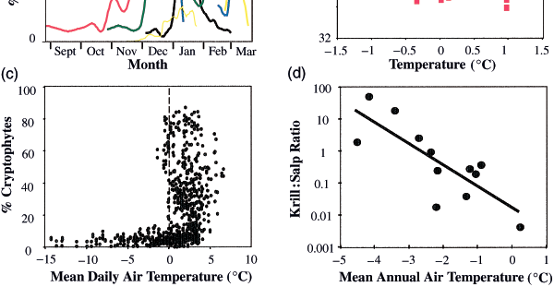

Slide 7
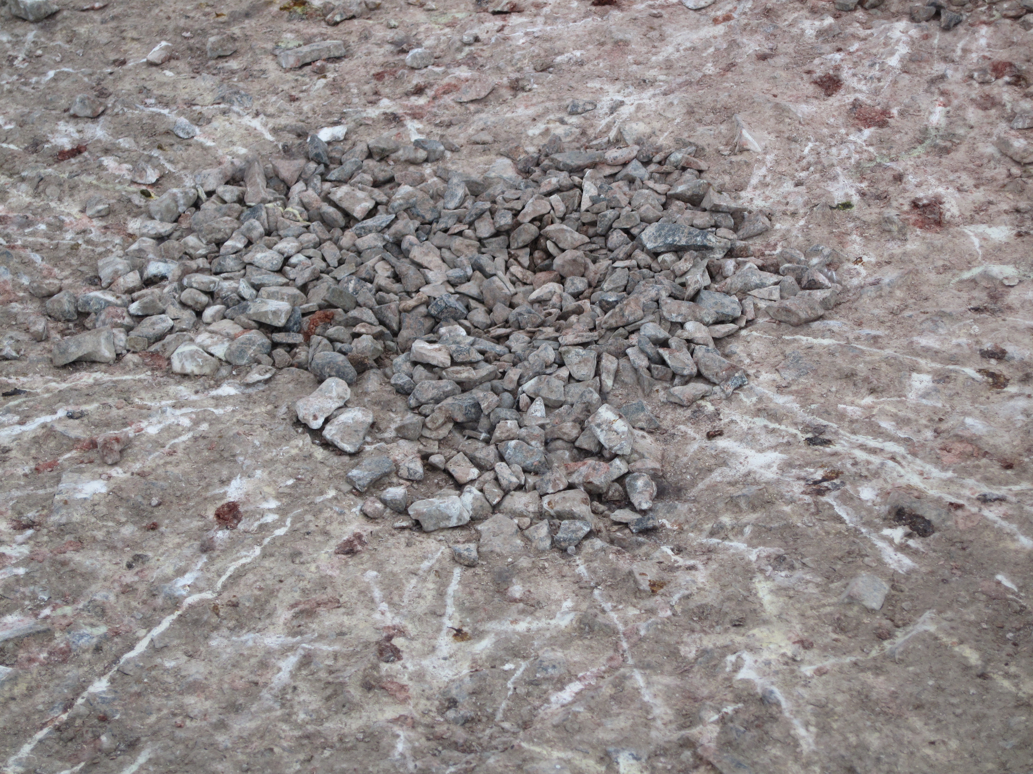
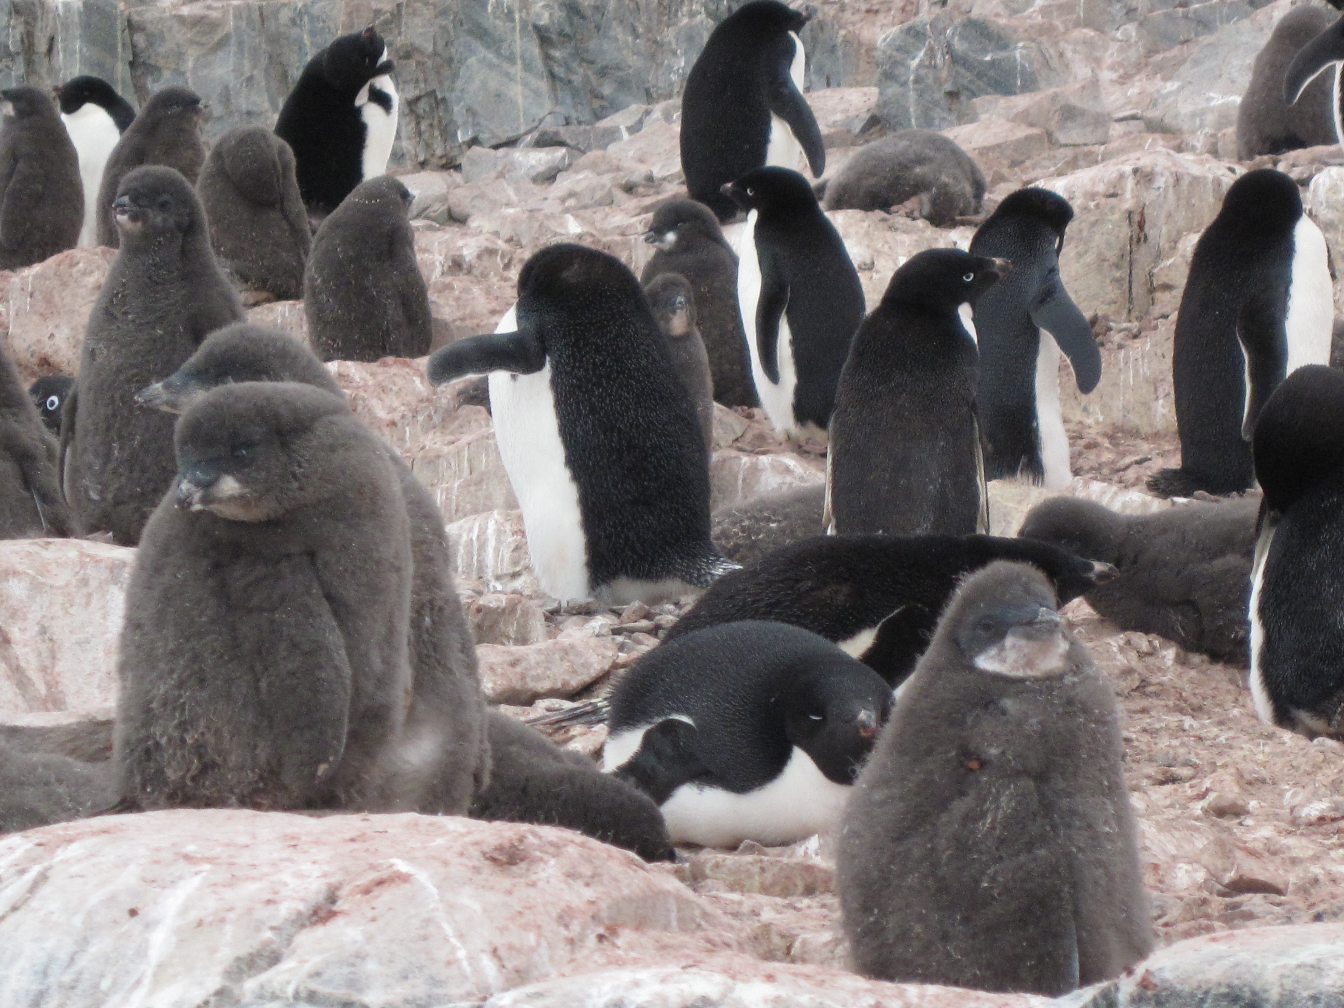
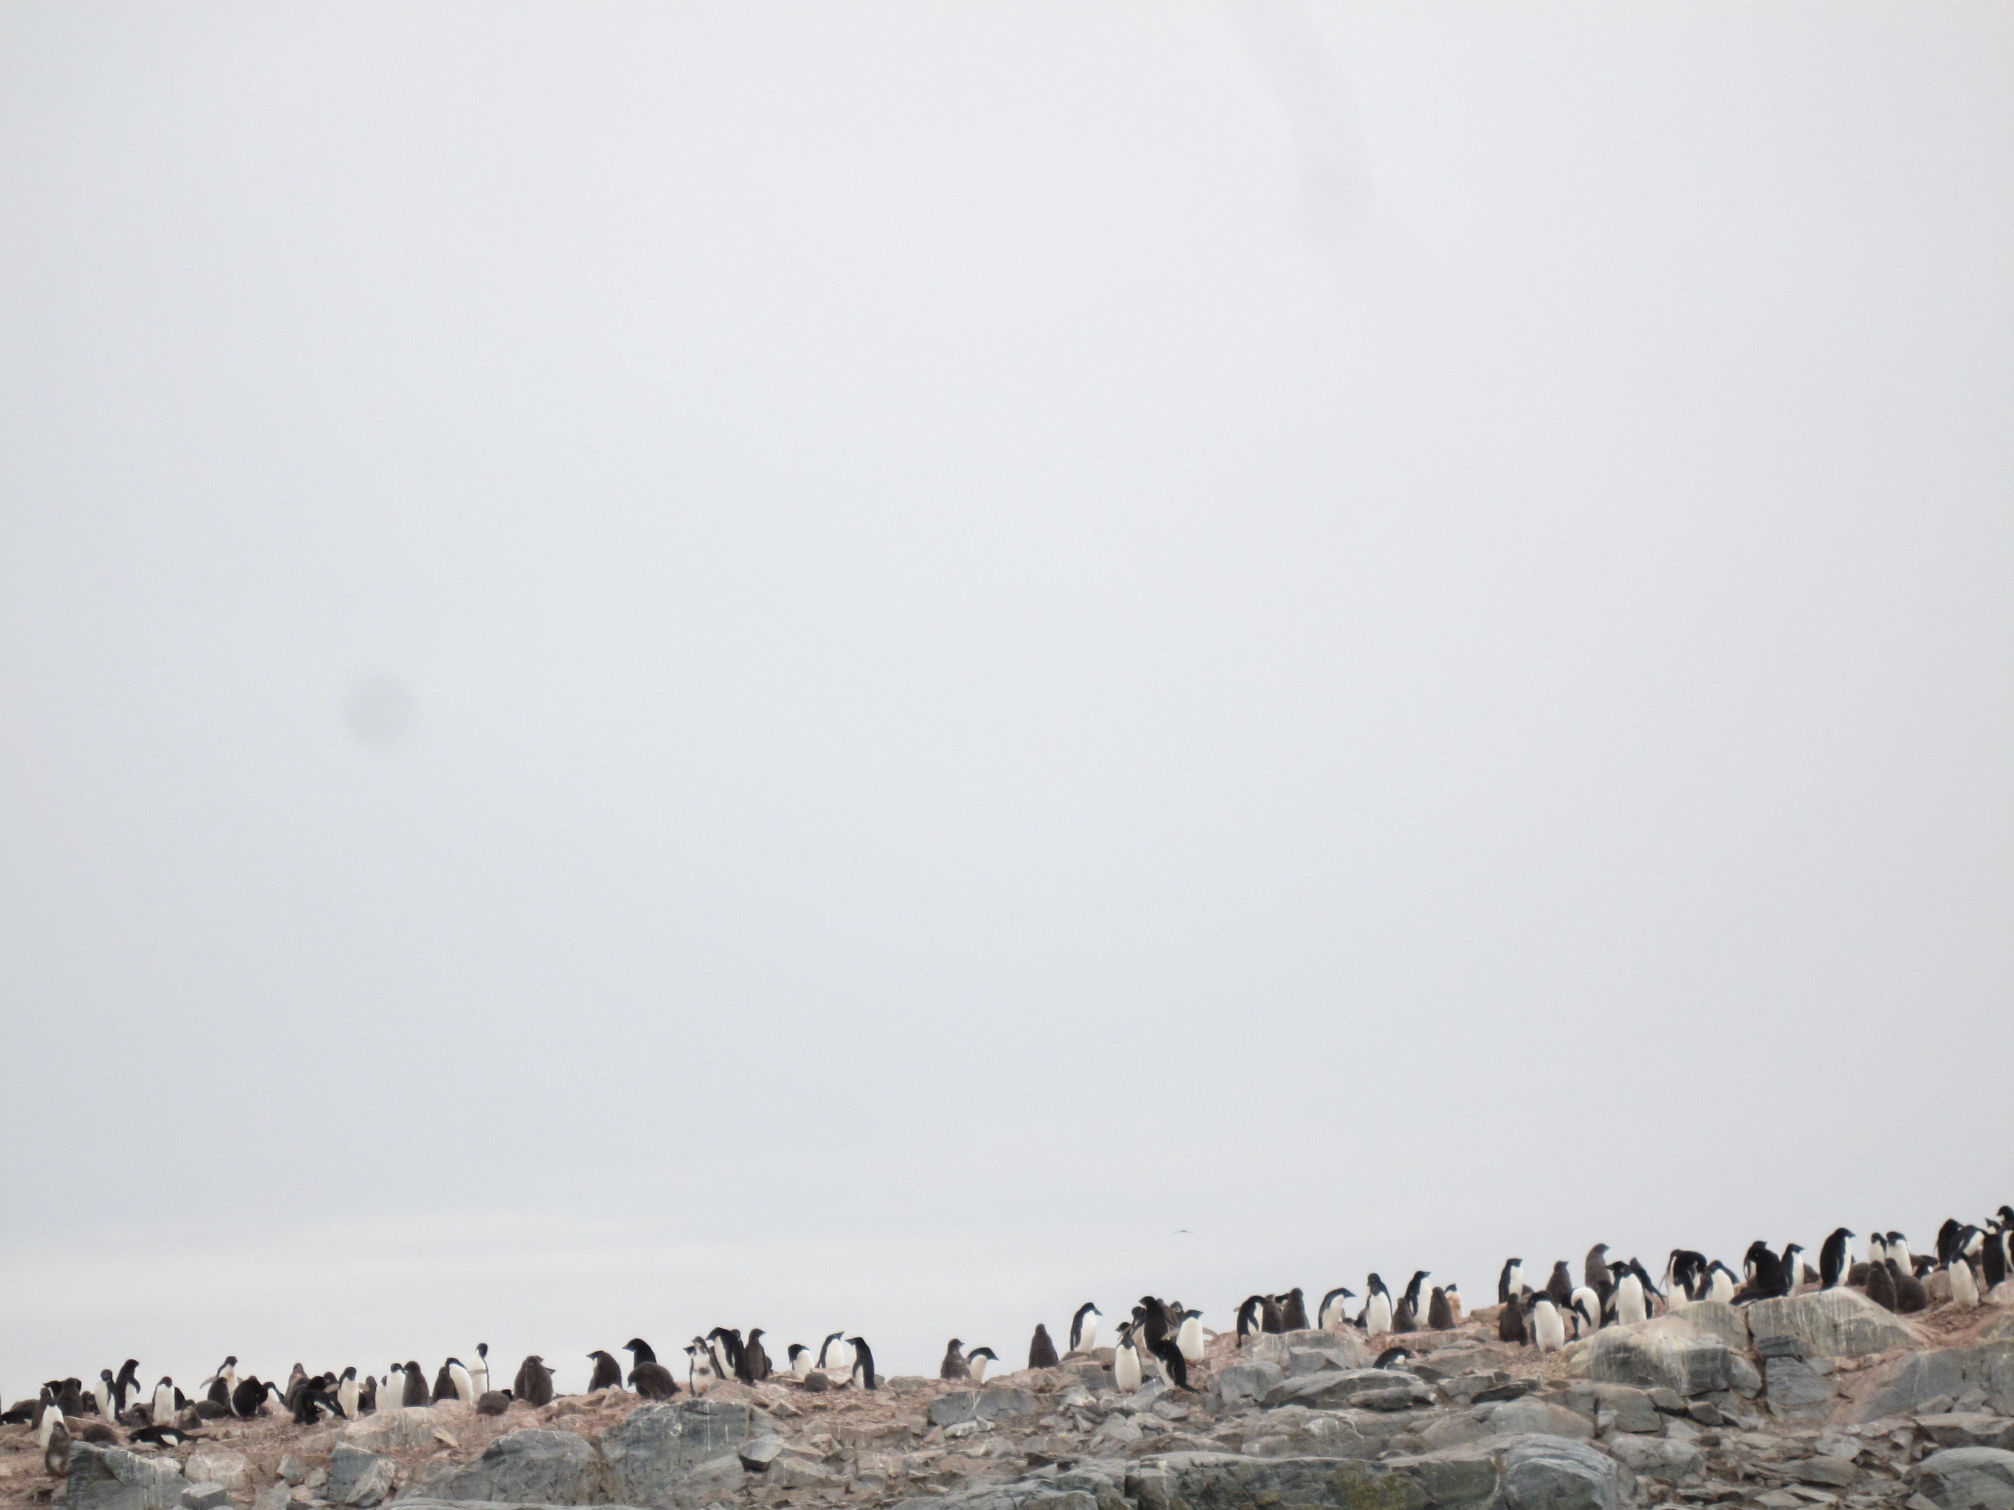
Background
Adélie penguins form rookeries in fixed locations year after year. Rookeries are formed and breeding pairs raise their young. For their young the parents need a predictable food resource that can be ascertained in a less then a days swim (December-February)

Slide 8
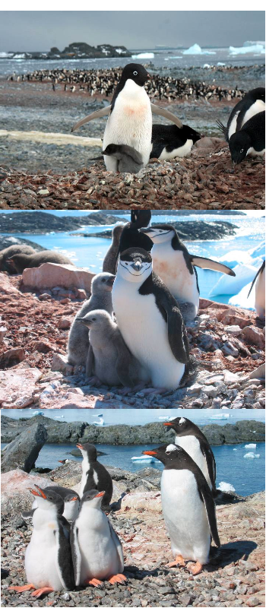
Background
Major changes seen in the upper trophic levels at
Palmer Station in the West Antarctic Peninsula

Slide 9
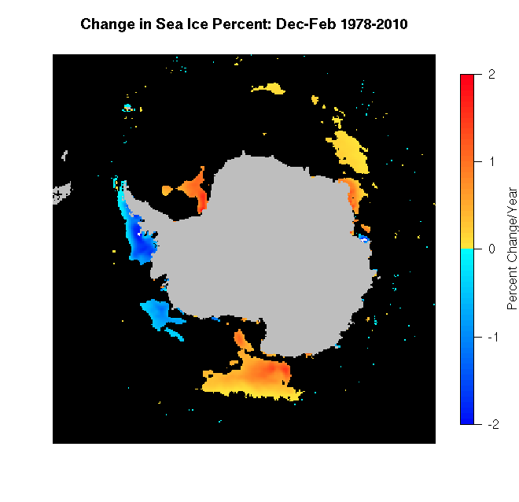
Changes in Environmental Parameters…
Focus on Important Breeding Months
Large Scale Remote Sensing/Modeling

Slide 10
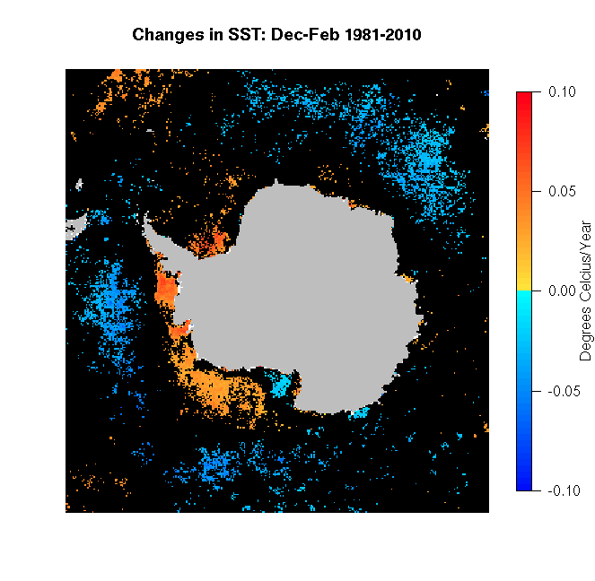
Changes in Environmental Parameters…
Focus on Important Breeding Months
Large Scale Remote Sensing/Modeling
Notes:
So its warmed 2.7C in 26 yrs

Slide 11
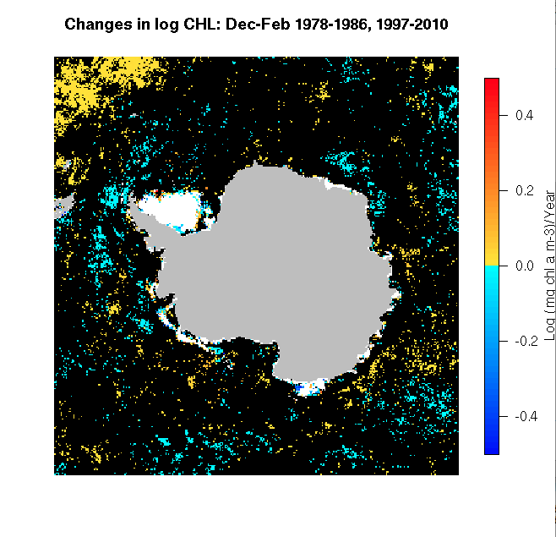
Changes in Environmental Parameters…
Focus on Important Breeding Months
Large Scale Remote Sensing/Modeling

Slide 12
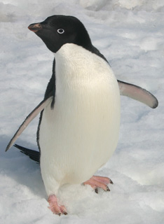
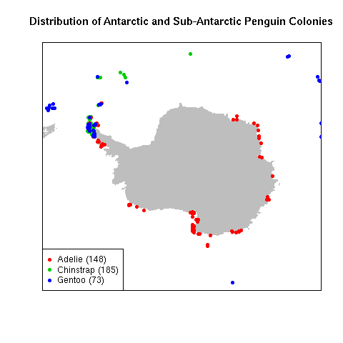
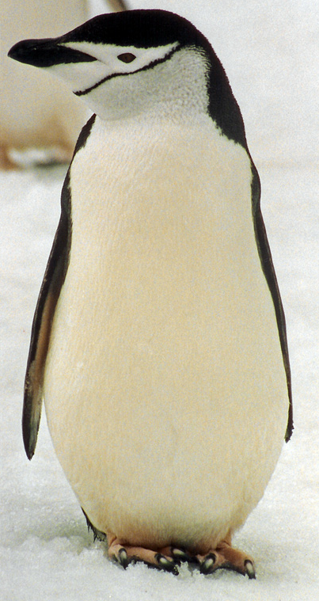
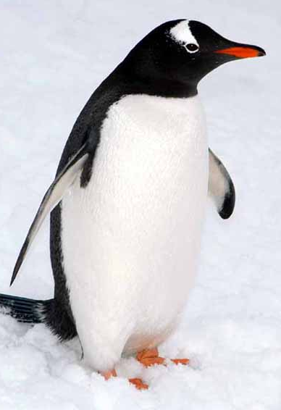
Palmer Station
Large Scale Remote Sensing/Modeling

Slide 13
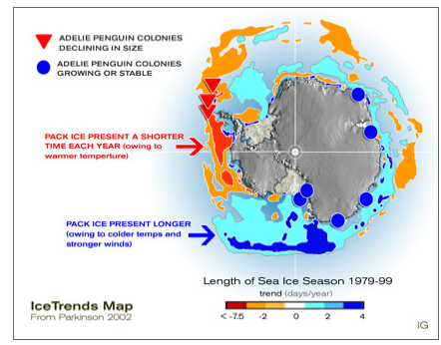
Separation of Adélie penguin colonies into Continental and West Antarctic Peninsula regions
Large Scale Remote Sensing/Modeling

Slide 14
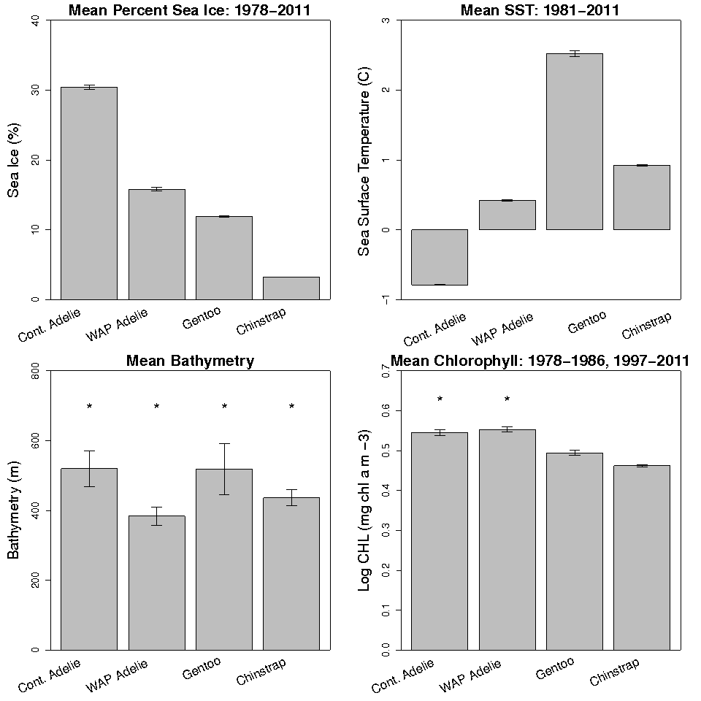
Large Scale Remote Sensing/Modeling

Slide 15
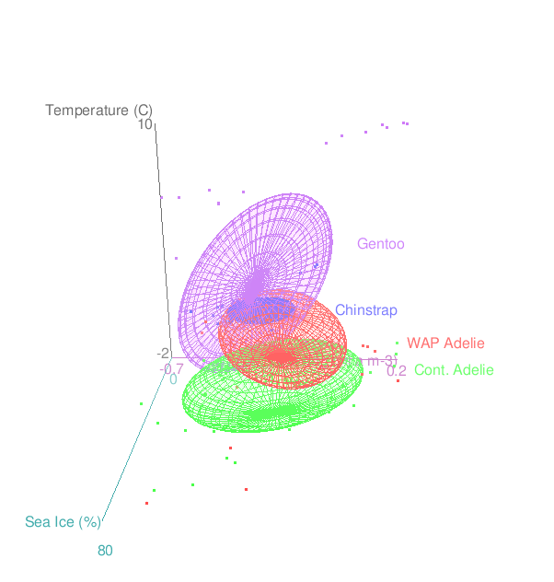
Large Scale Remote Sensing/Modeling

Slide 16
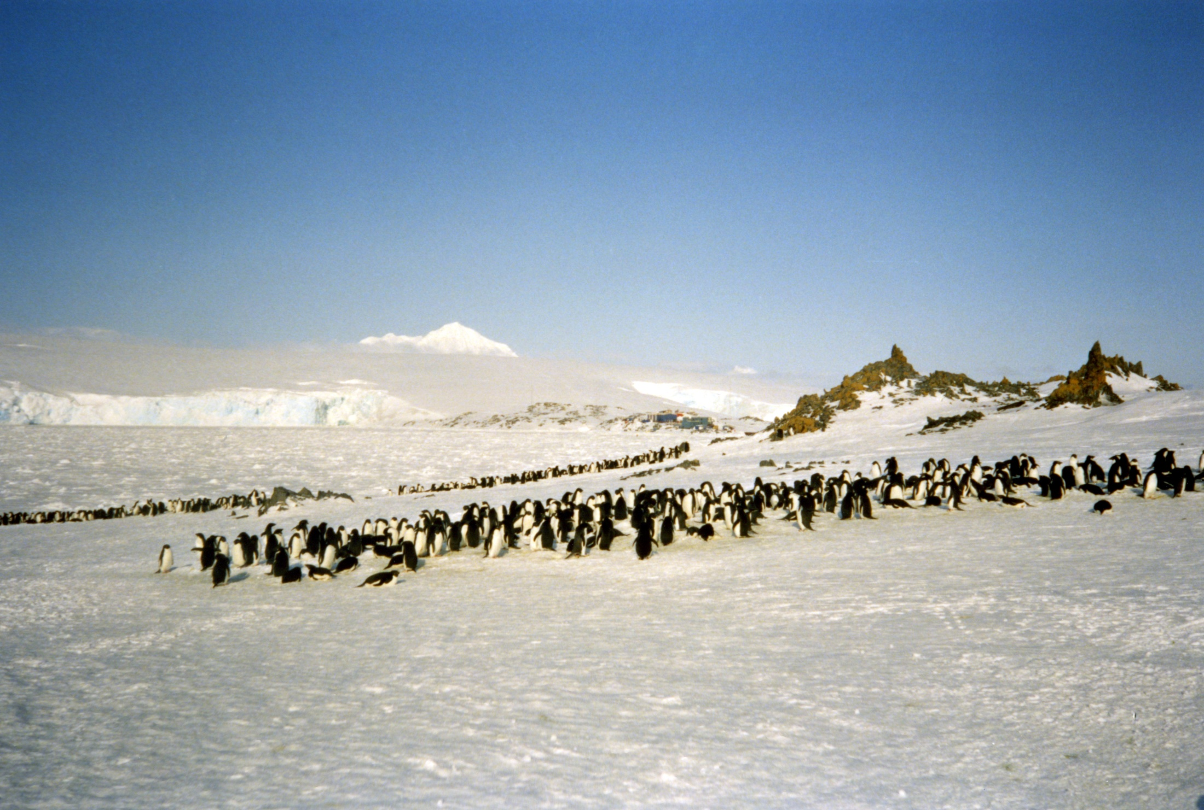
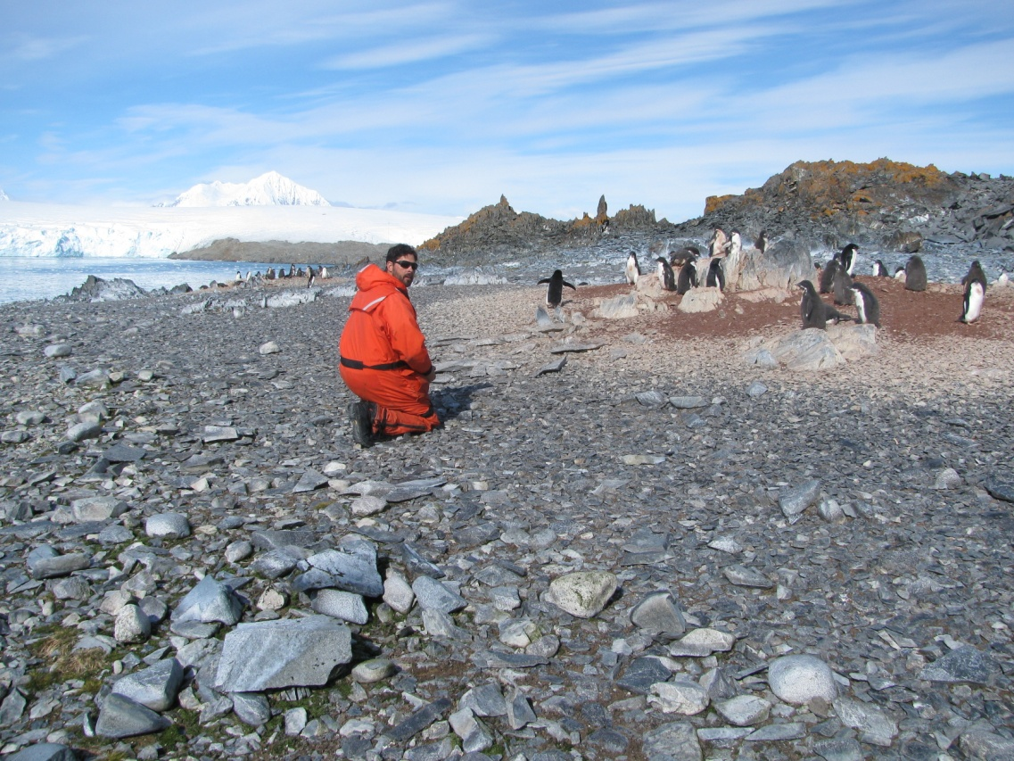
Torgersen Island 1991
Photo: Mark Moline
Torgersen Island 2011
Photo: Mark Moline

Slide 17
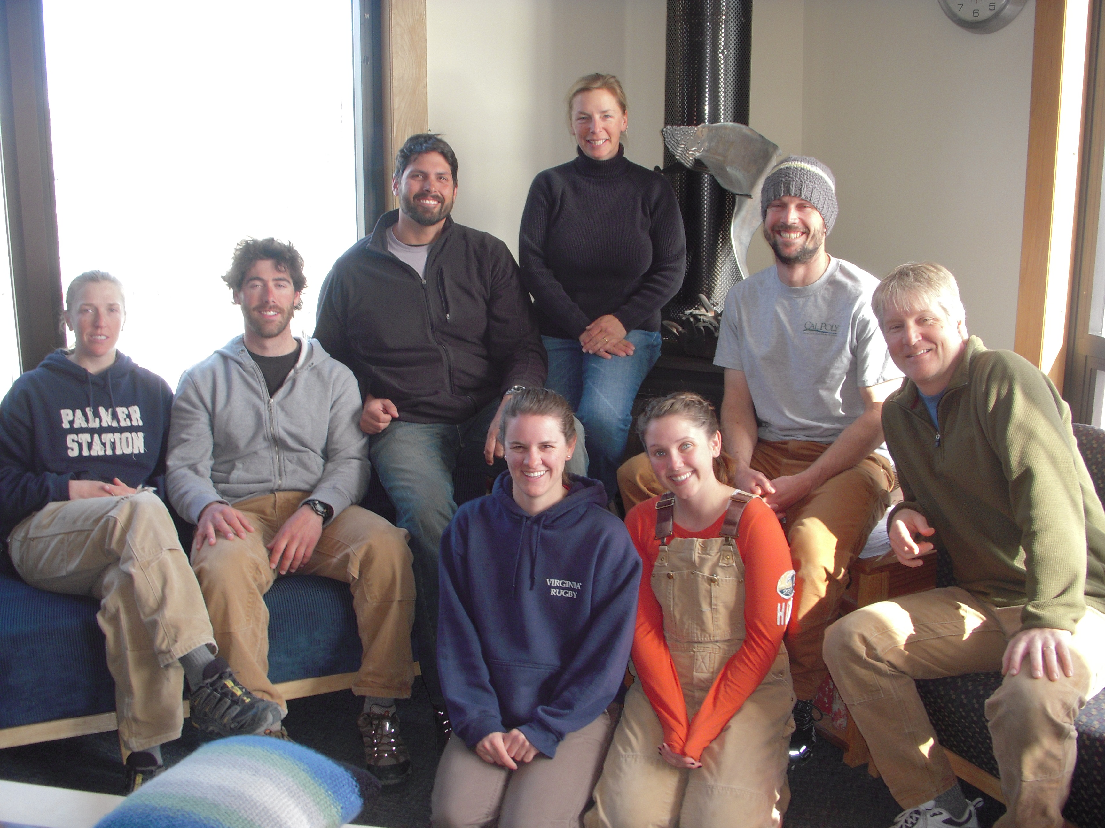
First Field Season

Slide 18
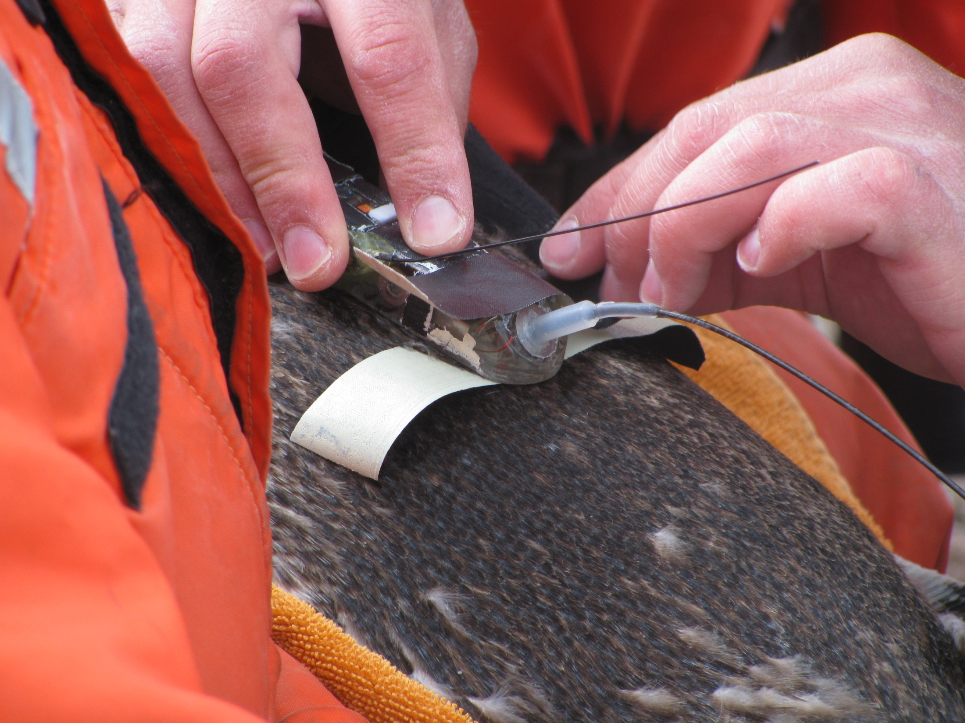
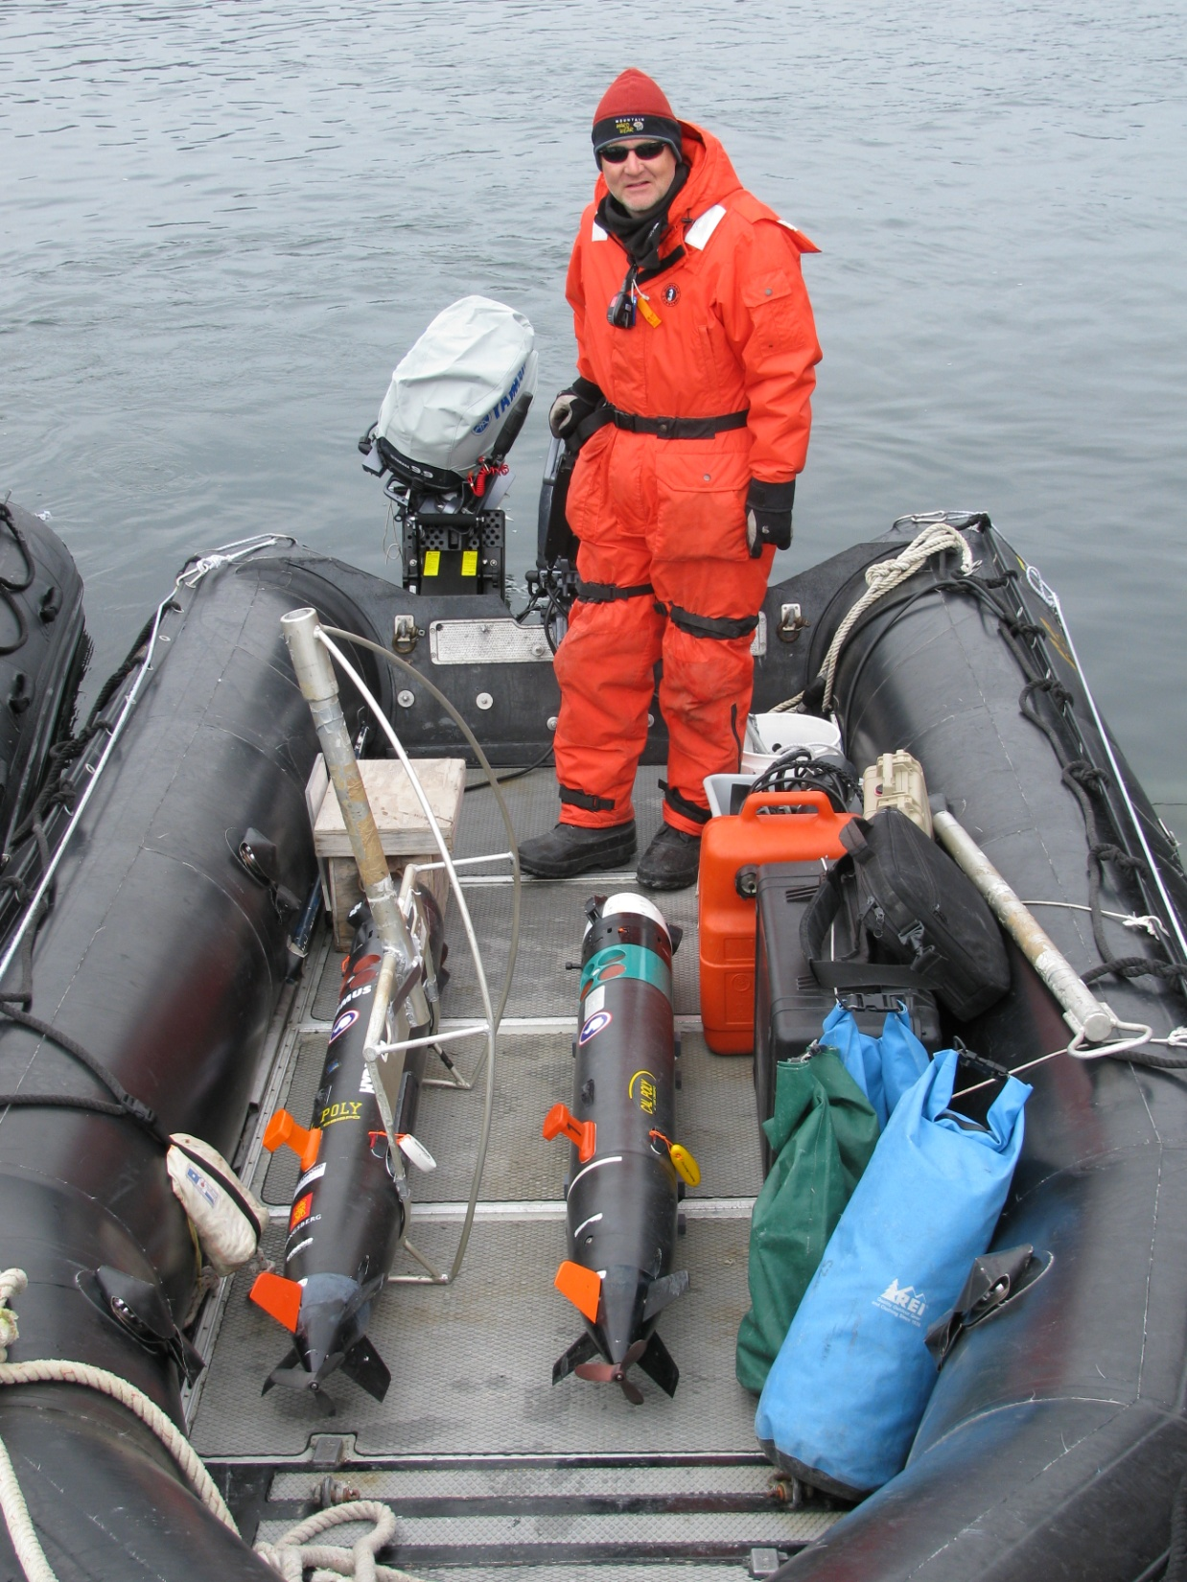
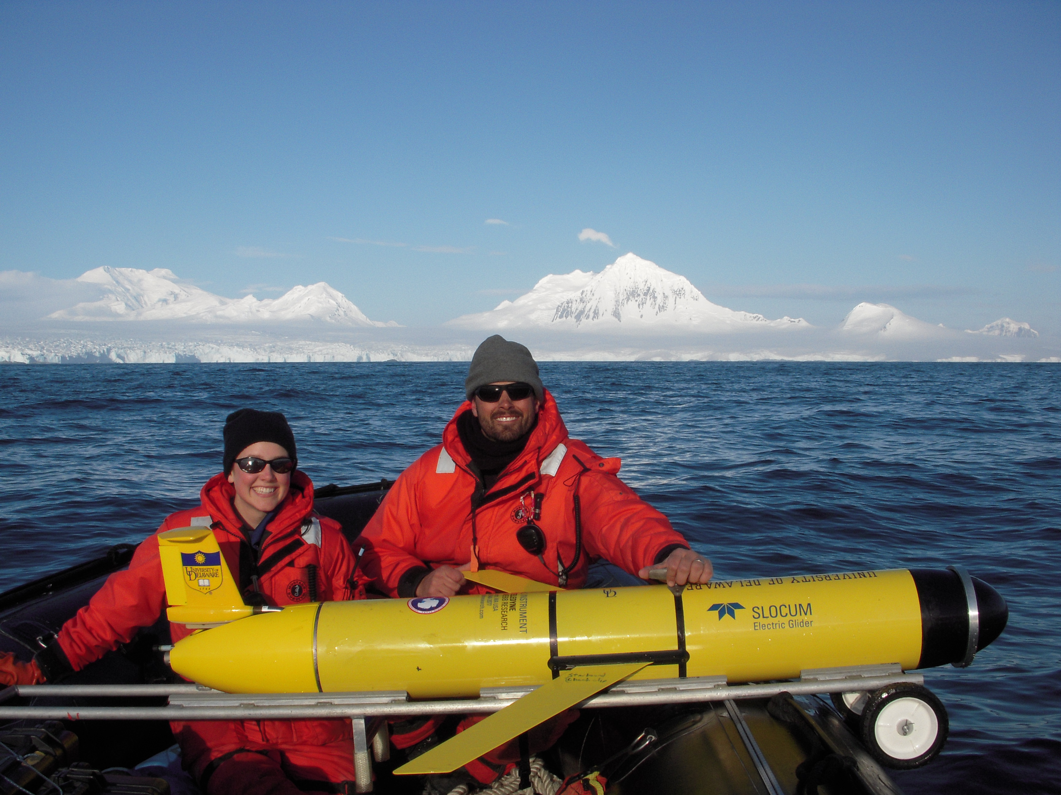
First Field Season
The Plan
Satellite Tags
ARGOS
Position
Mission Planning
Deployment
Assessment

Slide 19
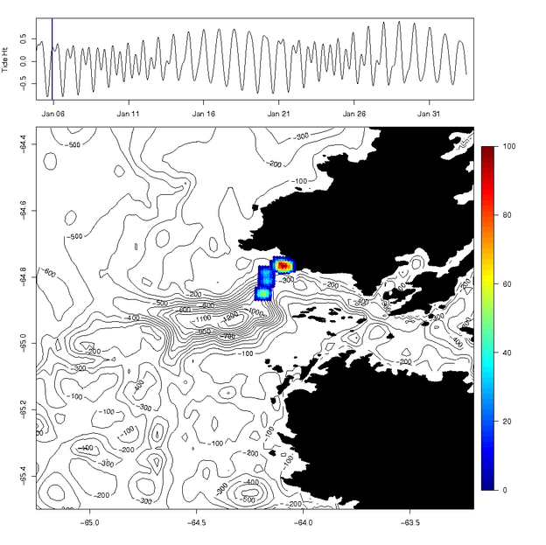
First Field Season
Near-Real Time Mapping of Penguin Foraging Locations

Slide 20
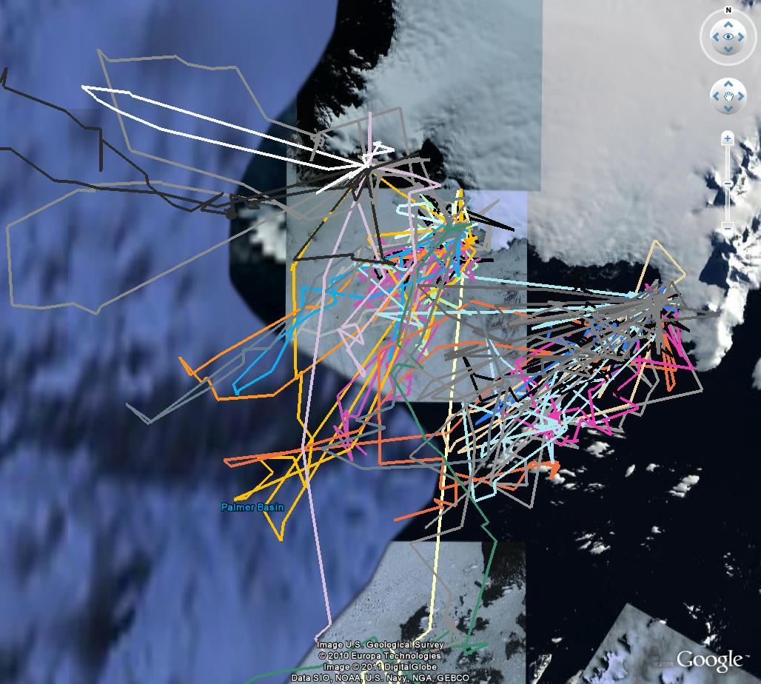
First Field Season
27 Birds!

Slide 21
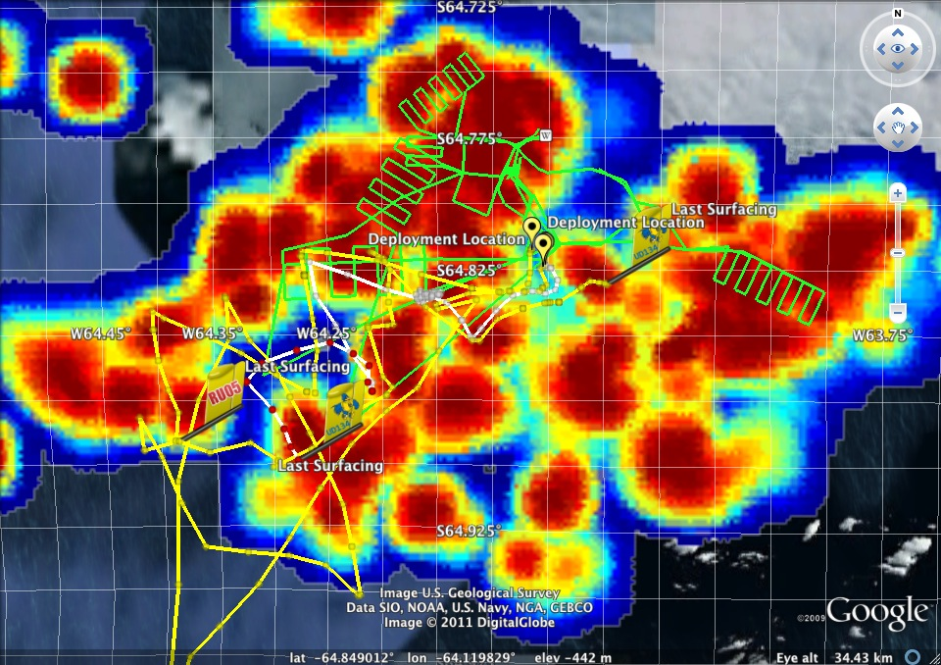
First Field Season
The Dance!
Notes:
Trained on Cont ad. With chl in model.
Not many sig p val., Similar trends though.

Slide 22
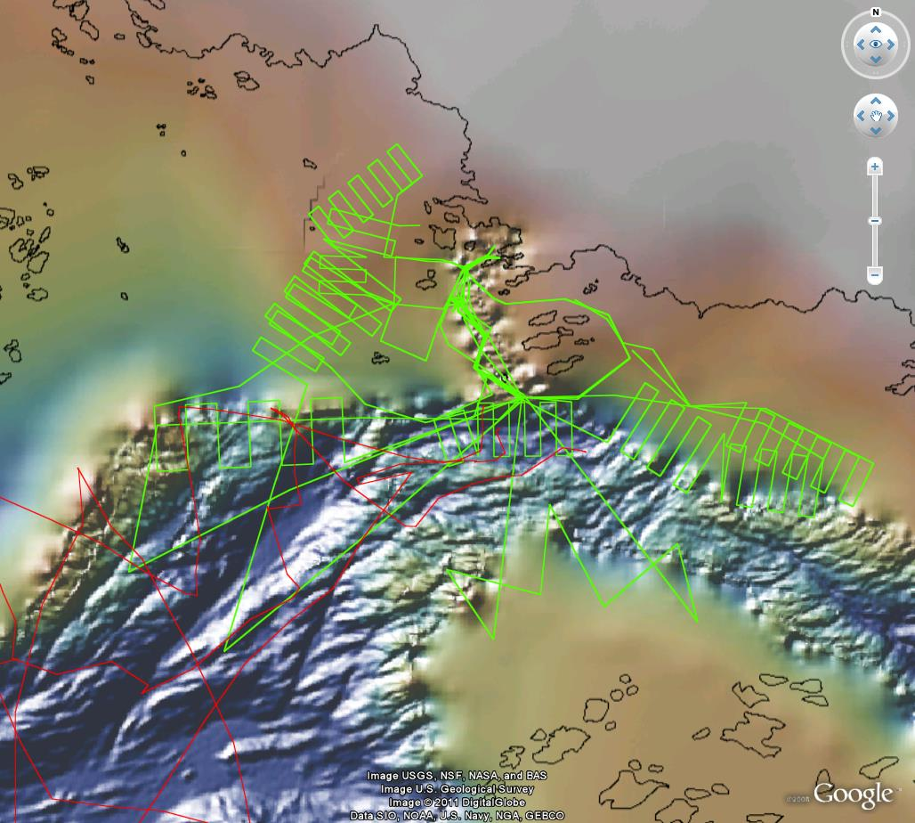
First Field Season

Slide 23
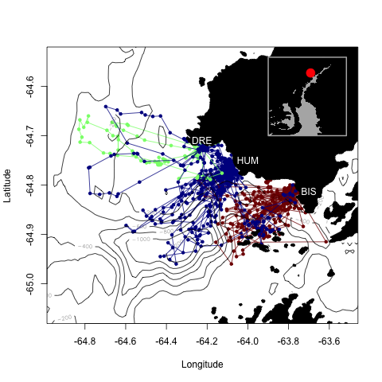
First Field Season Results
Filtered Adélie (blue), Gentoo (red) and Chinstrap (green) penguin satellite tracks located at Humble island (HUM), Dream Island (DRE) and Biscoe Pt. (BIS)

Slide 24
First Field Season Results
Currents integrated over the top 100m of the water column as measured by a Slocum Glider AUV.

Slide 25
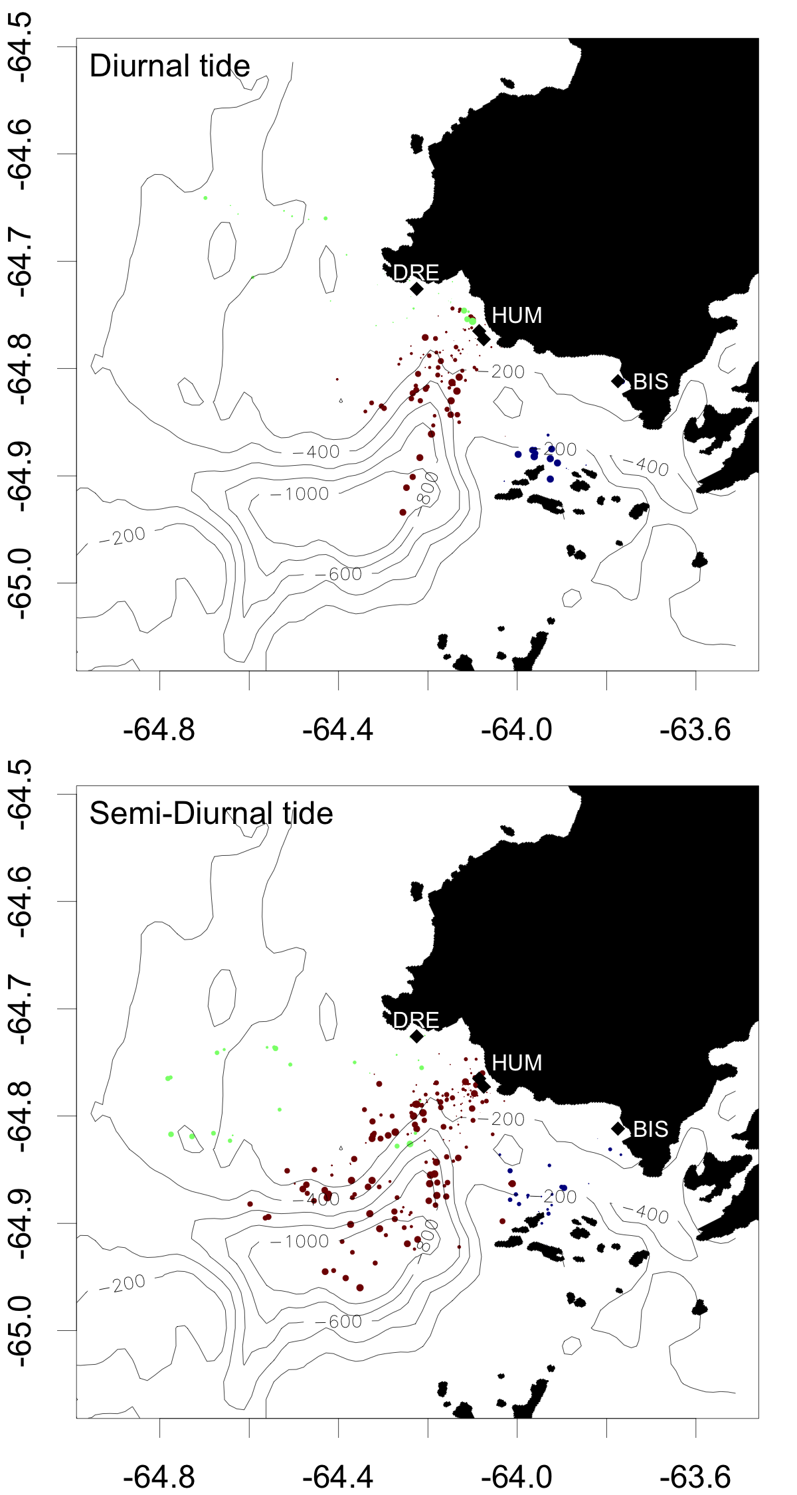
During diurnal tides, Adélie penguins from Humble Isl. forage much closer to land than during semi-diurnal tides.

Slide 26
For ten seasons (2001-2011), 95% of Adélie penguin GPS locations were located within the blue contour during diurnal tides and located within the red contour during semi-diurnal tides.
Adélie penguins tended to be further over Palmer Canyon during semi-diurnal tides.

Slide 27
First Field Season Results
The Adélie penguin mean distance from Humble Island for each day of a given tidal phase for diurnal and semi-diurnal tides.
Bars represent twice the standard error of the mean.

Slide 28
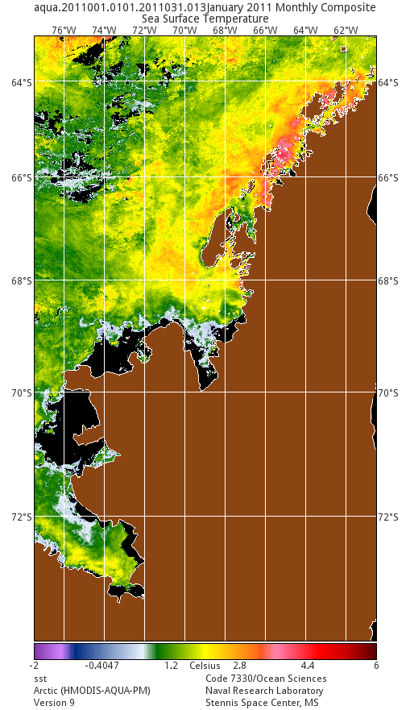
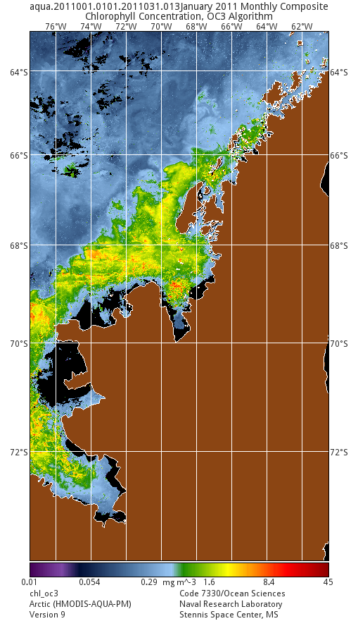
Future Directions
for second field season
Analyze remote sensing data from first field season

Slide 29
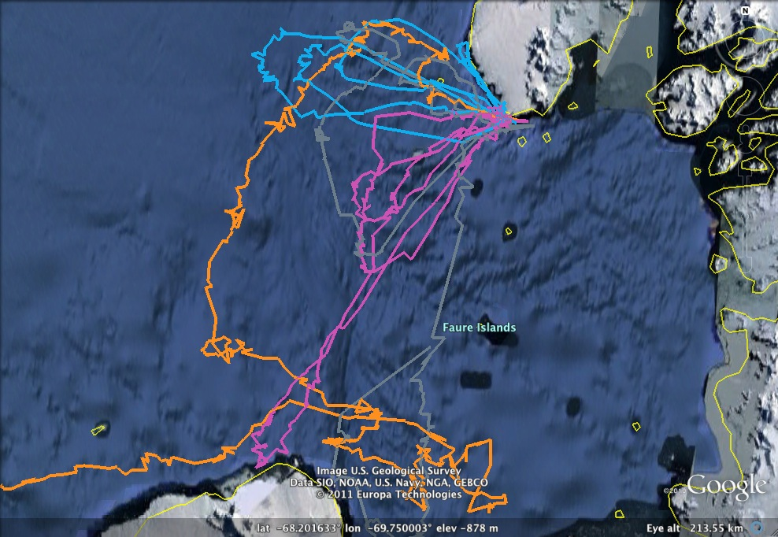
Future Directions
for second field season
Analyze tracks from Marguerite Bay

Slide 30
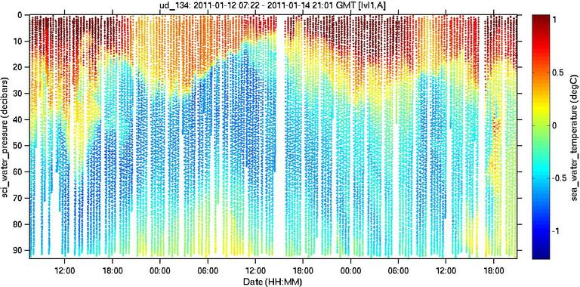
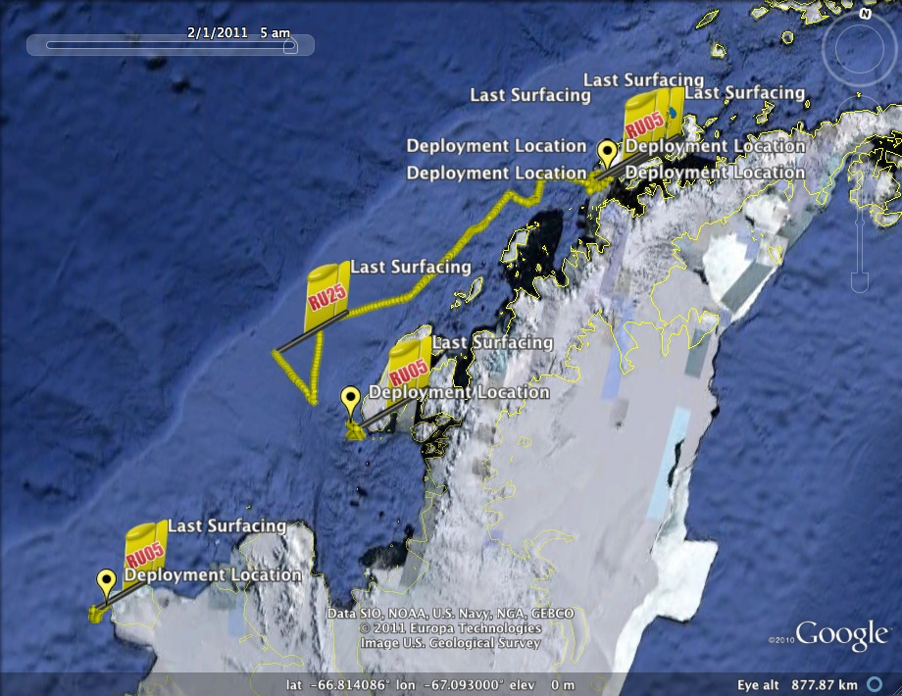
Future Directions
for second field season
Incorporate vertical dimension from REMUS and Gliders with penguin foraging

Slide 31
Summary
Large Scale Remote Sensing/Modeling Results
  MaxEnt models show interesting trends
  Merge with Climate Models
First Field Season
  Dynamic planning based on penguin location
Results of First Field Season
  Foraging of penguin species are spatially segregated
  Long-term affect of the tide
  Likely pushing krill around
Future Analyses and Field Season
  Analyze local high res satellite data
  Increase mapping of krill
  Incorporate vertical information from REMUS and Gliders

Slide 32
Hypothesis 1: The spatial extent of time resolved satellite derived regional and local water
masses, along with satellite derived sea-ice and wind patterns, can be used to predict
phytoplankton, krill and penguin abundance and distributions on decadal time scales in the PAL LTER study region.
- Krill yet to do here
Hypothesis 2: The spatial extent of the summer water masses associated with the hotspots has changed along the PAL LTER region of the WAP, reflecting the effects of climate migration and its associated impacts on physical properties and biological populations.
- Krill yet to do here
Hypothesis 3: Satellite- and AUV-driven GAM species abundance models are able to spatially predict the foraging space of the apex predator, Adélie penguin, in the PAL LTER region of the WAP.
- AUV data is showing we have to deal with regional physics first, then foraging spaces

Slide 33
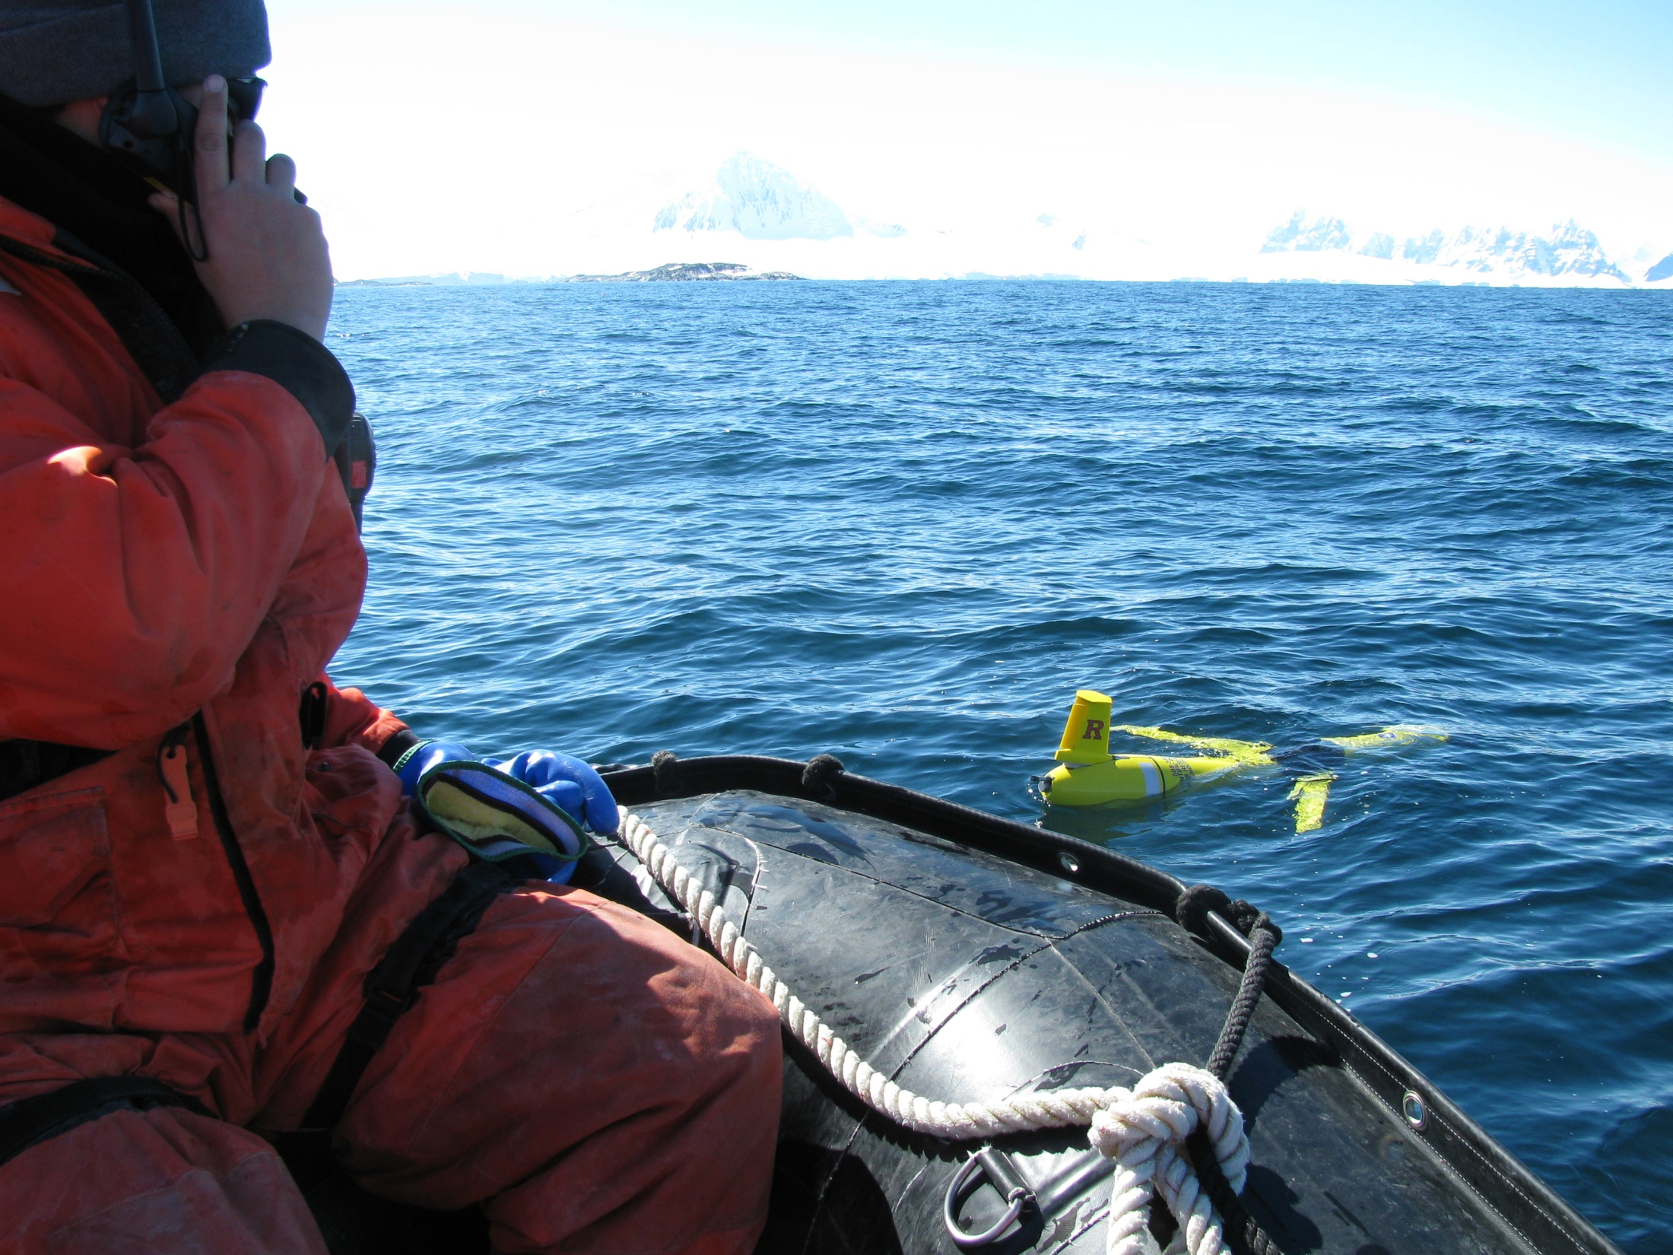
First Field Season
24 Days!
300 km!

Slide 34
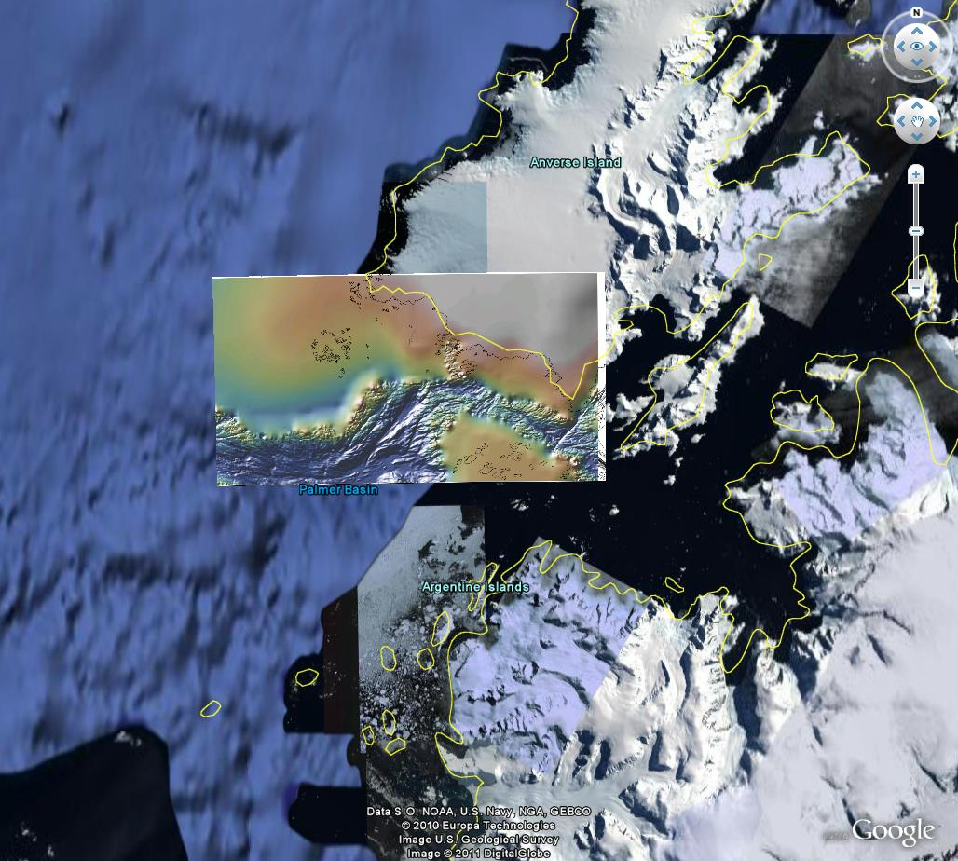
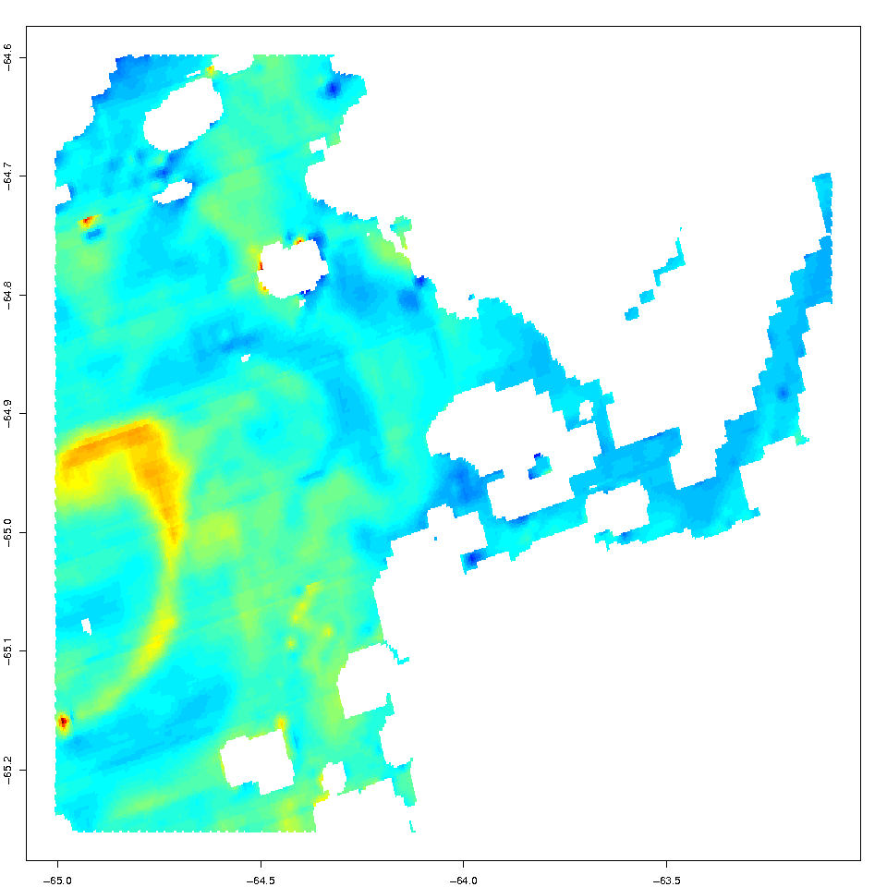
First Field Season

Slide 35
First Field Season Results
An example dive record of an Adélie Penguin where infrequent diving is followed by a long transit and then to frequent diving.

Slide 36
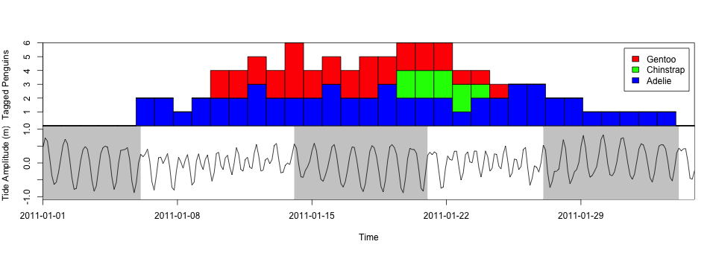
First Field Season Results
The number and species of deployed penguins each day over the course of the experiment.
Mixed tide cycles at Palmer Station during the field season showing the shift from diurnal to semi-diurnal tides.
Diurnal tides are shaded in grey.

Slide 37
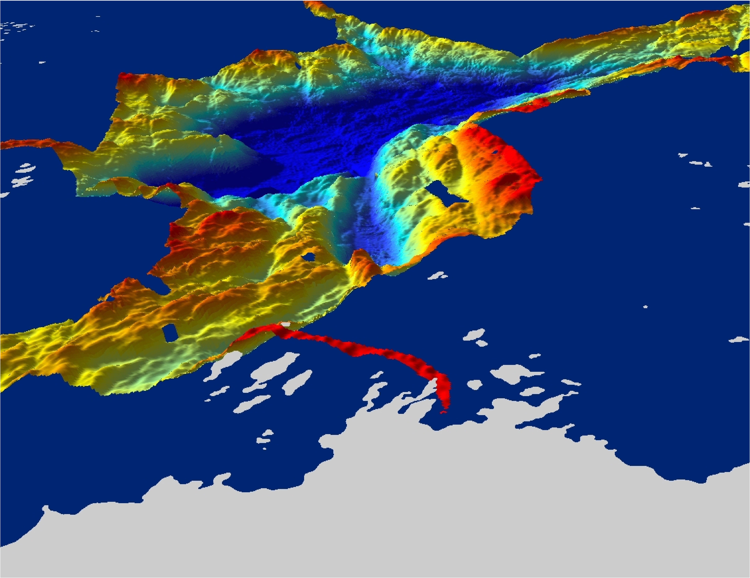
Background
Anvers Island
Hot spots along the peninsula are associated with
deep undersea canyons located near suitable breeding areas,
which can be reached in a days foraging effort (~30 km).

Slide 38
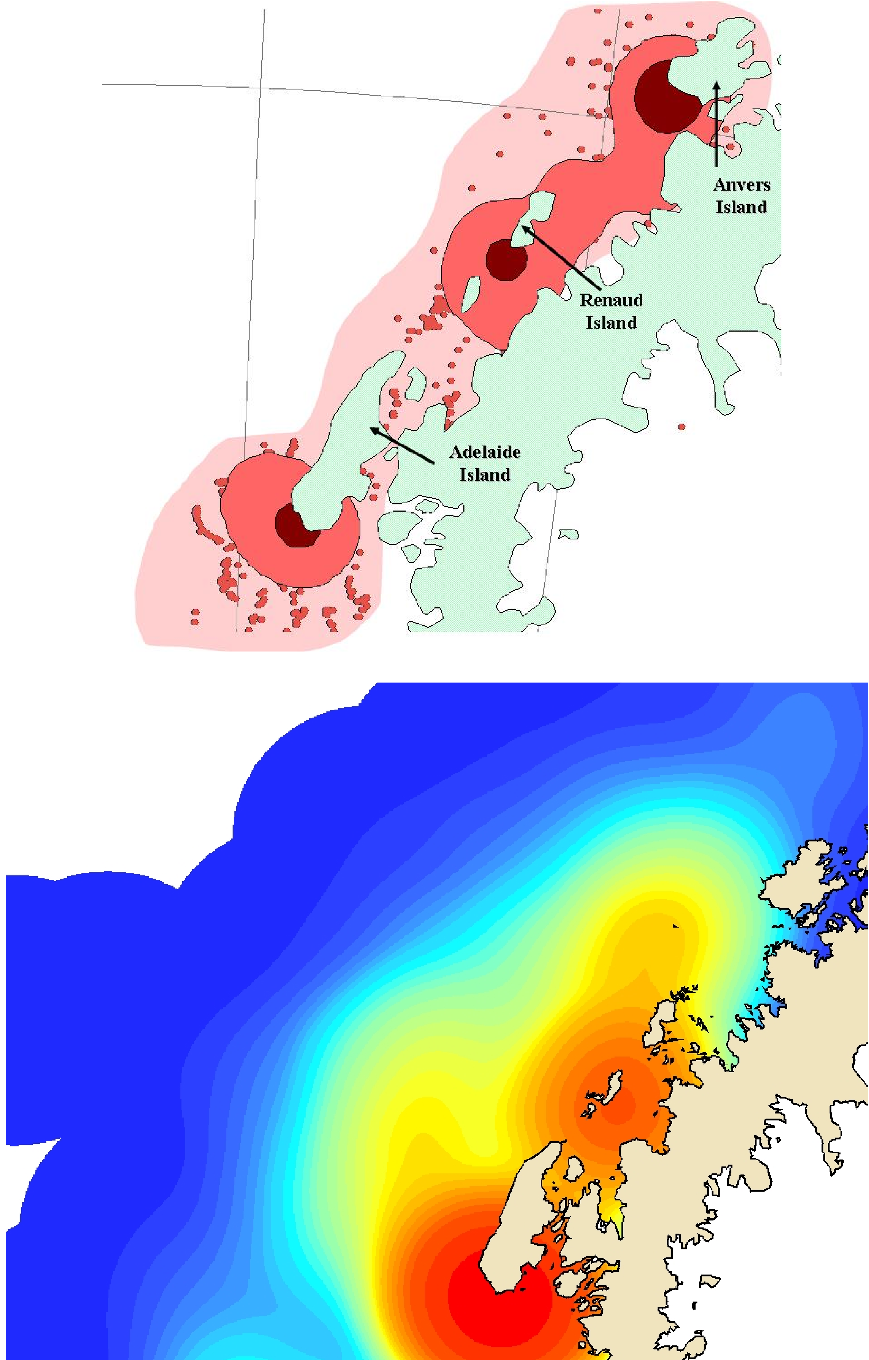
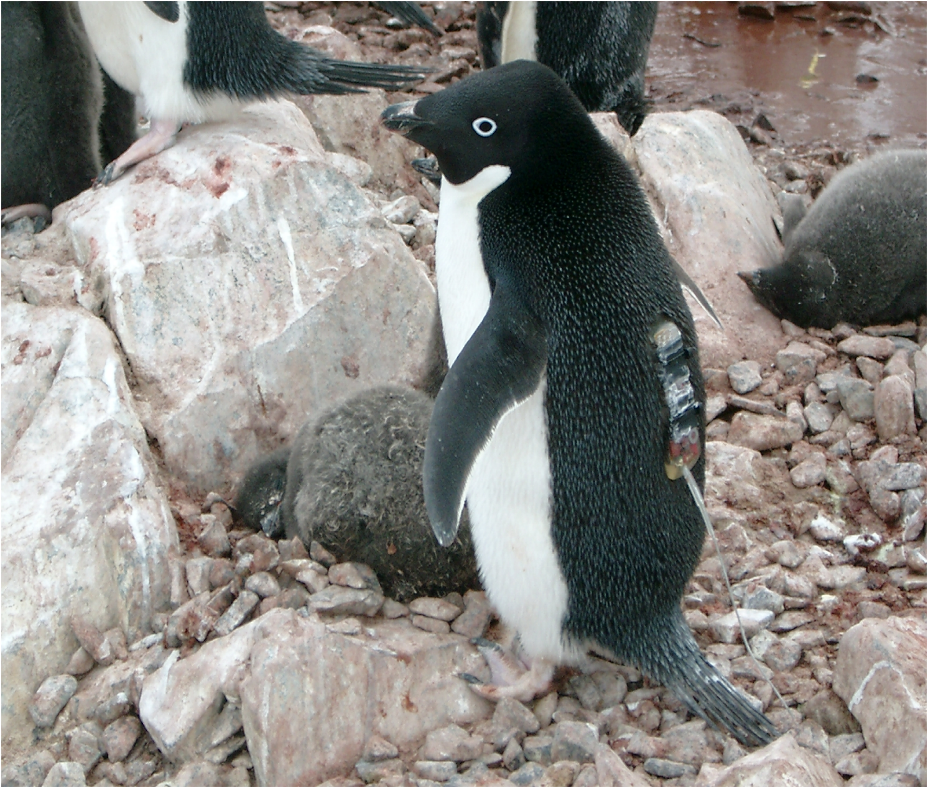
Background
Summer
Foraging
Regions
What are the main foraging regions?
To determine that we take advantage of the ecology/evolution which has determined the prime locations to be. How?? glue stick…..
Winter
Foraging
Regions

