Slide 1
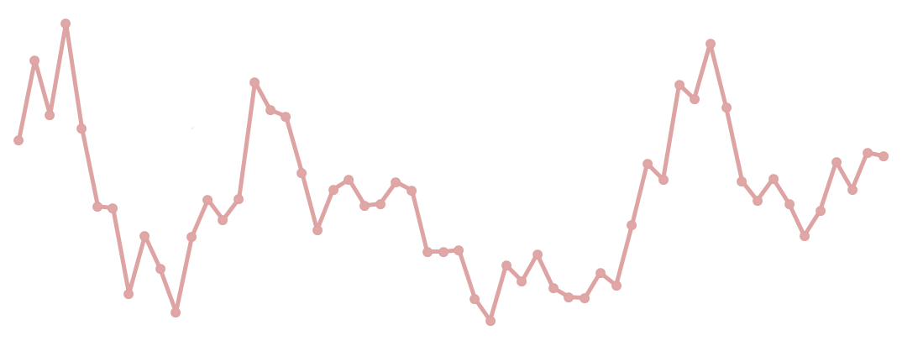
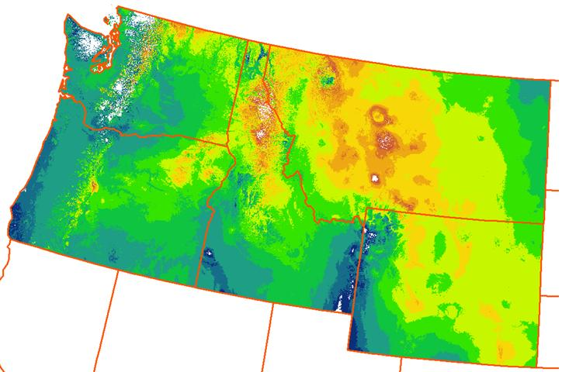
Migratory Species Response
to Climate Impacts
PI – Crabtree with Sheldon, Weiss, Gibson, Manlove; Potter; Kimball; Johnson, Boomer
Research question(s): Can we predict migratory species movements in response to climate change and climate-related impacts? What are the demographic consequences of these combined impacts and movements?
Enhancement Activities: Augment EAGLES with data products, tools, and improved analysis (with R in ArcGIS) based on practitioners feedback
Approach: Conduct mid-continent impact analysis; climate, disturbances… then first build spatio-temporal predictive models before AHM modification
deficient models lead to biased results & poor decision-making
agency adoption; end-to-end with key data products, tools, and models
translational ecology: bridging the gap between scientists and end-users
55-year Greenness Onset
Anomalies
Yukon Flats National Wildlife Refuge, Alaska 5/24/09
Surface Water
www.coasterdata.net
Weiss and Crabtree, RSE 2011

