Slide 1
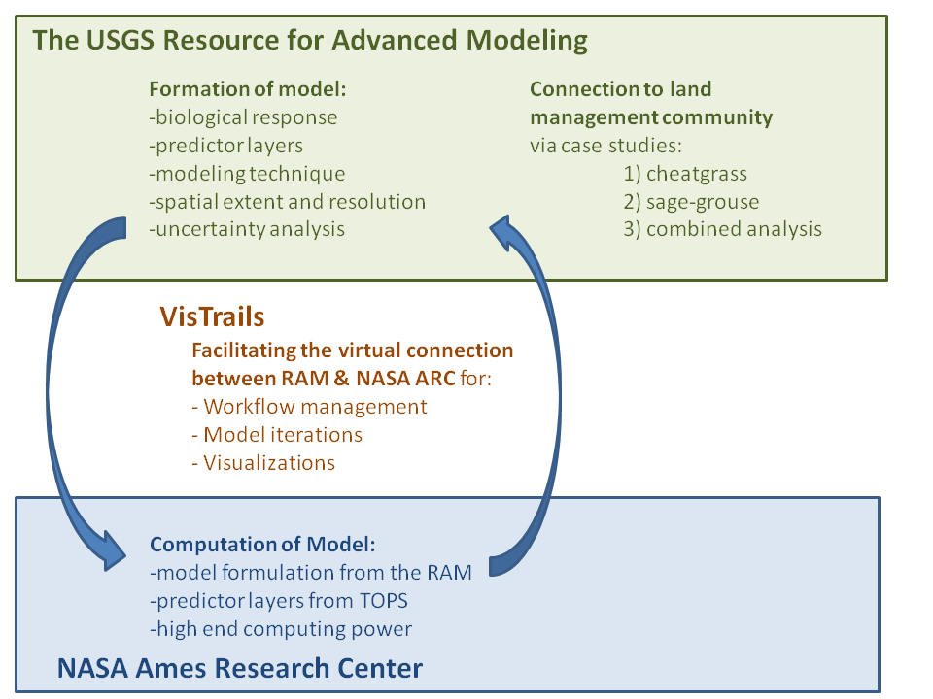
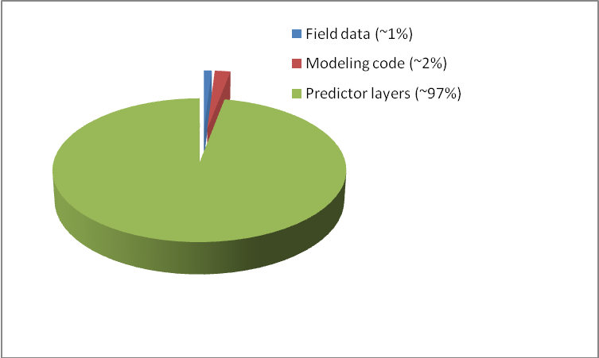
Using the USGS “Resource for Advanced Modeling” to connect climate drivers to biological response
Jeff Morisette/USGS, Petr Votova/Ames, Claudio Silva/NYU Poly

