Slide 1
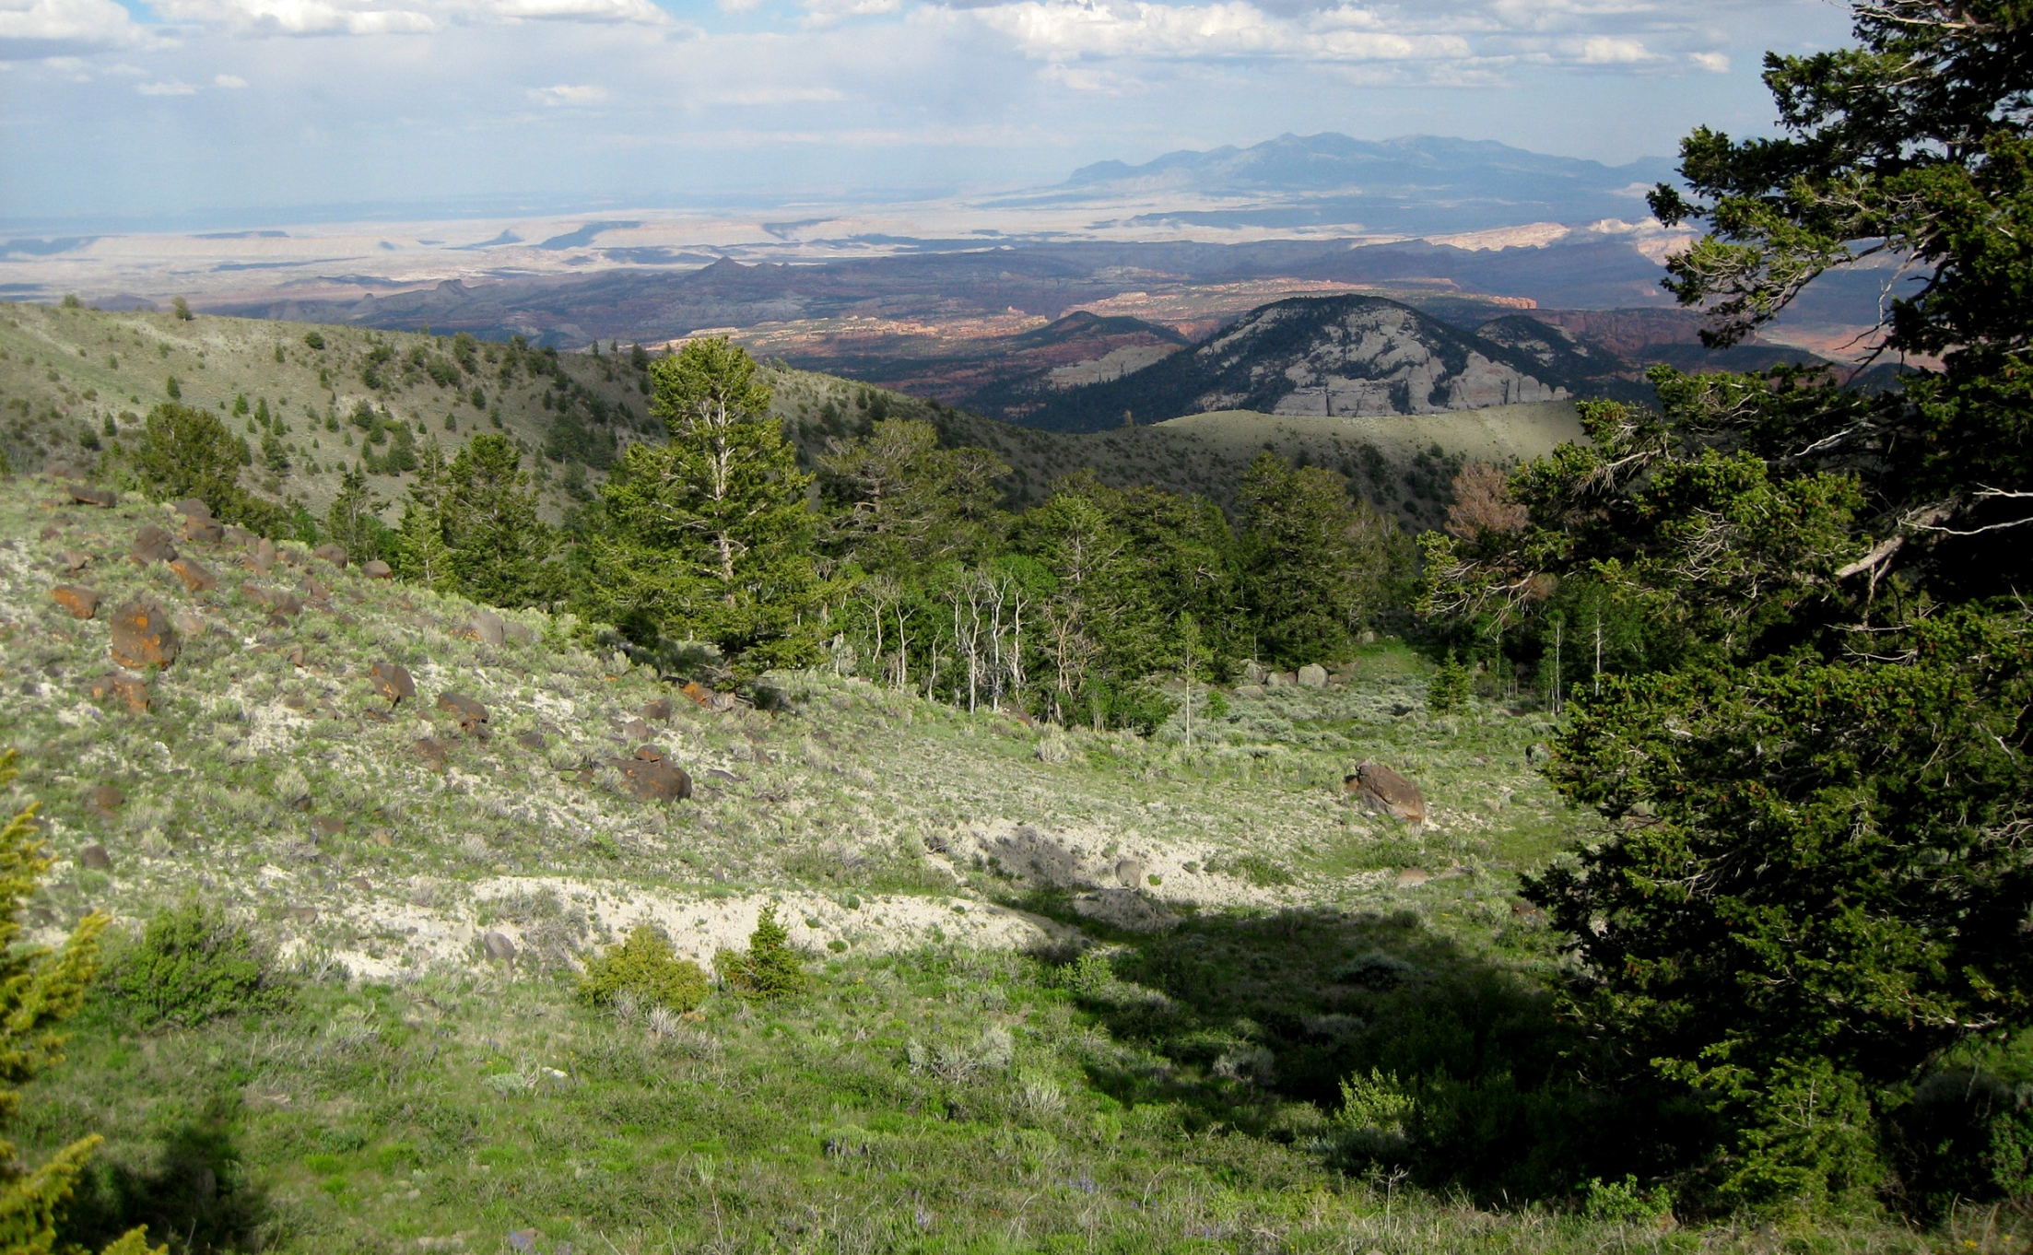
Responses to Climate across Trophic Levels
Joe Sexton University of Maryland
David Mattson U.S. Geological Survey
Questions
What are the spatial, demographic, and energetic responses of terrestrial vertebrates to climate?
How do climate effects transmit through the trophic chain?
Approach
Model movement, survival, energetics, and connectivity of large mammals on the Colorado Plateau using GPS telemetry, satellite measurements of vegetation, and climate datasets.
Key elements
Large database of herbivore and carnivore locations spanning 10 years of vegetation phenology measurements from MODIS.
Quantify and propagate uncertainty between trophic levels with hierarchical Bayesian models.
Assess habitat connectivity through graph-theoretic analyses.
Near-term efforts
Wavelet analysis of animal movements; comparison of terrain roughness indices; environmental gradient analysis of cougar diet and related prey responses
CLIMATE
VEGETATION
HERBIVORES
CARNIVORES

