Slide 1
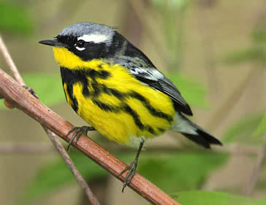
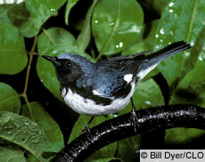
Continental Scale Modeling of Bird Diversity using Canopy Structure Metrics of
Habitat Heterogeneity
Scott Goetz
Mindy Sun
(WHRC)
Ralph Dubayah
Anu Swatatran
(UMD)
Andy Hansen
Linda Phillips
(MSU)
Richard Pearson
Ned Horning
(AMNH)
Magnolia warbler
Black throated blue warbler
Collaborators:
Matthew Betts
(OSU)
Richard Holmes
(Dartmouth)
NASA Annual
Biodiversity Meeting
Oct 2011

Slide 2
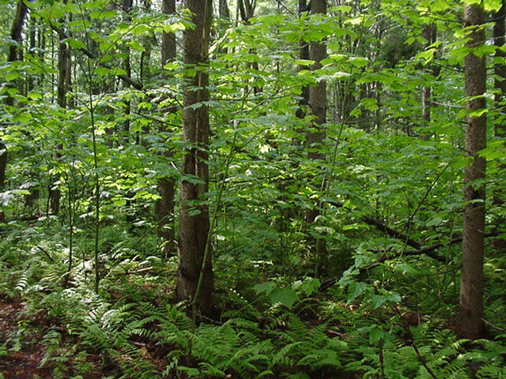
Objectives / Research Questions
(1) How can patterns of ecosystem structure be observed and modeled at regional to continental scales using remotely-sensed observations of canopy structure?
(2) What is the influence of satellite measurements of canopy structure on biodiversity model predictions (extent, richness and abundance)?
(3) What are the relationships between bird species richness, vegetation structure and ecosystem productivity at regional to continental-scales?
~
Summer Tanager. Photo by Scott Somershoe, USGS.

Slide 3
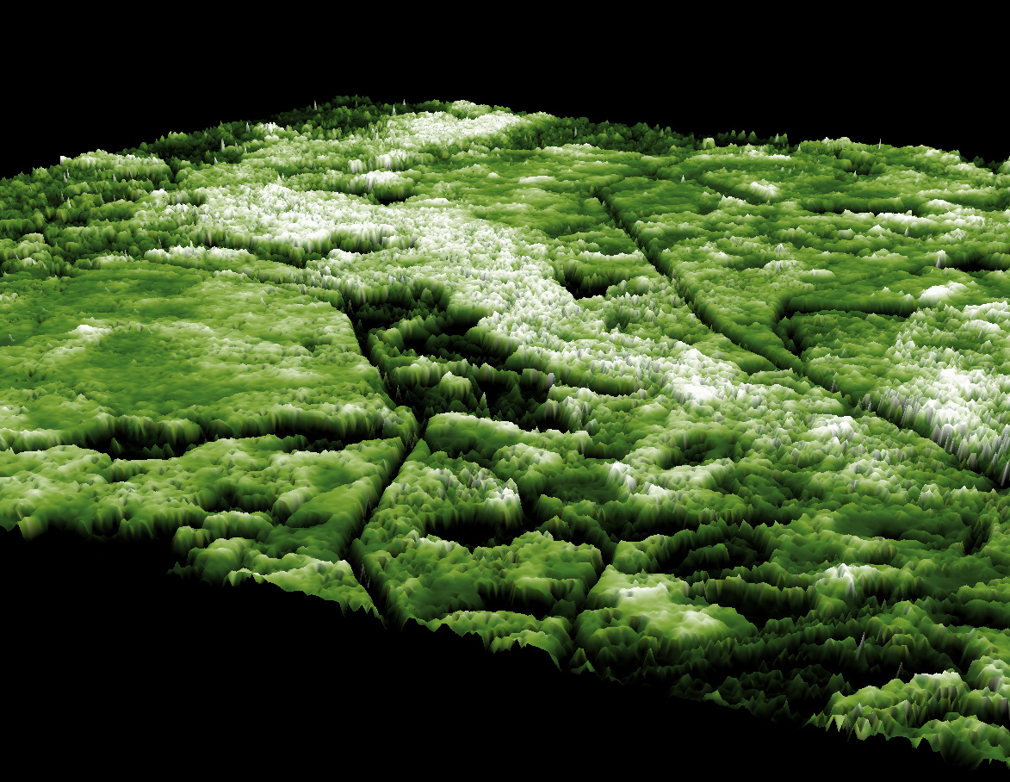
1) How can patterns of ecosystem structure be observed and modeled across scales using remotely-sensed observations of canopy structure?
LVIS Canopy Height
Oblique View
Patuxent Wildlife Refuge, MD
Notes:
This is an oblique view of Laser Vegetation Imaging Sensor “imagery” over the Patuxent Wildlife Reserve in Maryland. This would have blown MacArthur’s mind.

Slide 4
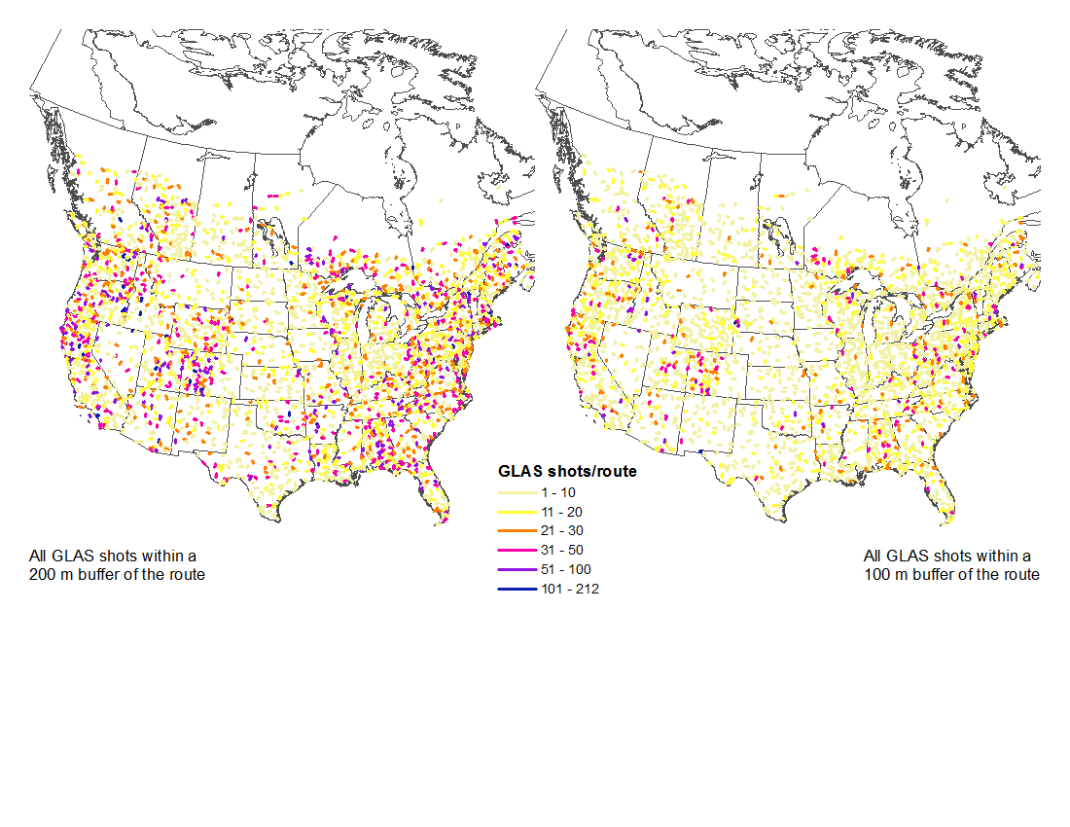
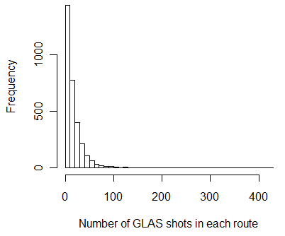
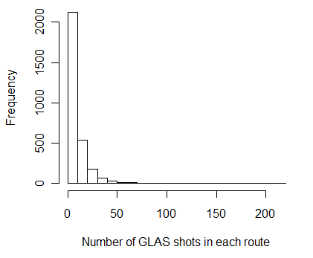
2) What is the influence of satellite measurements of canopy structure on biodiversity model predictions (extent, richness and abundance)?
At least 10
GLAS shots within BBS routes
Notes:
Number of GLAS lidar shots within a 200m buffer of BBS routes (left) and 100m buffer (right). We used the 200m buffer.

Slide 5
National Breeding Bird Survey
Species Stratified by Guild
Deserts | 334
Forest | 39430
Grassland | 23526
Lake/Pond | 9133
Marsh | 9429
Mountains | 1787
Ocean | 72
Open Woodland | 45793
River/Stream | 266
Scrub | 10334
Shore-line | 912
Town | 10711
Birds not included | 8938
3700 active routes, 2900 surveyed annually
Each route is randomly located and 40km long
Table shows total number of birds for all routes in each habitat guild for 2006
688 species recorded
Notes:
We stratified BBS bird data into habitat guilds – and focused on 4 of them (Forest, Grassland, Woodland and Scrub).

Slide 6
National Scale Predictors of Bird Diversity Patterns
Categories of predictors (see poster 161 for details)
Physical Environment: climate and topography
Vegetation Properties: canopy density / percent cover, functional groups, biomass
Vegetation Productivity: NPP, GPP (MODIS)
Vegetation Structure: GLAS metrics
Notes:
NLCD LC and Synmap are calculated as % forested, % developed, etc, in the 200m buffer surrounding the route
NLCD TC & all other variables were averaged & variance calculated
Multi-year variables averaged (e.g. 3 years of MODIS products)
GPP and NPP: MODIS Gross and Net Primary Production (1 km, 2004-2006, C5)
VCF: MODIS Vegetation Continuous Fields Percent tree cover (1 km, 2003-2005, C5)
NLCD 2001: Tree cover and Land Cover (30m)
Climate: WorldClim (1 km 1950-2000)
Topology: GTOPO30 elevation (1km) and SRTM
IceSat / GLAS (~70m samples, 2003-2007)
Biomass: CONUS Forest (250m) and NBCD (30m)
SynMap: Forest functional types (spatial res: 30')

Slide 7
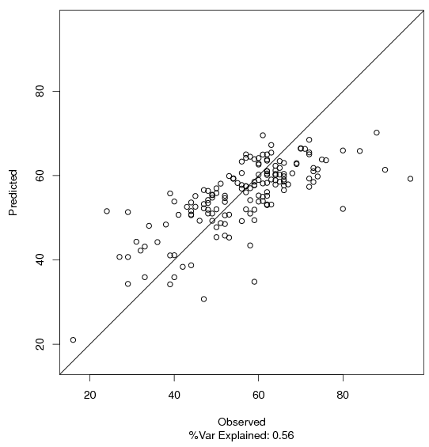
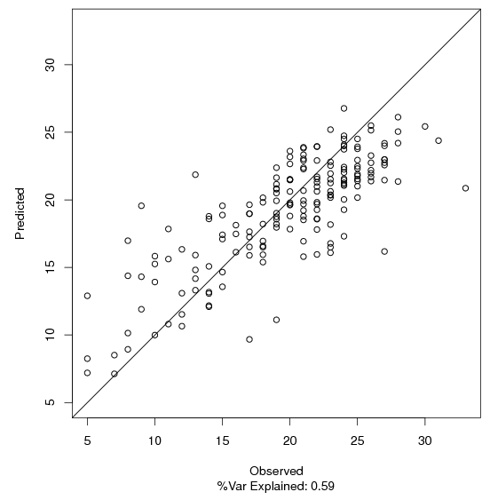
Predictions of Bird Species Richness are Robust
All species
Explained Variance = 56%
Open Woodland species
Explained Variance = 59%
829 routes
781 routes
Cross-validated with 10% reserved BBS routes
Goetz et al. (forthcoming)
Notes:
Using RandomForest (ensemble regression trees) we are able to explain a good deal of the variation in BBS species richness, particularly when we stratify by habitat guilds. The x-axis in the lower graphs shows variable importance expressed as percent increase in mean square error (%IncMSE) if variable is not included (i.e., more important variables are toward the top).

Slide 8
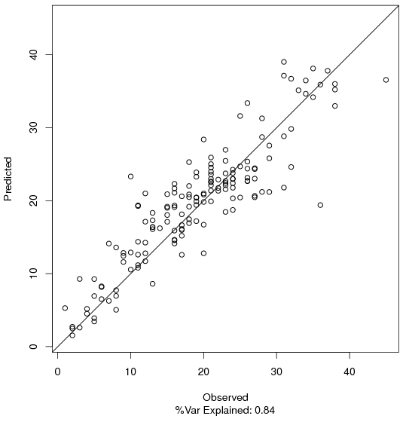
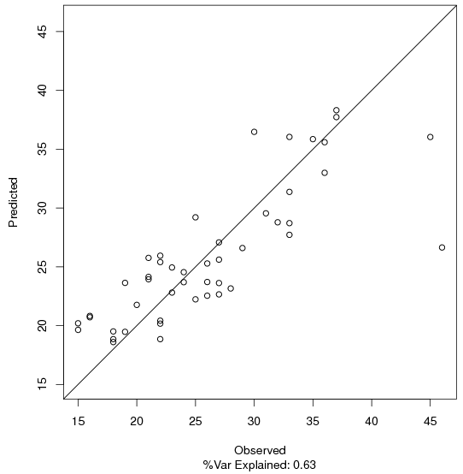
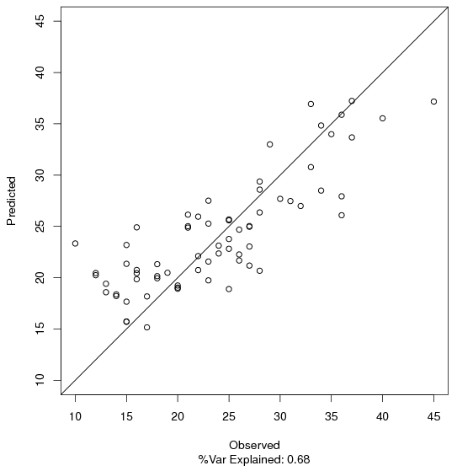
Forest Birds are predicted particularly well
Even in high Canopy Cover & Productivity areas
All Forest Birds
Explained Variance = 84%
Cross-validated with 10% reserved BBS routes
All 730 routes
High Canopy Cover
Explained = 63%
High Productivity
Explained = 68%
High Canopy Cover routes (259)
High productivity
routes (389)
Notes:
Stratifying even further to examine, e.g. forest birds in high canopy cover or high productivity areas, still explained a good amount of the variance. Climate variables & tree cover explain most of the variance at this spatial scale.

Slide 9
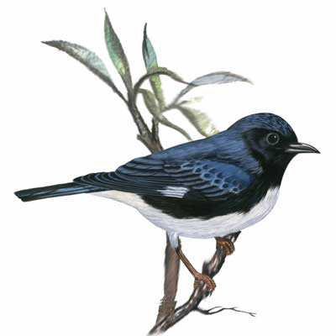
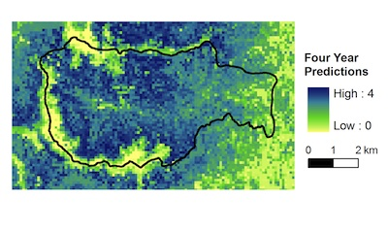
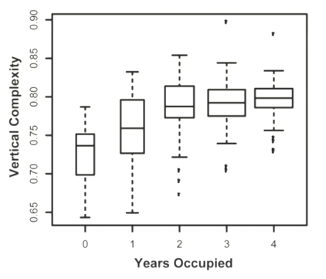
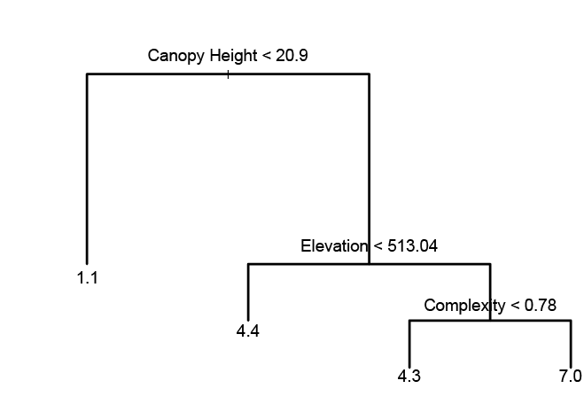
At the local scale Canopy Structure Matters.. we can even map multi-year habitat use..
Black throated
blue warbler
Hubbard Brook Experimental Forest
Goetz et al. (2010) Ecology 91:1569-1576
Notes:
The number of years that black-throated blue warblers occupied specific breeding habitat locations (between 0-4 years) was observed in the field and used to develop a model from remote sensing observations. Lidar metrics of canopy height and complexity were particularly useful predictors of breeding habitat. The developed model (part of which is shown here as a decision tree) was used to predict multi-year habitat use over the extent of the HBEF and environs (upper right image). A model based on 3 years of observations also had good skill at predicting site occupancy in the 4th year.

Slide 10
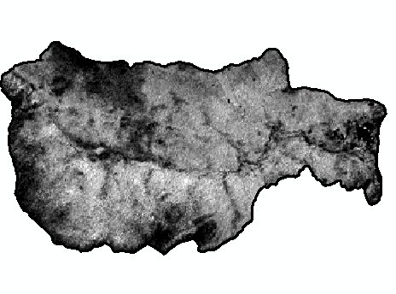
Fusion with optical, hyper-spectral, hyper-resolution, SAR even better..
Hubbard Brook Experimental Forest
LVIS RH100
0 5 10 15 20 25 >30 m
DRL Canopy Height
0 5 10 15 20 25 >30 m
UAVSAR
Landsat
NDVI difference
0 0.6
Notes:
It is possible that RH100 is overestimated but both LVIS and DRL heights have similar relationships with field height - the DRL underestimates canopy height by a few meters (average of 2m) .
Plotting LVIS waveforms with LVIS RH100 and DRL CH, the DRL heights were consistently lower than LVIS canopy top peak.

Slide 11
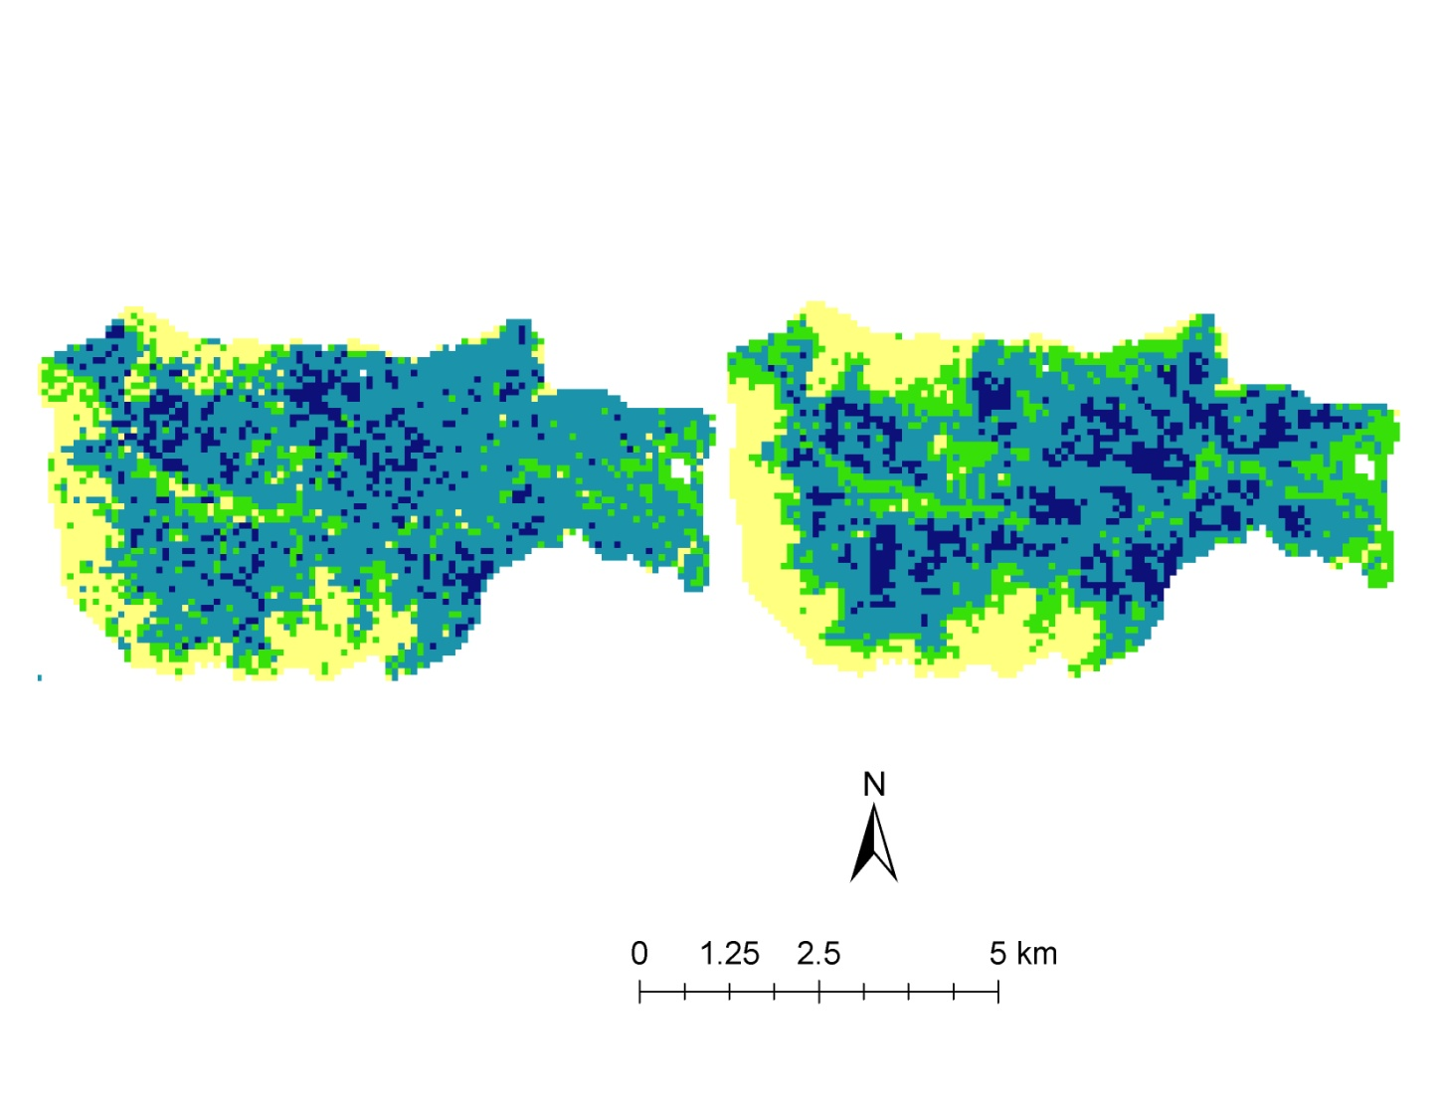
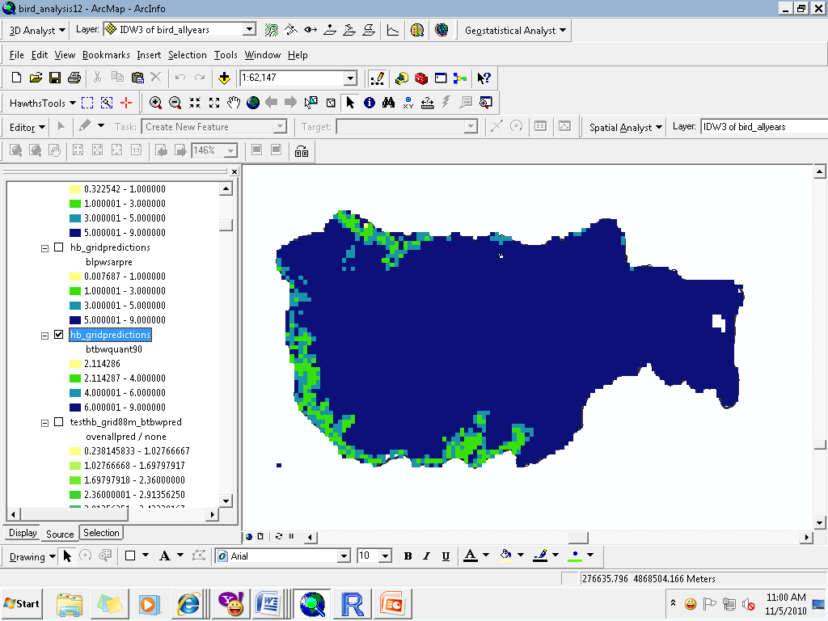
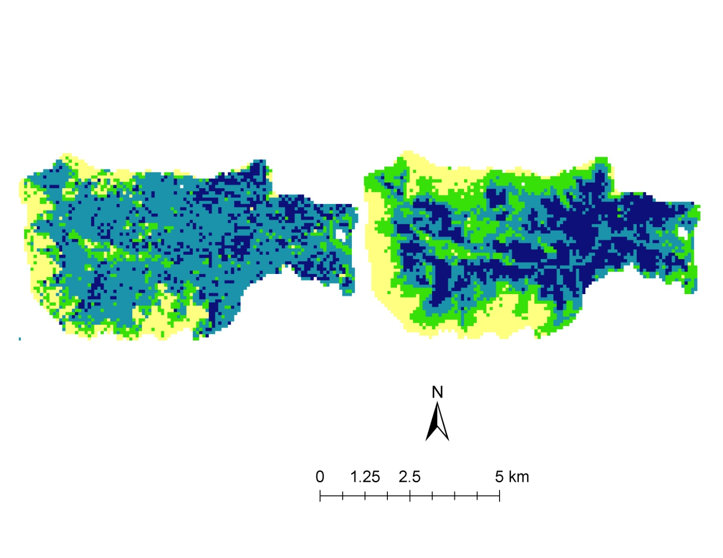
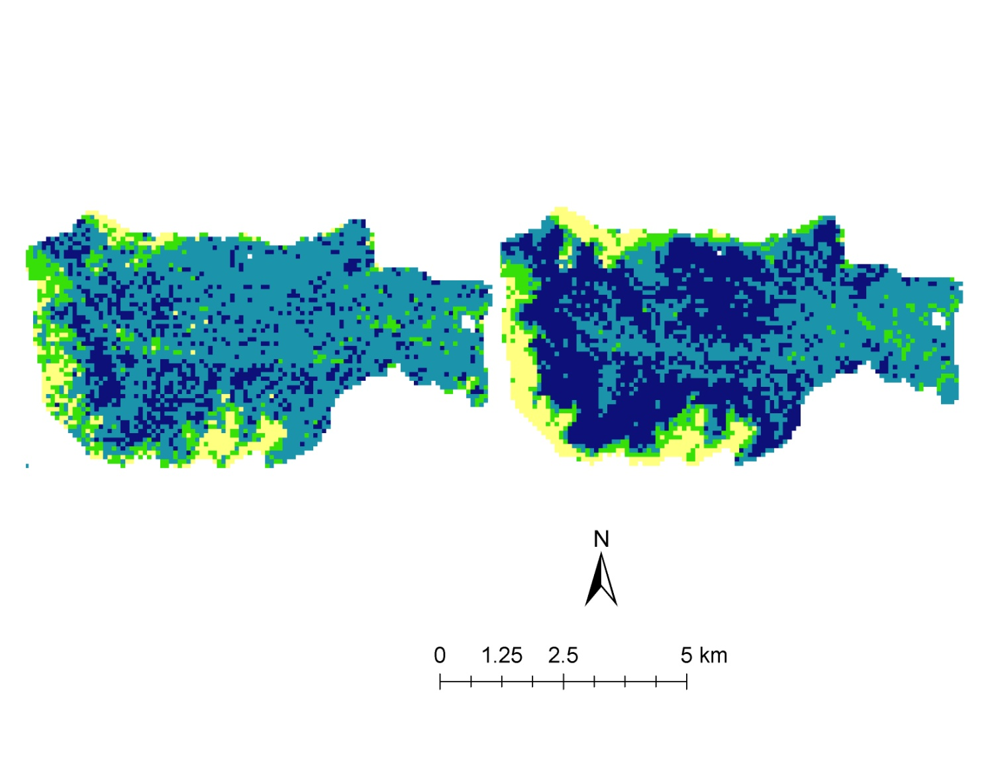
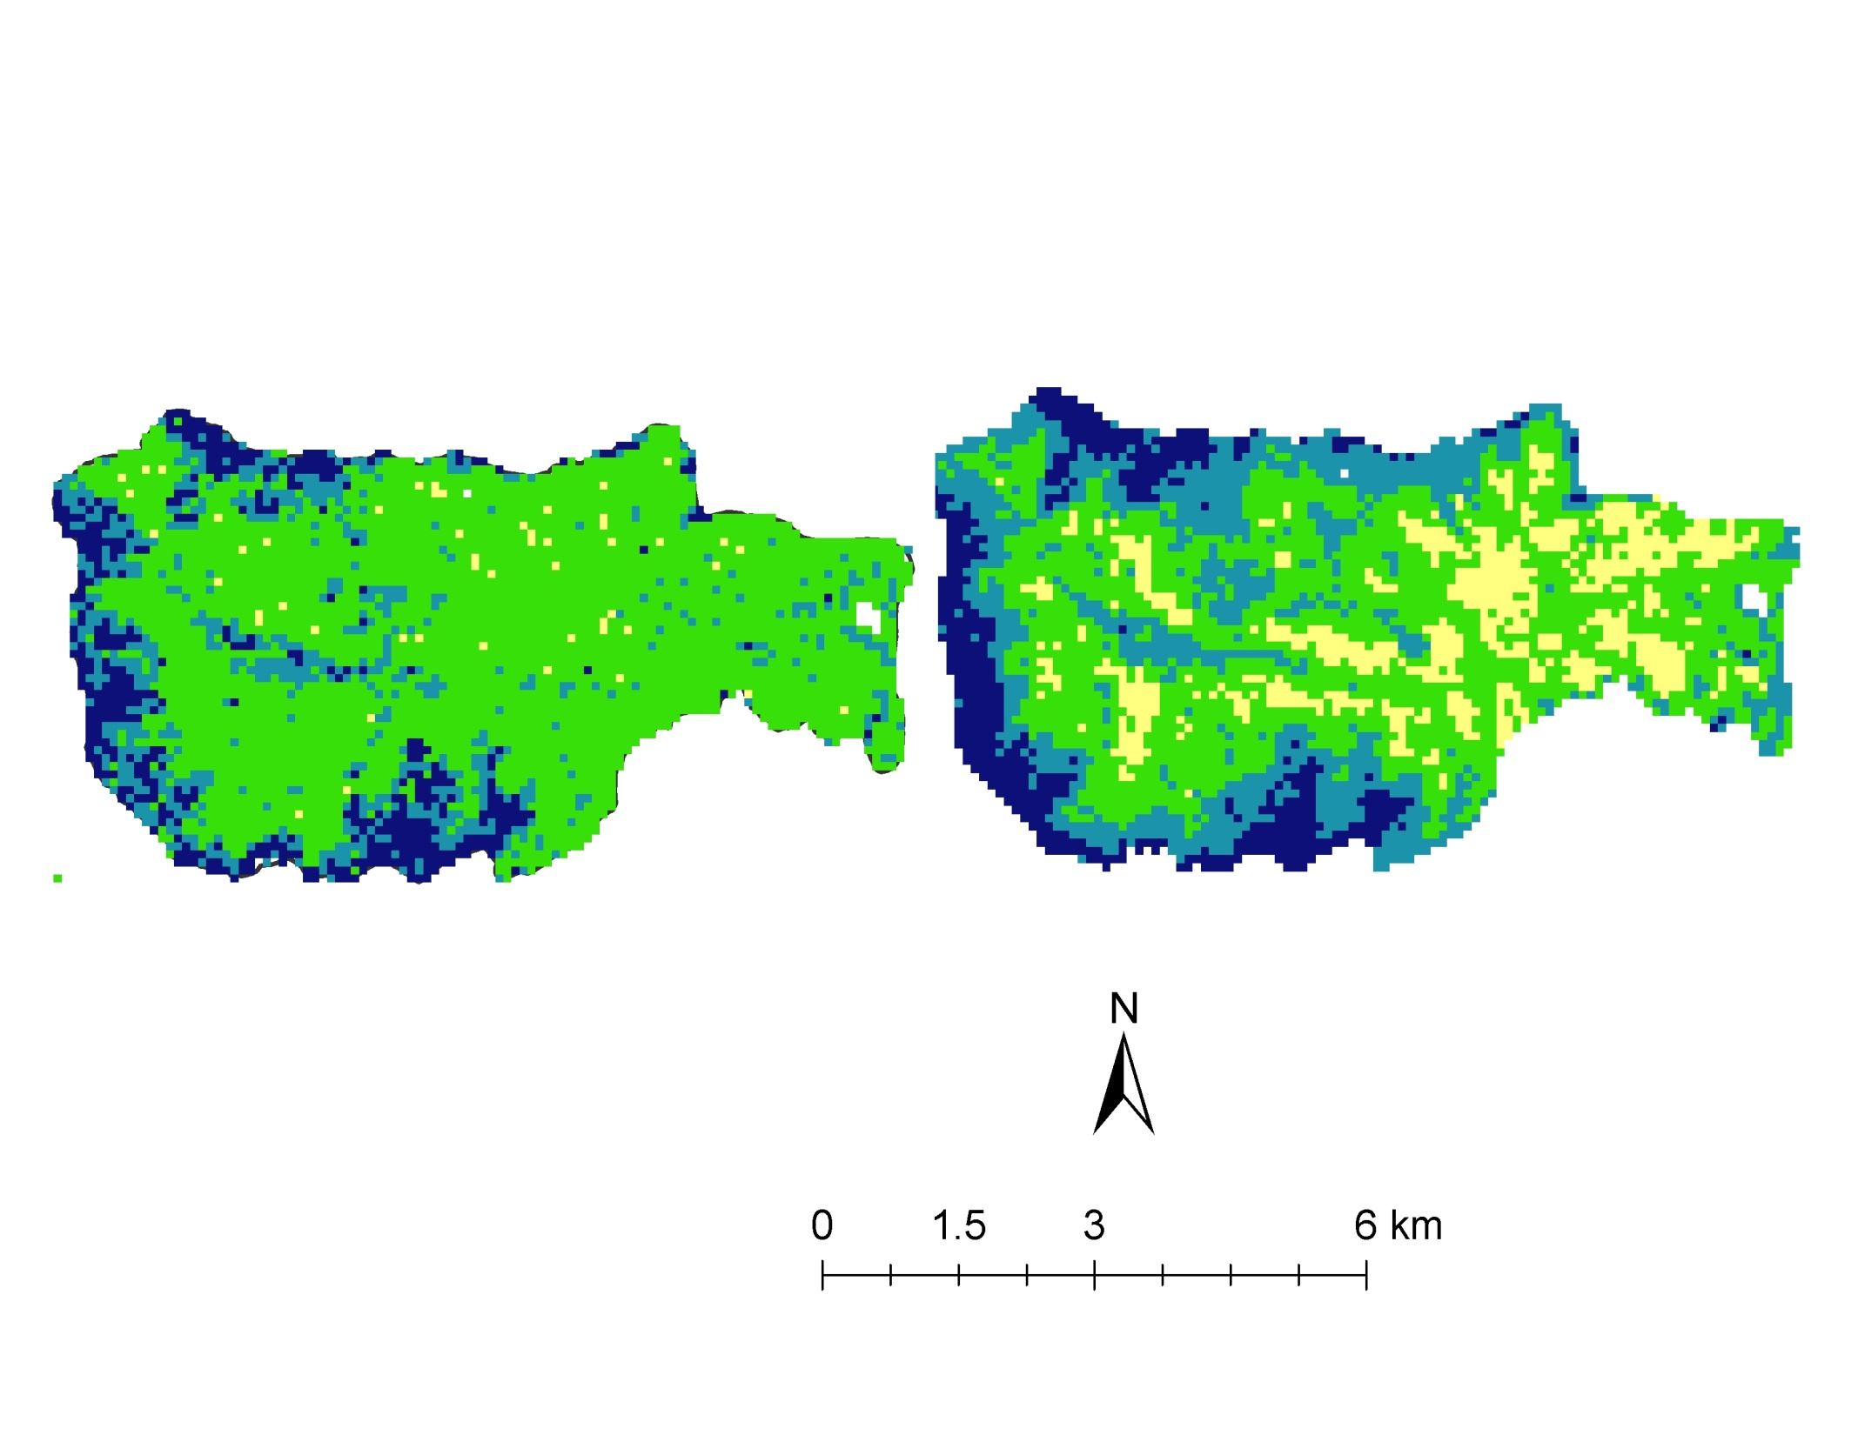
Radar only
All metrics
Prevalence
Oven bird
< 2
2 – 4
4 – 6
6 - 9
Red eyed Vireo
Black-throated Warbler
Swatatran, Dubayah, Goetz, et al. (in press) PlosOne
Notes:
Predicted prevalence from radar metrics alone (left) and all metrics together (right).

Slide 12
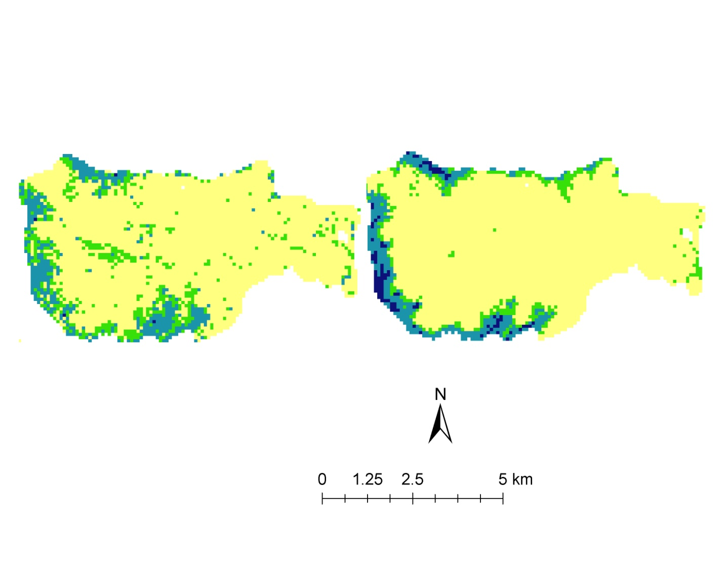
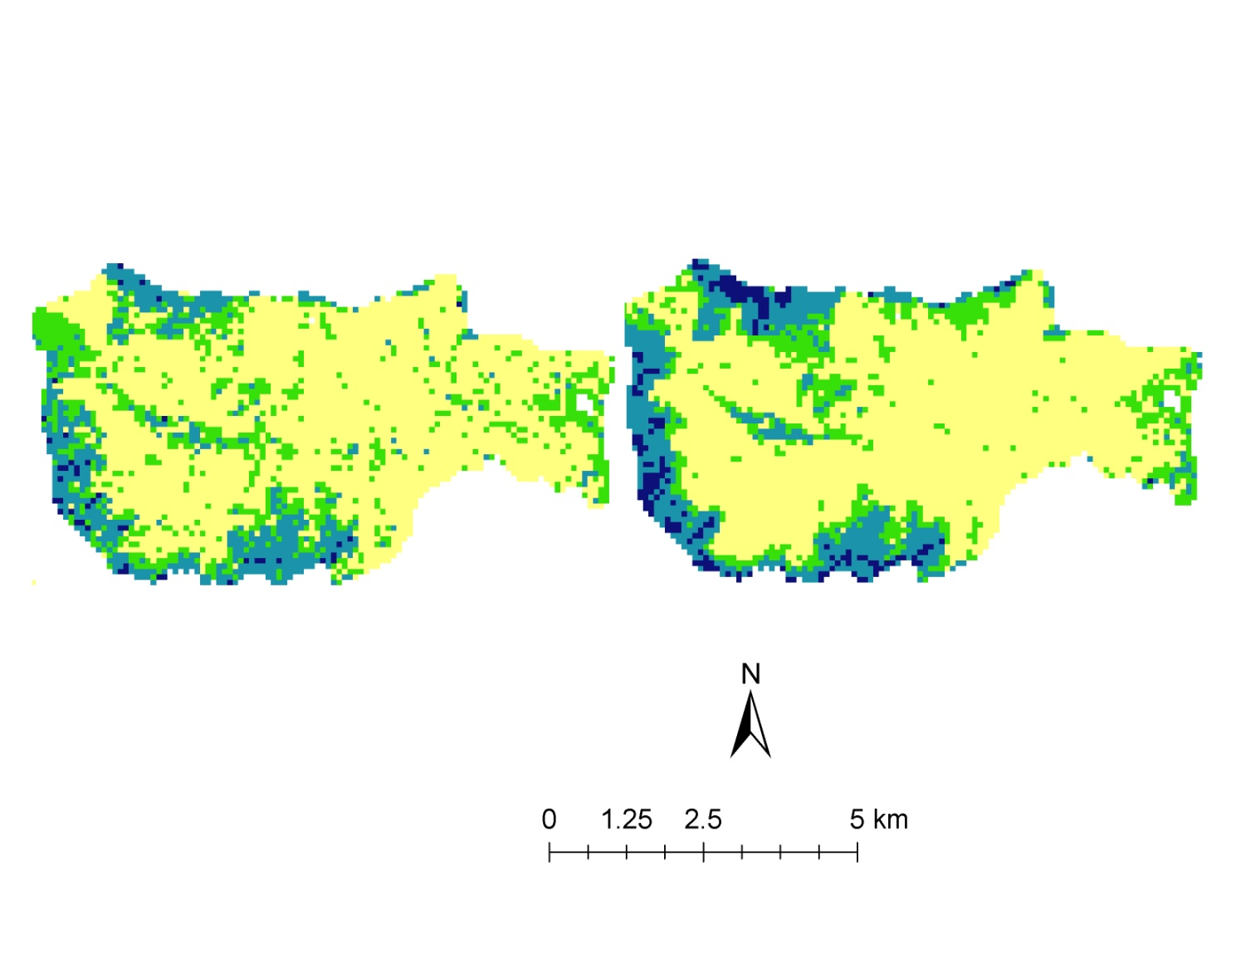
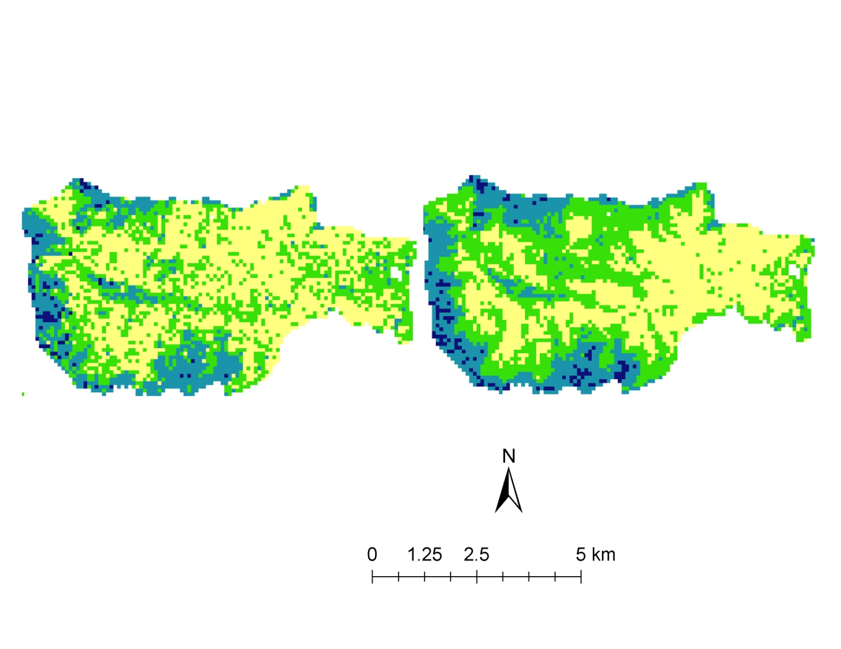
Radar only
All metrics
Prevalence
< 2
2 – 4
4 – 6
6 - 9
Blackpoll Warbler
Magnolia Warbler
Yellow Warbler
Swatatran, Dubayah, Goetz, et al. (in press) PlosOne
Notes:
Fig 7a. Predicted prevalence from radar metrics alone (left) and all metrics together (right) . For species codes refer to table 1
BLPW = Blackpoll Warbler
MAWA = Magnolia Warbler
MYWA = Yellow Rumped Warbler

Slide 13
Single versus multi-sensor predictions of Bird Species Richness
% variance explained
Hubbard Brook Experimental Forest
Swatatran, Dubayah, Goetz, et al. (in press) PlosOne
Notes:
Average predictive power for of each data set for all species taken together.

Slide 14
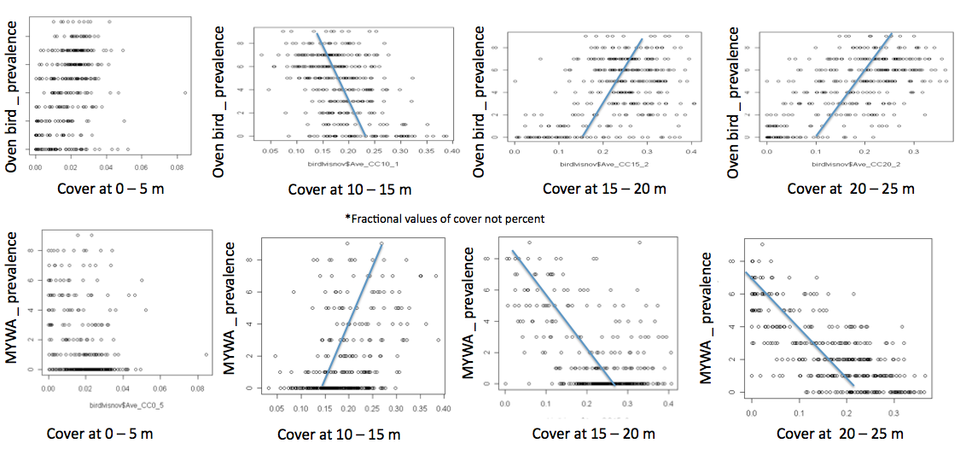
Species habitat use varies with vegetation cover across a range of heights
Ovenbird more prevalent in upper canopy
Yellow-rumped warbler more prevalent in lower canopy
Notes:
MYMA = yellow rumped warbler

Slide 15
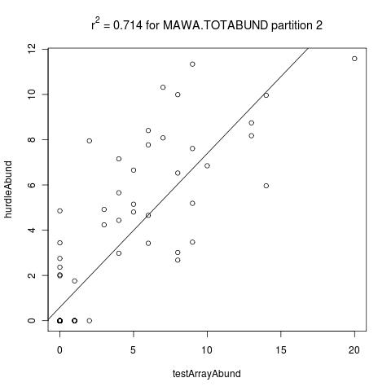
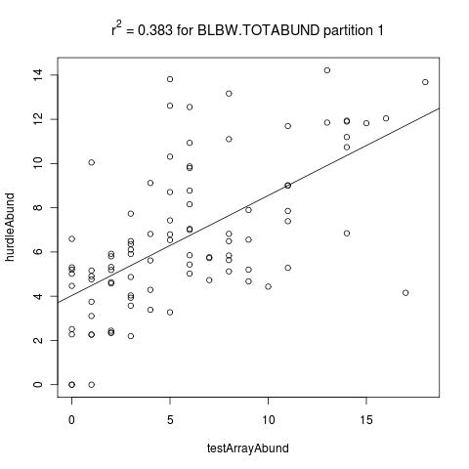
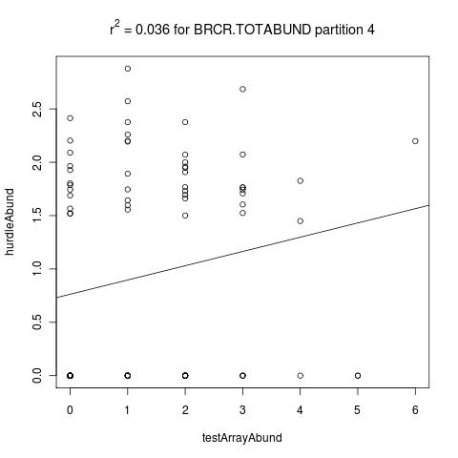
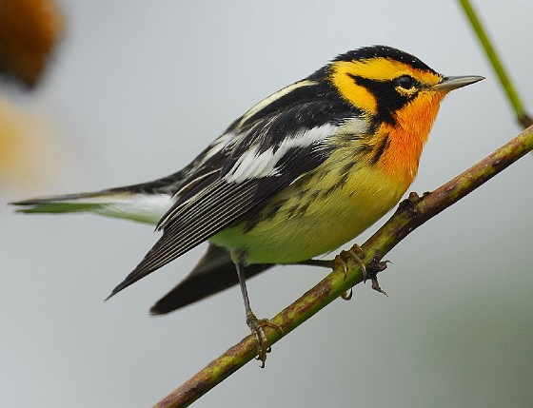
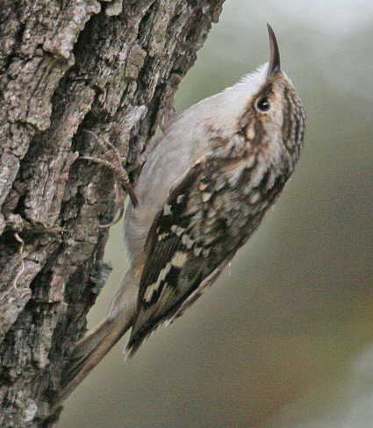
Predicting Abundance more difficult..
Boosted Regression Tree Model predictions of species abundance at HBEF
Average prediction…
(mean r² for 16 species = 0.38)
Good prediction…
Poor prediction…
Magnolia Warbler, r²=0.71
Blackburnian Warbler, r²=0.383
Brown Creeper, r²=0.036
Notes:
Aim: To test how well bird abundance can be predicted at the Hubbard Brook Experimental Forest (HBEF) using predictor variables derived from LVIS
Model: We use a hurdle model with boosted regression trees. This involves two steps: (1) a presence/absence model is run with a Bernoulli (binomial) distribution, and (2) an abundance model, with all zeros excluded, is fitted with a truncated Poisson count distribution. The final prediction is then obtained by multiplying the results from both steps, such that the predictions can be interpreted as being abundance given suitable habitat. This approach has proven effective for modeling bird abundance when the dataset is ‘zero-inflated’ (meaning that for each species there are lots of sites with zero abundance). Thus, the approach combines a presence/absence model with an abundance model. Previous studies have worked at coarser spatial scales – our goal is to use LIDAR data to make useful predictions at fine spatial resolution.
Results: Mean r-squared across all 16 species = 0.382, with max = 0.714 and min = 0.036. For the presence-absence model, mean accuracy = 0.790 (max=0.968, min = 0.533) and mean Kappa = 0.776 (max= 1.0,min=0.556). Overall, results are a little disappointing – we had hoped for stronger predictive power. We have tried to improve predictions by parameterizing the models differently; in particular, by testing alternative approaches for thresholding the presence/absence models. This has only resulted in small improvements.
A way forward is to try additional multisensor predictor variables.

Slide 16
Summary of Findings thus far..
National scale bird species richness can be robustly predicted using a suite of environmental variables
  At the national scale LIDaR canopy structure metrics are not selected as the most important variables
At local scale (HBEF, Patuxent) bird species richness and habitat use (multi-year prevalence) can be robustly predicted using lidar and multi-sensor canopy structure
  Abundance more difficult

Slide 17
Next Steps & in Progress
Extend regional & national scale analyses across productivity, land use and disturbance gradients
Analyze SE LVIS transect data and intersections with BBS routes
We have made some progress on this..

Slide 18
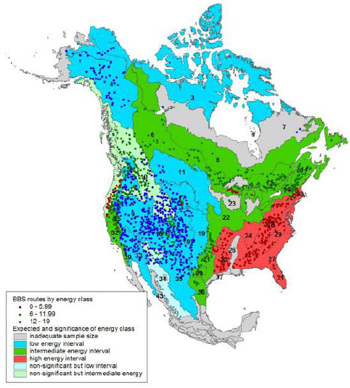
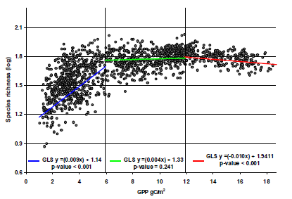
3) What are the relationships between bird species richness, vegetation structure and ecosystem productivity at regional to continental-scales?
Geographic regions differ in the slope of the species -productivity relationship
Phillips et al. (2010) Ecological Applications

Slide 19
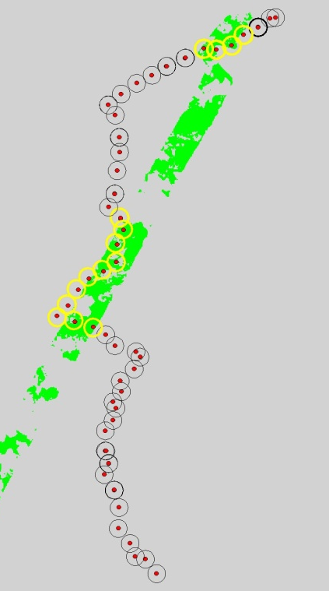
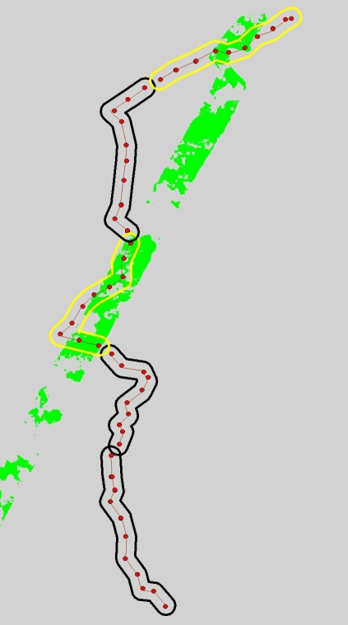
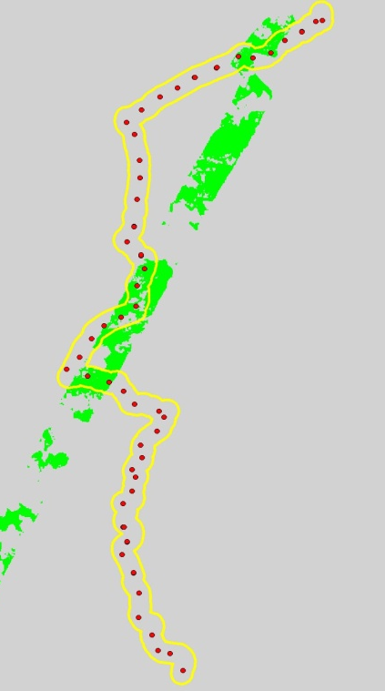
Southeast LVIS Transect
Point
Segment
Route
BBS stop locations
Three analysis units
Intersection of BBS routes with LVIS acquisitions

Slide 20
Regional Interactions among Ecosystem Productivity
and Canopy Structure
Geographic Location
Southeast US
Three Analysis units
BBS sample locations, Segments, Routes
Stratify
Disturbance History and Land Use
Response variable
BBS species richness and diversity
Predictor variables
LVIS
Canopy cover
Canopy cover by height class
Land cover
Percent Ag
Percent developed
Percent Canopy
Variety of cover types
MODIS
GPP
VCF forest
Soil fertility
Other biophysical
Temperature
Precipiation
Elevation
NDVI

Slide 21
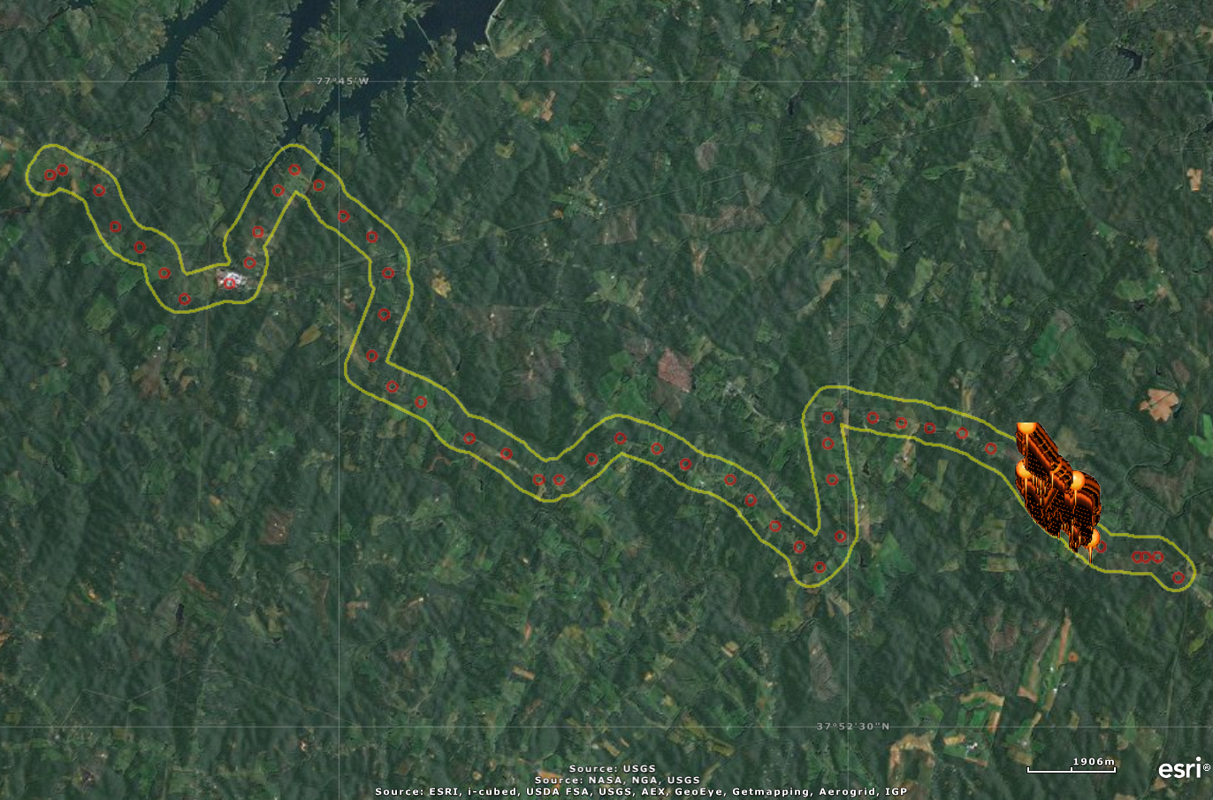
Stop locations and BBS route buffer
LVIS transect overlap
Collected GPS stop location data collected for 53 of 63 BBS routes from BBS Surveyor and/or driving the route GPS

Slide 22
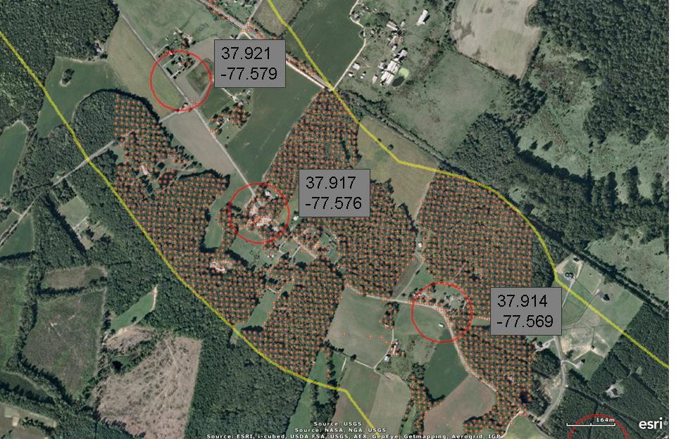
Stop locations and BBS route buffer
LVIS points in red
BBS stop locations buffered (Red)
BBS route buffered (Yellow)

