Slide 1
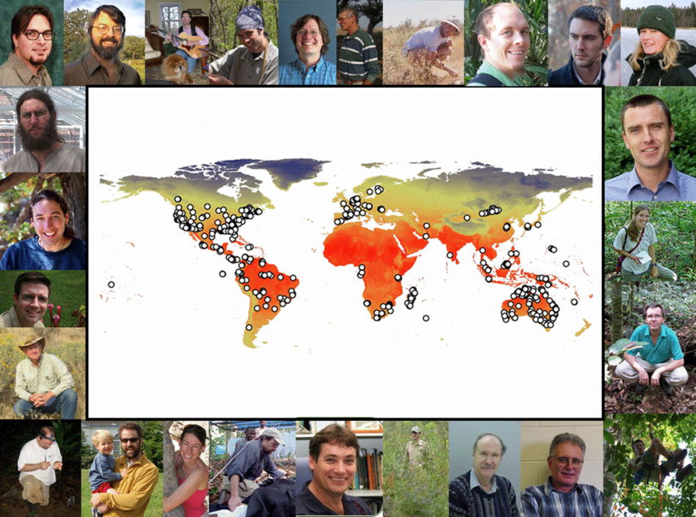
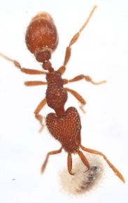
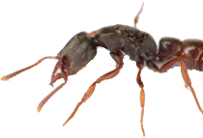
You Probably Stepped on an Ant Today
Clinton Jenkins, Andrea Lucky, Nathan Sanders, Michael Weiser, Matthew Fitzpatrick, Robert Dunn, Benoit Guénard, Sarah Diamond, Beth Gardner…
Finding the ants
Predicting diversity
Climate change and ant diversity
Urban ants
Ants and the public

Slide 2
Ant Diversity in Light of Climate Change
Jenkins et al. (2011) Diversity and Distributions
Generalized Linear Model
Climate: temperature, precipitation, aridity
Geography: biogeographic region
Interactions: region * climate

Slide 3
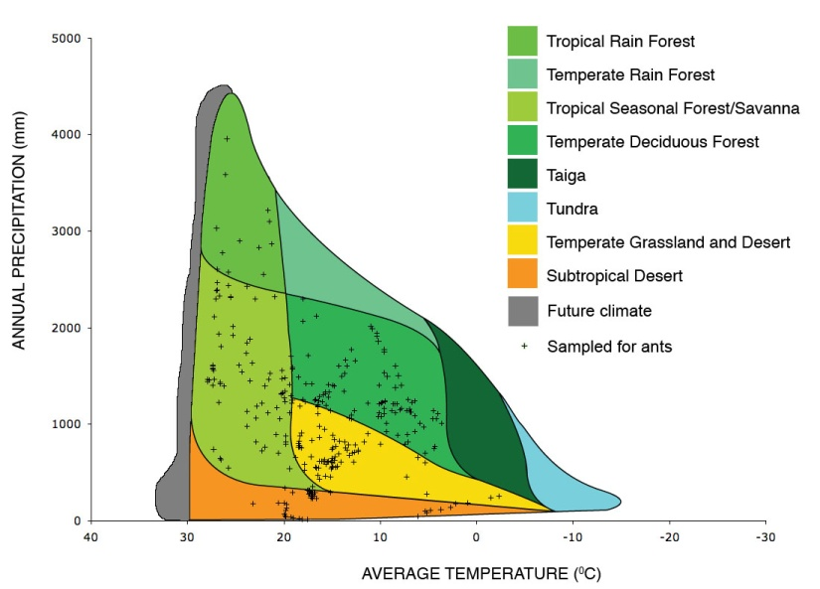
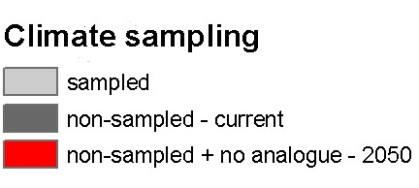
Gaps in our Knowledge
Lots of ant data
Not so many data
No-analogue climates
& new biomes
Precipitation
Temperature
Lots of ant data
No-analogue
climates

Slide 4
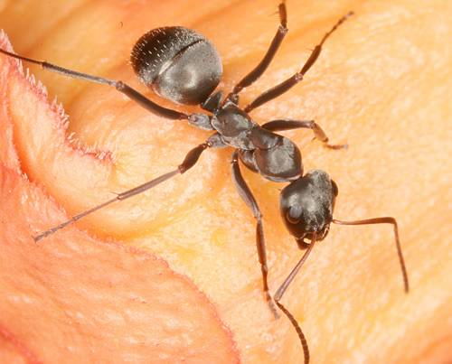
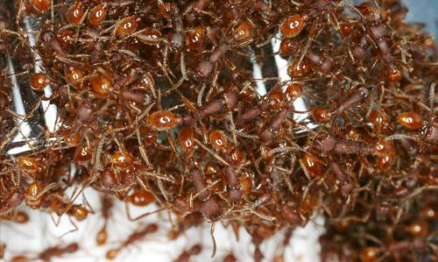
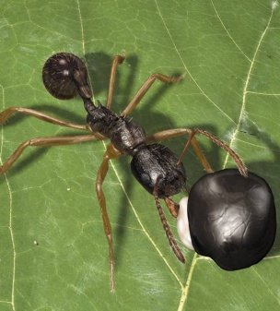
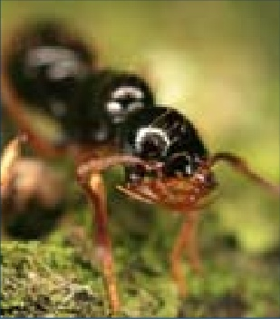
Findings
Ant diversity generally increases with temperature
At the highest temperatures diversity is also the most variable, ranging from 1 to 145 species
Future climates will be more like these hot places, which are also where we know the least

Slide 5
New directions
Individual species modeling
Urbanization and phenology
Missing ant diversity
School of Ants

Slide 6
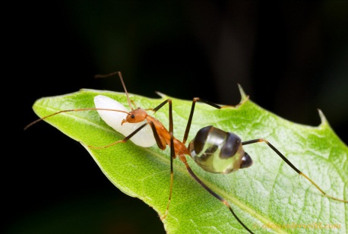
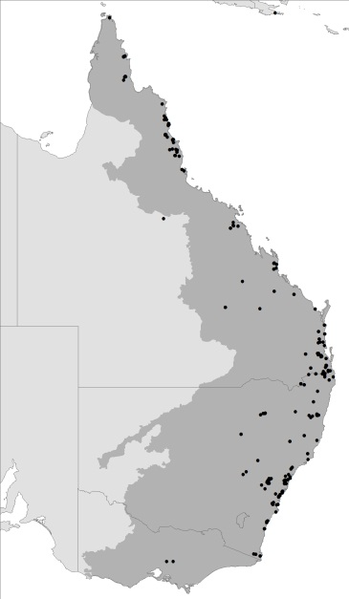
Spider Ants (Leptomyrmex spp.)
Name is appropriate
SE Asia / Australia
Wingless queens = limited dispersal
Maxent models + others(?)
Climate works well
Other remotely sensed variables
ID environmental variables separating species
L. darlingtoni
Localities

Slide 7
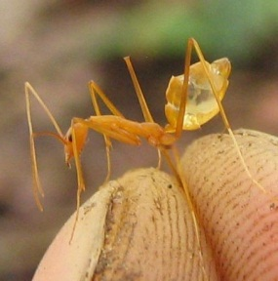
Spider Ants
Covariates
Dataset | Instrument / Source
Climate | WorldClim
Aridity | derived
Potential Evapotranspiration | derived
NDVI | MODIS
Gross primary productivity | MODIS
Net primary productivity | MODIS
QuikSCAT | QuikSCAT
Percent tree cover (VCF) | MODIS
L. fragilis

Slide 8
Suitability for L. erythrocephalus
MaxEnt
Maxlike
Climate +
remote sensing
Climate +
remote sensing
Climate
Climate

Slide 9
Summary of spider ants
Species distribution models work
Climate explains most of it
Remotely sensed variables help resolve finer scale

Slide 10
SE Climate Science Center / Global Change Forum Urban Warming & Phenology Working Group

Slide 11
Working group questions
How are phenologies of organisms altered by living in urban environments?
Can we apply these findings to understand responses of organisms to climate warming?
Identify available datasets to address this question (VIP Explorer)

Slide 12
Cities as windows into climate change
Urban heat islands: “a metropolitan area which is significantly warmer than its surrounding rural areas”
Mimic future warming
Comparisons with adjacent rural areas provide useful controls

Slide 13
Phenological metrics
Date of first appearance
Date of last appearance
Duration of activity period
Peak activity period
Change in phenology over time (longitudinal)
Current phenology (space for time)

Slide 14
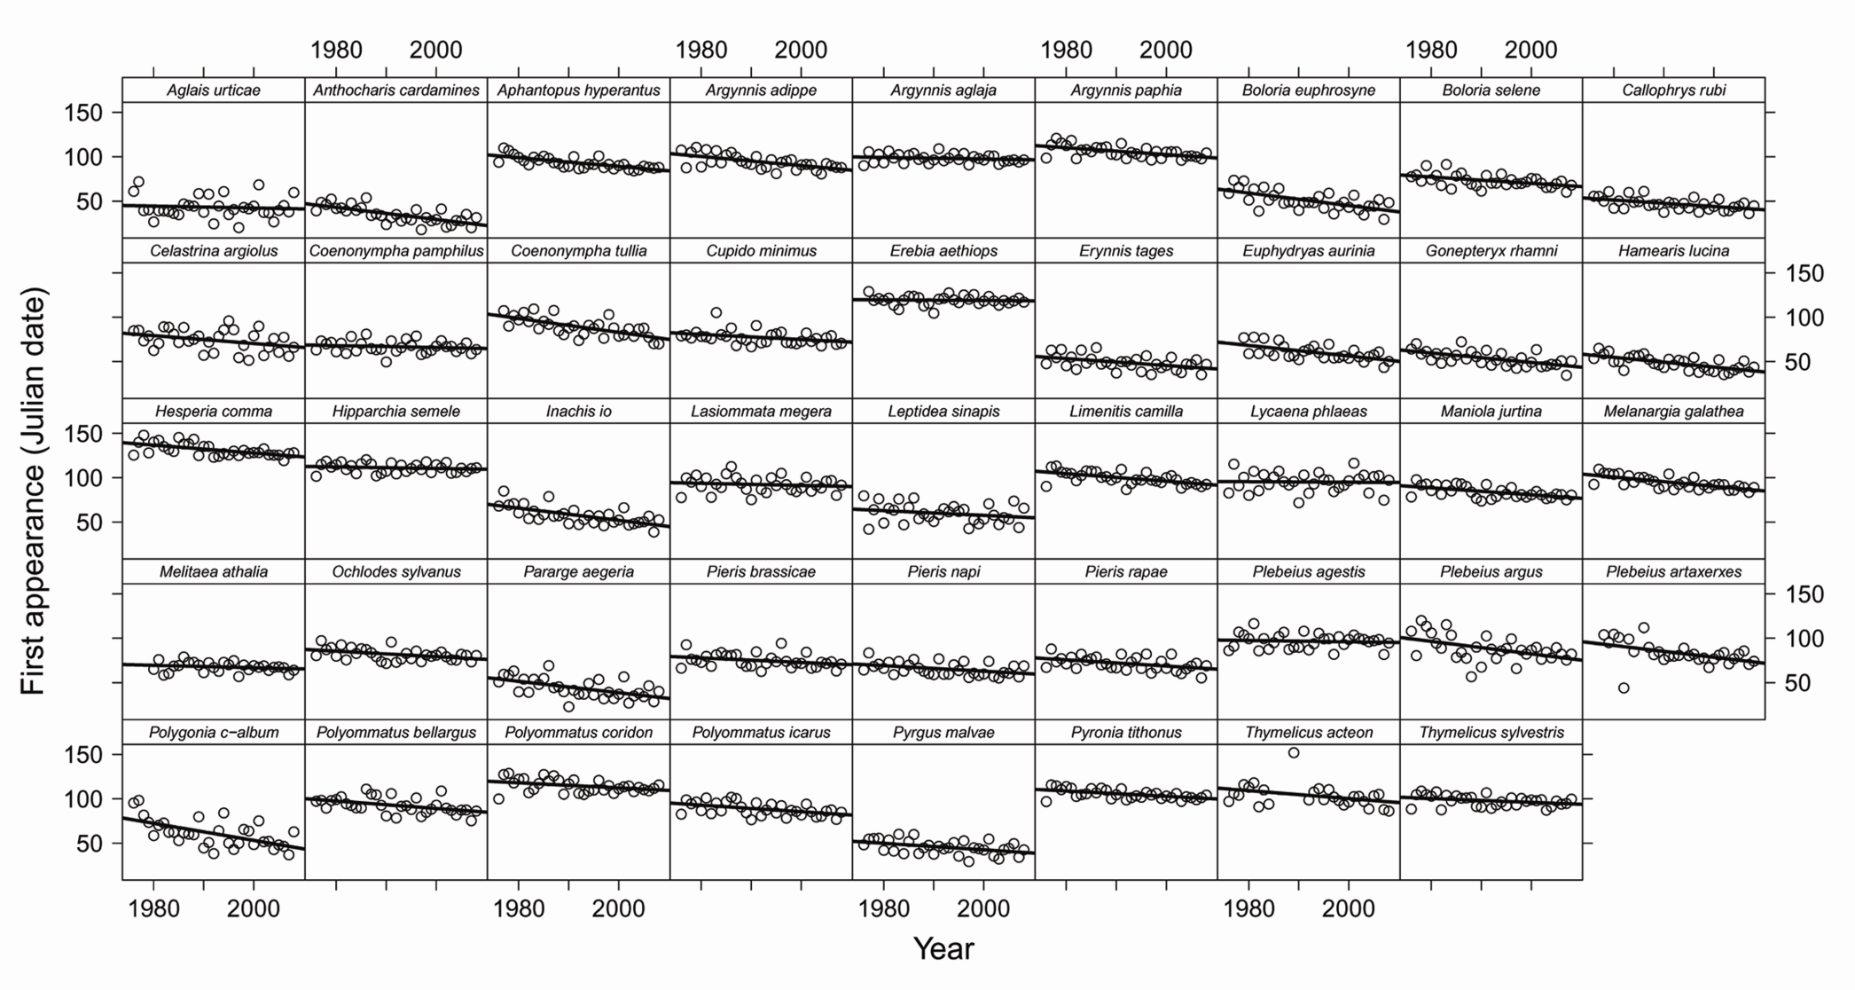
Phenology of UK butterflies (1976-2008)

Slide 15
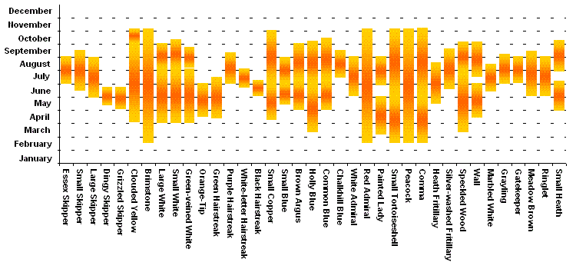
Flight phenology of UK butterflies:
Date of first appearance

Slide 16
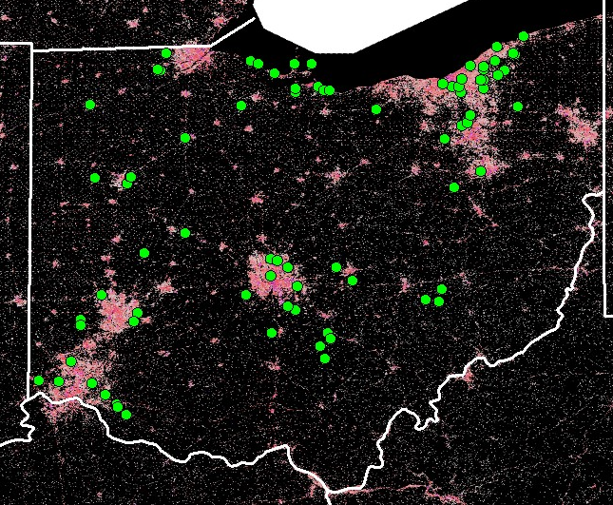
How does phenology vary as a function of urbanization?
Urbanization metric
Heat island model
% impermeable surface
Climate stations
Others?

Slide 17
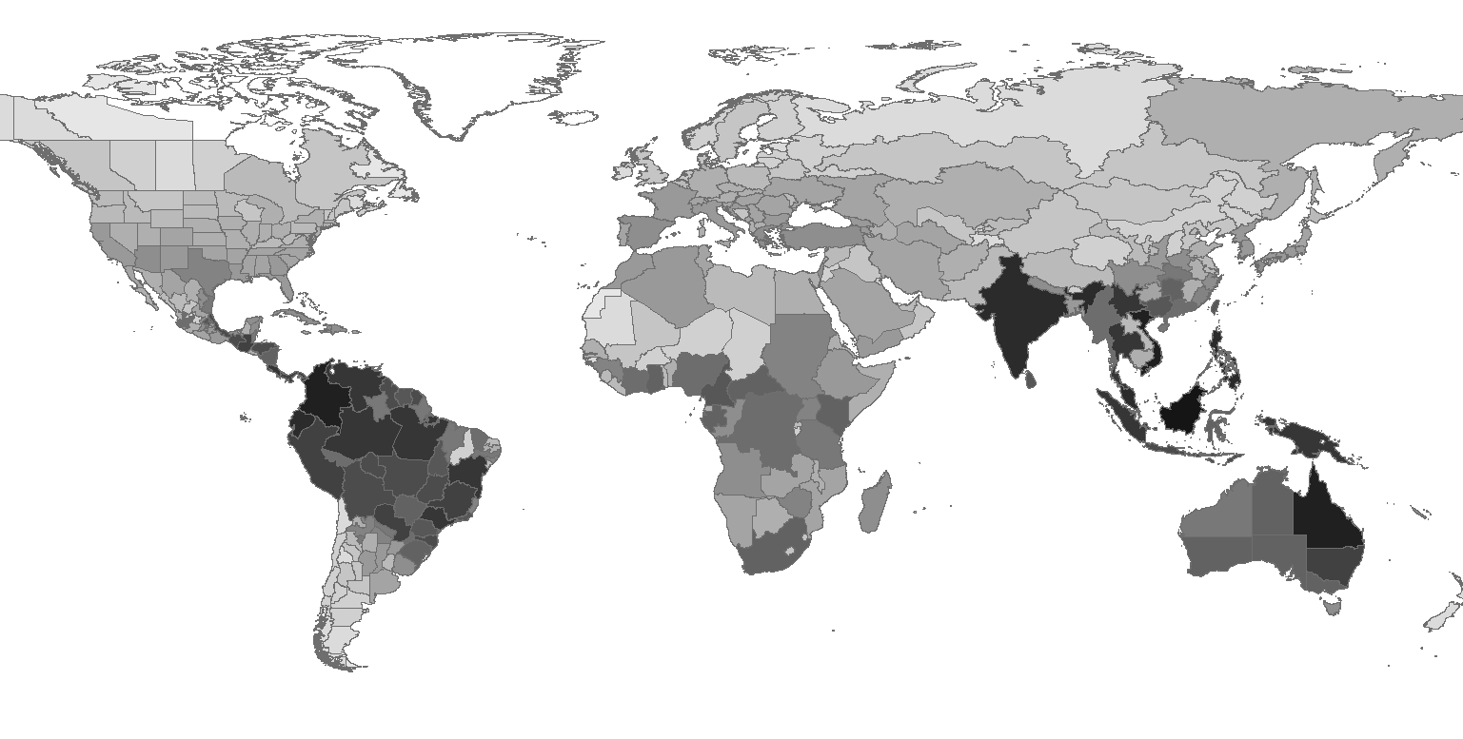
Generic diversity of ants
http://www.antmacroecology.org/ant_genera/index.html

Slide 18
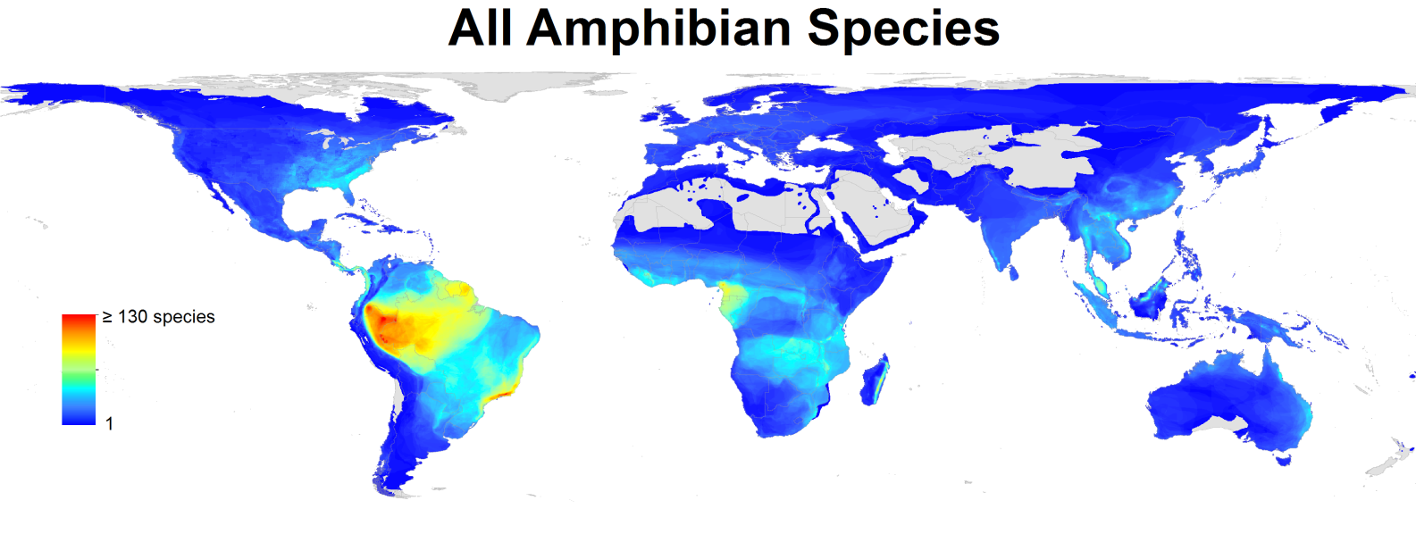
Mapping approaches to mapping diversity
Range maps
Global Amphibian Assessment
Model species diversity
Kreft & Jetz 2007. PNAS

Slide 19
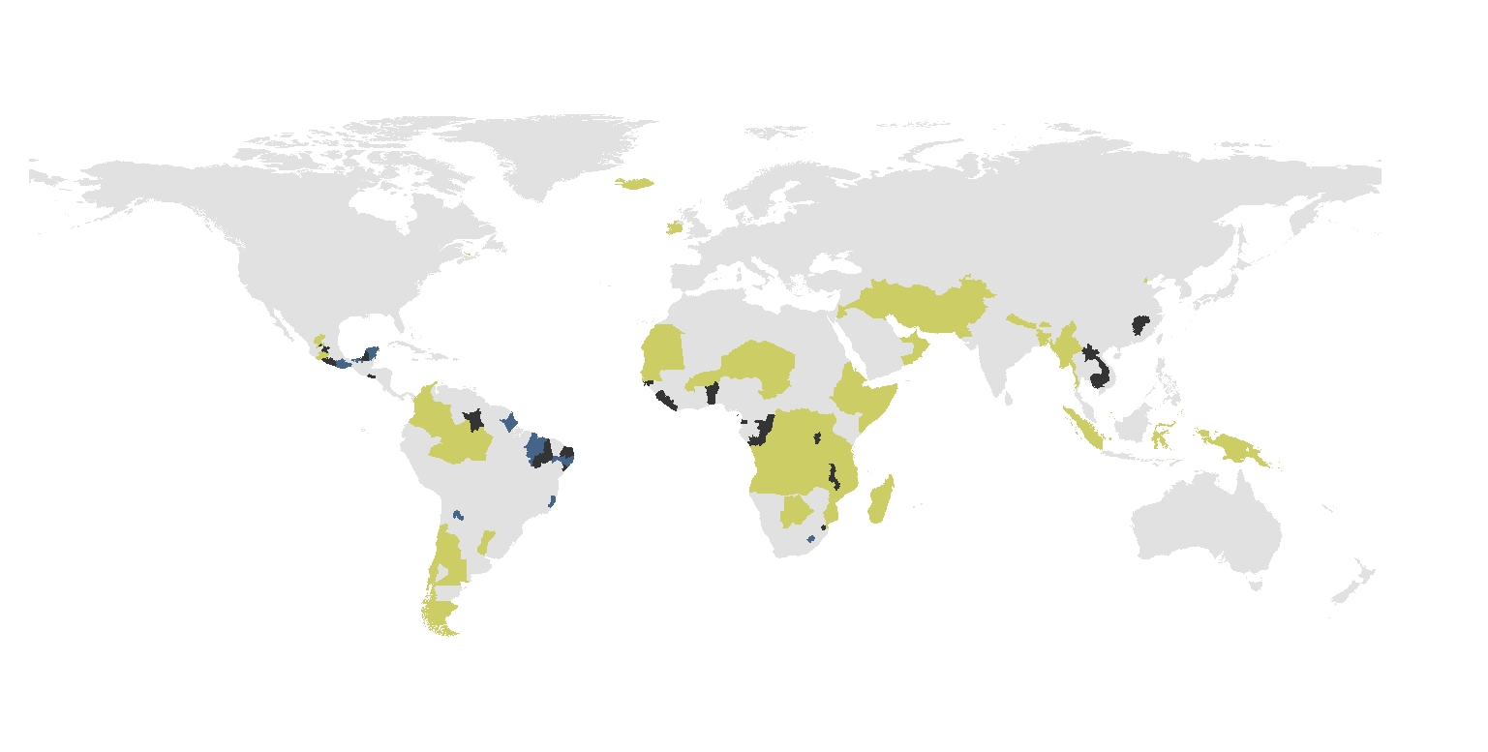
Missing diversity
Predicted by the expert model
Predicted by the environmental model
Predicted by both models
Model of generic diversity based on better sampled regions

Slide 20
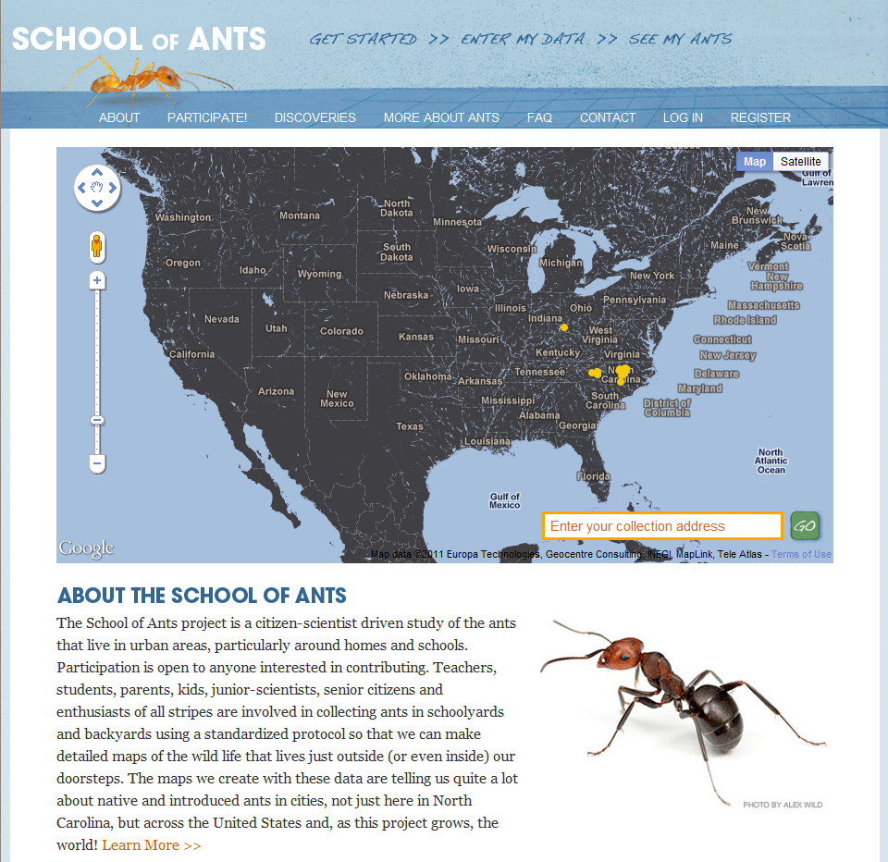
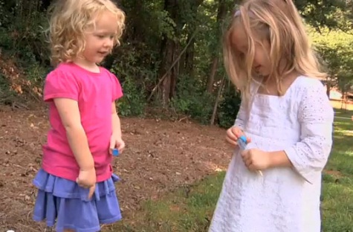
>10,000 requests to participate
500 sampling kits returned
1,000s of ants to identify.
Tiny myrmecologists on YouTube.
http://www.youtube.com/watch?v=gMg55LTJ6gQ

Slide 21
Stuff we’d love from NASA
Update WorldClim
Global, multi-temporal dataset of NDVI, EVI, etc.
Global impervious surface
Time series of surface water

