Slide 1
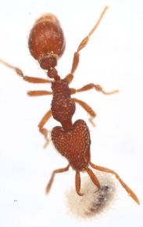
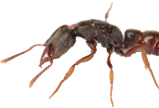
Limits to our knowledge of ant diversity in light of climate change
Clinton N. Jenkins, Nathan J. Sanders, Michael D. Weiser, Matthew C. Fitzpatrick, Robert R. Dunn
How much do we know about ants?
What will climate change do to diversity?
Where can we learn the most the fastest?

Slide 2
Local Ant Assemblages Sampled
Lots of data
Not so many data
Lots of data
And all the places in between?

Slide 3
Ant Species Richness of the World: minus some parts
Generalized Linear Model
Climate: temperature, precipitation, aridity
Elevation
Continent
Continent * climate

Slide 4
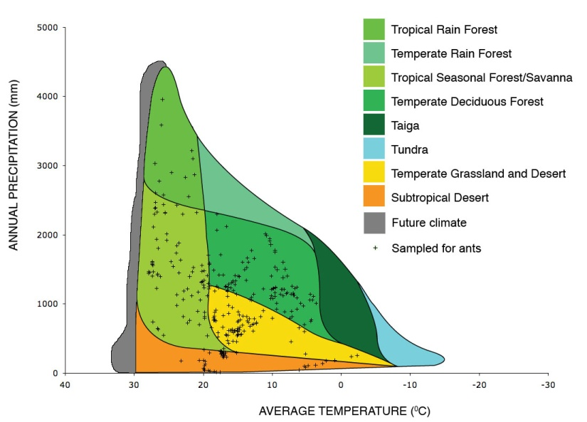
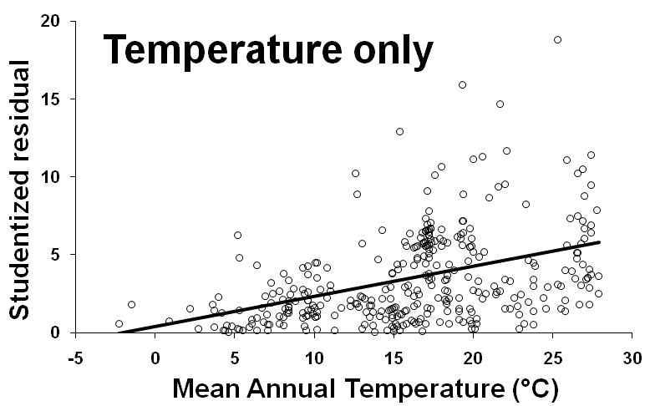
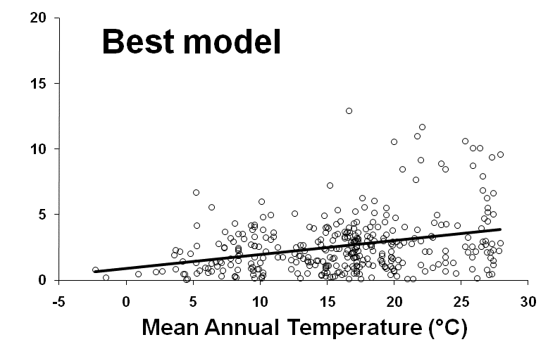
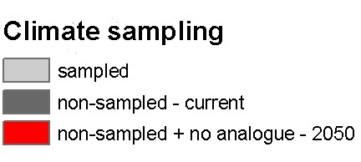
Places Where We Are Ignorant
Precipitation
Temperature

Slide 5
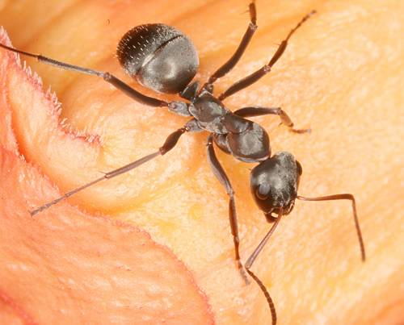
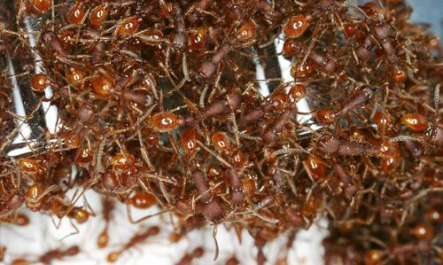
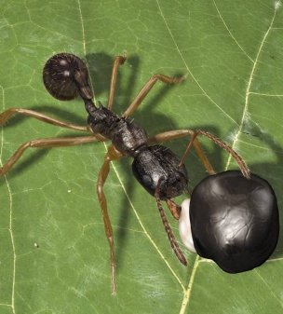
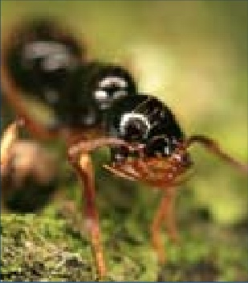
Conclusions
Ant diversity generally increases with temperature
At the highest temperatures diversity is also the most variable, ranging from 1 to 145 species
Future climates will be more like these hot places, which are also where we know the least

