Slide 1





Spatial Responses to Climate Across Trophic Levels:
Monitoring and Modeling Plants, Prey, and Predators in the Intermountain Western United States
2014 Research Progress Review
6-9 May 2014, Silver Spring, MD
NASA Funding Opportunity #NNH11AR55I
2014 Research Progress Review, Silver Spring, MD 6-9 May 2014
NASA Funding Opportunity #NNH11AR55I

Slide 2
Research Teams
University of Maryland, Global Land Cover Facility, College Park, MD
  Joe Sexton, Jyothy Nagol, Anupam Anad
U.S. Geological Survey, Southwest Biological Science Center, Flagstaff, AZ and U.S. Geological Survey, Western Ecological Science Center, Las Vegas, NV
  David Mattson (ret.), Kirsten Ironside (AZ), Kathy Longshore (NV), David Choate (NV)
U.S. Geological Survey, Utah Cooperative Fish and Wildlife Research Unit, & Utah State University, Logan, UT
  Thomas Edwards, David Stoner, Andrew Sims
2014 Research Progress Review, Silver Spring, MD 6-9 May 2014
NASA Funding Opportunity #NNH11AR55I

Slide 3
Core Research Progress
Core research elements reported today:
  #1: Research baseline data and technical issues resolved
  #2: Ungulate migration patterns and forage quality (as estimated using NDVI)
  #3: Ungulate and cougar densities, and relationships with forage quality
  #4: Forage quality and ungulate reproductive parameters
  #5: Trade-offs between predation risk, reproduction, and forage quality in ungulates
  #6: Forage quality, reproduction, and climate effects on ungulate habitat use and migration
2014 Research Progress Review, Silver Spring, MD 6-9 May 2014
NASA Funding Opportunity #NNH11AR55I

Slide 4
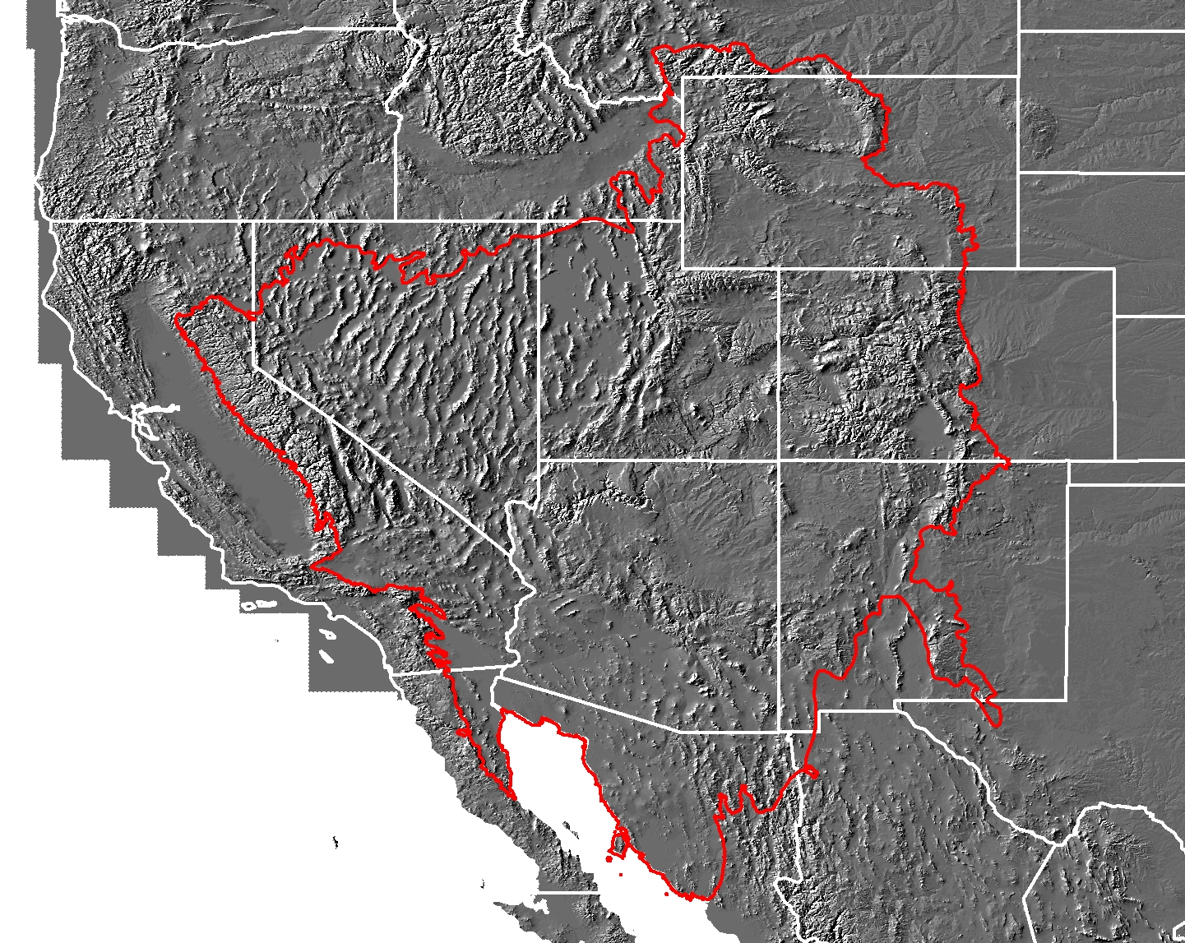
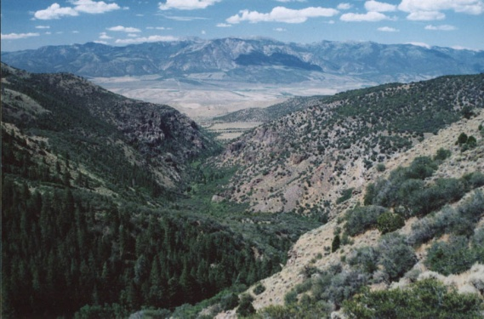
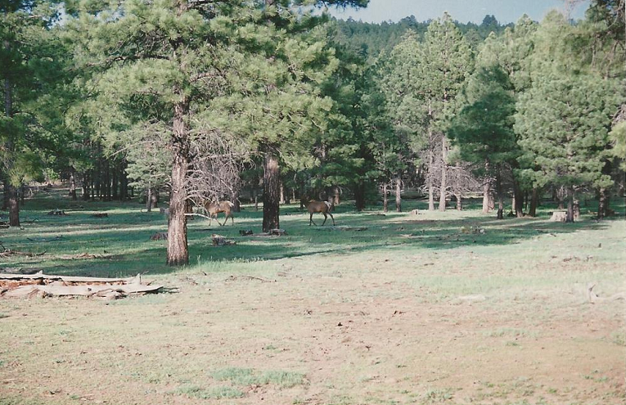
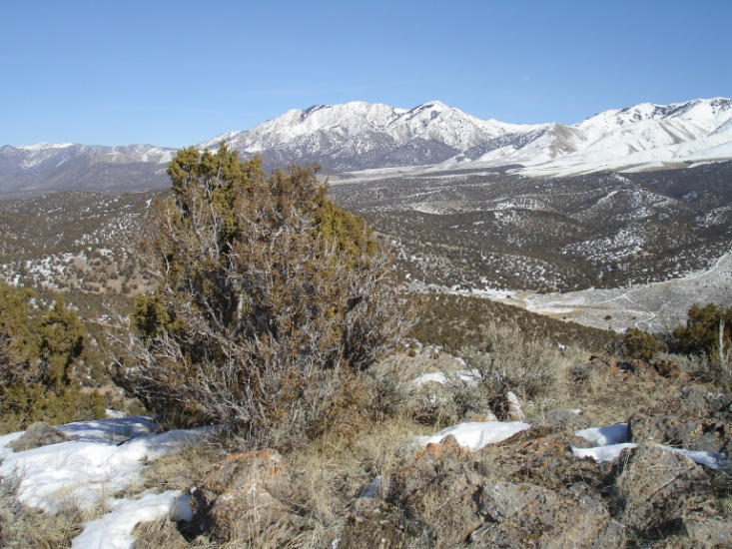
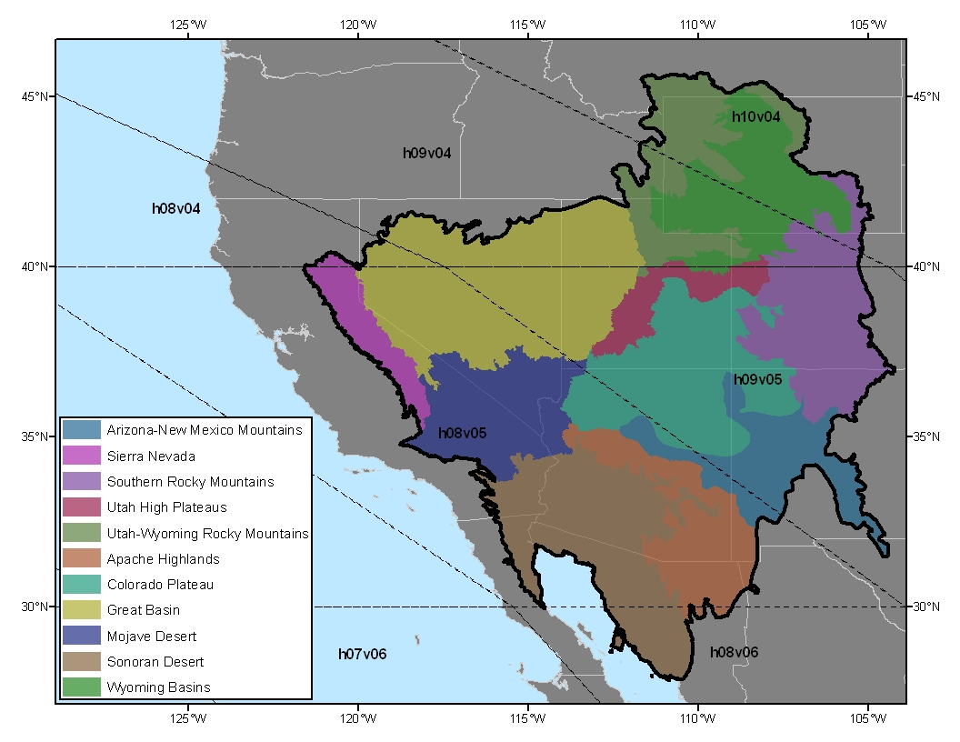
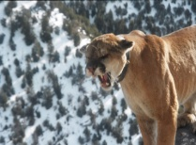
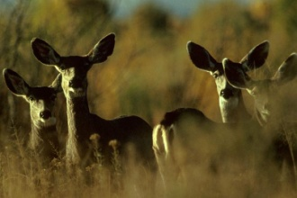
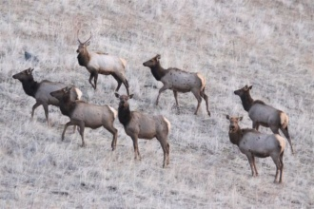
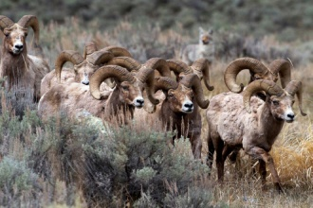
Research Study Region
Where We Work and What We Study
WY
NV
UT
CO
Portions of 9 ecoregions
AZ
NM
CA
Spatial extent: ~1.5 million km²
2014 Research Progress Review, Silver Spring, MD 6-9 May 2014
NASA Funding Opportunity #NNH11AR55I

Slide 5
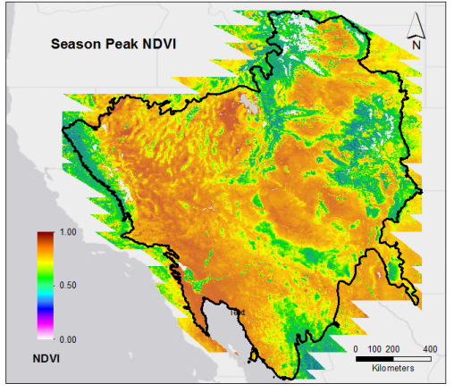
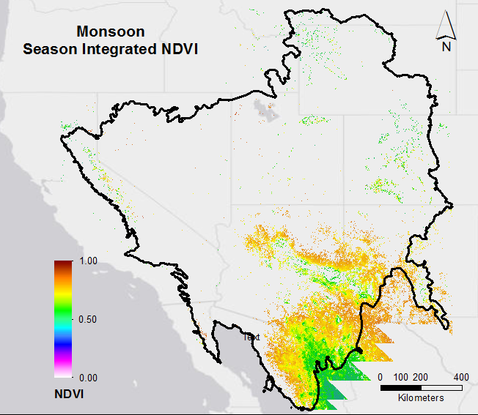
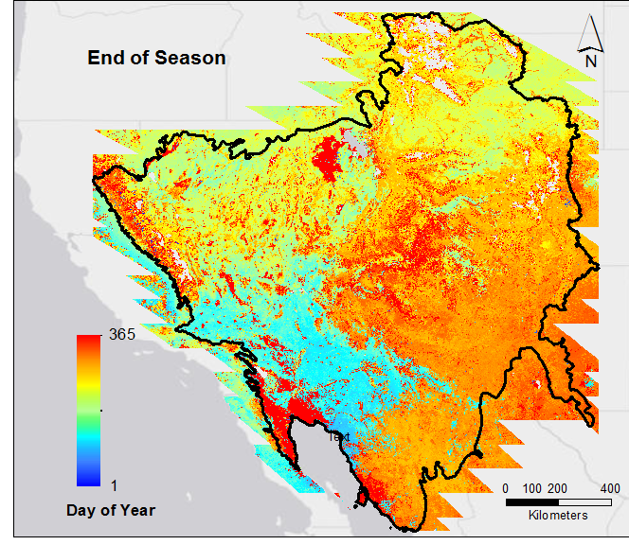
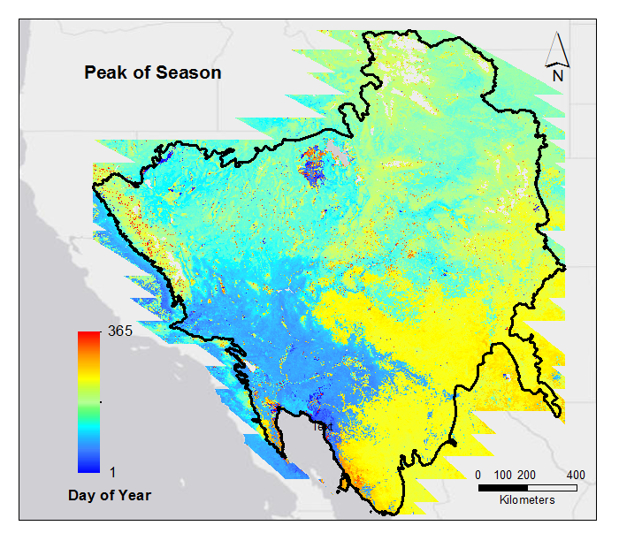
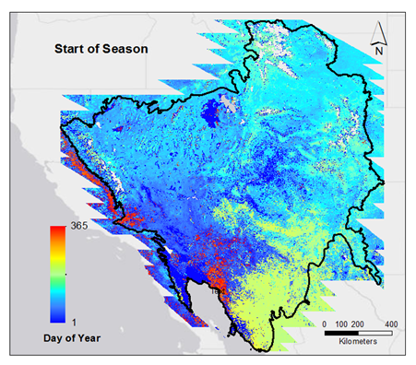
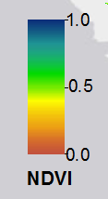
Module #1: Technical Issues and Baseline Data
Vegetation Metrics from MODIS – The “NDVI Stacks”
YEAR
MODIS NDVI (2000-2013, daily, 500 m)
Response Variable = NDVI; scaled 0-1
2013
Julian dates 1–5,110
( 1 Jan 2000 to 31 Dec 2013)
2000
2014 Research Progress Review, Silver Spring, MD 6-9 May 2014
NASA Funding Opportunity #NNH11AR55I

Slide 6
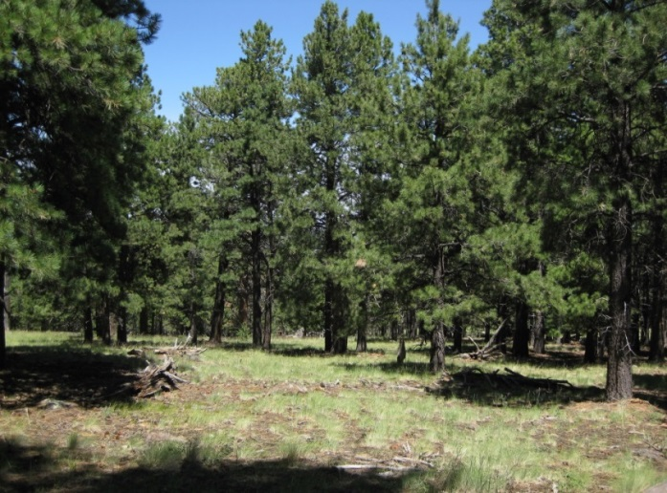
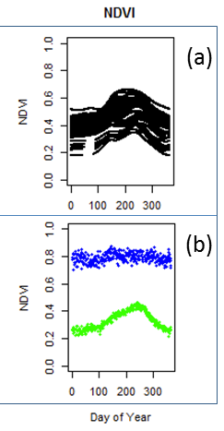
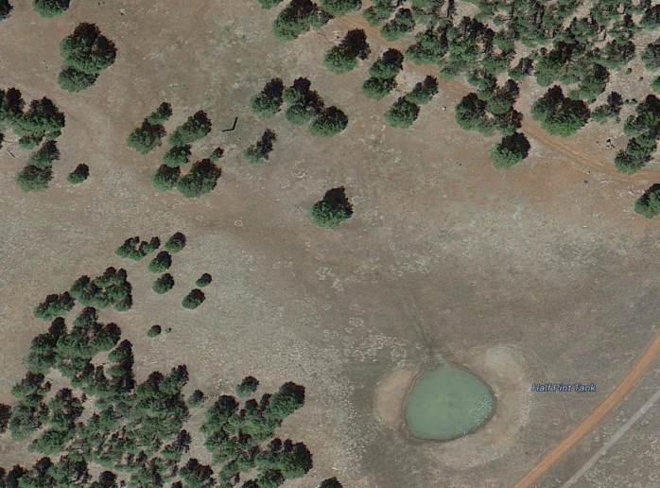
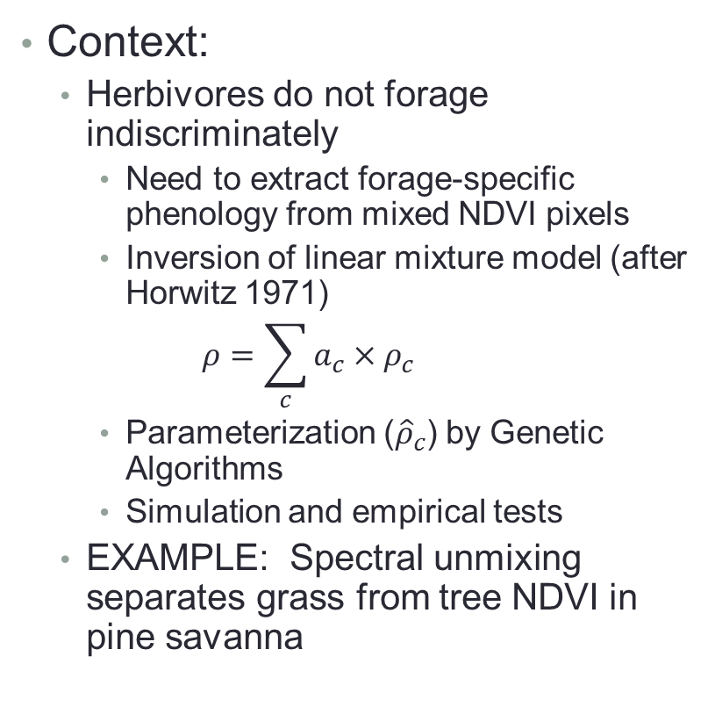
Module #1: Technical Issues and Baseline Data Retrieving Specific Phenologies by Spectral Unmixing
Context:
  Herbivores do not forage indiscriminately
    Need to extract forage-specific phenology from mixed NDVI pixels
    Inversion of linear mixture model (after Horwitz 1971)
    $$ρ=\sum_{c}{a_{c}×ρ_{c}}$$
    Parameterization (${\hat{ρ}}_{c}$) by Genetic Algorithms
    Simulation and empirical tests
  EXAMPLE: Spectral unmixing separates grass from tree NDVI in pine savanna
Unmixed tree & grass phenologies; semi-arid pine savanna
2014 Research Progress Review, Silver Spring, MD 6-9 May 2014
NASA Funding Opportunity #NNH11AR55I

Slide 7
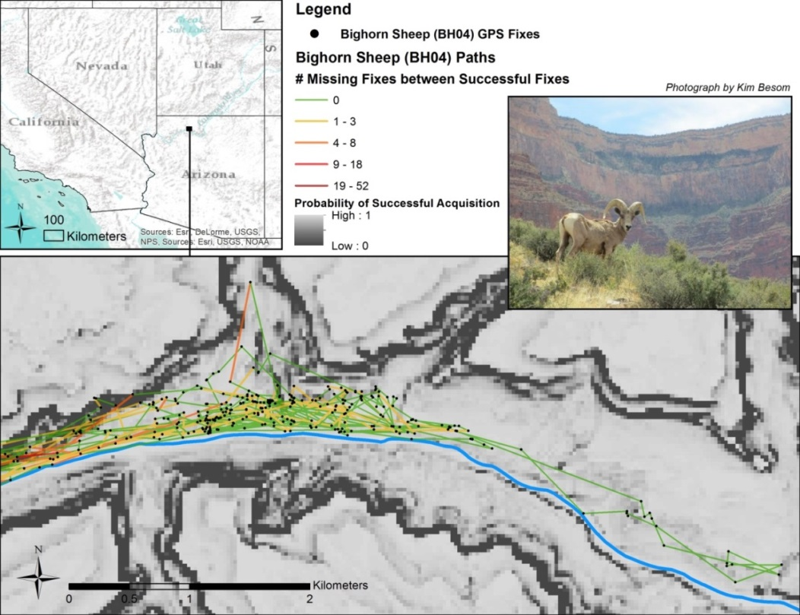
Module #1: Technical Issues and Baseline Data
Environment and Detection Biases in GPS Collars
Context:
  Environmental factors – especially topography - interfere with GPS collar satellites and result in missed fixes
  We modeled the effects of topography and overhead vegetation on the ability of GPS collars used on large mammals to acquire a fix
    No adjustment required on deer and elk datasets
    Cougar and bighorn sheep in canyons exhibit systematic loss; hence require adjustment
2014 Research Progress Review, Silver Spring, MD 6-9 May 2014
NASA Funding Opportunity #NNH11AR55I

Slide 8
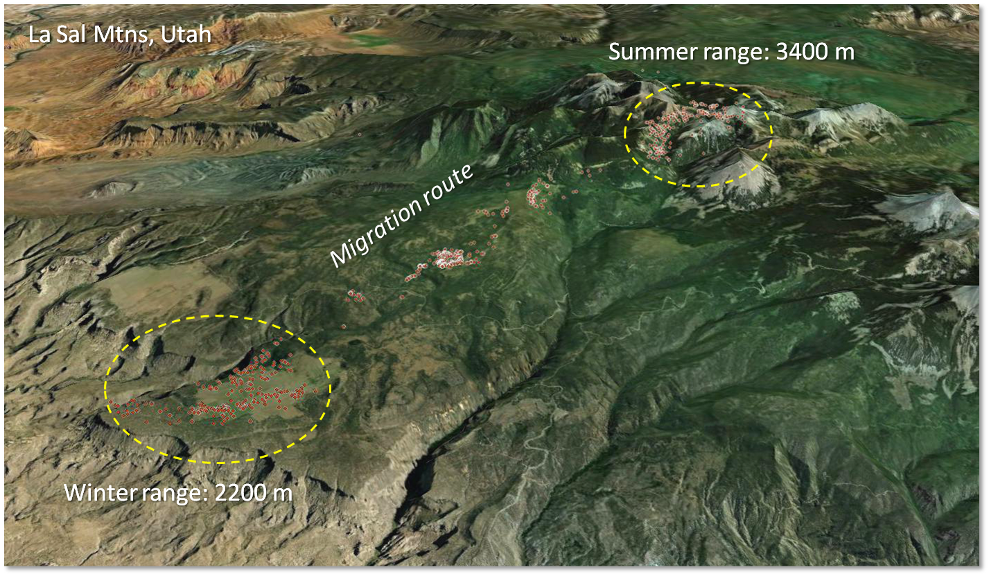
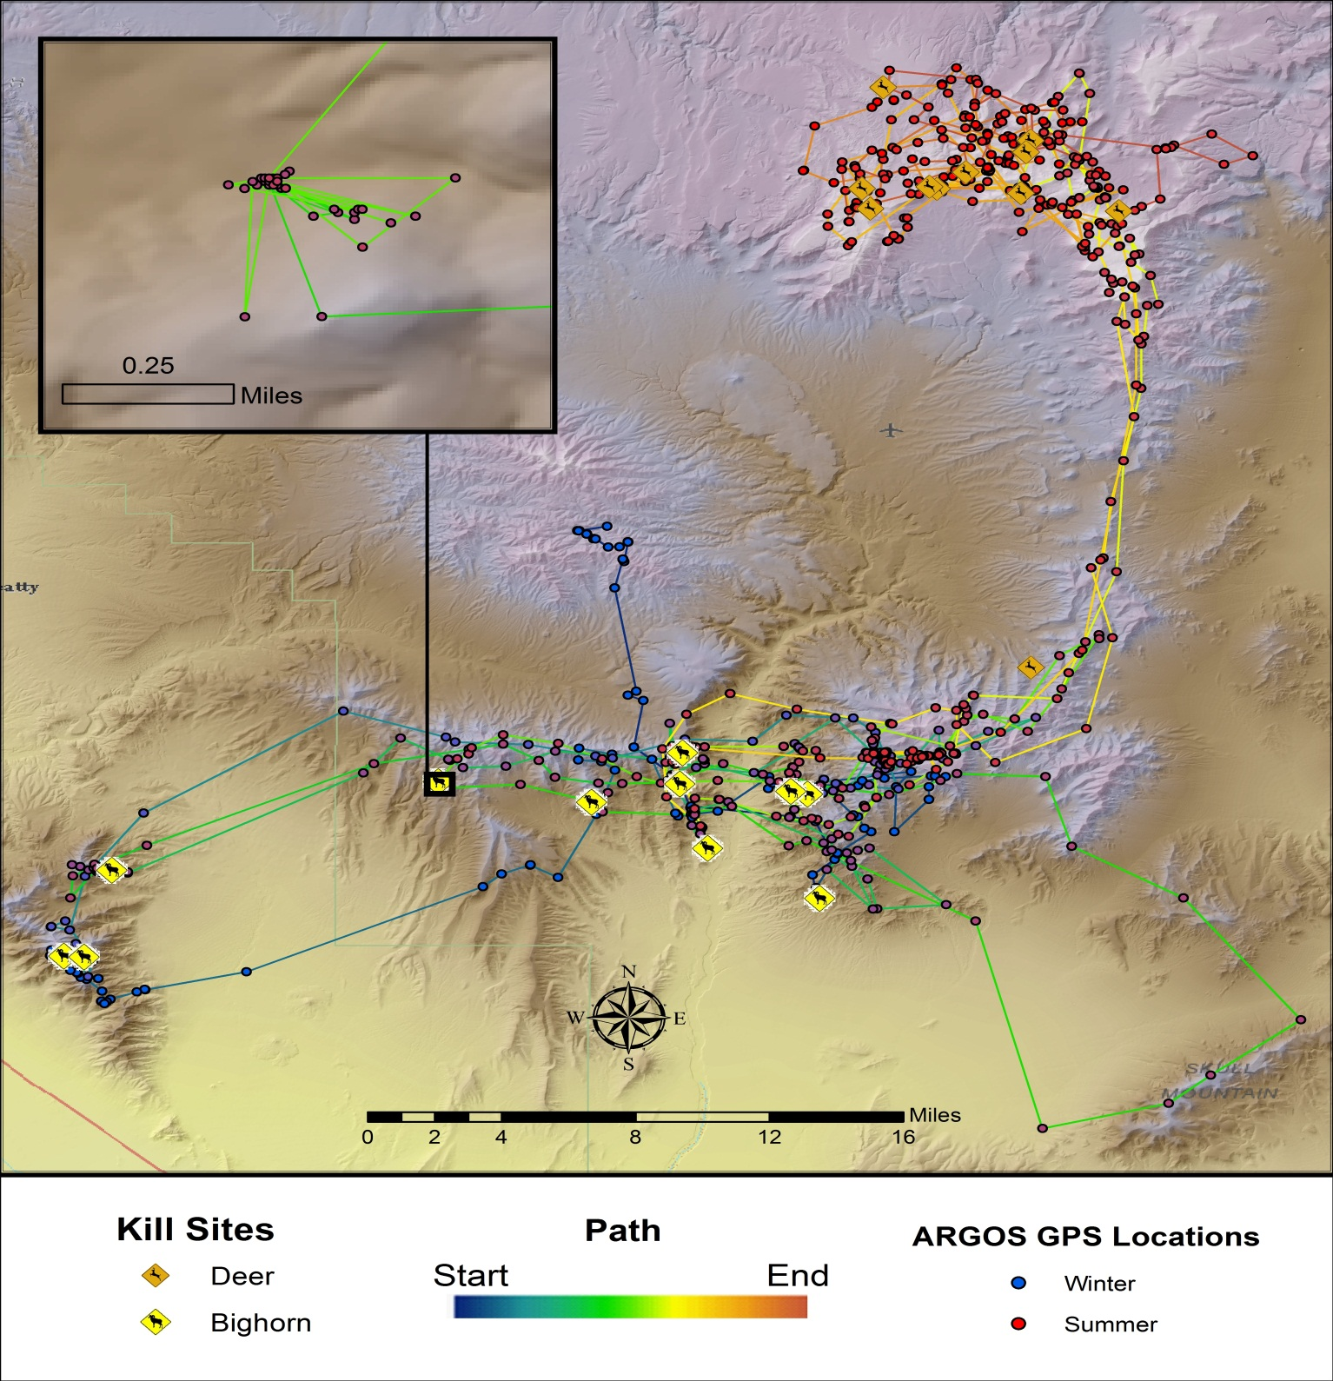
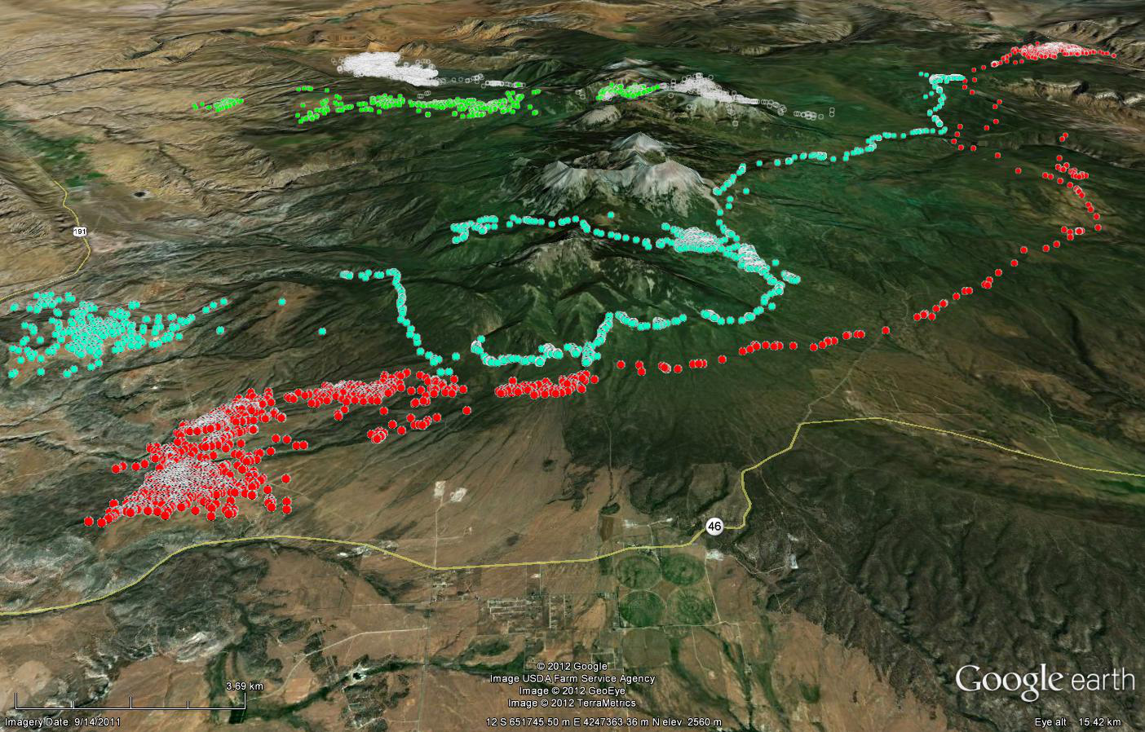
Module #2: Migration and Forage Quality
Movement Patterns in Relation to NDVI “Green-up”
Context:
  Phenology as measured by NDVI strongly affects migration pathways and speed of movement across landscape by ungulates
2014 Research Progress Review, Silver Spring, MD 6-9 May 2014
NASA Funding Opportunity #NNH11AR55I

Slide 9
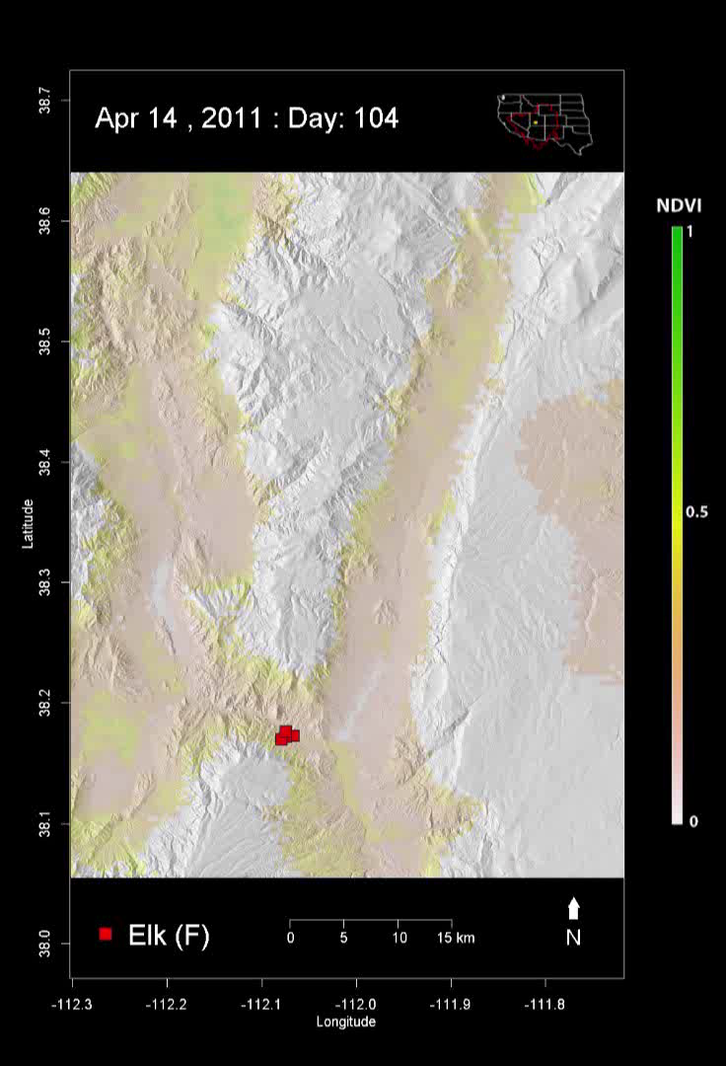
Module #2: Migration and Forage Quality
Movement Patterns in Relation to NDVI “Green-up”
  In the Intermountain West, ungulates track primary productivity (forage quality) as measured with NDVI
    Note how animal follows edge of NDVI “green wave”
  Start:
    Mid-April on winter range (pink-yellow)
    Note “pulses” into snow-covered areas (white)
    Final movement into summer range (greens)
  End:
    Movement back to winter range (pink-yellow)
2014 Research Progress Review, Silver Spring, MD 6-9 May 2014
NASA Funding Opportunity #NNH11AR55I

Slide 10
Module #3: Ungulate, Cougar Density and NDVI
Movement Patterns in Relation to NDVI “Green-up”
Context:
  NDVI correlates with both deer abundance and cougar home range
  These relationships will serve as basis for modeled distributional responses of ungulates and cougar to climate change effects on vegetation
y = 3,445.12x^{3.68}
R² = 0.66
y = 4,923.79x^{-0.83}
R² = 0.88
2014 Research Progress Review, Silver Spring, MD 6-9 May 2014
NASA Funding Opportunity #NNH11AR55I

Slide 11
Module #4: Forage Quality and Reproduction
Seasonal Maximum NDVI and Fawning Date
Context:
  Deer give birth ~ June (red; constant)
  Parturition in southern latitudes offset from peak NDVI (green), our measure of forage quality
Northern extent of monsoon
8/23
Date MAX NDVI
Date Parturition
6/19
Parturition-NDVI offset
2014 Research Progress Review, Silver Spring, MD 6-9 May 2014
NASA Funding Opportunity #NNH11AR55I

Slide 12
Module #4: Forage Quality and Reproduction
Seasonal Maximum NDVI and Number of Fawns
Context:
  Fawn counts (tan) in south are consistently lower than those in north
  Variance (dashed line, error bars) is higher in southern latitudes
Northern extent of monsoon
2014 Research Progress Review, Silver Spring, MD 6-9 May 2014
NASA Funding Opportunity #NNH11AR55I

Slide 13
Module #5: Modelling Risk
Trade-offs Between Predation Risk and Forage Quality
Context:
  In the Intermountain West, ungulates track primary productivity as measured with NDVI
    However, green-up pattern different in deserts
  In deserts, bighorn sheep balance forage needs with predator avoidance by selecting for escape terrain
  Within escape terrain, NDVI is related to visibility (e.g., shrubs) &/or food (e.g. high quality annuals)
Locations by sex on escape terrain:
≥ 40% slope &
Vector Ruggedness Measure,
vrm>0.002
2014 Research Progress Review, Silver Spring, MD 6-9 May 2014
NASA Funding Opportunity #NNH11AR55I
Notes:
Main Pts: Within escape terrain, ewes choose sites with lower NDVI when they have lambs (Jan-Mar solitary, Apr-Jun in groups); and use sites closer to matching available NDVI as lambs mature.

Slide 14
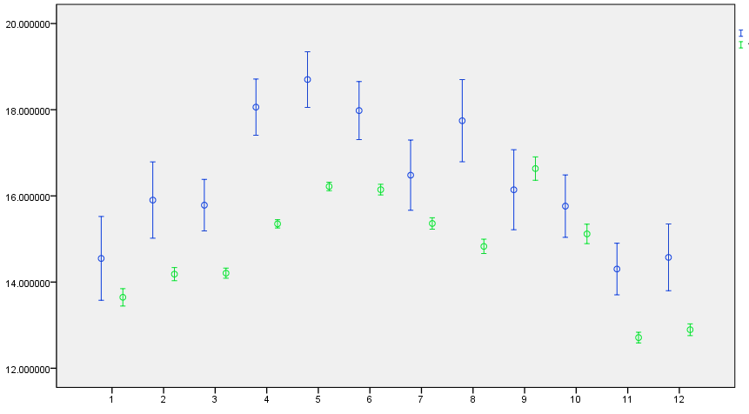
Module #5: Modelling Risk
Trade-offs Between Predation Risk and Forage Quality
Modelling forage: NDVI within escape terrain
random
bighorn
NDVI
(mean ± 95%CI)
Lambing season
Month
2014 Research Progress Review, Silver Spring, MD 6-9 May 2014
NASA Funding Opportunity #NNH11AR55I

Slide 15
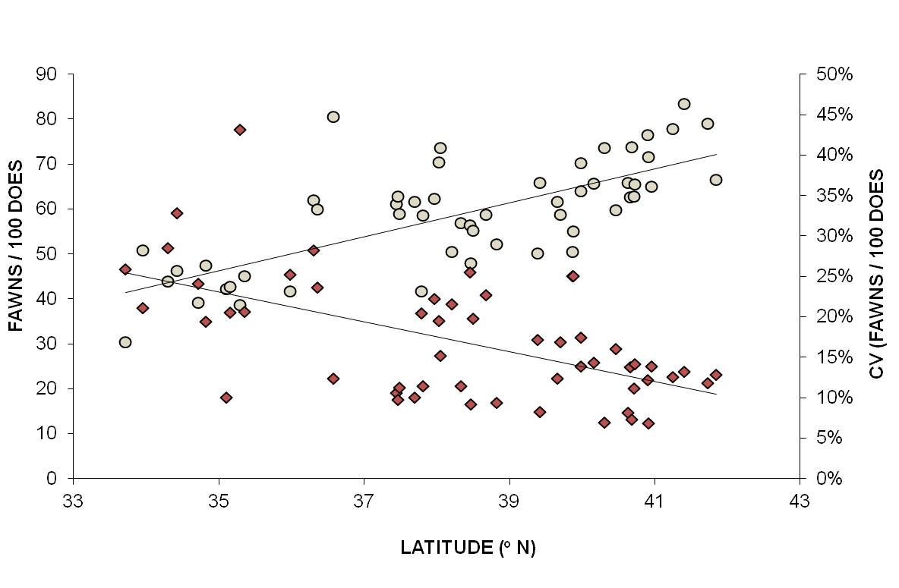
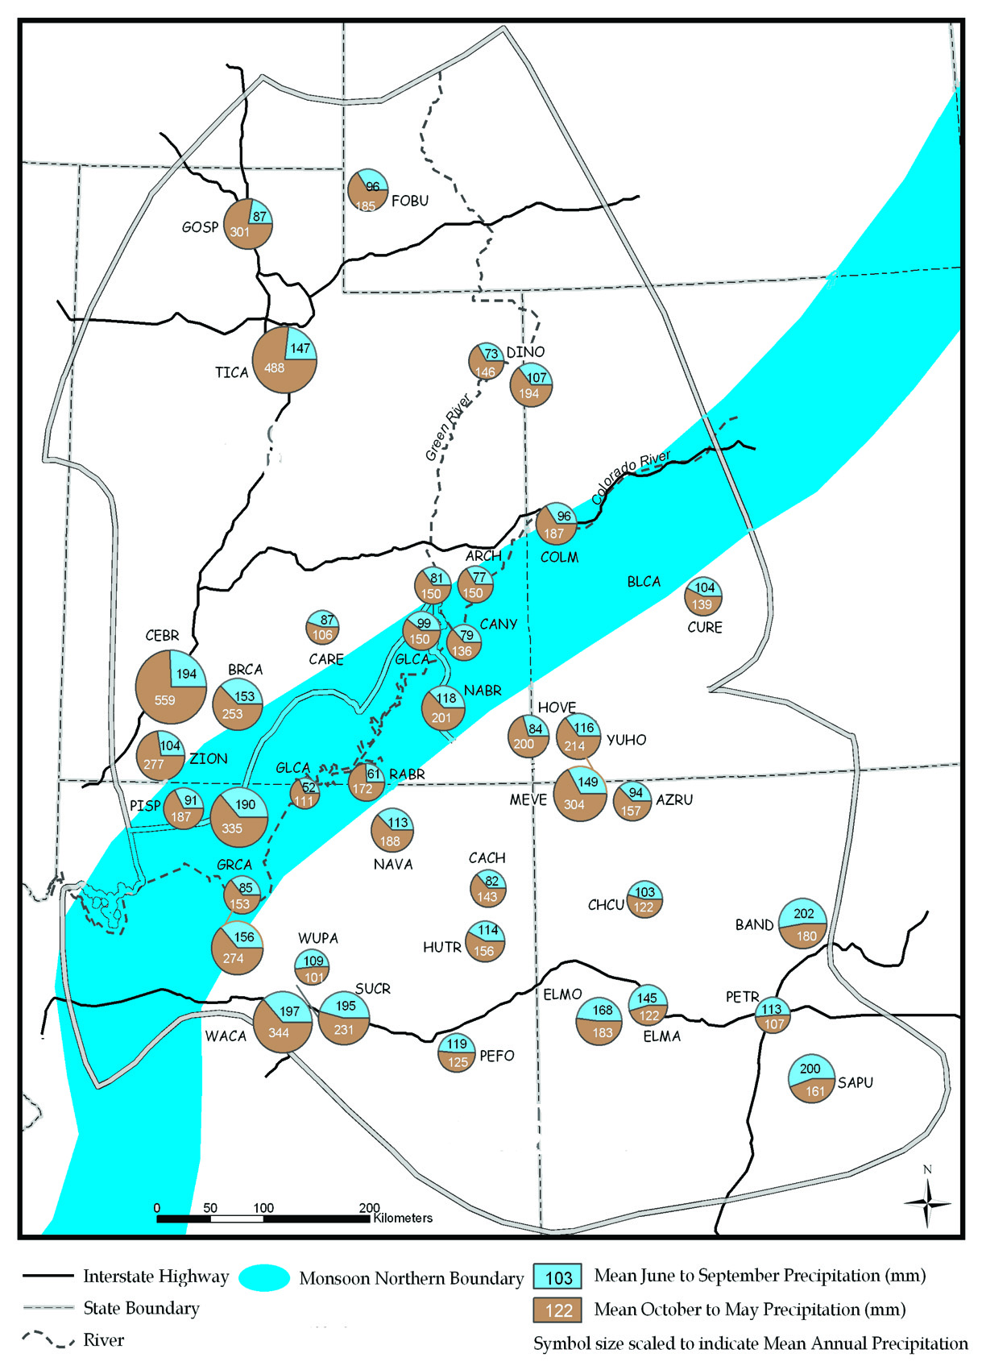
Module #6: NDVI, Reproduction, & Climate
Seasonal Maximum NDVI and Fawning Numbers
Fawn production by latitude
  Mean increases and variance declines
Northern extent of monsoon
2014 Research Progress Review, Silver Spring, MD 6-9 May 2014
NASA Funding Opportunity #NNH11AR55I

Slide 16
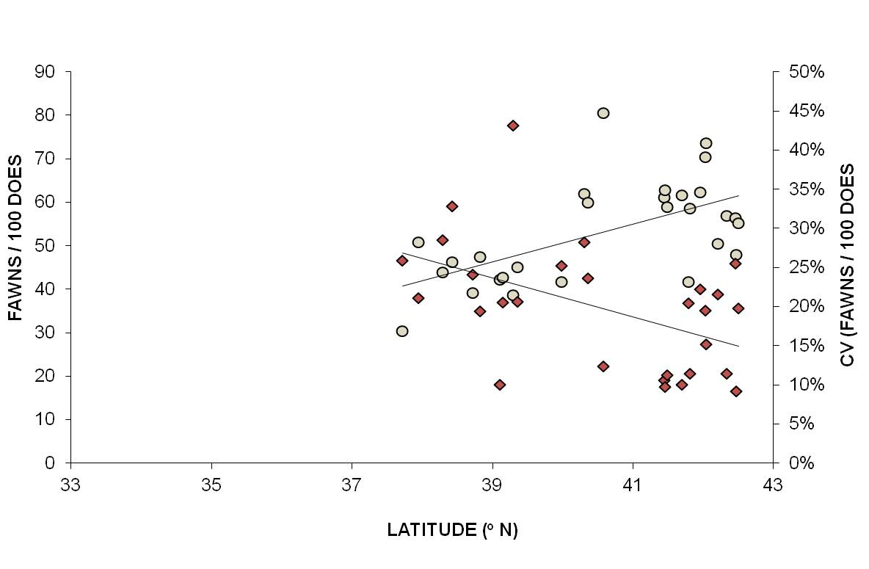
Module #6: NDVI, Reproduction, & Climate
Seasonal Maximum NDVI and Fawning Numbers
Projected extent of change in monsoon suggests ungulate reproductive patterns observed in southerly latitudes may shift northwards
Projected northern extent of monsoon
????
2014 Research Progress Review, Silver Spring, MD 6-9 May 2014
NASA Funding Opportunity #NNH11AR55I

Slide 17
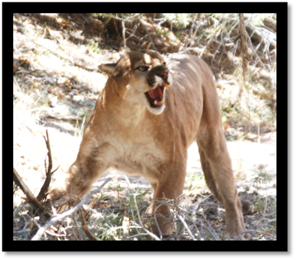

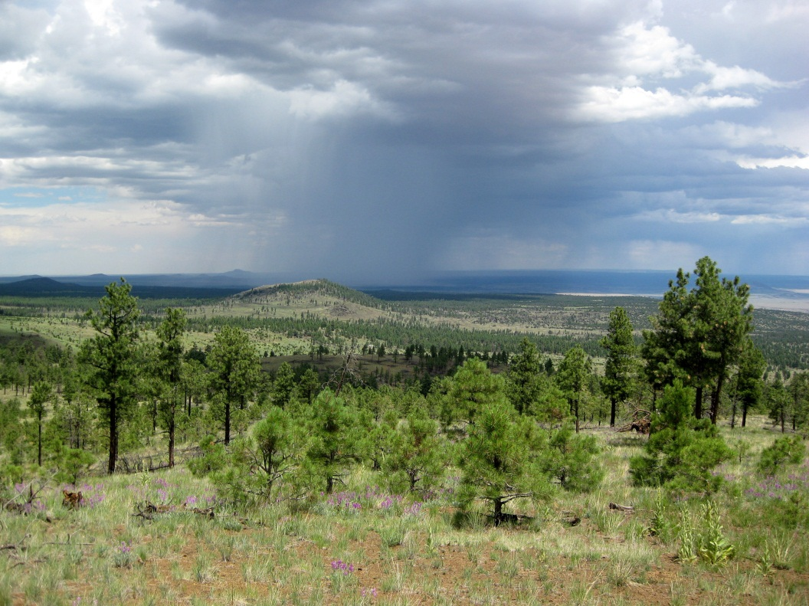
Conclusions and Next Steps
Strong linkages exist between climate, NDVI, animal performance and movement
Modelling climate × land-use projections
  Linking NDVI to climate projections
  Phenological unmixing
  Dynamic (seasonal) habitat-use maps
  Carnivore functional responses to NDVI, prey, and landscape fragmentation
Predator Density & Distribution
Prey Density & Distribution
Climate & Weather
Topography
Primary Productivity
2014 Research Progress Review, Silver Spring, MD 6-9 May 2014
NASA Funding Opportunity #NNH11AR55I

