Slide 1
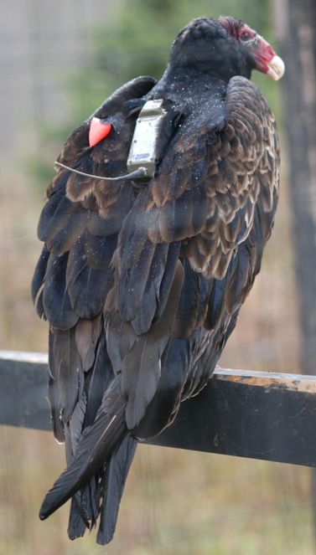
Discovering Relationships between Climate and Animal Migration with New Tools for Linking Animal Movement Tracks, Weather and Land Surface Data
Gil Bohrer
Associate Professor for Ecological Engineering
Department of Civil, Environmental & Geodetic Engineering The Ohio State University
Roland Kays, David Brandes, David Douglas,
Jiawei Han, Martin Wikelski
Somayeh Dodge, Keith Bildstein, Sarah C. Davidson,
Rolf Weinzierl, David Barber,

Slide 2
Movement is tightly linked with the environment – along the path, and the path not taken

Slide 3
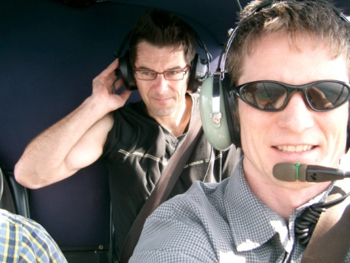
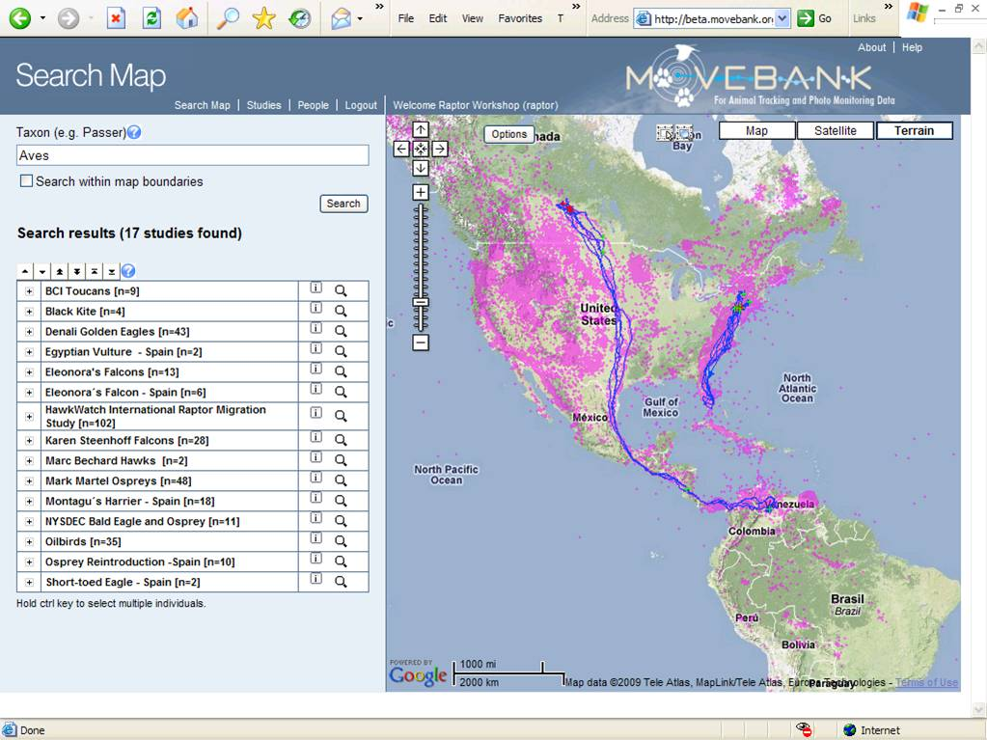
www.movebank.org
What to do with track data?

Slide 4
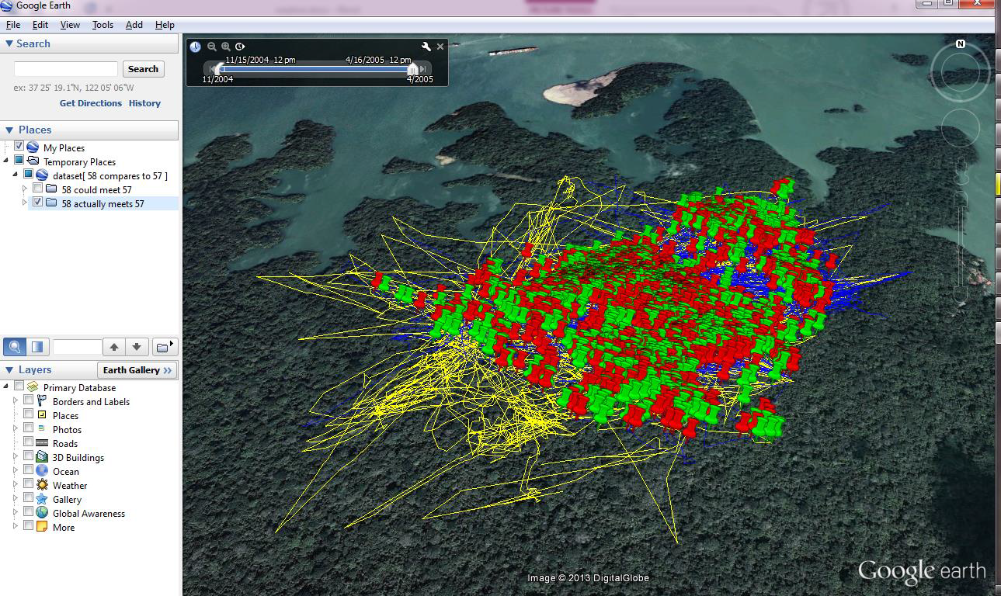
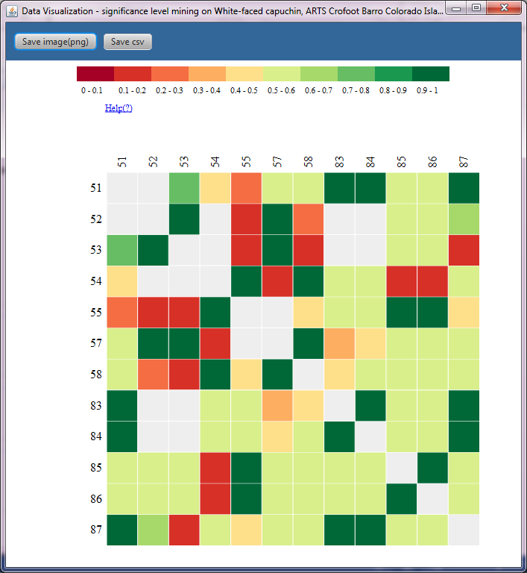
MoveMine track analysis tools

Slide 5
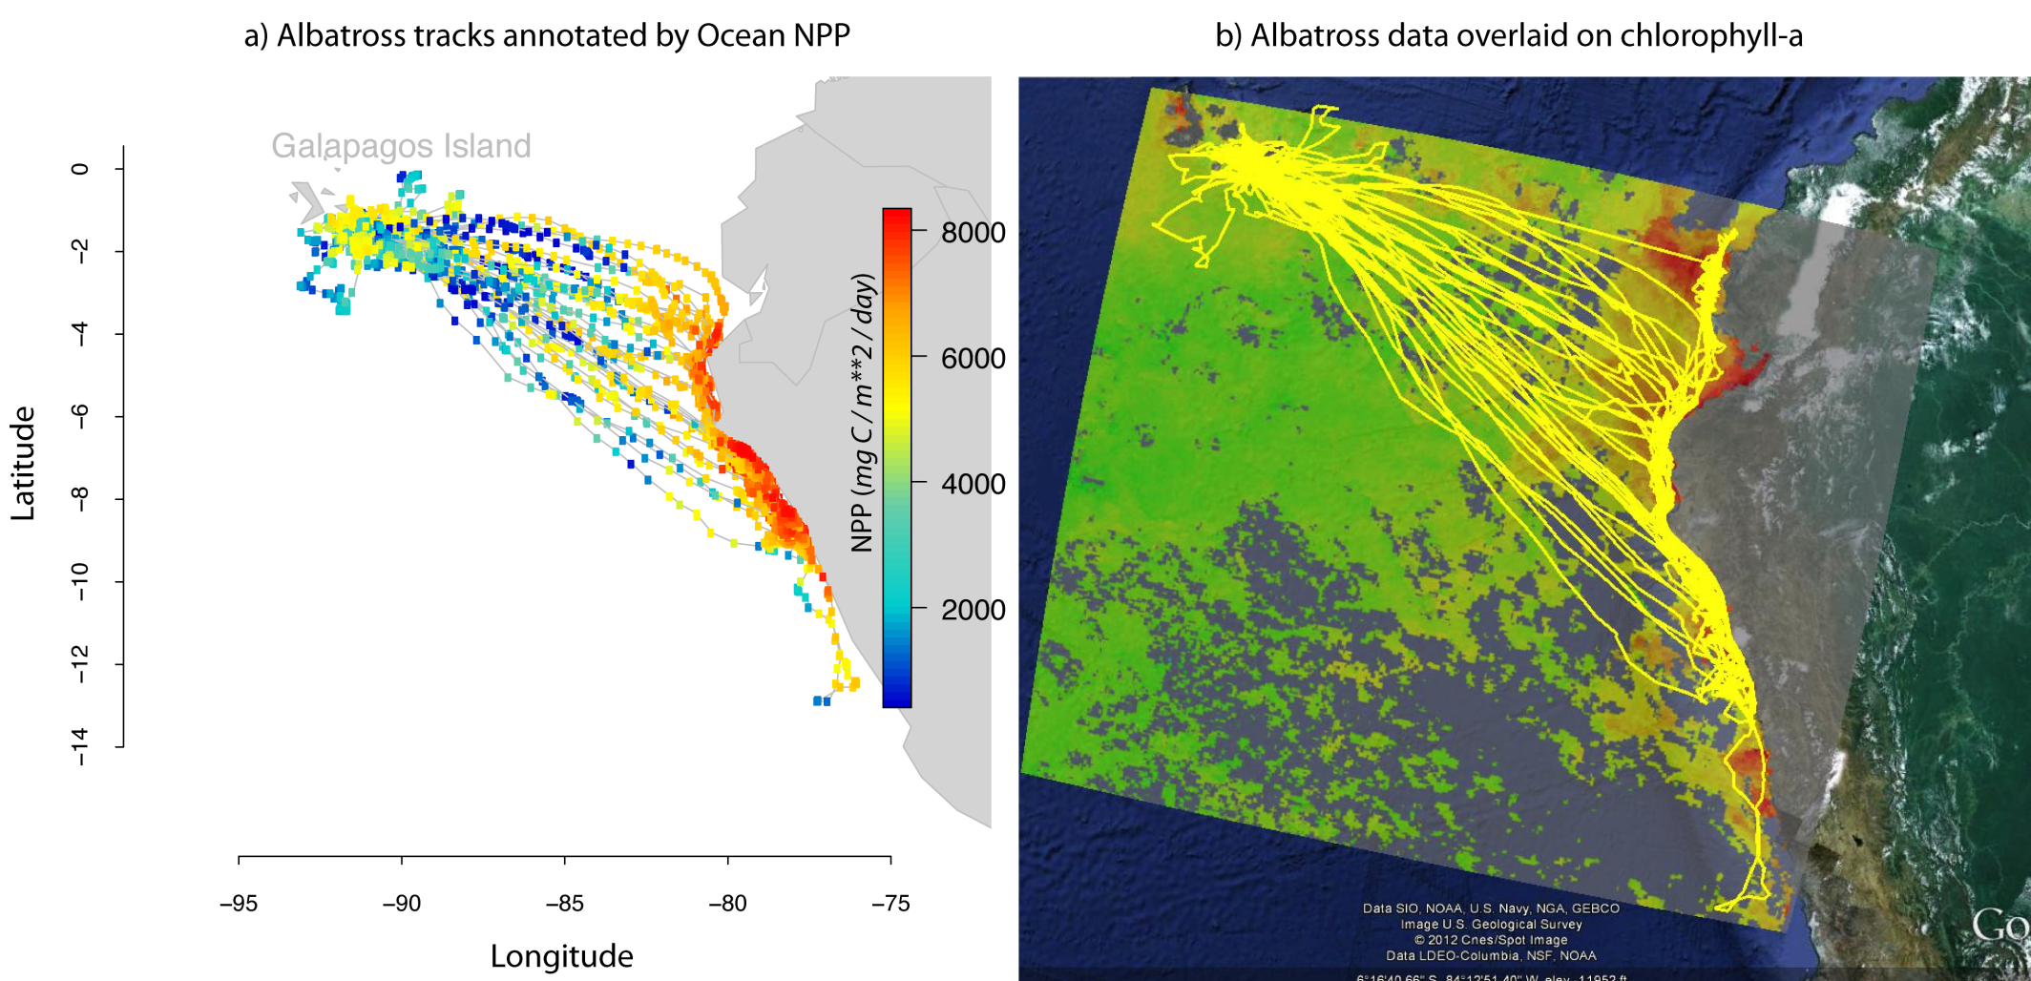
Env-DATA– Environmental Data Automated Track Annotation system in MoveBank
Track annotation Areal (home-range) annotation
Dodge et al 2013, Movement Ecology, 1:3

Slide 6
Datasets | Data Source | Temporal Coverage
TRMM | NASA http://trmm.gsfc.nasa.gov/ | 1998– present
AVHRR land NDVI | NASA http://glcf.umiacs.umd.edu/data/gimms/ | 1989–present, 1982–present
NCEP Global Reanalysis 2 | NOAA http://www.esrl.noaa.gov/psd/data/gridded/data.ncep.reanalysis2.html/ | 1948–present
North American Regional Reanalysis | NOAA http://www.emc.ncep.noaa.gov/mmb/rreanl/ | 1979–present
ECMWF Global mid/High resolution Reanalyses | ECMWF http://www.ecmwf.int/ | 1979–present
MODIS Land | NASA https://lpdaac.usgs.gov/ | 2002–2012
MODIS Ocean | NASA http://oceancolor.gsfc.nasa.gov/
MODIS Snow | NASA http://modis-snow-ice.gsfc.nasa.gov/
Ocean productivity | http://www.science.oregonstate.edu/ocean.productivity/ | 1997–2009
ASTER GDEM | USGS http://asterweb.jpl.nasa.gov/gdem.asp
SRTM | NASA http://www.cgiar-csi.org/data/srtm-90m-digital-elevation-database-v4-1/
GlobCover | ESA http://dup.esrin.esa.it/prjs/prjs68.php | 2009
Socioeconomic data | http://sedac.ciesin.columbia.edu/gpw/global.jsp | 1990–2010
Ocean Surface Current (OSCAR) | NASA http://www.oscar.noaa.gov/ | 1993–present

Slide 7
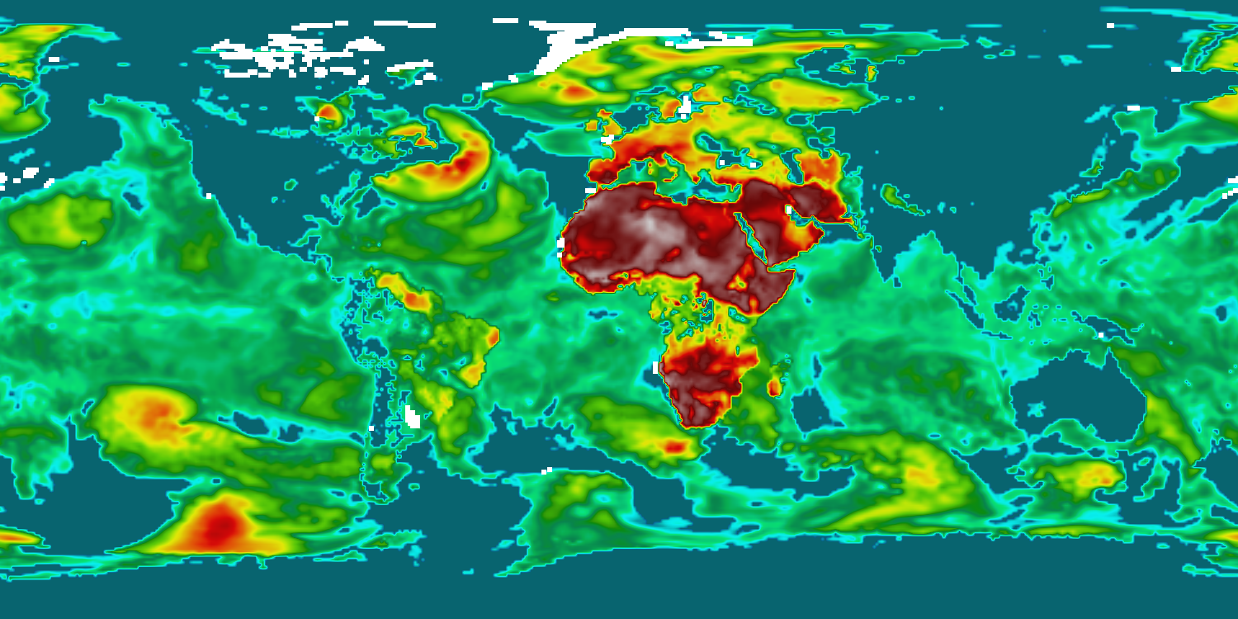
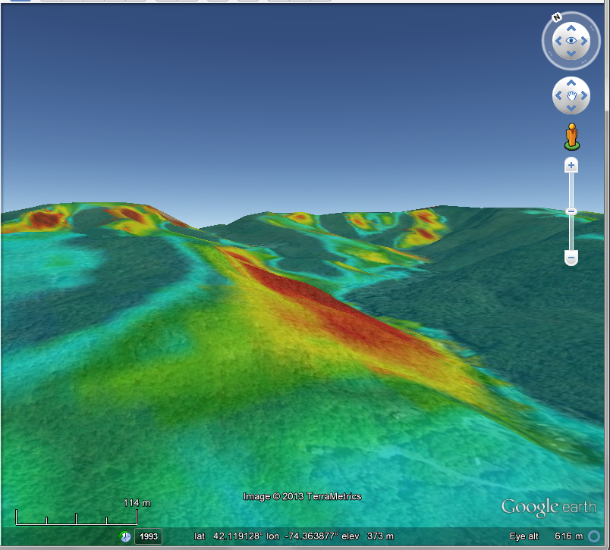
Derived Variables
Thermal uplift
Orographic uplift

Slide 8
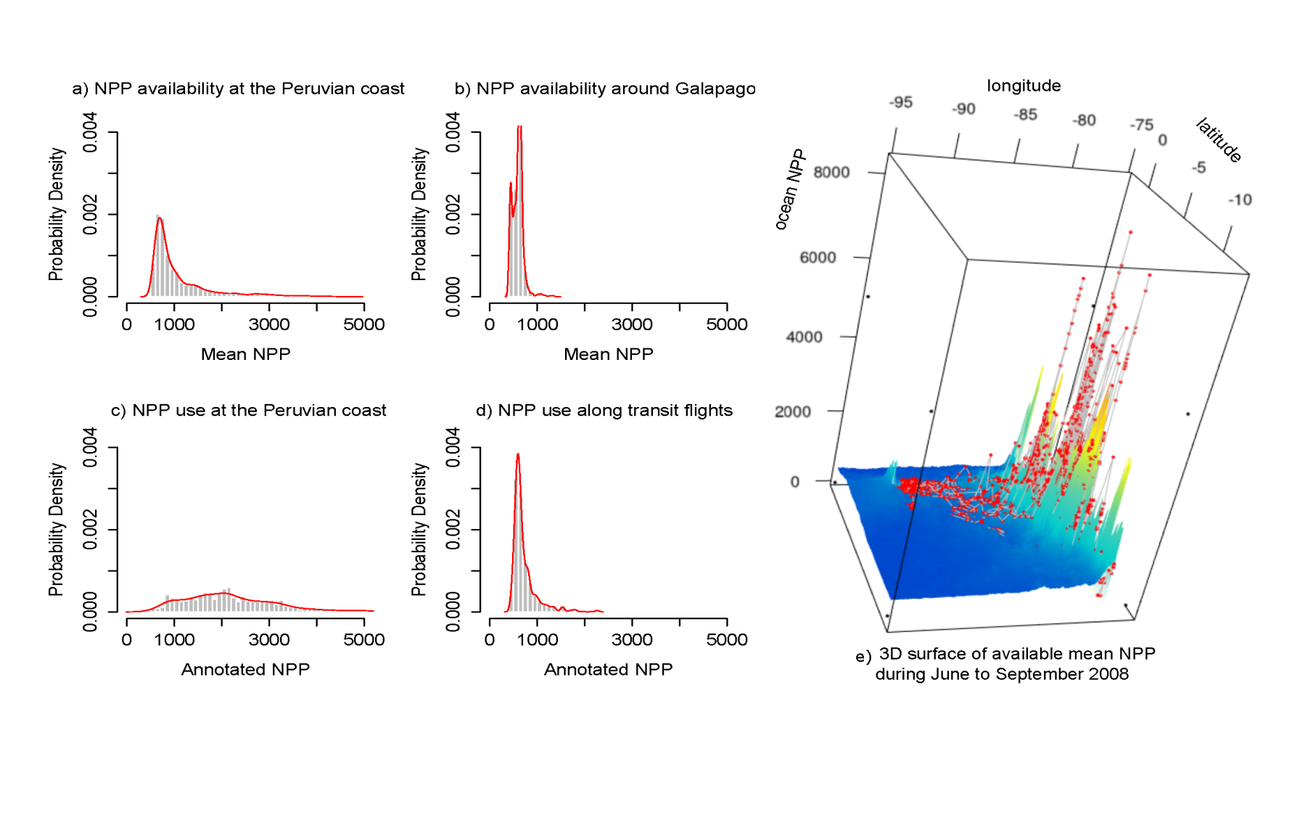
What can annotated tracks tell us about what the animals are doing?
Peruvian Coast
Around Galapagos
Available
Used
Climatology surface
Distribution of ocean productivity in albatross tracks
Resource-selection and niche analysis

Slide 9
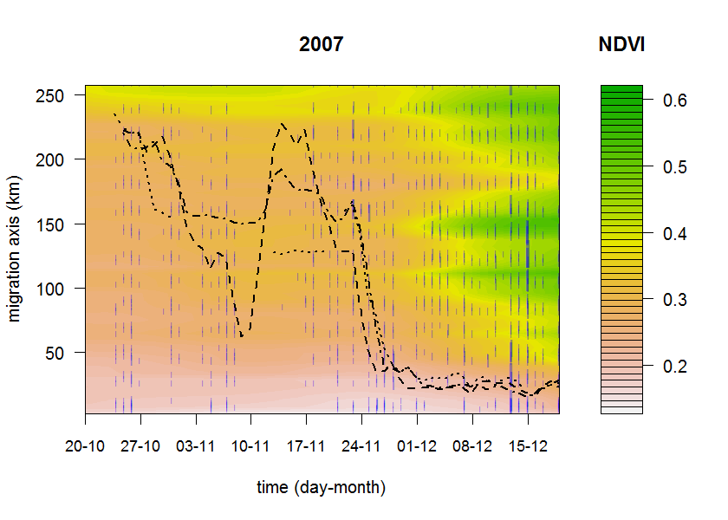
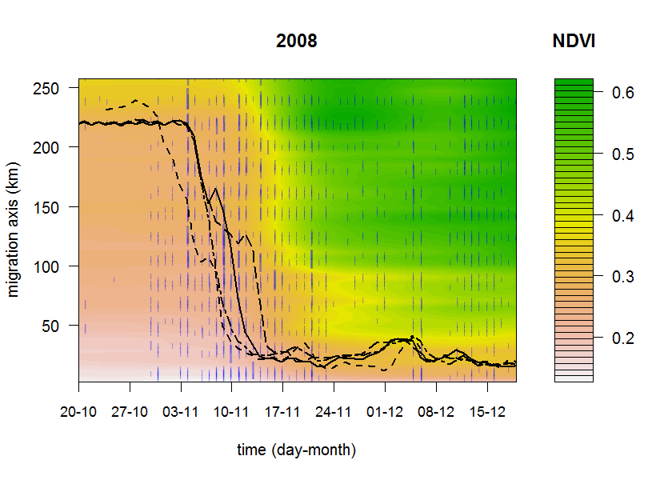
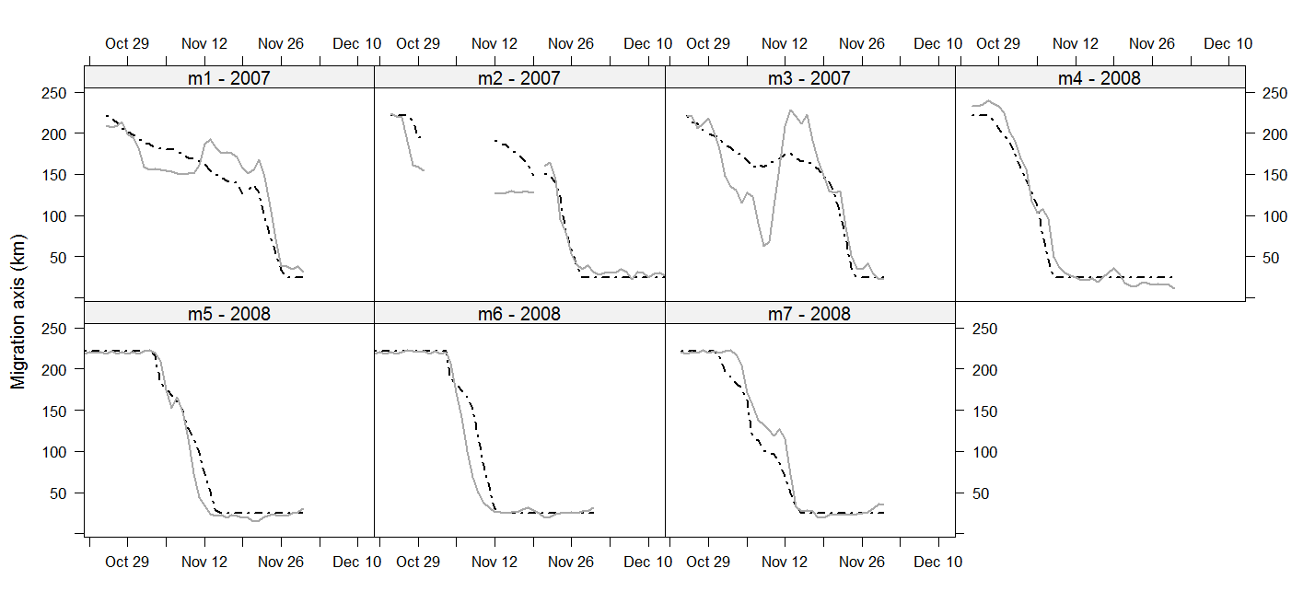
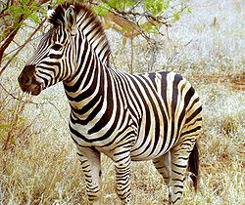
Individual-based movement models
What can annotated tracks tell us about what the animals are doing?
Modelled
Observed
Bartlam-Brooks et al 2013, Journal of Geophysical Research-Biogeosciences, 118:1427–1437
Bohrer et al 2014, Movement Ecology 2:2 (Elephants)

Slide 10
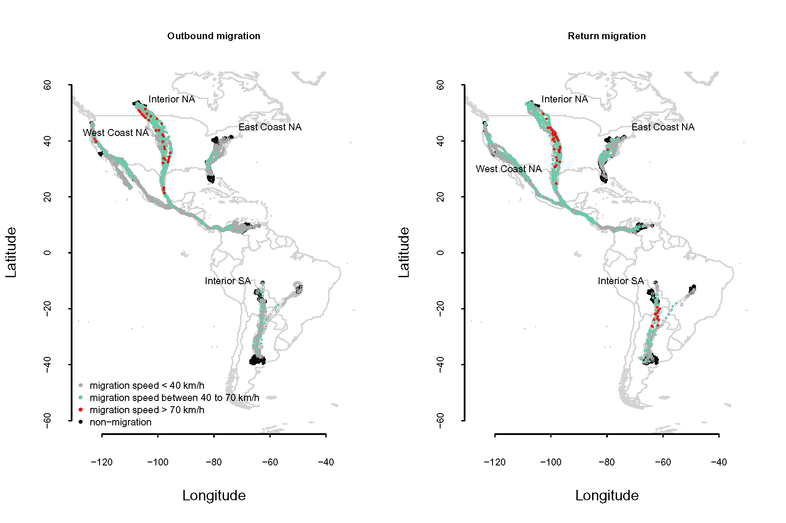
Going global - Trans-American migration of Turkey Vulture
Bohrer et al. 2012 Ecology Letters 15:96-103
Dodge et al. 2014 Philosophical Transactions of the Royal Society B (in press)

Slide 11
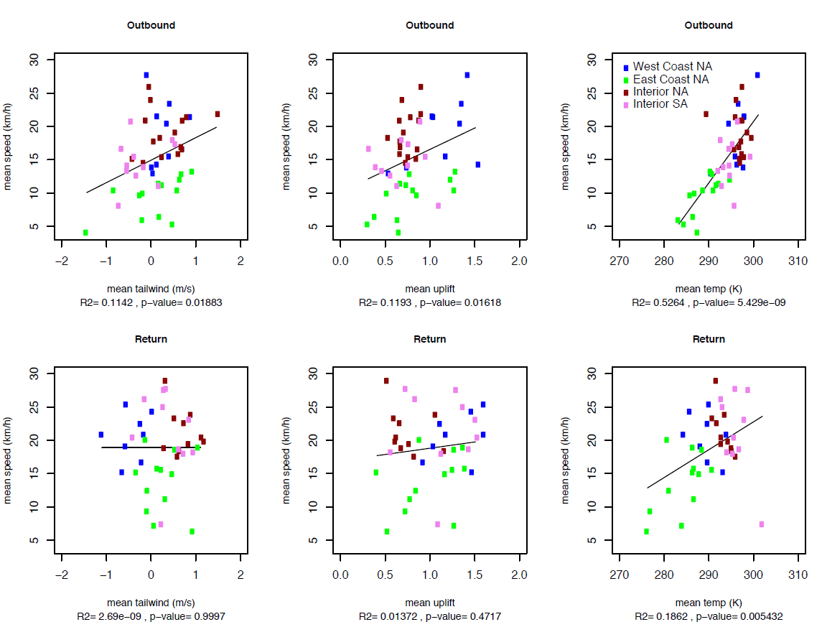
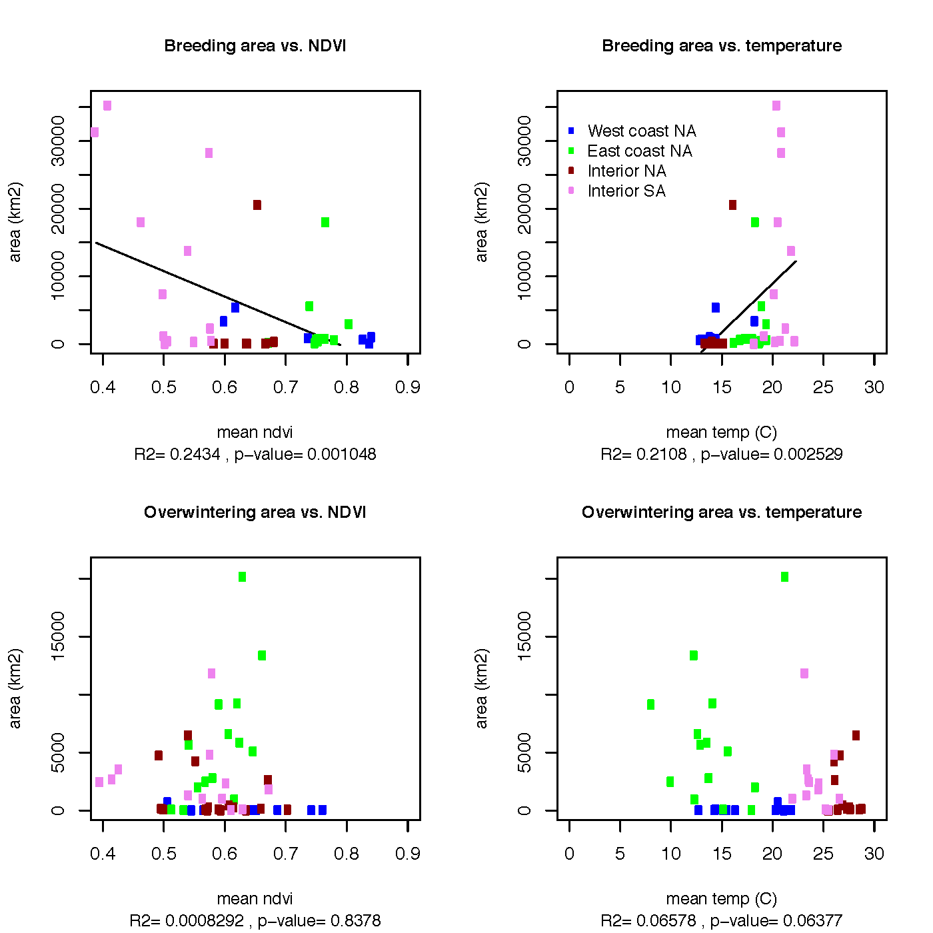
Variation in migration speed between individuals and populations is explained by wind and temperature

Slide 12
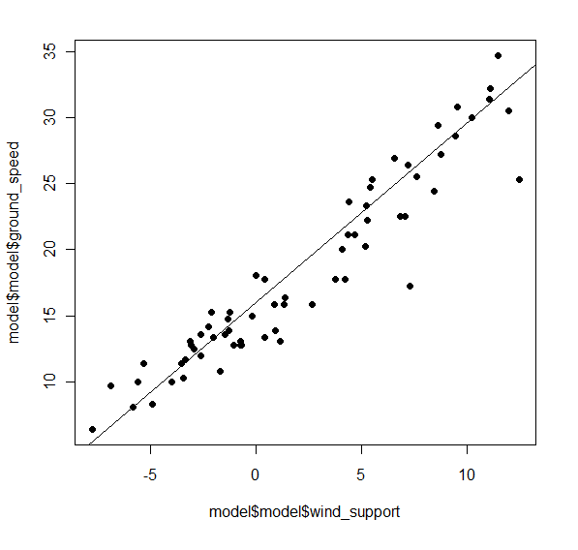
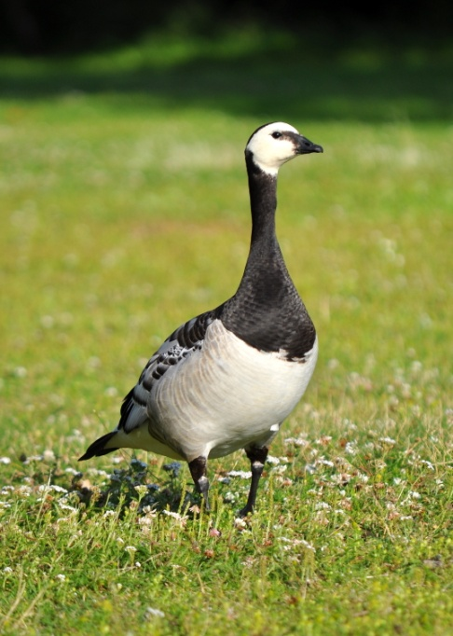
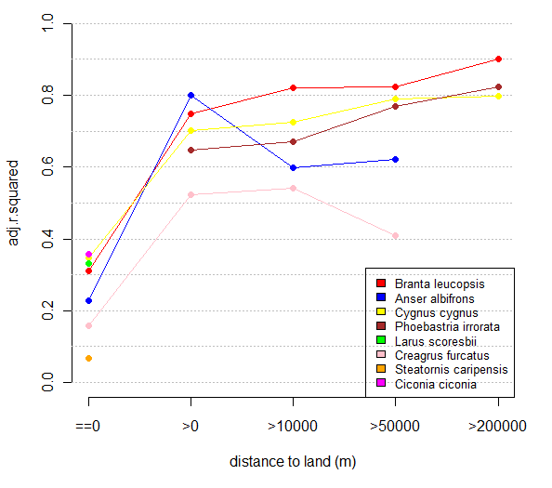
Environmental drivers of movement – wind support in waterfowl
Facilitate global scale collaborations
Branta Leucopsis
Safi et al 2013, Movement Ecology, 1:4

Slide 13
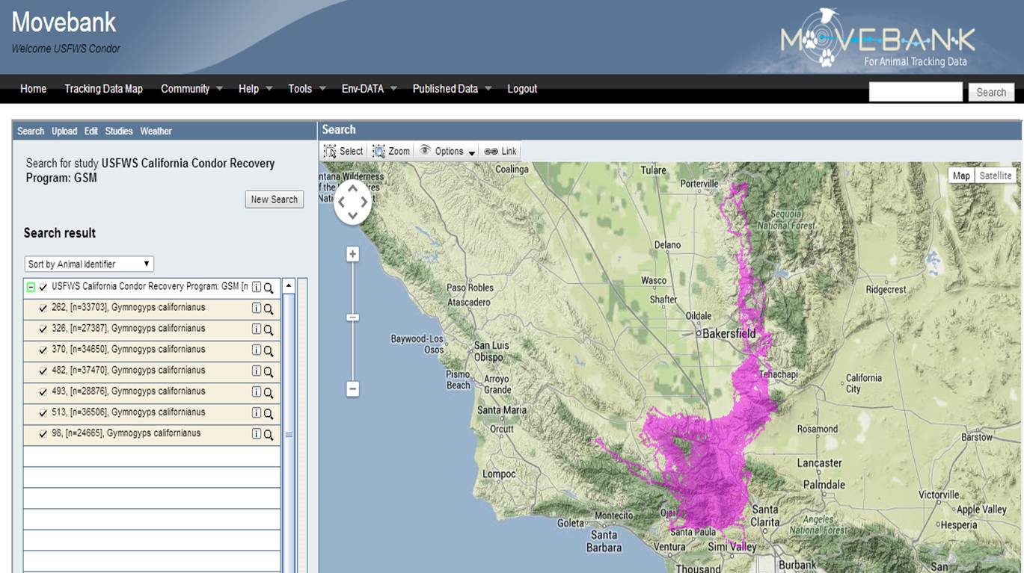
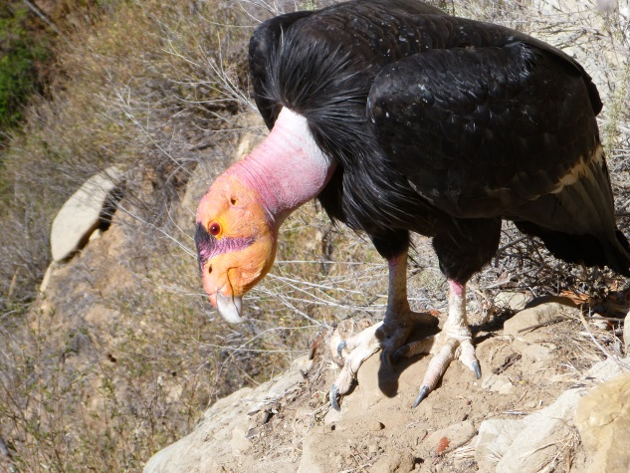
Operational implementation –
FWS-USGS condor population management
USGS project G14AC00091

Slide 14
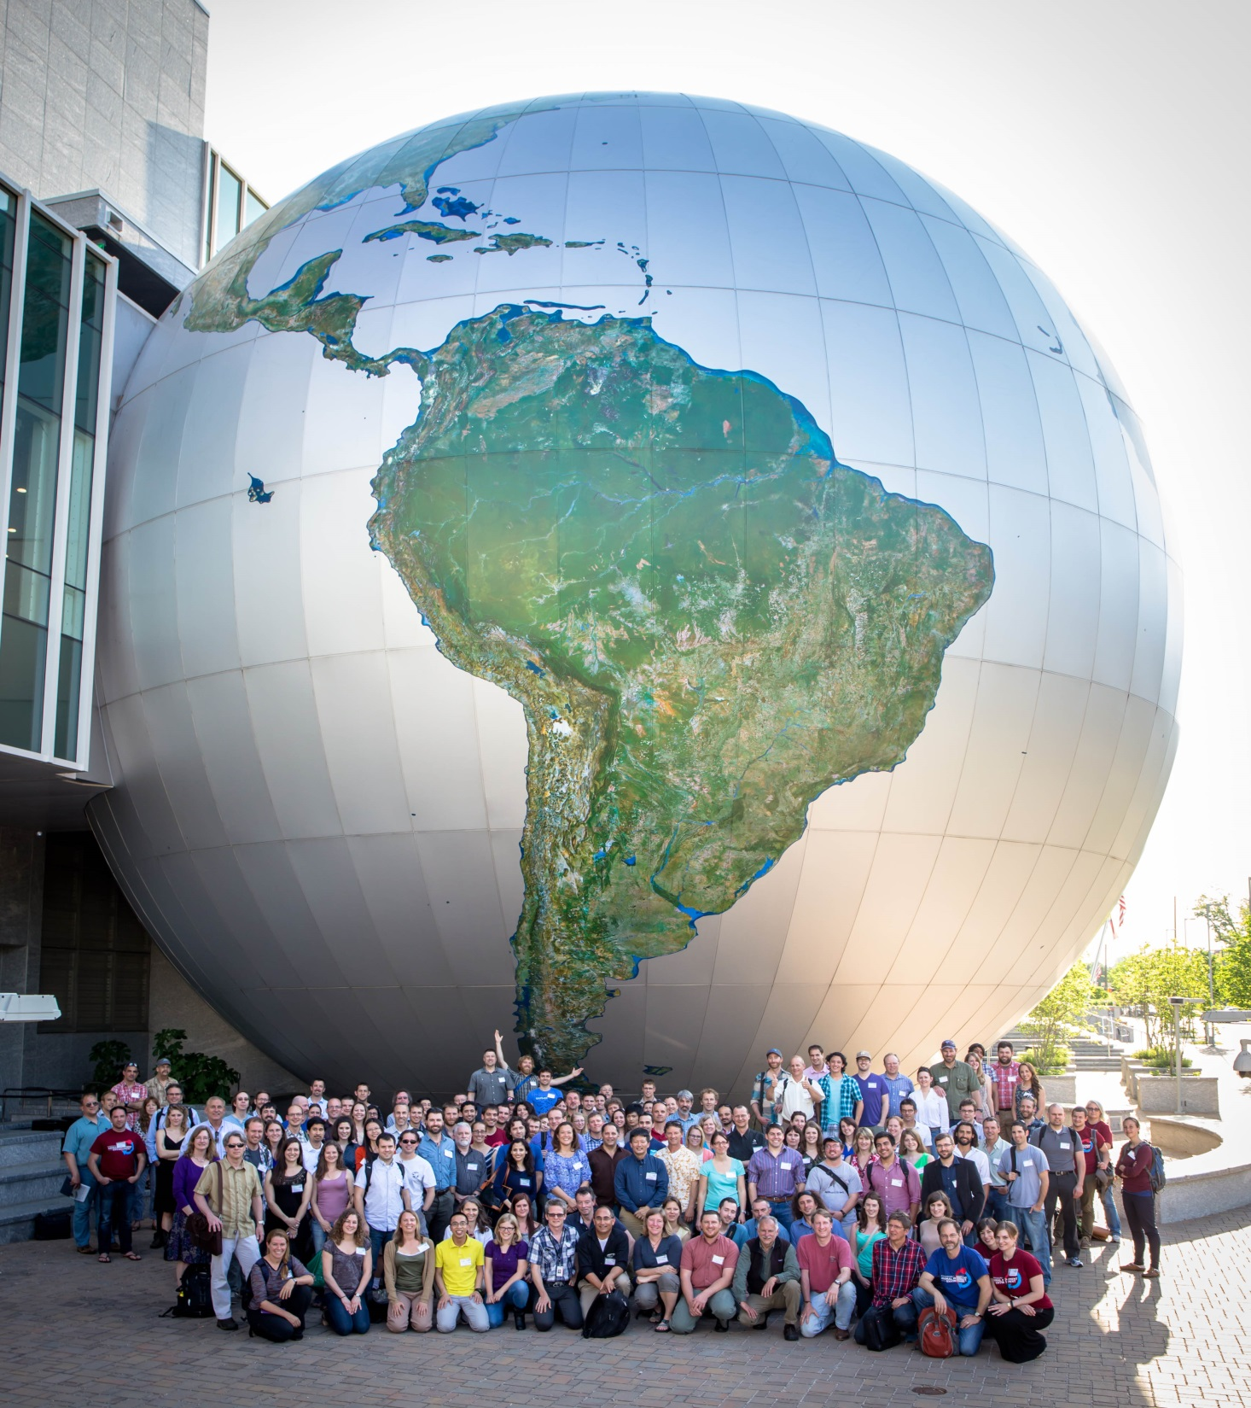
Symposium for Animal Movement and the Environment Raleigh NC, May 5-7

Slide 15
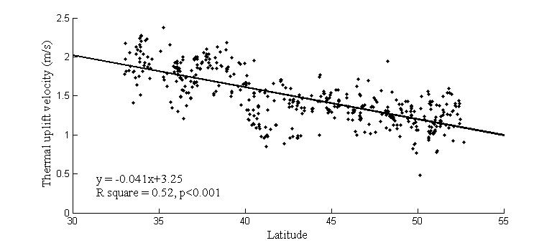
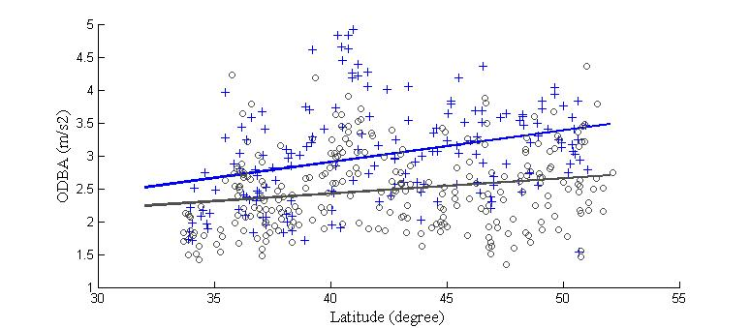
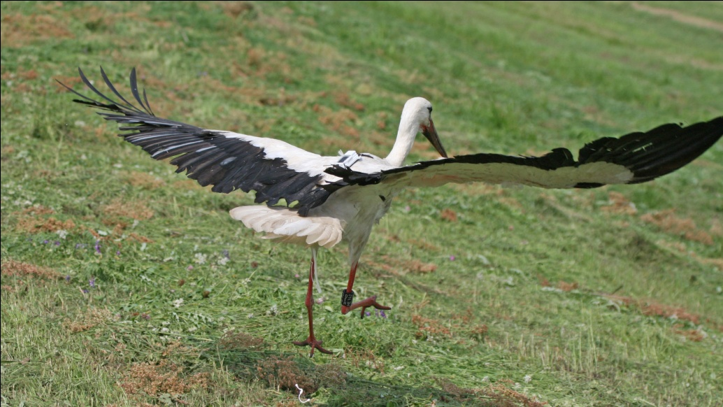
Adult storks better utilize uplift
Implementation by users is taking off
Juveniles +
Adults o
Migration direction
Migration direction
Energy expenditure in flight
Thermal uplift
Latitude
Latitude
Shay Rotics et al 2014, Symposium for Animal Movement and the Environment

Slide 16
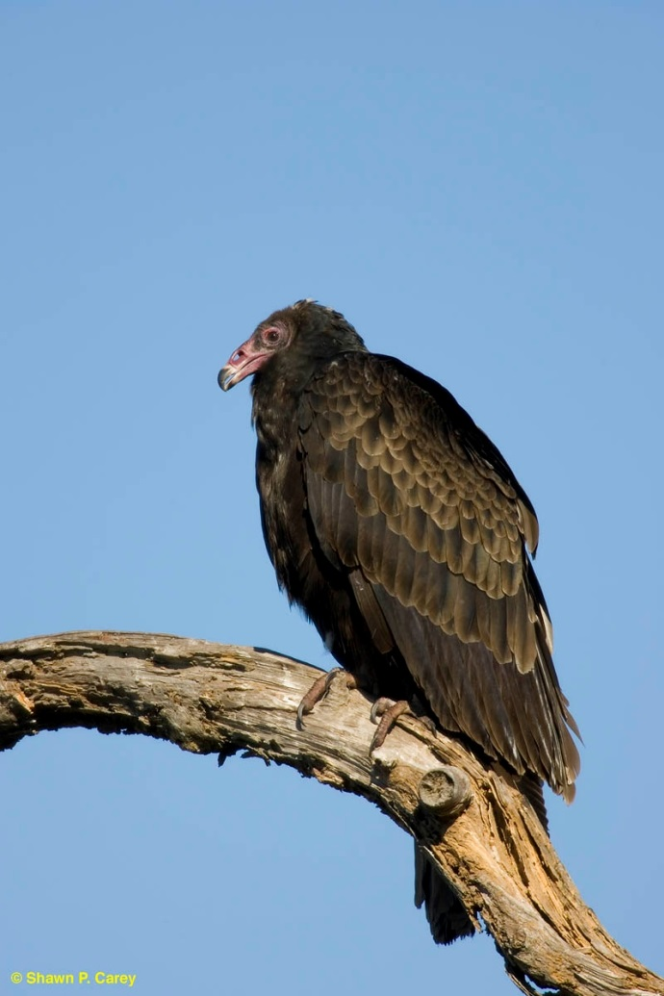
The End
Questions?
NASA Biodiversity, project #NNX11AP61G

