Slide 1
Forest carbon assessment for REDD+ in the East Africa SERVIR region
“Filling the gap between carbon science and policy”
Nadine Laporte - Patrick Jantz & Scott Goetz Woods Hole Research Center, MA
Ned Horning American Museum of Natural History, NY
NASA Biodiversity and Ecological Forecasting, DC, May 2014

Slide 2
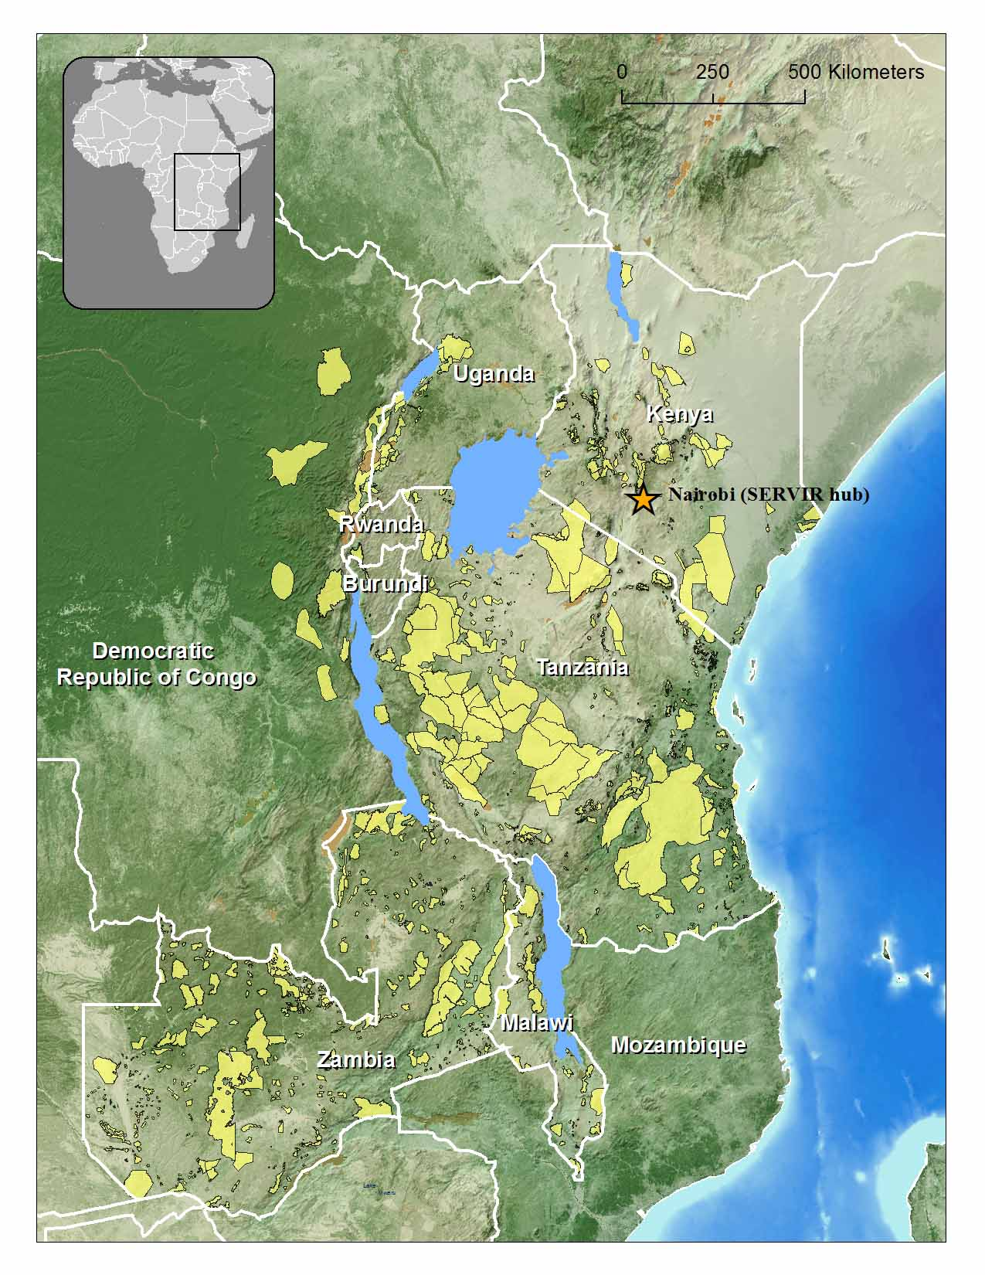
Forest Carbon Assessment for REDD+ in the East Africa SERVIR Region Woods Hole Research Center
Objectives
Our Project demonstrates how NASA Earth science products and derived models can assist East African countries, including the DR Congo, with their terrestrial carbon assessment and forest conservation strategy. The main focus of the project is:
Establishing forest carbon stock baselines and trends, assessing historical and current carbon emissions from deforestation and degradation (Gov/NGOs/Universities)
Identifying corridors of high forest carbon stock to be preserved and potential areas to be replanted in order to connect parks and protected areas and sustain biological diversity. (Science WHRC- Implementation GOV/NGOs)
Training and building capacity in the use of maps, tools and models to be developed as part of this project ( SERVIR Hub, AMNH, JGI partners)
Our project is assisting countries with developing strategies for reducing emissions from deforestation and forest degradation (REDD) to effectively decrease forest-based emissions.

Slide 3
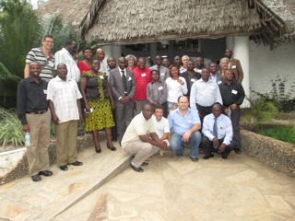
Forest Carbon Assessment for REDD+ in the East Africa SERVIR Region Woods Hole Research Center
Other
logo(s)
Capacity building to support REDD
“ Establishing forest carbon stock baselines”
Workshop in Tanzania 2012
Co-organized local partner -Jane Goodall Institute (JGI), AMNH
40 participants from East Africa region
Focused on mapping biomass with MODIS and GLAS lidar metrics
Biomass predictor tool for Tanzania ( EarthEngine)
http://www.whrc.org/education/tanzania/
Tanzania- NASA-SERVIR-workshop 2012
Notes:
Tools for carbon mapping and training
Open source tools for mapping above-ground forest biomass
Primarily based on using R scripts
Training resources focused on geospatial processing in R
All training materials released with open licenses

Slide 4
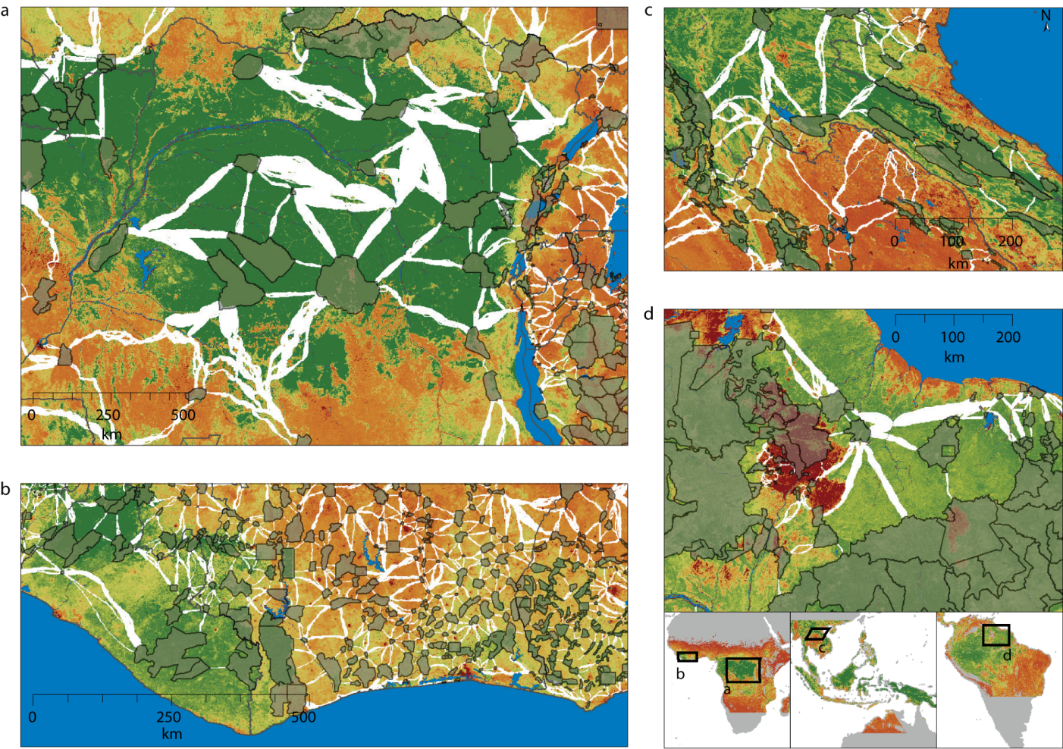
Forest Carbon Assessment for REDD+ in the East Africa SERVIR Region Woods Hole Research Center
Other
logo(s)
Policy Relevance
Guidance is needed for targeting & prioritizing REDD+ efforts
Where could we better conserve carbon or restore forests ?
We can identify Carbon Stock Corridors that can simultaneously
increase protected area effectiveness
allow species to migrate & disperse with climate change
avoid carbon emissions from deforestation
Notes:
Governments need guidance to prioritize their REDD effort, so we argued that we can identify corridors that will

Slide 5
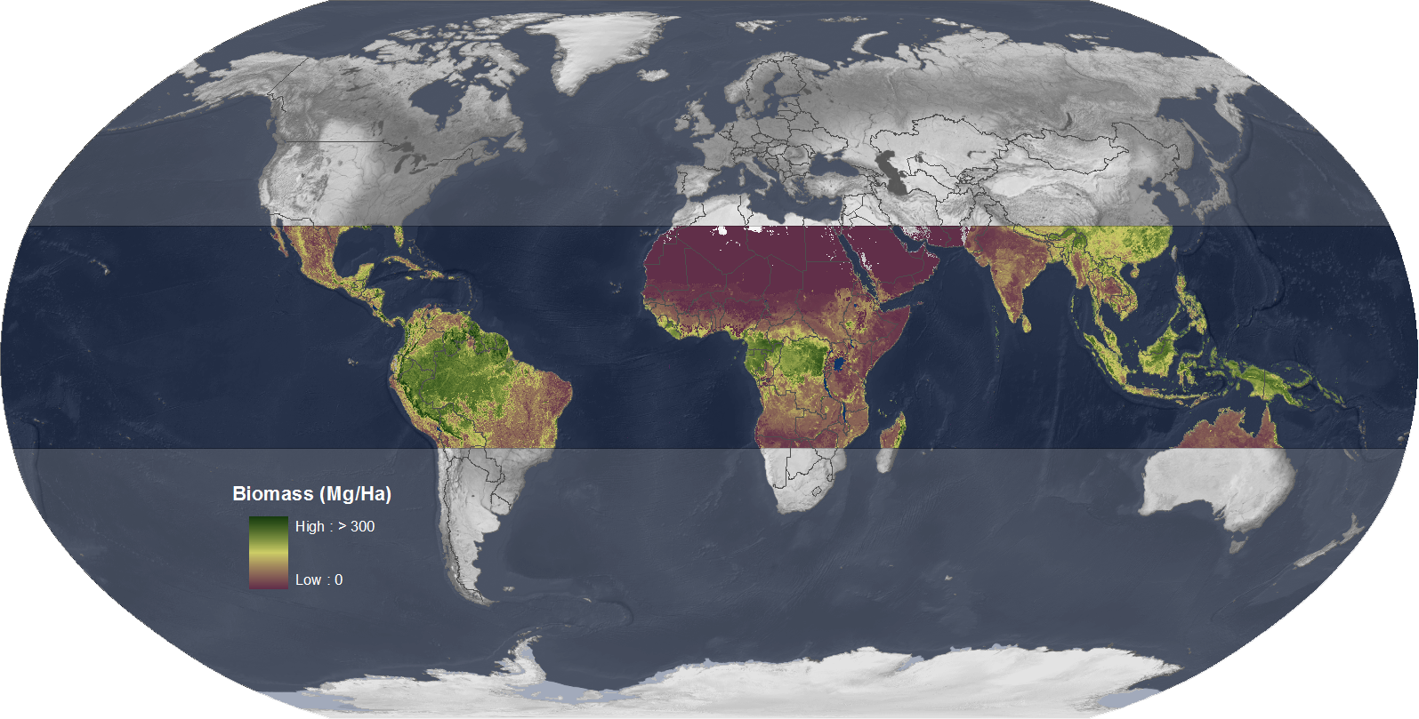
Forest Carbon Assessment for REDD+ in the East Africa SERVIR Region Woods Hole Research Center
Other
logo(s)
Science – “Mapping Vegetation Carbon Stock Corridors “
“How to Mitigate Climate Change and Promote Biodiversity”
Pantropical Data sets
MODIS 500m vegetation carbon stock ( Baccini et al, 2012)
World Database on Protected Areas
Model for corridor
Conditional minimum transit cost algorithm to map corridor between PA
TOPSIS to rank them
Brazil case study:
Endemism
Species richness
Deforestation risk
Land tenure
Opportunity costs
(data from Soares et al, 2006)
Pan-Tropical Mapping of Forest Carbon
(MODIS- GLAS)- 500m resolution
Notes:
TOPSIS scoring to rank the corridors.

Slide 6
Vegetation Carbon Stock Corridors provide Biodiversity and Climate Change Mitigation Co-Benefits
Jantz et al. 2014 Nature Climate Change
Southeast Asia
Central Africa
Guiana Shield – South America
West Africa
Corridors were mapped across the tropics
- Corridors are shown in white
- VCS ranges from greens (high) to reds (low)
Corridors contain 15% of the total tropical unprotected aboveground biomass

Slide 7
Additional Factors Can Be Used to Prioritize Corridors for REDD+
Species endemism
Species richness
Deforestation Threat
Economic Opportunity Cost
Corridors in red have
high VCS
- high biodiversity
high vulnerability
- low EOC
Corridor Anchor Carbon Density (tons C per hectare)
Jantz et al. 2014 Nature Climate Change
Notes:
Through one of our collaborator in Brazilwe had access

Slide 8
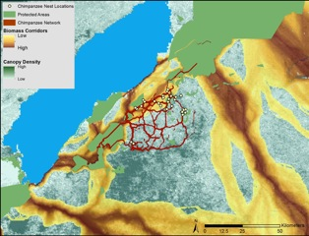
Forest Carbon Assessment for REDD+ in the East Africa SERVIR Region Woods Hole Research Center
Other
logo(s)
Future work
Capacity building / Technical trainings
Biomass and Corridor mapping
Continue developing web based mapping tools like the Biomass Predictor with Google (available on EarthEngine)
Next workshop at the NASA hub in Nairobi
Science/ Policy outreach
Continue to engage with REDD+ stakeholders (COP, etc.)
Continue corridor mapping –with an integration of biodiversity, deforestation threats for specific tropical countries or regions
Work with partners on species specific Carbon corridors at finer scale (JGI, WCS)
Continue developing web-based GIS interface to distribute findings, such as the Vegetation Carbon Corridors:
http://whrc.org/mapping/pantropical/habitatcorridors/index.html

Slide 9
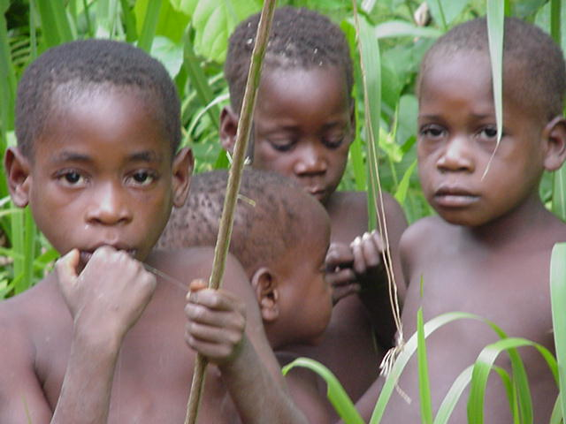
Forest Carbon Assessment for REDD+ in the East Africa SERVIR Region Woods Hole Research Center
Other
logo(s)
Acknowledgements
NASA Applied Sciences Program – SERVIR
NGOs and forest communities for their assistance with field work and the workshops in the tropics
Thanks !

Slide 10
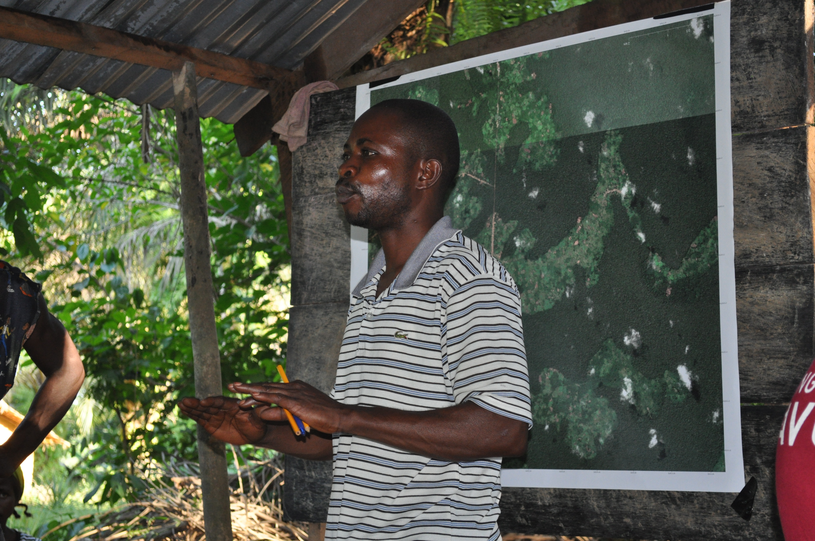
Laporte’s SERVIR AST project moves from feasibility (ARL 3) to development (ARL 4): focusing future REDD+ activities in biological corridors maintains tropical forest and biodiversity
Problem: Decision makers need tools to make choices that enable development yet preserve forests and biodiversity, and thereby improve carbon stocks and reduce CO2 emissions.
What SERVIR did: A SERVIR AST effort led by Nadine Laporte developed maps to help stakeholders identify biological corridors, quantify their carbon stocks, formulate conservation plans, and reduce CO2 emissions.
High-res veg carbon stock data was derived from MODIS and GLAS datasets to map corridors traversing areas of highest biomass between tropical protected areas. Results revealed:
Many corridors have carbon densities equal to or above that of protected areas.
As pathways for animal movement, corridors also mitigate effects of land use and climate change on biodiversity.
Training is ongoing for local stakeholders in use of GPS technology for collecting field info to develop land use maps in support of REDD+ implementation.
This work was recently highlighted in Nature Climate Change: http://dx.doi.org/10.1038/NCLIMATE2105.
Central African corridors shown in white, protected areas in semi-transparent grey, and biomass as a gradient from low density in red to high density in green
|‌ 10
Trainer Dauphin Mboka Lomboto teaches in the Congo
Notes:
This SERVIR AST project led by PI Nadine Laporte has shown that focusing on biological corridors through REDD+ activities could maintain tropical landscapes and benefit biodiversity, even in the face of increased land use and climate change.
Laporte’s project began in late 2012 in the Discovery and Feasibility phase (phase 1) of the Application Readiness Level scale for Applied Sciences project development. With the latest important steps – shown on this slide -- the project has transitioned to an ARL of 4, signifying advancement into the Development, Testing and Validation phase (phase 2), where interactions with end-users are key. An ARL of 4 in terms of capacity building signifies that initial integration and verification of the project’s applications are occurring within the end-user environment.
Training completed and planned:
Villagers participatory mapping for REDD+ tested in the Congo in November 2013
Tanzania in-country technical workshop in November 2013 funded by SERVIR to build the capacity of the region’s technical and political leaders to assess and manage their carbon stocks
Training in carbon management for REDD+ planned for Congo technicians and villagers planned for April 2014
Kenya workshop in collaboration with SERVIR-Africa planned for 2014
A vegetation carbon stock biological corridor is a habitat area that serves as a pathway between protected areas.
REDD+ stands for Reducing Emissions from Deforestation and Forest Degradation. It is a new carbon finance mechanism discussed under the United Nations Framework Convention on Climate Change (UNFCCC) to effectively decrease deforestation-based CO2 emissions, which account for 10-25% of annual emission. Tropical countries will receive funds in proportion to their effort to reduce their emissions or enhance their carbon stocks and identify and finance incentives to lead to low-carbon paths to sustainable development. "REDD+" goes beyond deforestation and forest degradation, and includes the role of conservation, sustainable management of forests, and enhancement of forest carbon stocks.
Biomass was estimated as a function of MODIS Nadir Bidirectional Reflectance Distribution Function Reflectance (NBAR), temperature, and SRTM elevation (Described in Baccini et al, 2012 in Nature CC)
MODIS (Moderate Resolution Imaging Spectroradiometer)
SRTM (Shuttle Radar Topography Mission)

