Slide 1
Physiological Impacts of Climate Change
Using Remote Sensing
David S Wethey, Sarah A Woodin, Thomas J Hilbish, Venkat Lakshmi
University of South Carolina
Brian Helmuth, Northeastern University
wethey@biol.sc.edu

Slide 2
Biogeographic Modeling
Ecosystem engineering species that control the rest of the assemblage
  competitive dominants
  sediment stabilizers
  sediment destabilizers
Age structured metapopulation
Reproduction controlled by Sea Surface Temperature
Gridded ICOADS temperatures
  1850-present
Dispersal
  10% N, 10% S
  10 km max
Seed entire coast with species in 1850 and allow population distribution to evolve over time

Slide 3
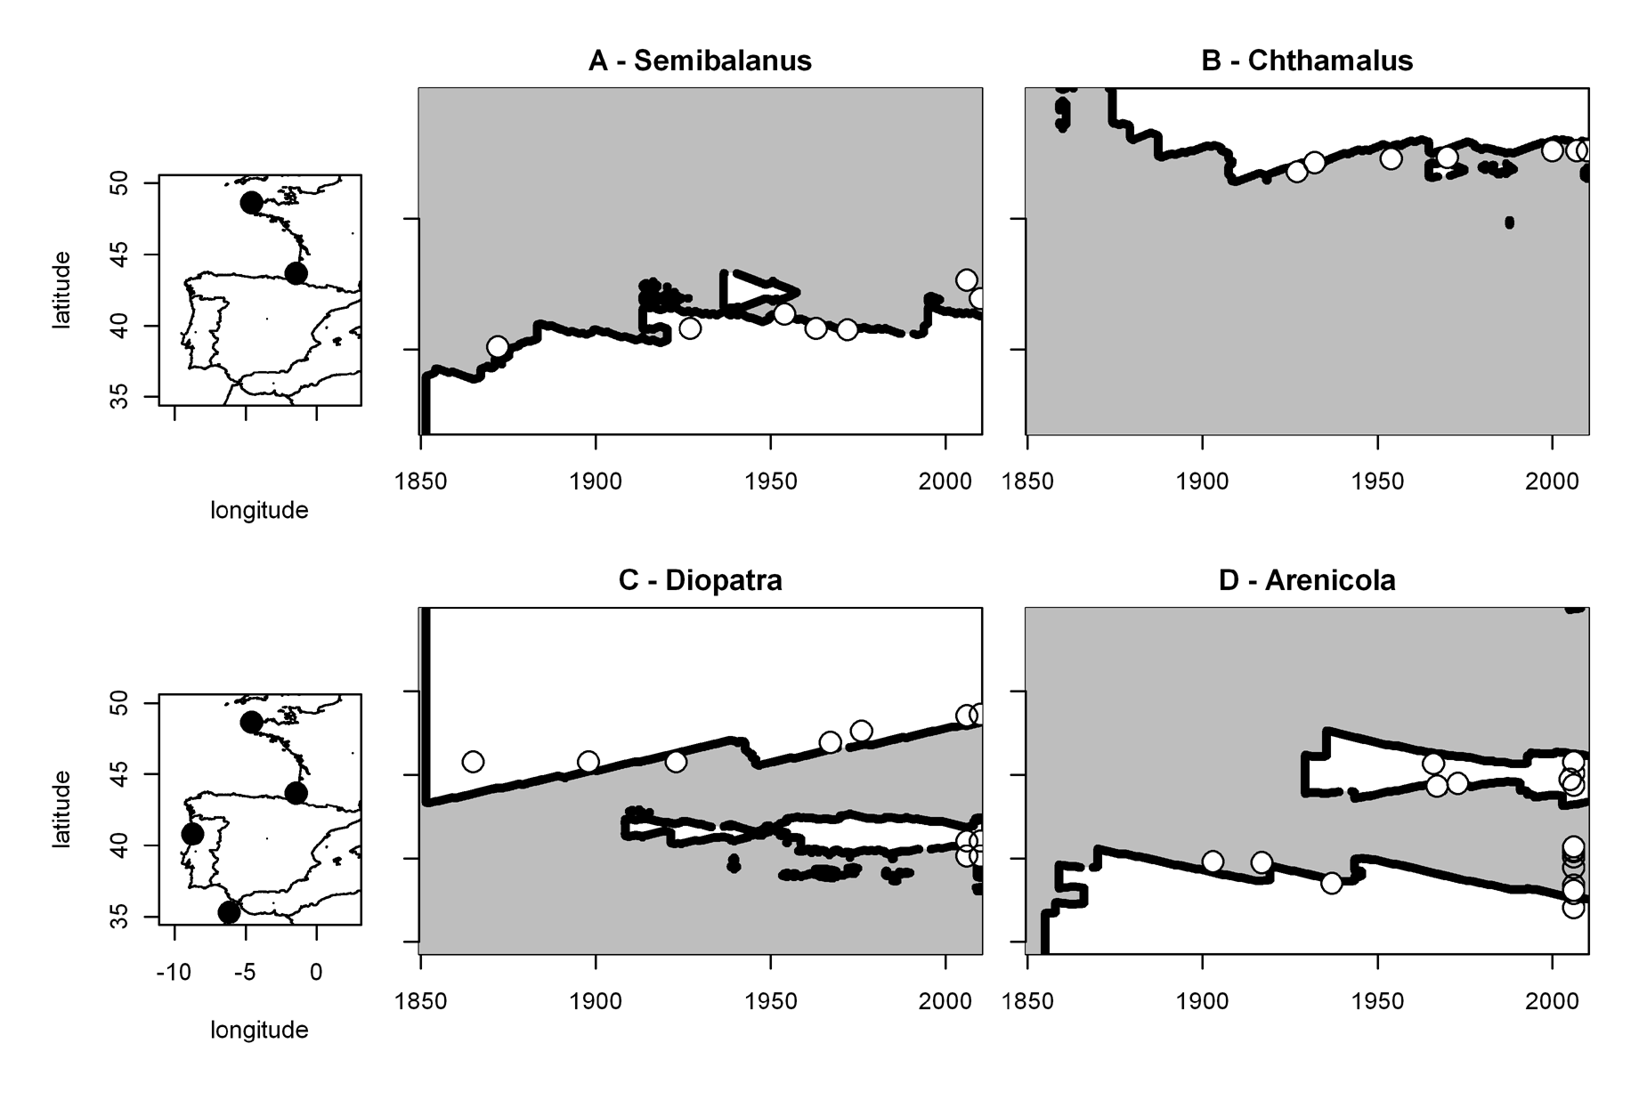
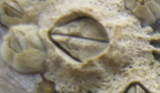
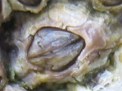
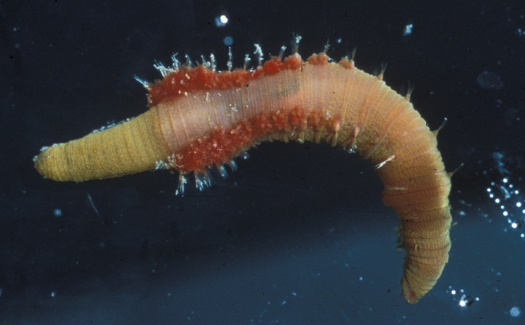
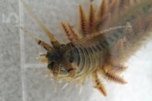
Hindcasts of Geographic Limits (lines) and
Historical Records of Limits (dots)
Wethey et al. 2011. J Exp Mar Biol Ecol 400:132-144

Slide 4
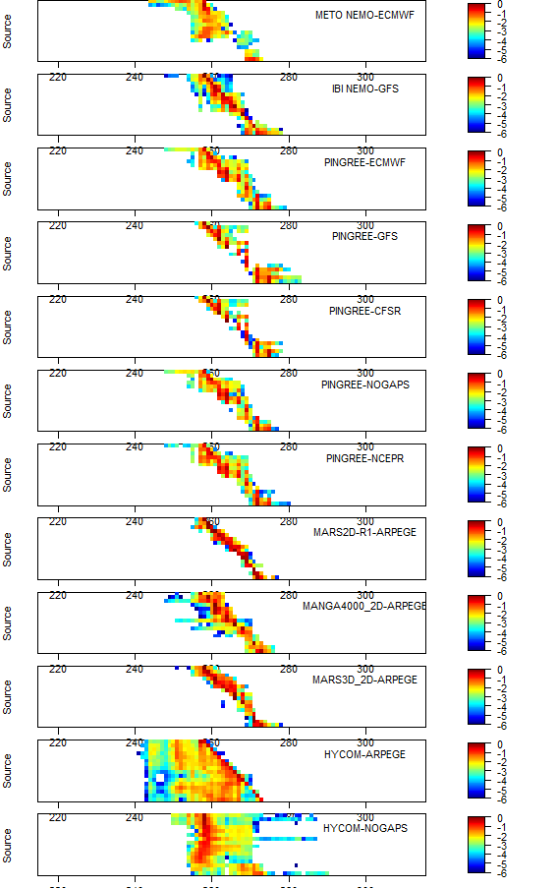
Effect of Ocean Model on Estimates of Population Connectivity
NEMO – UK Met Office & Spain Puertos del Estado
Hycom – US Navy & French Navy
MARS - IFREMER
Pingree & Griffiths Model with same winds

Slide 5
Species Distribution Modeling
Correlative niche models
Mechanistic niche models
These models assume that mechanisms and patterns found in one geographic region or epoch can be used to predict distribution in another. This is the concept of niche conservatism, model stationarity or model transferability.

Slide 6
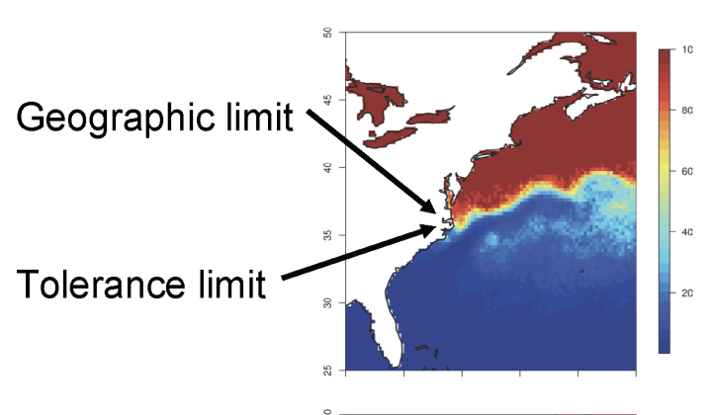
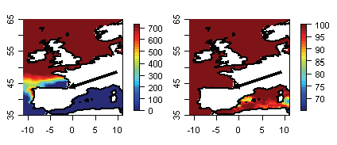
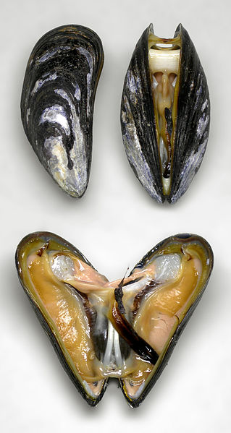
Can physiology inform species distribution models?
Examine difference between lethal vs performance limits
      Thermal death vs scope for growth / energy budget
Commercially important shellfish
      Extensive physiology, production, biogeography data
Extremely important to find reasons for failure of assumption of niche conservatism in species distribution models that work in one geographic region but fail to make correct predictions elsewhere.
Species Distribution Model Based On Thermal Tolerance
Marine mussel
Mytilus edulis
Distribution Model
Validated for
US East Coast
Fails utterly
in Europe
Woodin et al. 2013 Ecology & Evolution 3:3334-3346

Slide 7
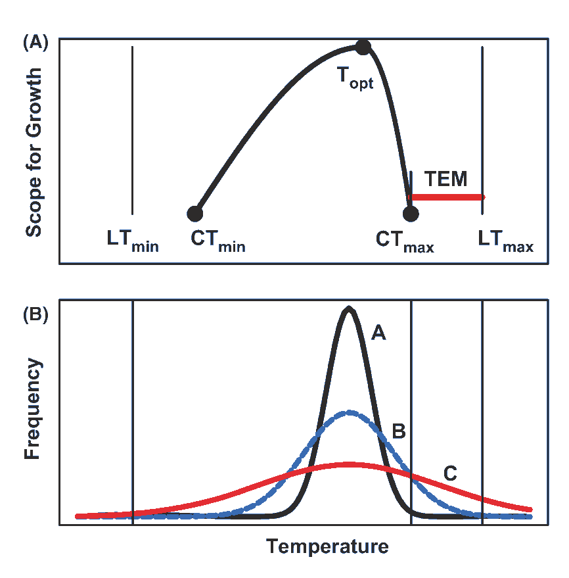
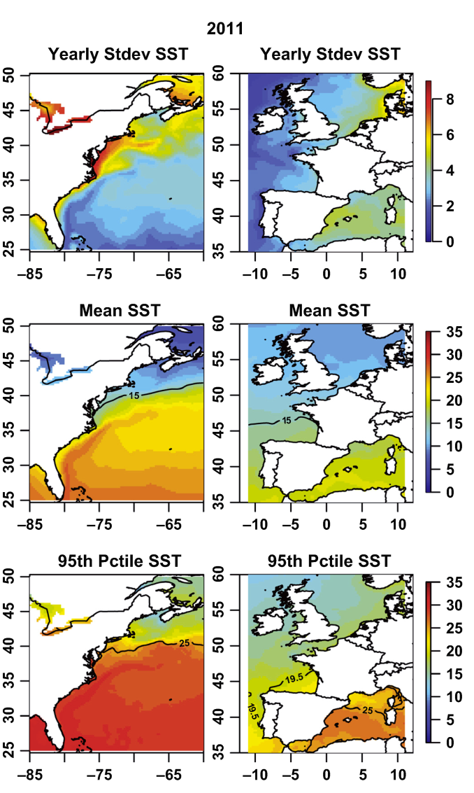
Models are likely to fail if ecological performance limits are different from physiological tolerance limits, and environmental variance differs between regions
TEM = transient event margin
CT_{max}= physiological performance limit
LT_{max} = lethal temperature
Woodin et al. 2013 Ecology & Evolution 3:3334-3346

Slide 8
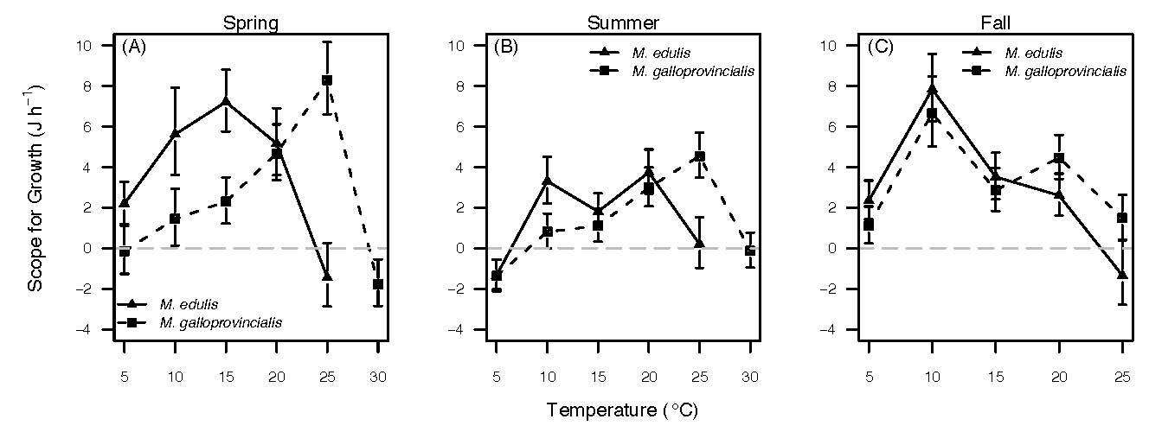
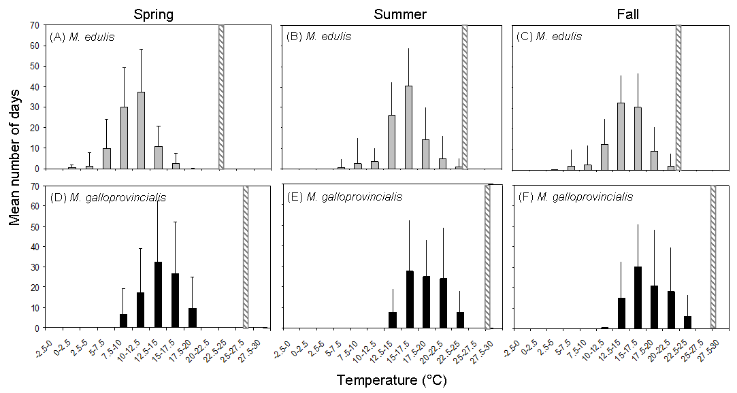
Scope for growth and biogeography of commercial mussels in Europe
Fly & Hilbish 2013. Oecologia 172:35-46

Slide 9
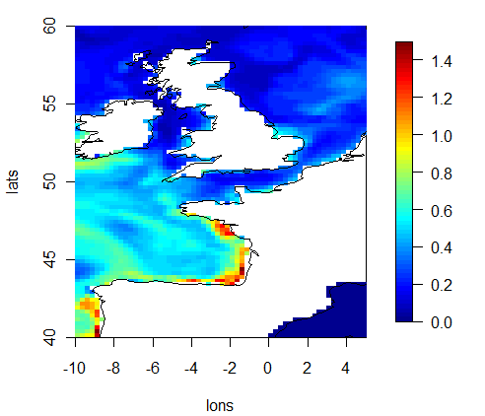
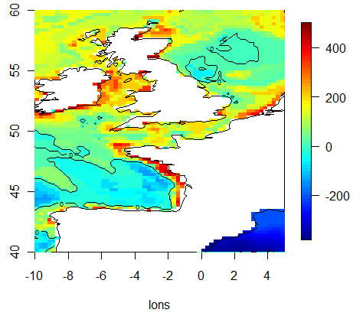
Scope for Growth Models incorporating daily SST and
Satellite Chlorophyll yield the approximate
southern limit of Mytilus edulis in Europe
Chlorophyll µg/L End of Year body mass via SFG
Fly et al. in press

Slide 10
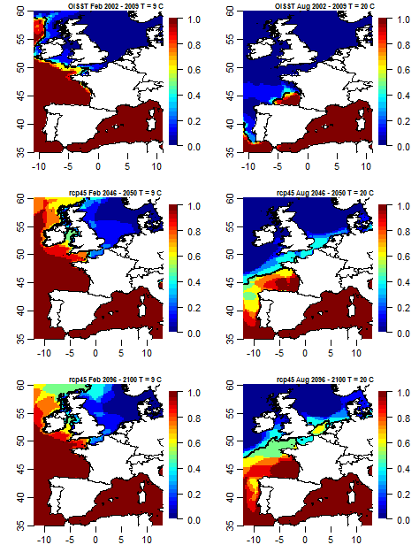
Mussel Thermal Projections in Europe
M galloprovincialis M edulis
Present climate
Fraction of years
hotter than threshold
RCP 4.5 2046-2050
Fraction of models
predicting years
hotter than threshold
RCP 4.5 2096-2100
Primary source of
mussel seed for
Europe will no longer
exist
Fly et al. In press

Slide 11
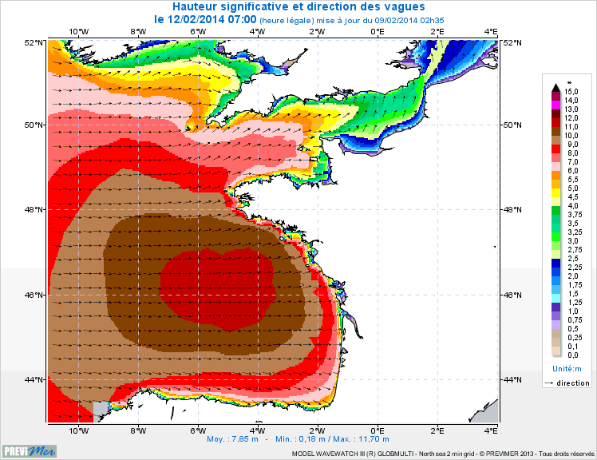
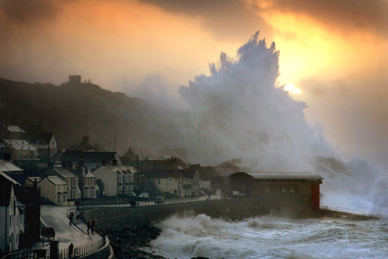
Effects of storms on biogeography? Waves in 2014
Diopatra
Range Edge
Low
Recruitment
North of
here
Sennen Cove, Cornwall, 2014

Slide 12
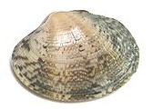
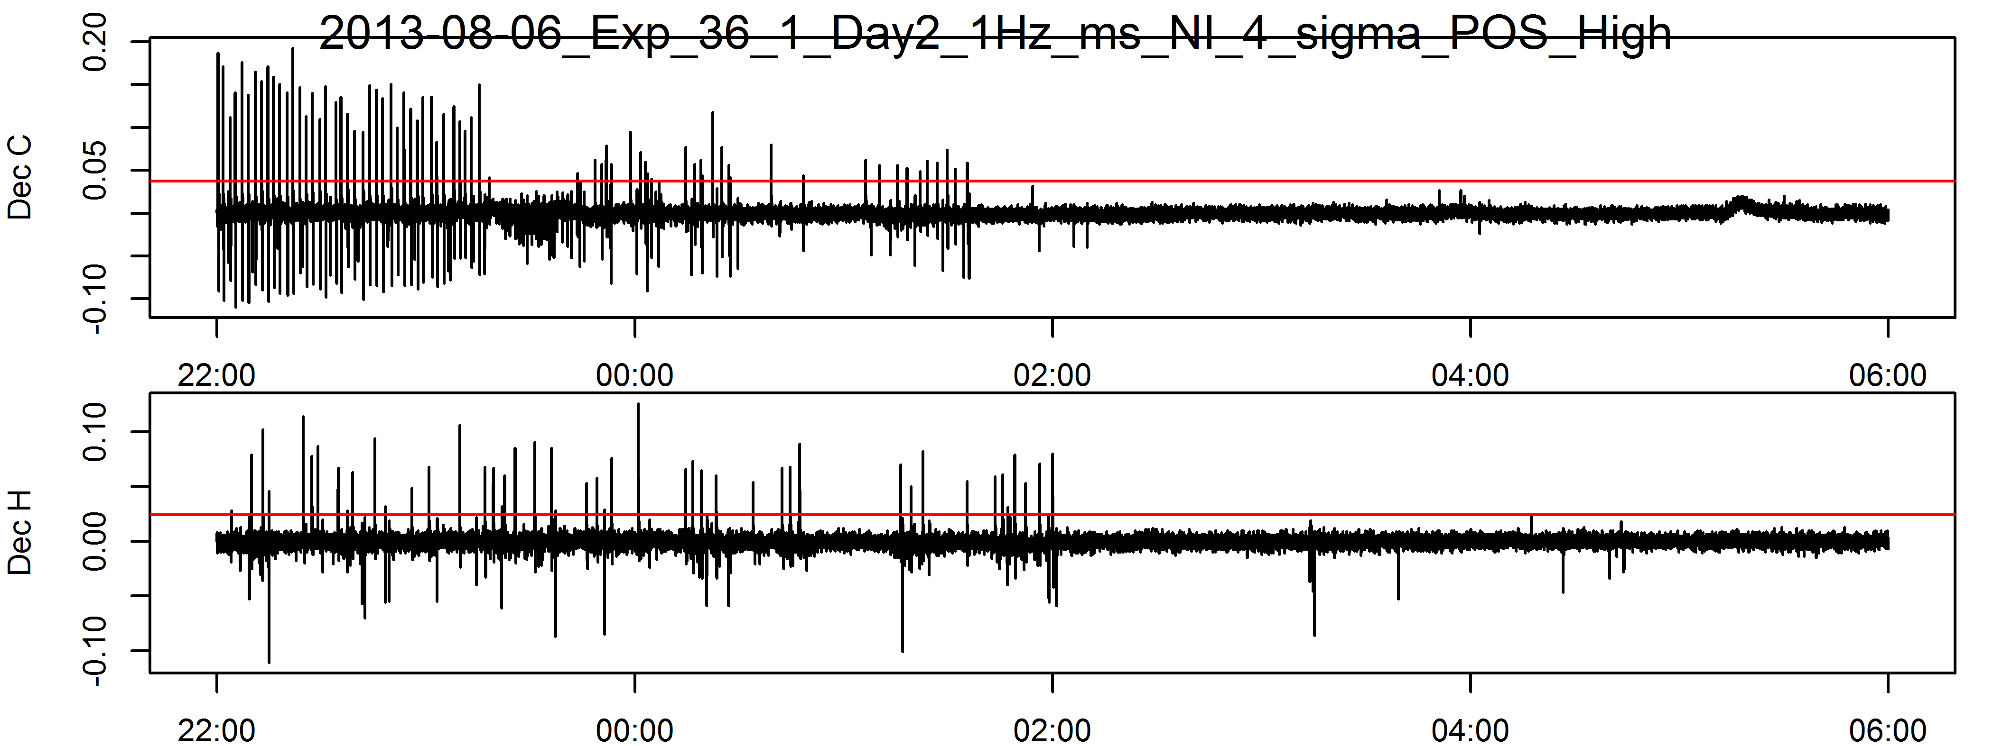
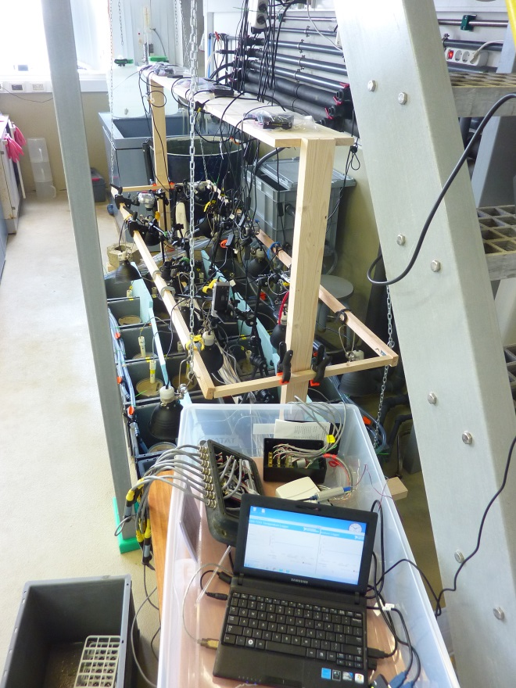
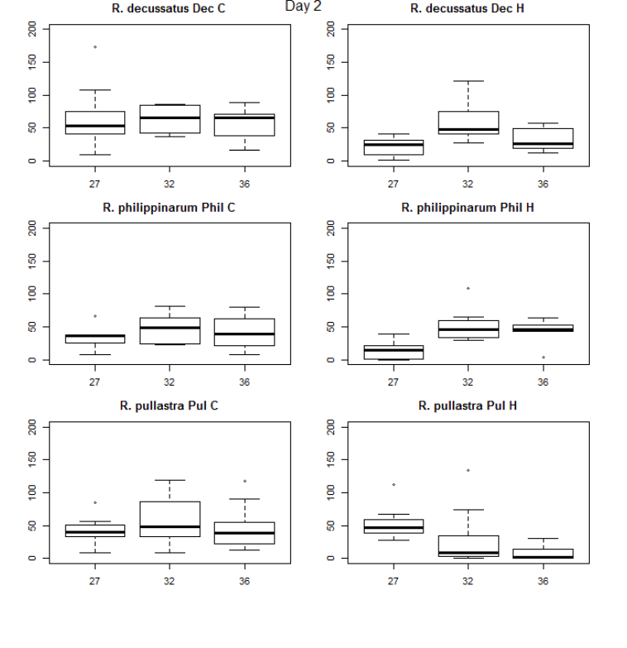
Effect of Temperature on activity of commercial clams in Spain
Porewater pressure dynamics due to burrowing
Pressure Pulses per Hour
R decussatus
Ameixa fina
€ €
R philippinarum
Ameixa xaponesa
€
R pullastra
Ameixa babosa
€ € €
Decussatus increased activity 32°C
Philippinarum increased act up to 36°C
Pullastra reduced activity 32°C died 36°C

Slide 13
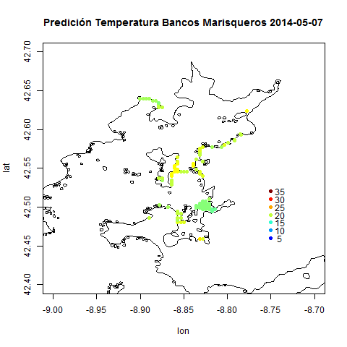
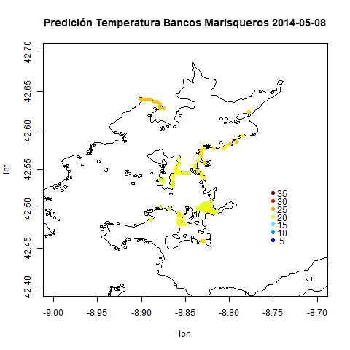
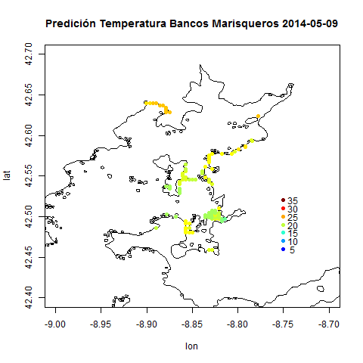
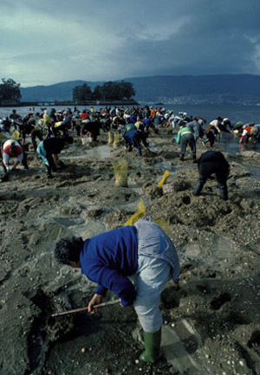
Collaboration with fisheries cooperatives in Galicia (NW Spain)
Short-term forecasting of temperatures in commercial intertidal clam beds
Ría de Arousa – most important grow-out region in Spain
5 km
Short term intertidal temperature forecasts
1km WRF meteorological model (Meteo-Galicia)
250 m MOHID ocean model (Meteo-Galicia)
NOAH intertidal sediment land surface model
3-day forecasts of risky conditions
Advance warning of die-offs

Slide 14
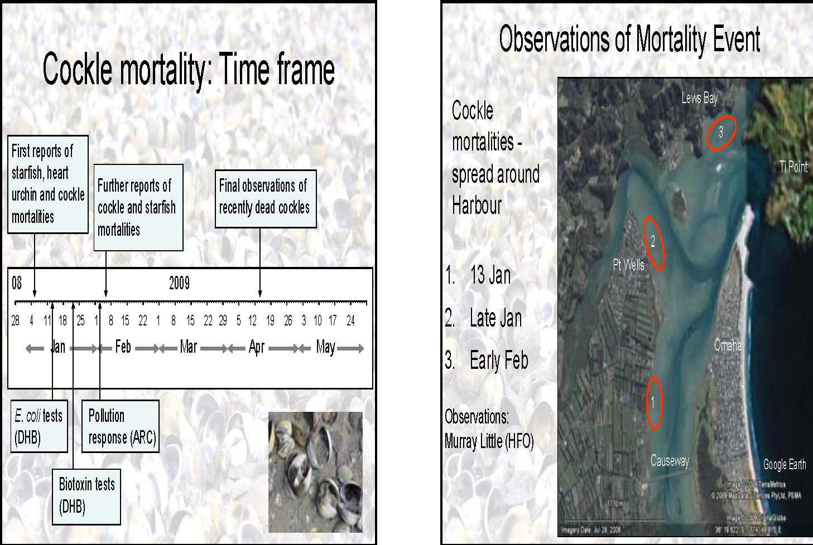
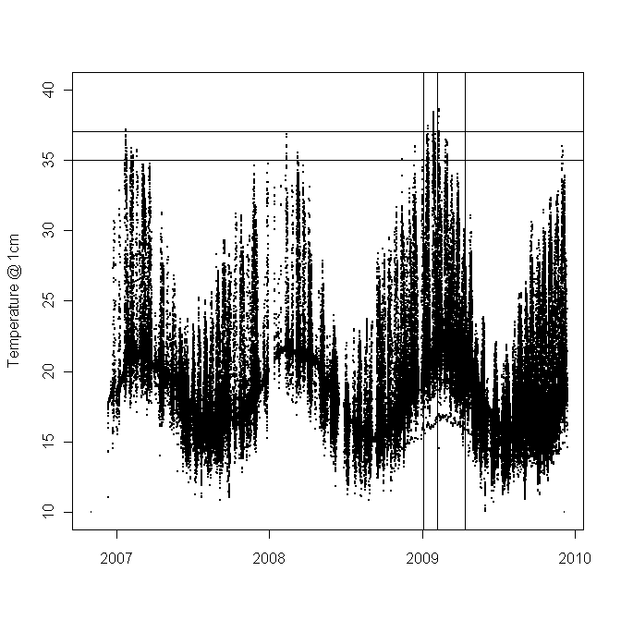
Whangateau Harbor Cockle Mass Mortality 2009
Forecasts of intertidal temperatures 2007-2010
High cockle mortality occurred
during unusually hot conditions
in the intertidal:
>35°C at 1cm depth in sediment
Cockle data: Karen Tricklebank

Slide 15
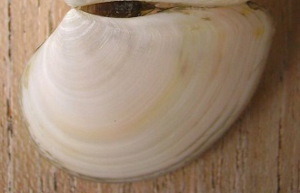
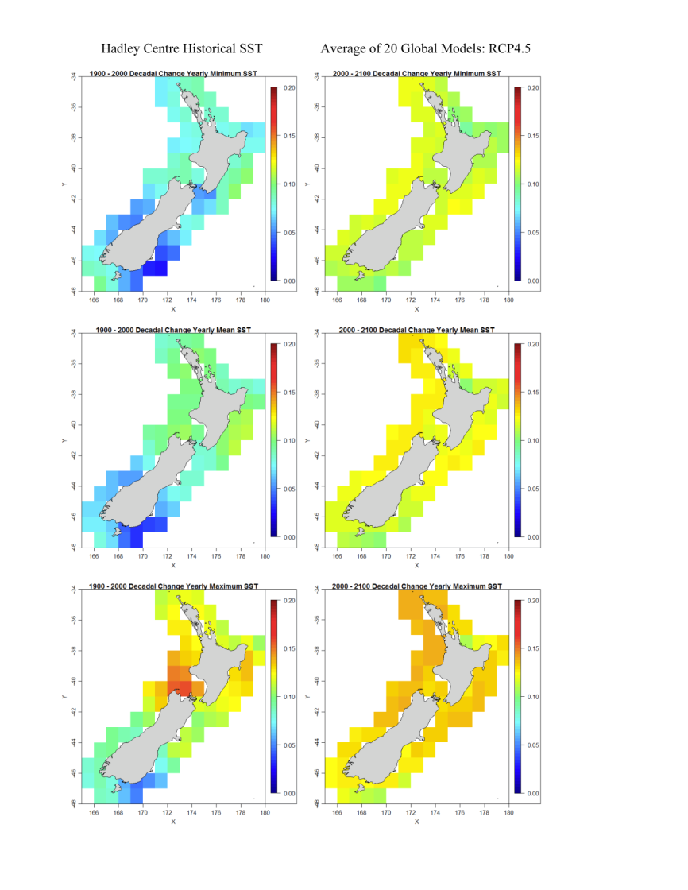
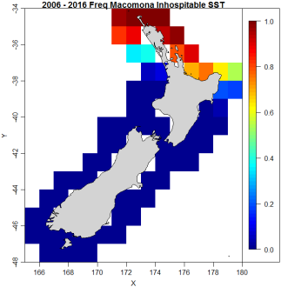
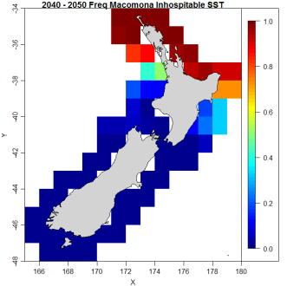
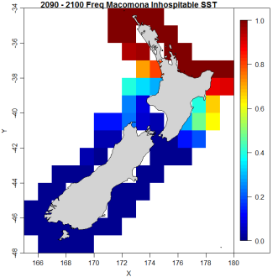
Biogeography of Ecosystem Engineers in NZ
Macomona lilliana clam– dominant contributor to benthic-pelagic coupling
Decadal rates of change CART Model
of SST NIWA field data
Hadley Centre CMIP 5 Forecasts
HISST 1900-2000 RCP 4.5
Macomona densities low if
winters hotter than 14°-15°C
Maps are fractions of winters
above 15°C in a decade
Average fractions based on
20 GCMs RCP 4.5
All time series adjusted for
2006-2012 SST bias
Expect large reduction in benthic nutrient fluxes by mid century in North Island
2006
2016
2040
2050
2090
2100
Min
SST
Mean
SST
Max
SST

Slide 16
Summary
Ecosystem engineers and commercially important species moving poleward
  Consequences for mariculture, nutrient fluxes, community composition
Important to consider physiological performance in species distribution models
Metapopulation approach is very powerful
  BUT need to be very careful in estimating connectivity
Model stationarity/transferability related to physiological performance and environmental variability
All models are hypotheses
  Don’t trust any individual model – use ensembles

Slide 17
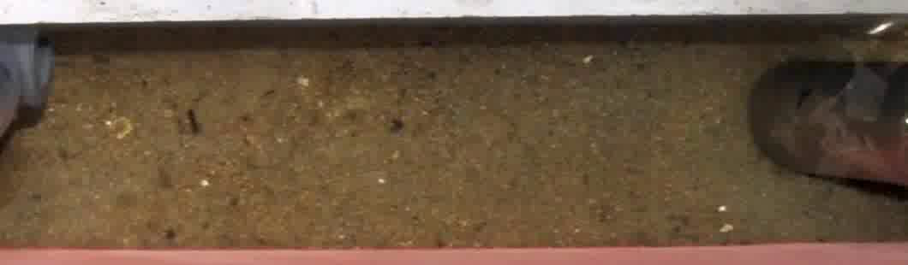
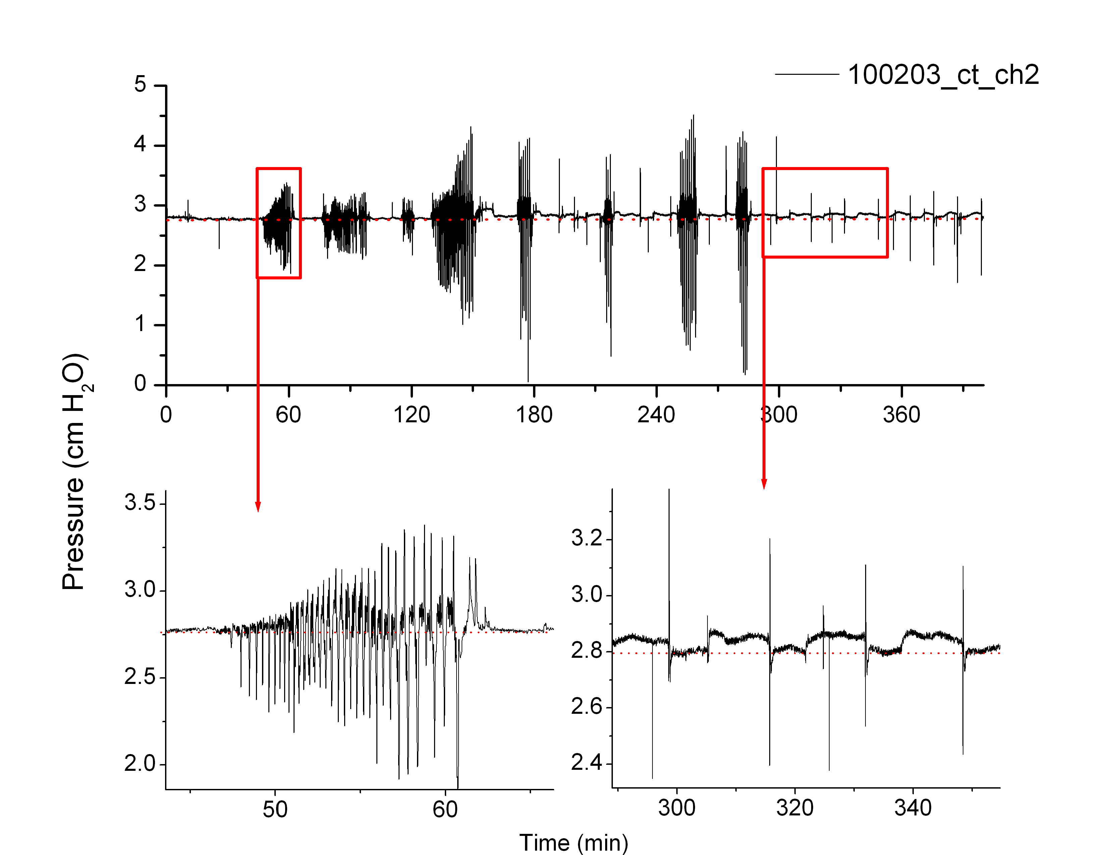
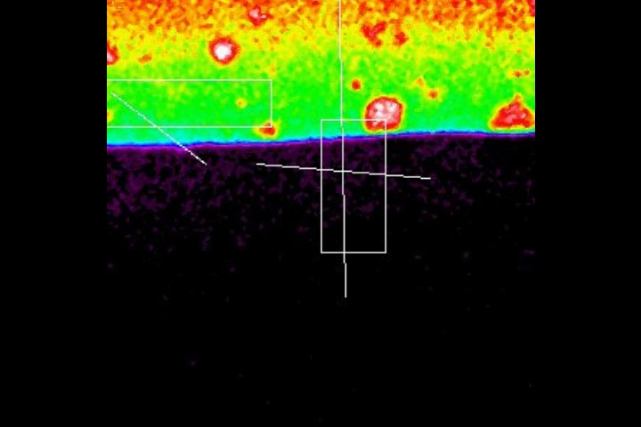
Macomona burrowing and feeding

