Slide 1






Predicting the consequences of climate change on hummingbird diversity
Catherine Graham, Susan Wethington, Donald Powers, Pieter Beck, Tina Cormier, Scott Goetz, Frank La Sorte, Gil Bohrer, Ben Weinstein, Boris Tinoco, Sarah Supp, Anusha Shankar and Marisa Lim, team of Latin American interns

Slide 2
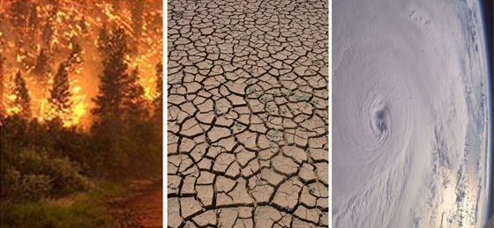
Human induced environmental changes…

Slide 3
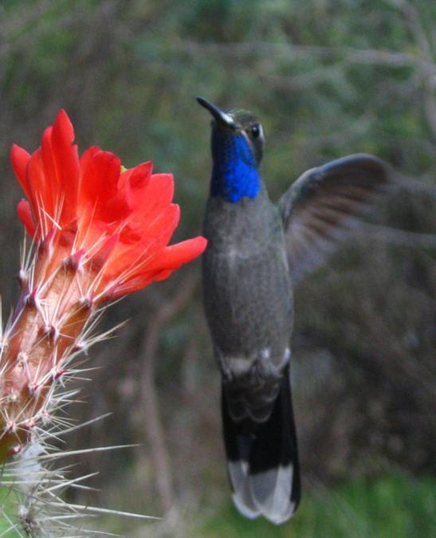
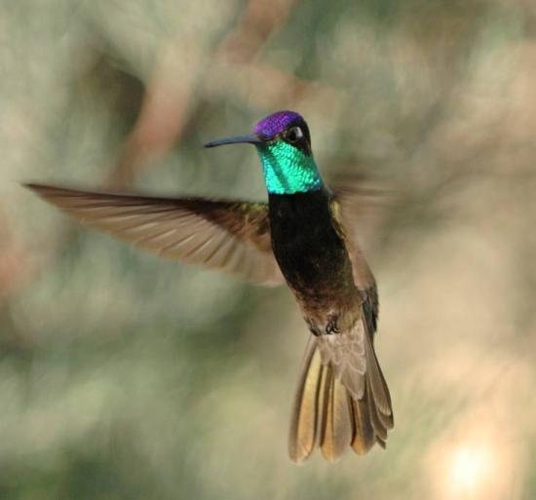
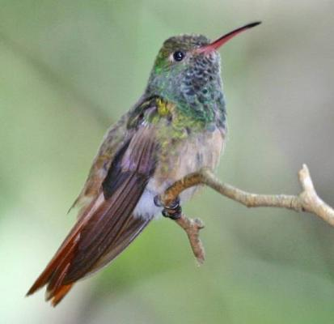
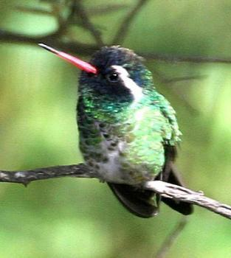
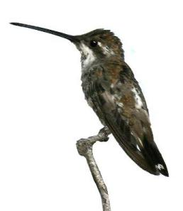
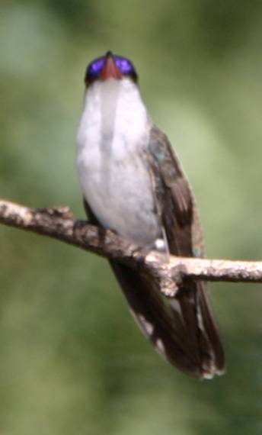
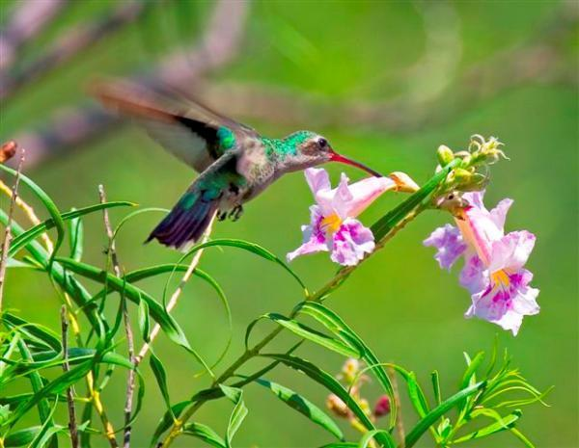
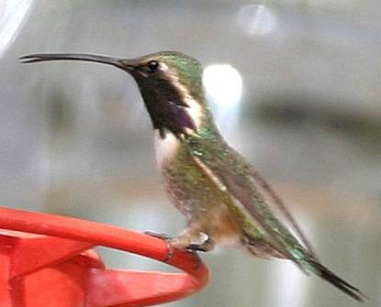
Why Hummingbirds?
They operate at the limits of endothermic physiology. Daily energy requirements are very high.
Climatic changes that reduce energy resources make it more difficult for hummingbirds to meet daily energy demands and drive shifts in their distribution.
Most diversity in the Andes.
US has 57 species (40% endemic)
Notes:
328 described species of hummingbirds -- live in a variety of environments though about 80% of species are dependent of forest vegetation.
Highest concentration in the northern Andes (109 species; Rahbek & Graves 2000) where up to 35 species co-exist in a local area.
North American has 57 species, of which 40% are endemic and 14% are of high conservation concern
Why hummingbirds?
Because of their small size (many species < 3 g) hummingbirds operate at the limits of endothermic physiology. Daily energy requirements are among the highest measured in vertebrates. Climatic changes that reduce energy resources may make it more difficult for hummingbirds to meet daily energy demands and drive shifts in their distribution
A key plant – animal interaction for ecosystem functioning and diversity maintenance is pollination – if plants/vegetation changes then hummingbird distribution will likely change and likewise pollination services will likely change

Slide 4
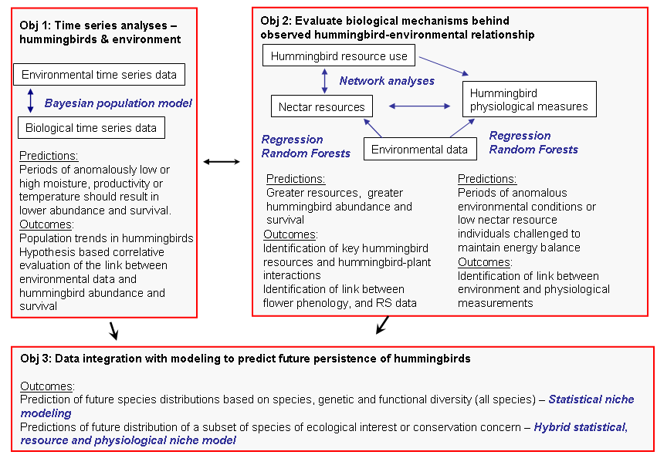
Time series hummingbird & remote-sensing
Notes:
Our three main objectives focus on
identifying patterns (objective 1) – i.e., be determining the association between hummingbird abundance, distribution and survival and environmental variables. Specifically we think that periods of anomalously low or high moisture, productivity or temperature should result in changes in abundance, distribution and survival
Evaluating some of the biological mechanisms --- we focus on what we think are the two main mechanisms – nectar resources and physiological response; Nectar is the main food source of hb so understanding what they eat and how their food is distributed has important implications for their survival and distribution, therefore we quantify nectar availability and use across regions and time. Physiological measures provide direct information on hummingbird health and their ability to maintain an energy balance in different environmental (and nectar) conditions.
Finally we will integrate these data into statistical and physiological models.

Slide 5
Biological mechanisms – landscape scale
Notes:
Our three main objectives focus on
identifying patterns (objective 1) – i.e., be determining the association between hummingbird abundance, distribution and survival and environmental variables. Specifically we think that periods of anomalously low or high moisture, productivity or temperature should result in changes in abundance, distribution and survival
Evaluating some of the biological mechanisms --- we focus on what we think are the two main mechanisms – nectar resources and physiological response; Nectar is the main food source of hb so understanding what they eat and how their food is distributed has important implications for their survival and distribution, therefore we quantify nectar availability and use across regions and time. Physiological measures provide direct information on hummingbird health and their ability to maintain an energy balance in different environmental (and nectar) conditions.
Finally we will integrate these data into statistical and physiological models.

Slide 6
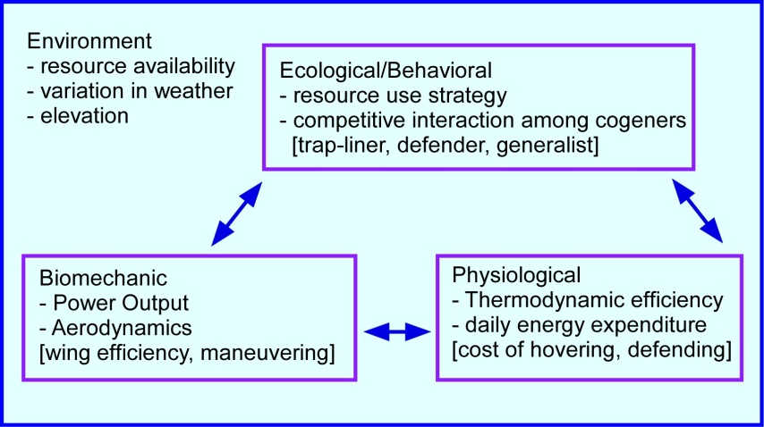
Landscape Scale

Slide 7
Landscape Scale

Slide 8
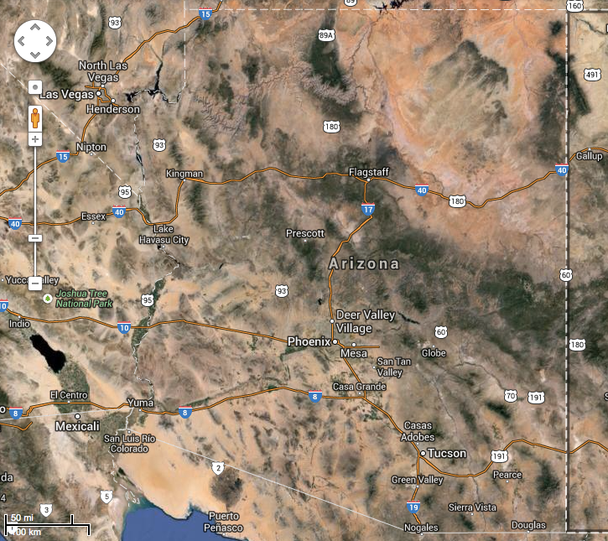
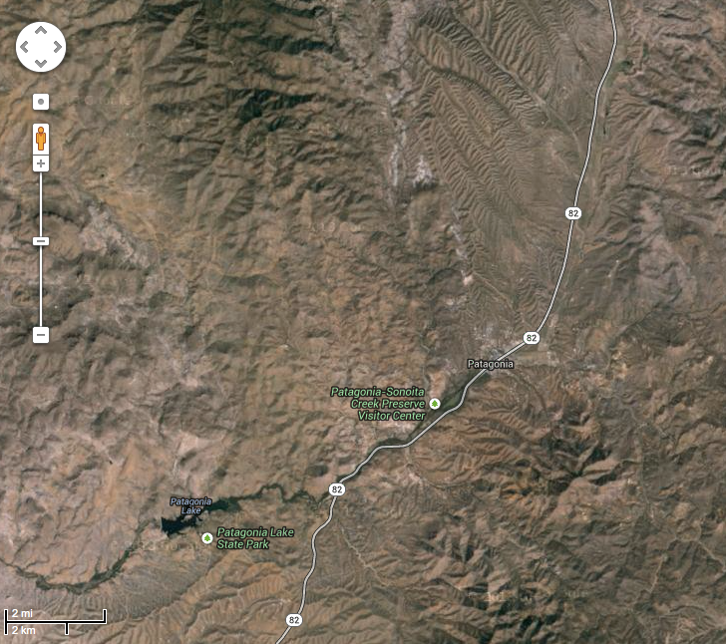
Experimental Landscapes
*
Sonoita Creek State Natural Area
Harshaw Creek

Slide 9
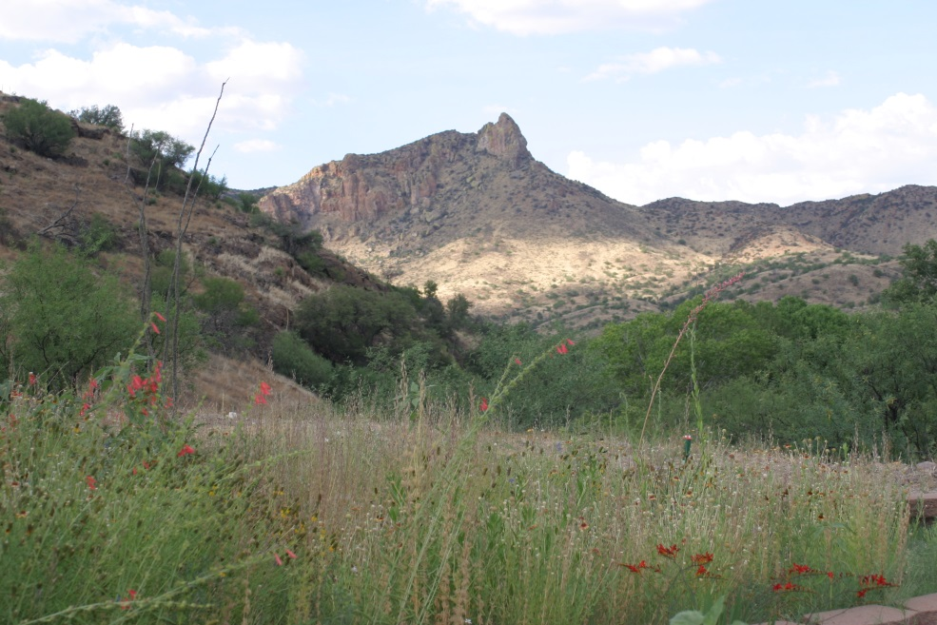
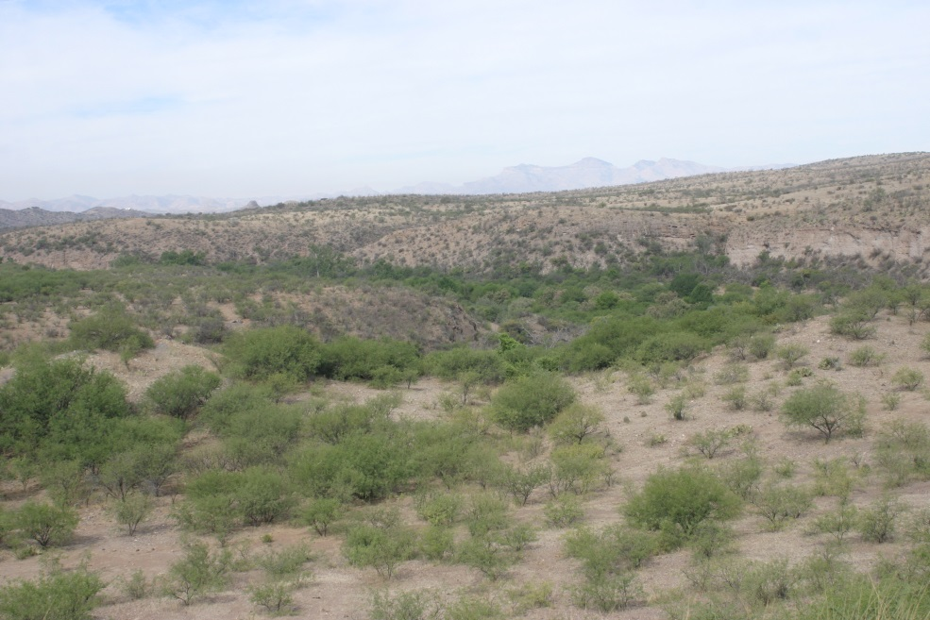
Experimental Landscapes
Harshaw Creek (HC)
Elevation: ~1300-1700 m
Sonoita Creek State Natural Area (SC)
Elevation: ~1100 m

Slide 10
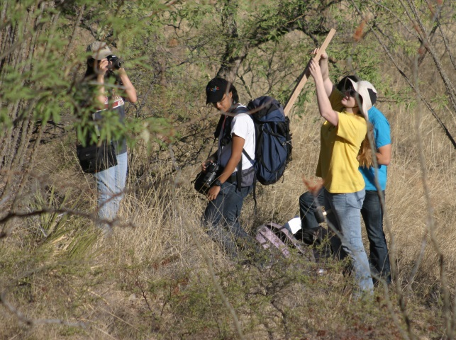

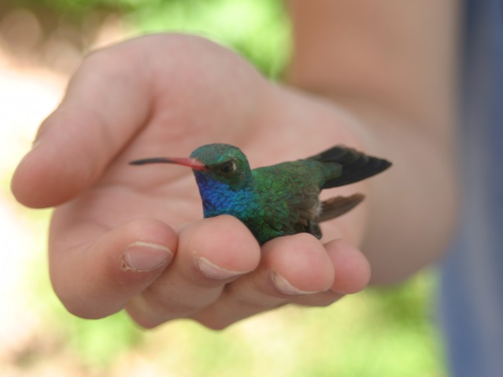
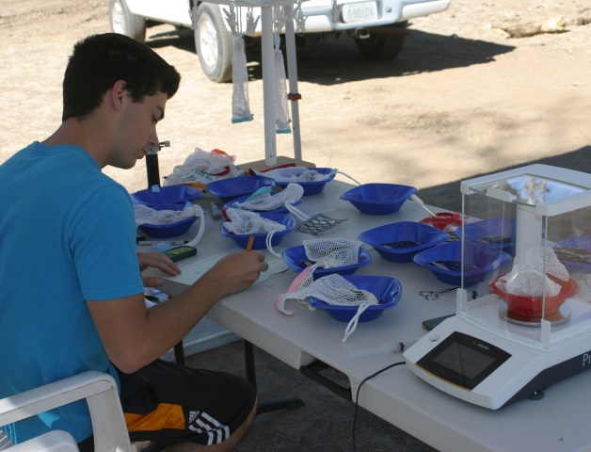
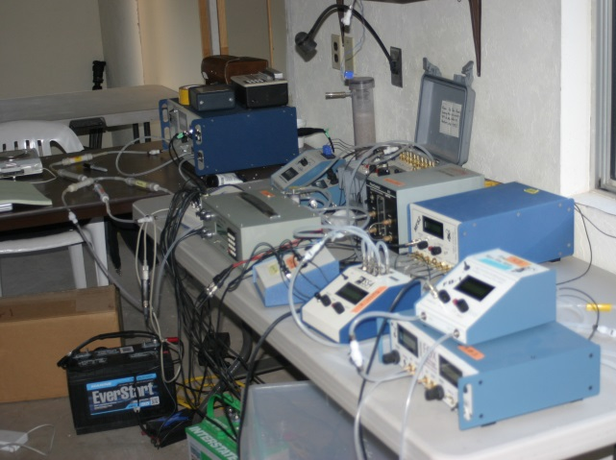
Physiological overview
Goal: To understand the physiological (energetic) tolerance of hummingbirds to temperature increases predicted to occur in their environments.
Key: Make measurements on free-living hummingbirds.
Relevance: Define variables that can be used in predictive models.
Problem: While climate change is occurring effects on hummingbirds is a future event.

Slide 11
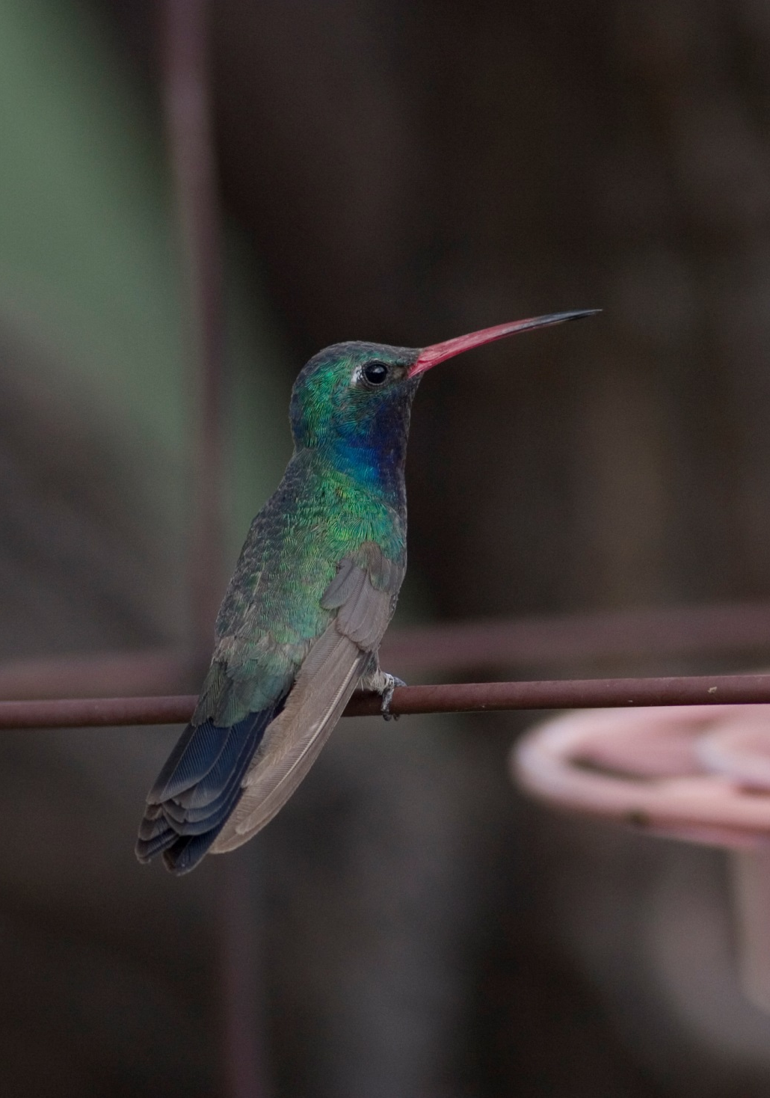
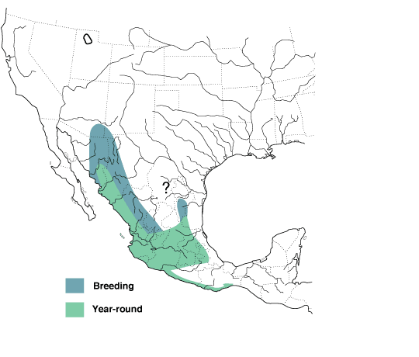
Study Species
Broad-billed Hummingbird
Cynanthus latirostris
3.0-3.4g
Migratory: breed in SE Arizona/SW New Mexico and winters in Mexico.

Slide 12
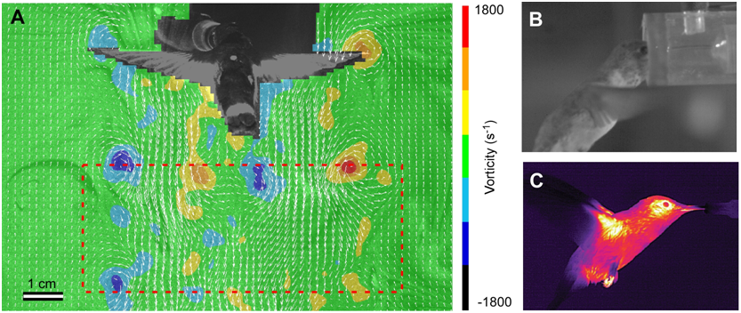

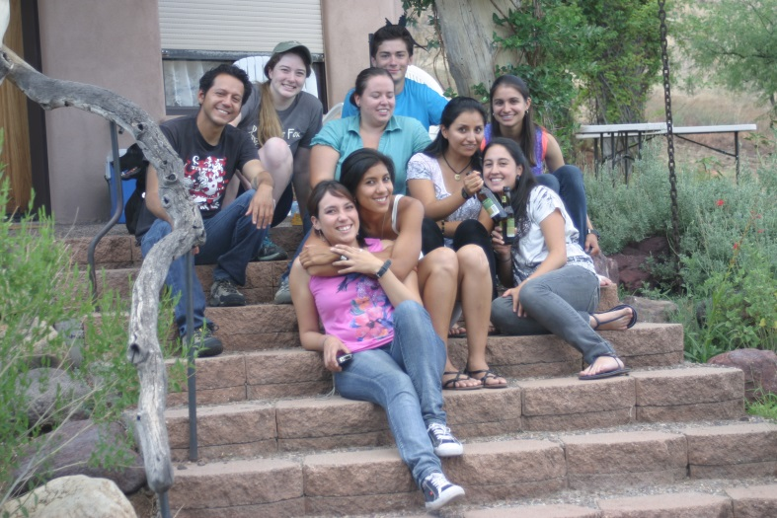
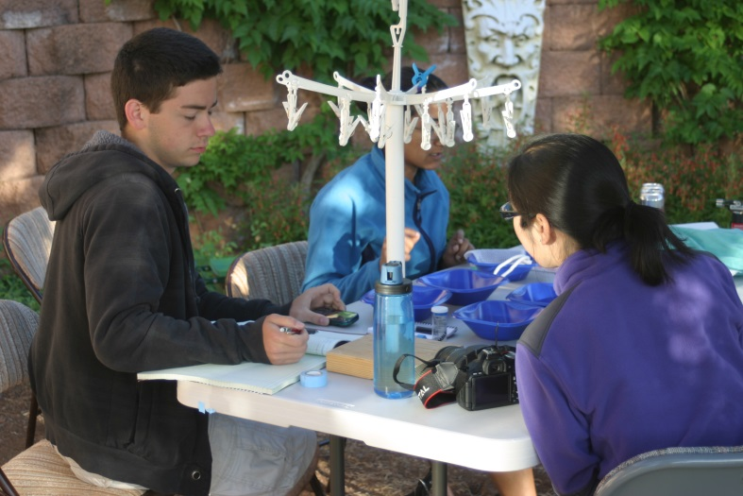
Physiological Response
Environmental Temperature (T_{a}/T_{e})
Thermal Load
(IR Imaging)
DEE/FMR (DLW)
Torpor

Slide 13

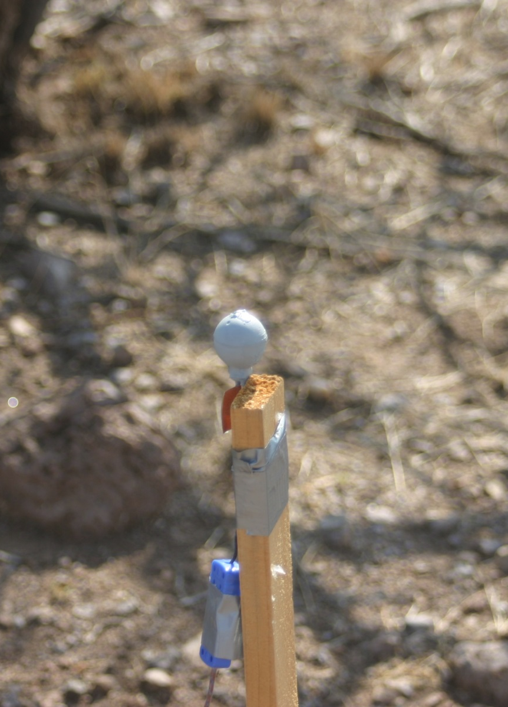
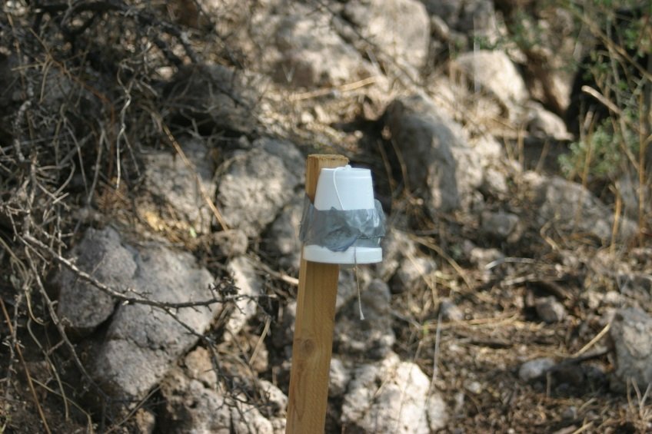
Landscape Temperature Profiles
Environmental Temperature (T_{a}/T_{e})

Slide 14
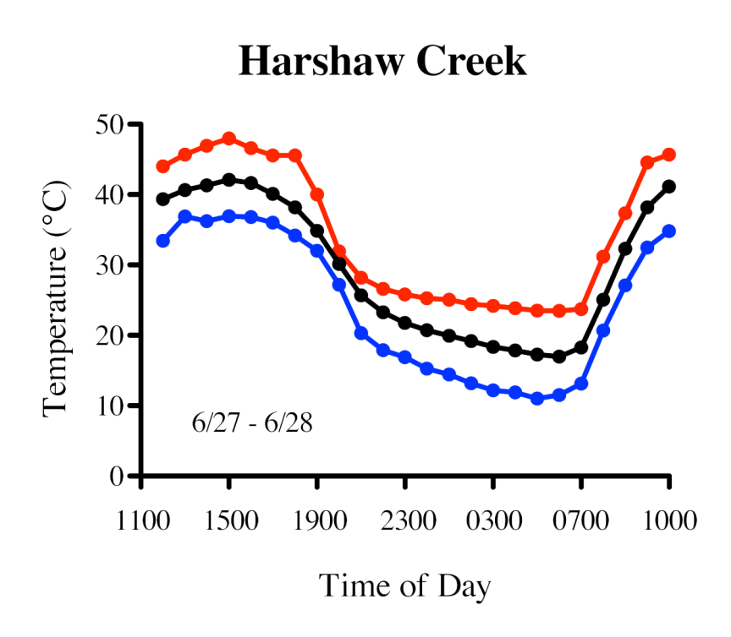
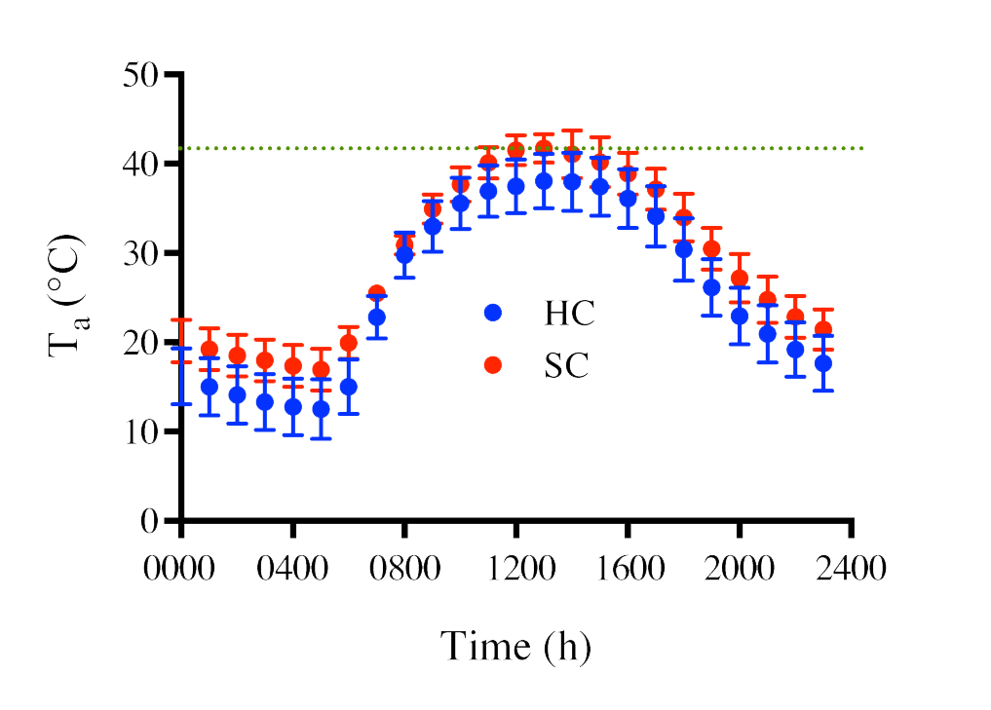
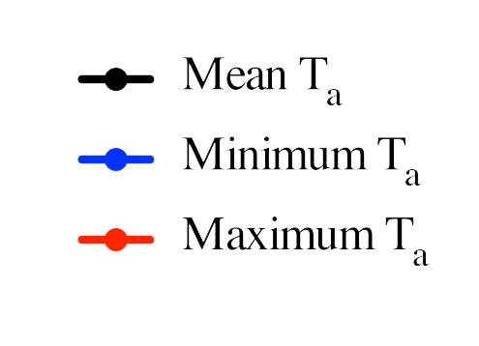
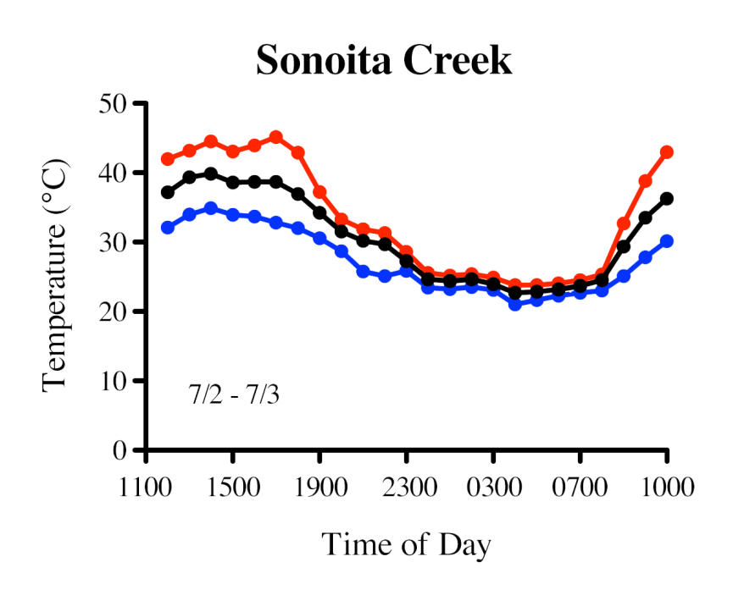
Night
Average Daily T_{a}/T_{e} Cycle Pre-Monsoon Season
Night
Ambient (T_{a}) and operative (T_{e}) temperatures at Sonoita Creek were significantly higher (~ 3-5 °C) than at Harshaw Creek.
Nighttime T_{a} was more variable at Harshaw Creek than Sonoita Creek.

Slide 15

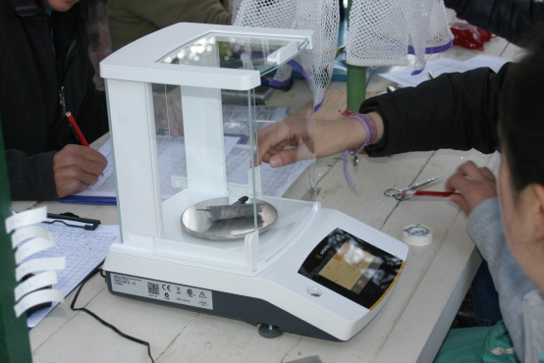


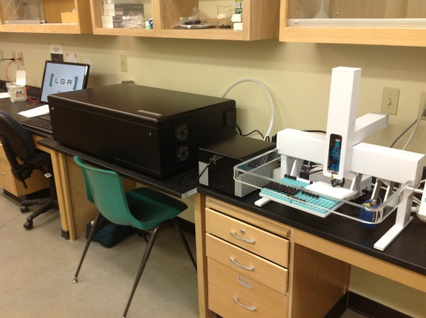
Physiological Response
Landscape Effects on Energy Costs
(Doubly labeled Water)
Environmental Temperature (T_{a}/T_{e})
DEE/FMR (DLW)

Slide 16
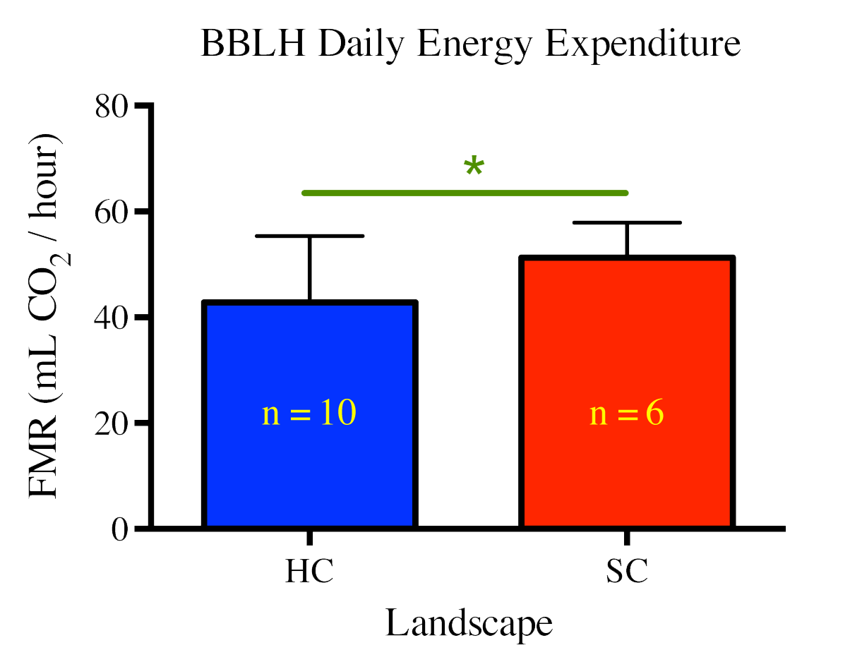
Daily energy expenditure (DEE) was significantly (16.5%) higher at SC.

Slide 17
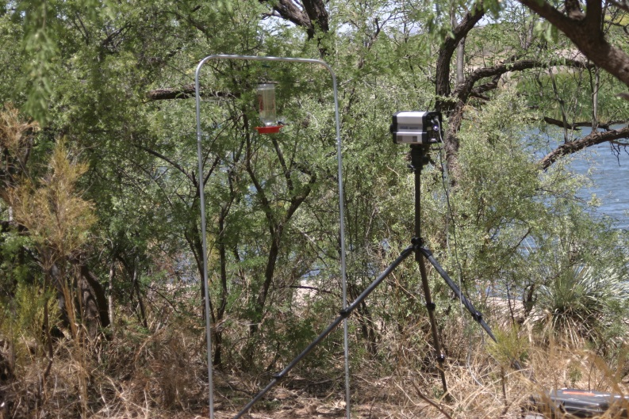
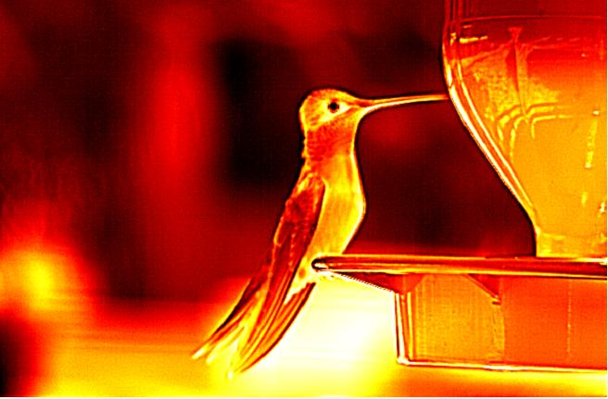
Physiological Response
Daytime Temperature Effects
Environmental Temperature (T_{a}/T_{e})
Thermal Load
(IR Imaging)
DEE/FMR (DLW)

Slide 18

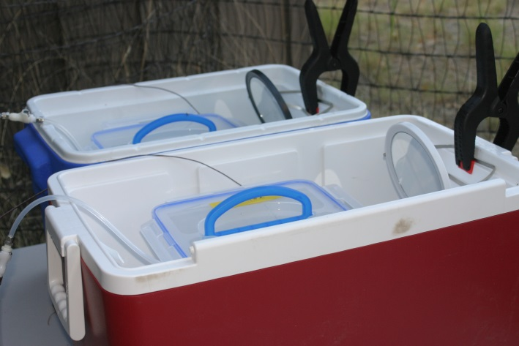
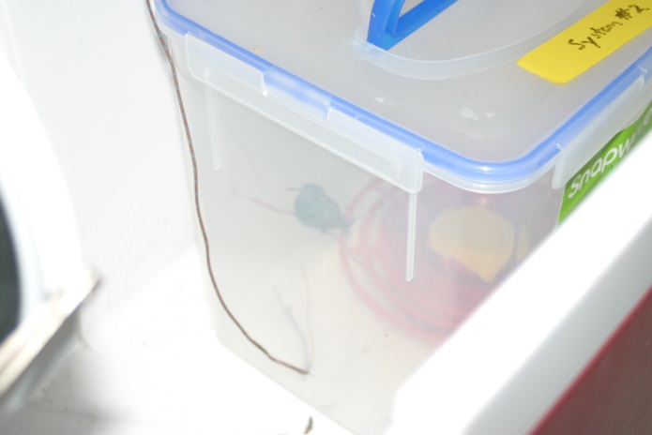
Physiological Response
Environmental Temperature (T_{a}/T_{e})
Thermal Load
(IR Imaging)
DEE/FMR (DLW)
Torpor

Slide 19
Conclusions from physiological work
Higher environmental temperature (abiotic factor) can increase broad-billed hummingbird daily energy expediture.
Broad-billed hummingbirds can likely take advantage of environmental heterogeneity (including vegetative diversity (biotic factor) to find suitable microclimates that provide refugia from thermal extremes.

Slide 20
Population survival and movement – broad spatial and temporal scale
Notes:
Our three main objectives focus on
identifying patterns (objective 1) – i.e., be determining the association between hummingbird abundance, distribution and survival and environmental variables. Specifically we think that periods of anomalously low or high moisture, productivity or temperature should result in changes in abundance, distribution and survival
Evaluating some of the biological mechanisms --- we focus on what we think are the two main mechanisms – nectar resources and physiological response; Nectar is the main food source of hb so understanding what they eat and how their food is distributed has important implications for their survival and distribution, therefore we quantify nectar availability and use across regions and time. Physiological measures provide direct information on hummingbird health and their ability to maintain an energy balance in different environmental (and nectar) conditions.
Finally we will integrate these data into statistical and physiological models.

Slide 21
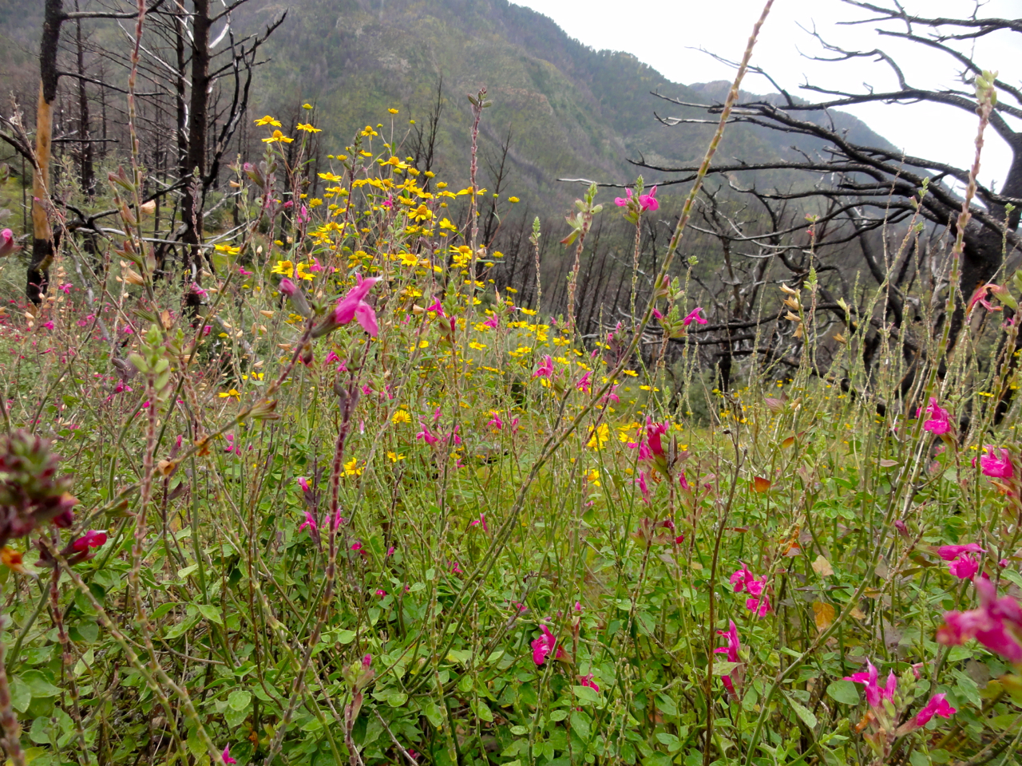
What drives migration?

Slide 22
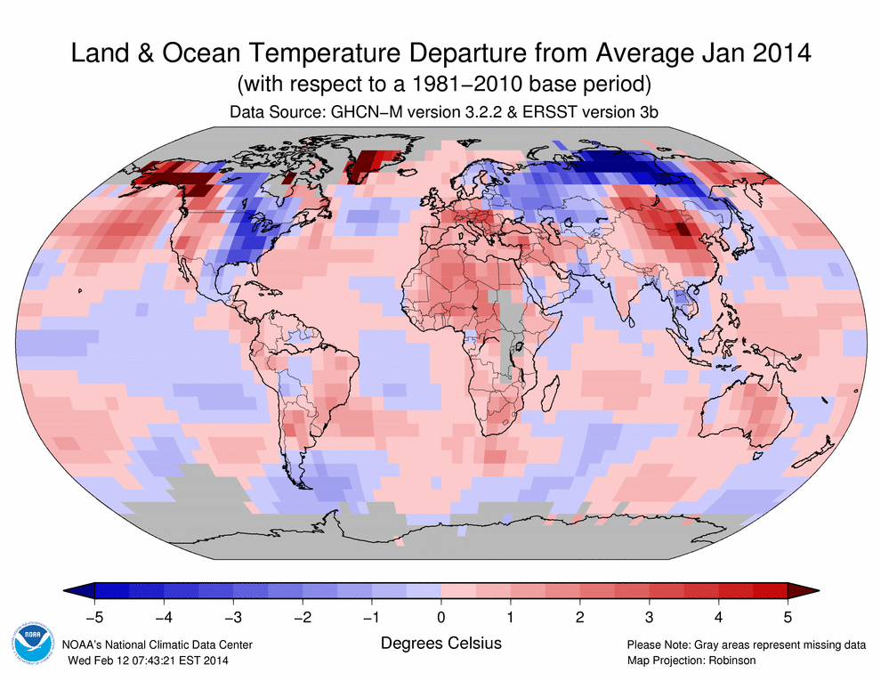
Notes:
Jan 2014 was warmest since 2007.
Migrating species experience temperatures at different locations throughout the year.
And they depend on access to appropriate environments and resources for energy to migrate, breed, and survive.
So we are especially concerned with what drives migration across seasons, years, and the variation in migration route and timing.

Slide 23
What drives migration?
How are seasons different?

Slide 24
What drives migration?
How are seasons different?
How much do routes vary from year-to-year?

Slide 25
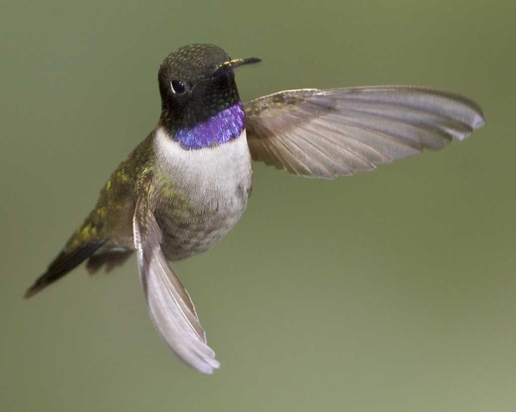
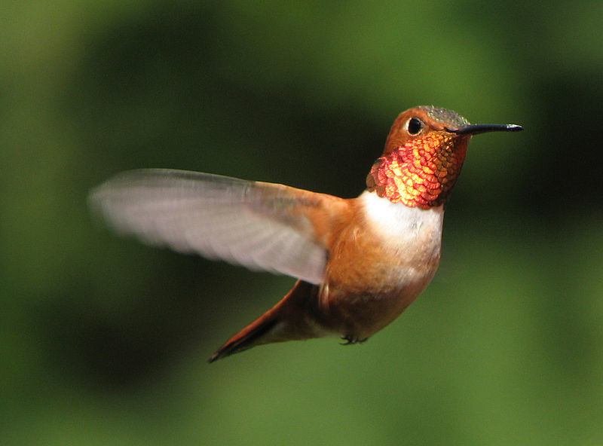
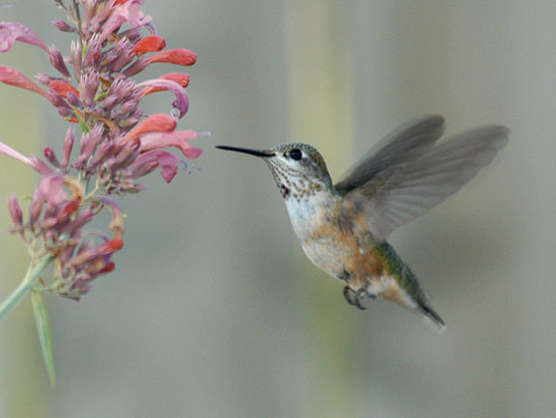
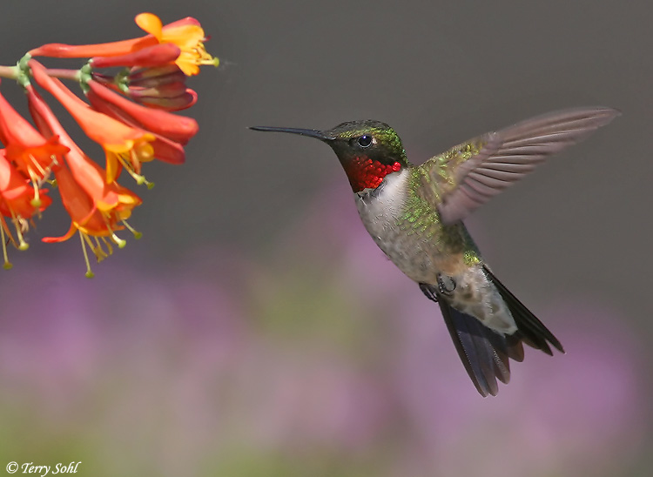
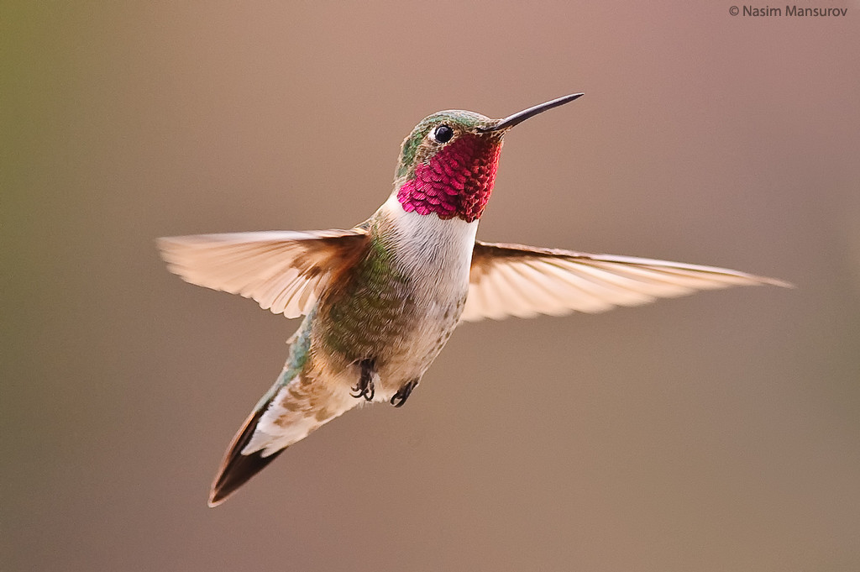
Latitudinal Migrants
Black-chinned hummingbird
Rufous hummingbird
Calliope hummingbird
Broad-tailed hummingbird
Ruby-throated hummingbird
birds.audubon.org
Photo: Ryan Bushby
Photo: Bill Schmoker
Photo: Terry Sohl
Photo: Nasim Mansurov
Notes:
Is the eastern species expected to display different patterns?
How might we include the partially migratory species?

Slide 26
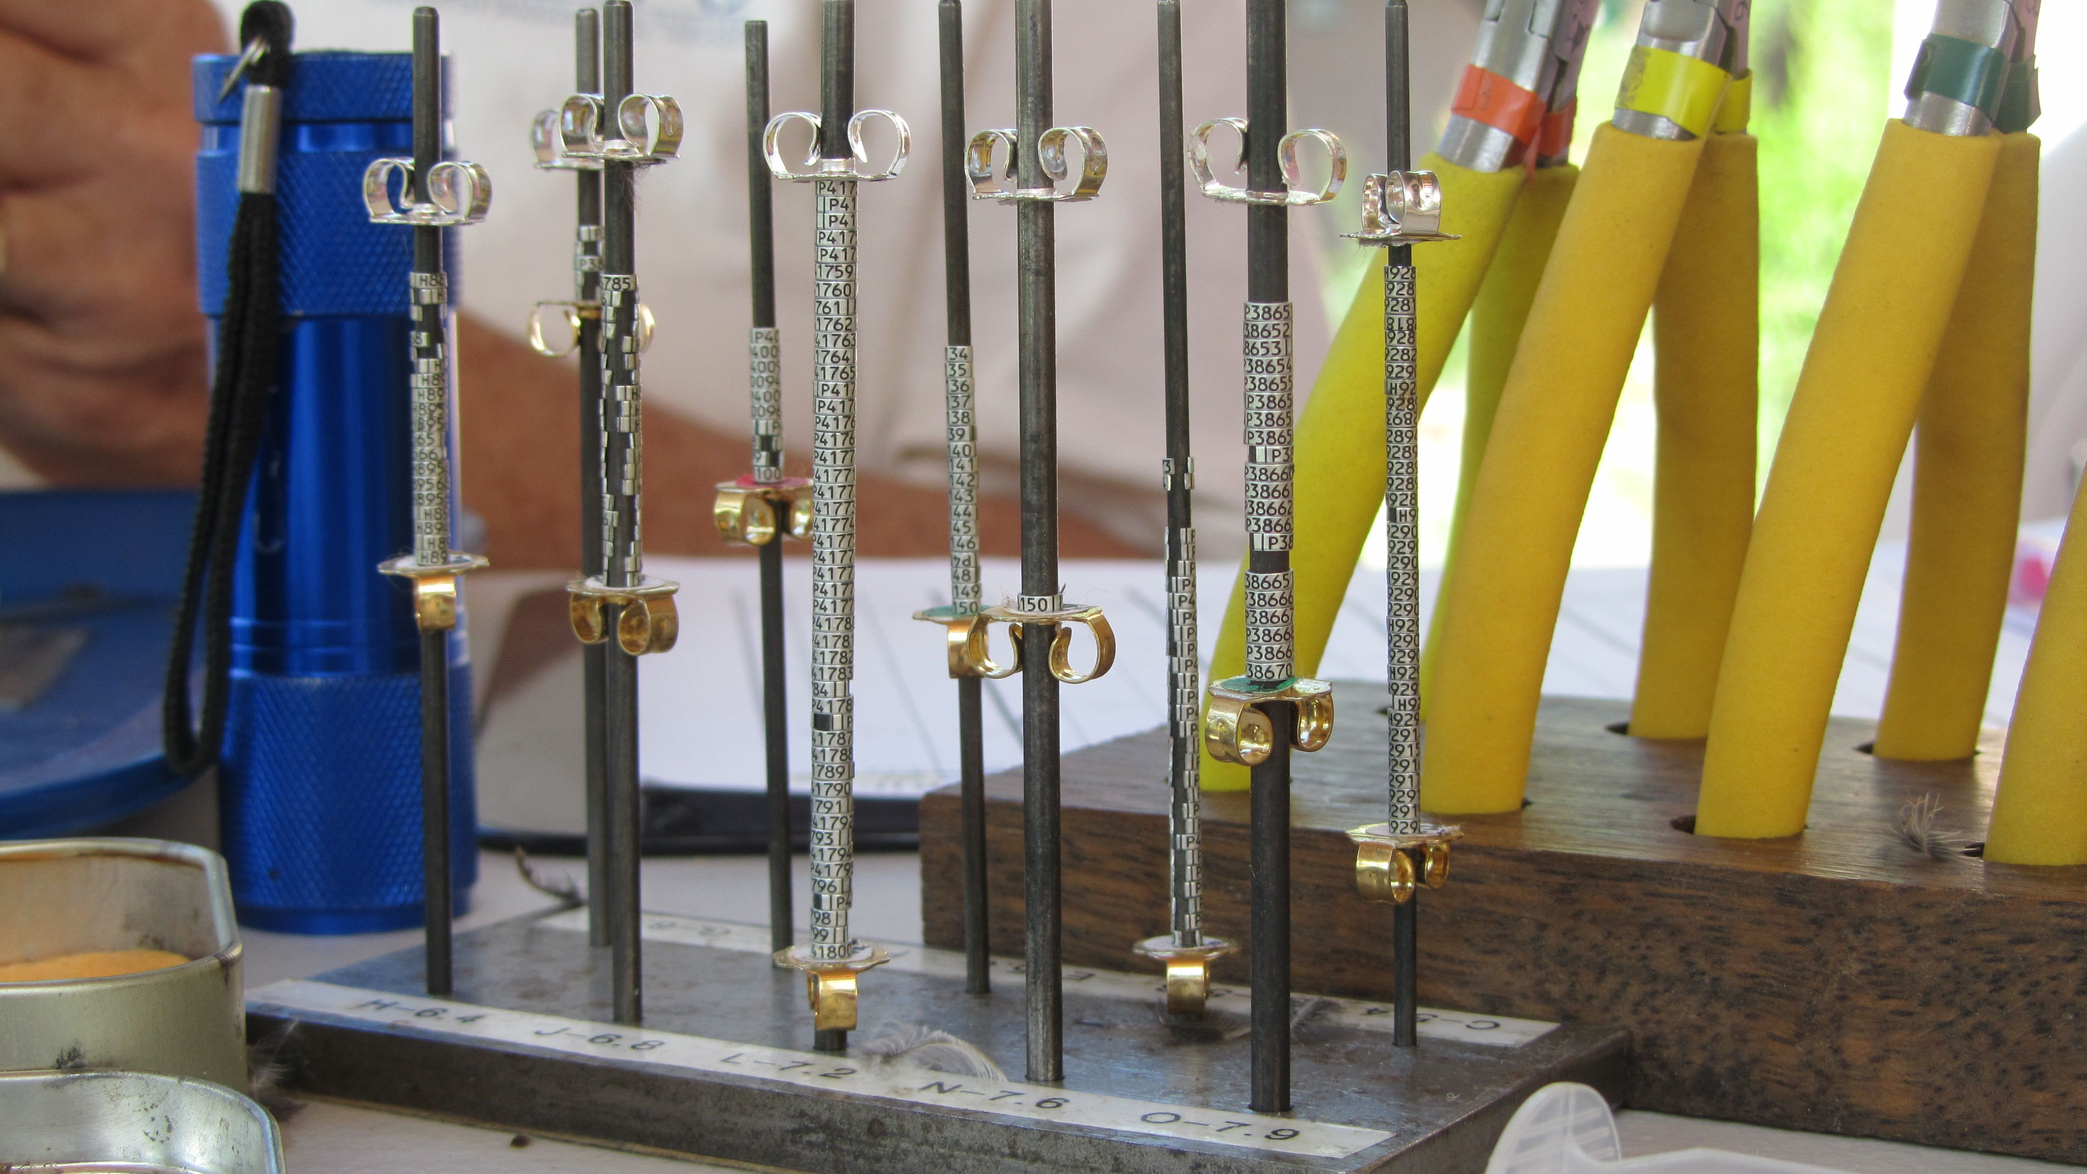
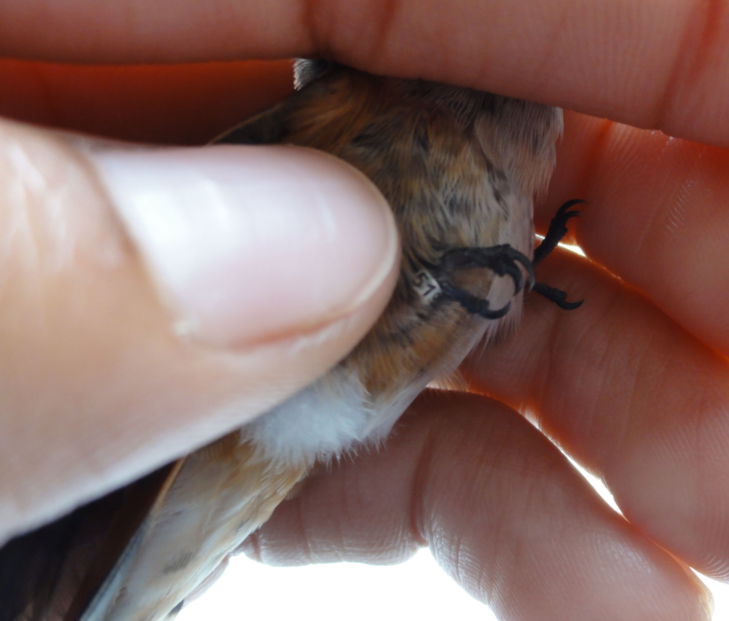
Bird Banding Data

Slide 27
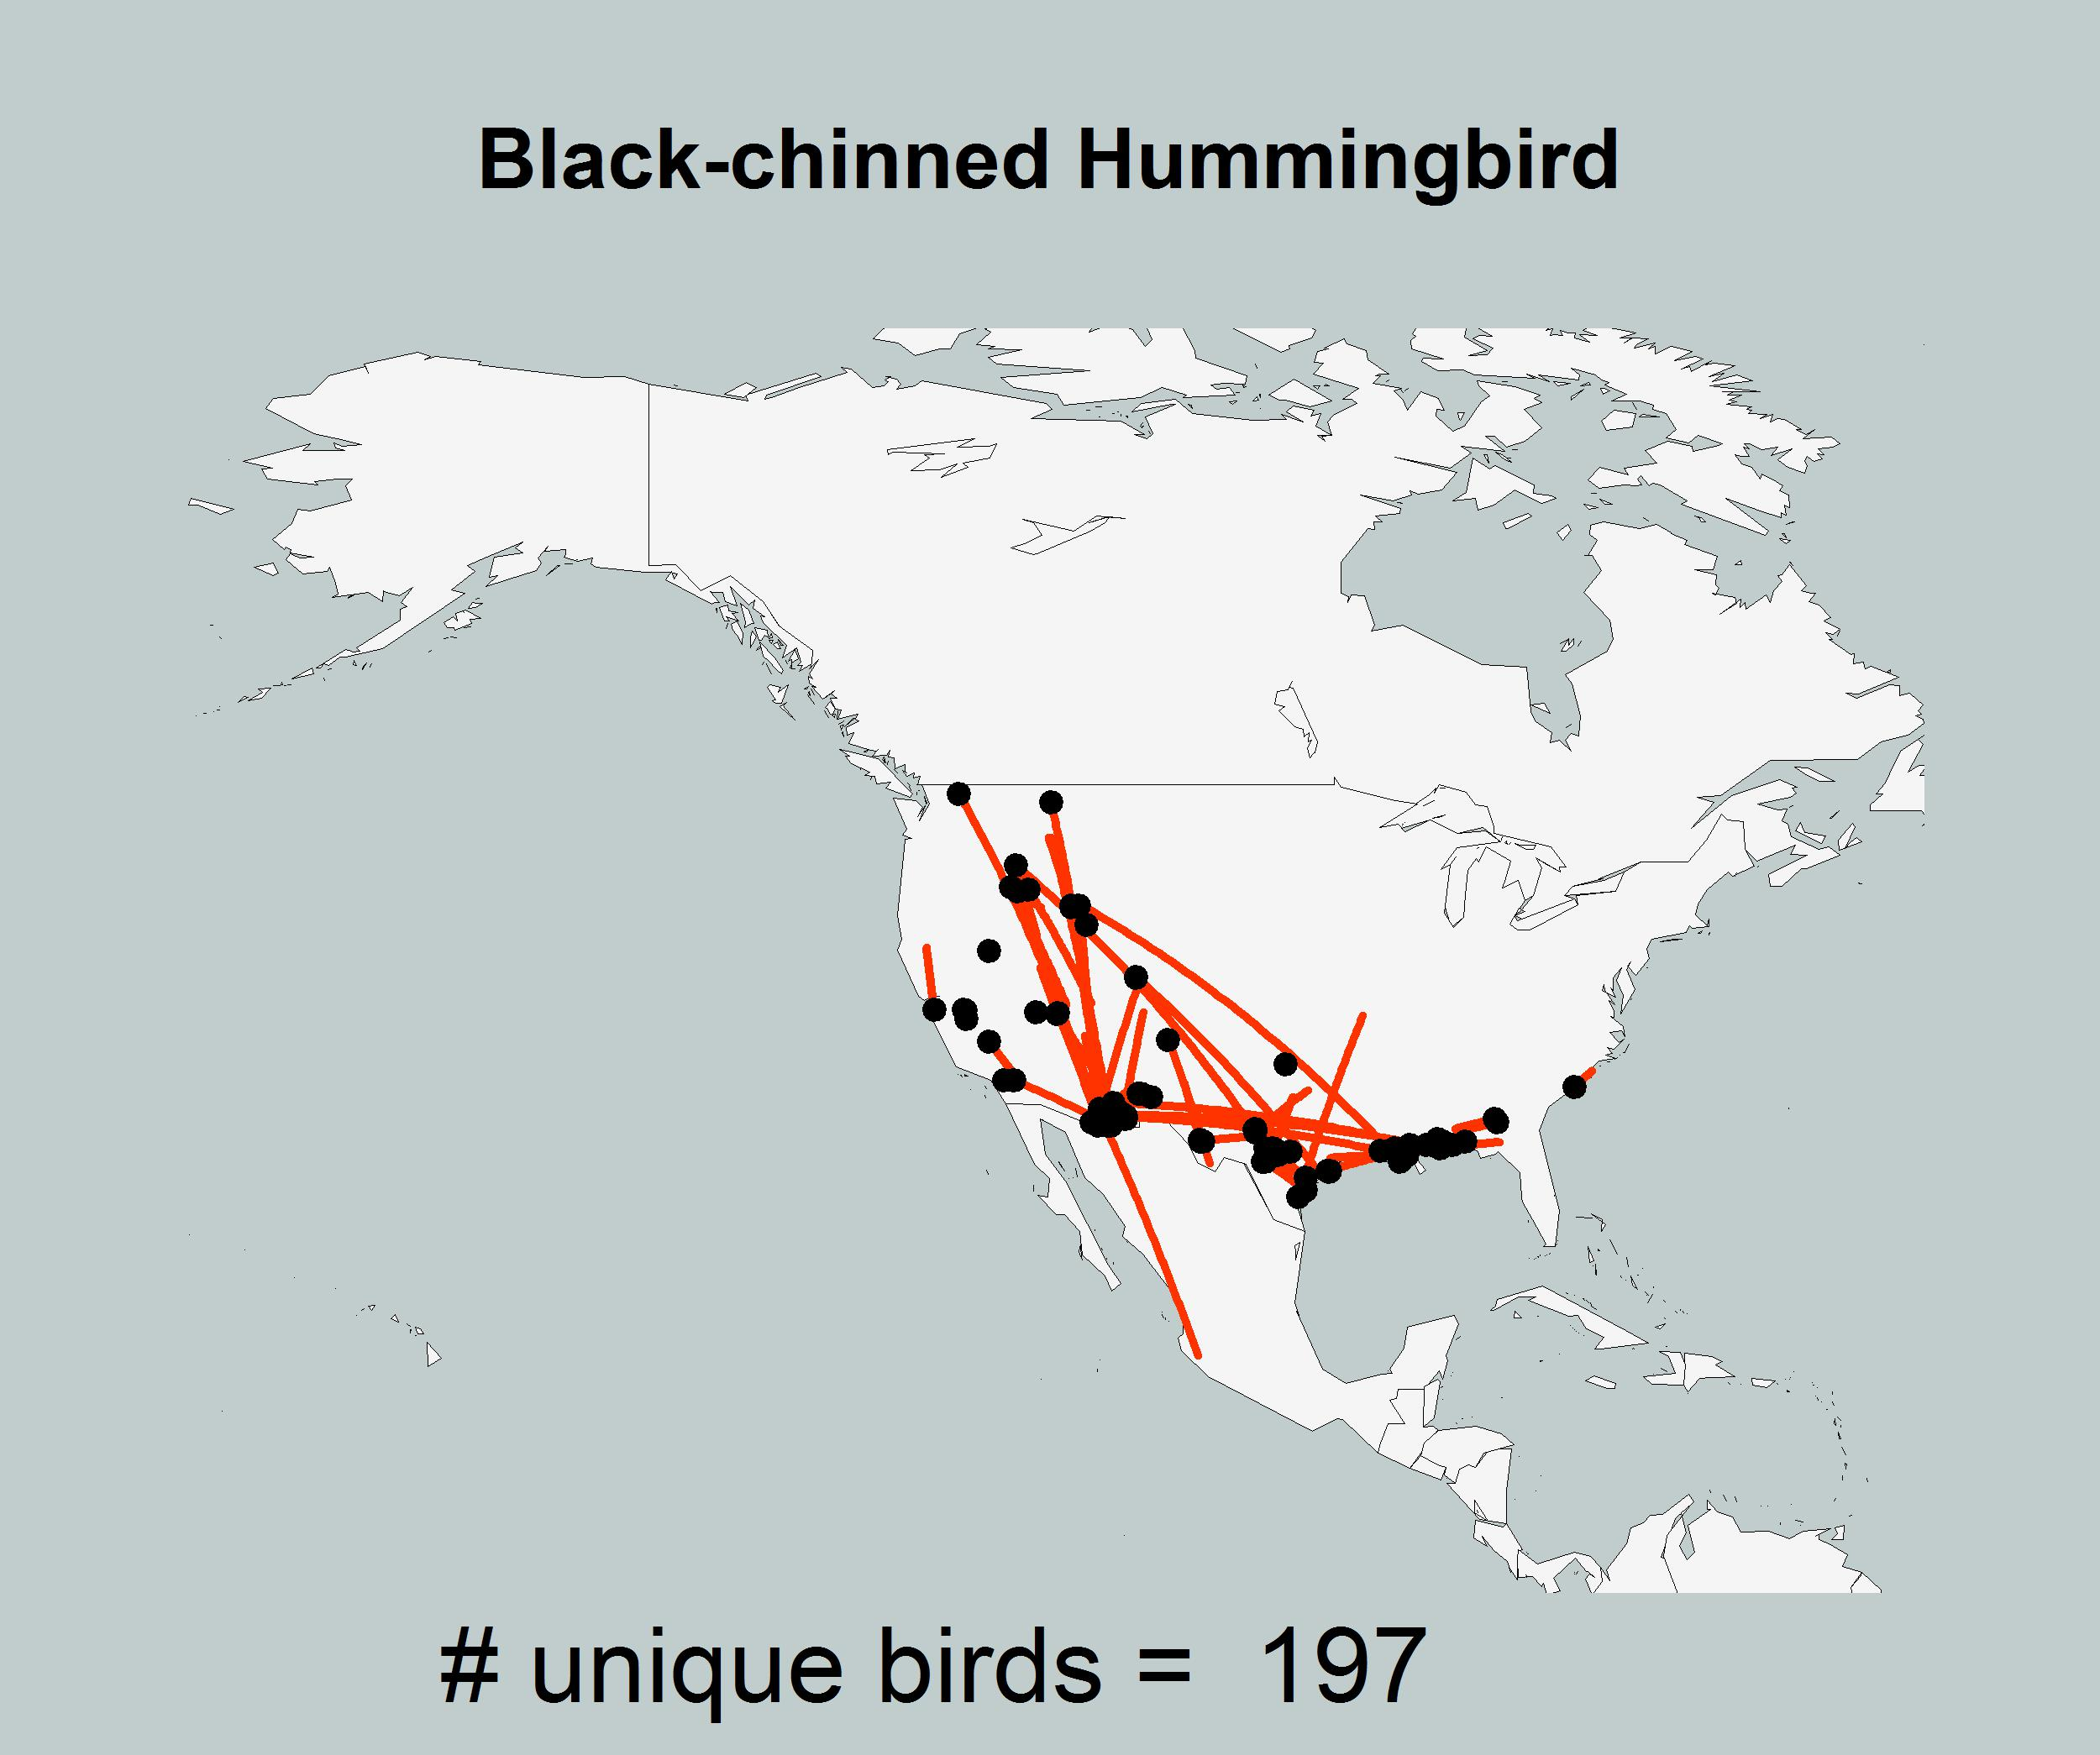

Marisa Lim, Bird Banding Lab foreign recapture data
Notes:
Marisa has been working on foreign recapture data for migratory species, but even with data points going back to 1930s, there is frustratingly little data and few recaptures.

Slide 28
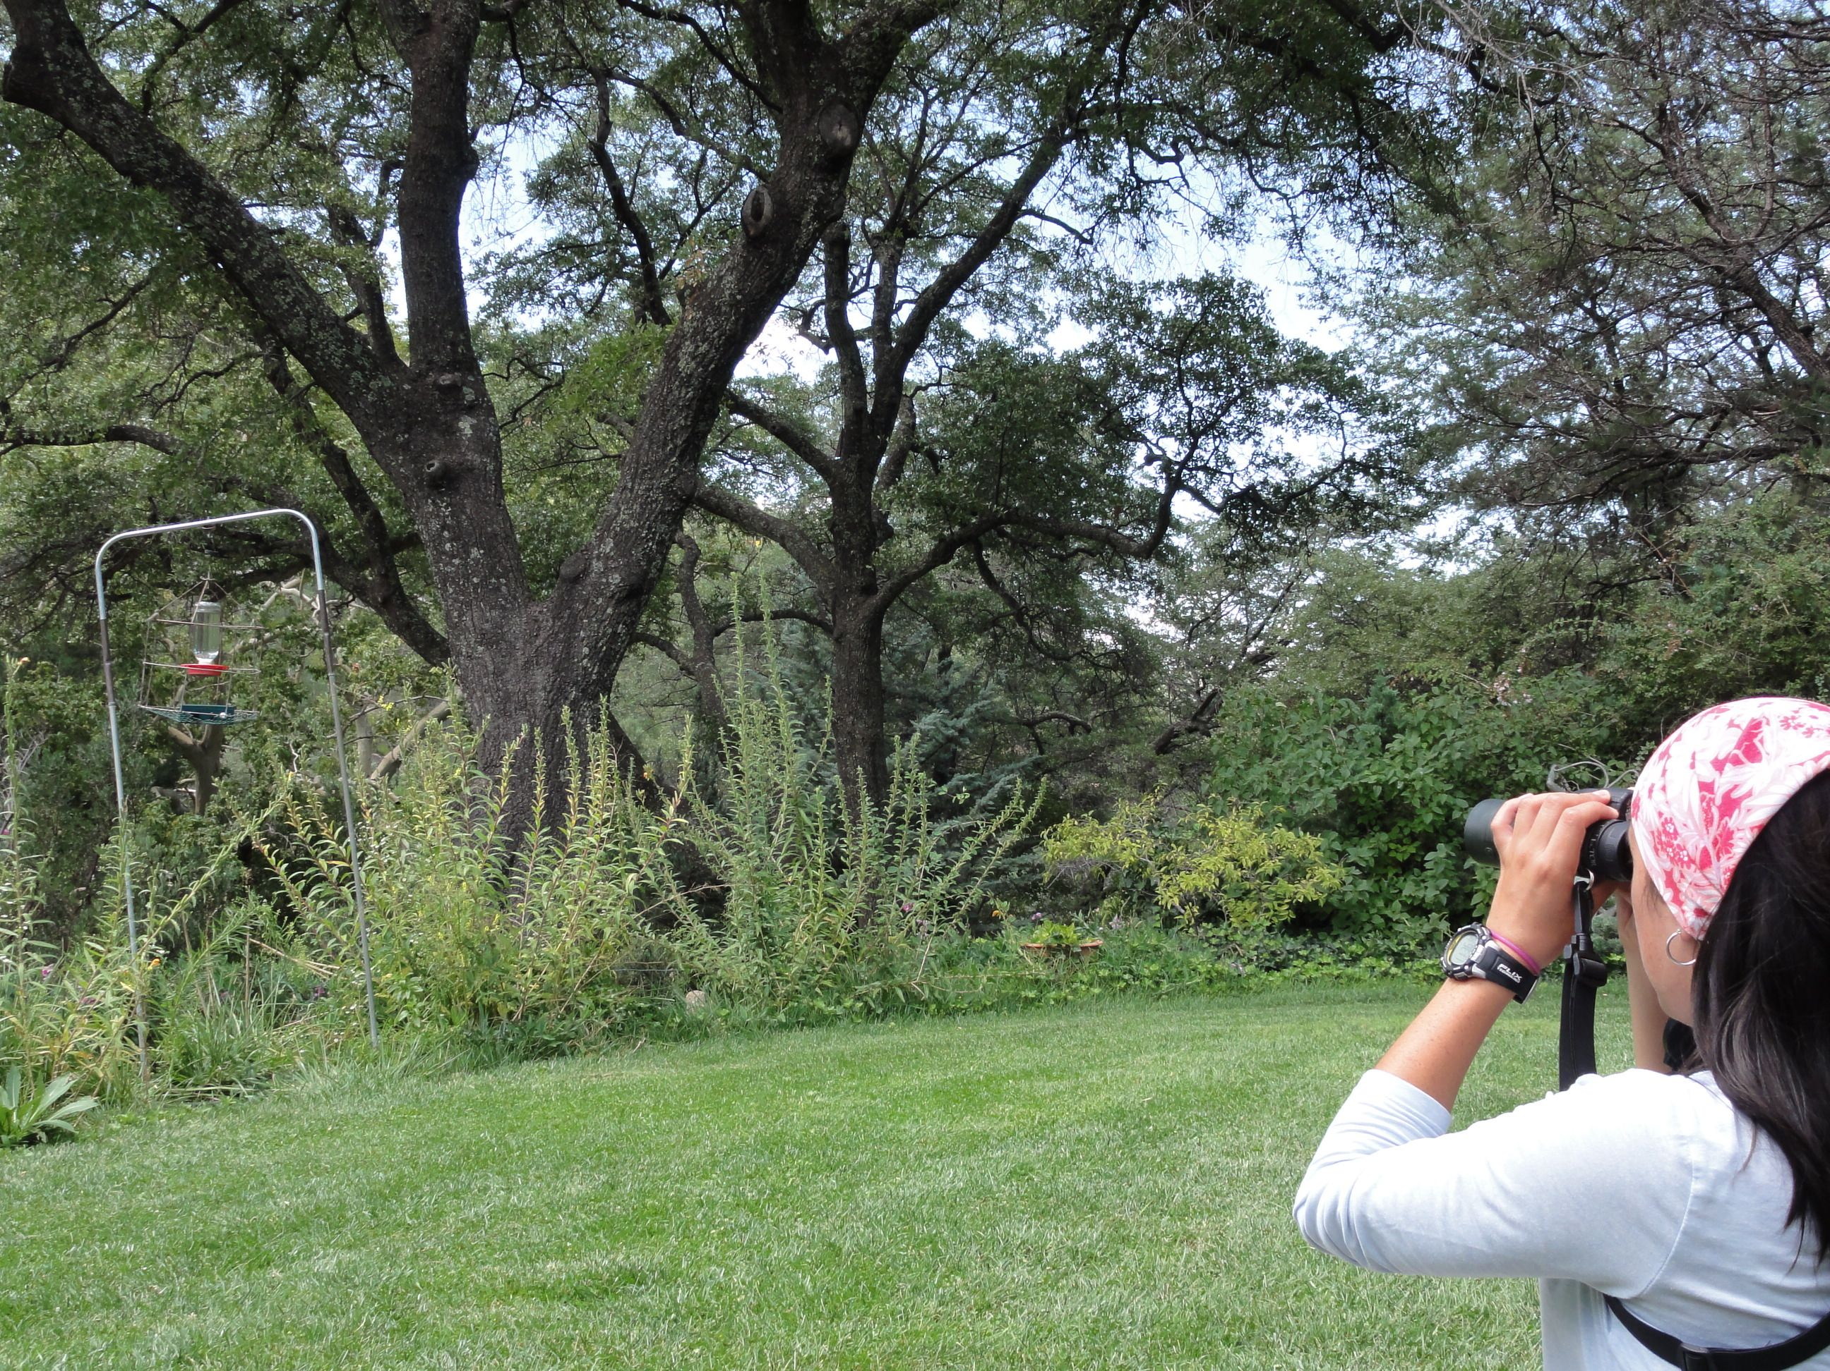
eBird
Harness power of bird watchers to track seasonal movement of species
Notes:
In particular, hummingbirds are difficult to track individually.
There are few foreign recaptures.
Too small to attach satellite or GPS tags to.
Of particular interest to a lot of people, so there are a lot of observations!

Slide 29
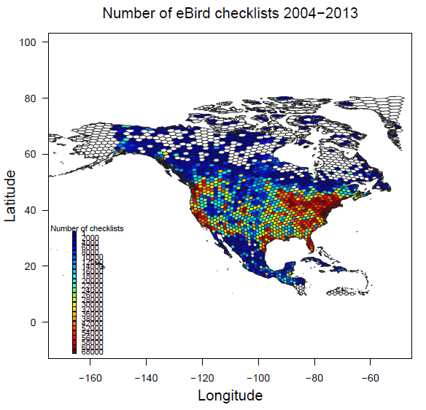
Notes:
Through citizen scientists and dedicated birdwatchers, eBird has good coverage over most of North America. This is the total number of eBird checklists submitted in 2004-2013.
eBird has > 150 Million observations and receives 300-400K checklists per month!

Slide 30
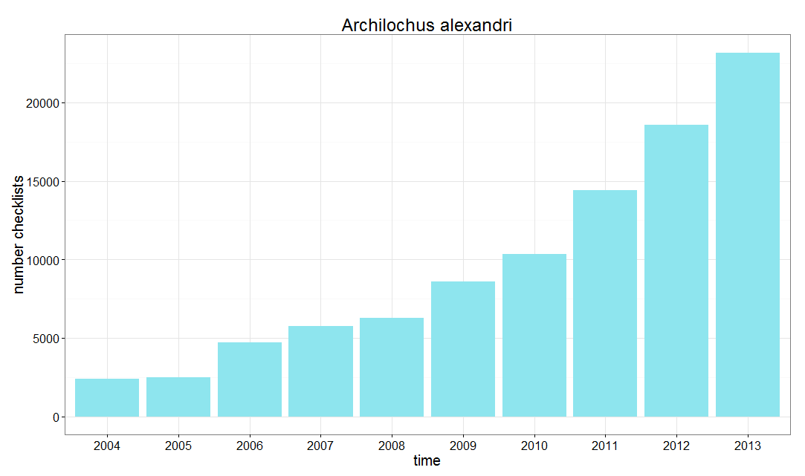
Archilochus alexandri
birds.audubon.org
Notes:
eBird submissions continue to increase. Because of this, we use data after 2007.
This is in line with the rationale other projects done by the Cornell Lab of Ornithology.

Slide 31
Archilochus alexandri
birds.audubon.org
Notes:
eBird submissions continue to increase. Because of this, we use data after 2007.
This is in line with the rationale other projects done by the Cornell Lab of Ornithology.

Slide 32
Summarizing migration route
1. Population-level summary of where birds are located and when movement occurs
2. Evaluate seasonal and annual variation in route and timing
Notes:
We use a centroid approach, which has been used in other papers using eBird data (see La Sorte et al. 2013)

Slide 33

2008
Photo: Ryan Bushby
Notes:
All observations for rufous

Slide 34

2009
Photo: Ryan Bushby
Notes:
All observations for rufous

Slide 35

2010
Photo: Ryan Bushby
Notes:
All observations for rufous

Slide 36

2011
Photo: Ryan Bushby
Notes:
All observations for rufous

Slide 37

2012
Photo: Ryan Bushby
Notes:
All observations for rufous

Slide 38

2013
Photo: Ryan Bushby
Notes:
All observations for rufous

Slide 39

Elevation
Using all eBird observation data
Notes:
Rufous hummingbird, 2013 data shown as an example (lots of eastern birds biasing results. Real or sampling bias?)

Slide 40

Elevation
Using all eBird observation data
Elevation
Use western Flyway only (103rd meridian)
La Sorte et al. 2013
Notes:
Rufous hummingbird, 2013 data shown as an example (lots of eastern birds biasing results. Real or sampling bias Distinct migration pathways?)

Slide 41
Describe
Preliminary Conclusions

Slide 42

Population-level migration speed
Species | Total Distance (km) | Spring | Fall
Black-chinned | 1721.49 | 25.63 | 30.68
Broad-tailed | 1737.89 | 37.16 | 33.50
Calliope | 3252.82 | 73.92 | 58.83
Rufous | 4102.58 | 71.49 | 42.21
Ruby-throated | 2765.86 | 28.77 | 29.51
Most species migrate faster in the spring.
Sensu La Sorte et al. 2013
Notes:
Migration speed was estimated as the median value of the top 5 migration speeds (great-circle distance traveled between daily centroid locations). Median taken to account for outliers.

Slide 43
Population-level migration timing
Species | Spring median date | Spring sd | Fall median date | Fall sd
Black-chinned | Feb 27 | 10.95 | Nov 5 | 12.08
Broad-tailed | Feb 18 | 19.83 | Nov 4 | 19.99
Calliope | Mar 28 | 21.17 | Oct 26 | 30.84
Rufous | Feb 21 | 7.71 | Dec 3 | 20.90
Ruby-throated | Mar 10 | 5.16 | Nov 12 | 10.07
Most species have more variance in the estimated date for end of fall migration.
2008:2013
Notes:
Migration speed was estimated as the median value of the top 5 migration speeds (distance traveled between daily centroid locations). Median taken to account for outliers.

Slide 44
Spatial variation across years
Species | R² Latitude | R² Longitude
Black-chinned | 0.96 | 0.98
Broad-tailed | 0.86 | 0.72
Calliope | 0.90 | 0.85
Rufous | 0.98 | 0.96
Ruby-throated | 0.96 | 0.61
Generalized additive mixed models (gamm4) with year as random effect
2008:2013

Slide 45
Spatial variation across years
Species | R² Latitude | R² Longitude
Black-chinned | 0.96 | 0.98
Broad-tailed | 0.86 | 0.72
Calliope | 0.90 | 0.85
Rufous | 0.98 | 0.96
Ruby-throated | 0.96 | 0.61
Date is a good predictor of geographic location, regardless of year.
2008:2013

Slide 46
Spatial variation across years
Species | R² Latitude | R² Longitude
Black-chinned | 0.96 | 0.98
Broad-tailed | 0.86 | 0.72
Calliope | 0.90 | 0.85
Rufous | 0.98 | 0.96
Ruby-throated | 0.96 | 0.61
Longitude is a weaker fit than latitude.
Do populations adjust their locations east-west?
2008:2013

Slide 47
Mechanism
Getting Started

Slide 48
Scaling up
Remote sensing data + movebank

Slide 49


Gridded Species Range
to Table of Unique
Pixel IDs
Annotation Input: Every pixel in species range for all dates

Slide 50
Gridded Species Range
to Table of Unique
Pixel IDs
Annotation Input: Every pixel in species range for all dates
Automated Annotation request, Env-DATA
Resources – NDVI, EVI
Physiological Demand – Temp
Opportunity - Wind

Slide 51

Environmental Annotation
Notes:
This approach is a novel use of Movebank, so it requires some adjustments in how we interface with the site. We are interested in creating spatiotemporal distribution models, so we need to acquire environmental data for points in space and time where we know a hummingbird was sighted, but we also need background locations that can serve as pseudo-absences. Movebank typically requires the user to upload their tracking data to their website and all of the annotation happens through tools available within the web interface. In this system, we use Movebank's API to generate automated requests for a grid that covers our entire study area.

Slide 52


Dates and Locations
Environmental Annotation
PostgreSQL - PostGIS
Database
Notes:
Each grid cell has a unique ID that we track through a postgreSQL/postGIS database. We have a series of scripts that generate and track the status of requests automatically, and when the annotation is available, it is automatically downloaded and inserted into the database. Within the database, we can link eBird observations with the environmental data we gathered from Movebank. Such variables include MODIS NDVI and EVI, temperature, and wind at various elevations. Our hope is to use these and other variables to better understand the drivers of migration decisions.

Slide 53



Identify and Describe Spatial Relationships
Notes:
Such variables include MODIS NDVI and EVI, temperature, and wind at various elevations. Our hope is to use these and other variables to better understand the drivers of migration decisions.

Slide 54

Photo: Ryan Bushby
Notes:
Rufous hummingbird observations from eBird correlated with NDVI
MODIS 250 m images.

Slide 55

Linking physiology with remote sensing variables

Slide 56

Linking local observations with remote sensing informed patterns

Slide 57
Integrative modeling to forecast influence of climate change
Notes:
Our three main objectives focus on
identifying patterns (objective 1) – i.e., be determining the association between hummingbird abundance, distribution and survival and environmental variables. Specifically we think that periods of anomalously low or high moisture, productivity or temperature should result in changes in abundance, distribution and survival
Evaluating some of the biological mechanisms --- we focus on what we think are the two main mechanisms – nectar resources and physiological response; Nectar is the main food source of hb so understanding what they eat and how their food is distributed has important implications for their survival and distribution, therefore we quantify nectar availability and use across regions and time. Physiological measures provide direct information on hummingbird health and their ability to maintain an energy balance in different environmental (and nectar) conditions.
Finally we will integrate these data into statistical and physiological models.

Slide 58





Undergrad research and posters, workshops, graduate training, American and Latin-American internship program

