Slide 1
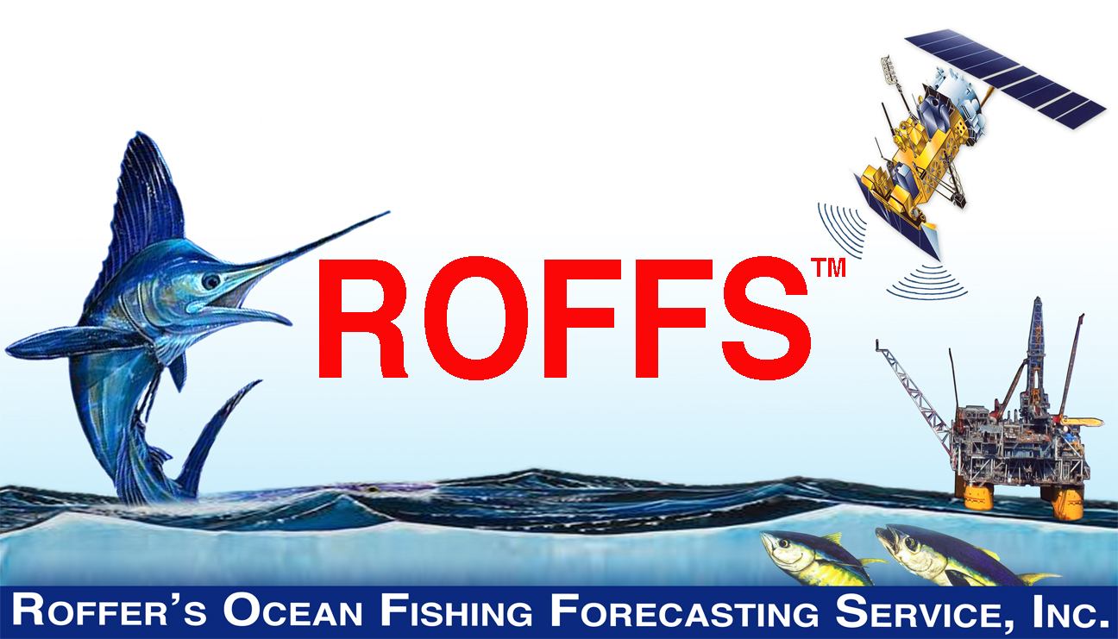

NASA Biodiversity and Ecological Forecasting Science Team Meeting
May 09, 2014
Notes:
Welcome

Slide 2



NASA PROJECT
Management And Conservation Of Atlantic Bluefin Tuna (Thunnus Thynnus) And Other Highly Migratory Fish In The Gulf Of Mexico Under IPCC Climate Change Scenarios: A Study Using Regional Climate And Habitat Models.
  PI: M. A. Roffer – ROFFS™
  Co-I: J.T. Lamkin (NOAA), F.E. Muller-Karger (USF), S-K Lee (UM CIMAS), B.A. Muhling (UM CIMAS), G.J. Goni (NOAA)
  Other Investigator: Y. Liu (UM CIMAS), M.A. Upton, (ROFFS™) & G. Gawlikowski (ROFFS™), G.W. Ingram (NOAA)
  Other collaborators added: W. Nero (NOAA), J. Franks (USM), J. Quattro (USC)
    D. Enfield (NOAA), John F. Walter (NOAA), A. Bakun (UM RSMAS), K. Ramirez (INAPESCA), F. Alemany (IEO), A. Garcia (IEO) . . and growing
  Start date September 06, 2011 – End date September 05, 2015
Multi-sector and multi-disciplinary partnership,
including government fishery scientists and managers
Notes:
Intergovernmental panel on Climate Change

Slide 3
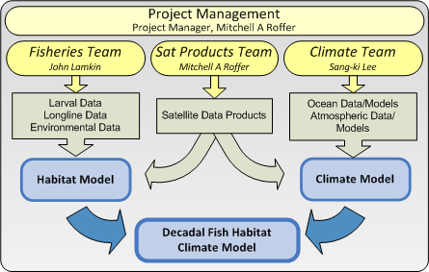
Core Team Approach

Slide 4
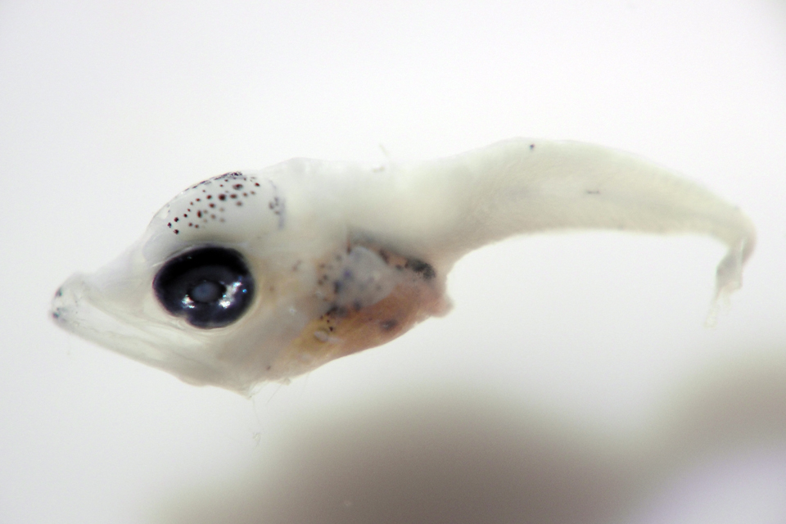
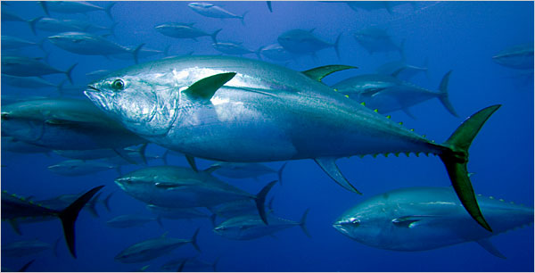
NASA Applications Research
Focuses on enhancing the management of Atlantic bluefin tuna (Thunnus thynnus) and other highly migratory tunas and billfishes in the Gulf of Mexico and surrounding waters considering climate change.
  Using data with differing scales.
    MM to M to KM to 1000 KM scales
    Hourly to daily to 100 year time scales
  Transition the routine use of satellite data

Slide 5
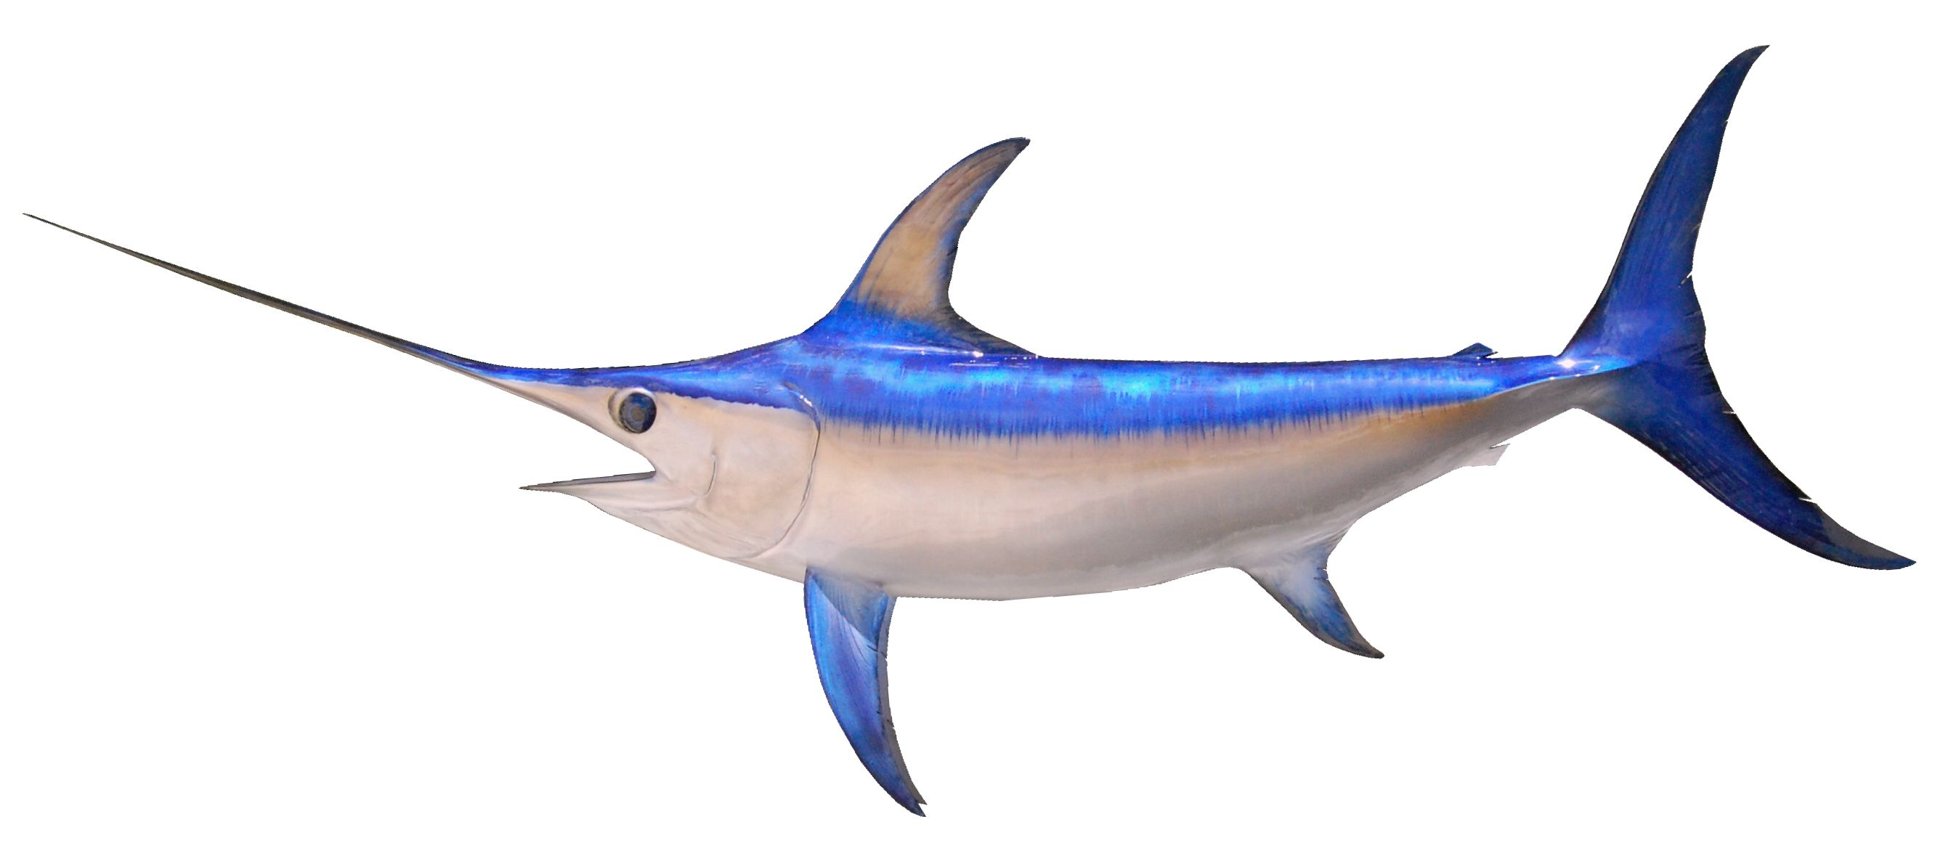
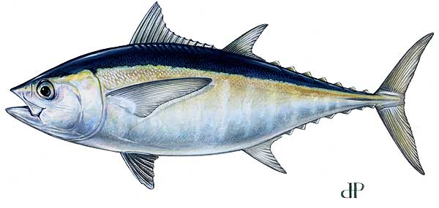
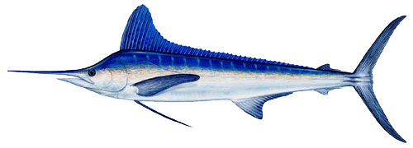
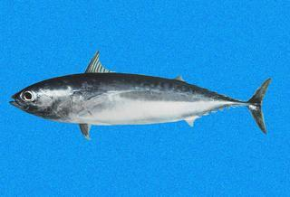
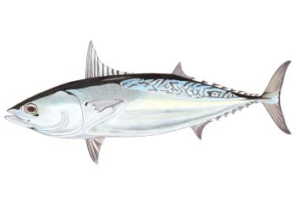
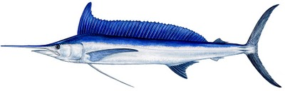
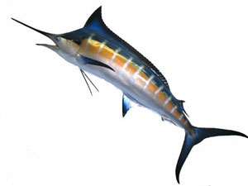


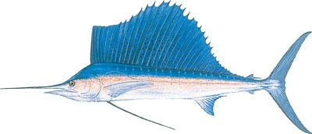
Charismatic Mega Fauna
Atlantic bluefin tuna (Thunnus thynnus)
Atlantic blue marlin (Makaira nigricans),
Atlantic sailfish (Istiophorus platypterus),
Atlantic white marlin (Tetrapturus albidus),
Blackfin tuna (Thunnus atlanticus),
Bullet mackerel (Auxis rochei),
Frigate mackerel (Auxis thazzard),
Longbill spearfish (Tetrapturus pfluegeri),
Swordfish (Xiphias gladius),
Yellowfin tuna (Thunnus albacares)
Skipjack tuna (Katsuwonis pelamis)

Slide 6

Significance to Fisheries Management
  Bluefin tuna and other highly migratory fish species that use the Gulf of Mexico as their essential habitat are still largely managed under the assumption that ecosystem parameters do not change over time.
  But we are making progress on changing this!
The research is significantly contributing already in understanding some functional links between climate variability, oceanographic processes, and recruitment at oceanic, regional, local, and smaller scales.
3D T°, S%, O₂, currents, chl., predator - prey

Slide 7

Importance
The expected outcomes of the research include essential enhancements to NOAA fisheries management applications:
  1: Improved fisheries assessments;
  a. Catchability (availability and vulnerability)
  2: Adaptive harvest management strategies;
  3: A better understanding of possible scenarios for future stock rebuilding under climate change.

Slide 8

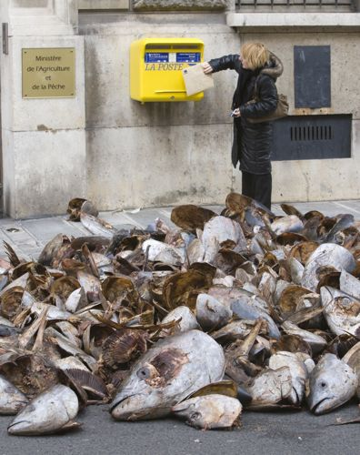
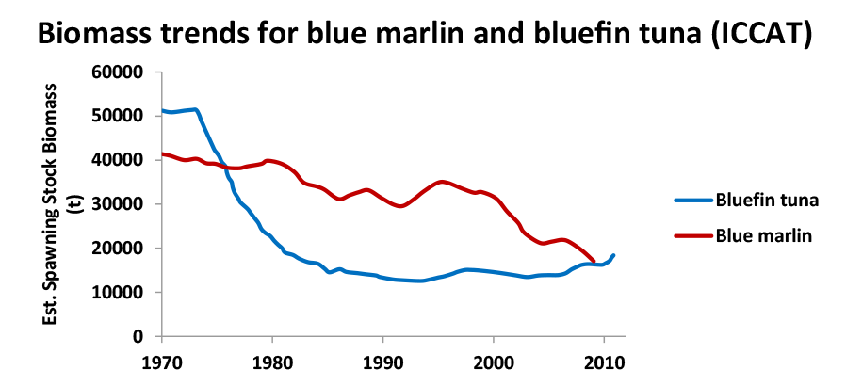
Increased Importance
Managed internationally International Commission for the Conservation of Atlantic Tunas
Convention on International Trade In Endangered Species (CITES) continues threat for an Endangered Species Listing: a“CITES Listing” for Atlantic bluefin tuna and Atlantic marlins
Effects of the Deepwater Horizon oil spill and ?
Effects of climate change

Slide 9
Specific NOAA NMFS Management Needs In A Varying Environment
  Reproduction and recruitment processes.
    Improved larval indices.
    Improved adult spawning stock size estimates.
    Location & timing spawning grounds.
      Will it change over time?
  Changes in distribution.
  Varying vulnerability and availability.
  Varying fishing and natural mortality.
  Studying entire life cycle which is complicated by age/size/sex specific physiological requirements – behavior.
  Problem of lumping catch data.

Slide 10
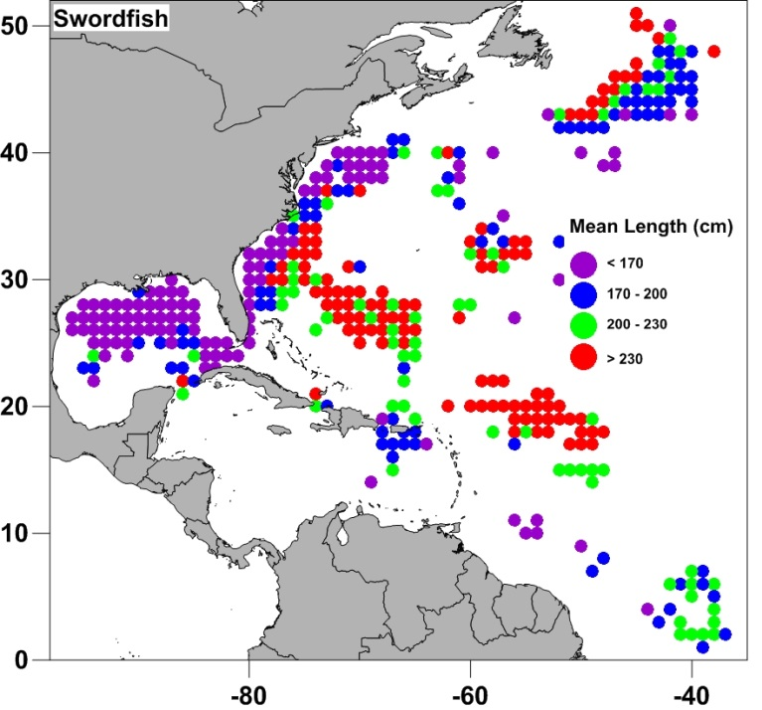
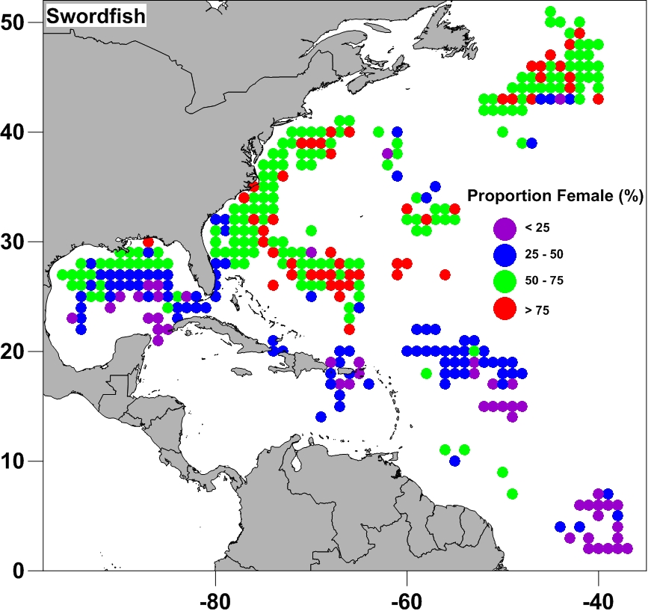
Habitat modeling: Size & Sex Considerations
Swordfish occupy different regions and habitats depending on their life stage
Males and females grow at different rates, and occur in different places
Mean Fish Length
Proportion of Females

Slide 11
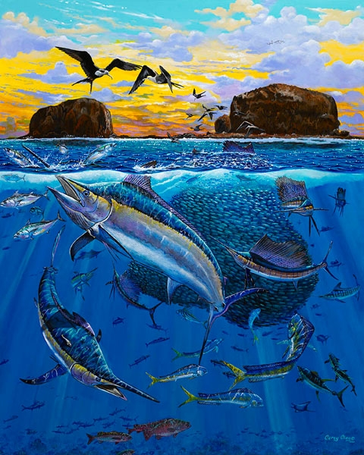
Always Thinking About:
Fisheries Managers & Possible Effects of Climate
Changes in lengths of spawning seasons (dates of spawning commencement and end)
Changes in spatial and temporal extent of 3D habitat of adult fish.
Implications for potential effects on recruitment, species – species guilds and sustainability of stocks.

Slide 12

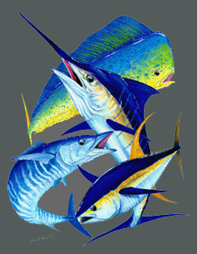

Results
Will enhance our nation's input to the International Commission for the Conservation of Atlantic Tunas (ICCAT) the international governing organization for tunas and billfishes.
The approach developed here can then be applied by others (e.g. NOAA, fish management councils) to assess options for other important fisheries, as well as, to the management of other resources including marine protected areas*.
*1) Already happening: IOOS SECOORA Project
South Atlantic Fisheries Management Council with reef species (triggerfish, porgy, snapper, sea bass).
2) Spanish colleagues
3) Others: e.g. HI Ocean Sciences Meeting 2014

Slide 13
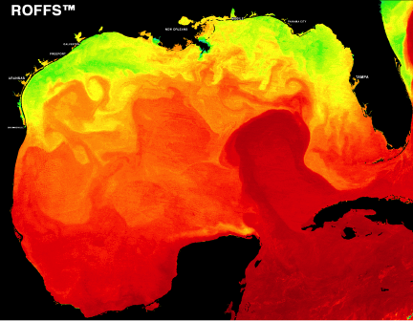
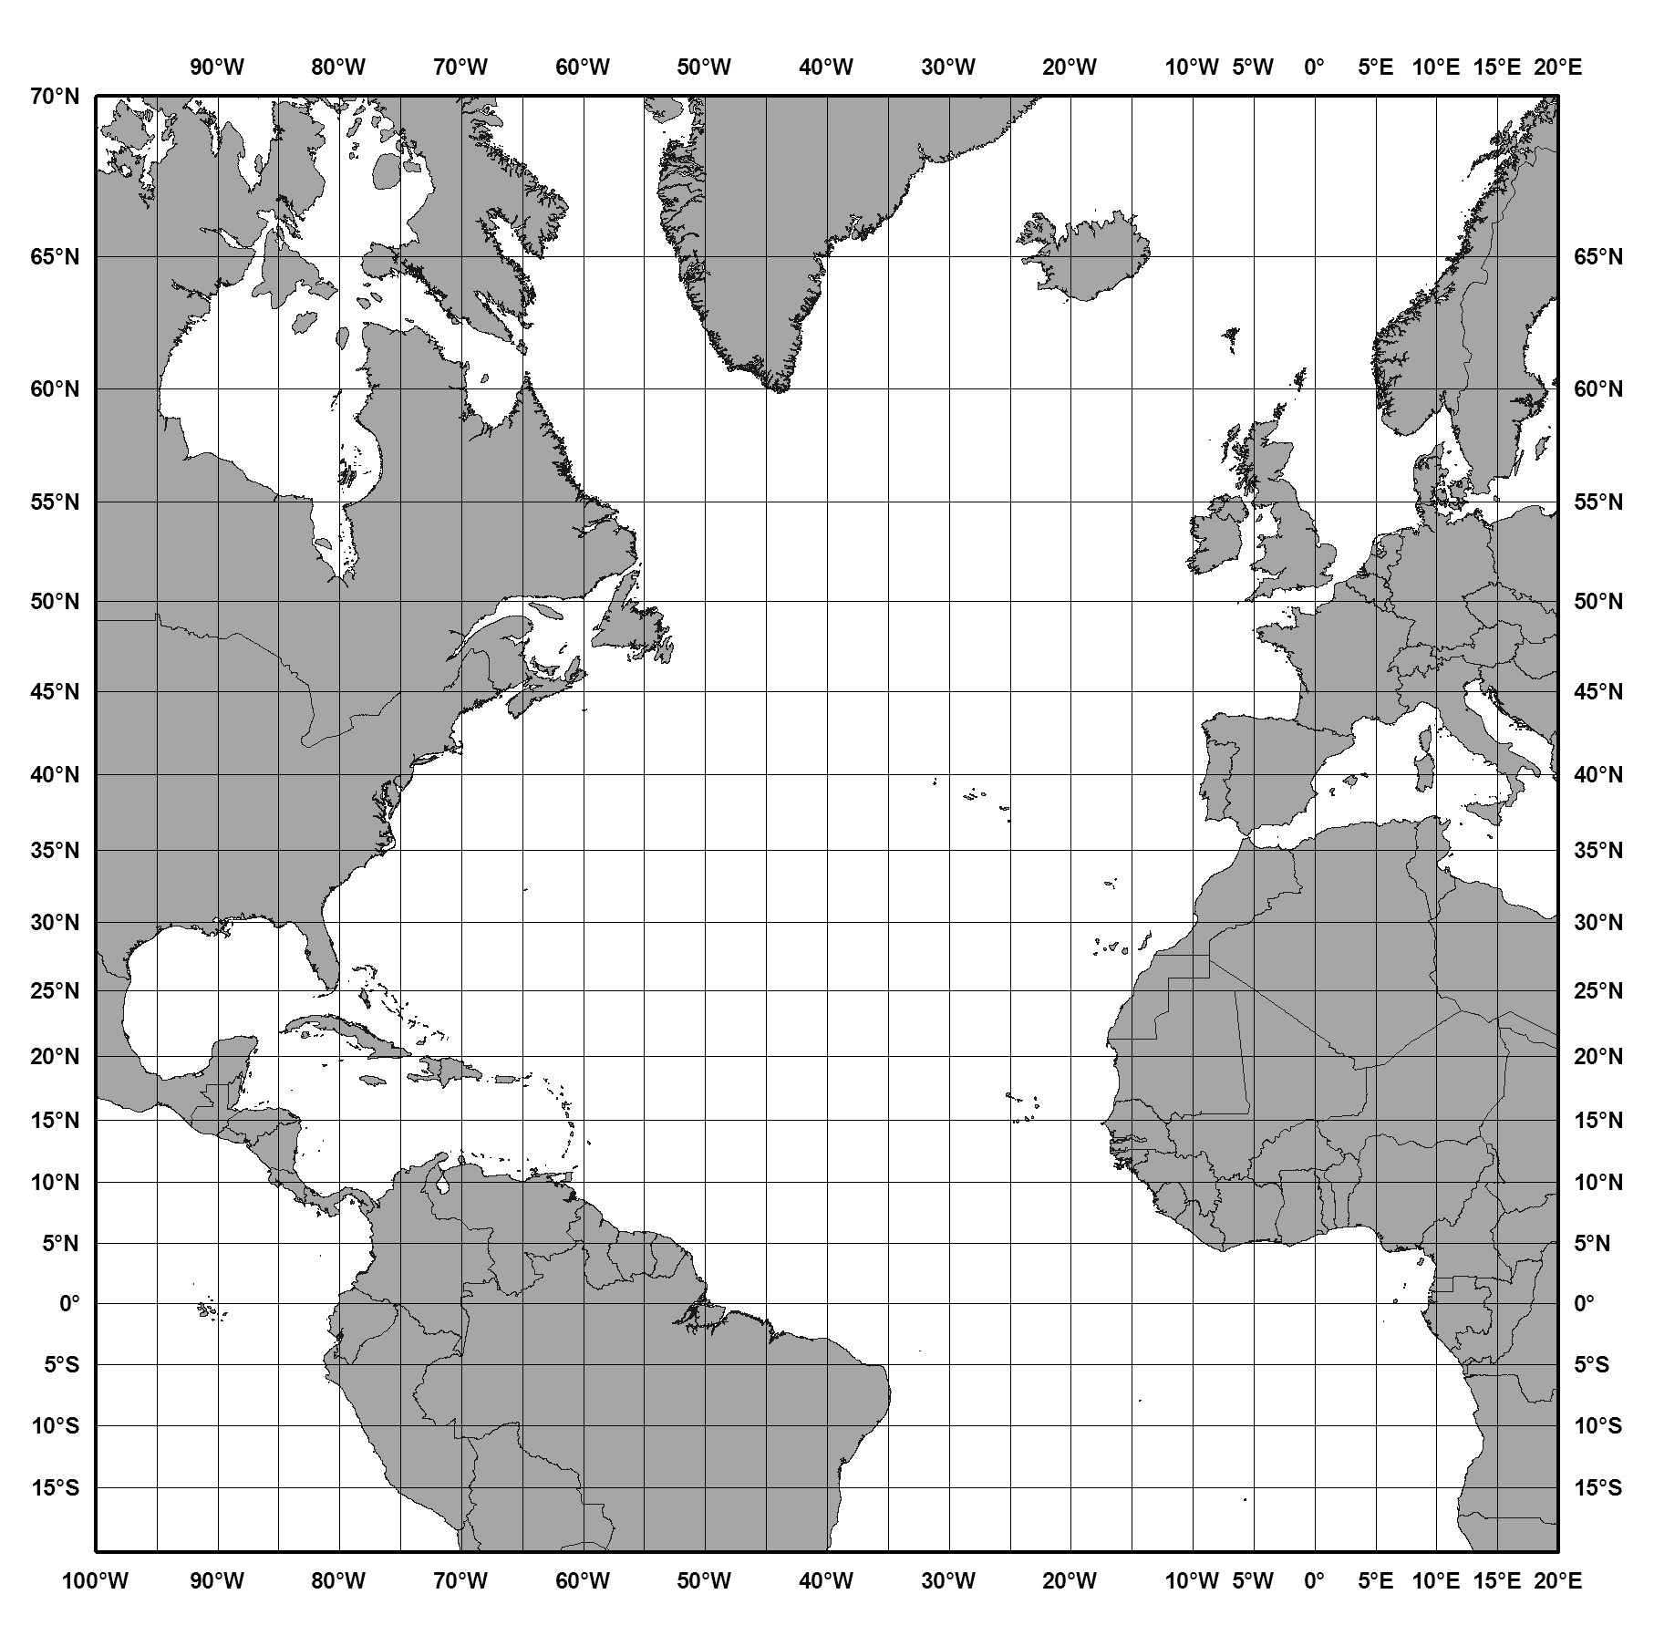
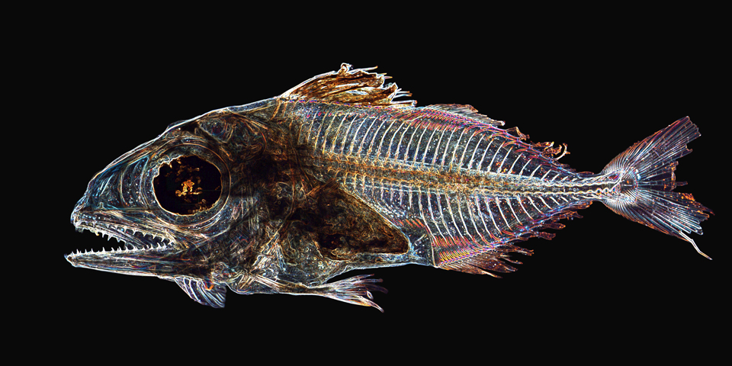
Initial Project Focus:
Gulf of Mexico Reproduction and Climate Change
But we learned that we had to look at their primary range to better understand the adult dynamics
Climate model domain
30+ years of larvae cruise
data (larvae, in situ, satellite)
6 MM
23 years commercial
longline data
Notes:
Model domain for downscaling

Slide 14
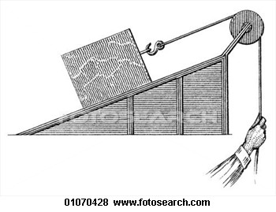
Summary of Methods
Developed habitat models of larvae and adults using boosted classification tree and neural network models.
  Multivariate, non-parametric methods
Downscaling climate models
  CMIP5 simulations using MOM4 (GFDL Modular Ocean Model) – Grid: 0.1° in GOM, 0.25° outside
  Now MOM4-TOPAZ biogeochemical model.
Satellite IR, ocean color, (NASA-MODIS, NOAA, JPSS-VIIRS), altimetry
  In habitat model development
  Provide strategic and tactical cruise work
  Climatology of GOM
  Validation of climate models

Slide 15

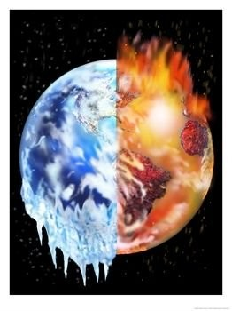


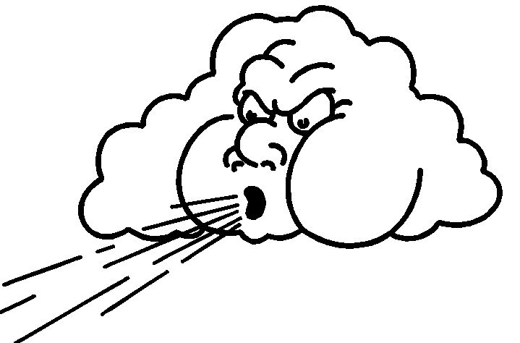
Downscaling simulations with MOM4* in Gulf of Mexico
First three separate runs:
Late 20C run (1981-2000) -> no larger than 0.5°C bias !
Mid 21C run (2041-2060) under RCP4.5 and RCP8.5
Late 21C run (2081-2100) under RCP4.5 and RCP8.5
*Representative concentration pathways of CO₂ representing radiative forcing values 4.5 and 8.5 Watts/m²
    Liu et. al, 2012 (J. Geophys. Res: 117)
Notes:
Hope you saw our posters

Slide 16
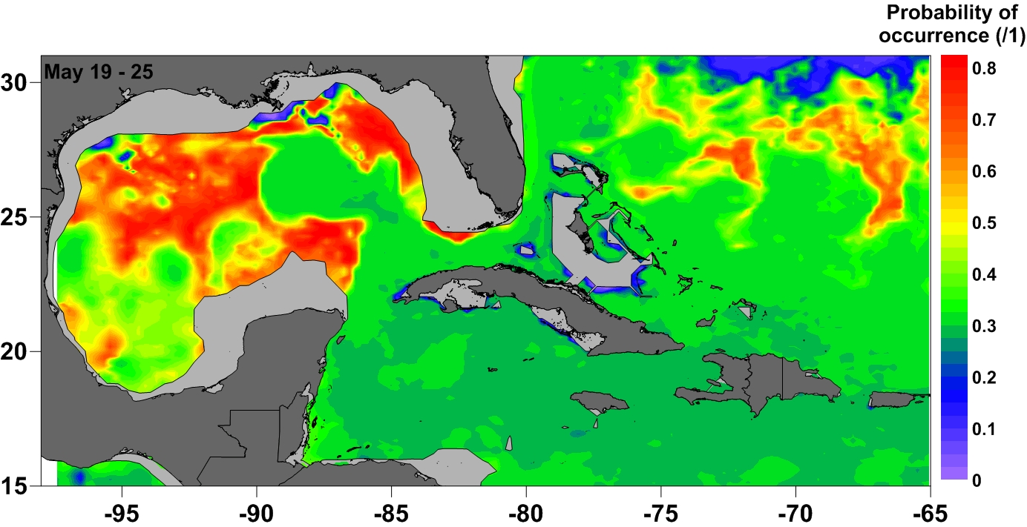
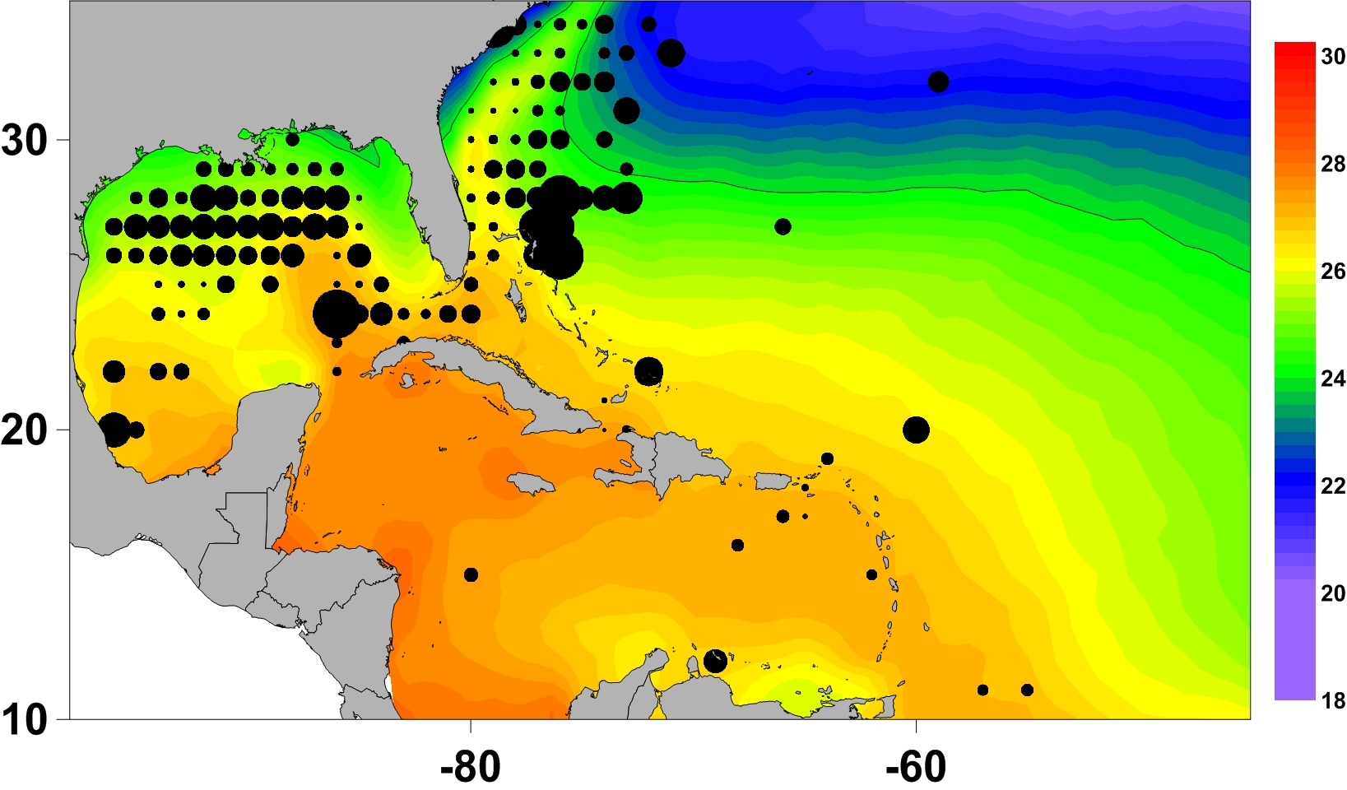
Use of Habitat Models for
Finding Alternative Spawning Areas
Other Than Gulf of Mexico With Satellite Derived Oceanographic Guidance
Adult Catches 1987-2012
ABT larvae habitat model product :
(satellites 1-4km + other ocean data + larvae)
May 19-25, 2013

Slide 17
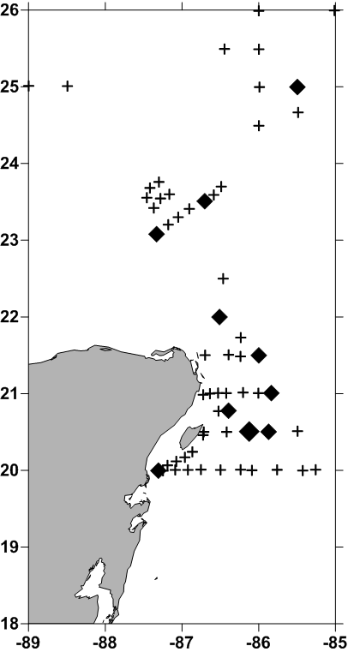
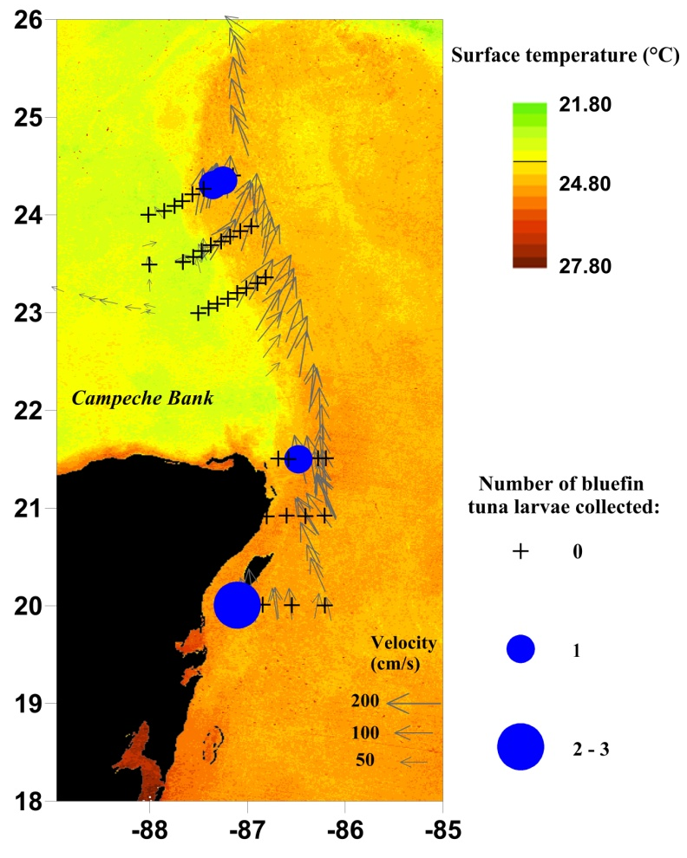
Previous Project Results
Catch locations of larval bluefin tuna in (left) and April 2010 (right)
1
1+
April 2009
April 2010

Slide 18
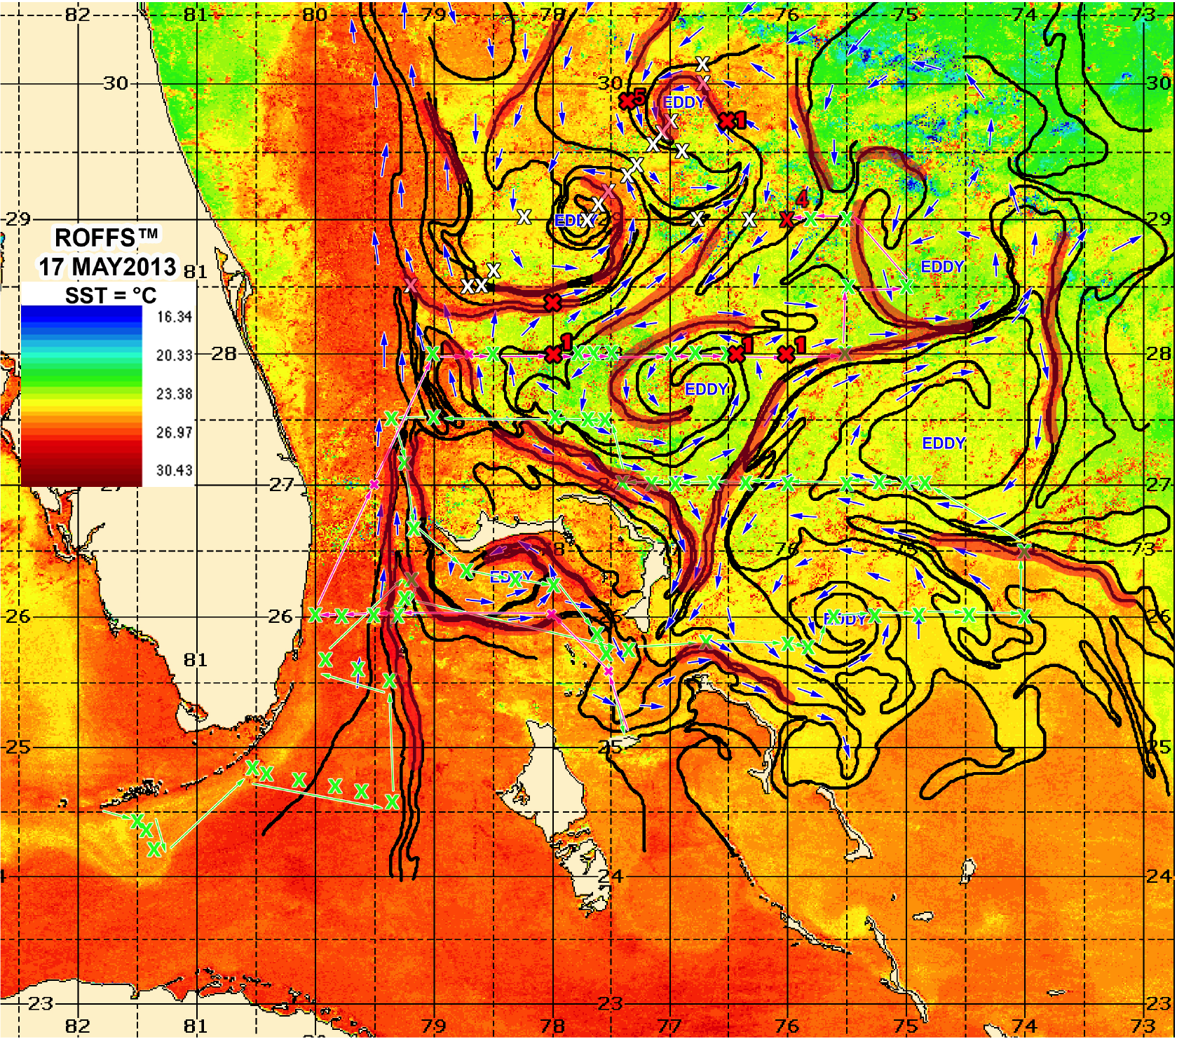
Results:
Tactical & Strategic Cruise Planning
14 ABT larvae
Notes:
Used MODIS and AVHRR IR oceanographic frontal analyses to location bluefin in areas outside of the Gulf of Mexico where the origin is not likely GOM.

Slide 19
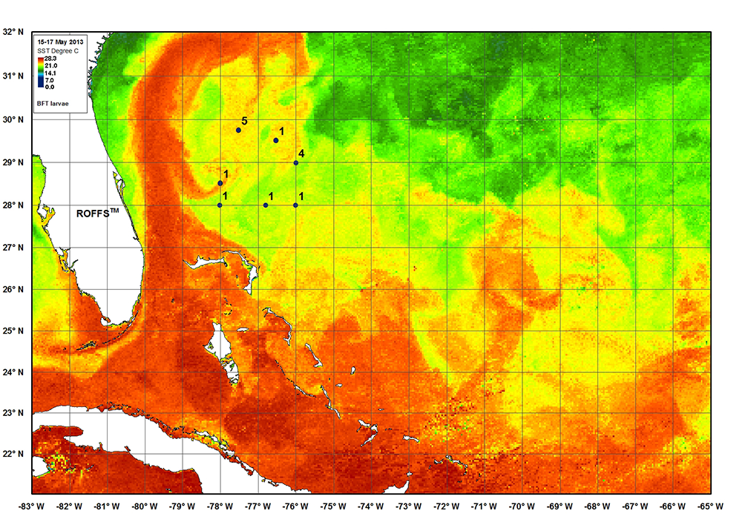
Raises Additional Questions
Are they spawning east?
Is this a sub-population?
Will it flourish when the the
habitat in GOM changes?
How do species survive over
millennia when habitats
change?
What are the conditions that affect
larval survival? Patch size, patch
component species? Will survival
benefit from earlier spawning or fail?

Slide 20
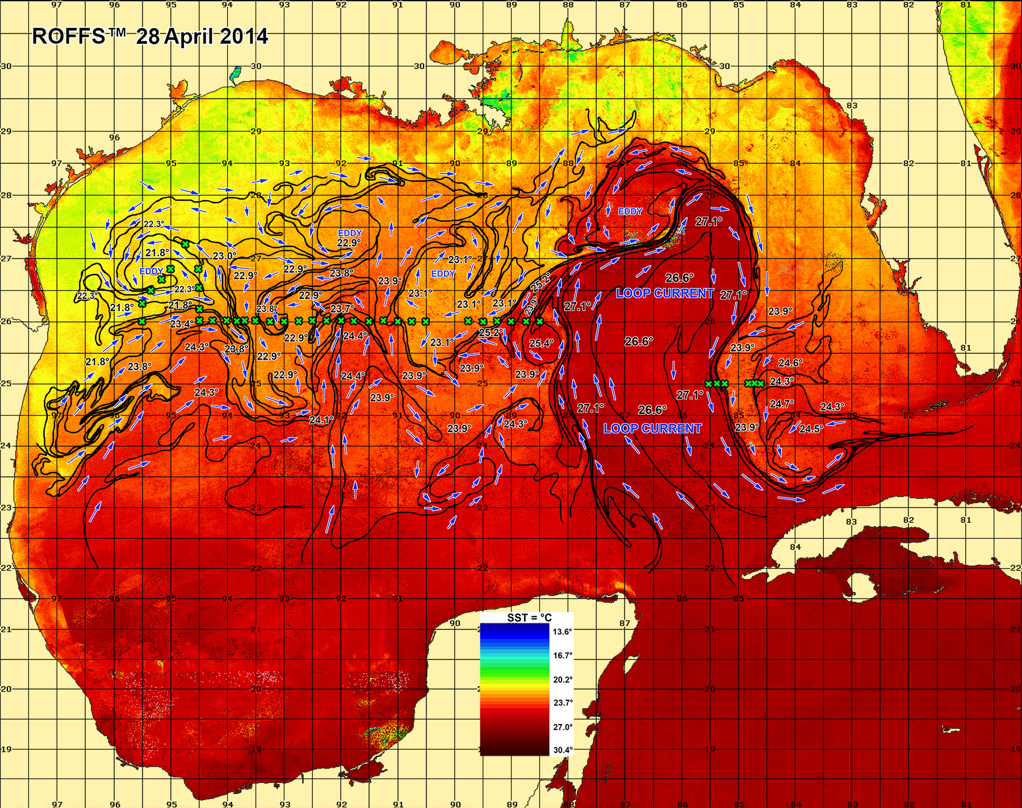
2014 Targeted Sampling
Leg One

Slide 21
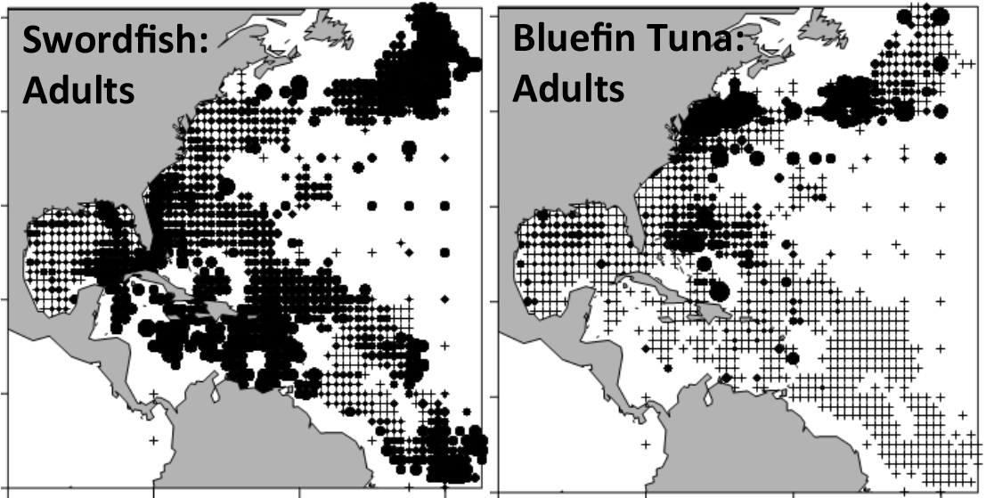
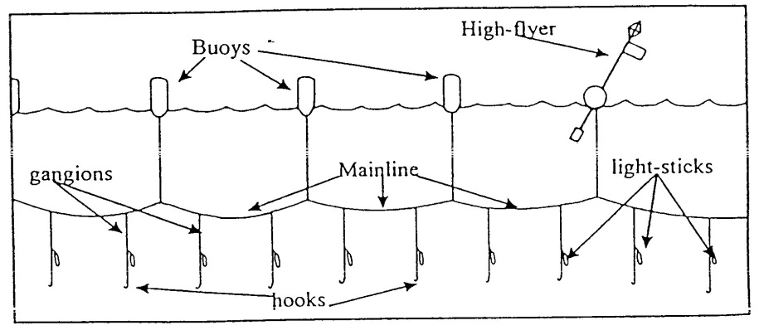
Habitat Modeling: Adults
The most comprehensive source of adult data is from fisheries-dependent records
  Logbook program: all US fishing vessels are required to submit catch logbooks detailed catch composition and gear deployed for each longline set. Mandatory since 1992
  Observer program: government observers are placed on fishing vessels, and record more detailed information on size, weight and sex of fish. Program began in 1992, but coverage is very limited
  ICCAT Task 2 database
Many issues with the data, target species, reliability, gear changes, management changes (e.g. quotas, closed areas), not include recreationally caught fish…….., but it is the primary data one uses.

Slide 22
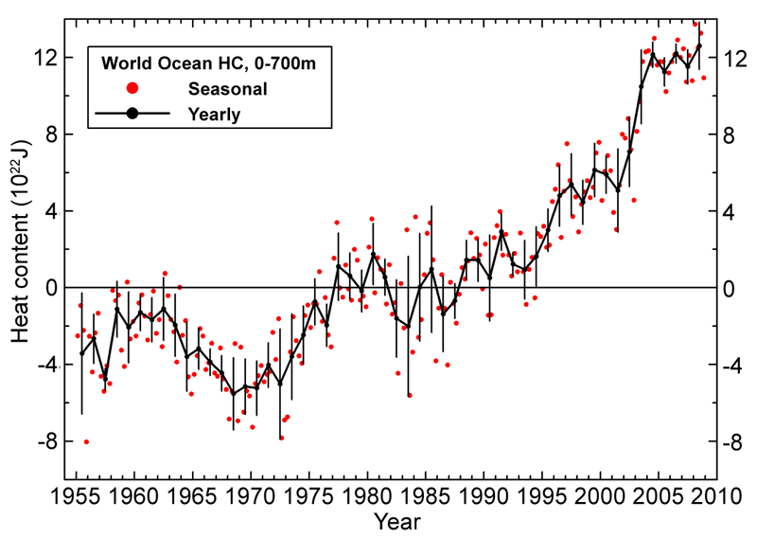
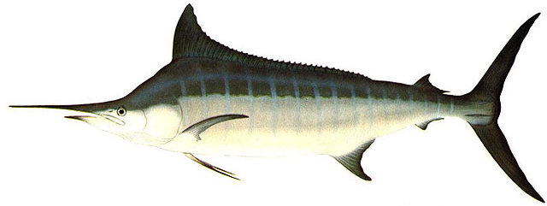
Temperature limits on adult distribution
All fish species have physiological limits to both cold and warm temperatures
South->North Warming oceans could result in:
  A northwards shift of southern distribution limits, due to upper temperature limits (southern waters get too warm)
  A northwards shift of northern distribution limits, to lower temperature limits (northern waters no longer too cold)
?!

Slide 24
Use of biogeographic zones by adult fish
Mean probability of occurrence for each species of interest varied widely among zones
Bluefin tuna and swordfish were much more likely to use colder, higher chlorophyll habitats
Blackfin tuna, blue marlin, sailfish and skipjack tuna used warm tropical habitats nearly exclusively
Bluefin Tuna
Skipjack Tuna
Blackfin Tuna
Swordfish
Blue Marlin
Yellowfin Tuna
Sailfish
White Marlin

Slide 25
A simple 1D model
A simple model of temperature → bluefin tuna adults → eggs → larvae → juveniles was created using delayed differential equations in Matlab
Published values of adult distributions, spawning activity, mortality and effects of temperature were parameterized
Results were re-run for future temperature increases of 0.5, 1.0 and 2.0°C
Preliminary results suggest an earlier spawning season under climate change conditions, but fish must be ready or will they move to another area?

Slide 26
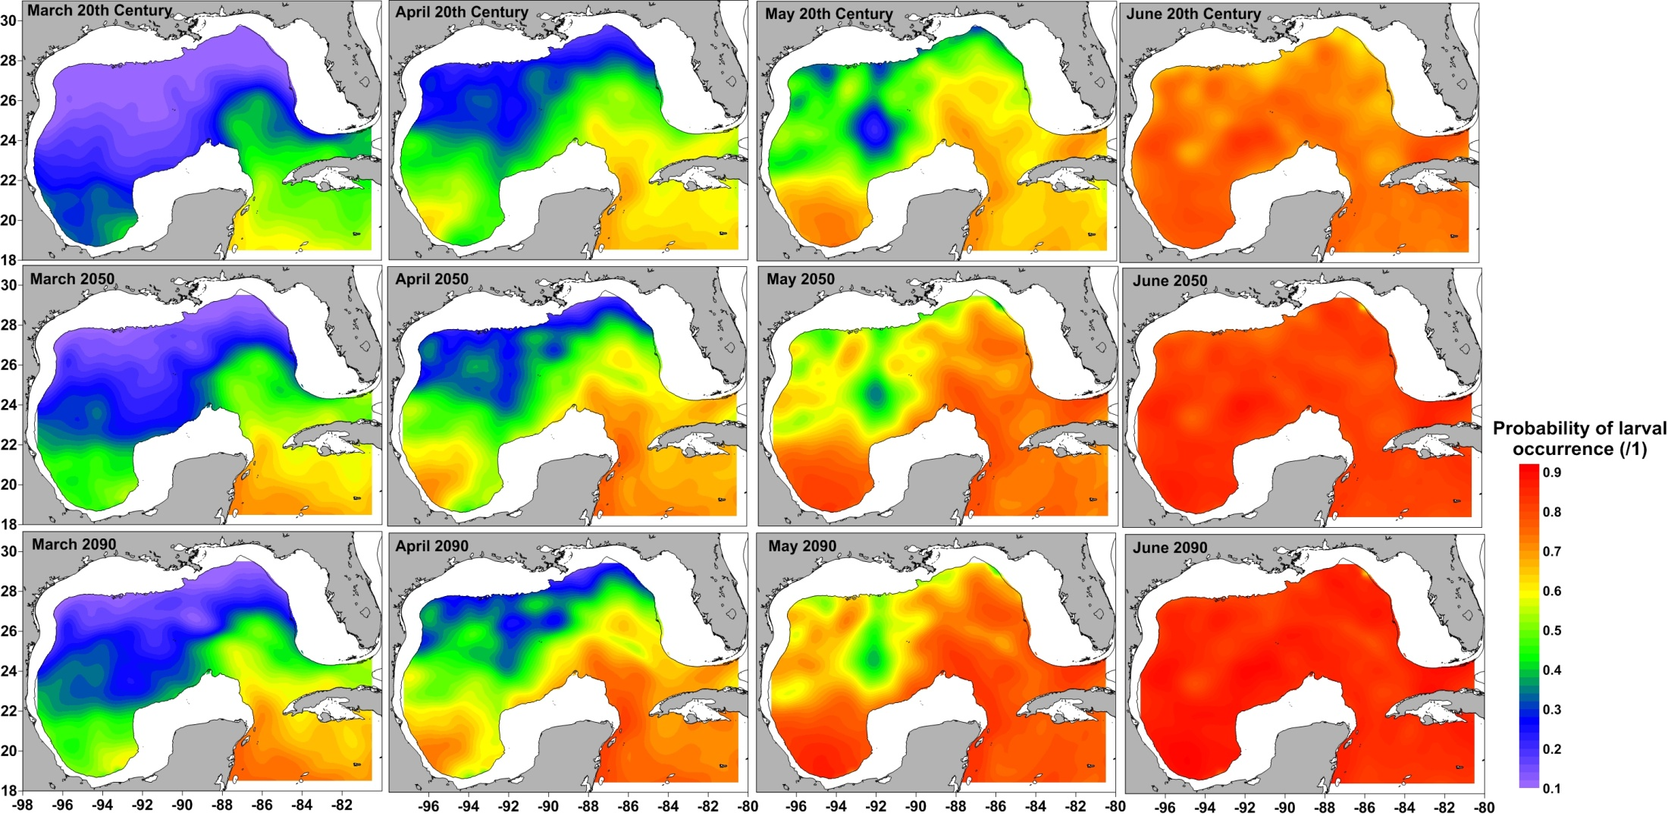
Larvae Habitat Results: Yellowfin/Blackfin
During the late 20th century, Thunnus spp. increased spawning activity throughout spring
By the end of the 21st century, warming temperatures are predicted to increase the suitability of spawning habitat in all spring months
Notes:
Not all climate changes results in losers

Slide 27
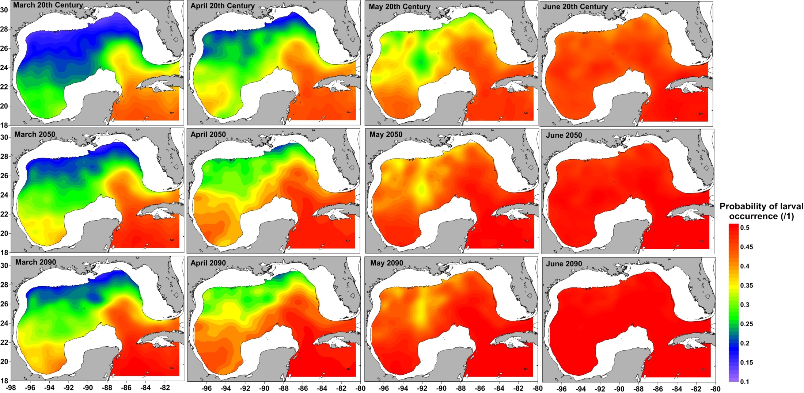
Larvae Habitat Results: Skipjack
Similarly to yellowfin/blackfin tuna, skipjack tuna spawning grounds were predicted to increase in suitability through to the end of the 21st century

Slide 28


Always Thinking About Transition & Outreach !
The goal at the end of the third year is to pass on the basic knowledge of satellite oceanography so that our partner NOAA researchers can routinely use satellite data for this and future projects.
This has been reached!

Slide 29
Publications
Muhling, B.A., Lamkin, J.T., Roffer, M.A. (2010) Predicting the occurrence of bluefin tuna (Thunnus thynnus) larvae in the northern Gulf of Mexico: Building a classification model from archival data Fisheries Oceanography 19: 526-539.
Muhling, B.A., Lamkin, J.T., Quattro, J.M., Smith, R.A., Roberts, M.A., Roffer, M.A., Ramirez, K.A. (2011) Collection of larval bluefin tuna (Thunnus thynnus) outside documented western Atlantic spawning grounds. Bulletin of Marine Science 87: 687-694.
Muhling, B.A., Lee, S-K, Lamkin, J.T. (2011) Predicting the effects of climate change on bluefin tuna (Thunnus thynnus) spawning habitat in the Gulf of Mexico. ICES Journal of Marine Science 68: 1051-1062.
Muhling, B.A., Roffer, M.A., Lamkin, J.T., Ingram, G.W. Jr., Upton, M.A., Gawlikowski, G., Muller-Karger, F., Habtes, S., Richards, W.J. (2012) Overlap between Atlantic blueﬁn tuna spawning grounds and observed Deepwater Horizon surface oil in the northern Gulf of Mexico. Marine Pollution Bulletin, doi:10.1016/j.marpolbul.2012.01.034.
Liu Y., S.-K. Lee, B. A. Muhling, J. T. Lamkin and D.B. Enfield, 2012: Significant reduction of the Loop Current in the 21st century and its impact on the Gulf of Mexico. J. Geophys. Res., 117, C05039, doi:10.1029/2011JC007555
Liu, Y., S.-K. Lee, C. Wang, D. B. Enfield, B. A. Muhling and J. T. Lamkin, 2013: Impact of the Atlantic Multidecadal oscillation on North Atlantic Ocean gyre circulation variability. Being revised for re-submission.
Muhling, B.A., P. Reglero, L. Ciannelli, D. Alvarez-Berastegui, F. Alemany, J.T. Lamkin, and M. A. Roffer. 2013. A comparison between environmental characteristics of larval bluefin tuna (Thunnus thynnus) habitat in the Gulf of Mexico and western Mediterranean Sea. Marine Prog. Ser. 486:257-276.
Muller-Karger, F.; Roffer, M.; Walker, N.; Oliver, M.; Schofield, O.; Abbott, M.; Graber, H.; Leben, R.; Goni, G., 2013. "Satellite Remote Sensing in Support of an Integrated Ocean Observing System," Geoscience and Remote Sensing Magazine, IEEE , 1 (4):8-18, 2013 doi: 10.1109/MGRS.2013.2289656

Slide 30
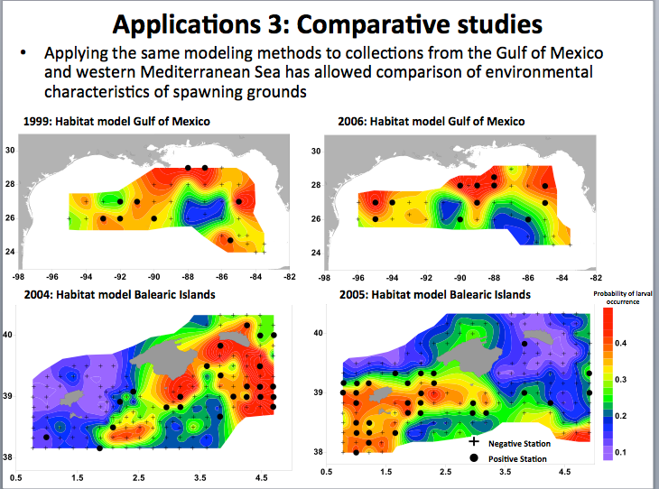
Thanks - Questions

Slide 31
Part II Climate Modeling
Need Another 15 Minutes
What we have done: CMIP5 simulations under historical, RCP4.5, and RCP8.5 scenarios are downscaled for the GoM and CBN using MOM4.
Highlight of our findings: CMIP5 downscaling results are mainly consistent with CMIP3 downscaling simulations.  Both the Loop Current (LC) and Caribbean Current (CC) are significantly reduced during the 21st century, consistent with a similar rate of reduction in the AMOC.

Slide 32
Year 3
Reprioritized task: Downscale CMIP5 model simulations for the 21st century using MOM4-TOPAZ
Justification for the new task: Preliminary model simulations show that the volume transport across the Yucatan Channel is not realistic in ROMS

