Slide 1
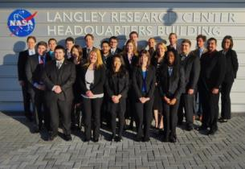
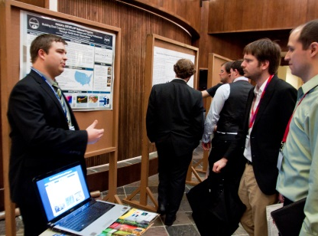
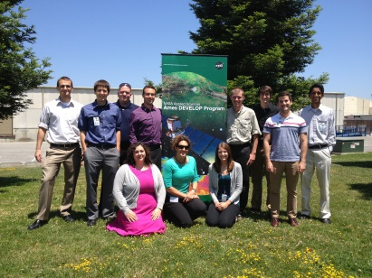
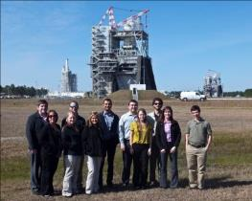
National Aeronautics and Space Administration
DEVELOP National Program
Partnering with DEVELOP:
Program & Projects Overview

Slide 2
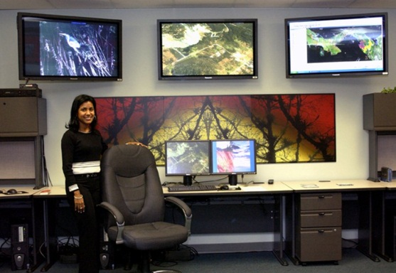
NASA’s Capacity Building Program
Interagency and Global Capacity Building
SERVIR Coordination Office (MSFC)
Building international capacity with hubs in East Africa, Hindu Kush – Himalaya, and Mesoamerica
GOMI – Gulf of Mexico Initiative (SSC)
Building the Gulf region’s capacity for local issues
ARSET – Applied Remote SEnsing Training (GSFC)
On-line and hands-on basic and advanced training to build domestic skills
DEVELOP National Program Office (LaRC)
Dual workforce and partner organization capacity building using collaborative projects
Notes:
Project Partner- We have partnered with the USDA ARS and with the US Forest Service on various projects in the past. For example, the Great Plains drought project and the US plant hardiness zone project both partnered with the USDA ARS, and a currently ongoing Sierra Nevada project is partnered with the Forest Service
Hosting a Node- We currently have a node at the USGS NCCSC, where Jeff Morisette is the host and one of the main science advisors. This summer, we will also have a project at the NOAA’s data center in North Carolina.

Slide 3
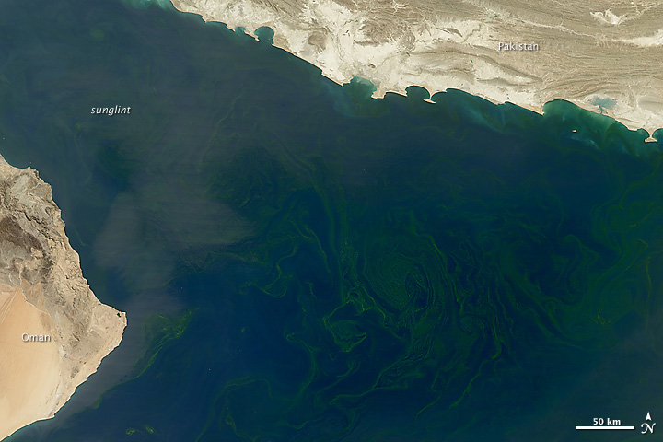
NASA’s Capacity Building Program
NASA Applied Sciences Program
appliedsciences.nasa.gov
Earth Science Data Access
earthdata.nasa.gov
Capacity Building Program Manager
Nancy D. Searby, PhD
nancy.d.searby@nasa.gov
GOMI
Duane Armstrong
curtis.d.armstrong@nasa.gov
SERVIR
Dan Irwin, daniel.irwin@nasa.gov
DEVELOP
Mike Ruiz, michael.l.ruiz@nasa.gov
ARSET
Ana Prados, aprados@umbc.edu
Notes:
Project Partner- We have partnered with the USDA ARS and with the US Forest Service on various projects in the past. For example, the Great Plains drought project and the US plant hardiness zone project both partnered with the USDA ARS, and a currently ongoing Sierra Nevada project is partnered with the Forest Service
Hosting a Node- We currently have a node at the USGS NCCSC, where Jeff Morisette is the host and one of the main science advisors. This summer, we will also have a project at the NOAA’s data center in North Carolina.

Slide 4
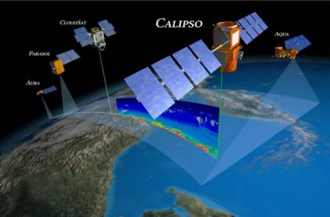
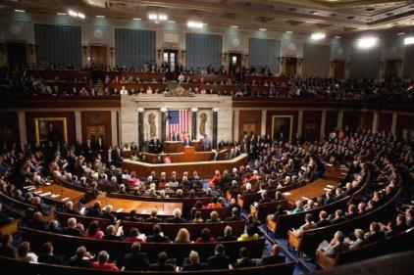
What is DEVELOP?
Measurements
and Predictions
Communities
DEVELOP, part of NASA’s Applied Sciences Program, addresses environmental and public policy issues through interdisciplinary research projects that apply the lens of NASA Earth observations to community concerns around the globe. Bridging the gap between NASA Earth Science and society, DEVELOP builds capacity in both participants and partner organizations to better prepare them to address the challenges that face our society and future generations. With the competitive nature and growing societal role of science and technology in today’s global workplace, DEVELOP is fostering an adept corps of tomorrow’s scientists and leaders.
DEVELOP Website: http://develop.larc.nasa.gov

Slide 5
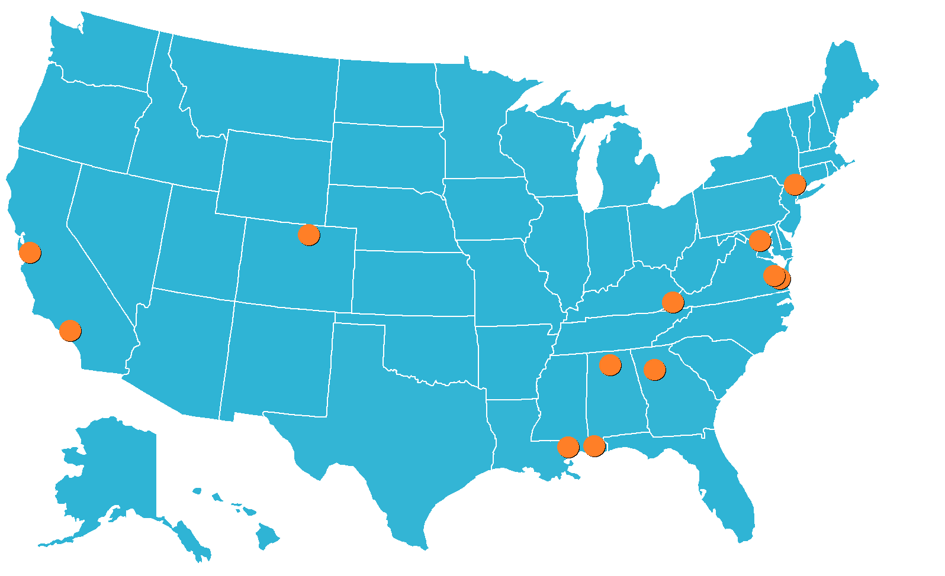
DEVELOP Office Locations
NASA Centers
Ames Research Center – Moffett Field, CA
Goddard Space Flight Center – Greenbelt, MD
Jet Propulsion Laboratory – Pasadena, CA
Langley Research Center – Hampton, VA
Marshall Space Flight Center – Huntsville, AL
Stennis Space Center – Stennis, MS
Regional & Academic Locations
International Research Institute – Palisades, NY
Mobile County Health Department – Mobile, AL
Patrick Henry Building – Richmond, VA
University of Georgia – Athens, GA
USGS at Colorado State University – Fort Collins, CO
Wise County Clerk of Court’s Office – Wise, VA

Slide 6
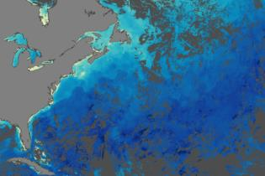
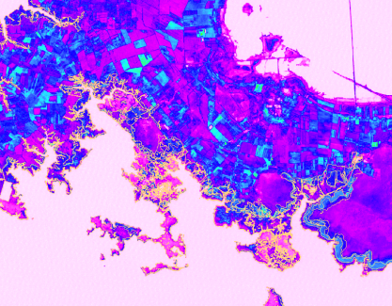
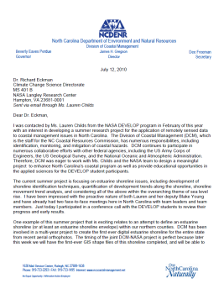
Project Characteristics
Focus on the utilization of NASA Earth observations
Highlight the capabilities of NASA satellite and airborne Earth remote sensing science and technology
Address community concerns relating to environmental issues
Align with at least one of the nine NASA Applied Sciences Program’s Application Areas
Partner with local, state, regional, federal and/or international organizations who can benefit from using NASA Earth observations to enhance decision making
Meet partner needs by providing decision support tools
Research is conducted by teams with diverse backgrounds
Science advisors and mentors from NASA and partner organizations provide guidance
All projects culminate in a set of deliverables (technical report, poster, presentation, video, etc.)
Ten weeks long (spring, summer and fall terms)

Slide 7
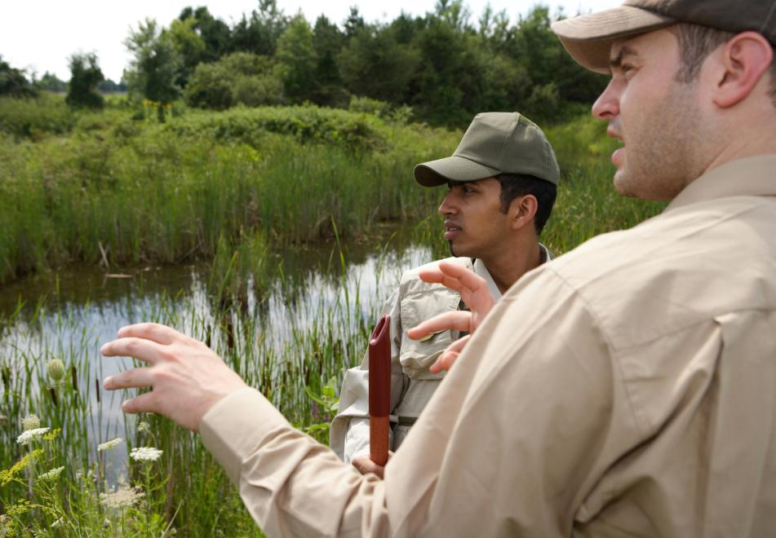
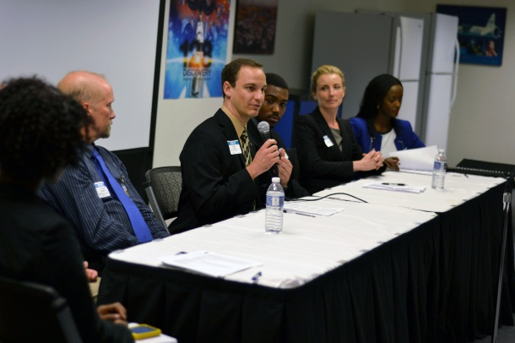
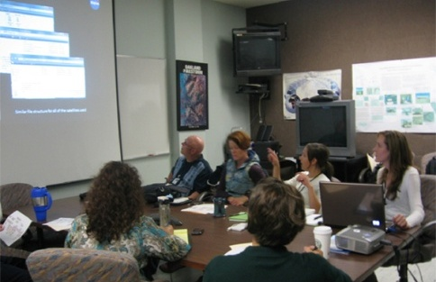
Benefits to Partners & End-Users
Introduction to new methods to augment current practices: Cost-saving & time-saving
Enhanced decision support through use of NASA EOS
Increased exposure to NASA Earth Science technologies and capabilities
Introduction to NASA’s Applied Sciences Program and its contributions to local communities, the country, and the world
Hands-on training with practical applications of remote sensing and NASA Earth science
Improved remote sensing and geographic information science (GIS) capabilities
Interaction with bright and innovative young professionals
Opportunities for networking with the NASA community
Strong recruiting pool of early career professionals with a knowledge of Earth observations and their capabilities

Slide 8
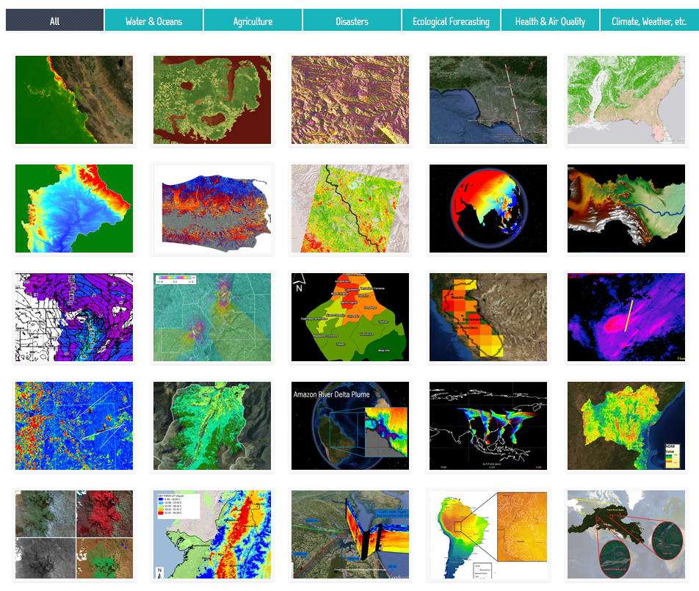
Chad Ecological Forecasting
Myanmar Ecological Forecasting
South Africa Ecological Forecasting
Previous Project Examples

Slide 9
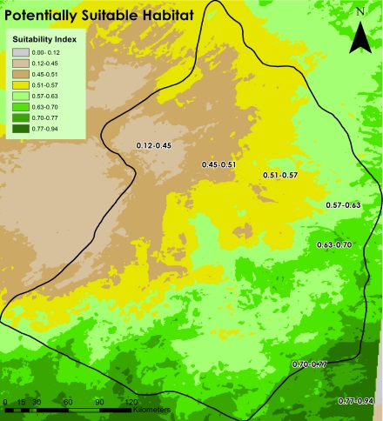
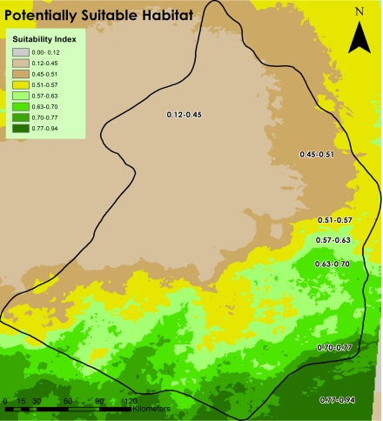
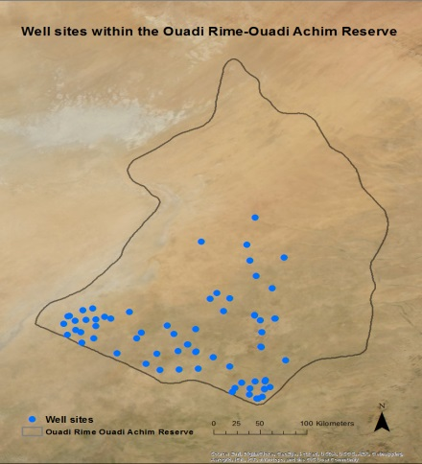
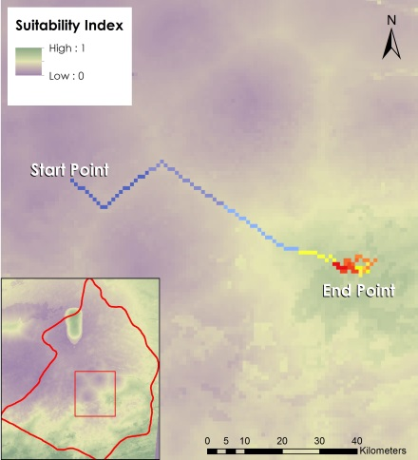
Chad Ecological Forecasting
Community Concerns
Once populated by large herds, the Scimitar-Horned Oryx became extinct in the northern Africa wild (mostly Nigeria and Chad) in 1999
Synthesizing central environmental data and creating habitat suitability maps will increase the chance of a successful reintroduction
Partner
Smithsonian Conservation Biology Institute
Overview
Habitat Suitability Maps (Year Average, Hot Season, Rainy Season)
Animal Movement Model
Well sites in the study region
Hot Season
Rainy Season
Well Sites
Movement Model

Slide 10
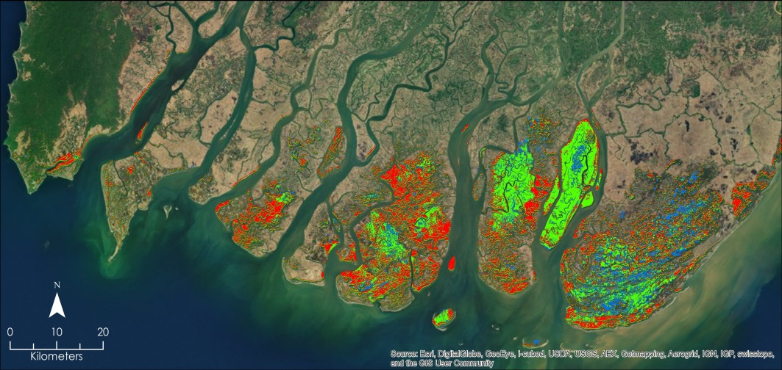
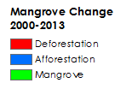
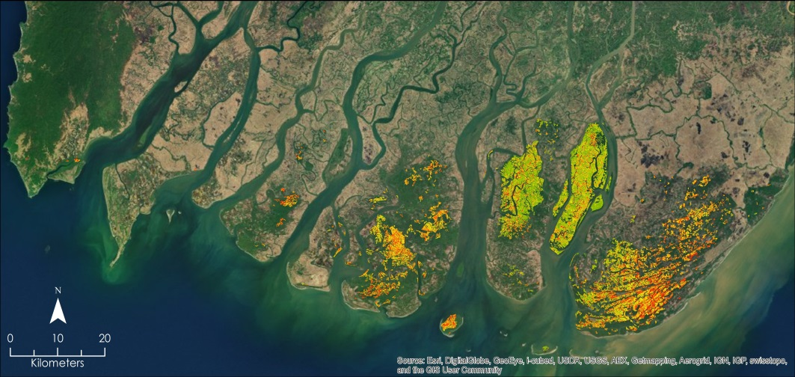
Myanmar Ecological Forecasting
Community Concerns
Rapidly growing populations are putting stress on coastal mangroves that provide valuable natural resources and biodiverse ecosystems
Mangroves act as a buffer to protect the densely populated shoreline from wind, waves, and tropical cyclones
Partners
Smithsonian Conservation Biology Institute
Myanmar Ministry of Environmental Conservation and Forestry
Overview
Mangrove change maps from 2000 to 2013
Projected Vulnerability Maps to focus conservation and restoration efforts

Slide 11
South Africa Ecological Forecasting
Overview
A time series showing woodland degradation in the park
Habitat sustainability model to illustrate current elephant habitat and potential future areas
Partner
Kruger National Park
Community Concerns
Kruger National Park is currently experiencing landscape change from woodland to grassland habitat
Both elephant foraging activities and aggressive behavior may be contributing to the landscape change

Slide 12
Partnering w/DEVELOP
Project Partner (10 weeks)
Project activity takes place at an established DEVELOP node
Partner Provides: Project Idea, Advising
DEVELOP Provides: Participants (pay and limited travel), Project Management
Steps forward:
Express interest to DEVELOP NPO, complete a project proposal, begin communication with the DEVELOP node that will conduct the project (DEVELOP NPO will make connection)
Interested in partnering with DEVELOP?
Express interest to:
Tiffani Orne, Tiffani.N.Orne@nasa.gov
Lauren Childs-Gleason, Lauren.M.Childs@nasa.gov
Dr. Kenton Ross, Kenton.W.Ross@nasa.gov
Work with DEVELOP to define project topic and scope, and compose a project proposal (template available by email)
Any questions? Contact Lauren.M.Childs@nasa.gov
Notes:
Project Partner- We have partnered with the USDA ARS and with the US Forest Service on various projects in the past. For example, the Great Plains drought project and the US plant hardiness zone project both partnered with the USDA ARS, and a currently ongoing Sierra Nevada project is partnered with the Forest Service
Hosting a Node- We currently have a node at the USGS NCCSC, where Jeff Morisette is the host and one of the main science advisors. This summer, we will also have a project at the NOAA’s data center in North Carolina.

Slide 13
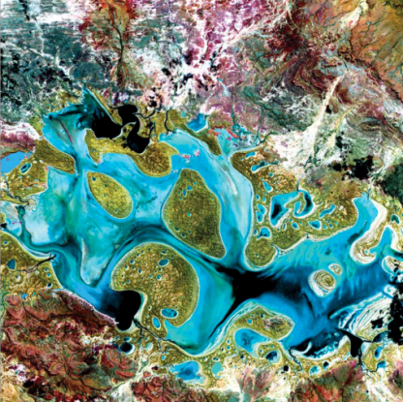
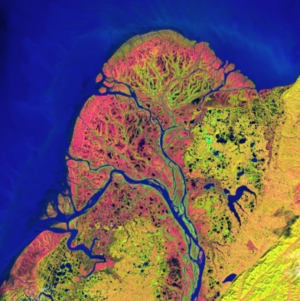
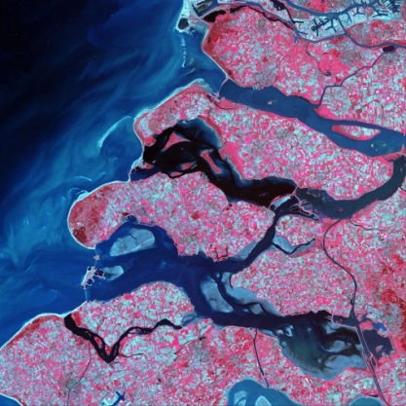
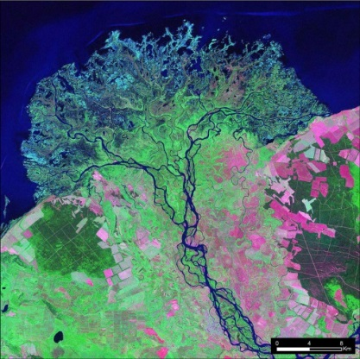
Project Idea & Proposal Timeline
Spring Projects
Collection of ideas & writing of proposals: due mid-September
Spring Term: late January to early April
Summer Projects
Collection of ideas & writing of proposals: due early December
Summer Term: early June to early August
Fall Projects
Collection of ideas & writing of proposals: due mid-April
Fall Term: mid-September to mid-November

Slide 14
Thank You!
Questions?
NASA-DL-DEVELOP@mail.NASA.gov

