Slide 1
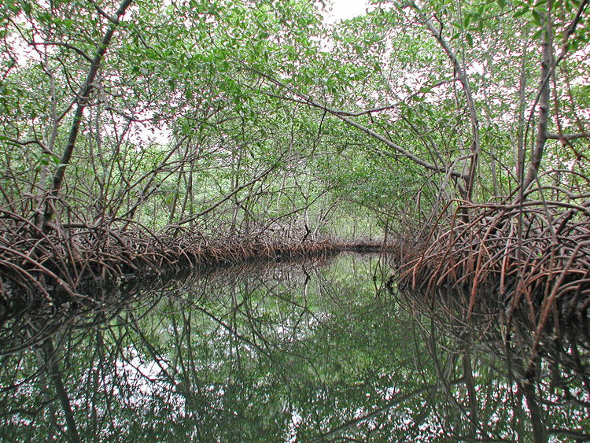
Sensitivity of Mangrove Ecosystems to Climate Change
Ilka C. Feller¹, Kyle Cavanaugh^{1, 2}, Daniel Gruner³, Jim Kellner², Richard Osman¹, John Parker¹, Wilfrid Rodriguez¹
¹Smithsonian Environmental Research Center
²Brown University
³University of Maryland, College Park

Slide 2
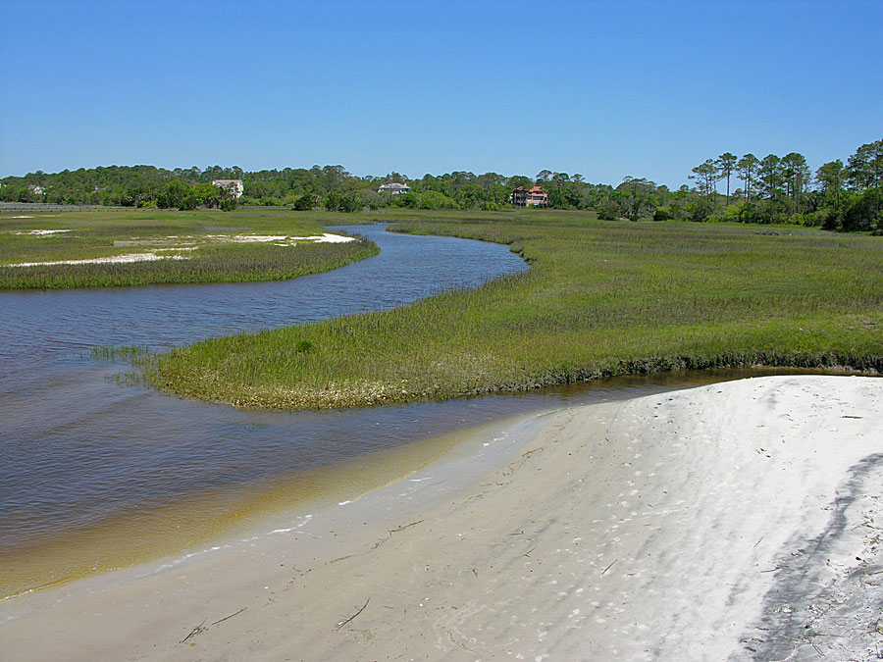
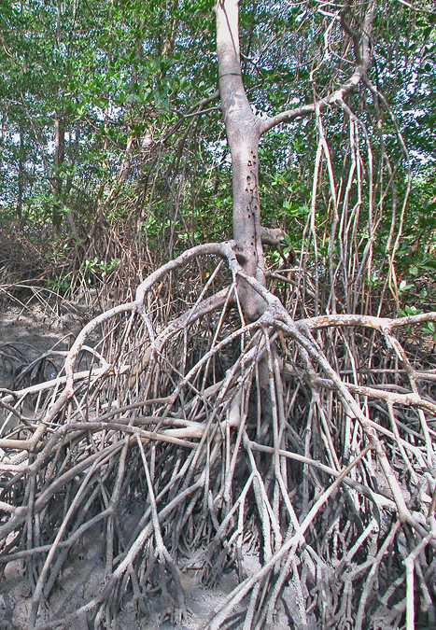
30°30′ N
0° 30′ S
Notes:
On the left, saltmarsh on Amelia Island in northern Florida… 30°30′ N
On the right, a mangrove forest at the Equator… just to the south of the mouth of the Amazon.
These coastal wetlands are separate by climate, but occupy similar intertidal habitats.
Both are highly valued both ecologically and economically.
As a consequence of climate, mangroves are expanding poleward and landward.
We can see this encroachment of mangroves into salt marshes at the ecotone.

Slide 3
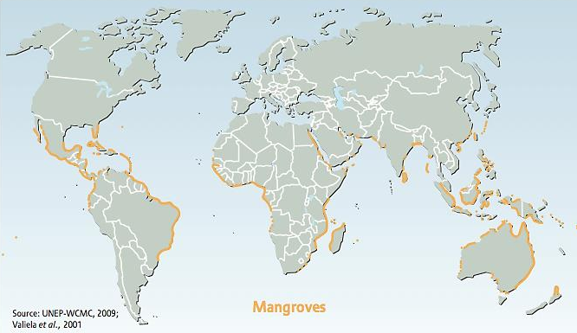
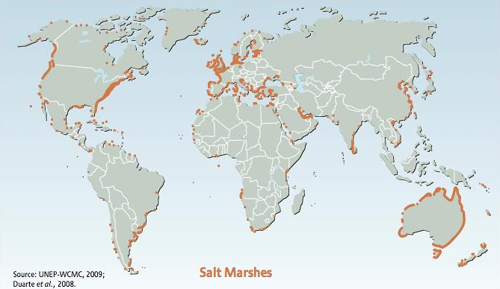
Atlantic-East Pacific Indo-West Pacific
Atlantic-East Pacific Indo-West Pacific
Notes:
Mangroves are a tropical species and they cannot tolerate freezing temperatures very well
poleward limit generally occurs around 30 in the Northern Hemisphere and around 37 in the Southern Hemisphere.
Saltmarshes coexist with mangroves in some locations

Slide 4
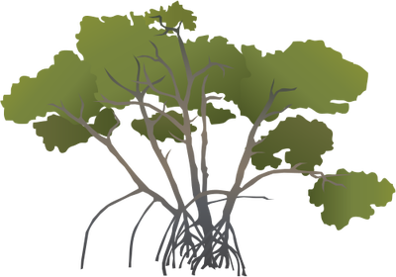

Factor 1 (e.g., temperature, CO₂)
Factor 2 (e.g., competition,
disturbance, herbivory)
SALT MARSHES
MANGROVES
-Biomass
-Diversity
-Shoreline stability
-Nutrient cycling
-Carbon storage
WOODY
HERBACEOUS
Temperate
Tropical
Mangrove-Salt Marsh Ecotone along a climatic gradient
Ecotone (def.): zone of transition between adjacent ecological systems (Holland 1988)
Notes:
The ecotone or zone of transition around these range limits is a good place to observe the encroachment of mangroves into salt marsh
Conceptual diagram
The driving mechanisms behind the poleward range expansion of mangroves and their encroachment into salt marshes remain obscure but are thought to involve multiple interacting environmental factors including warming temperatures, changes in rainfall patterns, and increasing atmospheric CO₂.
In contrast, processes such as competition between mangrove seedlings and established saltmarsh, disturbance events such as hurricanes, and herbivory may serve to resist the advance of mangroves and promote the persistence of salt marshes in some locations

Slide 5


SALT MARSHES
HIGH
Elevation
MANGROVES
LOW
Mangrove-Salt Marsh Ecotone along an intertidal gradient (topography rather than climate)
Notes:
There have also been a number of observations of landward encroachment of mangroves into saltmarshes. This conceptual diagram shows a mangrove-saltmarsh ecotone along an intertidal gradient

Slide 6
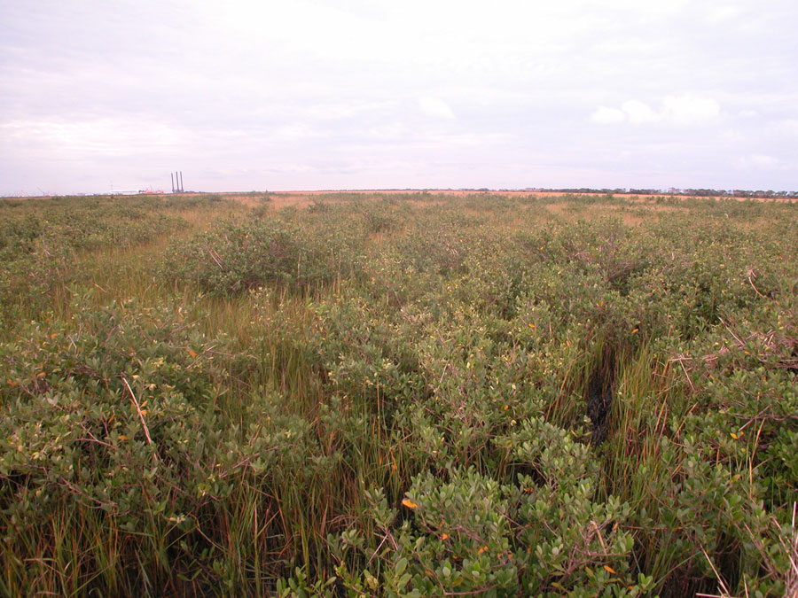
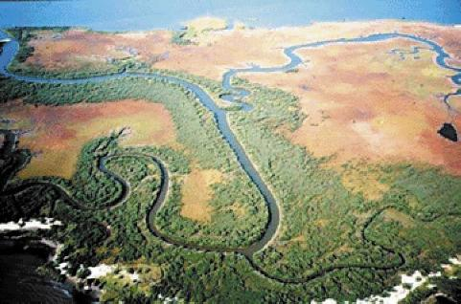
Port Fouchon, Louisiana
USGS
Notes:
Clearly, sea level rise has the potential to dramatically impact the dynamics of this intertidal ecotone.

Slide 7
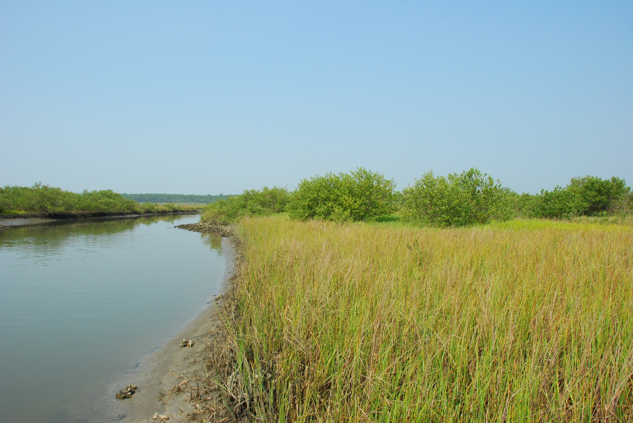
Objectives:
  to understand the effects of climate change and nutrient enrichment on the expansion of mangrove trees into temperate salt marshes
  to predict the consequences of this invasion for the functionality and biodiversity of coastal habitats
St Augustine, Florida
Notes:
Whether the expansion of mangroves is poleward or landward, this transition from salt marshes to mangroves is expected to have major impacts on the community structure and ecosystem functioning of these wetlands.

Slide 8
Objectives:
  to understand the effects of climate change and nutrient enrichment on the expansion of mangrove trees into temperate salt marshes
  to predict the consequences of this invasion for the functionality and biodiversity of coastal habitats
Approach:
  relate the regional mangrove invasion front to climate patterns
  examine the role of land use and especially its impact on nutrient and sediment flow; document mangrove expansion into salt marshes
  investigate interactions between mangrove and salt marsh plants, including their distinct and shared food webs

Slide 9
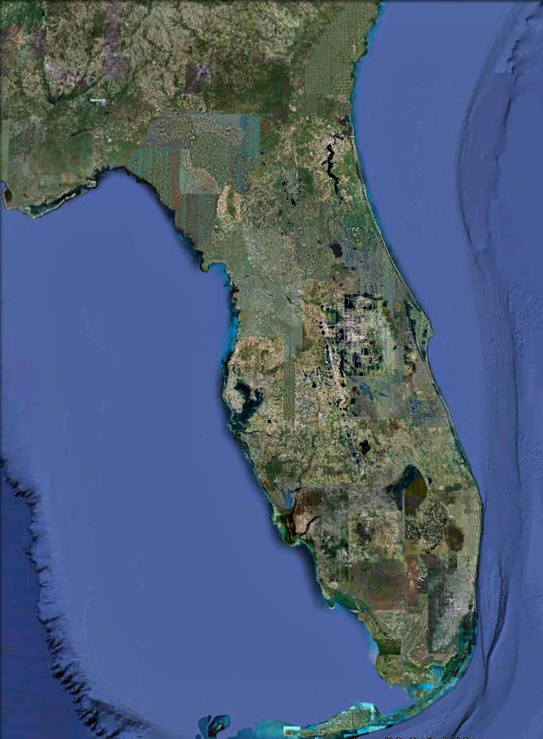
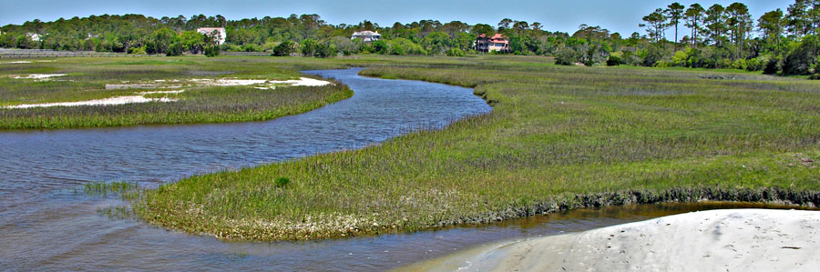
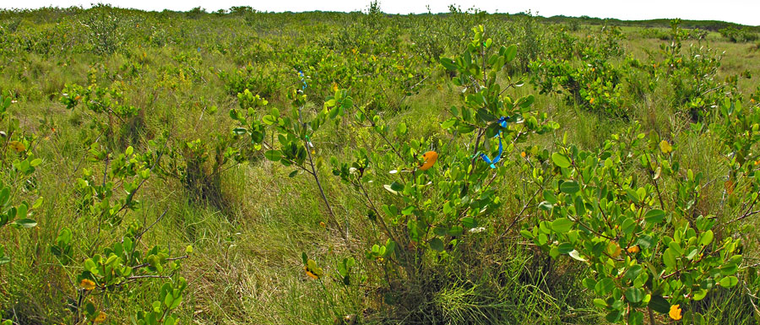
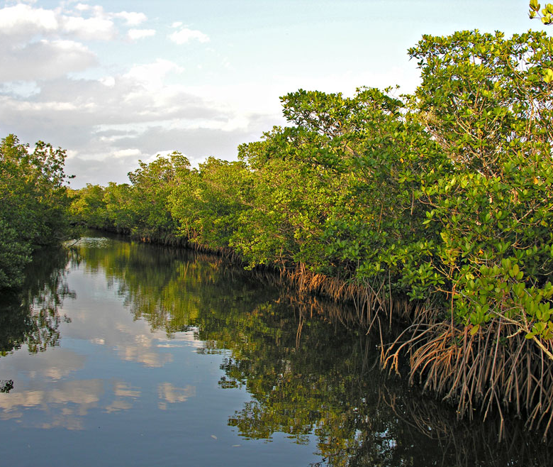
Pure Saltmarsh
Mangrove-Saltmarsh Ecotone
Pure Mangrove
Notes:
We used a 28-year time series of Landsat TM imagery to examine changes in mangrove area along this coastline each year from 1984 to 2011.

Slide 10
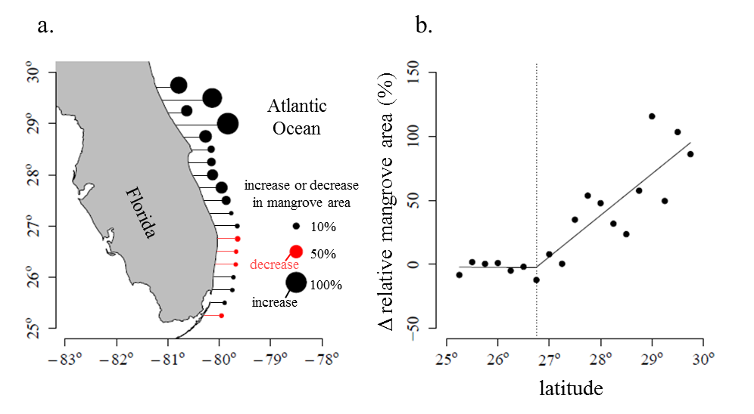
There is a strong relationship between latitude and the magnitude of increase in mangrove cover
Map shows long-term increase (black) or decrease (red) in mangrove in northern portion of study area.
Latitude relative change in mangrove area. Solid line represents a piecewise regression and the vertical dotted line gives the breakpoint (26.75°N) of the piecewise regression.
©2014 by National Academy of Sciences
Cavanaugh K C et al. PNAS 2014;111:723-727
Notes:
These two figures show the long-term change in mangrove area as a function of latitude. On the left hand figure black represents increases and red represents decreases. The size of the circle corresponds to the magnitude of the increase or decrease

Slide 11
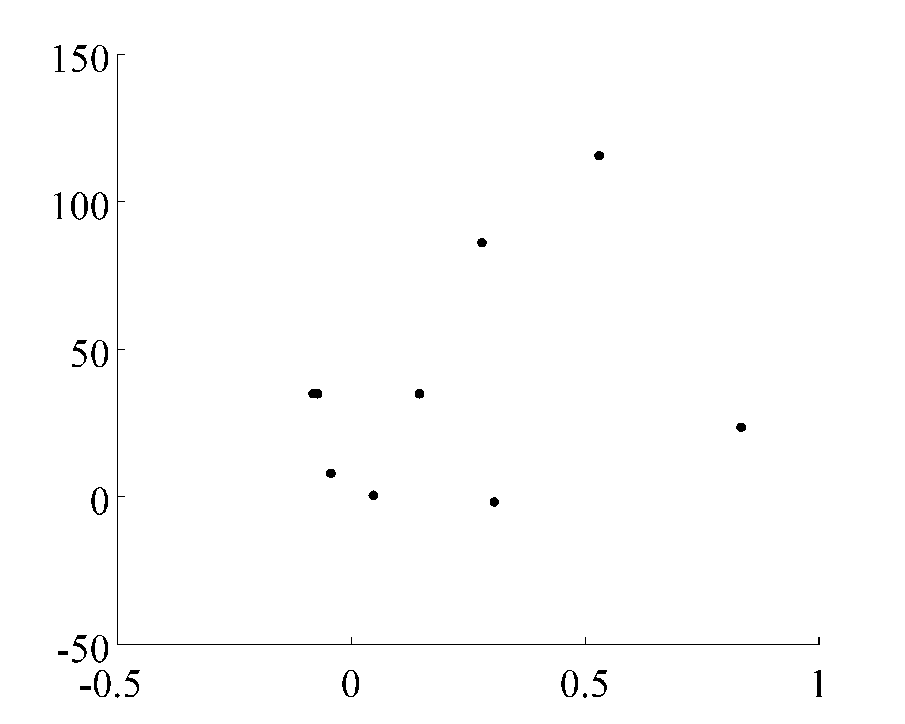
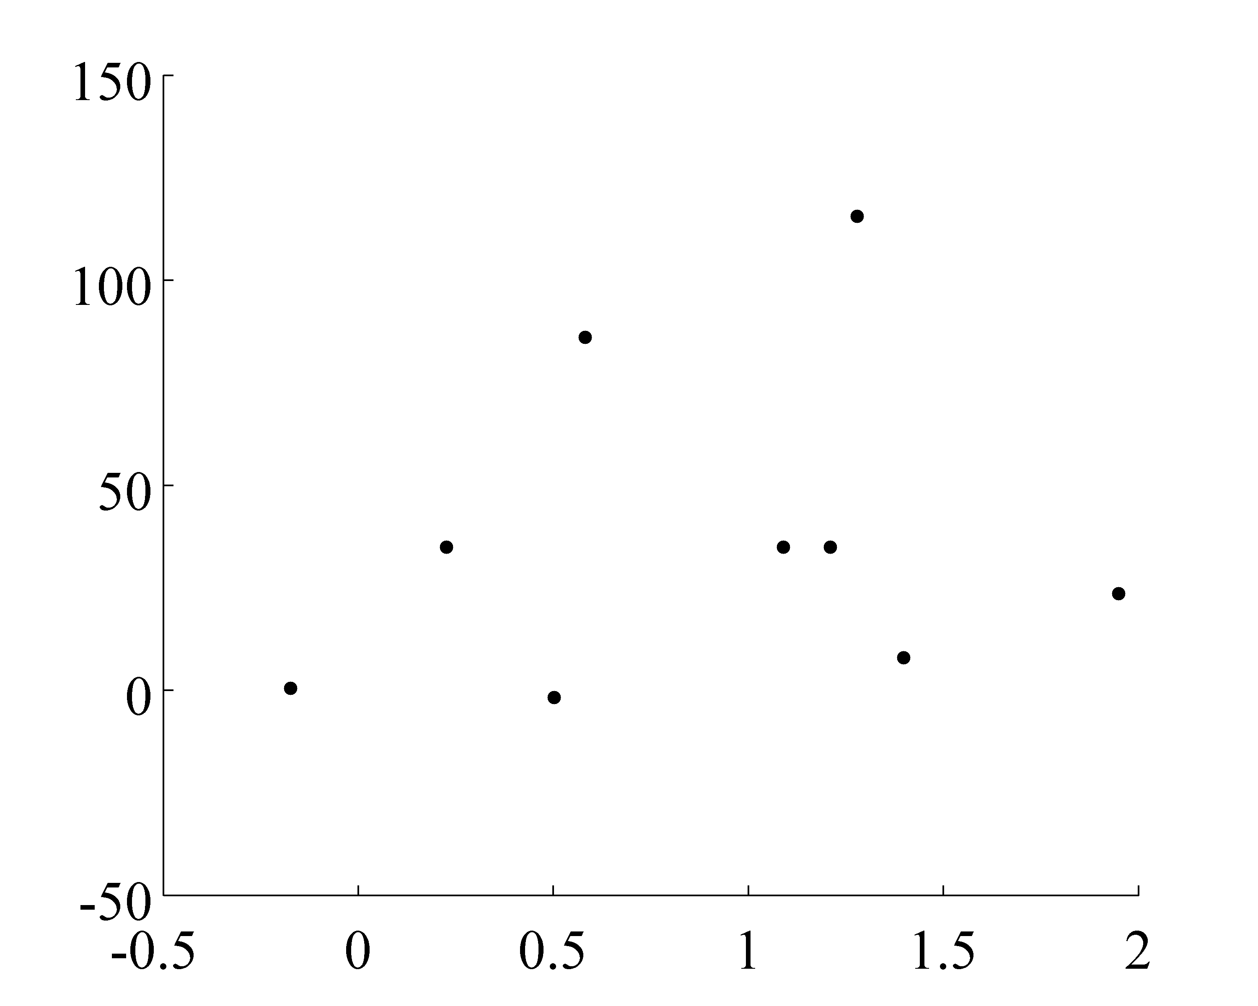
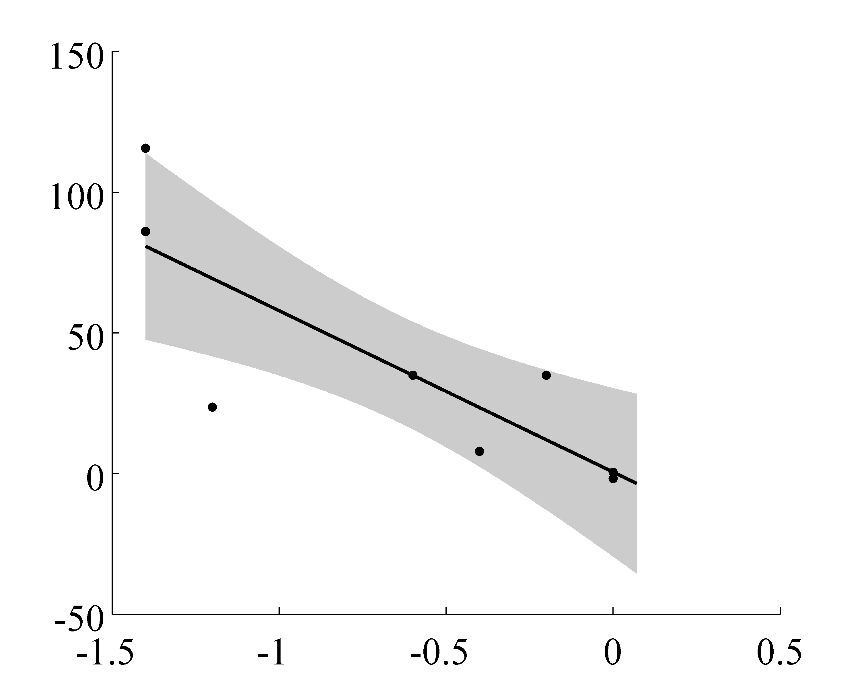
Strong relationship between change in mangrove cover and change in frequency of extreme freeze events
Δ mangrove area (%)
Δ annual mean temp (°C)
Δ winter mean temp (°C)
Δ mangrove area (%)
r² = 0.73
p = 0.003
Δ # days below -4 °C (1985-2011)

Slide 12
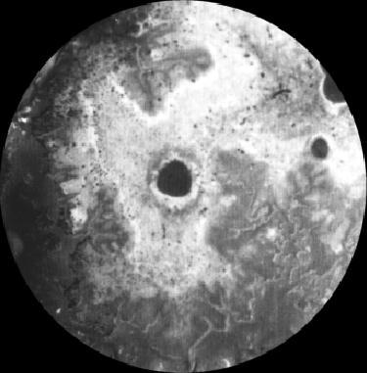
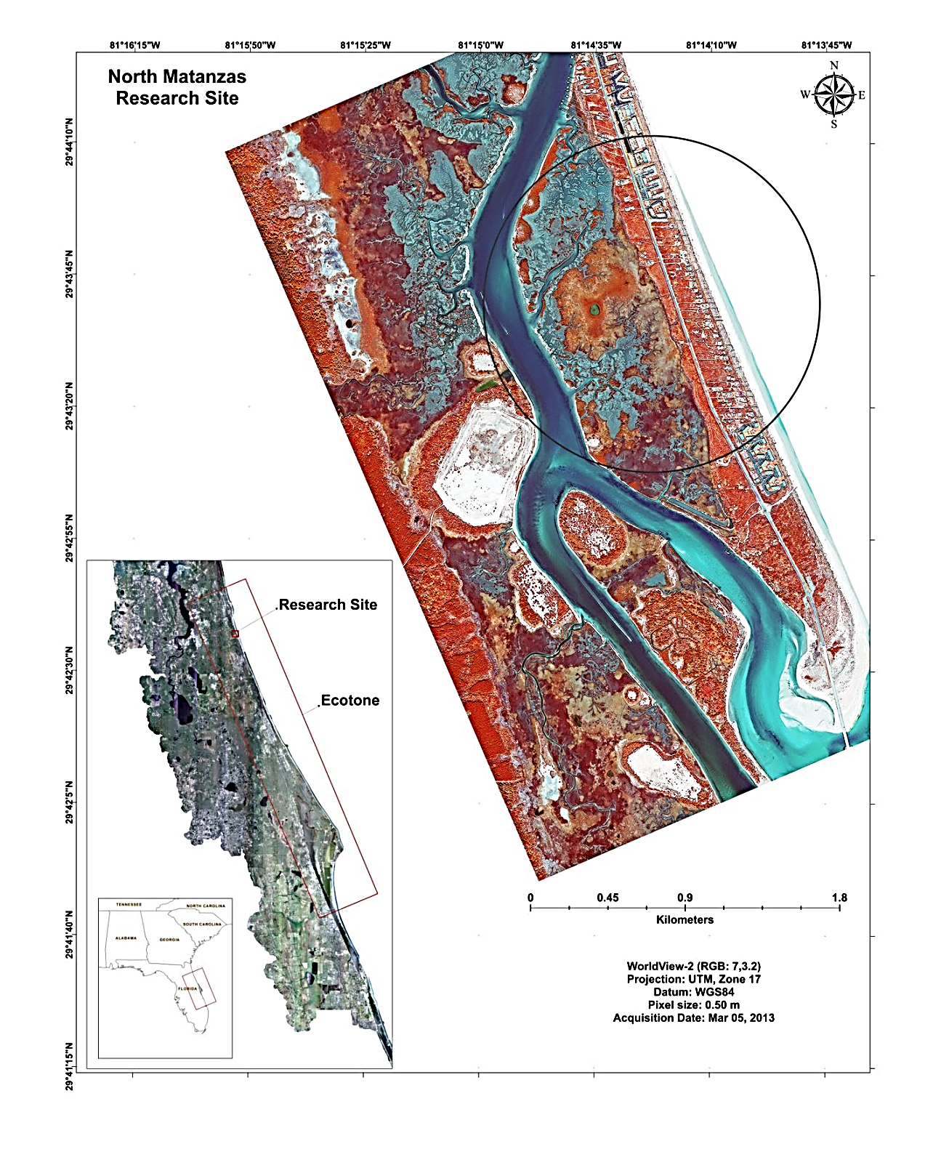
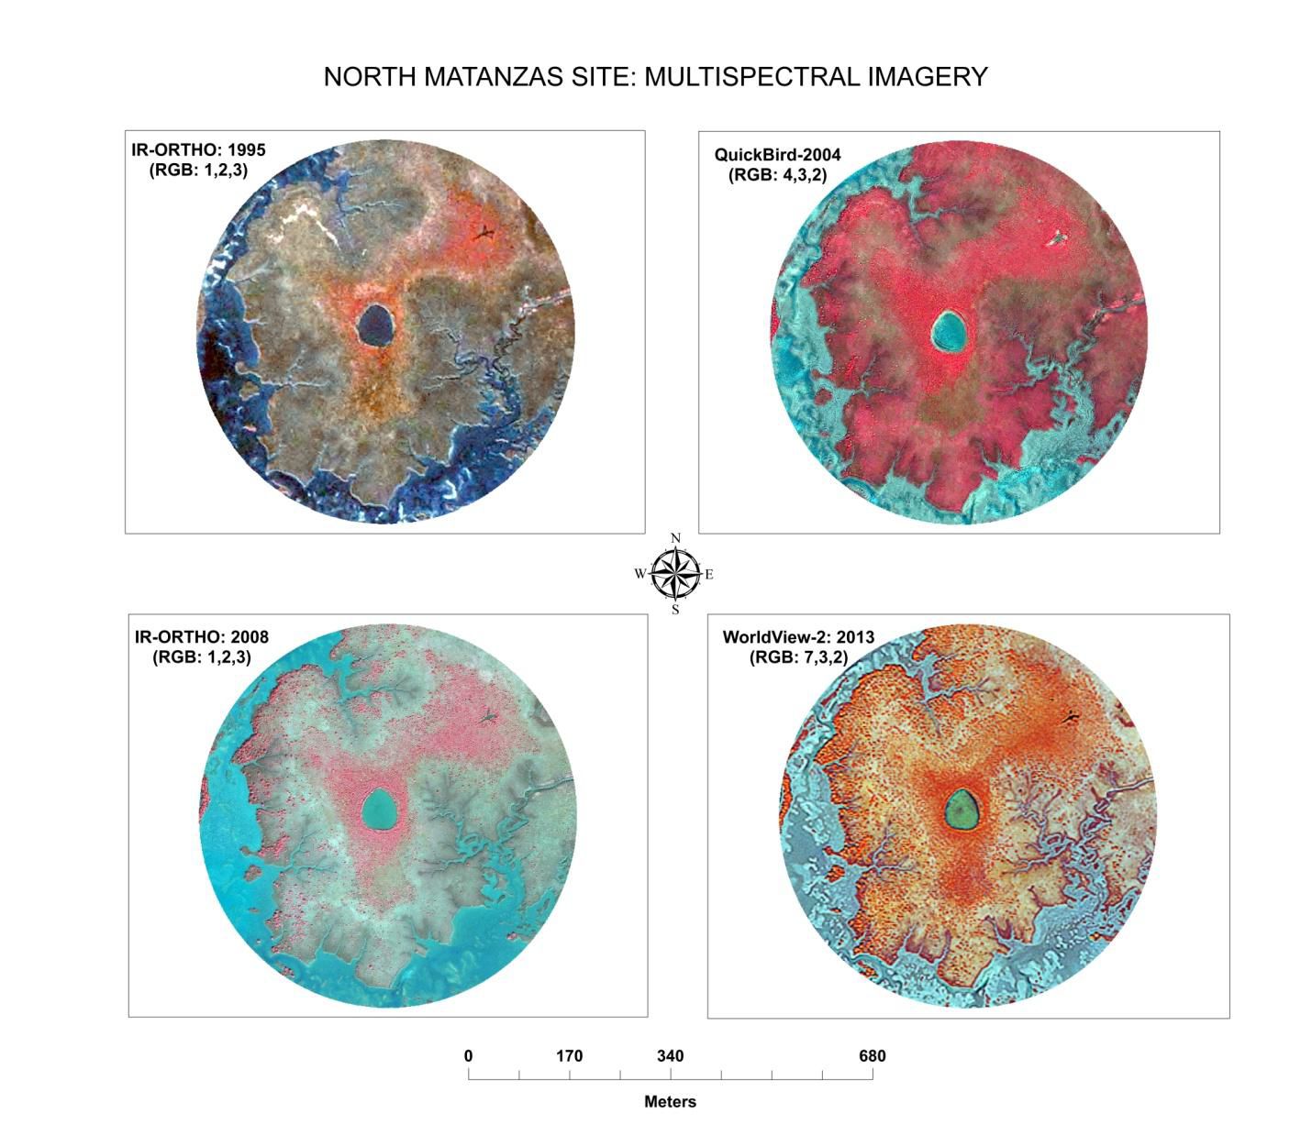
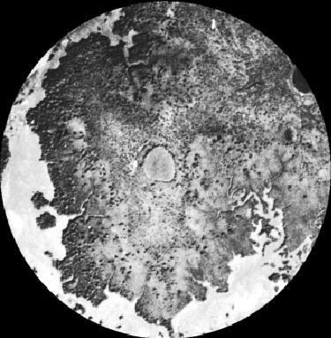
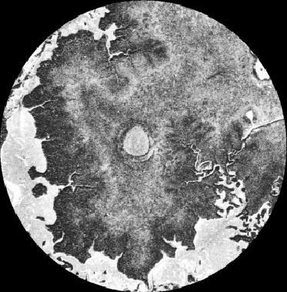
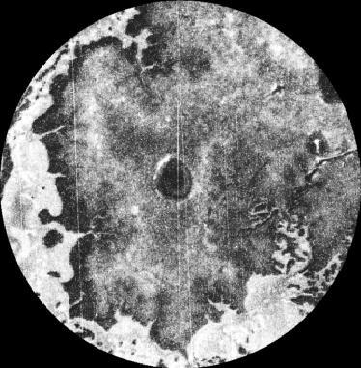
1942
1951
1971
1980
…1971 to 2013, ~0.24 ha per yr increase
Rodriguez et al. in review
Notes:
Results of our habitat classification shows a positive and significant (R² = 0.8784; P = 0.0058) increase of mangrove vegetation from 1971 to 2013, a time period of 42 yrs. The slope of the non-linear regression line showed a rate of change of approximately 0.24 ha per yr.
This gives us a detailed picture of how mangroves move into and expand across a landscape.

Slide 13
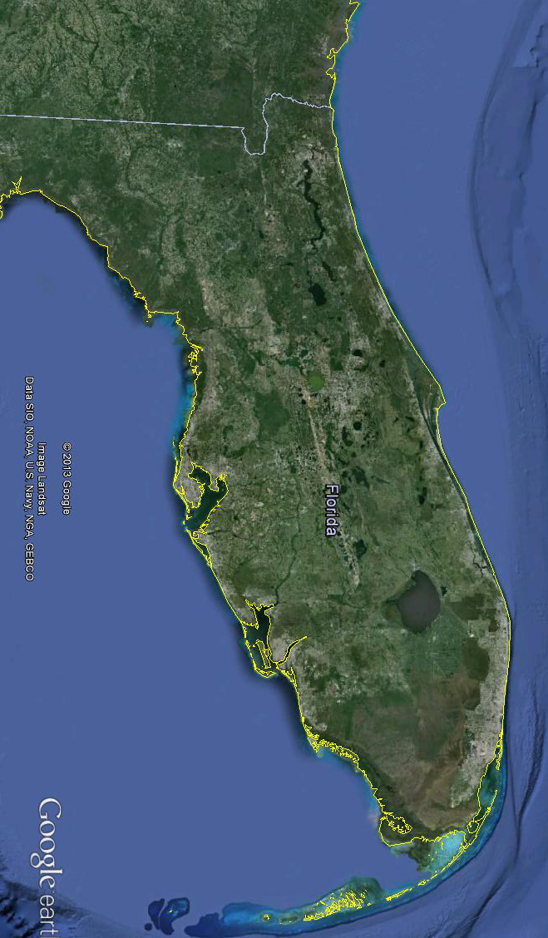
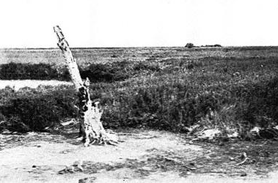
Bartram 1765-66, reported Avicennia germinans at Anastasia Island
Michaux 1788, reportedAvicennia germinans and Rhizophora mangle at Anastasia Island and Turtle Mound
Audubon 1835, spent a very cold night aground… on a “mangrove island” , New Smyrna in search of a brown pelican specimen;
Dr J R Motte 1836-38, Army surgeon; Fort Ann, Merritt Island; reported lush tangle mangrove forest killed by severe winter of 1835 from New Smyrna to Haulover Channel.
Historical records of mangrove distribution
From The East Coast of Florida, by John Milton Hawks (1887). He says on p. 44, "Port Orange is the farthest northern limit of the mangrove bushes which ted cover the low mud islands…”
Nicholson 1928 (The Wilson Bulletin) reported finding Macgillivary Seaside Sparrows nesting in small mangrove trees on Merritt Island; photo shows salt marsh with big dead Avicennia germinans tree in foreground
Notes:
From Sketches, Historical and Topographical, of the Florida: More Particularly East Florida. by James Grant Forbes (1821). He says on p. 59, regarding the climate of east Florida, “In St. Augustine, and south of it, the winter is scarcely perceptible at mid-day, at which time the ice previously formed melts. On the 3d of January, 1766, frost destroyed all the tropical production in the Country, except oranges. But this does not happen more than twice, perhaps, In half a century.” On p. 61, Forbes says “In the winter of 1773-1774, there was a snow storm in Florida, which was not injurious, being succeeded by moderate warm showers throughout the season;”.
From The Journal of Andrew Ellicott, late commissioner on behalf of the United States, by Andrew Ellicott (1803), based on expedition 1796-1800. Camped Point Peter on the St Mary’s River in north Florida, January 9-11, 1799: 9th. Thermometer 38° at sun rise, rose to 42. –Fine rain part of the day, and rain with hail during the night – wind N.E.; 10th. Thermometer 37 at sun rise, rose to 40. –Snow and hail the whole day! Which continued till 10 o’clock in the evening, when the thermometer fell to 32, the wind shifted to N.W. and it became clear at midnight; 11th. Thermometer 28 at sun rise, rose to 40. –Snow five inches deep

Slide 14
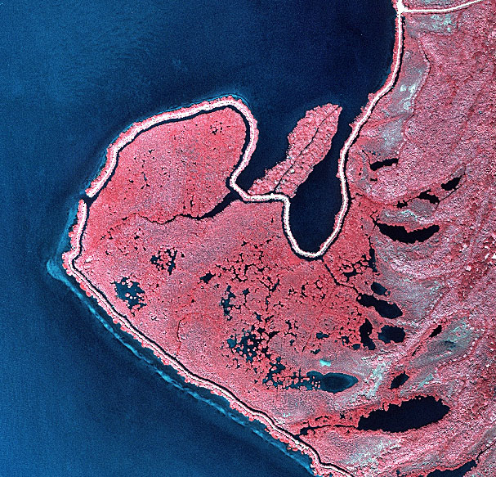
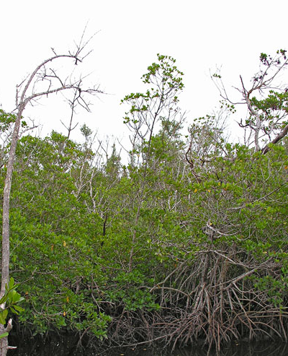
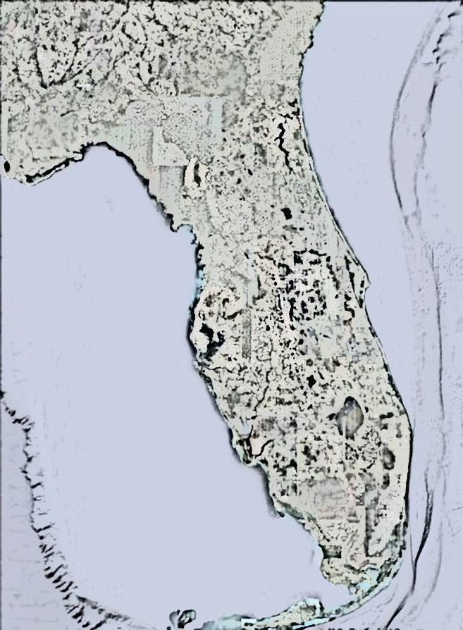
2005
27°32′34″N, 80°19′52″W
Avalon State Park, North Hutchinson Island, IRL, FL
Notes:
~~1 degree south along the Florida coast… North Hutchinson Island just north of Ft Pierce. Here, pure mangrove forests dominate.

Slide 15
2005
27°32′34″N, 80°19′52″W
Avalon State Park, North Hutchinson Island, IRL, FL
Notes:
The photo on the left is a satellite image take in 2005; on the right, a ground-level view also in 2005. This area is flooded and is now dominated by the red mangrove.
But, that wasn’t always the case.

Slide 16
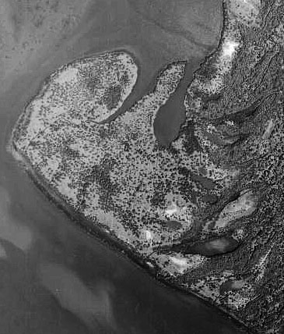
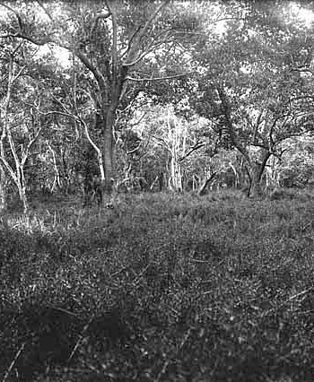
1943
27°32′34″N, 80°19′52″W
Avalon State Park, North Hutchinson Island, IRL, FL
Notes:
Here is an aerial photo of the same area… in 1943.
At that time, …67 years ago, this area was a mangrove forest, but a very different kind of forest… a black mangrove forest with a herbaceous assemblage of salt marsh species in the understory.

Slide 17
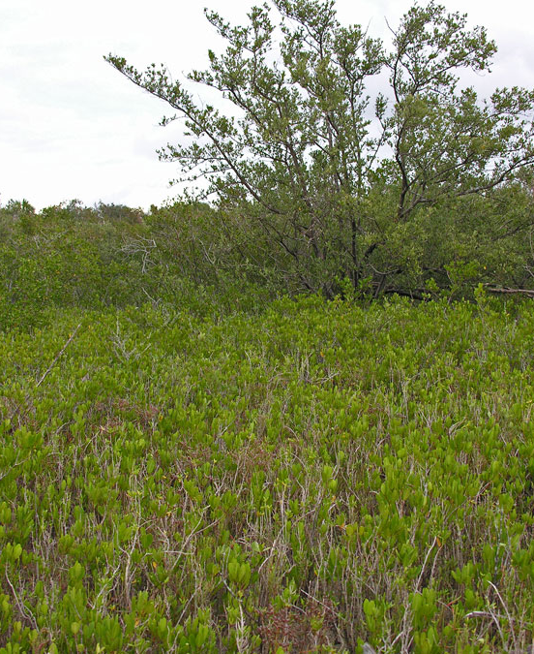
2013
1943
27°32′34″N, 80°19′52″W
Avalon State Park, North Hutchinson Island, IRL, FL
Notes:
This type of mangrove forest still exist in this location, but is restricted to the high intertidal.
We suspect that the switch from a black mangrove/saltmarsh mix to a red mangrove-dominated forest is the result of increased flooding due to sea level rise and man-made changes to this area’s hydrology.

Slide 18
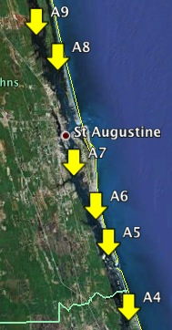
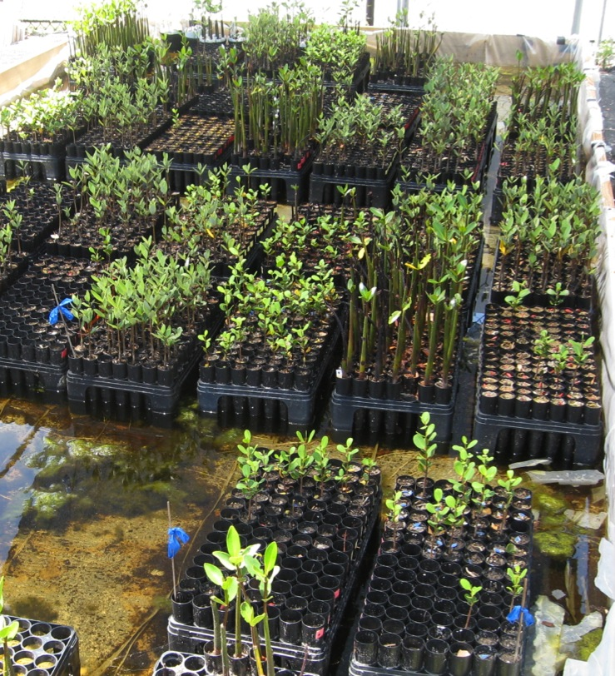
Stem growth higher in seedlings from northern populations
A4
A5
A6
A7
A8
A9
South
North
Forde CERF 2013

Slide 19
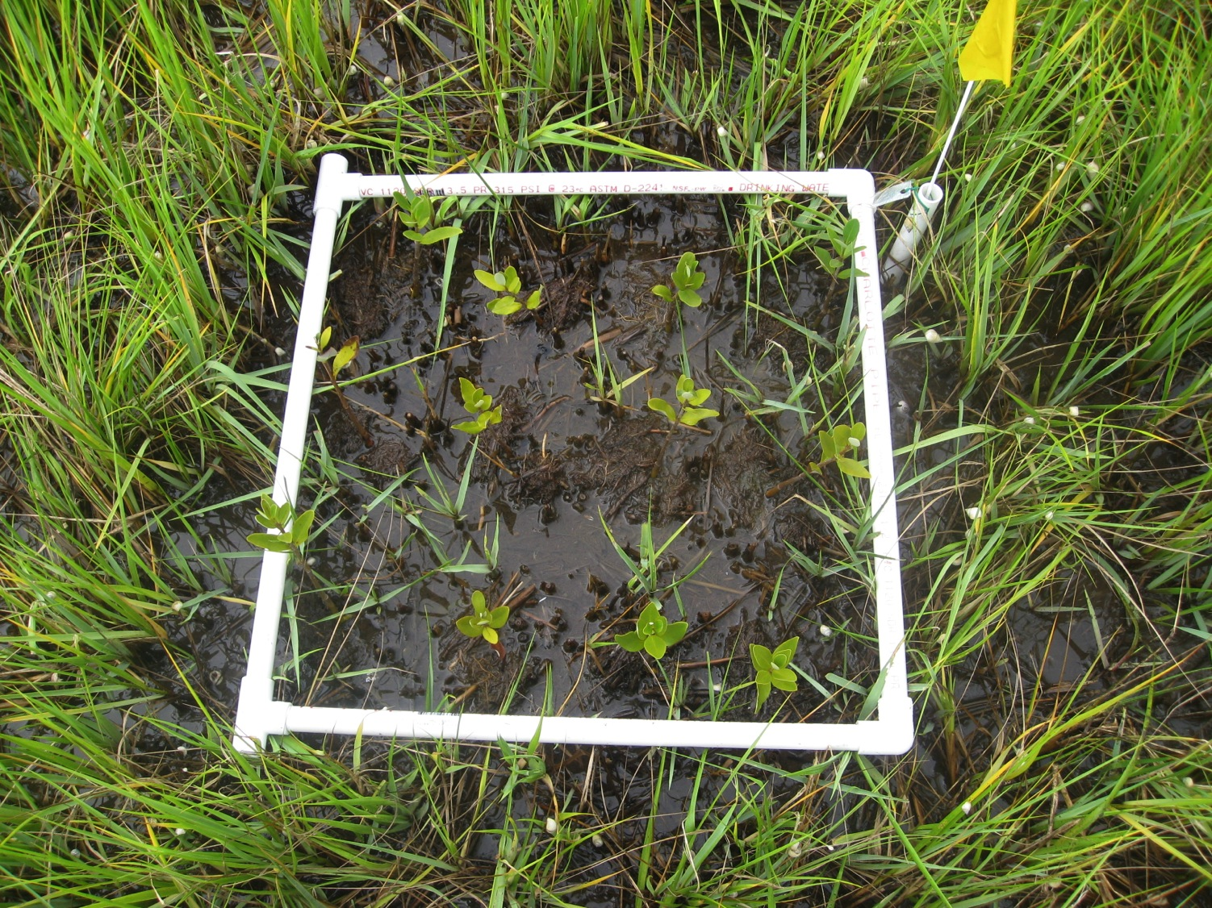
Stem and leaf growth higher in seedlings from northern populations
Forde CERF 2013

Slide 20
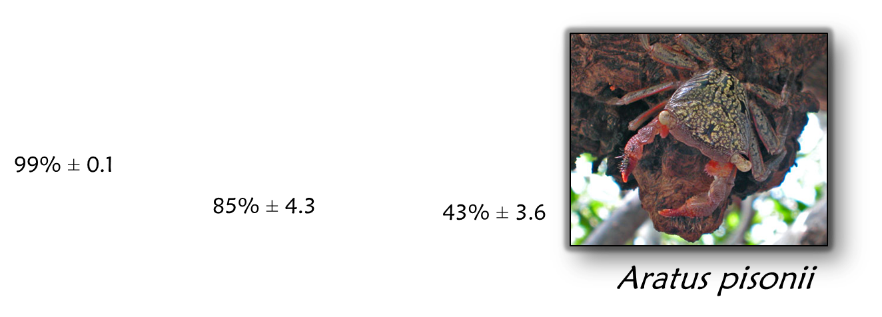
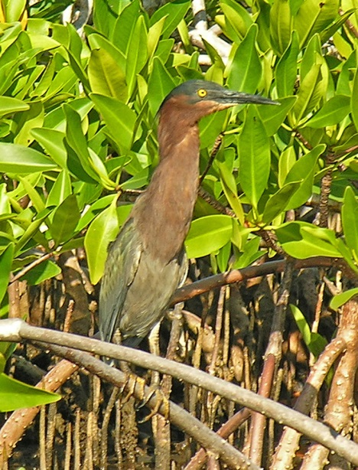
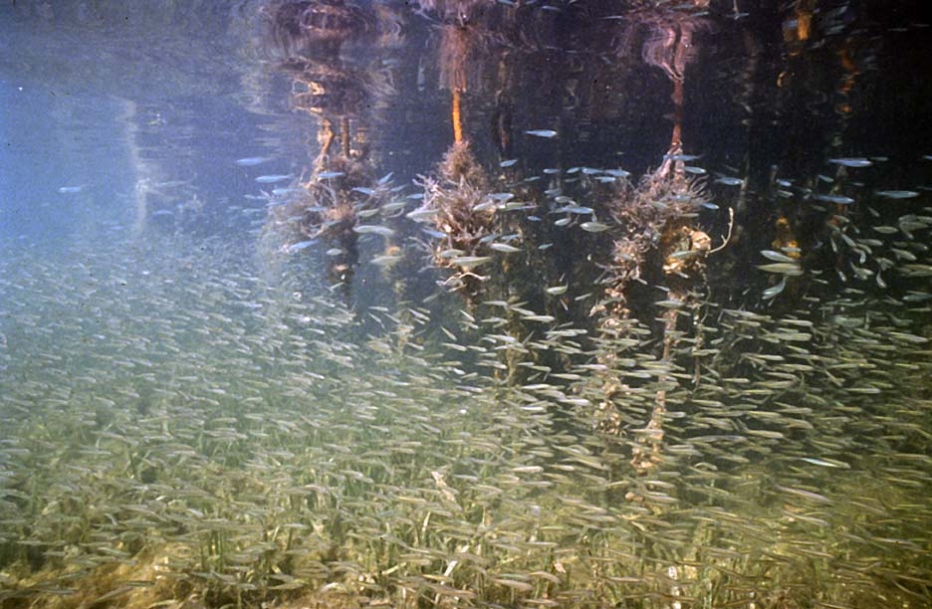
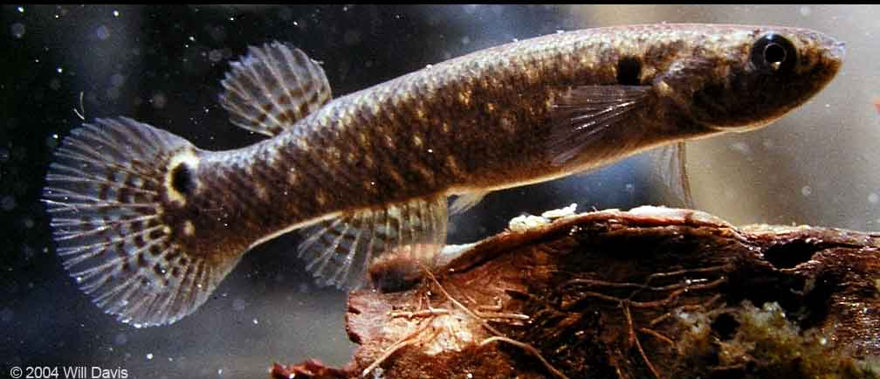
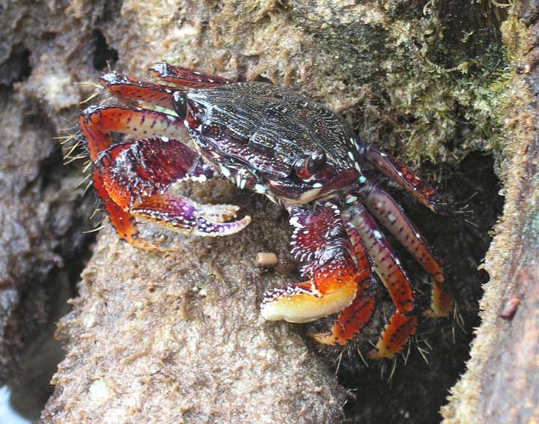
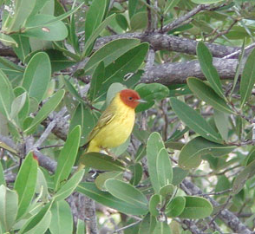
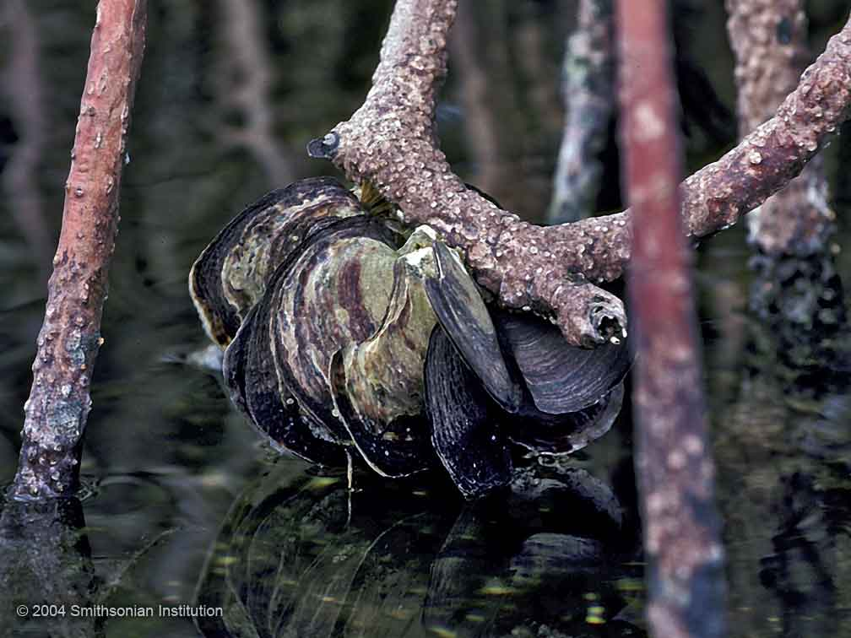
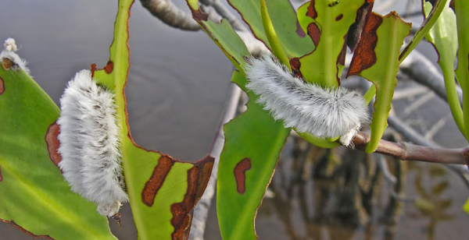
Faunal surveys
Aratus pisonii
Green heron
Mangrove rivulus
Goniopsis cruentata
Mangrove yellow warbler
Megalopyge dyerii
Isognomon alatus

Slide 21
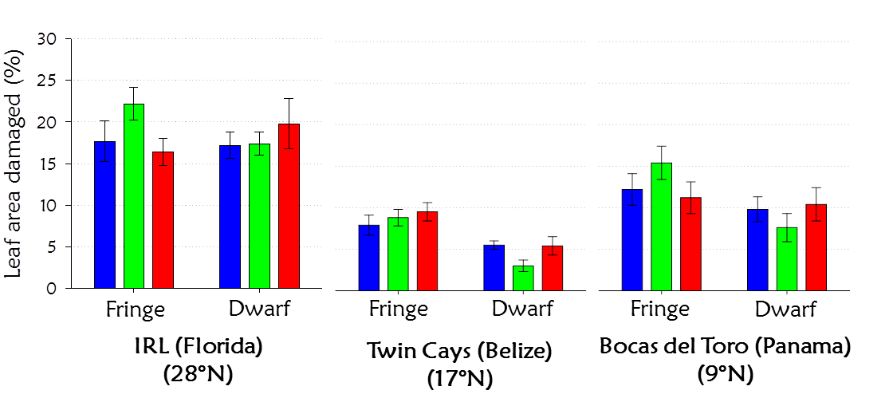
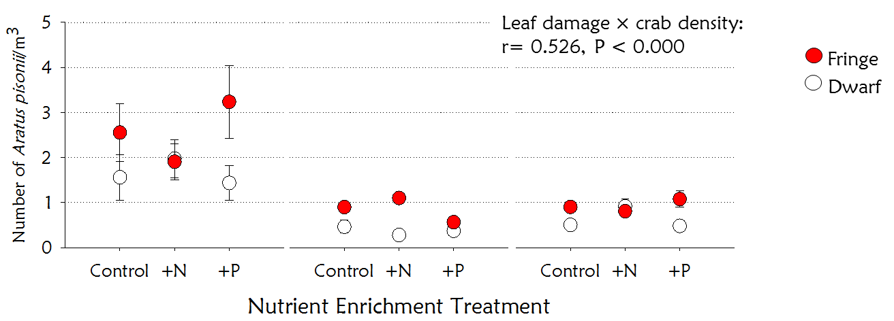
Feller et al Ecosystems 2013

Slide 22
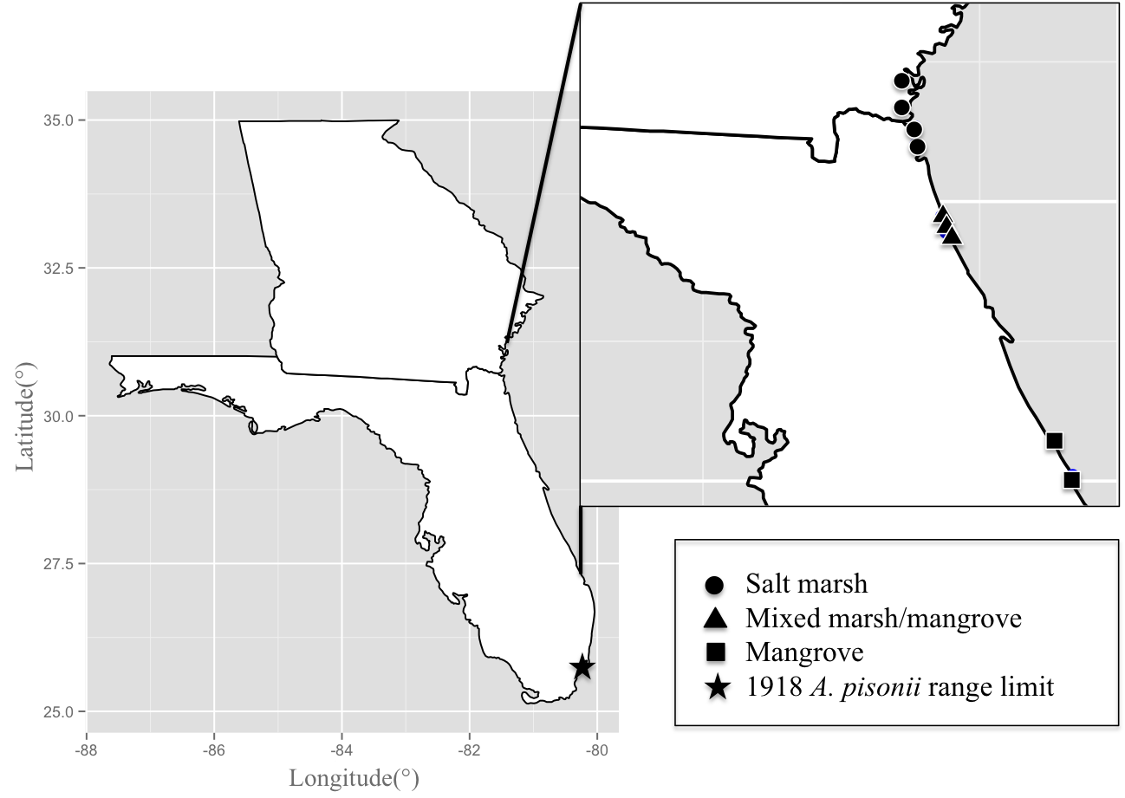
Range Expansion of Aratus pisonii
Survey of Atlantic coast of Florida and southern Georgia , June-August 2013.
Sites (N to S): Little Satilla Creek, Crooked River SP, Fernandina Beach, Big Talbot Island SP,
Anastasia SP, Devil’s Elbow, Fort Matanzas National Monument, Sebastian Inlet SP,
Avalon SP.
Star = northernmost limit of A. pisonii in 1918 (reported by Rathbun (1918)….
~62 km/decade range expansion over the past century (Riley et al. 2014).
Riley CERF 2013

Slide 23
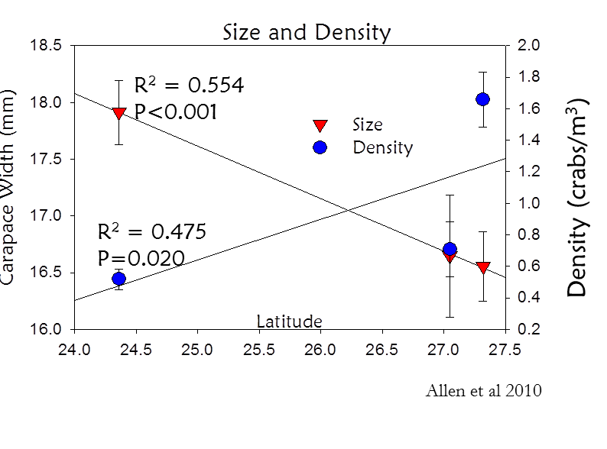
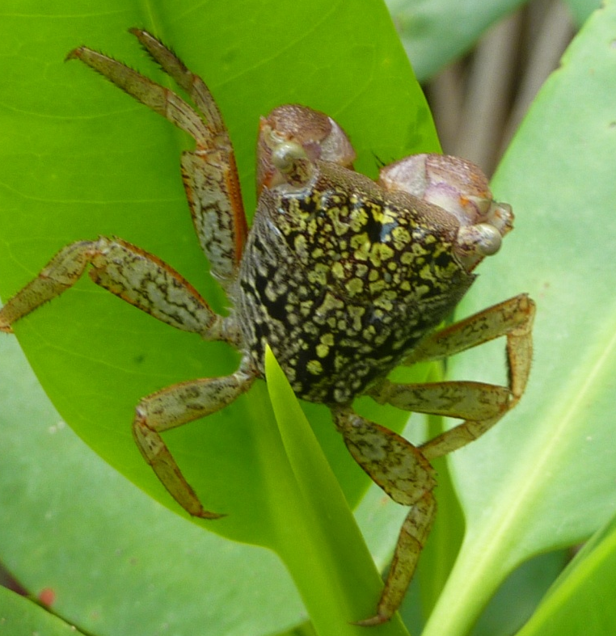
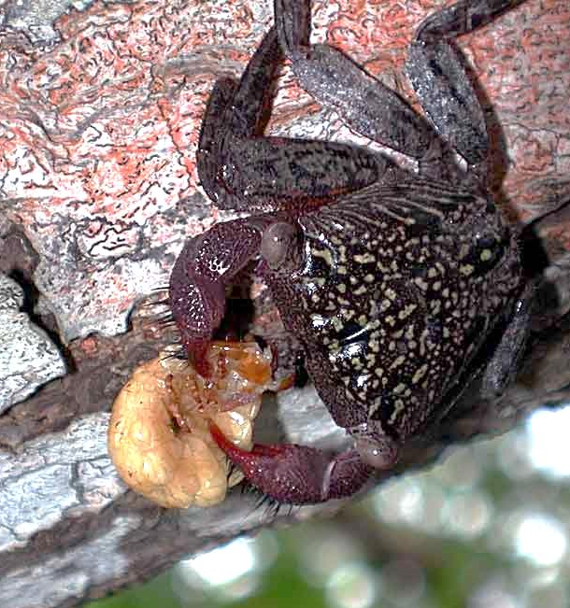
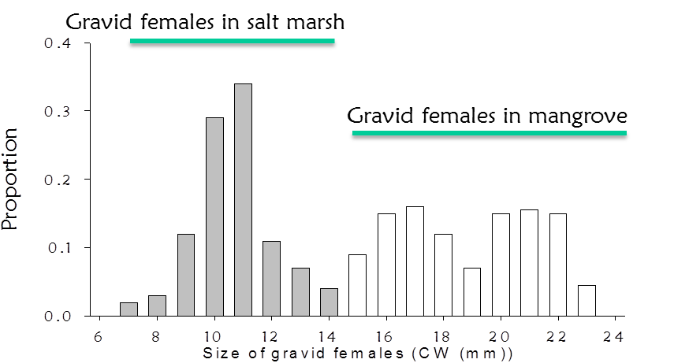
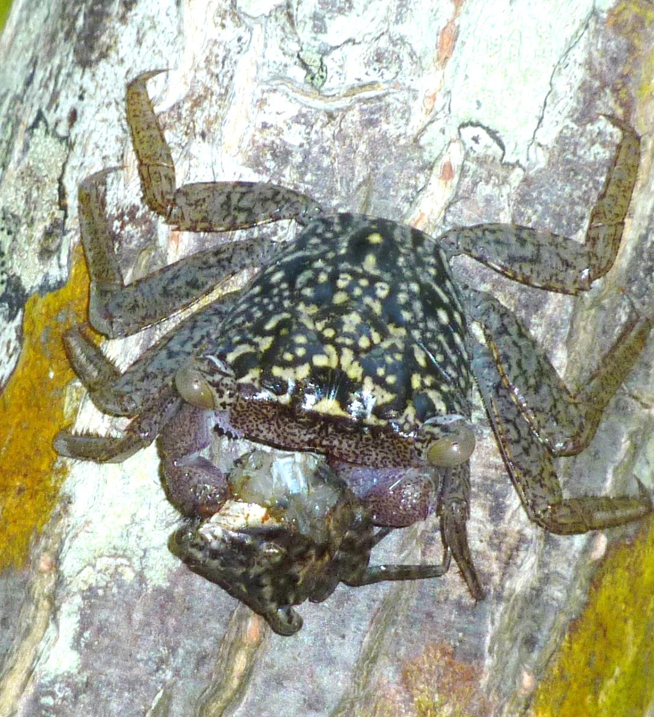
Range expansion of Aratus pisonii
Latitude
Riley CERF 2013

Slide 24
Summary
Mangroves and saltmarshes are changing in response to climate and land use change at multiple scales:
  climate/latitudinal ecotone
  intertidal ecotone
  local determinants of dispersal, recruitment, and growth
These changes are impacting:
  Community structure
  Ecosystem functions such as C storage & sequestration, nutrient cycling, sediment dynamics,
1943
2005

Slide 25








Thank you!
Acknowledgements
Susan Cook-Patton, Alex Forde, Mayda Nathan, Cora Johnston, Lorae Simpson, Mike Lehmann, Lisa Duckett, Megan Riley
NASA Biodiversity and Ecosystem Forecasting Program
NASA DEVELOP Program
UMD and Smithsonian field scientists
Guana Tolomato Matanzas National Estuarine Research Reserve
Thank you

