Slide 1

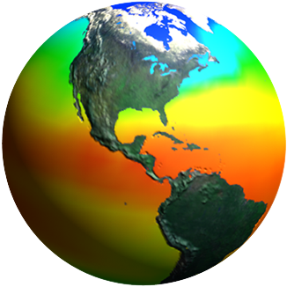
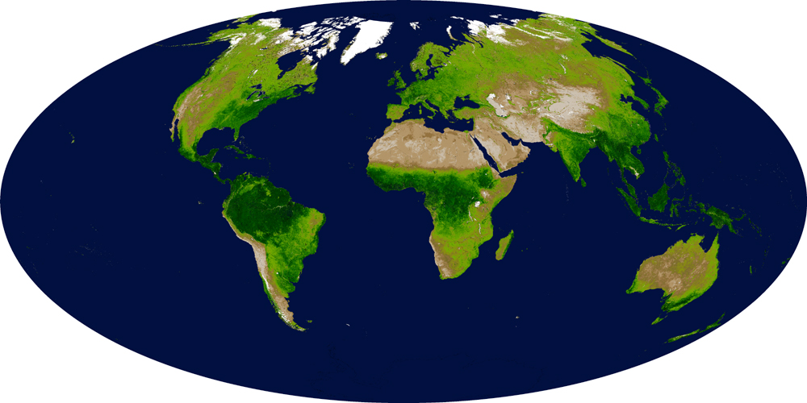
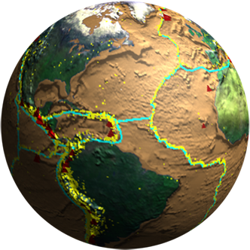
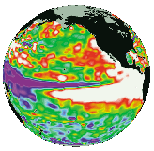

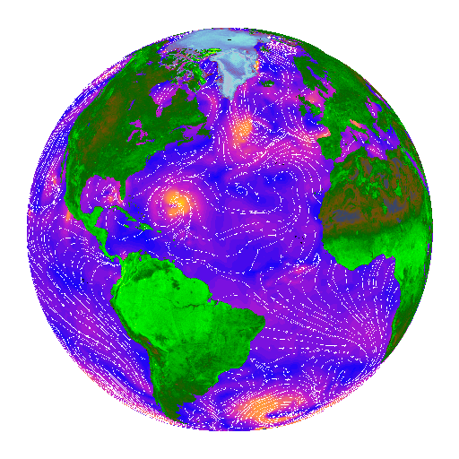
Biodiversity and Ecological Forecasting Team Meeting
Sheraton Silver Spring, Silver Spring, MD
Getting Ready for the Future
Woody Turner
Earth Science Division
NASA Headquarters
May 7, 2014
Notes:
Introduce Lawrence, Allison, Gary, Maury, Jay, and Cindy; ask DEVELOP students (Beth Brumbaugh, Sam Weber, Emily Voelker), PMs, Christine, etc. to introduce themselves.
A goal of this meeting is to prime the pump by getting the NASA Biodiversity and Ecological Forecasting communities to begin preparations for the next Earth Science Decadal Survey, both through consideration of key questions and topics for their communities and also by considering next steps (the process) to enable these communities to provide useful information to the decadal survey.

Slide 2
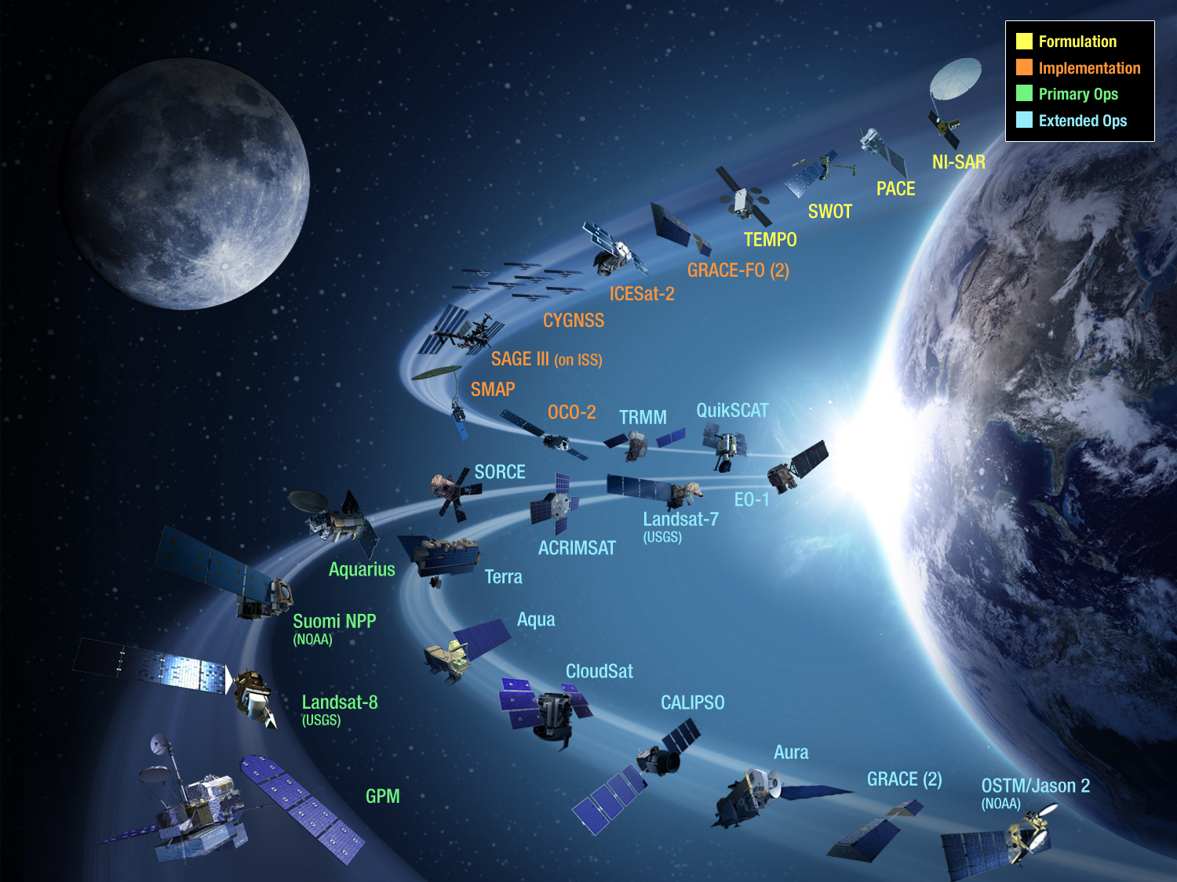
NASA Earth Science Missions
Current & Planned
Plus Earth Ventures
Notes:
Most of you are here today because you receive NASA funding. It’s always important to remember that NASA is a mission agency. We build and launch space missions.

Slide 3
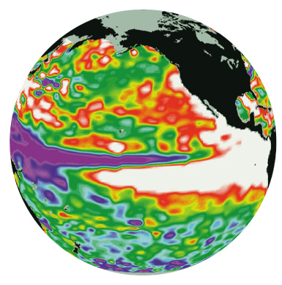


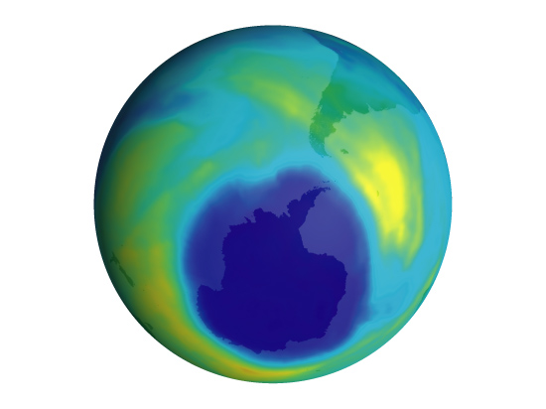
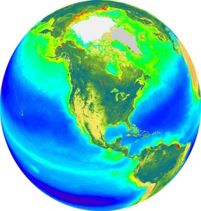
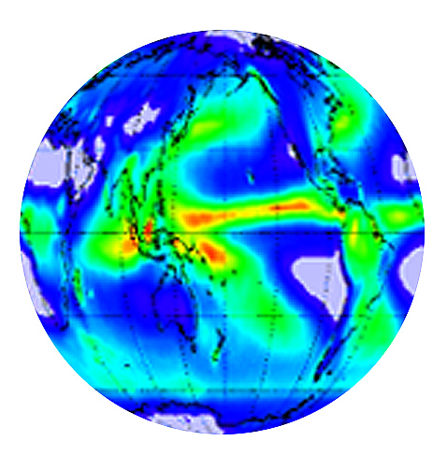


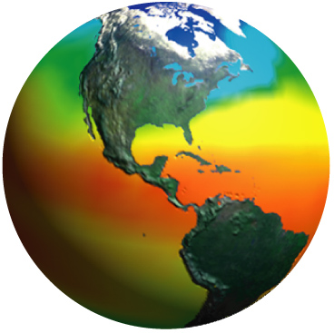
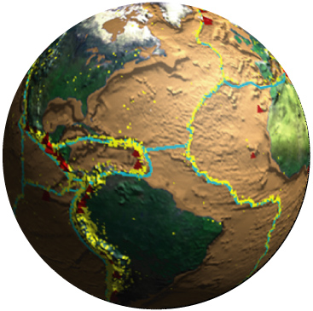
Why We Launch the Missions
Earth Science Focus Areas:
Climate Variability & Change
Atmospheric Composition
Carbon Cycle & Ecosystems
Water & Energy Cycle
Weather
Earth Surface & Interior
Earth Science Applications Areas:
Health &
Air Quality
Water Resources
Disasters
Ecological Forecasting
Notes:
Of course, the reason for these missions is why we are here: to do basic scientific research furthering understanding of the integrated Earth system and to promote the wider application of Earth science products for societal benefit. Lawrence Friedl will follow with a discussion of the evolving context and framework for Applied Sciences at NASA. Jack Kaye will provide a NASA Earth Science Research and Analysis update on Friday.

Slide 4

From Science & Applications to Missions
Notes:
But how does NASA get from scientific and applications categories to missions? Seven years ago (2007), the National Research Council (NRC) reported to NASA, NOAA, and USGS consensus recommendations from the Earth and environmental science and applications communities for high-priority science and applications activities the agencies should pursue during the coming decade. This Earth Science Decadal Survey’s mapping of science and applications to missions has made it a very influential document. It has served as a roadmap for NASA planning for the past seven years—a touchstone for NASA Earth Science.

Slide 5
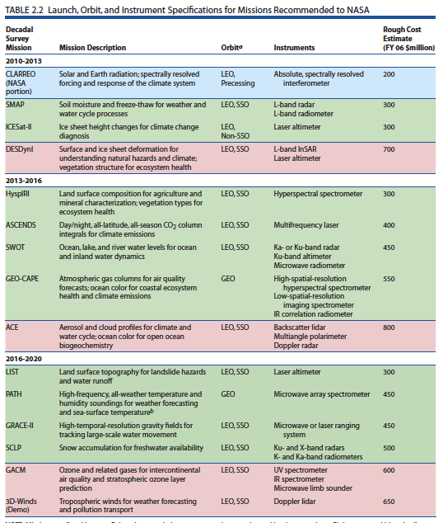
A Very Popular Table
Notes:
The Decadal Survey defined actual flight missions and activities to support national needs for research and monitoring of the Earth system. Its lists of recommended missions and mission summaries are perhaps the parts of the report receiving the most attention. Yet, these missions arose from the scientific and applications objectives in the report.

Slide 6
Round Two
Notional Schedule for Next Earth Science Decadal Survey
Notes:
The NASA Earth Science Division is now embarking on a new Decadal Survey with the NRC. In his talk, Steve Volz will provide an update of where we stand and our plans. Whether the next report will recommend a list of missions is still TBD. What it will almost certainly contain is a series of key scientific and applications questions and themes that the Earth Science Division needs to address to advance Earth System Science. Getting ready to inform this part of the process is where we come in. Now is the time to prepare and organize our biodiversity and ecological forecasting communities and begin to define the science and applications we need to see accomplished over the next 10+ years. Our breakout groups are a start.

Slide 7
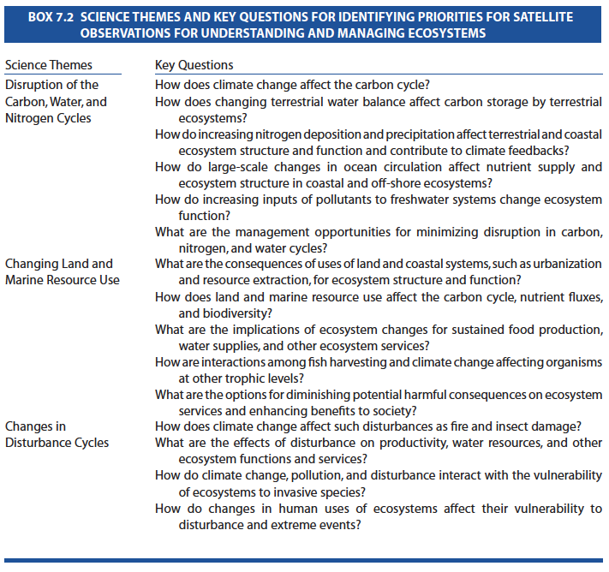
Much Remains to Do from 2007
(NRC, Earth Science and Applications from Space, 2007)
Notes:
Your homework (Chapter 7 of the 2007 Decadal Survey) gave you a sense of how the NRC developed the scientific and applications rationales for missions. It seems strikingly current in terms of some of the key questions and themes identified. There is still much to do in terms of this report.

Slide 8
Top 10 Questions for Conservation that can be addressed via Remote Sensing
How can global Earth observation data be integrated into models of species distributions and abundances to inform conservation action?
How can remote sensing improve the understanding of the processes controlling spatial and temporal dynamics of animal movements?
How can remotely sensed ecosystem variables be used to understand, monitor, and predict ecosystem response and resilience to multiple stressors?
How can remote sensing monitor the rate, magnitude, and spatial and temporal effects of climate on ecosystems?
How can near real-time ecosystem monitoring catalyze environmental enforcement, governance and compliance, and resource management decisions?
How can remote sensing inform configuration of protected area networks at spatial extents sufficient to maintain ecologically functional and resilient populations of target species and maintenance of ecosystem services?
How can remote sensing-derived products be used to value and monitor changes in ecosystem services?
How can remote sensing and associated analytical tools be used to monitor and evaluate the effectiveness of conservation efforts?
How does the rate and pattern of expansion and intensification of agriculture and aquaculture alter ecosystems and the services they provide?
How can remote sensing be used to determine the degree to which ecosystems are being disturbed or degraded, and the effects of these changes on species and ecosystem functions? (used with the permission of WCS/Robert Rose)
Notes:
While not intended for the Decadal Survey, in early 2013 the Wildlife Conservation Society hosted a workshop on behalf of the NASA Applied Sciences Ecological Forecasting Program to develop the top ten conservation questions that can be addressed through remote sensing. Participants interviewed over 100 experts and developed 360 questions that were whittled down to 183 by vote and then down to 10 at the workshop following a modified Delphi process published by Bill Sutherland et al. The paper resulting from the workshop is in prep for Conservation Biology.

Slide 9
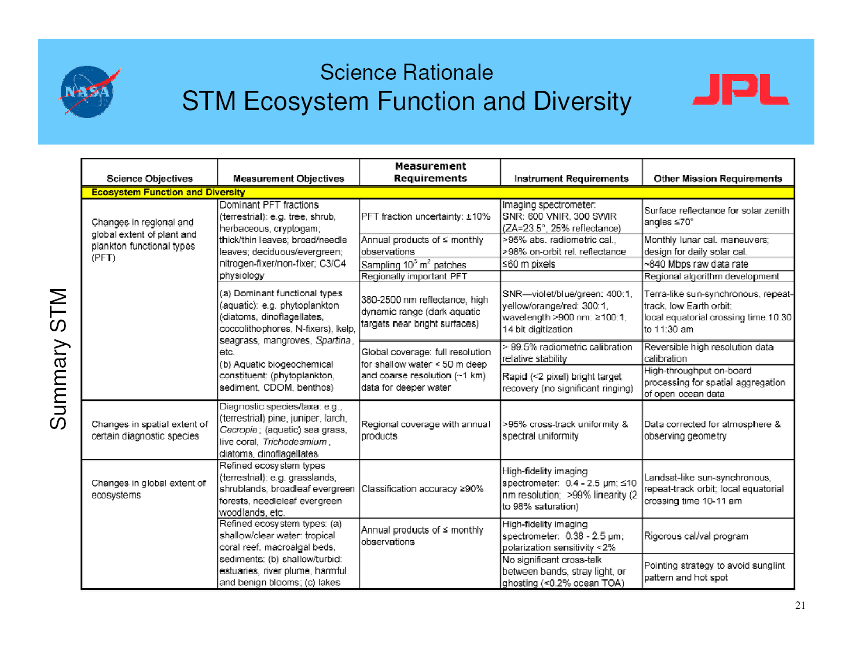
Notes:
Getting more specific, the translation from a key science question, theme, or objective to mission requirements is often done through a science traceability matrix (STM). The example above comes from JPL/Simon Hook and is for the pre-formulation HyspIRI mission. It addresses one of the key themes for that mission: “Ecosystem Function and Diversity.” STMs may have more columns than above and can get into much greater detail, as necessary for the task at hand.

Slide 10
An Applications Traceability Matrix
Notes:
Simon Hook has also developed an applications version of the STM called an Applications Traceability Matrix (ATM). Here is a row, focusing on water management, from an ATM for the HyspIRI mission.

Slide 11
What are your key questions and themes for NASA Biodiversity and Ecological Forecasting?
Notes:
Our breakout groups will allow us to begin a discussion of key questions and themes. This team is in its ninth year. We have an opportunity with this Decadal Survey to do some strategic and then tactical thinking about where NASA and the programs should go over the next decade. It’s an opportunity we cannot miss without risk of losing our science and applications entirely or at best having someone less able define them for us. Please speak for your communities. NASA is listening.

Slide 12
Guidelines for Breakout Groups
Self-select into 3 groups: Marine, Terrestrial Research, Terrestrial Applications
Each Group has a facilitator and rapporteur
Brainstorming: at start, each person has 10-20 seconds to suggest a key question or theme in biodiversity research or ecological forecasting with a remote sensing connection; rapporteur captures
After going around, use the remaining breakout time to refine these questions/themes as well as suggest and refine new ones
In plenary: speaker for each group spends 5 minutes reporting out questions and themes followed by 10 minutes discussion on that group’s questions and themes; x 3 = 45 minutes
Remaining 25 minutes in plenary for general discussion as well as consideration of next steps (the process) for the NASA Biodiversity and Ecological Forecasting programs to follow leading to Decadal Survey

Slide 13
Back Up

Slide 14
Terrestrial Research
Global land cover and disturbance (annual, 100m, continuous fields and nested classification, 1970 onwards where possible)
  Natural and human influence and response
Continuity of global daily moderate resolution vegetation indices (consistency between AVHRR, MODIS, VIIRS records)
  Link to climate; vegetation productivity and change, short and long term dynamics
Global sampling of Lidar (small footprint), systematic acquisition and opportunistic/tasked drone
  3D vegetation structure and terrain
Notes:
The first of three report-out slides from last’s years team-meeting breakout groups addressing what tools, observations, sensors, models, policies, and products are needed to make progress in our programs

Slide 15
Marine Group Feedback
Implement an observational system that will allow the collection of biodiversity and optics information to assess biodiversity from space. This system will include sentinel sites and surveys (coastal and pelagic)
Hyperspectral and hyperspatial data in the global coastal zone and deep ocean (spatial resolution to scale with the distance from the coast)
Develop Marine biodiversity model comprising global, basin and regional scales within a CF compliant framework. Develop tools to facilitate easy exchange of biodiversity data and data products
Develop an interagency and international policy framework to establish a comprehensive biodiversity observational network that links across land, ocean, and air

Slide 16
Terrestrial Applications
3D Canopy Structure
  Habitat structure upon which biodiversity depends
  Biomass, degradation
  Fuel loads
  Large complimentary with other sensors (fusion)
Open Access to and standardization of the results of what NASA funds
  Improved ease of use
  Standardized QA, formats, metadata, geo-referencing, coordinate system, and units
  Accessibility after standard period
“MODISization” of Landsat
  Examples of products include: Land cover, land cover change, productivity, disturbance, phenology, vegetation indices

