Slide 1






Satellite Driven Studies of Climate-mediated Changes in Antarctic Food Webs
May 7, 2014
Matthew Oliver, Megan Cimino, Andrew Irwin, William Fraser, Josh Kohut, Oscar Schofield, Mark Moline, Donna Patterson, Vince Saba

Slide 2
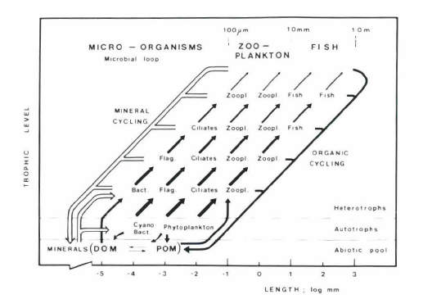
Satellite Driven Studies of Climate-mediated Changes in Antarctic Food Webs
Larger starting prey supports large predators with fewer trophic steps
Changes in lower trophic levels could be transferred to upper trophic levels
Trophic level
Azam et al, 1983
Length Scale (concentration) of prey

Slide 3
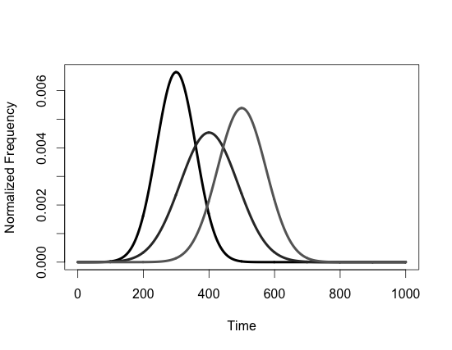
Short Food Webs Increase Chance of Prediction
Hypothesis: Environmental Trends Predict Upper Trophic Levels
Look for places with big environmental perturbations, and short food webs.
Enormous interest in conservation
Predator
Environmental Change
Prey

Slide 4
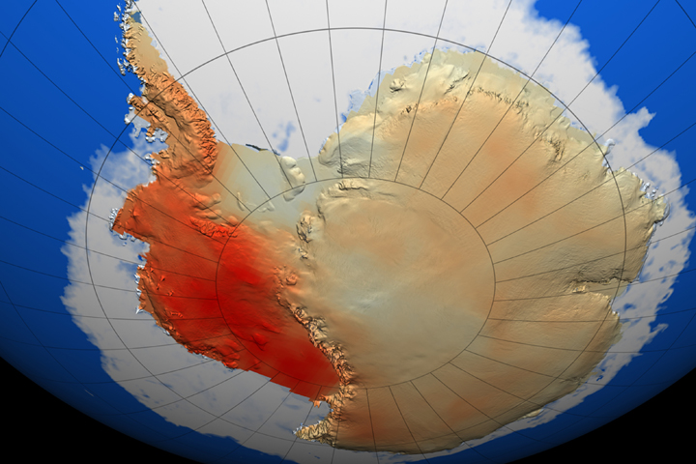

West Antarctic Peninsula is Rapidly Warming and Losing Ice
Penguins
Krill
Climate Perturbation

Slide 5
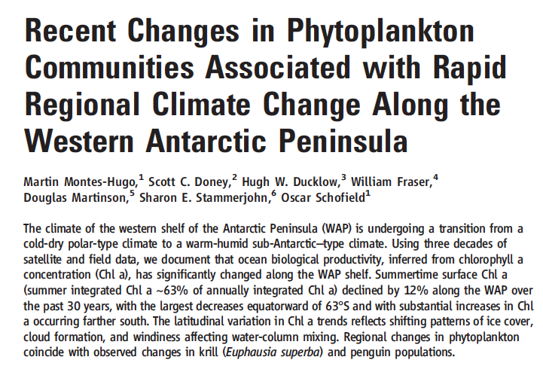
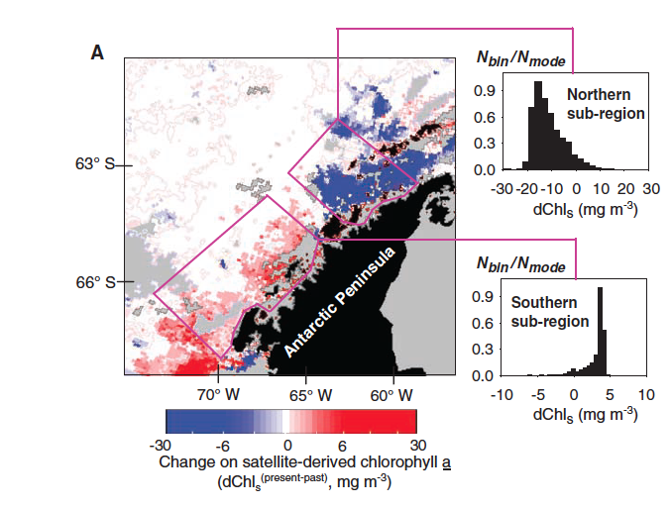
The changes in phytoplankton are at least regional (West Antarctic Peninsula)
West Antarctic Peninsula Losing Sea-Ice
Penguins
Krill
Climate Perturbation

Slide 6
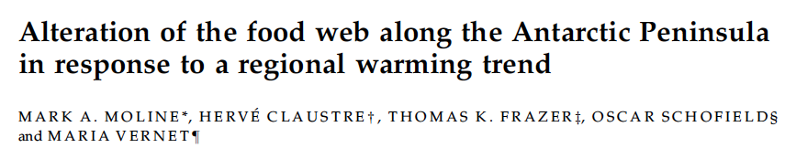
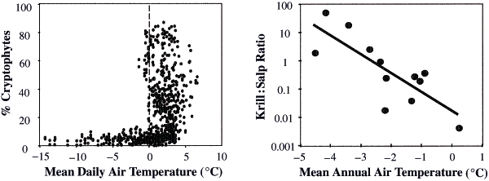
Changing Phytoplankton Community Composition in the WAP
Krill can not eat cryptophytes because they are too small

Slide 7
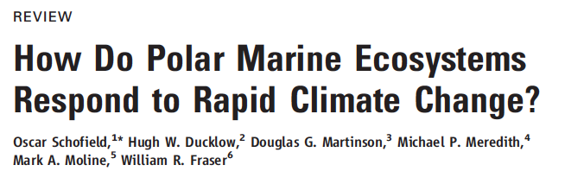

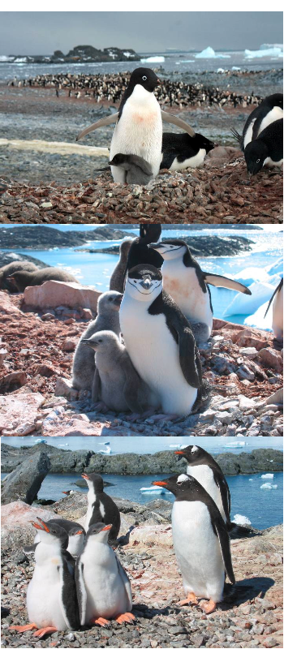
Background
Penguins are following suit with the change
NASA funded review of the system.

Slide 8
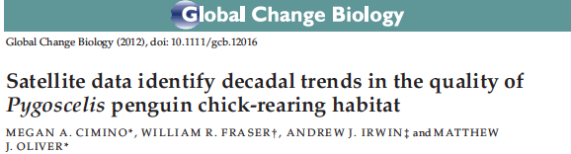
Short Food Webs Increase Chance of Prediction
Hypothesis: Environment Predicts Populations of Penguins
The error term encapsulates small scale or cyclical environmental variation, and any top-down component. This is a bottom-up approach.

Slide 9
Problem
We have penguin location information, but not many population counts
Change the terms of the hypothesis
The probability of finding a specific penguin species dependent on the environment
Sets up a nice natural experiment between the WAP and the Continent
So Far, we have decent estimates of

Slide 10
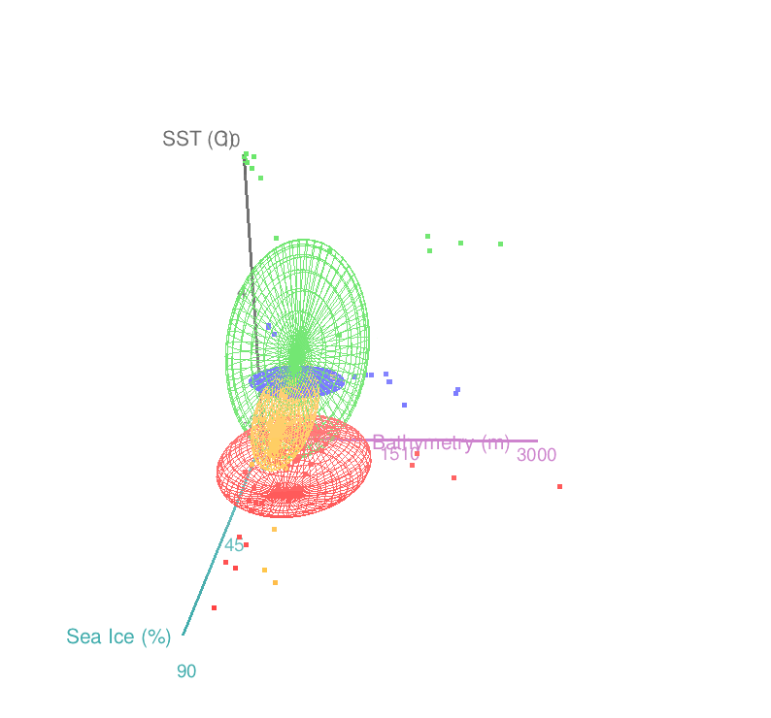
Continental
Adélie
WAP
Adélie
Chinstrap
Gentoo
Satellite Driven Niche Space of Chick Rearing Habitat (CRH)
Large Scale Remote Sensing/Modeling

Slide 11
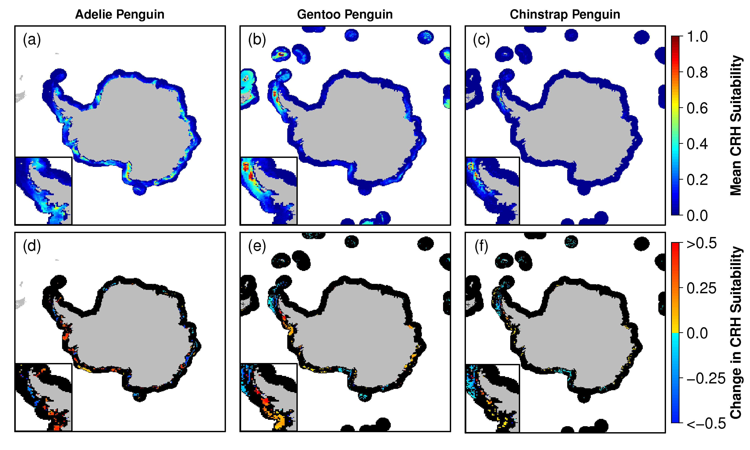
Quantify the distribution and the 30 year trend of CRH Niche Space
So What?
Notes:
0 and 1 of probability of presence.
The image uses colors to indicate predicted probability that conditions are suitable,
red indicating high probability of suitable conditions for the species,
green indicating conditions typical of those where the species is found,
lighter shades of blue indicating low predicted probability of suitable conditions.

Slide 12
Problem
We have a lot of location information for penguins, not but sparse records for penguin counts.
We can collapse the environment to an expected time series of penguin probabilities (CRH)
We can treat Penguin as a factor, and determine if CRH is the same across each factor (ANOVA)

Slide 13
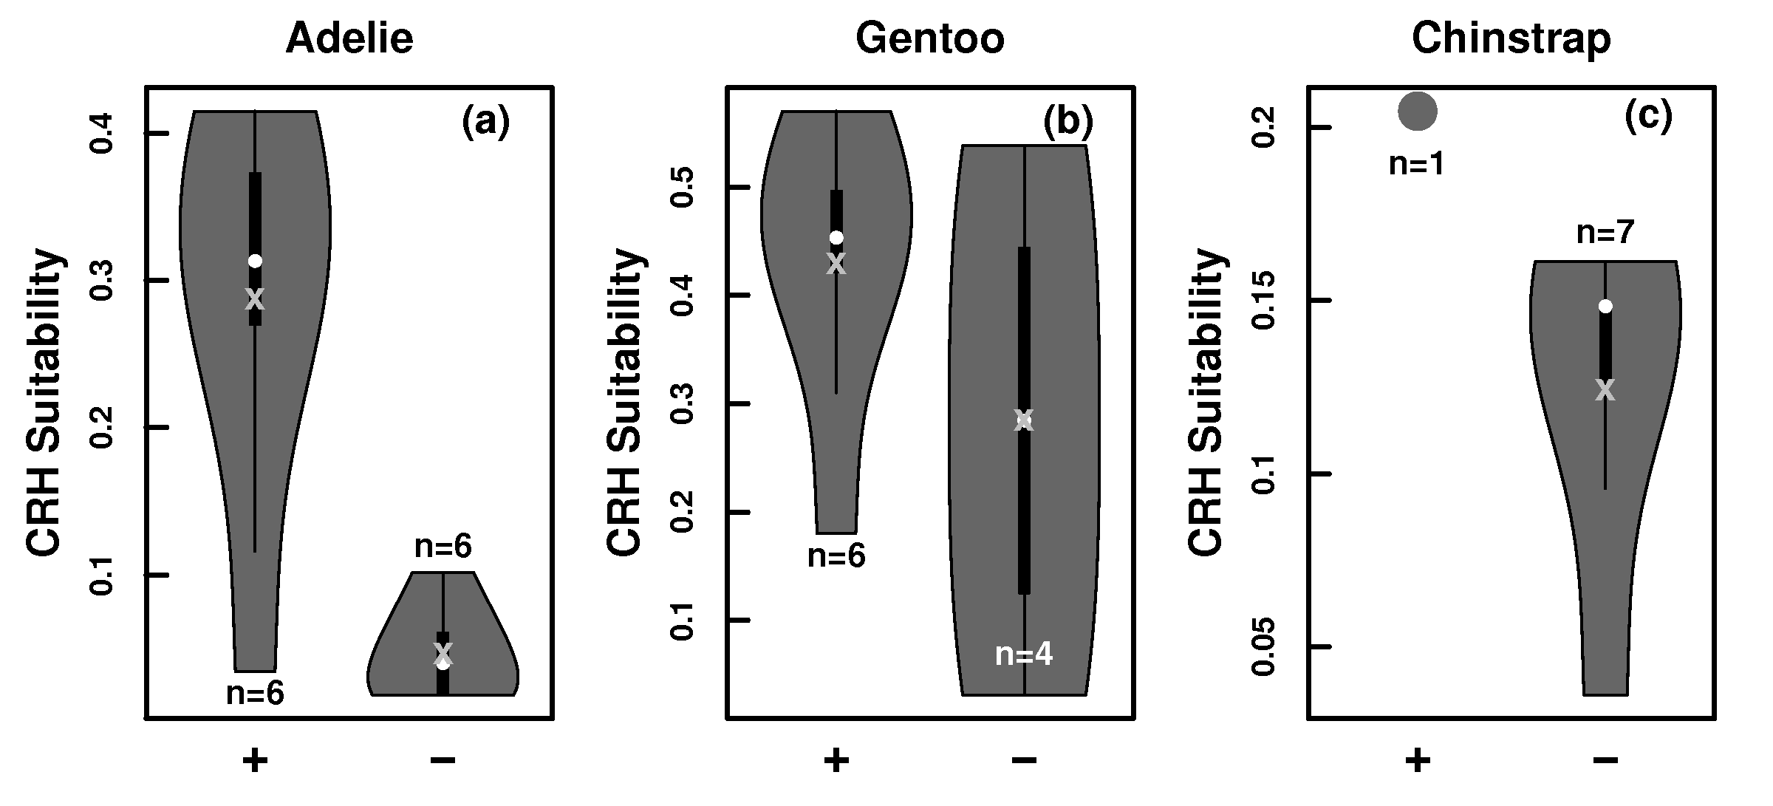
Problem
Hypothesis: Environment Predicts Populations of Penguins
The error term encapsulates small scale cyclical environmental variation, and any top-down component

Slide 14
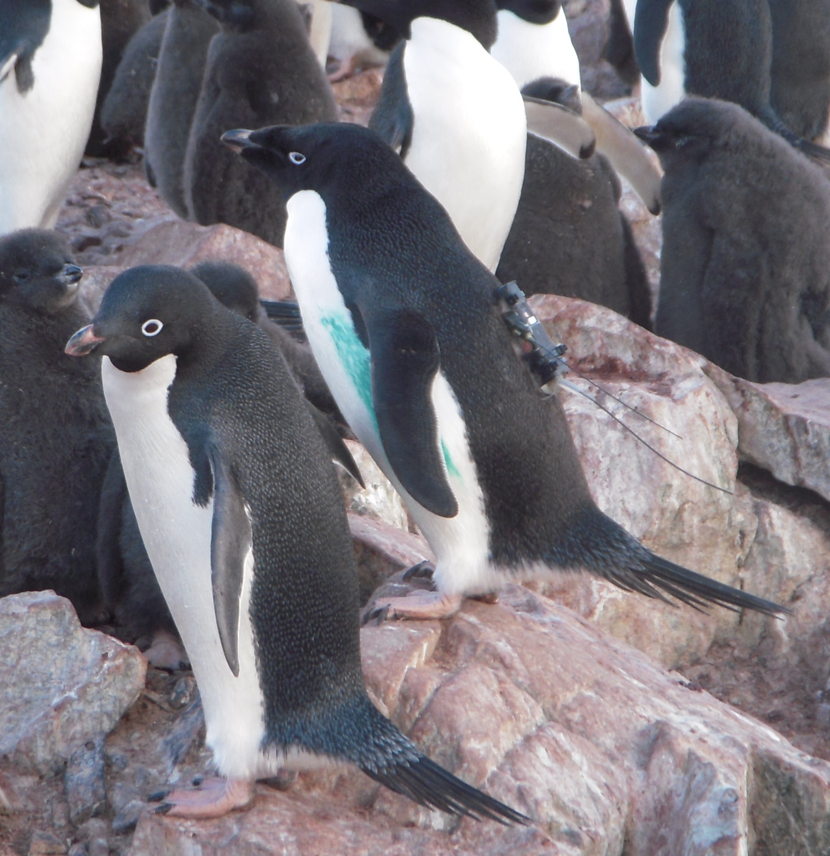
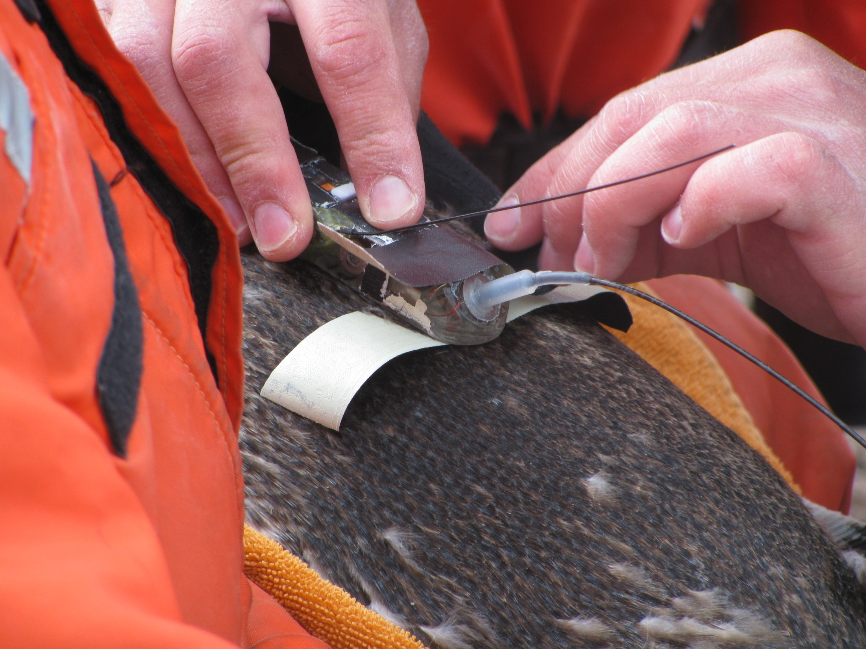
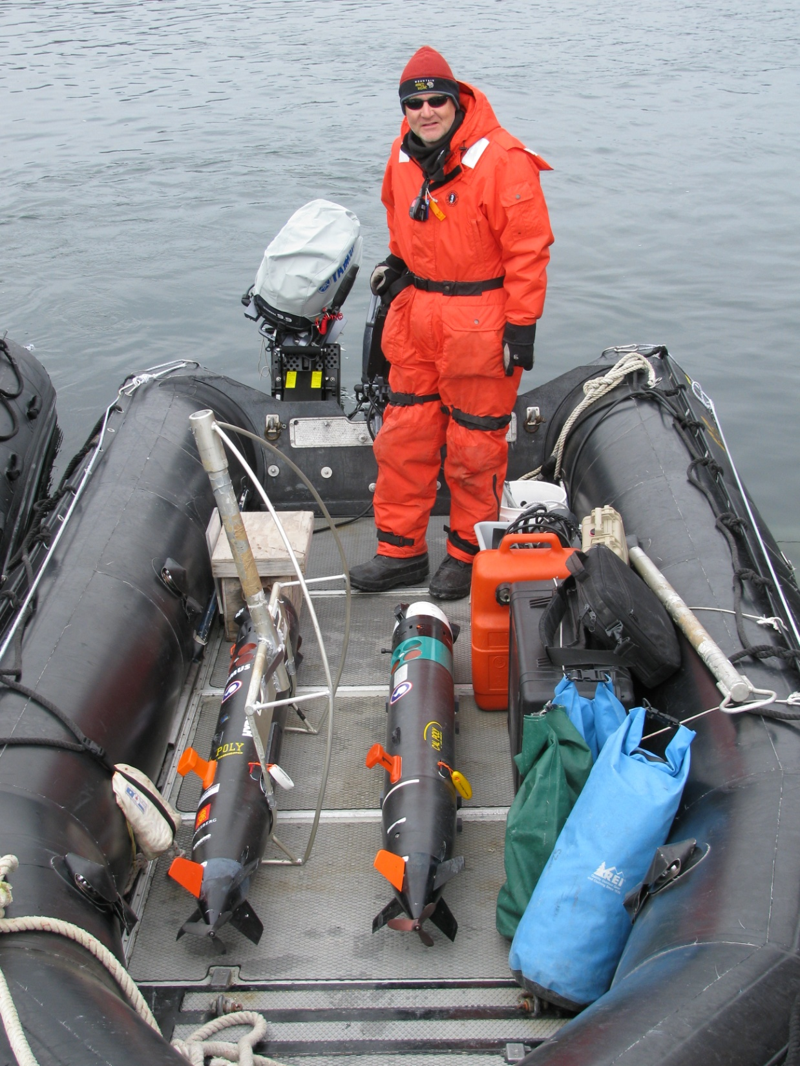
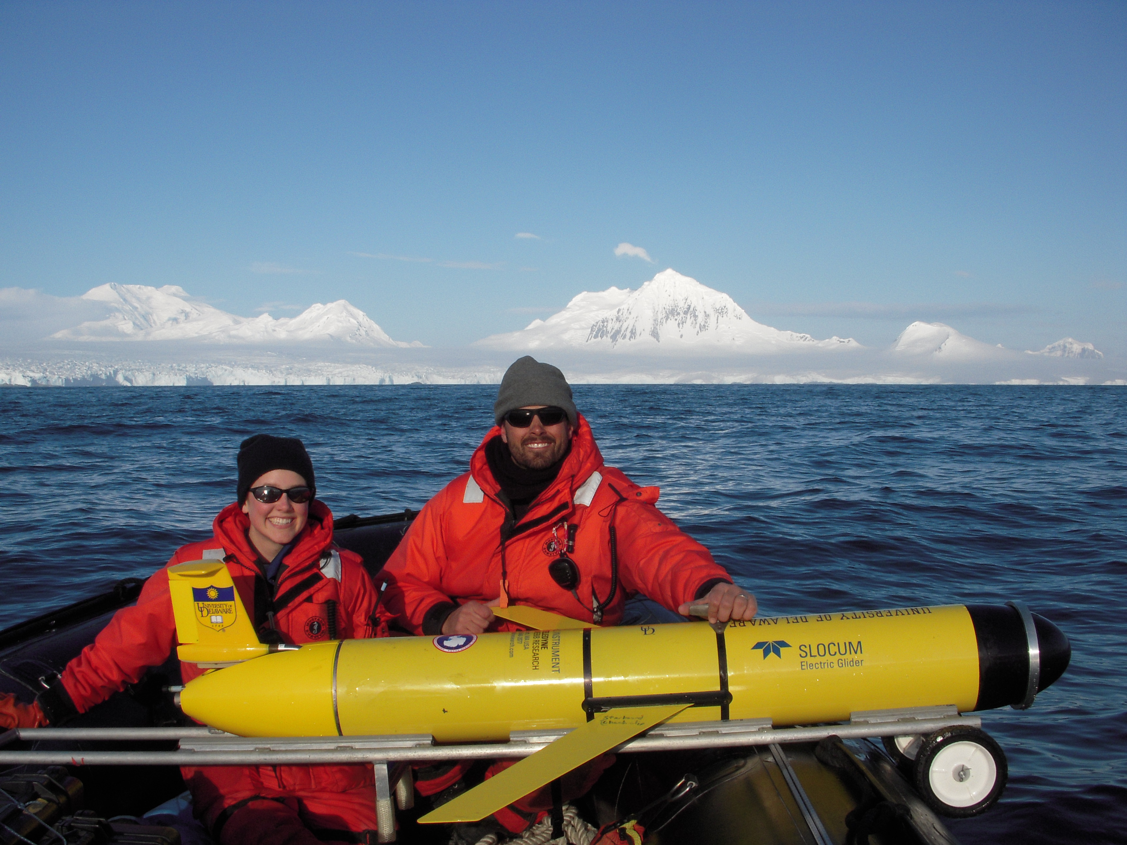
The Plan
Satellite Tags
ARGOS
Position
Mission Planning
Deployment
Assessment

Slide 15
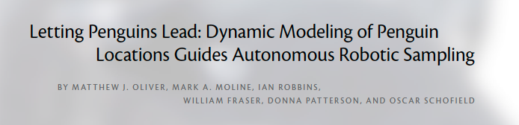
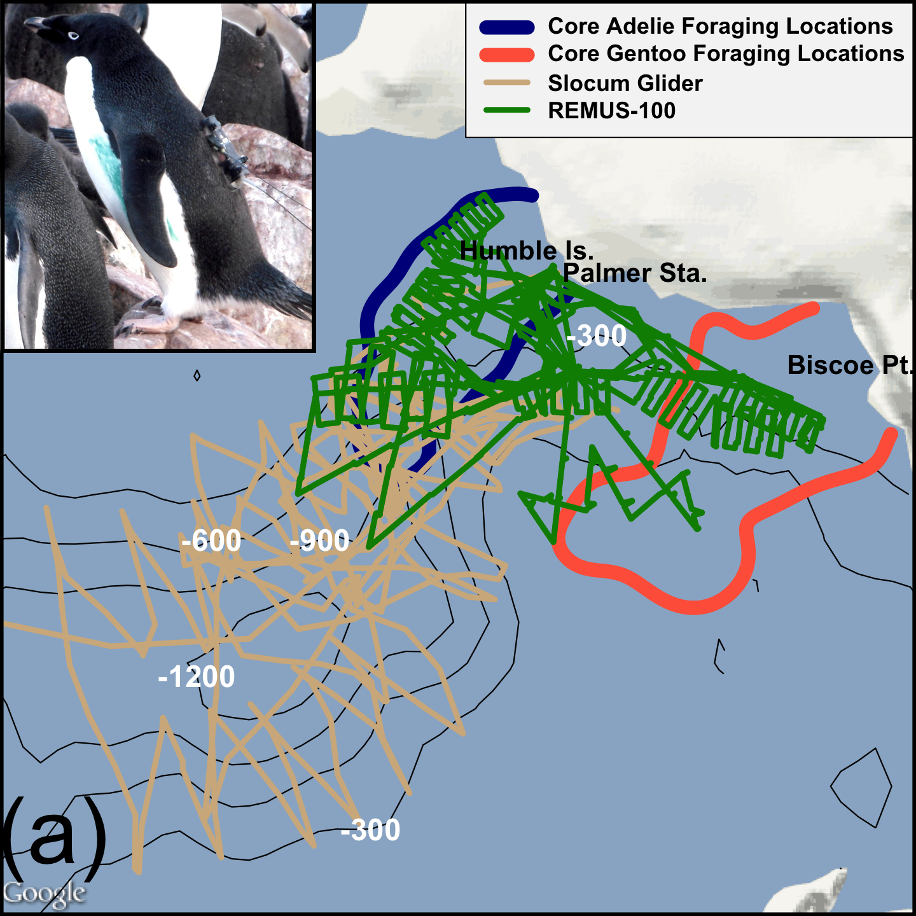
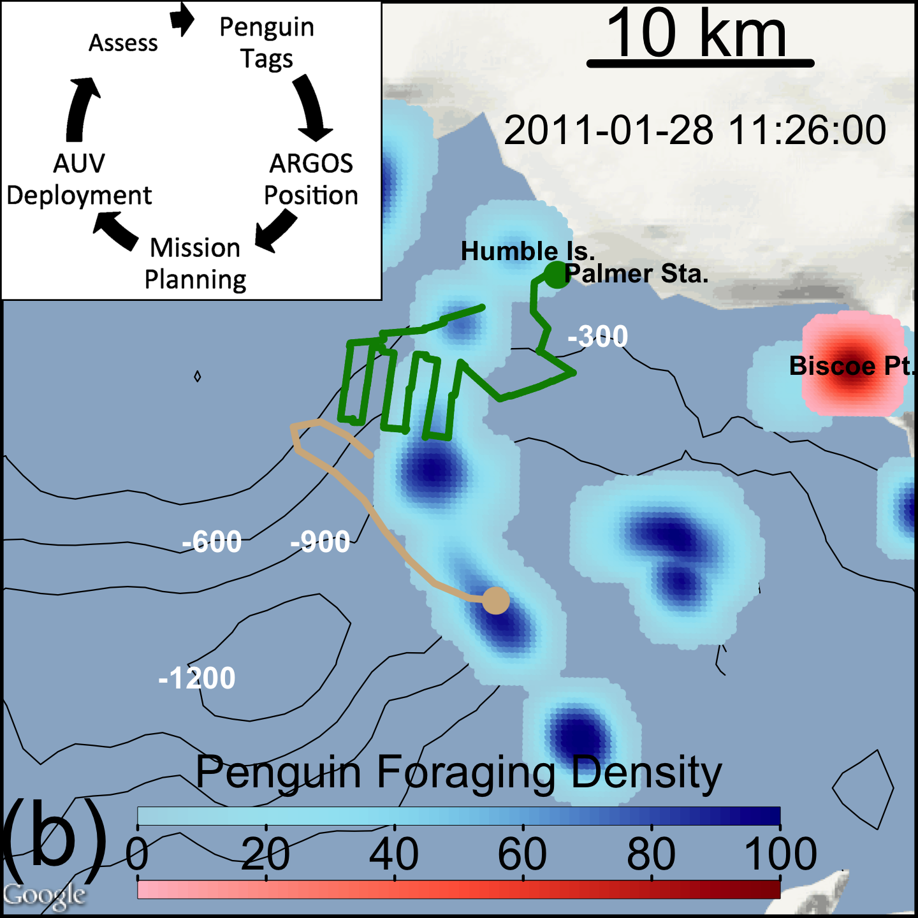
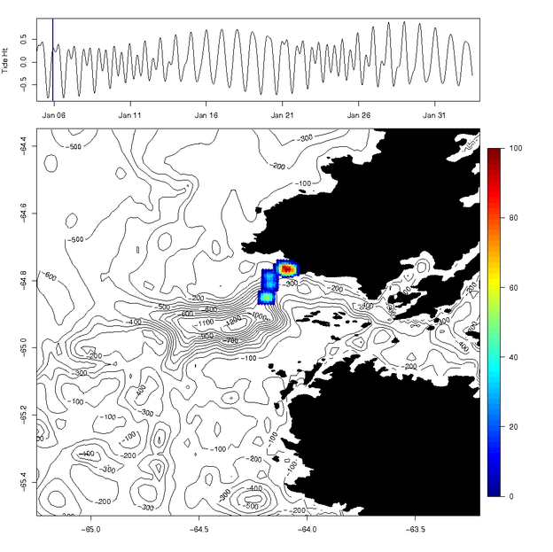
Notes:
Trained on Cont ad. With chl in model.
Not many sig p val., Similar trends though.

Slide 16
First Field Season Results
Glider Depth Integrated Currents
Diurnal Tides
Semi-Diurnal Tides

Slide 17
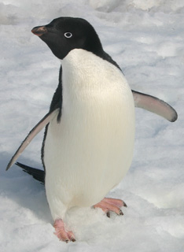
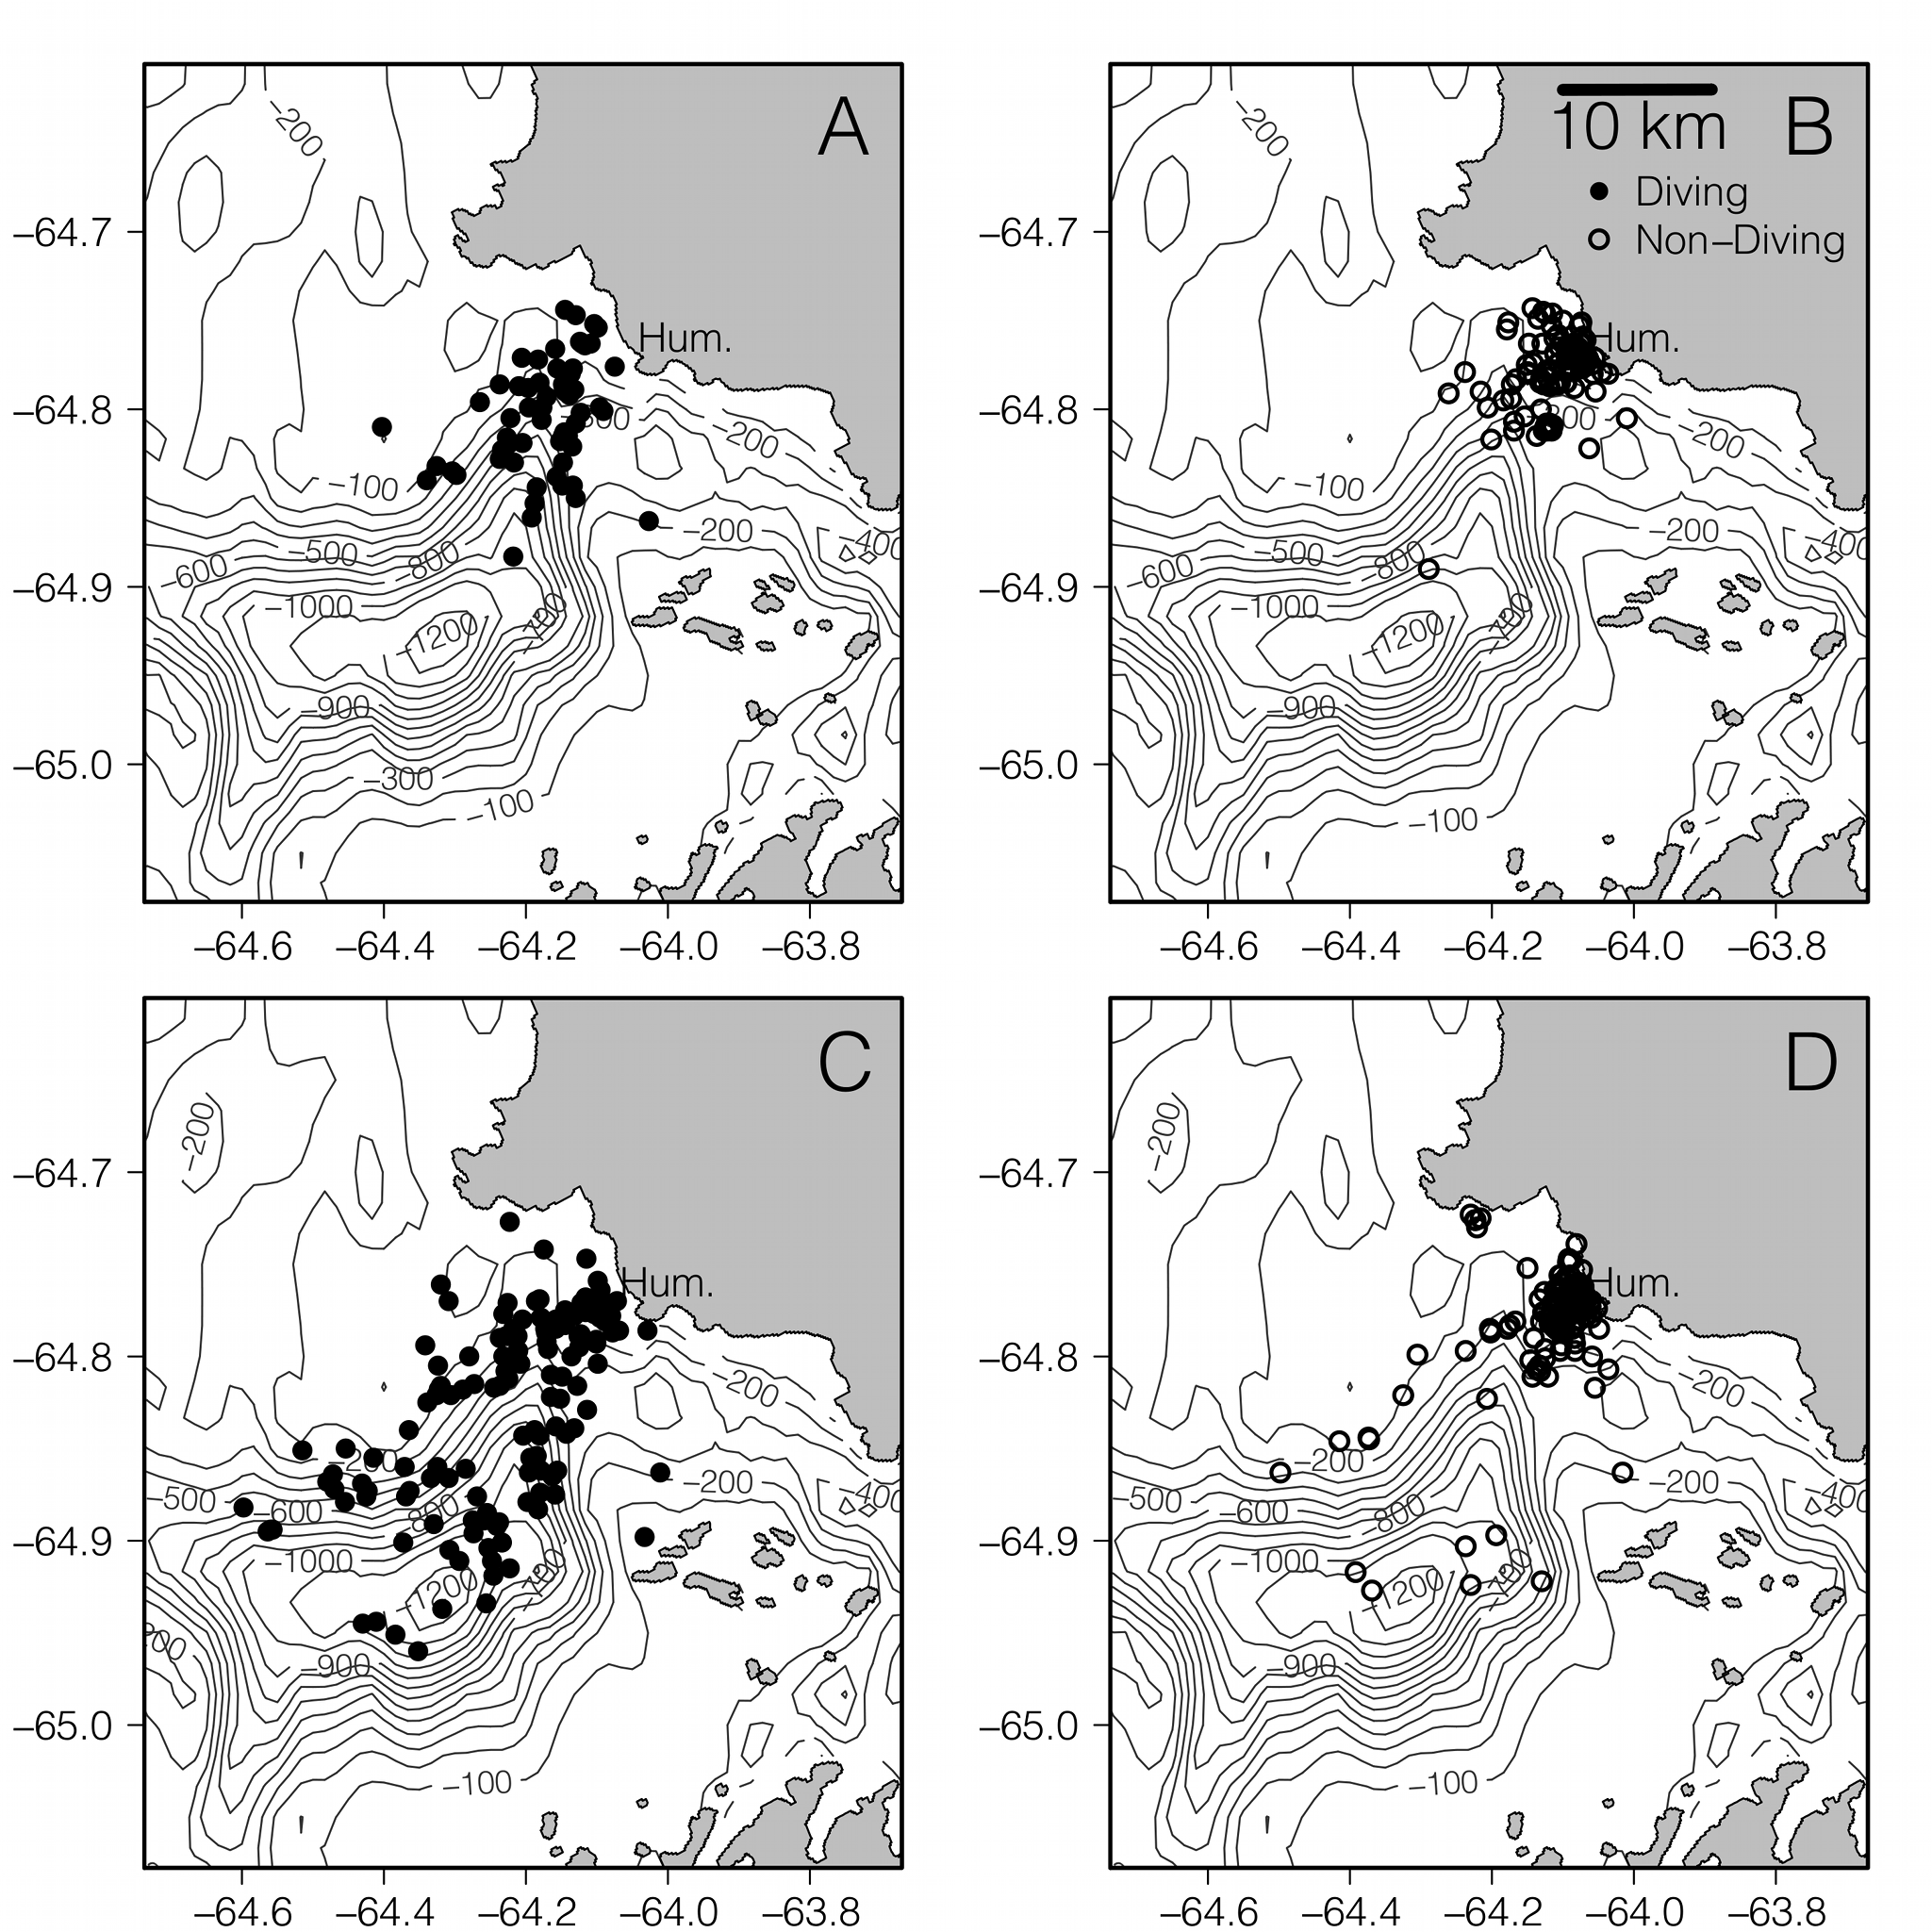
Diurnal
2011 Field Season
Krill
Semi-Diurnal

Slide 18
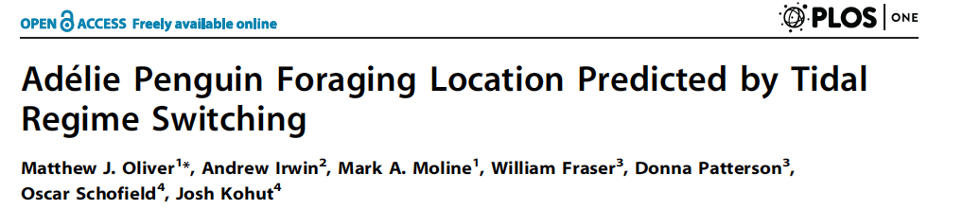
Results from 2002-2011 Penguin Locations
Why?
Krill

Slide 19
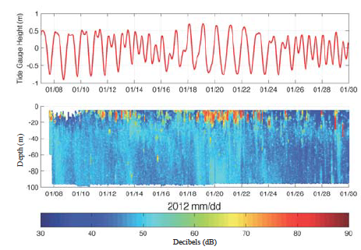
The Hypothesis
Penguin Foraging Location is Driven by Tide Regime
Tide Regime ~ Krill Density
Tidal Currents are strong enough to concentrate Krill
Courtesy: Travis Miles
Krill

Slide 20
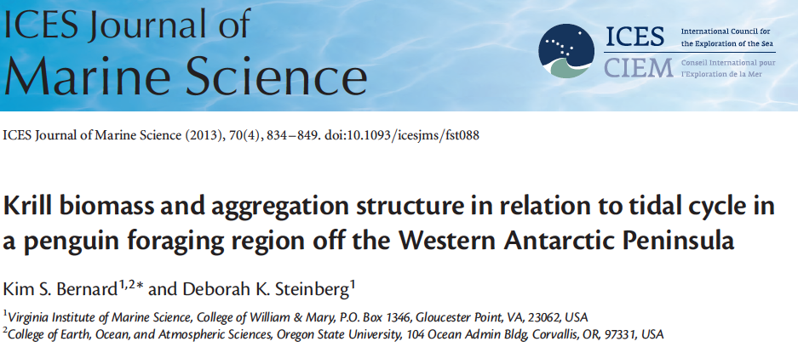
Nearshore Tidal and Offshore Comparisons of Krill

Slide 21
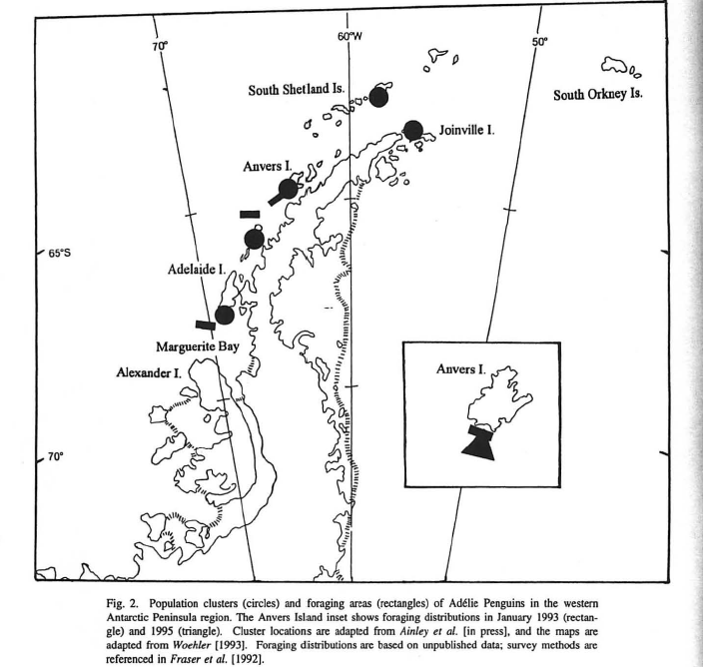
There is a “HotSpot” Phenomena
Fraser et al, 1996
Does this point to some important element of local variability?
Krill

Slide 22
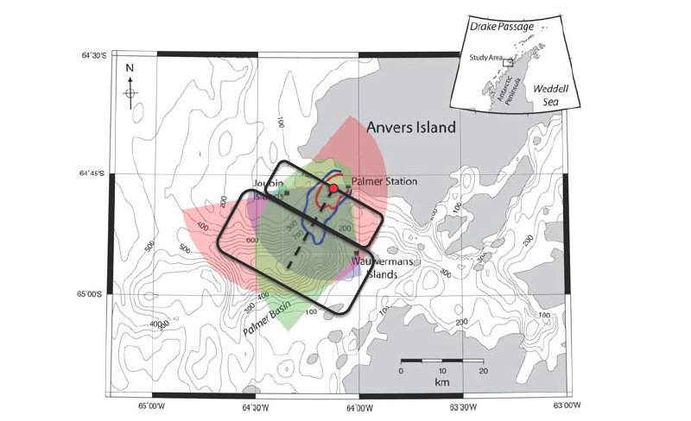
Future Work
Bring Down HF RADAR
Krill

Slide 23
Revisiting Original Model
The error term encapsulates small scale or cyclical environmental variation, and any top-down component. This is a bottom-up approach.
Krill
Implicit Resource Concentrating Signal
Non-Climate Signal
Broad-Scale Environmental Signal
So What?

Slide 24
Let’s speculate –Which is More Important?
Local Concentrating?
Trophic level
Changing Climate?
Length Scale (concentration) of prey

Slide 25
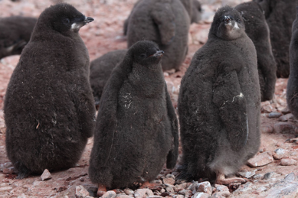
Interannual Variation in Mean Chick Fledging Mass – Chicks are the Integrated Investment
What are the dominant drivers of this interannual variability?
  Large-scale climate
  Local weather
  Food quality
  Tidal forcing

Slide 26
Stepwise Regression
Measured CFM vs. Estimated CFM
Ensemble was within ~0.03 kg
  Models Developed With;
  Climate Indices
  Local Weather
  Penguin Stomach Contents delivered to Chicks
                AIC_{c} < 2
                R² = ~0.60 to 0.70

Slide 27
Effects of Each Predictor Variable on CFM
~0.2 kg effect
~0.1 kg effect
  Climate and Weather Indexes were Dominant!
  Noticeable absence of tides
  Thermoregulatory Issue

Slide 28
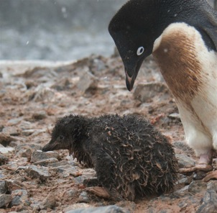
Conclusions
Satellite Driven Niche Spaces are fairly good at predicting general trends in penguin populations
Using AUV’s to Local variation in the physical delivery of krill to colony locations implicate local concentrating mechanisms that are not climate driven
A meta-analysis of Climate Scale vs Local Scale drivers reveal that Climate (especially terrestrial) is the most important for understanding chick weights.
Future work is focusing on the connection between the local physics and krill delivery to penguin colonies
Will not be treating tides as a mean across a season

Slide 29
Project Publications to Date
Schofield, O., H. W. Ducklow, D. G. Martinson, M. P. Meredith, M. A. Moline, and W. R. Fraser. 2010. How Do Polar Marine Ecosystems Respond to Rapid Climate Change? Science, 328328:1520.
Cimino, M. A., Fraser, W. R., Irwin A. J. Oliver, M. J. 2013. Satellite Data Identify Decadal Trends in the Quality of Pygoscelis Penguin Chick-Rearing Habitat. Global Change Biology, DOI: 10.1111/gcb.12016.
Oliver, M. J., Moline, M. A., Robbins, I., Fraser, W., Patterson, D., Schofield, O. 2012. Letting Penguins Lead: Dynamic Modeling of Penguin Locations Guide Autonomous Robotic Sampling, Oceanography, http://dx.doi.org/10.5670/oceanog.2012.84.
Oliver, M. J., Irwin, A. J., Moline, M. A., Fraser, W., Patterson, D., Schofield, O., Kohut, J. Adélie Penguin Foraging Location Predicted by Tidal Regime Switching. PLoS One, 10.1371/journal.pone.0055163.
Cimino, M. A., Fraser, W. R., Patterson-Fraser, D. L., Saba, V. S., Oliver, M. J. Large Scale Climate and Local Weather Drive Interannual Variability in Adélie Penguin chick fledging mass. Submitted to Marine Ecology Progress Series.

Slide 30
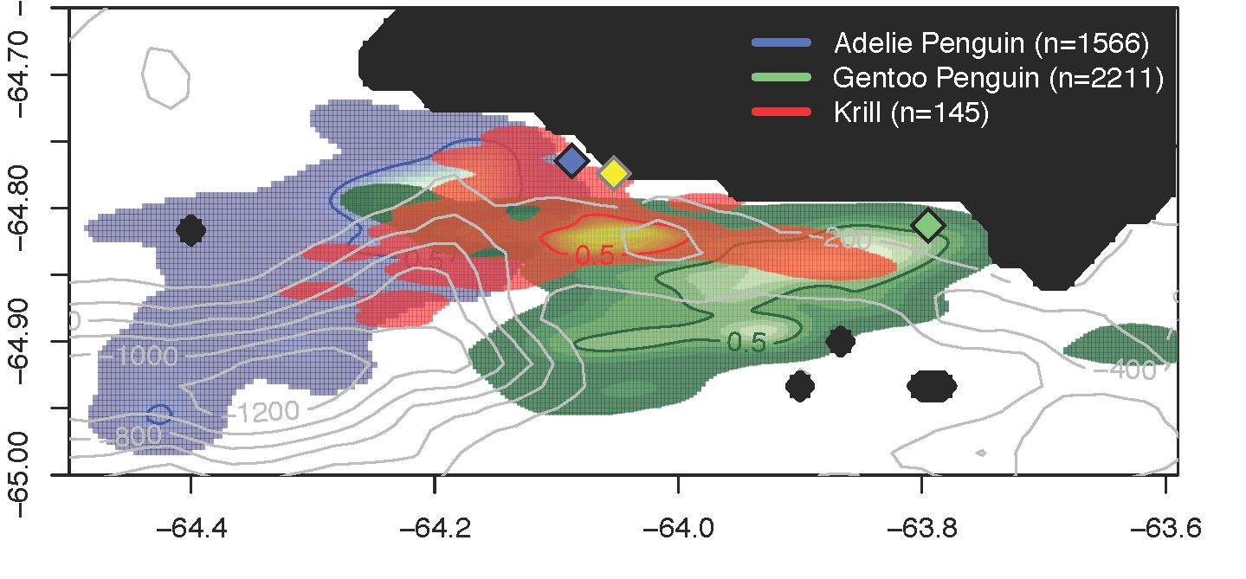
Adélie & Gentoo: Area of Overlap
2 Gentoo, 129 dives
7 Adelies, 243 dives
Density
Density

Slide 31
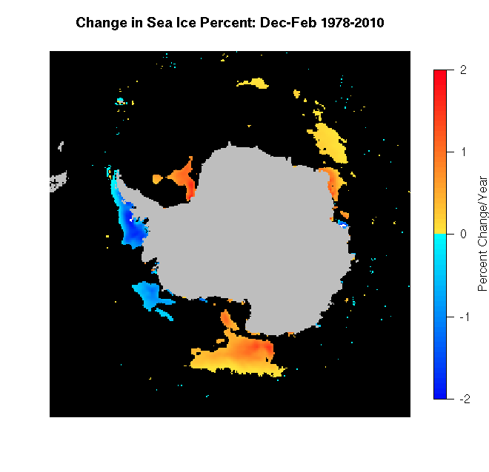
Look for places with big climate perturbations
West Antarctic Peninsula is Losing Ice, Warming Air and Water
Penguins
Krill
Climate Perturbation

Slide 32
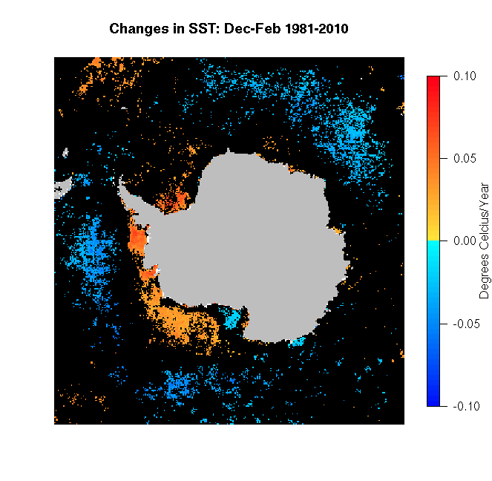
Look for places with big climate perturbations
West Antarctic Peninsula is Warming up during Summer Months
Penguins
Krill
Climate Perturbation

Slide 33
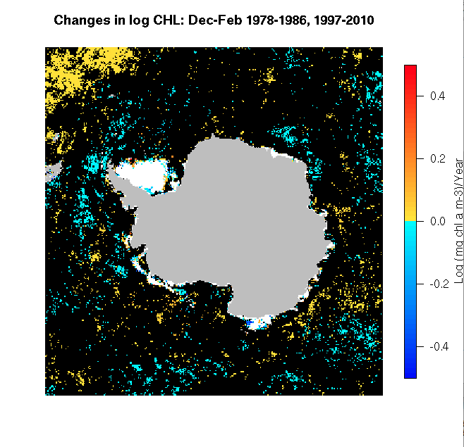
Look for places with big climate perturbations
Chlorophyll isn’t as clear of a signal on big scales
Penguins
Krill
Climate Perturbation

Slide 34
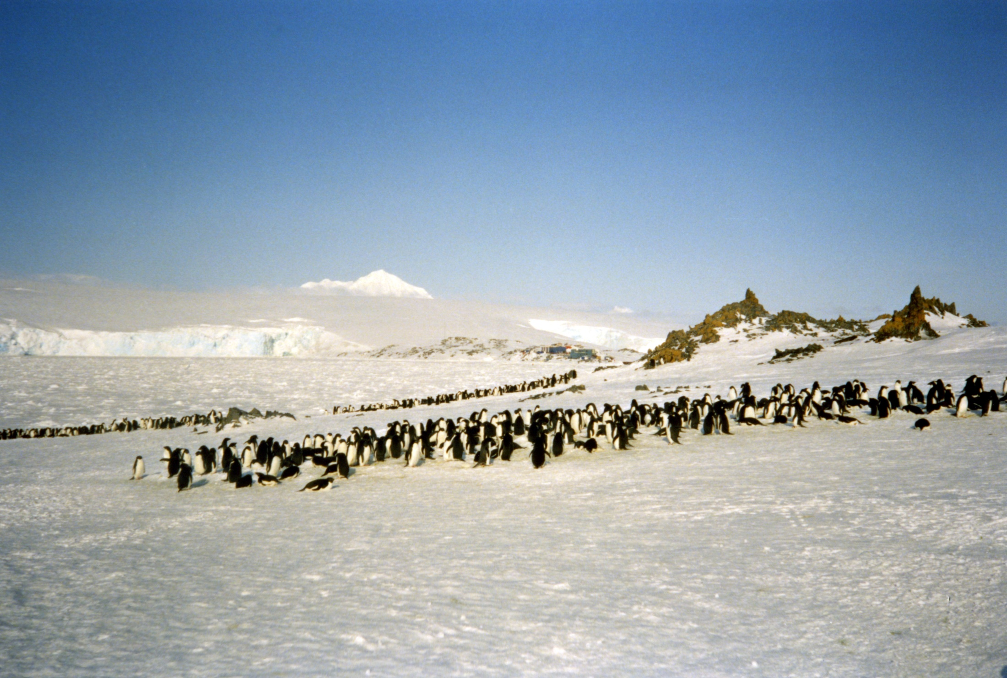
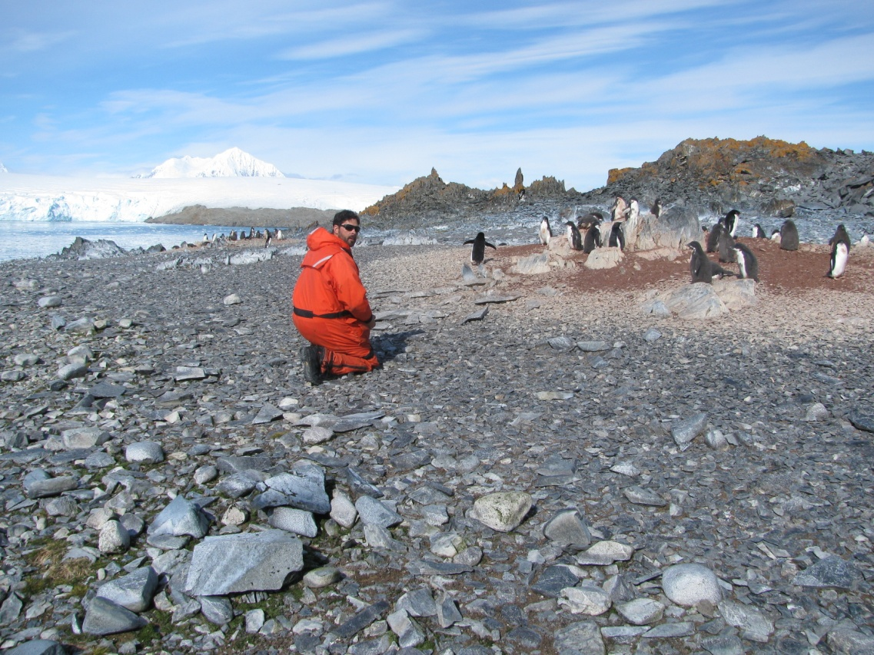
Torgersen Island 1991
Photo: Mark Moline
Torgersen Island 2011
Photo: Mark Moline

Slide 35
First Field Season
Near-Real Time Mapping of Penguin Foraging Locations

Slide 36
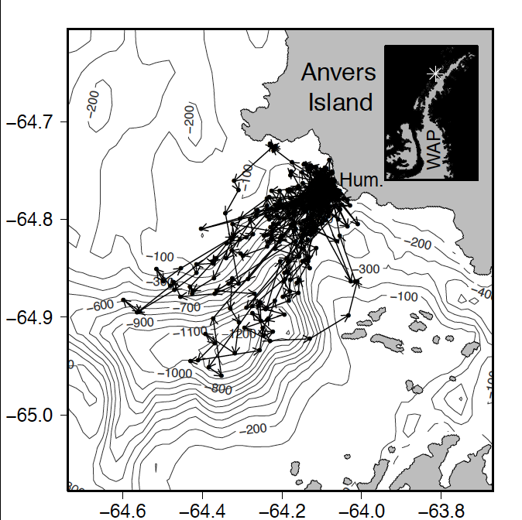
First Field Season Results
Tracking penguins from Humble Island
Where did the Adélie penguins go?

Slide 37
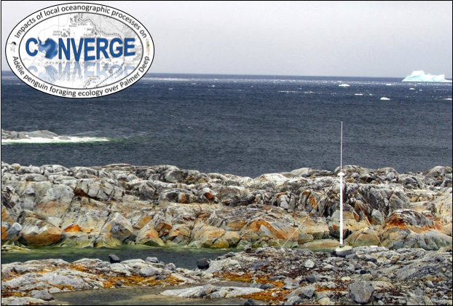
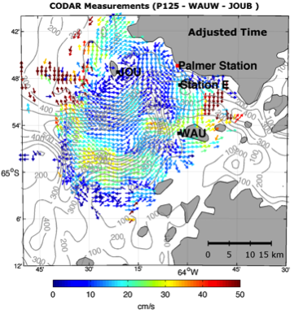
Future Work
Bring Down HF RADAR
Krill
Simulated results based on first years radar installations

