Slide 1


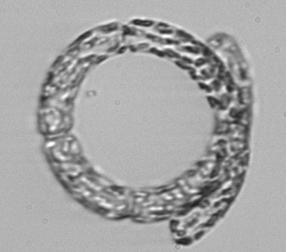


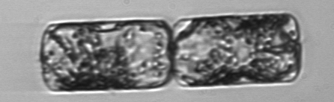
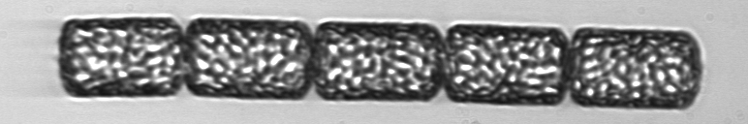
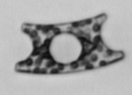
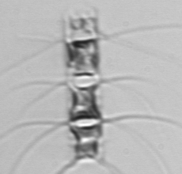

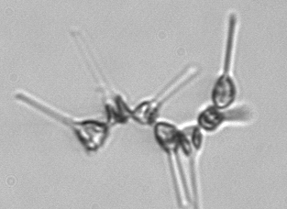
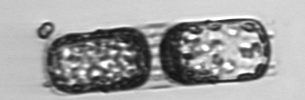
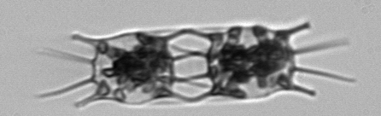
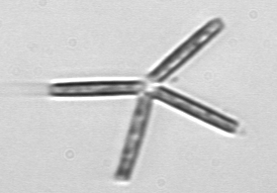

Seasonal to Interannual Variability in
Phytoplankton Biomass and Diversity on the New England Shelf
In Situ Time Series for Validation and Exploration
of Remote Sensing Algorithms
Heidi M. Sosik Hui Feng
Woods Hole
Oceanographic Institution
University of
New Hampshire
Notes:
Good afternoon. My co-PI on this work is Hui Feng from the University of New Hampshire.

Slide 2
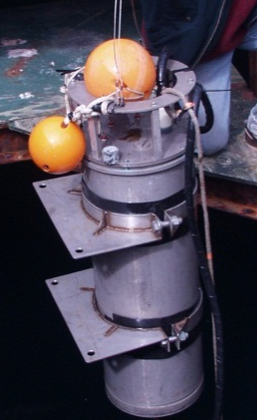
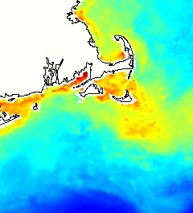


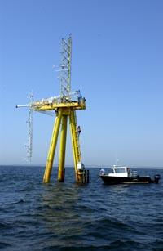


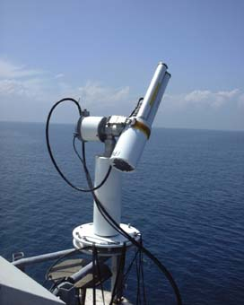
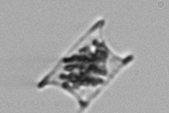


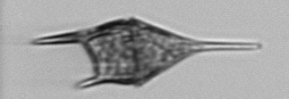
Project Overview
Goal: Use unique time series to evaluate algorithms that extend MODIS ocean color data beyond chlorophyll to functional type or size-class-dependent phytoplankton retrievals
Approach: End-to-end time series observations, with step-by-step algorithm evaluation and error analysis
single cells → phytoplankton community → bulk water optical properties → sea surface optical properties (air and water) → MODIS optical properties
Martha’s Vineyard Coastal Observatory
Tower mounted
AERONET-OC
Submersible Imaging
Flow Cytometry
MODIS products
Notes:
One of our main goals is to evaluate a wide range of algorithms for retrieving phytoplankton functional types from ocean color radiometry in temperate coastal waters. A critical element of our approach is that we have nested, multi-level time series that allow us to examine the links between phytoplankton cells, their contributions to the community and bulk water properties including inherent and apparent optical properties, and ultimately remotely sensed signals.
To do this we are taking advantage of cabled observatory facility on the New England shelf – the Martha’s Vineyard Coastal Observatory or MVCO for short. The offshore tower with power and real time communications at this site make it possible to use demanding automated in situ technologies like submersible flow cytometry and above water radiometry. This study site is also a good choice for this kind of project because it is part of a productive and dynamic system with seasonal and interannual variability in environmental forcing that leads to recurring and fairly dramatic changes in phytoplankton community structure.

Slide 3
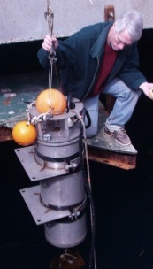
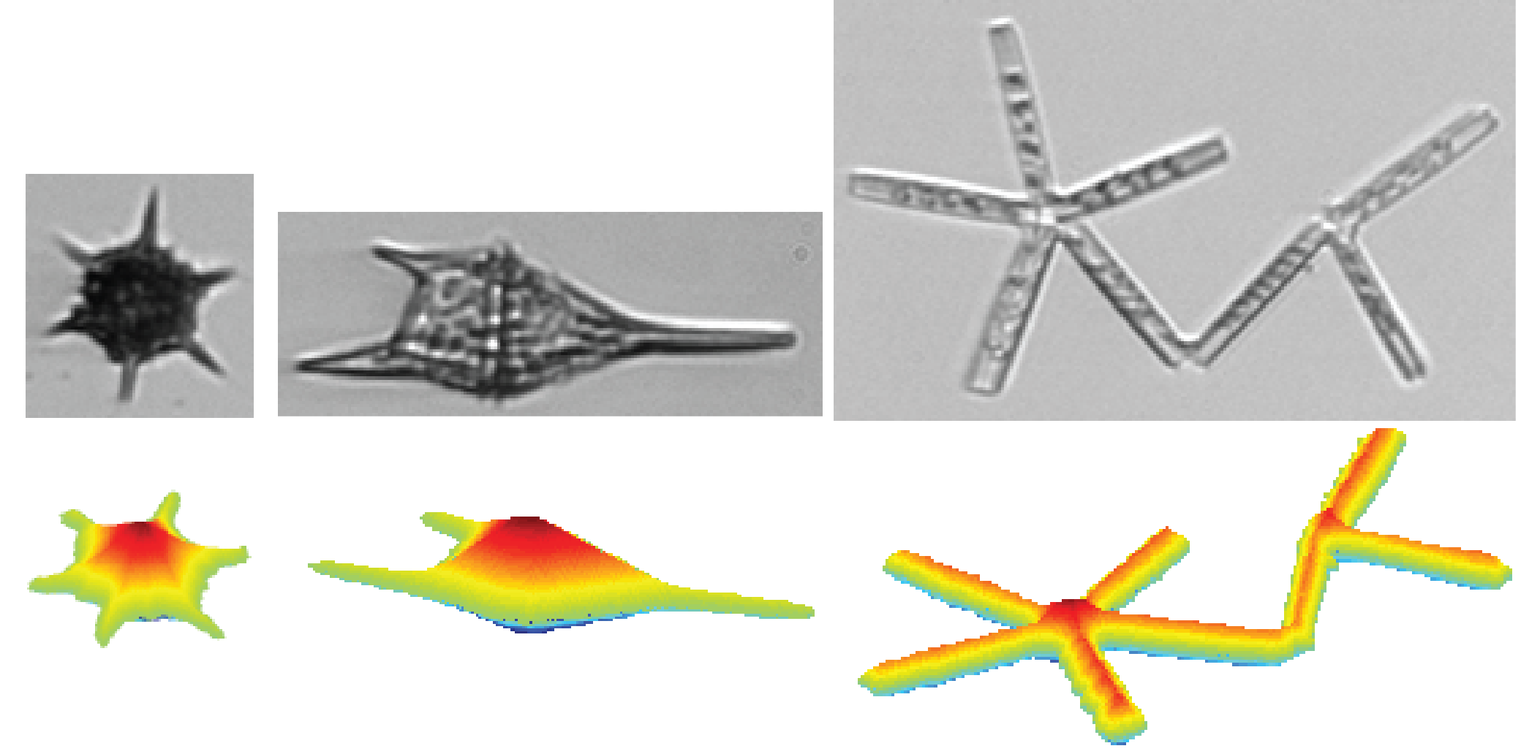
Approach
Phytoplankton Observations
  Single cells to communities
  Biomass, size- and taxon-resolved
Phytoplankton Algorithms
  Absorption spectral shape → size structure
  Diagnostic pigments → size structure
  Diagnostic pigments → taxonomic structure
Notes:
No time to explain in detail how we characterize phytoplankton with submersible flow cytometry – happy to discuss more later. Briefly these instrument measure thousands of individual microscopic cells every hour for months to years. From the measurements we can estimate size structure, biomass, and taxonomic composition.
We’re looking at different kinds of algorithms, but for the sake of time today I’m going to focus on use of pigments to infer taxonomic structure.

Slide 4
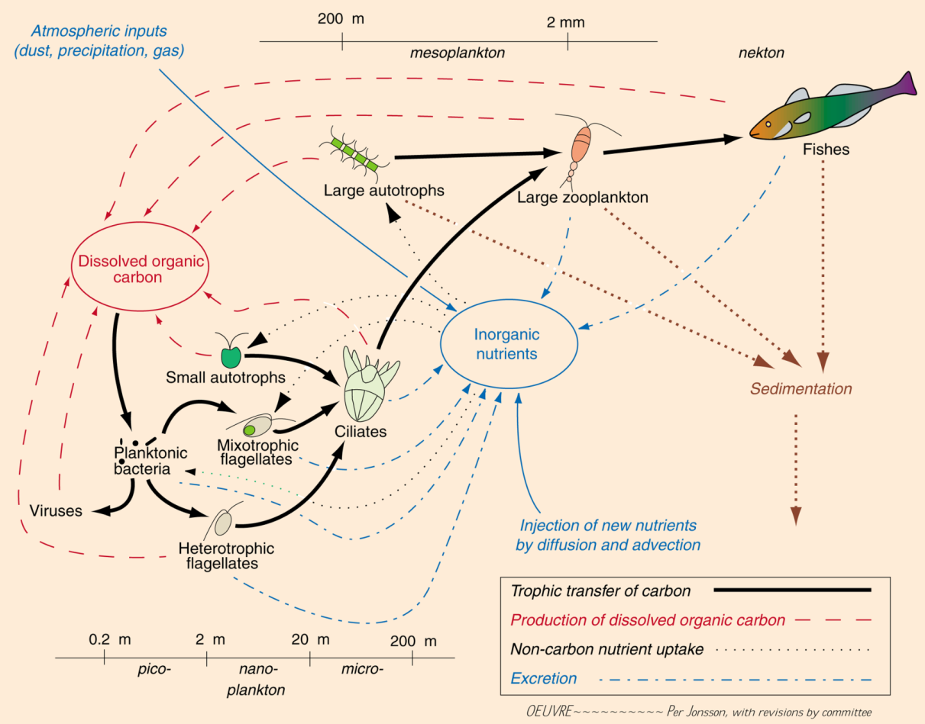
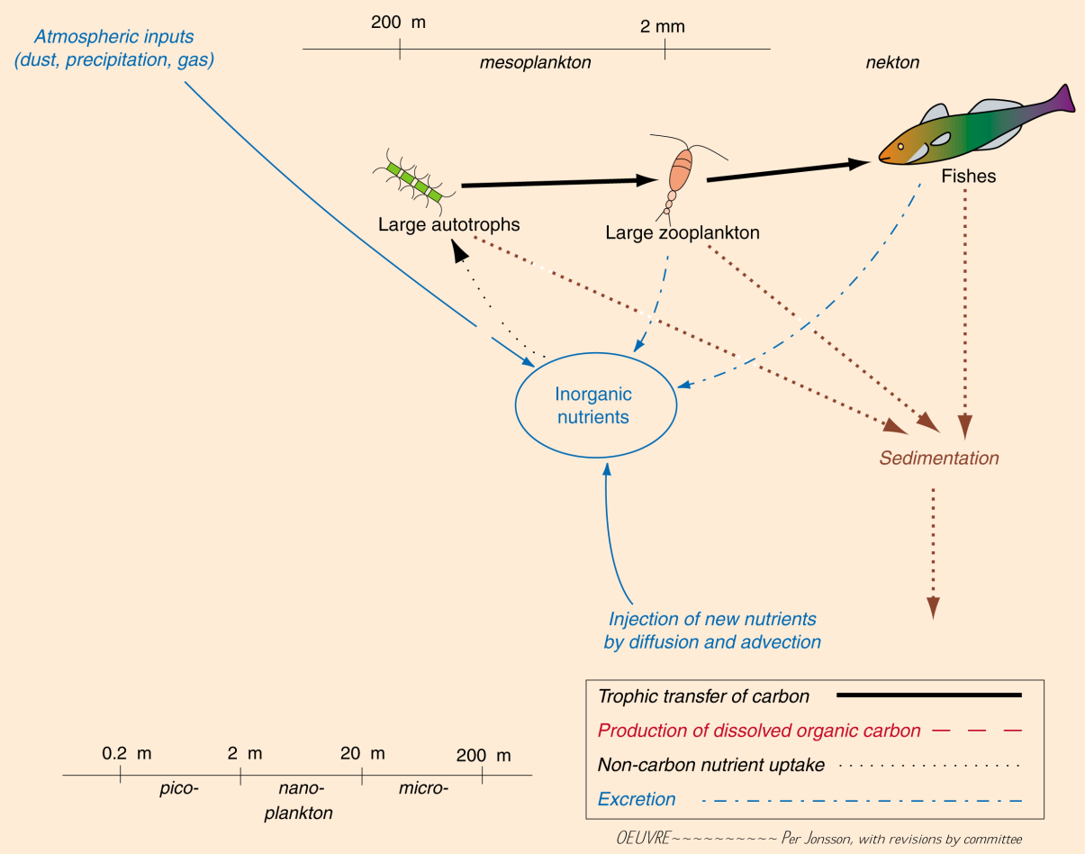
Variability in community structure
.
μ
μ
Diatoms
Cyano-
bacteria
μ
μ
μ
μ
μ
μ
μ
μ
Notes:
This study site provides ideal case for evaluating impt changes in community composition.
Example species specific time series from in situ fcm show that the dominant diatom and the dominant pico-cyanobacterium are consistently out of phase, with reg seasonal shifts in which is more abundant.
These organisms are 2-3 orders of magnitude different in size and are expected to structure different ecosystems, where diatoms typically support relative short food chains and export to higher trophic levels, while picoplankton are part of much larger web of interactions largely recycling.
Seasonal patterns in diatoms and cyanos in genl echo patterns shown by 2 example species.
C:\work\ifcB\code_svn\analyze_by_class\carbon_summary_plots.m
C:\work\ifcB\code_svn\analyze_by_class\SynGuinCarbon.m

Slide 5
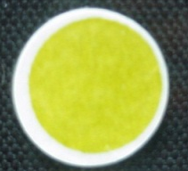
Pigment-based retrieval of taxonomic groups
Diatoms
In situ FCM
“CHEMTAX”
Mackey et al. 1996
Total Chl a = diatom Chl a + dinoflagellate Chl a + cyanobacteria Chl a + …
with partitioning according to accessory pigment ratios
Notes:
Since the 1990s oceanographers have taken advantage of differences in accessory pigment composition betw taxa to characterize communities.
We have compared this approach to estimates of group-specific biomass from flow cytometry. FCM carbon on x, pigment-based estimate on y, for diatoms pooled across all seasons and years. Some unexplained variability, but a robust correlation. These two approaches provide similar patterns in the seasonality of diatom biomass. This is an annual composite, taken from the full time series – where both methods characterize a long winter bloom period for diatoms.
C:\work\IFCB\code_svn\analyze_by_class\compare_chemtax_fcm.m

Slide 6
Pigment-based retrieval of taxonomic groups
Diatoms
Diatoms (mg m³)
Notes:
Since the 1990s oceanographers have taken advantage of differences in accessory pigment composition betw taxa to characterize communities.
We have compared this approach to estimates of group-specific biomass from flow cytometry. FCM carbon on x, pigment-based estimate on y, for diatoms pooled across all seasons and years. Some unexplained variability, but a robust correlation. These two approaches provide similar patterns in the seasonality of diatom biomass. This is an annual composite, taken from the full time series – where both methods characterize a long winter bloom period for diatoms.
C:\work\IFCB\code_svn\analyze_by_class\compare_chemtax_fcm.m

Slide 7
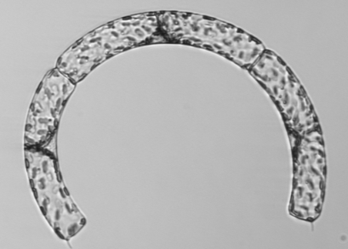
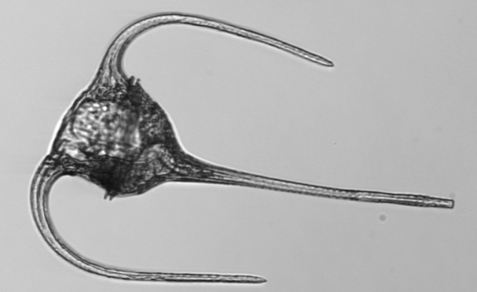
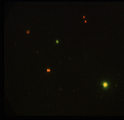
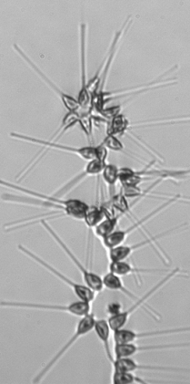
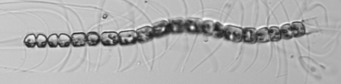
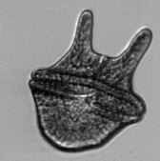
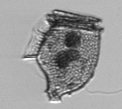







Pigment-based retrieval of taxonomic groups
Diatoms
Dinoflagellates
Cyanobacteria
~1 μm cells
10 μm
Notes:
This is the result for composite of all diatoms, which reflects a lot of different species in this system. For dinoflagellates the comparison is not as good – probably in part due to greater diversity in pigment types associated with different evolutionary paths; they also have less prominent blooms and lower overall biomass. And for cyanobacteria, the two methods are correlated at high biomass, but perhaps the pigment approach lead to overestimates during times of low biomass.
C:\work\IFCB\code_svn\analyze_by_class\compare_chemtax_fcm.m

Slide 8
Pigment-based retrieval of taxonomic groups
Diatoms
Dinoflagellates
Cyanobacteria
Chl or Carbon (mg m³)
~1 μm cells
10 μm
Notes:
Overall, we find these two approaches give remarkably consistent details about seasonality in these three groups. This is excellent – now how about the extension to remote sensing.
C:\work\mvco\MODIS\Rrs_Chemtax\chemtax_from_rs.m

Slide 9
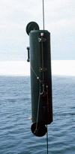
Diagnostic pigment retrieval from Rrs
Pan et al. 2010 band ratio algorithms
AERONET-OC
SeaPRISM, R_{rs}(λ)
Chl a
Fucoxanthin
Discrete samples
HPLC pigment analysis
Peridinin
Zeaxanthin
Notes:
For this we need to explore how well we can retrieve these diagnostic pigm from algs based on Rrs. In this case we’ve started with sea-surface measurements to avoid anything assoc with atm correction or other satellite product issues.
This shows the band ratio alg of Pan et al. 2010 for some of the pigments. We find MVCO match ups – the red points - fall well within range of obs used to develop alg.
In general our match ups are consistent with the algorithms, though there are some apparent issues like systematic biases for certain pigments.
So we can retrieve a set of pigment concentrations this way and then apply the same chemotaxonomy that we used for the in situ pigment data.
\\queenrose\MVCO2\fromHui_Jan2014\Taylor_updated_code\plot_SP_allPanpig_MeetingPlots.m

Slide 10
Pigment-based retrieval of taxonomic groups
Diatoms
Dinoflagellates
Cyanobacteria
Chl or Carbon (mg m³)
~1 μm cells
10 μm
Notes:
So – recall this good agreement we get between carbon and in situ pigment-based taxonomy.
C:\work\mvco\MODIS\Rrs_Chemtax\chemtax_from_rs.m

Slide 11
Remote sensing retrieval of taxonomic groups
Diatoms
Dinoflagellates
Cyanobacteria
Chl or Carbon (mg m³)
AERONET-OC
SeaPRISM, R_{rs}(λ)
→ Loss of seasonal resolution
Following:
Pan et al. 2010 band ratio algorithms
Pan et al. 2011 CHEMTAX application
Notes:
And now compare this to the pigment approach with satellite retrievals… Unfortunately, we find that this step leads a serious loss of the ability to resolve the important seasonal variations in diatoms in this system. Here the blue is same in situ pigment results from the previous plots and red is from remote sensing – here again from the sea truth observations at the MVCO tower.
C:\work\mvco\MODIS\Rrs_Chemtax\chemtax_from_rs.m

Slide 12
Remote sensing retrieval of taxonomic groups
Diatoms
Dinoflagellates
Cyanobacteria
Fraction of Chl a
AERONET-OC
SeaPRISM, R_{rs}(λ)
Relative contribution to total Chl a
→ Loss of seasonal resolution
Following:
Pan et al. 2010 band ratio algorithms
Pan et al. 2011 CHEMTAX application
Notes:
A way to look at this in more detail is to consider the fraction of Chl a associated with each group. From this we find that there is very little variation in the diatom and dino fraction from the remote sensing application. Cyanobacteria retrievals are an exception, but I have to explain that this results because Pan et al. were not able to retrieve the main diagnostic pigment for this group from ocean color alone, and they included an empirical temperature dependence in their retrieval algorithm – so this retrieved seasonal variability really just reflects our ability to detect the strong temperature seasonality.
C:\work\mvco\MODIS\Rrs_Chemtax\chemtax_from_rs.m

Slide 13
Remote sensing retrieval of taxonomic groups
Diatoms
Dinoflagellates
Cyanobacteria
Fraction of Chl a
Fraction of Chl a
Notes:
For those interested in the next step of extending this approach to MODIS detection, I’ll just make the quick point that we find very similar patterns to those from the sea truth reflectance. Same panels on top, MODIS on bottom. So in both cases, we have an approach that may capture the mean state of this system, but is disappointingly limited in its ability to resolve changes from the mean state.
C:\work\IFCB\code_svn\analyze_by_class\compare_chemtax_fcm.m

Slide 14
Ecosystem characterization
.
Decadal increase in pico-cyanobacteria at MVCO
Notes:
I want to wrap up by emphasizing why we are so interested in these departures from the mean. For this I’ll return your focus to the phytoplankton time series and the two species I showed you up front.
In the case of this picoplankter, when we remove the mean seasonal cycle, our time series shows a very robust trend toward increasing abundance and biomass at MVCO over that last decade. We would like to address how this pattern extends spatially and into the future. In fact, the method I showed today does reflect this same kind of increasing trend from remote sensing retrievals – but do recall that this is the case where an empirical temperature dependence is embedded in the retrievals so we are susceptible to uncertainty in extrapolating without a mechanistic basis.
C:\work\IFCB\code_svn\analyze_by_class\syn_anomaly_trend.m

Slide 15
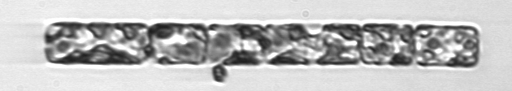
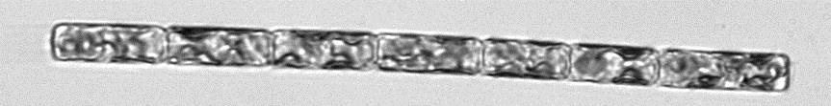


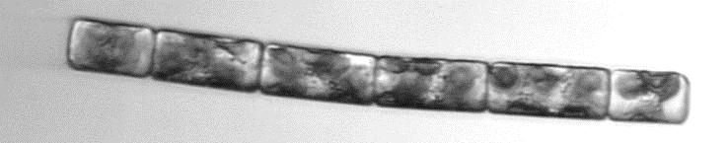

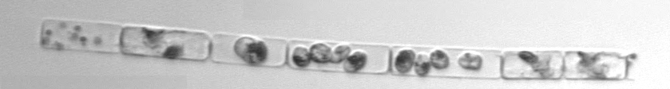


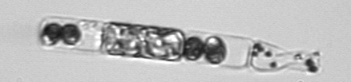
Ecosystem characterization
.
Peacock et al.
2014
50 μm
Notes:
For this diatom, I want to draw your attention to interannual variability. You see that this species typically blooms in winter, but you probably also see – from the red line here – that there is a lot of variability in the amplitude and duration from year to year. From our flow cytometry image, we have recently been able to show that this is strongly associated with interactions with a novel parasite. This tiny free swimming parasite lands on the host and is able to penetrate the frustule, at which point it enters a feeding stage, consumes all the contents of the host cell and then rapidly divides into 2,4,8 offspring – these then burst from the host and go on the infect other cells. But not before they leave behind this telltale fecal material. We see huge constrast between healthy host chains and those ravaged by parasites.

Slide 16
Ecosystem characterization
.
Peacock et al.
2014
Interannual fluctuations in diatoms → related to parasite infection
→ linked to temperature
Notes:
Our analyses show that we can explain a lot of the variability in bloom magnitude – shown here on the y-axis – and infection by these parasites. The parasites further seem quite sensitive to temperature with little to no infection occurring when the waters are coldest. This likely explains the winter predominance of this diatom. Our time series is long enough to encompass some anomalously warm winters – 2012 never got colder than about 4 C, parasites were present all winter, and the diatom bloom failed.
Currently we do not have the power to resolve these kinds of bloom variations with the remote sensing approaches I showed you today.

Slide 17
Looking forward on PFT characterization
Time series observations
single cells → phytoplankton community → bulk water optical properties → sea surface optical properties (air and water) → MODIS optical properties
Martha’s Vineyard Coastal Observatory
Tower mounted
AERONET-OC
Submersible Imaging
Flow Cytometry
MODIS products
Local detail
→ Trends and patterns of change
→ Regional to basin scales
Combined
in situ & satellite
observations
Notes:
On that note, I’ll leave you back where I started in terms of the observing strategy combining details from in situ observations with remote sensing and I’ll argue that we need to extend this approach beyond alg development and evaluation and consider this an on-going approach to address the important questions we have about how and why change is occurring in coastal ecosystems.

Slide 19
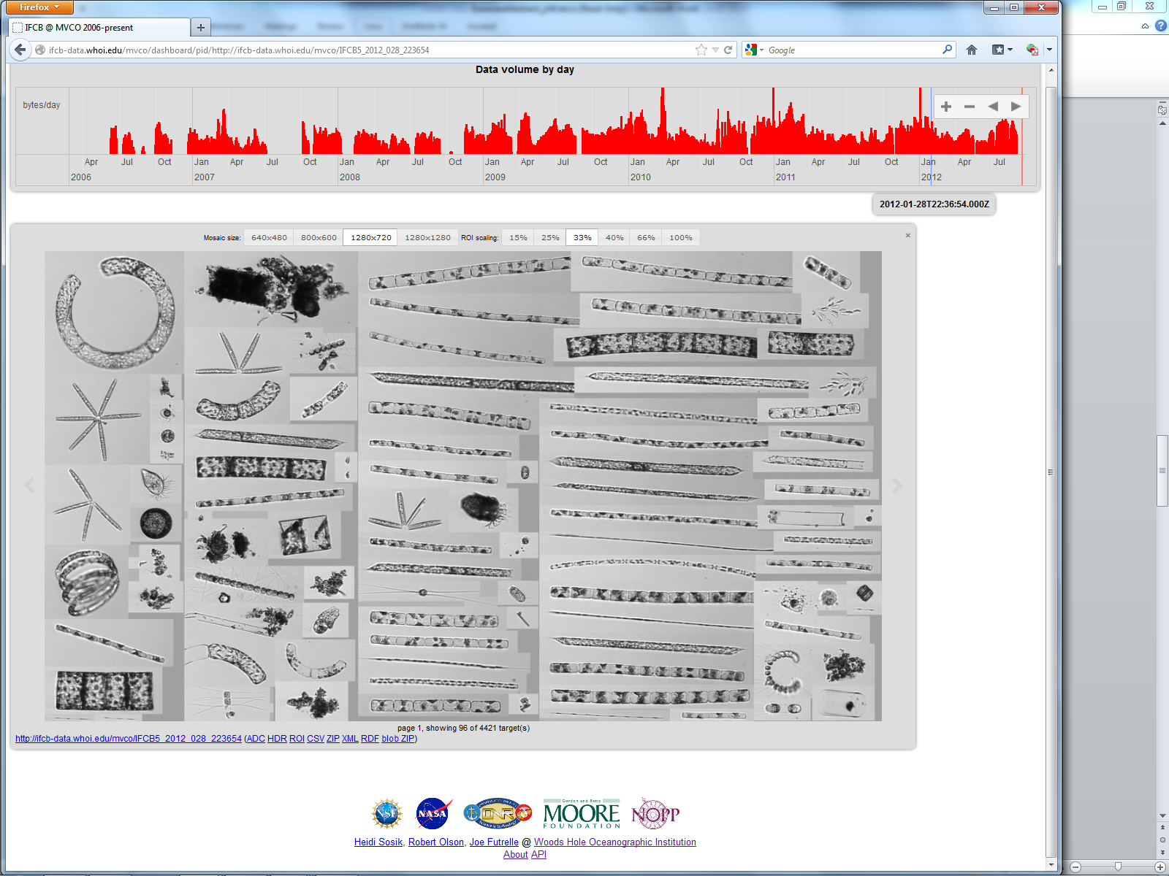
http://ifcb-data.whoi.edu/
Open data access
Standard formats
Processing pipelines
End-to-end provenance
Notes:
Image Informatics

Slide 20
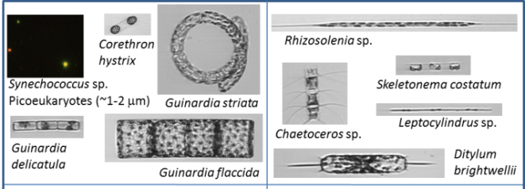
Ecosystem characterization
Cyanobacterium
Diatoms
Taxa with positive response to warmer winters
Taxa with negative response to warmer winters
Interannual variability – taxon specific
Seasonally adjusted
Biomass anomalies vs Temperature anomalies
Notes:
Conclude by emphasizing aspect of why we are interested in being able to make these kinds of functional group characterizations.
We have been analyzing patterns of interann var. Here I’m just showing examples for 3 taxa in mid-winter. Seasonally adj biomass anomalies in Syn, pico cyano, are correl with temperature anomalies. Such that anomalously warm winters favor much higher pico biomass. While diatoms have variable respsonses – some like Corethron are favored like Syn, while other such as Ditylum are favored by colder winters.
Extend to other species and ID groups of species favored by warmer winters as well as those with neg response to warmer conditions. Suggests hypotheses about possible long term trends with continued warming.
C:\work\ifcB\code_svn\analyze_by_class\syn_anomaly_trend.m

Slide 21
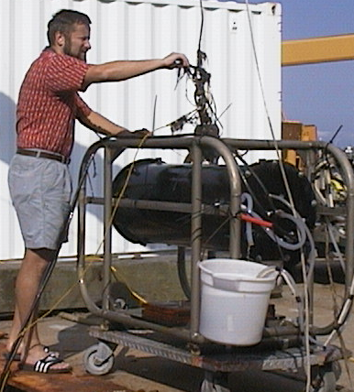

Observing Phytoplankton at MVCO
Martha’s Vineyard Coastal Observatory (MVCO)
Cabled site with power and two-way communications
Picoplankton
Microplankton
Automated features for extended deployment (>6 months)
Enumeration, identification, and cell sizing
Thousands of individual cells every hour
FlowCytobot
Imaging FlowCytobot
Laser-based flow cytometry
Fluorescence and light scattering
Flow cytometry
with video imaging
Olson et al. 2003
Olson & Sosik 2007
Notes:
The centerpiece of our phytoplankton observing strategy is the side-by-side deployment of two automated submersible flow cytometers. These instruments measure properties of single cells very rapidly. The laser-based FlowCytobot is optimized to measure picoplankton, while Imaging FlowCytobot with its integrated video imaging is optimized for microplankton. Both instruments can operate unattended for long periods and can count and identify organisms in many cases to genus or better.
This mode allows us to observe the entire phytoplankton community from picoplankton through microplankton over a very broad range of time scales.

Slide 22
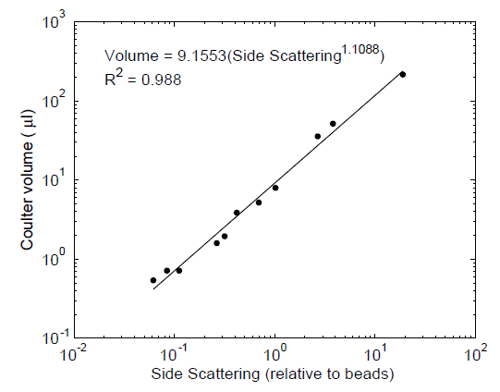
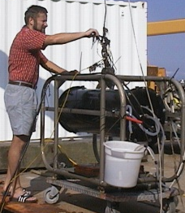

Single Cells to Biomass
Picoplankton
$$Carbon=\sum_{i}{C_{i}}$$
$C_{i}=$ ${f(V}_{i})$
Cell volume (μm³)
Menden-Deuer
and Lessard 2000
FlowCytobot
Light scattering
Volume from laser scattering
Olson et al. 2003
Microplankton
Imaging
FlowCytobot
Volume from image analysis
new “distance map” approach
Sosik and Olson 2007
Moberg & Sosik 2012
Notes:
Analysis of the huge quantities of data from these systems is a major challenge. For this project we have been refining an approach to construct full biomass budgets by summation of the contributions of individual cells. For the small cells, we use light scattering signals to estimate cell volume. We then use taxon and size-specific C:volume relationships from the published meta-analysis of Menden-Deuer & Lessard. For the larger cells, we have 400 million high resolution images to analyze, so we have worked hard to develop automated image processing procedures that allow us to estimate 3D shape and volume for each target. These are examples of original images and their 3D representations. I’d be happy to discuss details of how we’re doing this with anyone who is interested.

