Slide 1
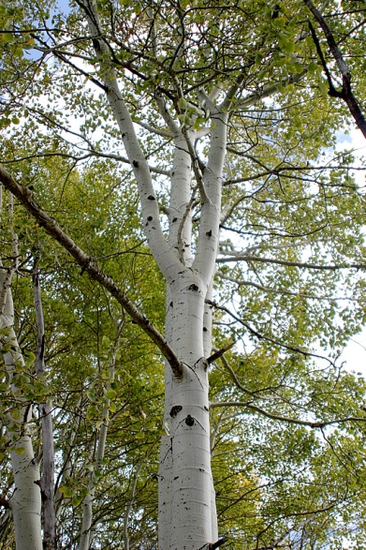
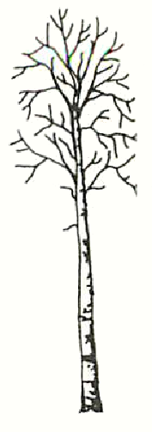
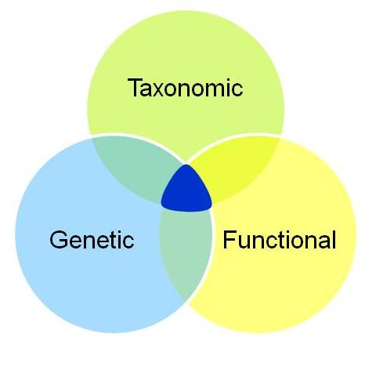
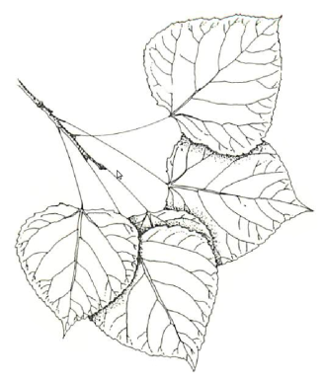
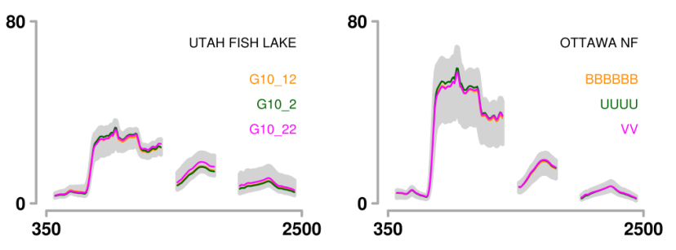
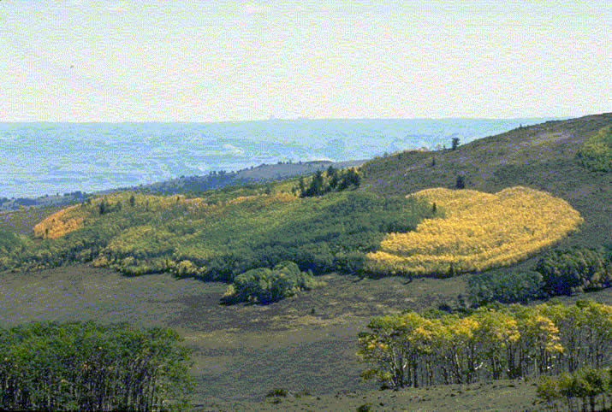




Imaging Spectroscopy
Links Aspen Genotype with Belowground Processes at Landscape Scales
Michael Madritch, Clayton Kingdon, Aditya Singh, Karen Mock, Richard Lindroth, Philip Townsend

Slide 2

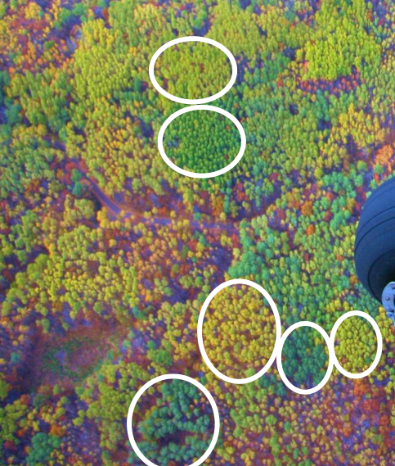
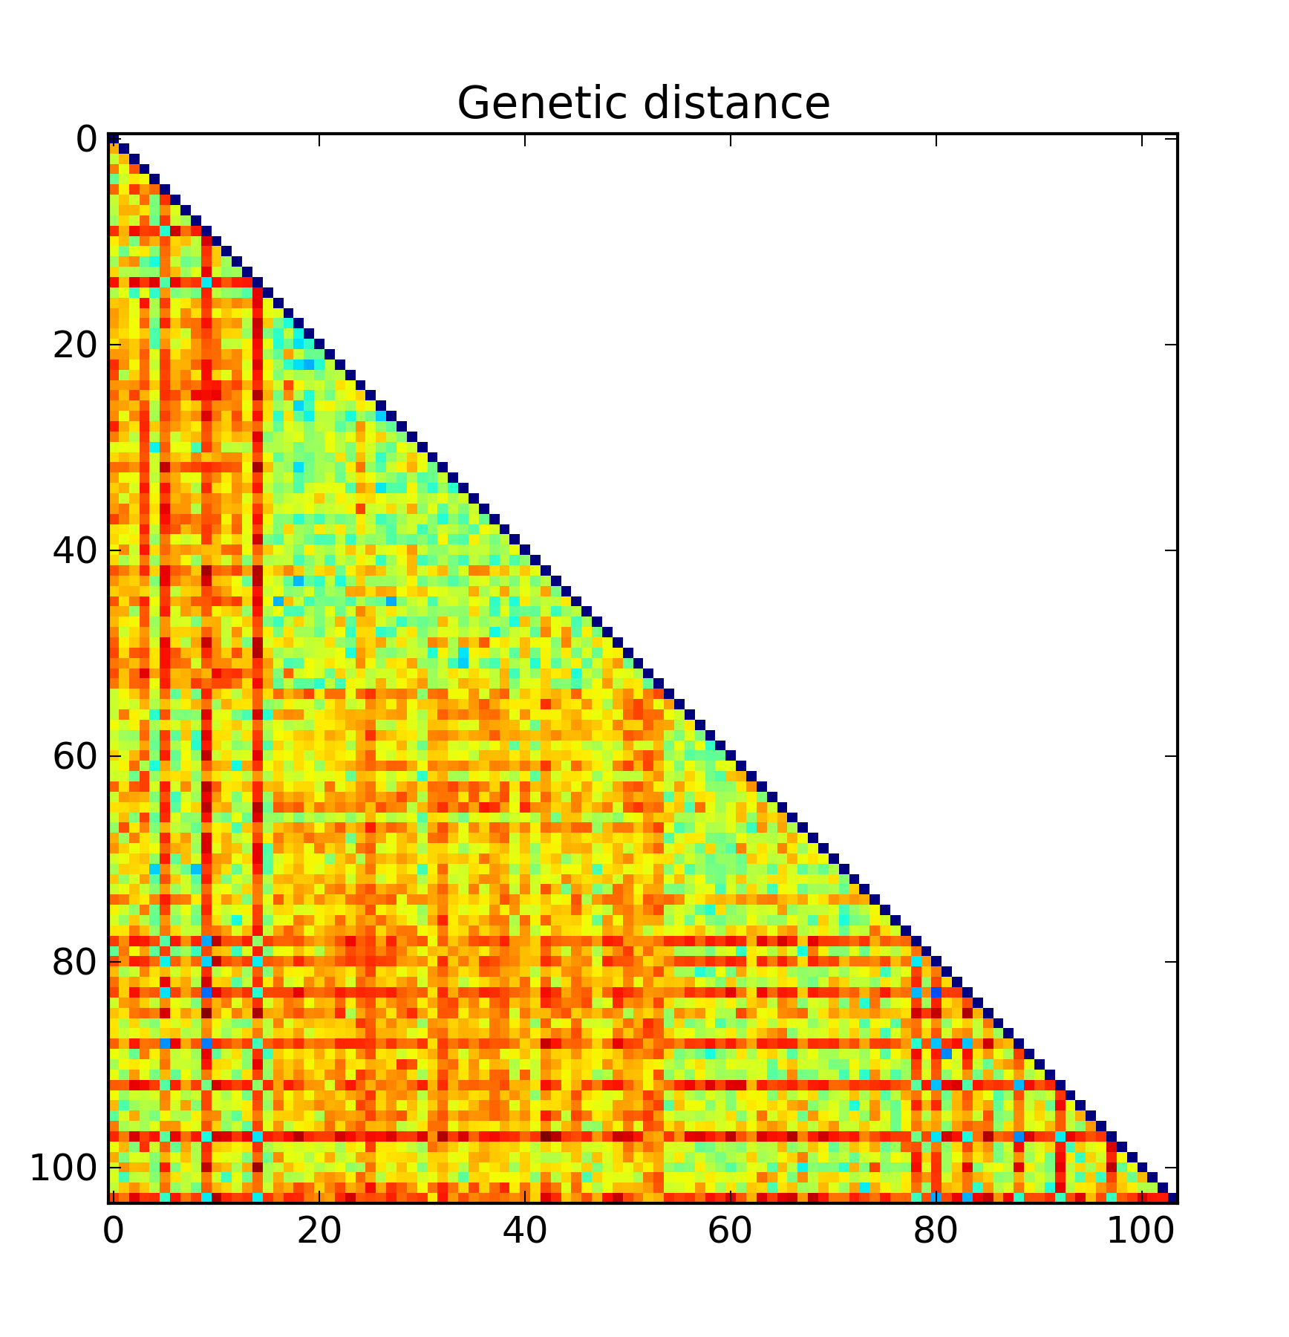
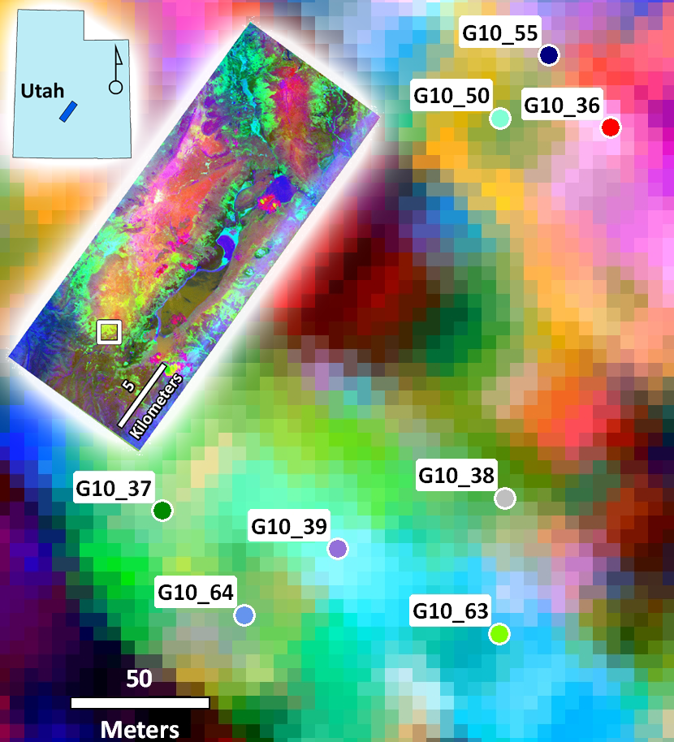

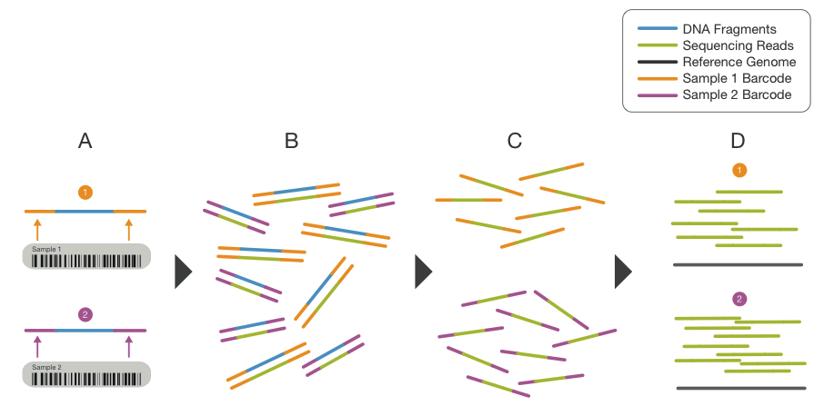
Brief synopsis of results to date.
Some of our more clever efforts.
PLFA, Microsats, AVIRIS
Teaser for the newer results.
Pyrosequencing to characterize microbial communities.
Future episodes:
Linkage to Genome-Wide Associate Mapping (GWA)
Next-generation Imaging Spectrometer (AVIRIS-NG)

Slide 3
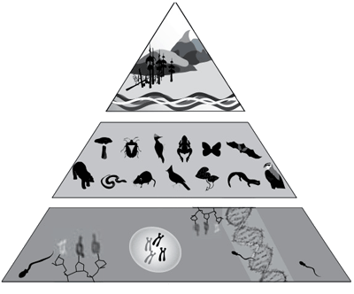
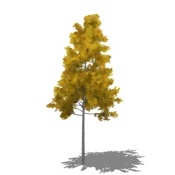
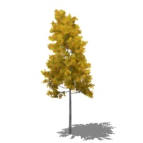
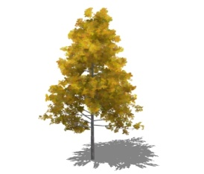
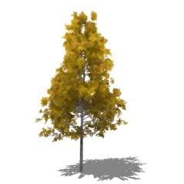
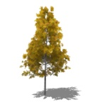
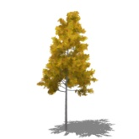

Overview
ecosystem
community
population
Genotype
Foliar Traits
Soil Microbes
species
genotype
I. Houde, www.biodiversitybc.org
our focus: intraspecific diversity
Notes:
This paper is one of the products to come from a project funded by NASA's biodiversity program and is motivated by the need to understand how biodiversity relates to ecosystem function. It's widely accepted that, by most measures, global biodiversity is declining. Accurately quantifying diversity now is the first step in monitoring how it changes.
Our focus is on intraspecific -- within species -- diversity. Our model system is populus tremuloides ... quaking aspen.
Most measurements of biodiversity focus on species or function. Genetic diversity is arguably more important and is often overlooked when assessing biodiversity. Also, the paradigm of species is a human imposed abstraction, whereas genetics approaches the "atomic level" for describing an organism.

Slide 4
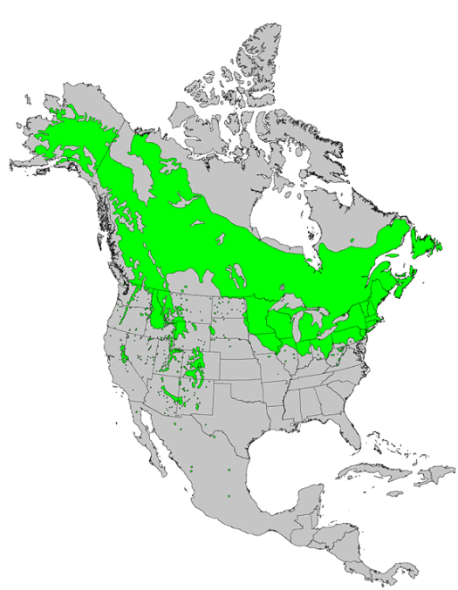

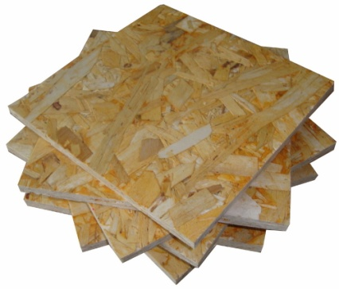
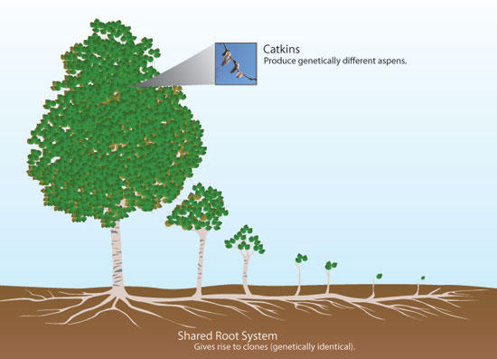
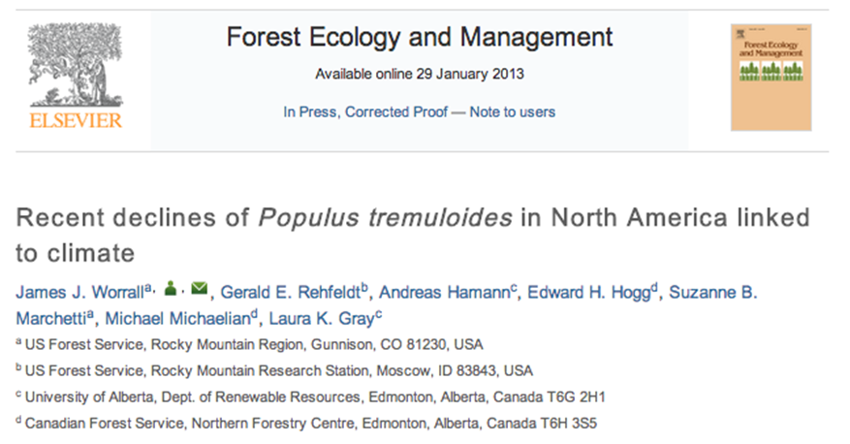
Quaking aspen (Populus tremuloides)
commercially important
impacted by climate
wide distribution
genetically diverse
vegetative expansion
large ‘mappable’ clones
source: USGS
esp.cr.usgs.gov/data/little/
genet
ramets
Grant, M. & Mitton, J. (2010) `
Notes:
So, why focus on aspen. First, most of my work happens in forests.
Aspen trees are an important commercial "crop". They're used for paper products .. everybody uses toilet paper .. and building materials, primarily OSB.
Aspen are impacted by changing climate .. recently drought conditions (SAD) have caused crown thinning, branch dieback, and mortality.
Second, as I said, we're interested in intraspecfic diversity.
Aspen grow both vegitatively and by seed .. that is: sexually and asexually. This, hopefully, means that clones .. that is genets .. are mappable.

Slide 5
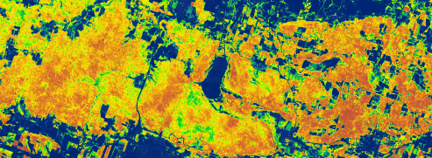

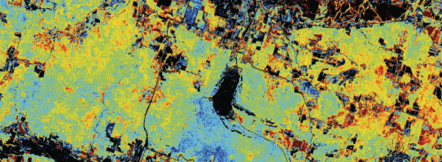
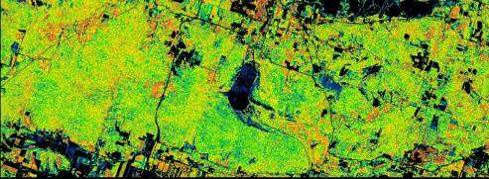
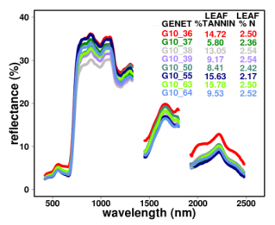
Genotypes vary in AVIRIS spectra and foliar traits
Tannin
Nitrogen
Lignin/Cellulose

Slide 6
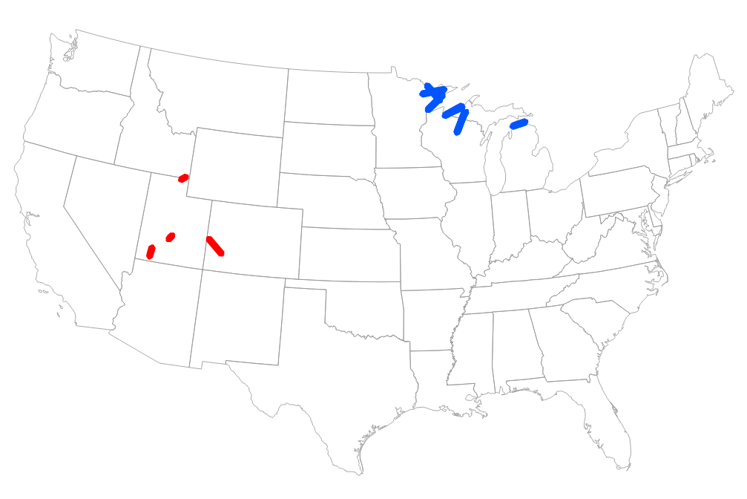
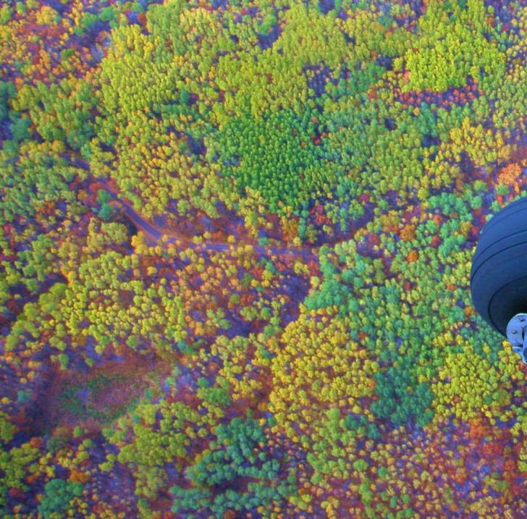
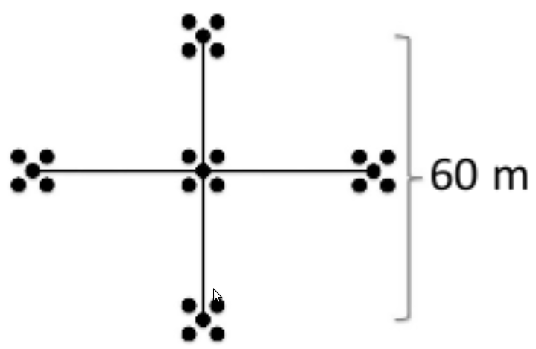
Study Sites and Imagery
Great Lakes
July 13 2009
6 scenes
Western
August 25 2010
6 scenes
Fishlake National Forest, Utah,
Photo by B. Campbell.
Notes:
We set out to find out if we could use AVIRIS to distinguish genotypes of aspen.
It seems obvious that you could use well-times Landsat images to discriminate. These photos both show aspen in our study areas, but these are taken in the fall.
I took this one while flying with former grad student Pete Wolter in fall 2008. He flew and I took pictures that he later geocorrected and incorporated into his dissertation on mapping host species (spruce budworm).
There's a clear phenotype, but do genotypes match phenotypes?

Slide 7
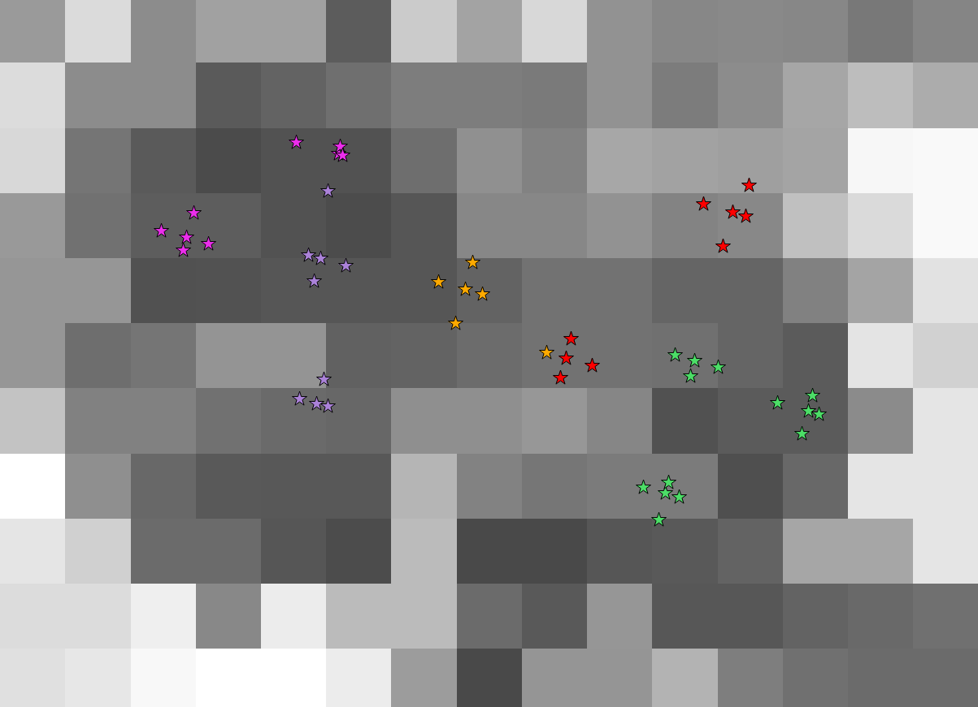
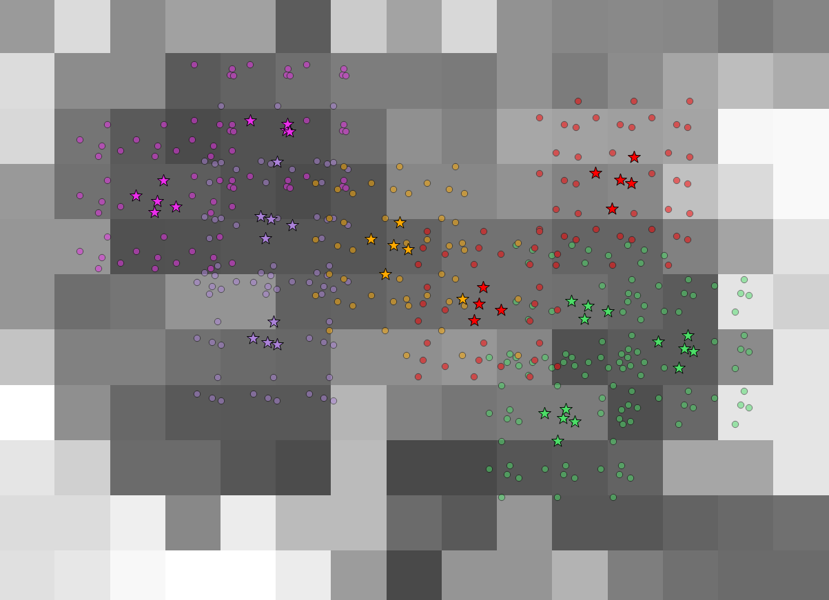
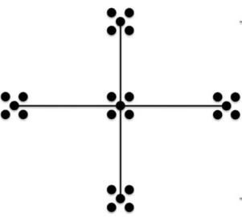
Image sampling scheme: How do we find a genet?
75 plots comprising 1674 trees
3 x 3 matrix of points around each ramet
cut points through images
pixel selection:
> 4 points
> 60% single genet
unit of measure: genet-pixel
Notes:
Each star represents a single tree (i.e ramet). Color represents a single genotype. So there are 5 genotypes represented here.
We weren't getting very good results from our models after cutting our plot data through images. There is often a 1 pixel gap between measured ramets of the same genotype.
There could be several reasons for this ...
geolocation errors:
GPS of plot/node locations
image pixel location error
possible pseudo-replication issue too: multiple ramets within one pixel
Also ...
pixel size is ~ 15m .. the nodes sometimes span multiple pixels and sampling of genotypes is non-contiguous. So, there is an real possibility that a "genet-pixel" is being missed if it is between ramets of the same clone.
Considering all of these things we decided to "resample" the points (representing a tree/ramet) .. created a 3 x 3 point matrix -- with 15m spacing -- around each tree.
The point of this is to keep pixels that are dominated by a single genet, and to drop less-pure pixels. This pixel falls on the cusp ... depending how you sum up points (obviously software can place the point in or out of the pixel) .. then this pixel may/man not be used.
Pixels are those where more than 4 points are contained, and more than 60% of those points are from a single genet. We could add more criteria (e.g. drop pixel if more than 3 genets), but we stopped here.
Our new unit of measure becomes the genet-pixel.

Slide 8
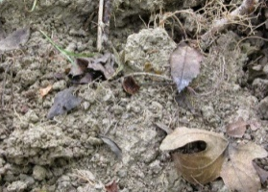

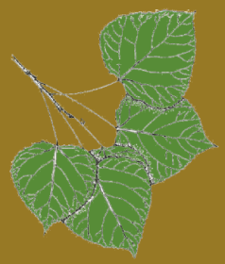

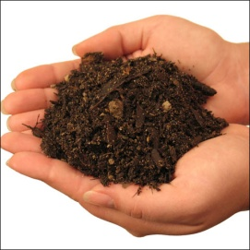

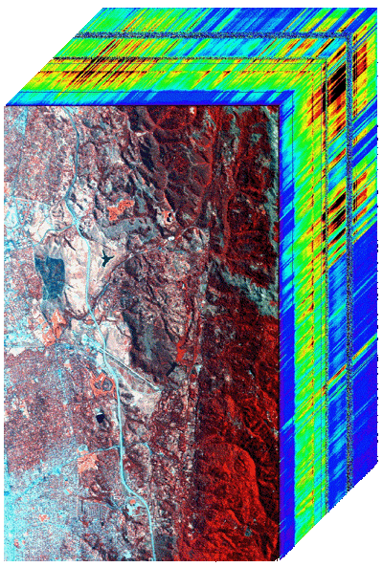
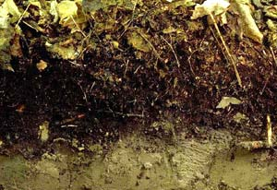


Canonical Correlation: Relating traits and image spectra
r
r
0.84
0.77
0.73
0.69
0.40
0.26
r
0.87
0.79
0.66
Are spectral traits related to foliar traits?
Are foliar traits related to soil traits?
Are spectral traits related to soil traits?
Notes:
This is a distillation of a figure from the paper and I have more detail on the next slide.
Implicit in the title of the paper is the need to address the connections between our three datasets: AVIRIS spectra, foliar traits, soil traits. We did this via CCA, Canonical Correlation Analysis.
CCA can simultaneously compute the relationship -- correlation coefficient (r) -- between two sets of variables. Our data lends itself to this kind of comparison.
This approach ignores genets and only looks at the continuous variables from each of the three datasets.
So, there are three questions we set out to answer ...
1) Are spectral traits related to foliar traits?
The literature has shown this (M-L Smith, Asner), so we weren't too surprised to see that there is a strong connection
The fat line is canonical axis 1, thinner is 2, thinnest is 3.
2) Are foliar traits related to soil traits?
We also expected to see a relationship here. They're not as strong as the connection between spectra and foliage, but they are still
3) Are spectral traits related to soil traits?
This was a bit more of a stretch, and little surprising, but yes, image spectra are almost as strongly related to soil traits as they are to foliar traits

Slide 9
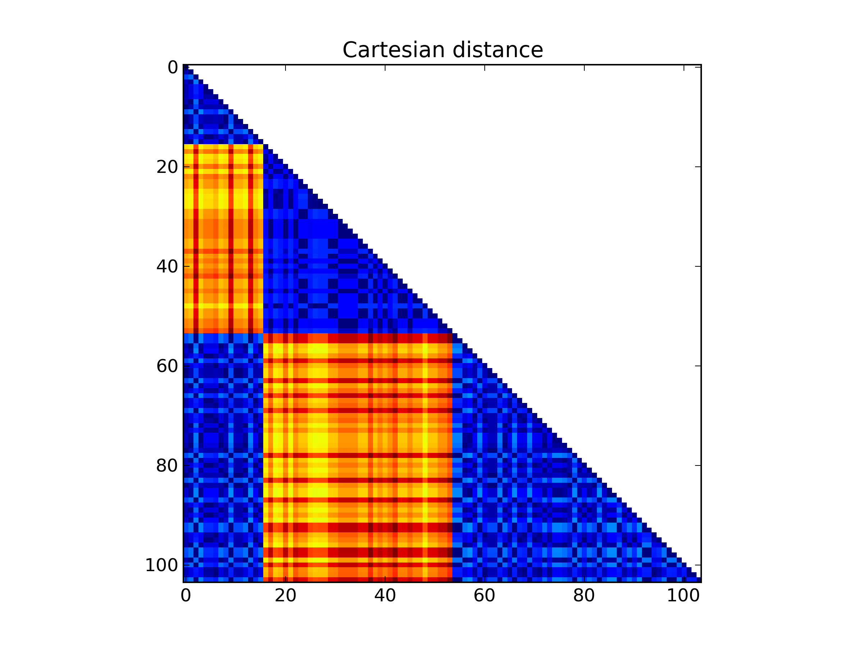

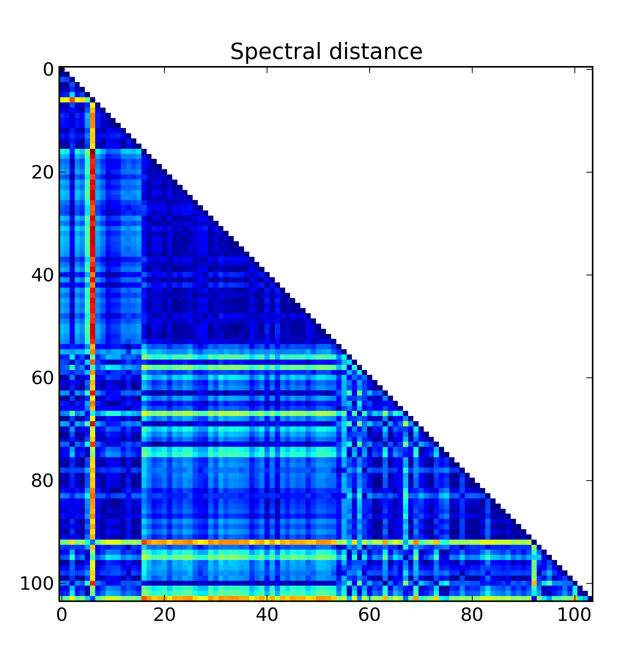
Mantel Tests and Discriminant Analysis
Genetic
When controlling for geographic distance (above):
As genets become more genetically dissimilar, they become more spectrally dissimilar. (More than soils or leaf traits.)
Spectral
Spectral traits better discriminated (mapped) genotypes than either foliar or soil properties.
Notes:
This is a distillation of a figure from the paper and I have more detail on the next slide.
Implicit in the title of the paper is the need to address the connections between our three datasets: AVIRIS spectra, foliar traits, soil traits. We did this via CCA, Canonical Correlation Analysis.
CCA can simultaneously compute the relationship -- correlation coefficient (r) -- between two sets of variables. Our data lends itself to this kind of comparison.
This approach ignores genets and only looks at the continuous variables from each of the three datasets.
So, there are three questions we set out to answer ...
1) Are spectral traits related to foliar traits?
The literature has shown this (M-L Smith, Asner), so we weren't too surprised to see that there is a strong connection
The fat line is canonical axis 1, thinner is 2, thinnest is 3.
2) Are foliar traits related to soil traits?
We also expected to see a relationship here. They're not as strong as the connection between spectra and foliage, but they are still
3) Are spectral traits related to soil traits?
This was a bit more of a stretch, and little surprising, but yes, image spectra are almost as strongly related to soil traits as they are to foliar traits

Slide 10
Next: Illumina ‘next generation’ sequencing
to describe microbial communities
Soil sample has barcoded primer that identifies the DNA sequence
PCR amplified fragments are pooled and sequenced in parallel.
Barcoded sequences are used to sort the fragments by sample ID
Each set of reads is aligned to a reference sequence, giving a list of unique DNA sequences (representing different taxa) per soil sample
Notes:
Each soil sample has specific barcoded primer that identifies the DNA sequence by soil sample ID
PCR amplified fragments are pooled and sequenced in parallel. Each read contains the barcoded ID and the fragment sequence.
Barcoded sequences are used to sort the fragments (de-multiplex) according to each soil sample.
Each set of reads is aligned to a reference sequence, giving a list of unique DNA sequences (representing different taxa) per soil sample
Illumina
Synthesis-based sequencing
Short reads, doubled by paired end reads
paired end reads ~250 bp
Very large scale reads; billion of reads/per run
Each sample has a barcode attached to the PCR primer.
Barcodes build library of treatment/sample
Thousands of different sequences at the end of each barcode correspond to thousands of type of bacteria/fungi in each sample

Slide 11
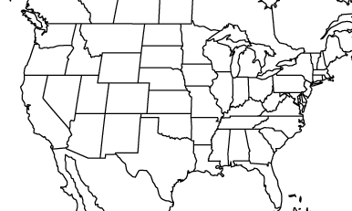
Soil sampling for Illumina sequencing
65 sites pooled from 303 tree/soil samples
  14 genets of variable size
Swan Flats, UT
Fish Lake, UT
Notes:
Points indicate center plot of pooled samples. Samples only pooled if all trees in 5x5 grid were of same genotype.
The analysis included more genets, but some were dropped during analysis for various gaps (failed pcr, too few reps, and others)

Slide 12
Illumina Data Analysis
Distill millions/billions of basepair reads
  Combination of MOTHUR and QIIME pipelines
Bacterial
  Assigned taxonomy ~genus level
Fungal
  Classified to ~class level
Do soil microbial communities vary by aspen genotype?
Are AVIRIS spectra related to key belowground microbial indices?

Slide 13
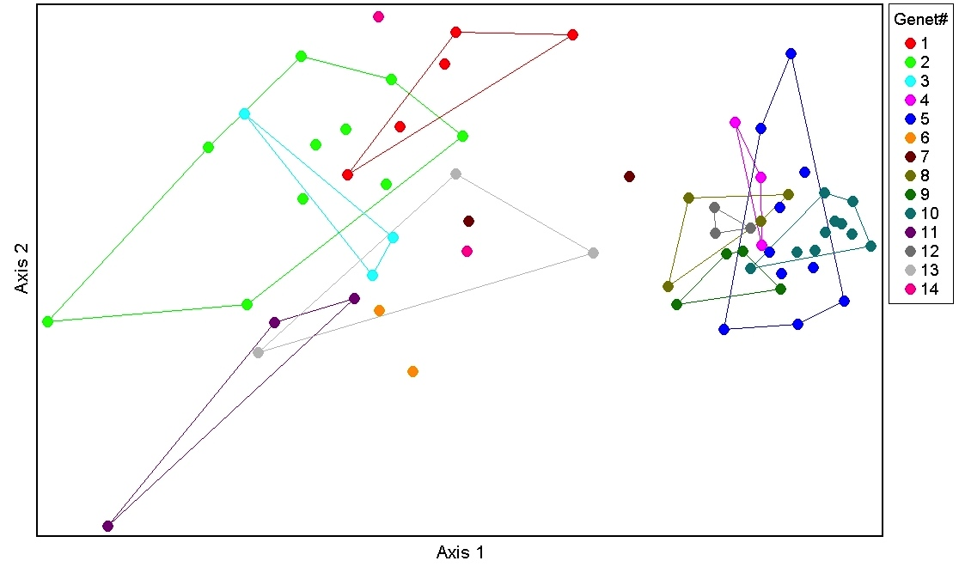
Belowground bacterial communities vary by aspen genet
NMS plot of two axes that describe ~89% of the variation in bacterial communities defined at the genus level. MRPP A = 0.42, P<0.001
Notes:
Coefficients of determination for axes:
Axis 1 .89
Axis 2 0.067
MRPP A = 0.42, P<0.001
A of 0.3 considered high, this A very high; bacterial communities very different by genet
CAVEAT: not corrected for spatial autocorrelation
Multiple Response Permutation Procedure (MRPP) provides a test of whether there is a significant difference between two or more groups of sampling units. (in vegan package and in PCORD)

Slide 14
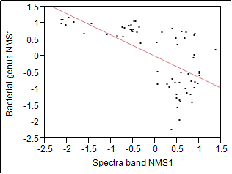
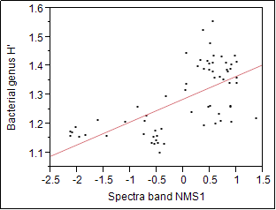
Bacterial-spectra relationship: NMS axes correlations
NMS axis describing most of the variation in bacterial communities is correlated with the NMS axis describing most of the variation in canopy spectra.
Belowground soil bacterial diversity (at the genus level) is correlated with the NMS axis describing most of the variation in canopy spectra.
r=0.41 P<0.001
r=0.40 P<0.001
Swan Flats and Fish Lake data
Notes:
Bands used in all spectral analysese
6-104 (wv0.414-1.323) 116-149 (wv1.443-1.772) 171-219 (wv1.968-2.447)
Spectra from 01_for_PLS-DA_freqfraccut then averaged for ILL group

Slide 15
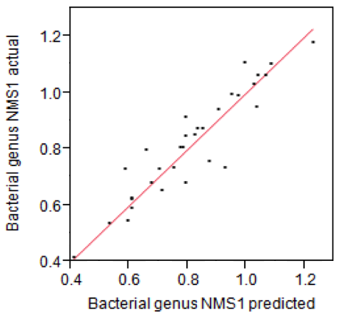
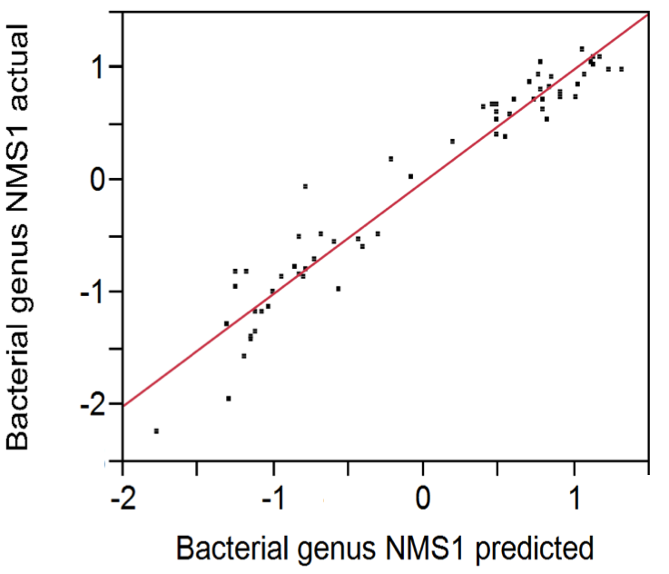
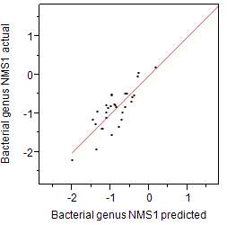
Soil bacterial community NMS axes are related to AVIRIS spectra: PLS results
r=0.87 P<0.001
Swan Flats
r=0.94 P<0.001
Swan Flats and Fish Lake
r=0.67 P<0.001
Fish Lake
Notes:
Bands used in all spectral analysese
6-104 (wv0.414-1.323) 116-149 (wv1.443-1.772) 171-219 (wv1.968-2.447)
Spectra from 01_for_PLS-DA_freqfraccut then averaged for ILL group
Obvious grouping of regions/scenes
PLS holds within scene analysis as well.

Slide 16
Soil bacterial community NMS axes are related to AVIRIS spectra: multivariate and PLS results
Dimensions of variation in soil bacterial communities at the genus level are strongly related to dimensions of variability in spectra – both NMS and diversity measures.
Predicting genus patterns using PLS:
r=0.94 P<0.001
r=0.41 P<0.001
Swan Flats and Fish Lake
Notes:
Bands used in all spectral analysese
6-104 (wv0.414-1.323) 116-149 (wv1.443-1.772) 171-219 (wv1.968-2.447)
Spectra from 01_for_PLS-DA_freqfraccut then averaged for ILL group
Obvious grouping of regions/scenes
PLS holds within scene analysis as well.

Slide 17
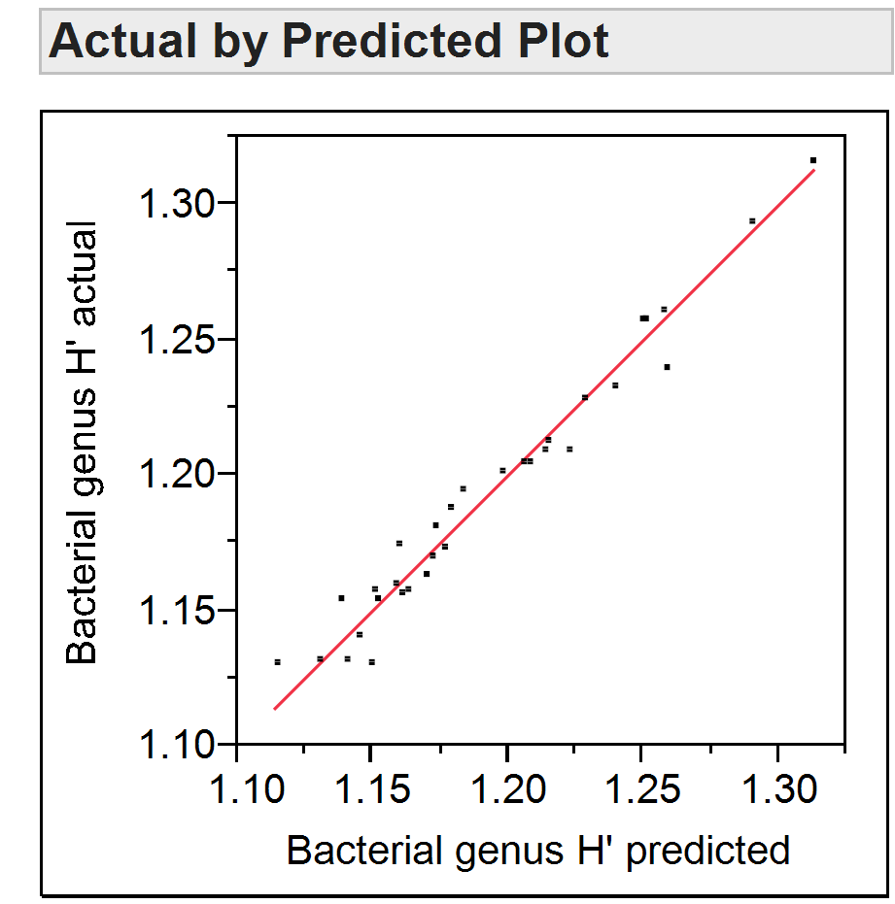
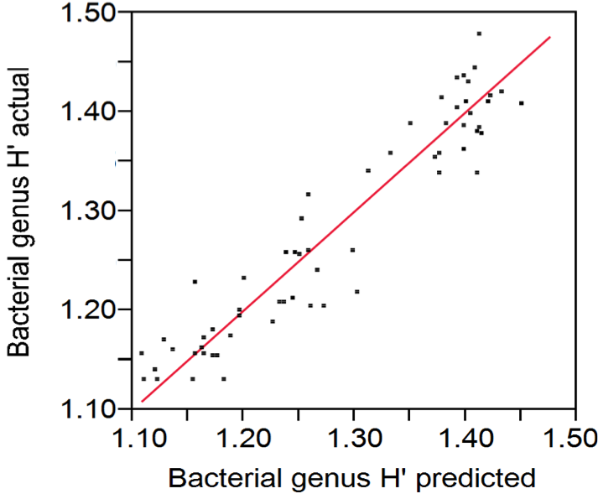
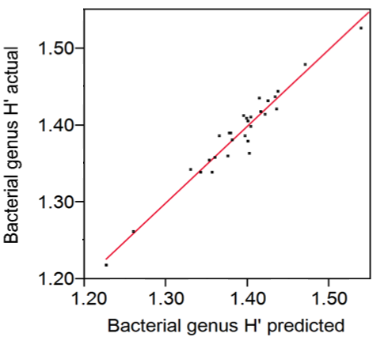
Soil bacterial diversity (H’) is related to AVIRIS spectra: PLS results
r=0.97 P<0.001
Swan Flats
r=0.90 P<0.001
r=0.95 P<0.001
Swan Flats and Fish Lake
Fish Lake
Notes:
NOTE TO PHIL: Microbial people use several field-specific diversity indicators (ACE Chao1 are the most popular). I don’t know how popular those metrics are outside of microbial ecology, so I just stuck with Shannon’s H because everybody is familiar with it.
Bands used in all spectral analysese
6-104 (wv0.414-1.323) 116-149 (wv1.443-1.772) 171-219 (wv1.968-2.447)
Obvious grouping of regions/scenes
PLS holds within scene analysis as well.

Slide 18
Soil bacterial diversity (H’) is related to AVIRIS spectra
Predicting genus diversity using PLS:
r=0.90 P<0.001
Swan Flats and Fish Lake
Notes:
NOTE TO PHIL: Microbial people use several field-specific diversity indicators (ACE Chao1 are the most popular). I don’t know how popular those metrics are outside of microbial ecology, so I just stuck with Shannon’s H because everybody is familiar with it.
Bands used in all spectral analysese
6-104 (wv0.414-1.323) 116-149 (wv1.443-1.772) 171-219 (wv1.968-2.447)
Obvious grouping of regions/scenes
PLS holds within scene analysis as well.

Slide 19
PLS factor 1 explains ~40% variation in bacteria NMS1 and in bacteria H’, and the following variation in AVIRIS wavelengths:
Notes:
PHIL; This is the variance explained in wavelengths by the first latent factor of the pls model. The same factor explained the most, about 40%, of the variation in both bacterial NMS1 and bacterial H'. I think I’m interpreting this correctly: Similar to our PTRS CCA analysis of spectra-soils, there are strong relationships in red-edge through NIR (canopy structure and C?), and with bands >2000 (foliar N and phytochemistry?) . My PLS experience is limited, so please double check my logic. I can’t figure out how to word the title appropriately.

Slide 20
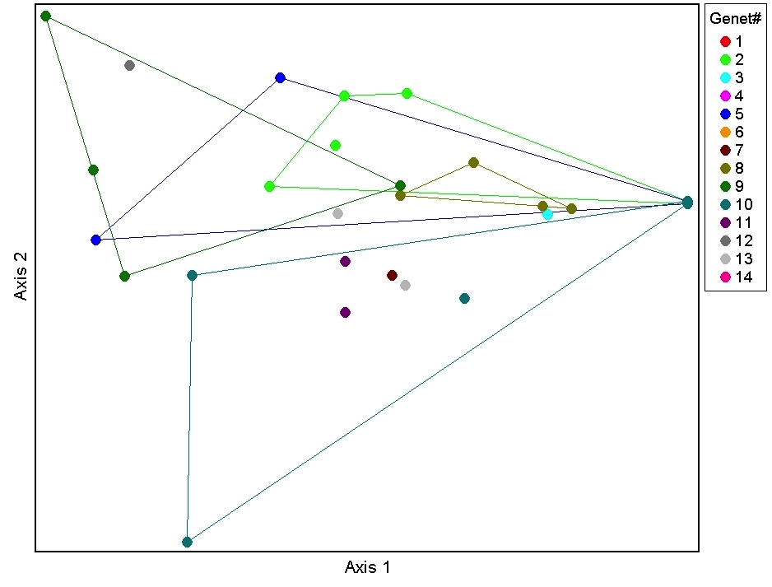
Belowground fungal communities vary by aspen genet
NMS plot of two axes that describe ~88% of the variation in bacterial communities defined at the genus level. MRPP A = 0.14, P=0.015.
Notes:
Fungal class NMS genet graph
OVERALL PATTERN DRIVEN BY LARGE NUMBER OF UNKNOWN SEQUENCES.
Coefficients of determination for axes:
Axis 1 .882
Axis 2 0.058
MRPP (applied only to replicate genets) A=0.14 P=0.015
NMS axis plots swamped by undefined taxa.

Slide 21
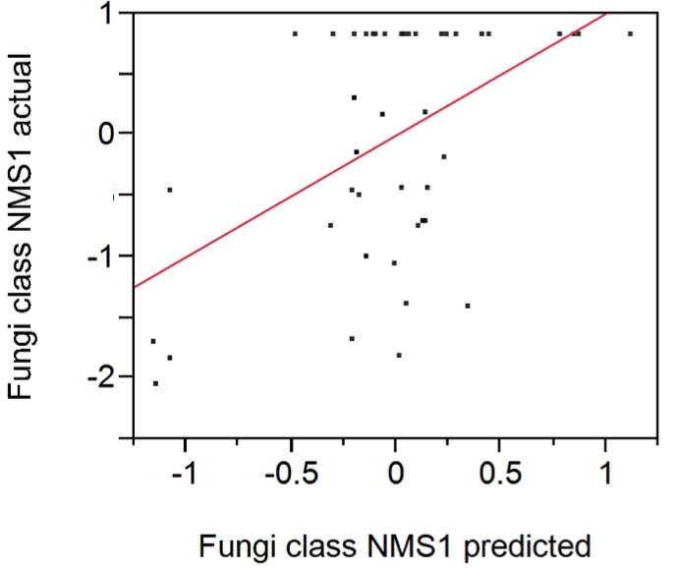
Relationships in fungal data generally much weaker than those found in bacterial data
Bacterial and Fungal community differences
No correlation between fungal NMS or H’ and spectral NMS
Weak PLS regressions
Very large number of unknown fungal sequences is problematic
r=0.30 P<0.01
Swan Flats and Fish Lake

Slide 22
Microbial community summary
Belowground microbial communities vary according to aspen genotype
  Bacterial and fungal communities
Canopy spectra provide information about belowground microbial communities, most likely because of strong relationship between canopy spectra and canopy chemistry.
  Bacterial patterns much stronger than are fungal patterns.
Current efforts focus on:
  Using imaging spectroscopy to map the variability associated with a) genotype and b) soil diversity
Principle of “optical surrogacy”

Slide 23
Next Steps – This Project

Slide 24



Next Steps – New Projects and Extensions
Jeannine Cavender-Bares: NSF-NASA Dimensions of Biodiversity (see poster!)
Linkage of manipulated plant biodiversity, optical diversity, functional diversity, belowground processes, etc.
John Gamon, Sarah Hobbie, Mike Madritch, Rick Lindroth, Rebecaa Montgomery, Art Zygielbaum
Notes:
This is a distillation of a figure from the paper and I have more detail on the next slide.
Implicit in the title of the paper is the need to address the connections between our three datasets: AVIRIS spectra, foliar traits, soil traits. We did this via CCA, Canonical Correlation Analysis.
CCA can simultaneously compute the relationship -- correlation coefficient (r) -- between two sets of variables. Our data lends itself to this kind of comparison.
This approach ignores genets and only looks at the continuous variables from each of the three datasets.
So, there are three questions we set out to answer ...
1) Are spectral traits related to foliar traits?
The literature has shown this (M-L Smith, Asner), so we weren't too surprised to see that there is a strong connection
The fat line is canonical axis 1, thinner is 2, thinnest is 3.
2) Are foliar traits related to soil traits?
We also expected to see a relationship here. They're not as strong as the connection between spectra and foliage, but they are still
3) Are spectral traits related to soil traits?
This was a bit more of a stretch, and little surprising, but yes, image spectra are almost as strongly related to soil traits as they are to foliar traits

Slide 25

Next Steps – Wisasp
Aspen common garden near Arlington, Wisconsin
~500 genotypes
>3 replicate trees/genotype
40,000 SNPs used to identify genotypes
Rick Lindroth: Association mapping of phenotypic traits in aspen
Leaf-level spectroscopy (for now)
Genome-wide associate mapping (GWA) to link phenotypic traits to genetic components
Traits of interest: growth/morphology, foliar chemistry, phenology, insects
Notes:
This is a distillation of a figure from the paper and I have more detail on the next slide.
Implicit in the title of the paper is the need to address the connections between our three datasets: AVIRIS spectra, foliar traits, soil traits. We did this via CCA, Canonical Correlation Analysis.
CCA can simultaneously compute the relationship -- correlation coefficient (r) -- between two sets of variables. Our data lends itself to this kind of comparison.
This approach ignores genets and only looks at the continuous variables from each of the three datasets.
So, there are three questions we set out to answer ...
1) Are spectral traits related to foliar traits?
The literature has shown this (M-L Smith, Asner), so we weren't too surprised to see that there is a strong connection
The fat line is canonical axis 1, thinner is 2, thinnest is 3.
2) Are foliar traits related to soil traits?
We also expected to see a relationship here. They're not as strong as the connection between spectra and foliage, but they are still
3) Are spectral traits related to soil traits?
This was a bit more of a stretch, and little surprising, but yes, image spectra are almost as strongly related to soil traits as they are to foliar traits

Slide 26


Next Steps – Citrus example (NGIS)
How do AVIRIS-NG spectra vary among citrus varieties?
Specifically: can we replicate the citrus phylogeny as a function of spectral distance?
Citrus Varietal Collection at UC-Riverside
Data from David Thompson, Ian McCubbin and numerous others at JPL
Similar project with North American oaks with Jeannine Cavender-Bares
Notes:
This is a distillation of a figure from the paper and I have more detail on the next slide.
Implicit in the title of the paper is the need to address the connections between our three datasets: AVIRIS spectra, foliar traits, soil traits. We did this via CCA, Canonical Correlation Analysis.
CCA can simultaneously compute the relationship -- correlation coefficient (r) -- between two sets of variables. Our data lends itself to this kind of comparison.
This approach ignores genets and only looks at the continuous variables from each of the three datasets.
So, there are three questions we set out to answer ...
1) Are spectral traits related to foliar traits?
The literature has shown this (M-L Smith, Asner), so we weren't too surprised to see that there is a strong connection
The fat line is canonical axis 1, thinner is 2, thinnest is 3.
2) Are foliar traits related to soil traits?
We also expected to see a relationship here. They're not as strong as the connection between spectra and foliage, but they are still
3) Are spectral traits related to soil traits?
This was a bit more of a stretch, and little surprising, but yes, image spectra are almost as strongly related to soil traits as they are to foliar traits

Slide 27


NDVI / EVI
PRI
Skin Temperature
Green / NPV Fraction
faPAR
Vegetation Type
Canopy Water Content
Chlorophyll
Specific Leaf Area
Nitrogen
Canopy Height (lidar)
Canopy Structure (lidar)
Lignin
Other Pigments
Fluorescence Yield
Secondary Metabolites
Vcmax / Jmax
Remote Sensing and Linkage to Ecosystem Traits
Optical Diversity
Genetic Diversity
Functional Diversity
Ecosystem Diversity
Microbial Diversity
Ecosystem Response to
Environmental Change
NASA Biodiversity Team Meeting, May 7, 2014
Notes:
Revised with Aditya’s ordering of traits.
SHOULD I INDICATE WHICH CAN BE RETRIEVED FROM PHYSICALLY BASED MODELS?
Some are indices—
Some are mapped traits—
Some retrieved from physically bbased models—
WE NEED ALL OF THESE
→ Point is if 2 or more approaches converge on the same answer, then we likely are truly measuring something

Slide 28

Also…
See the Snapshot Wisconsin poster for something completely different and application oriented.

