Slide 1




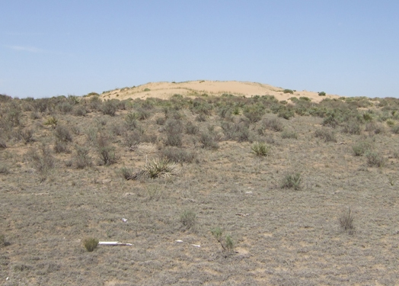
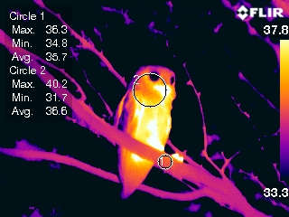
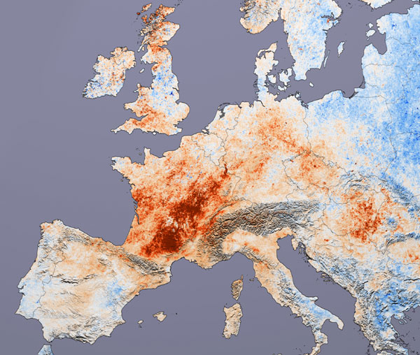
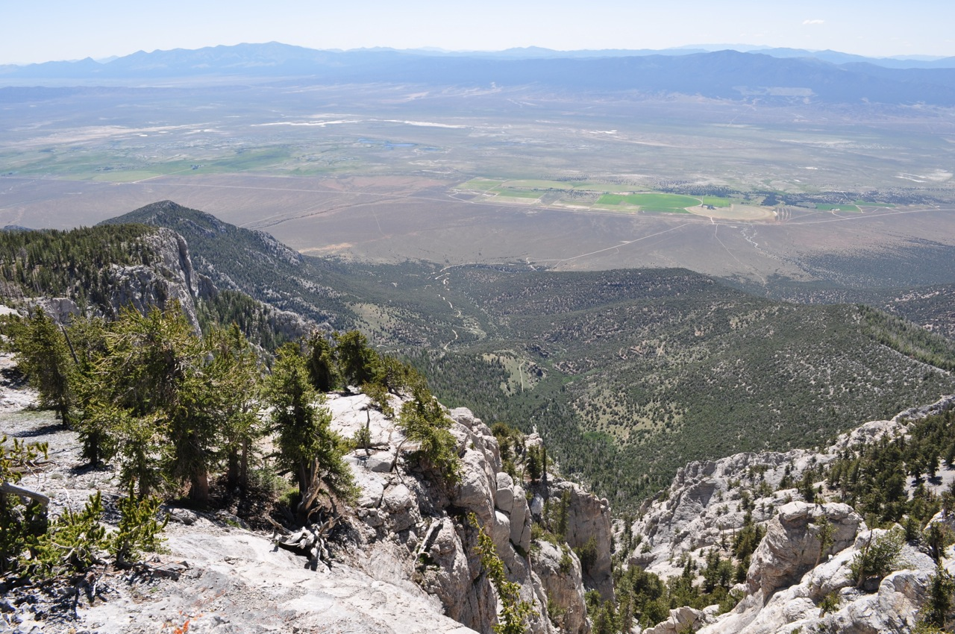
Desert Birds in a Warming World: Characterizing Thermal Stress with Daily Earth Observation Data in Complex Terrain and Microsites
Thomas P. Albright
Laboratory for Conservation Biogeography
Department of Geography
Mackay School of Earth Science & Engineering
& Program in Ecology, Evolution, and Conservation Biology
University of Nevada, Reno
NASA Biodiversity & Ecological Forecasting Science Team, Silver Spring, MD 7-9 May 2014

Slide 2
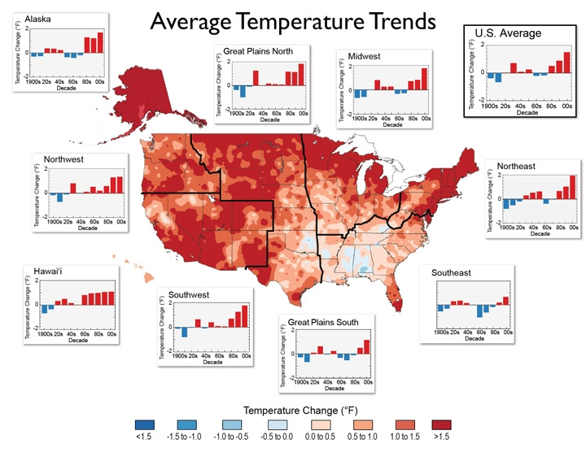
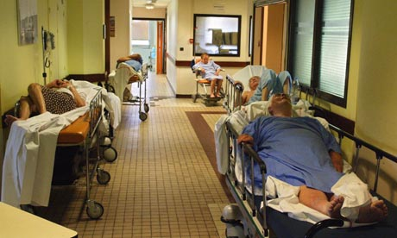

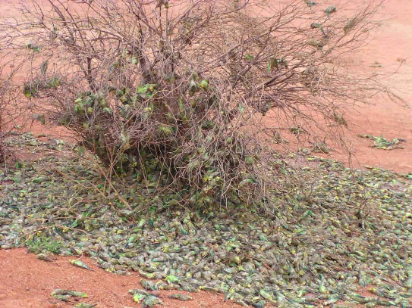
Motivation: Hot…
[Martin Bureau, Agence France Presse]
[National Climate Assessment 2014]
[Coker Dylan, Herald Sun]
[Northern Guardian]
Notes:
Make this graphical rather than linear.

Slide 3
Motivation: Hot and getting hotter
[Coumou & Rahmstorf, Nature Climate Change, 2012]
[IPCC AR4]
Notes:
Make this graphical rather than linear.

Slide 4
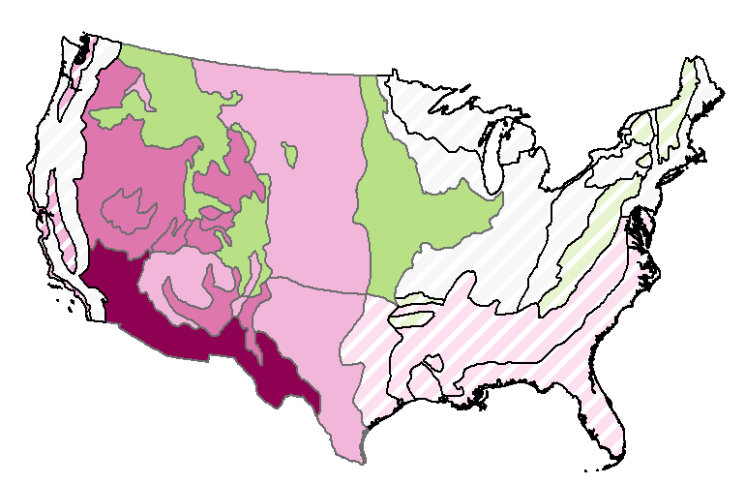
Motivation: Heat waves and birds
Indirect effects
Alteration of behavior, reproduction, and habitat selection
Exacerbate drought => vegetation effects
Direct effects
Dehydration
Hyperthermia
Ground-nesting bird
response to nominal
100-year heat event
[Albright et al., 2010 Ecosphere]

Slide 5
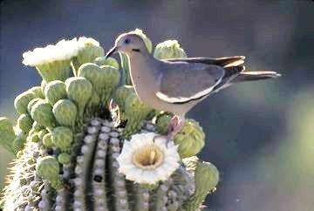
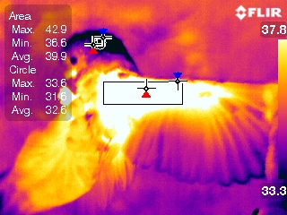
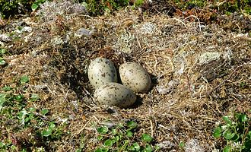
And yet…
Temperature extremes are highly variable in space and time at multiple scales
Animals vary greatly in ability to tolerate, buffer, and modify temperatures
[Dobrowski 2011,
Global Change Biology]
[B. Wolf]
[T. Albright]
[<= Banangraut, Wikimedia Commons]

Slide 6
Fundamental objective:
Improve understanding of effects of hot extremes and climate change on bird life, to inform:
  Basic ecology
  Resilient conservation
Characterize high temperature extremes at relevant scales using remote sensing,

Slide 7
Desert Birds in a Warming World: Project Briefing
Background and motivation
Project overview
Spatial data development
Physiological models
Other activities

Slide 8
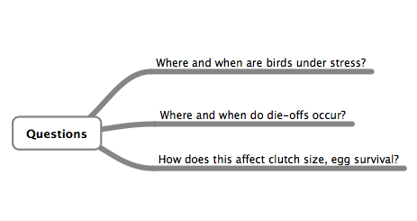
Project Overview

Slide 9
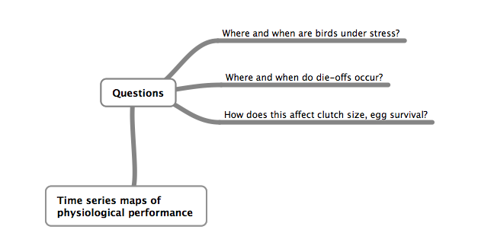
Project Overview

Slide 10
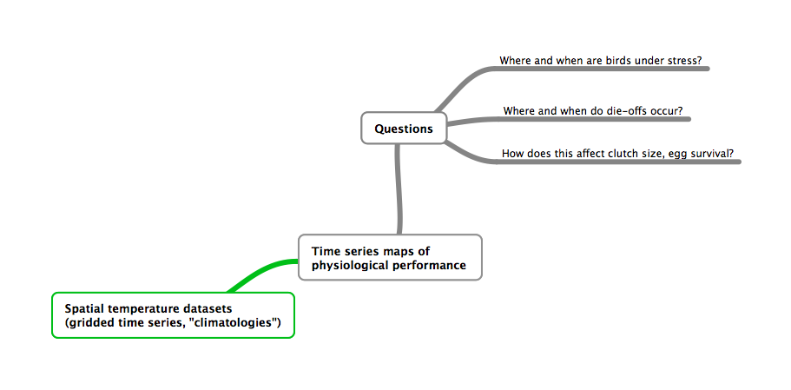
Project Overview

Slide 11
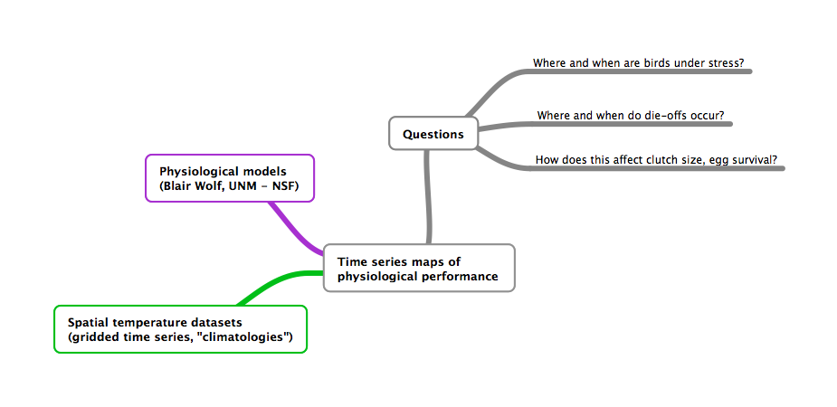
Project Overview

Slide 12
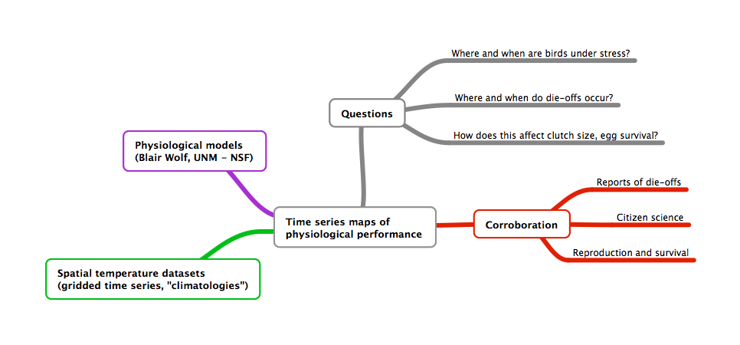
Project Overview

Slide 13
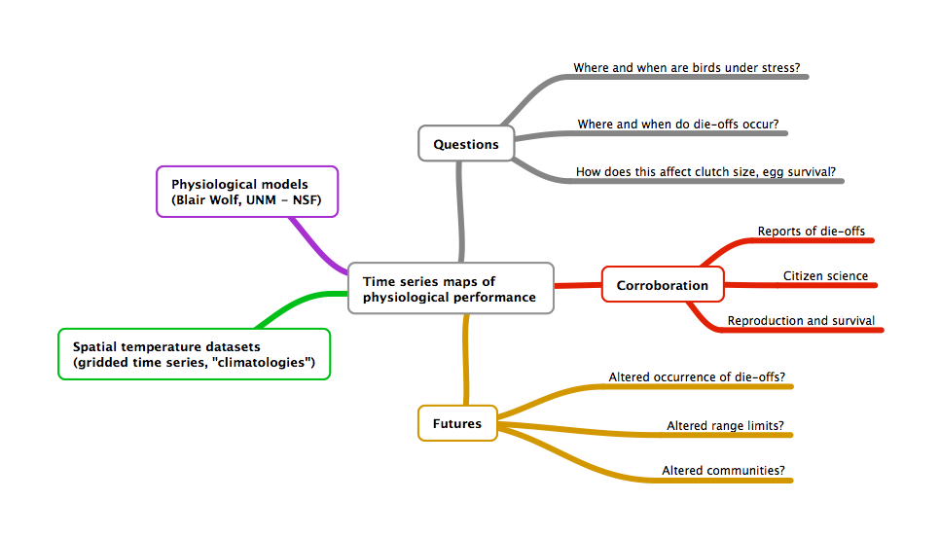
Project Overview

Slide 14


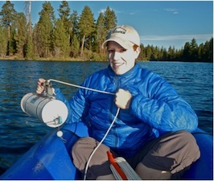





Project team & some collaborators
Denis Mutiibwa
Giancarlo Sadoti
Kerry Howard
Jacque Ewing-Taylor
Blair Wolf
U. New Mexico
Anna Pidgeon
U. Wisconsin-Madison
Markus Neteler,
Fondazione Edmund Mach
John Mejia
Desert Research Inst.
Notes:
Make this graphical rather than linear.

Slide 15
Desert Birds in a Warming World: Project Briefing
Background and motivation
Project overview
Spatial data development
Physiological models
Other activities

Slide 16
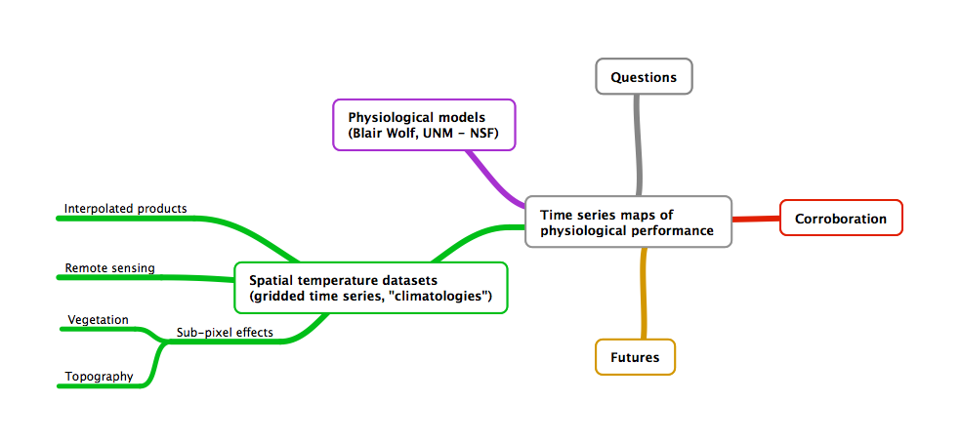
Spatial Temperature Datasets

Slide 17
Spatial Temperature Datasets
Purpose: Develop datasets over US Southwest that characterize temperature variability at spatial and temporal scales relevant to avian physiological stresses, validate data
Targets: sub-daily resolution, “topoclimate” spatial scale, microsite effects
Gridded datasets:
Daymet (daily, 1-km)
NLDAS (hourly, 14-km)

Slide 18
Temperature Data: Remote Sensing
MODIS (MOD11A1, MYD11A1)
Landsat TIR (future activity)
MODIS LST reconstruction 4x/day (M. Neteler)
  US product in progress…
[Metz et al.
Rem. Sens. 2014]

Slide 19
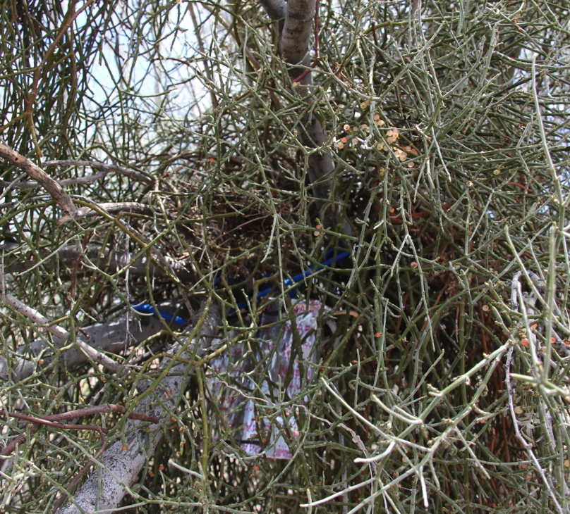
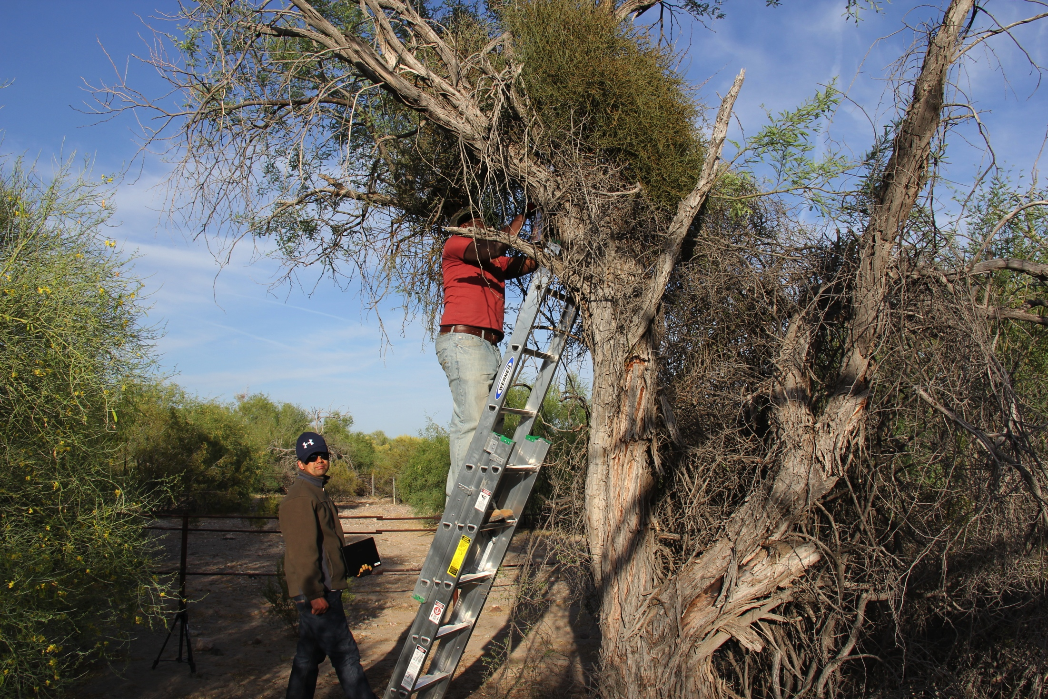
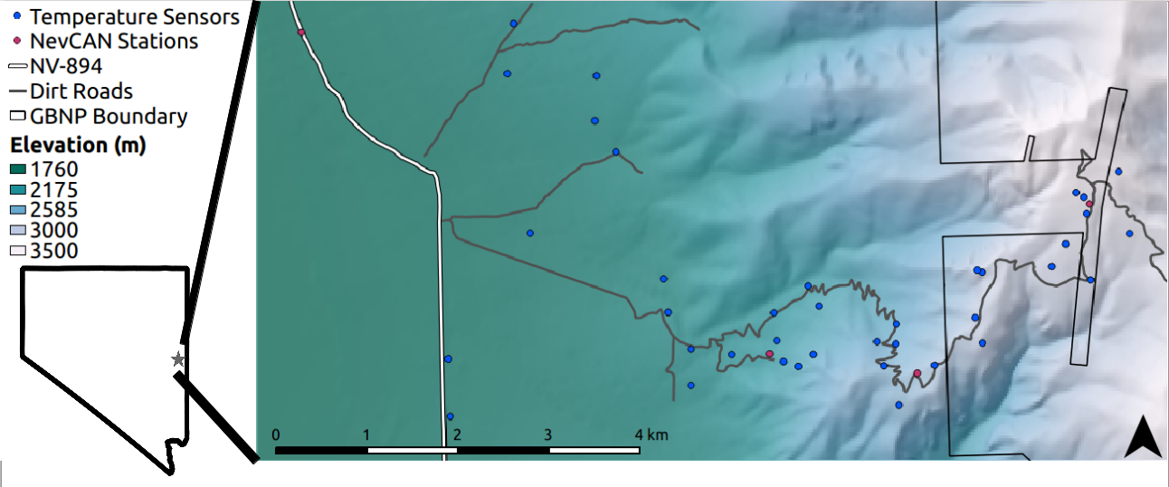
Temperature Data: In situ sensors
Complex terrain: Snake range (Eastern NV)
Microrefugia: Kofa Nat. Wildlife Refuge, AZ
American pika habitat: Great Basin (NV, OR; w/ Erik Beever, USGS)

Slide 20
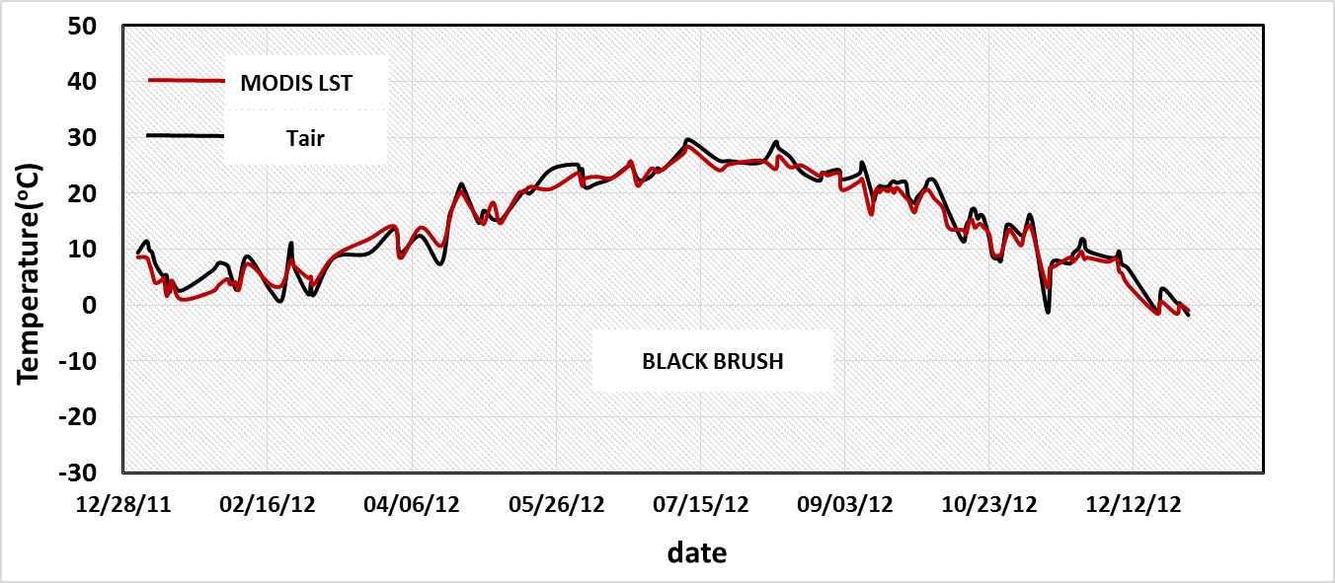
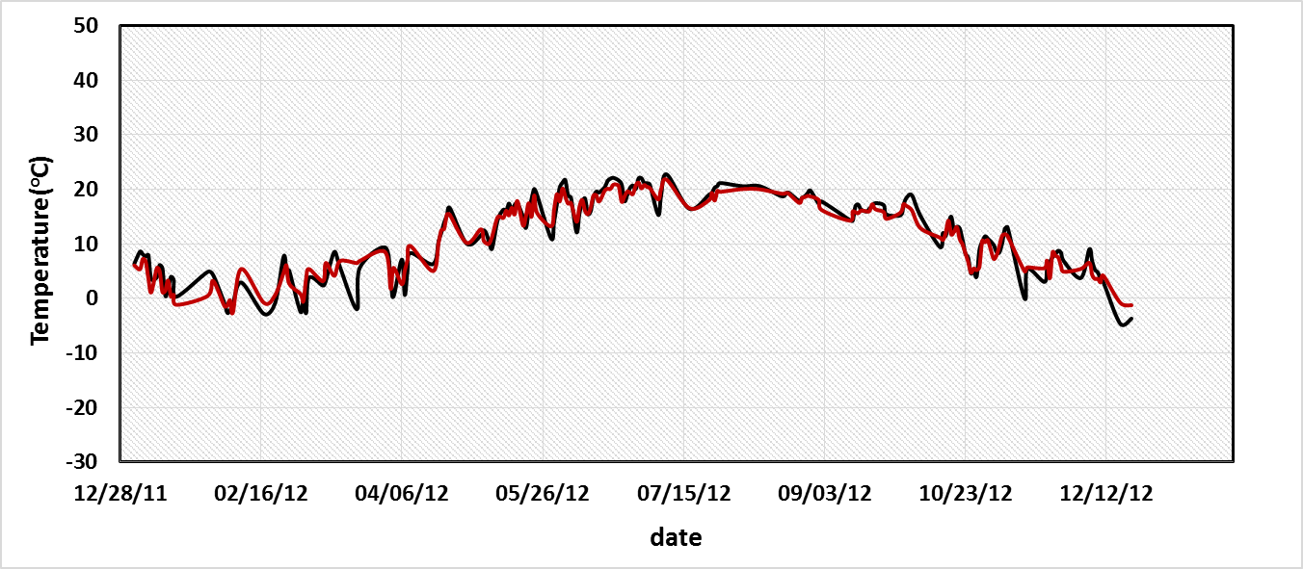
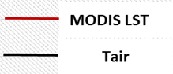
Can LST observations improve T_{air} estimates in complex terrain?
Evaluated in two desert ecoregions across 13 sites
Strongest relationships during daytime
Minimal vegetation zone, view angle effects
Developing models of T_{air} based on LST
[Mutiibwa et al. in prep.]
Notes:
Environmental conditions in the broadest sense (biotic interactions, both positive and negative)

Slide 21
Desert Birds in a Warming World: Project Briefing
Background and motivation
Project overview
Spatial data development
Physiological models
Other activities

Slide 22
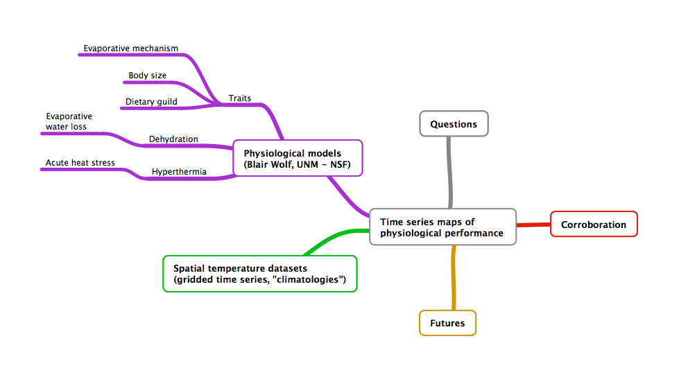
Physiological Models (w/ Blair Wolf)

Slide 23
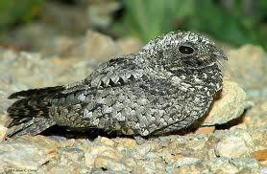
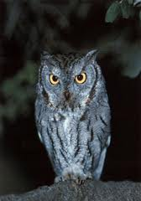
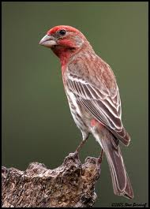
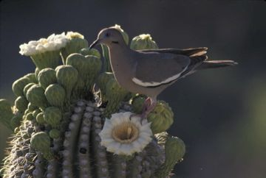
Evaporative mechanisms (Blair Wolf)
° C = ° F
66 = 151
64 = 147
62 = 144
58 = 136
54 = 129
50 = 122
48 = 118
46 = 115
44 = 111
42 = 108
40 = 104
38 = 101
How does EWL efficiency vary with lineage and mechanism?
Panting - Passeriformes
gular flutter - Strigiformes, Caprimulgiformes
cutaneous loss - Columbiformes
Evaporative water loss
52
62

Slide 24
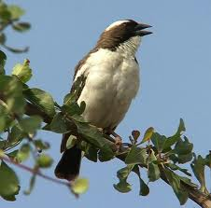
Heat stress & thermal tolerance (Blair Wolf)
° C = ° F
66 = 151
64 = 147
62 = 144
58 = 136
54 = 129
50 = 122
48 = 118
46 = 115
44 = 111
42 = 108
40 = 104
38 = 101
What are the highest body temperatures that species can tolerate?
How does body temperature change with increasing heat stress?
Notes:
Tb under thermo neutral conditions
Tb during mild heat stress
Tb during extreme heat stress
Differences among taxa
What explains these differences?

Slide 25
Desert Birds in a Warming World: Project Briefing
Background and motivation
Project overview
Spatial data development
Physiological models
Other activities

Slide 26
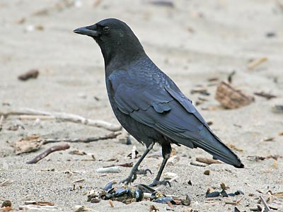
American Crow (n = 1,122)
Overall advance in laying date, most rapidly at lower elevations
Clutch size patterns show declines with multi-week temperature anomalies
108
6.0
2-week T_{min}
106
Relative elevation: +2 SD
5.5
104
5.0
+1 SD
Julian day
Clutch size
102
4.5
100
Mean (125 m)
4.0
98
-1 SD
3.5
4-week T_{min}
4-week T_{mean}
96
-2 SD
3.0
1890
1900
1910
1920
1930
1940
-10
-5
0
5
10
15
20
Year
Daily temperature anomaly (C)

Slide 27
Clutch size/laying cessation predicted by hot weather during egg formation (G. Sadoti w/ David Winkler, Cornell University)
Normal breeding temperatures
Laying period
Full incubation
physiological zero: ~22-26 C
Ambient / Egg
Temperature
Egg 1 Egg 2 Egg 3 Egg4 Egg 5 Egg 6 Egg 7
Heat wave (clutch viability hypothesis)
Laying
Partial incubation & follicular disruption
Full incubation
Ambient / Egg
Temperature
Egg 1 Egg 2 Egg 3 Egg4

Slide 28
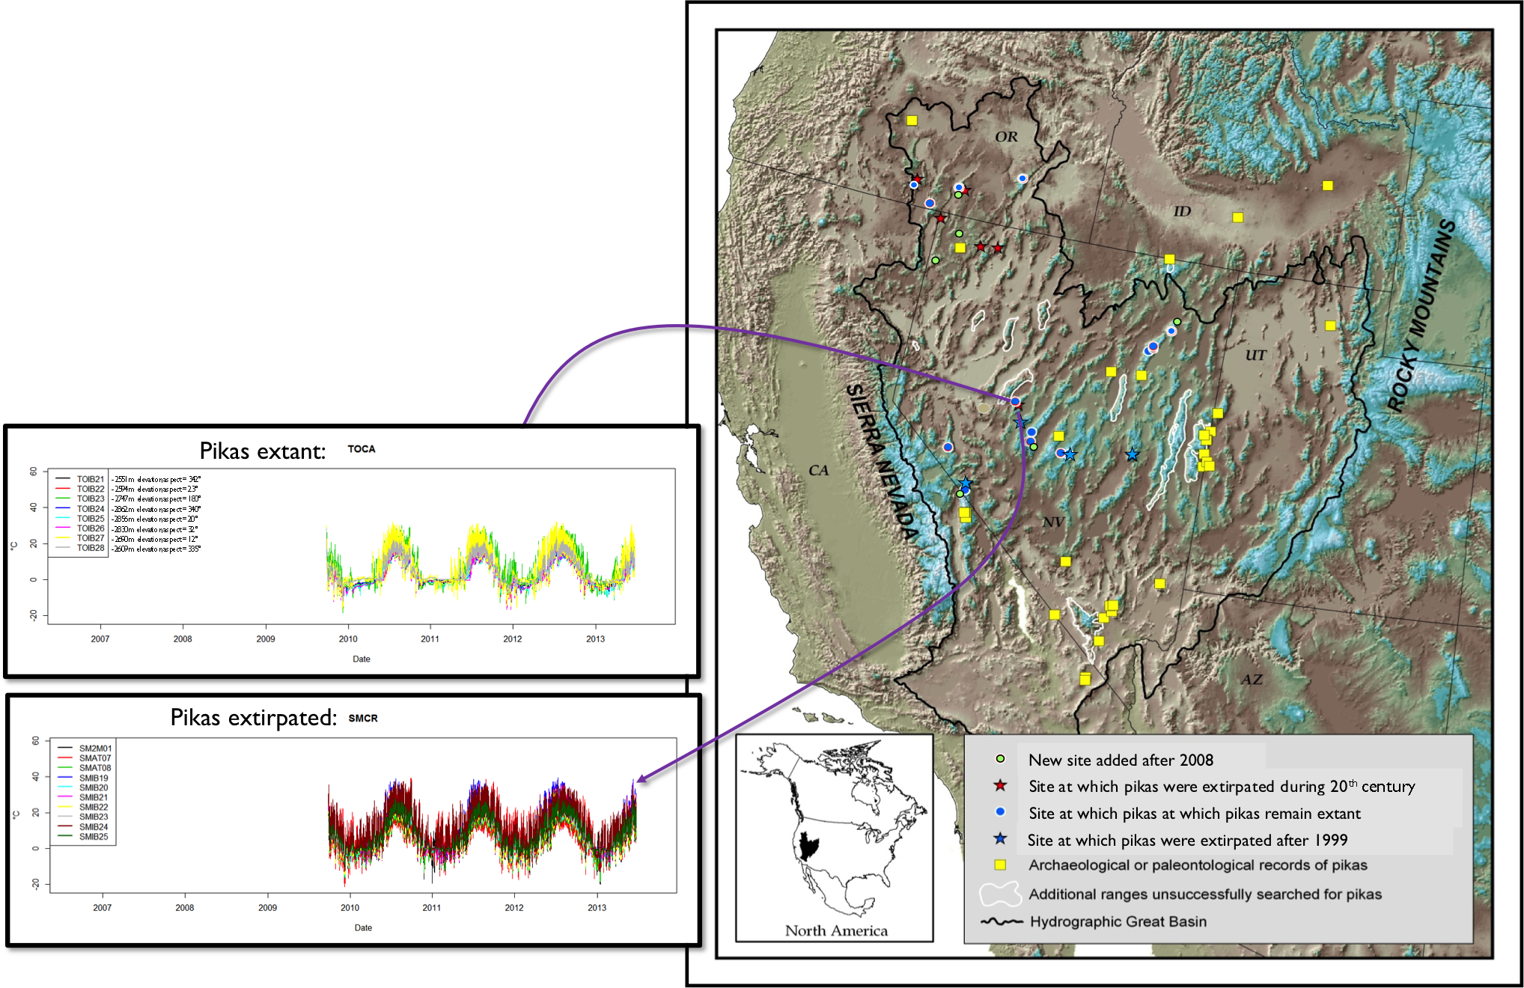
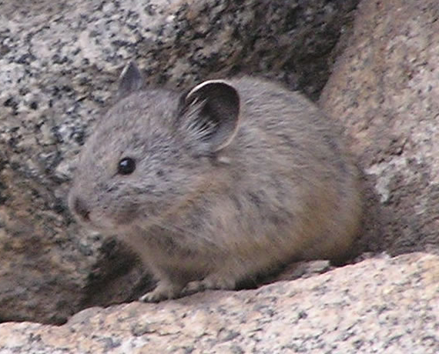
Testing hypotheses about American Pika extirpation
w/ Erik Beever/USGS; funding: GB LCC

Slide 29
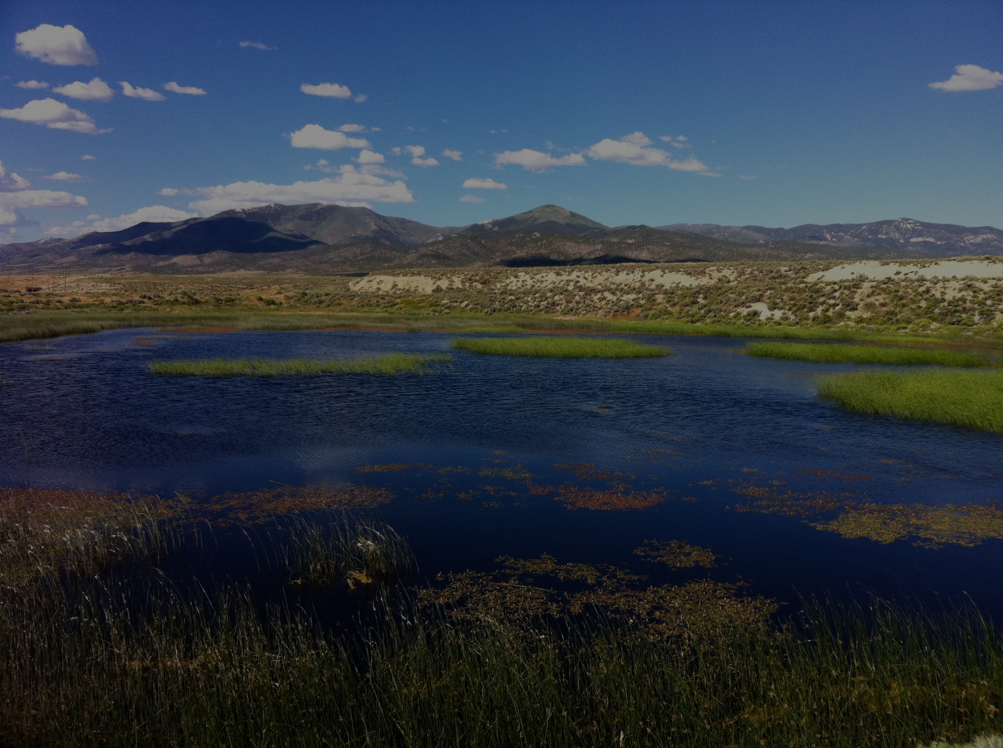


Acknowledgements
Funding: NASA New Investigator in Earth Science NNX13AB65G, NASA Biodiversity Program, NSF ESPCoR EPS- 0814372, Great Basin Landscape Conservation Cooperative
UNR: G. Sadoti, A. Vitale, D. Mutiibwa, K. Howard, J. Ewing-Taylor
Some collaborators: B. Wolf, A. Pidgeon, M. Neteler, E. Beever, J. Mejia
Field access: BLM, Long Now Foundation, Great Basin National Park, Kofa National Wildlife Refuge, and more…
http://wolfweb.unr.edu/~talbright/LCB/
talbright@unr.edu
@AlbrightLCB
[T. Albright]

