Slide 1
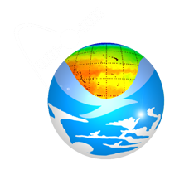
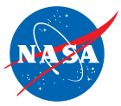
A Decision Support System for Ecosystem-Based Management of
Tropical Coral Reef Environments
C. Mark Eakin, Frank Muller-Karger
L. Guild, M. Vega-Rodriguez, R. Nemani, G. Liu,
S. Heron, E. Geiger, J. Li, S. Lynds, R. Ressl, S. Cerdeira Estrada
NASA and Earth Science
Earth Science Division
Applied Sciences Program

Slide 2





Partnerships
U. South Florida (F. Muller-Karger, M. Vega-Rodriguez)
NOAA NESDIS/CRW (M. Eakin, G. Liu, S. Heron, E. Geiger, J. Li)
NASA Ames (L. Guild, R. Nemani, J. Torres-Perez)
U. Colorado-CIRES (S. Lynds)
CONABIO (R. Ressel, S. Cerdeira Estrada)
UNEP-WCMC (L. Wood, C. Ravilious, C. Fitzgerald)

Slide 3

Acknowledgements
Funding provided by:
  NASA Applied Sciences Program
    Woody Turner
    2008 Ecological Forecasting application area
    4-year program (2009-2013 + 2014 NCE)
  NOAA
    Coral Reef Conservation Program

Slide 4
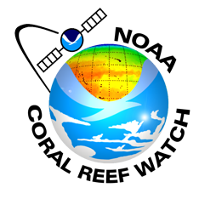
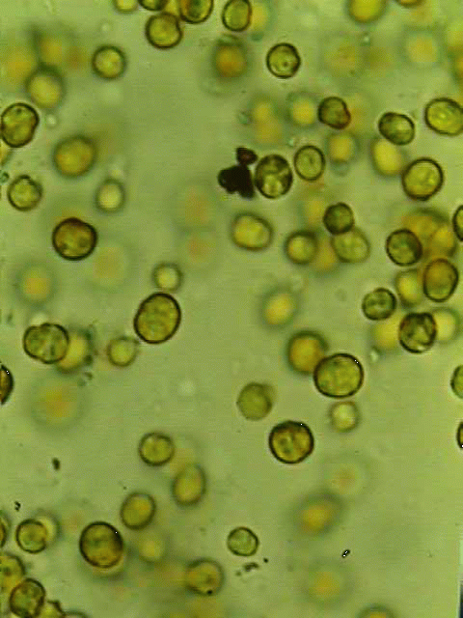
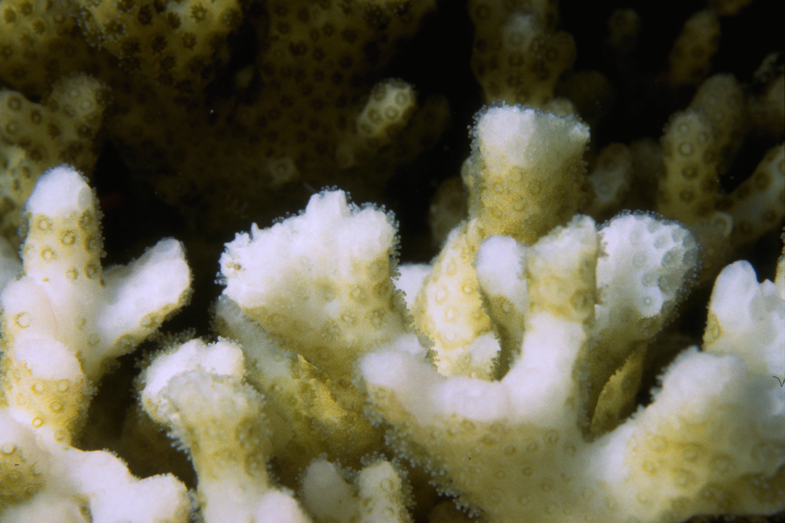
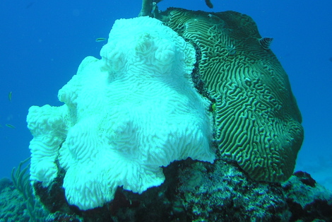
Coral Bleaching:
Impact of Climate Change
zooxanthellae
Most of corals’ food comes from photosynthesis
Scott R. Santos
Corals exposed to high temperatures and/or high light become stressed
Corals eject their algae; coral appears “bleached
If stress is mild or brief, corals recover, otherwise they die
Symbiotic algae
Mass bleaching covers 100-1000 kms

Slide 5
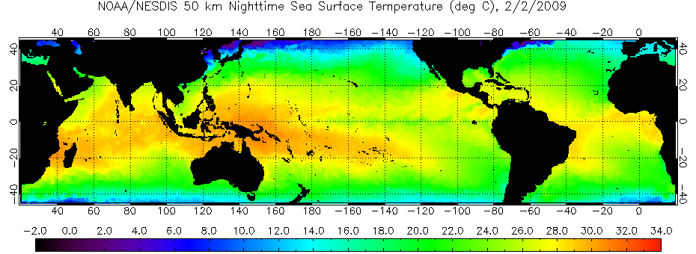
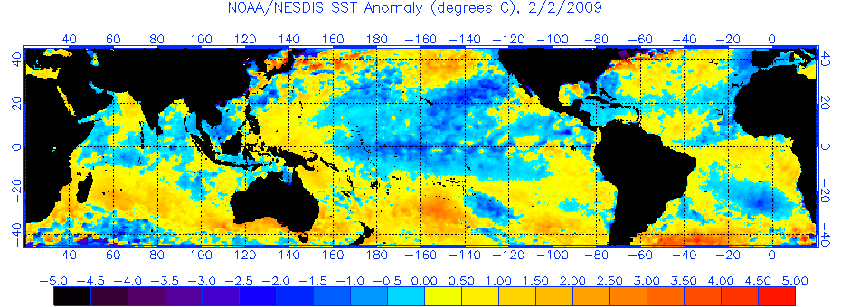
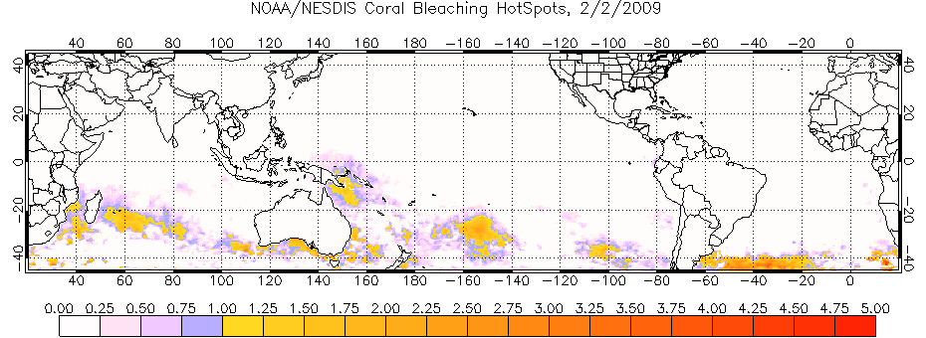
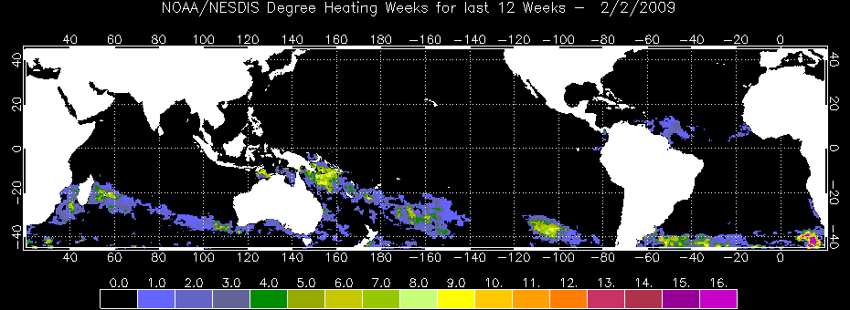
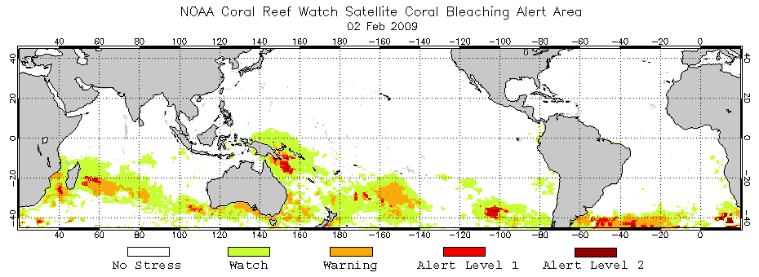
Coral Reef Watch
Satellite-Based Products
Primary Products: SST-based
50km Nighttime Sea Surface Temperature (SST)
Coral –
specific
SST Anomaly
HotSpot
Degree Heating Week
Bleaching Alert Areas

Slide 6
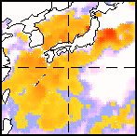
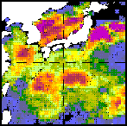
Degree Heating Week
Product Algorithm
SST
Bleaching threshold
(MMMSST+1ºC)
Maximum Monthly Mean SST
Climatology (MMMSST)
Week-0
a
b
Time
c
d
Week-12
HotSpots
12 weeks
Σ( HotSpot value × duration )
≥ 1°C
Degree Heating Weeks
≥ 4 DHWs coral bleaching is expected
≥ 8 DHWs mass bleaching and mortality are expected

Slide 7
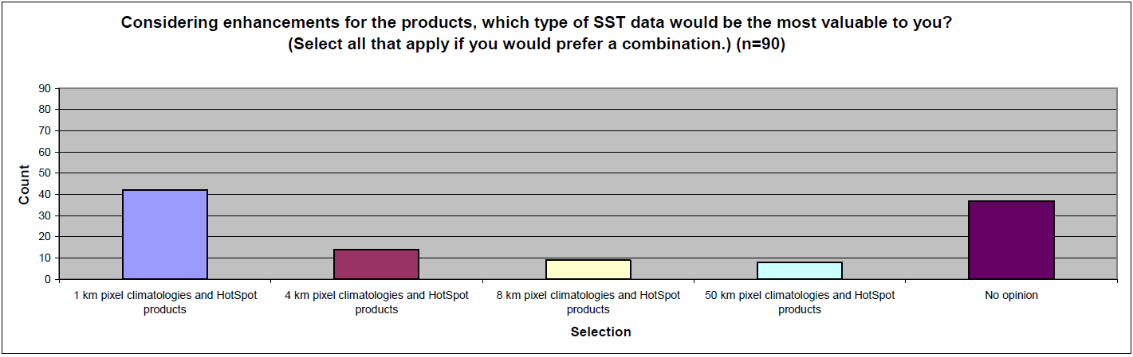
User surveys (S. Lynds / CIRES)
Users are interested in higher spatial resolution products

Slide 8
NOAA Coral Reef Watch:
New Decision Support System
Approach:
Develop and test new, high-resolution climatologies
  Global 4 km Pathfinder daily SST data
  Application of NEX for handling large data volumes
Develop 5 km global products (CRW)
Develop 1 km regional products (USF)
Develop full suite of high-resolution tools for coral reef managers

Slide 9
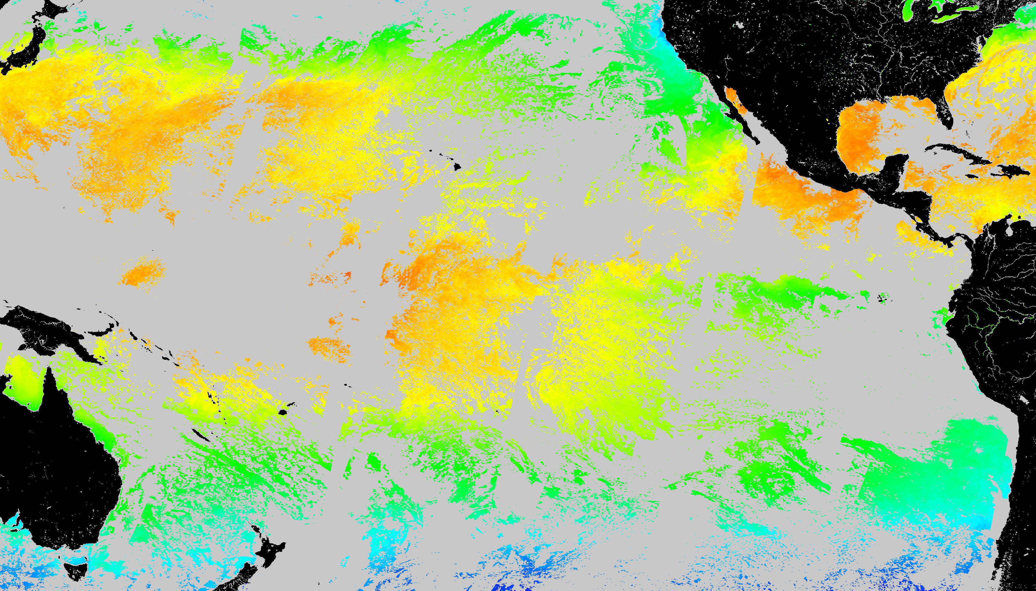
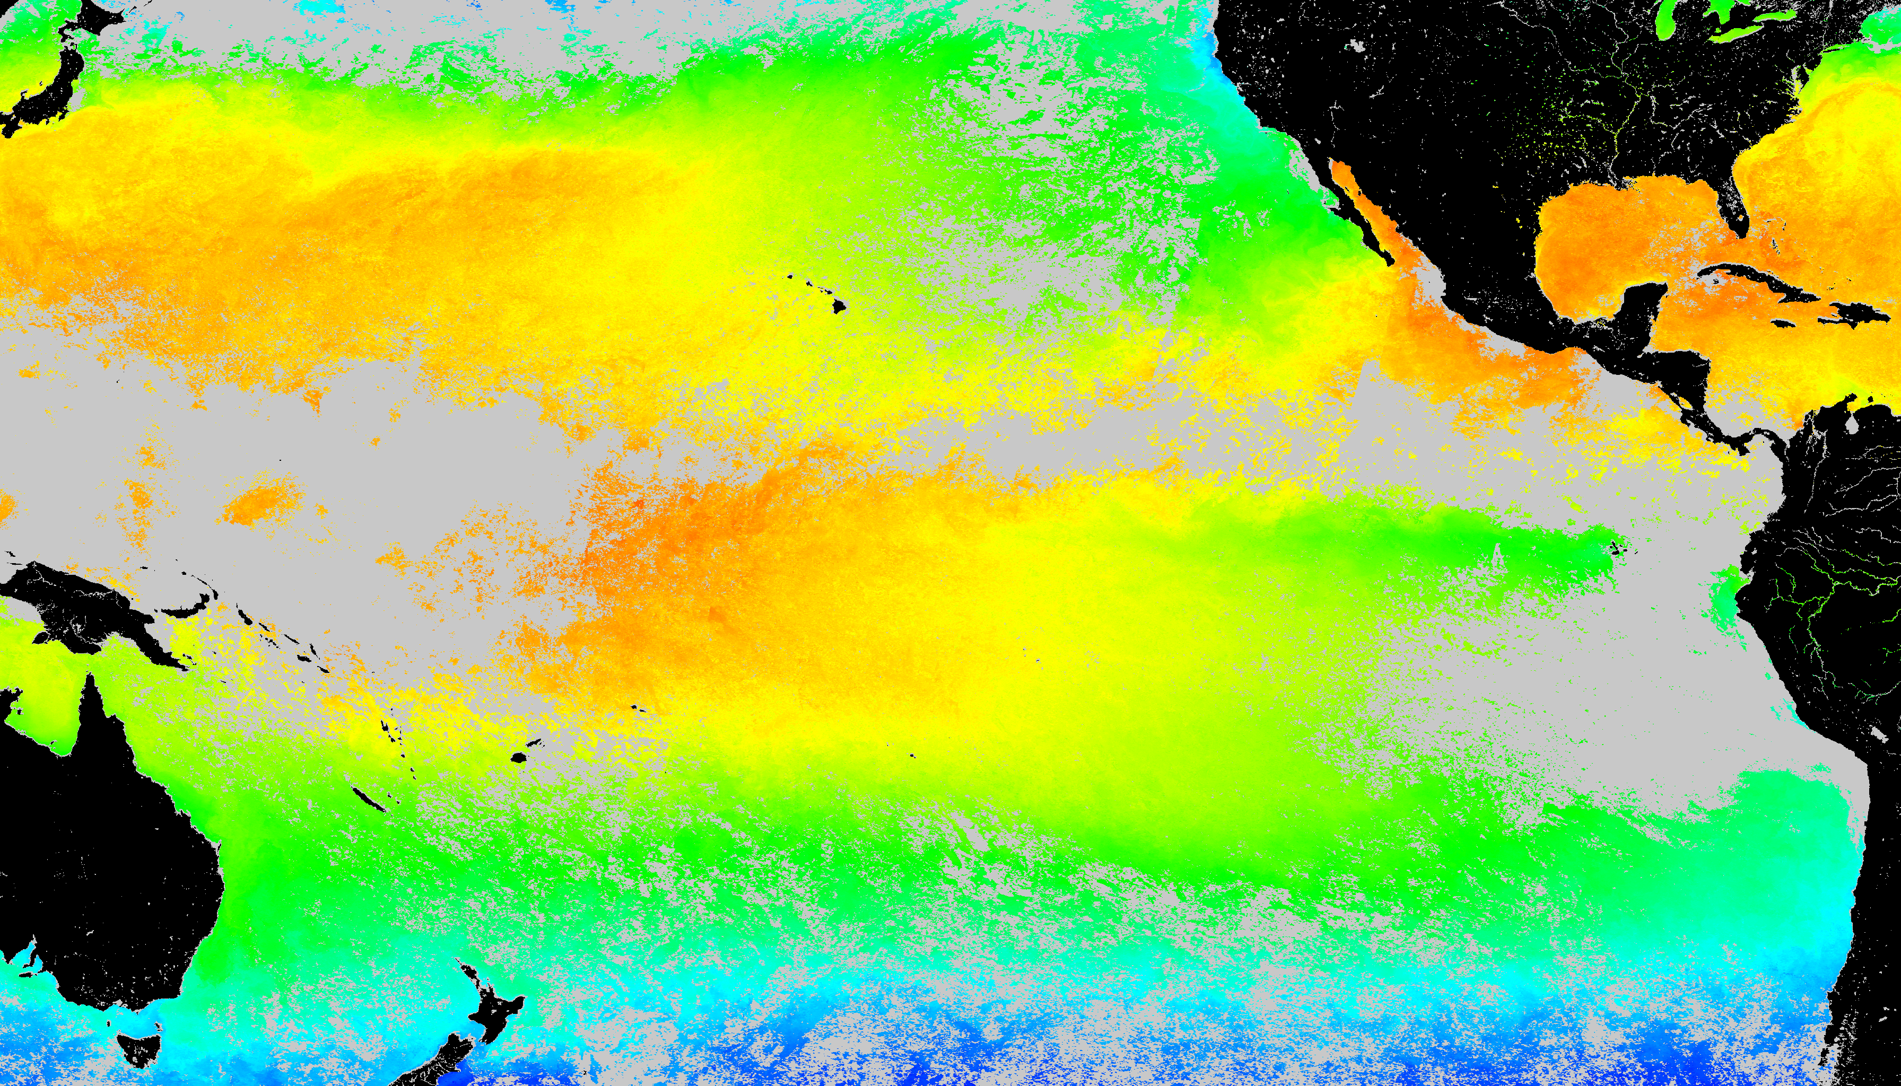
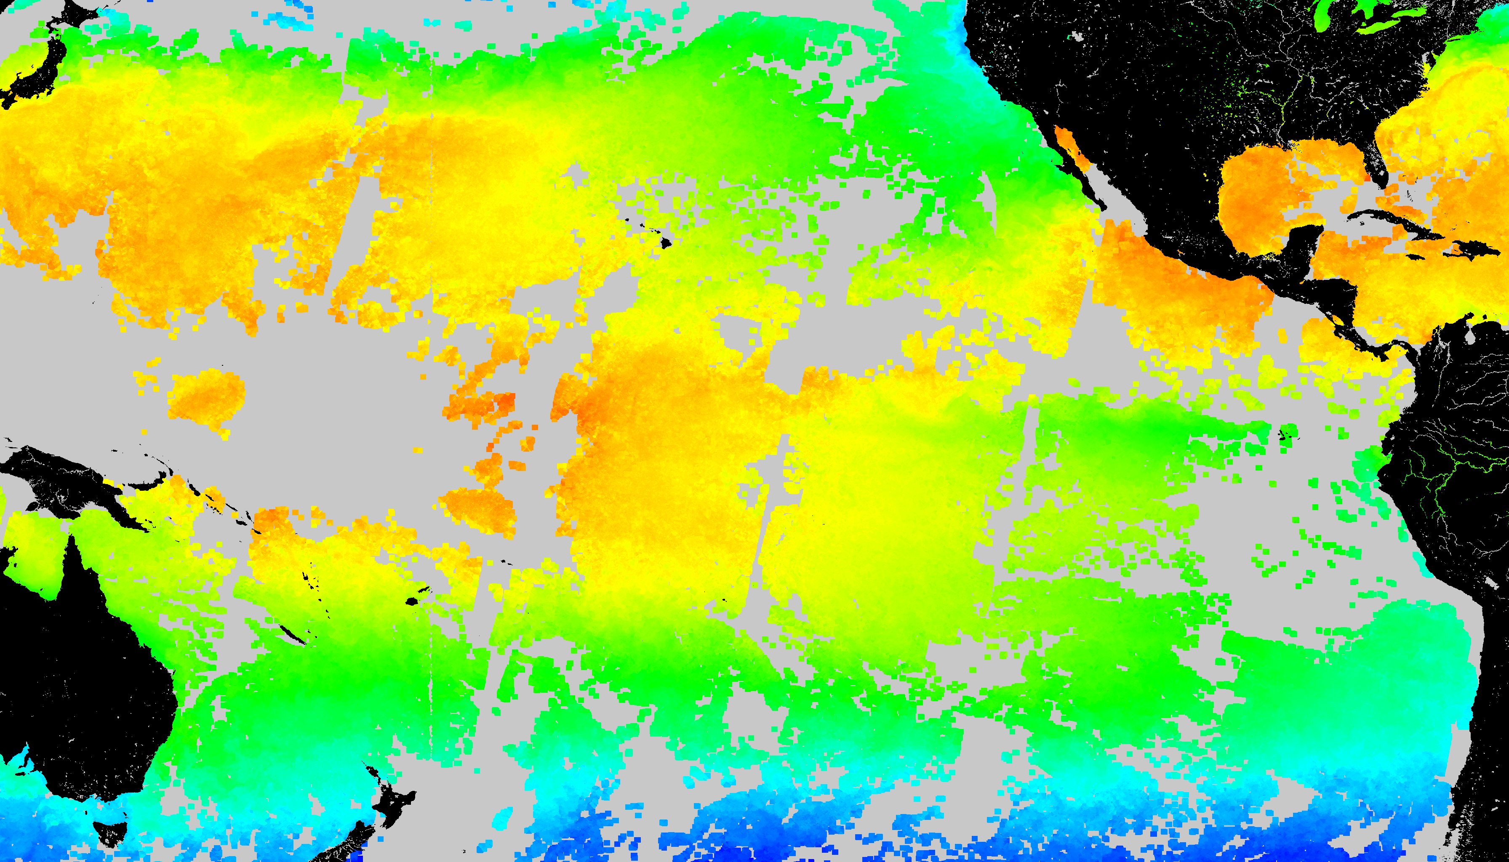
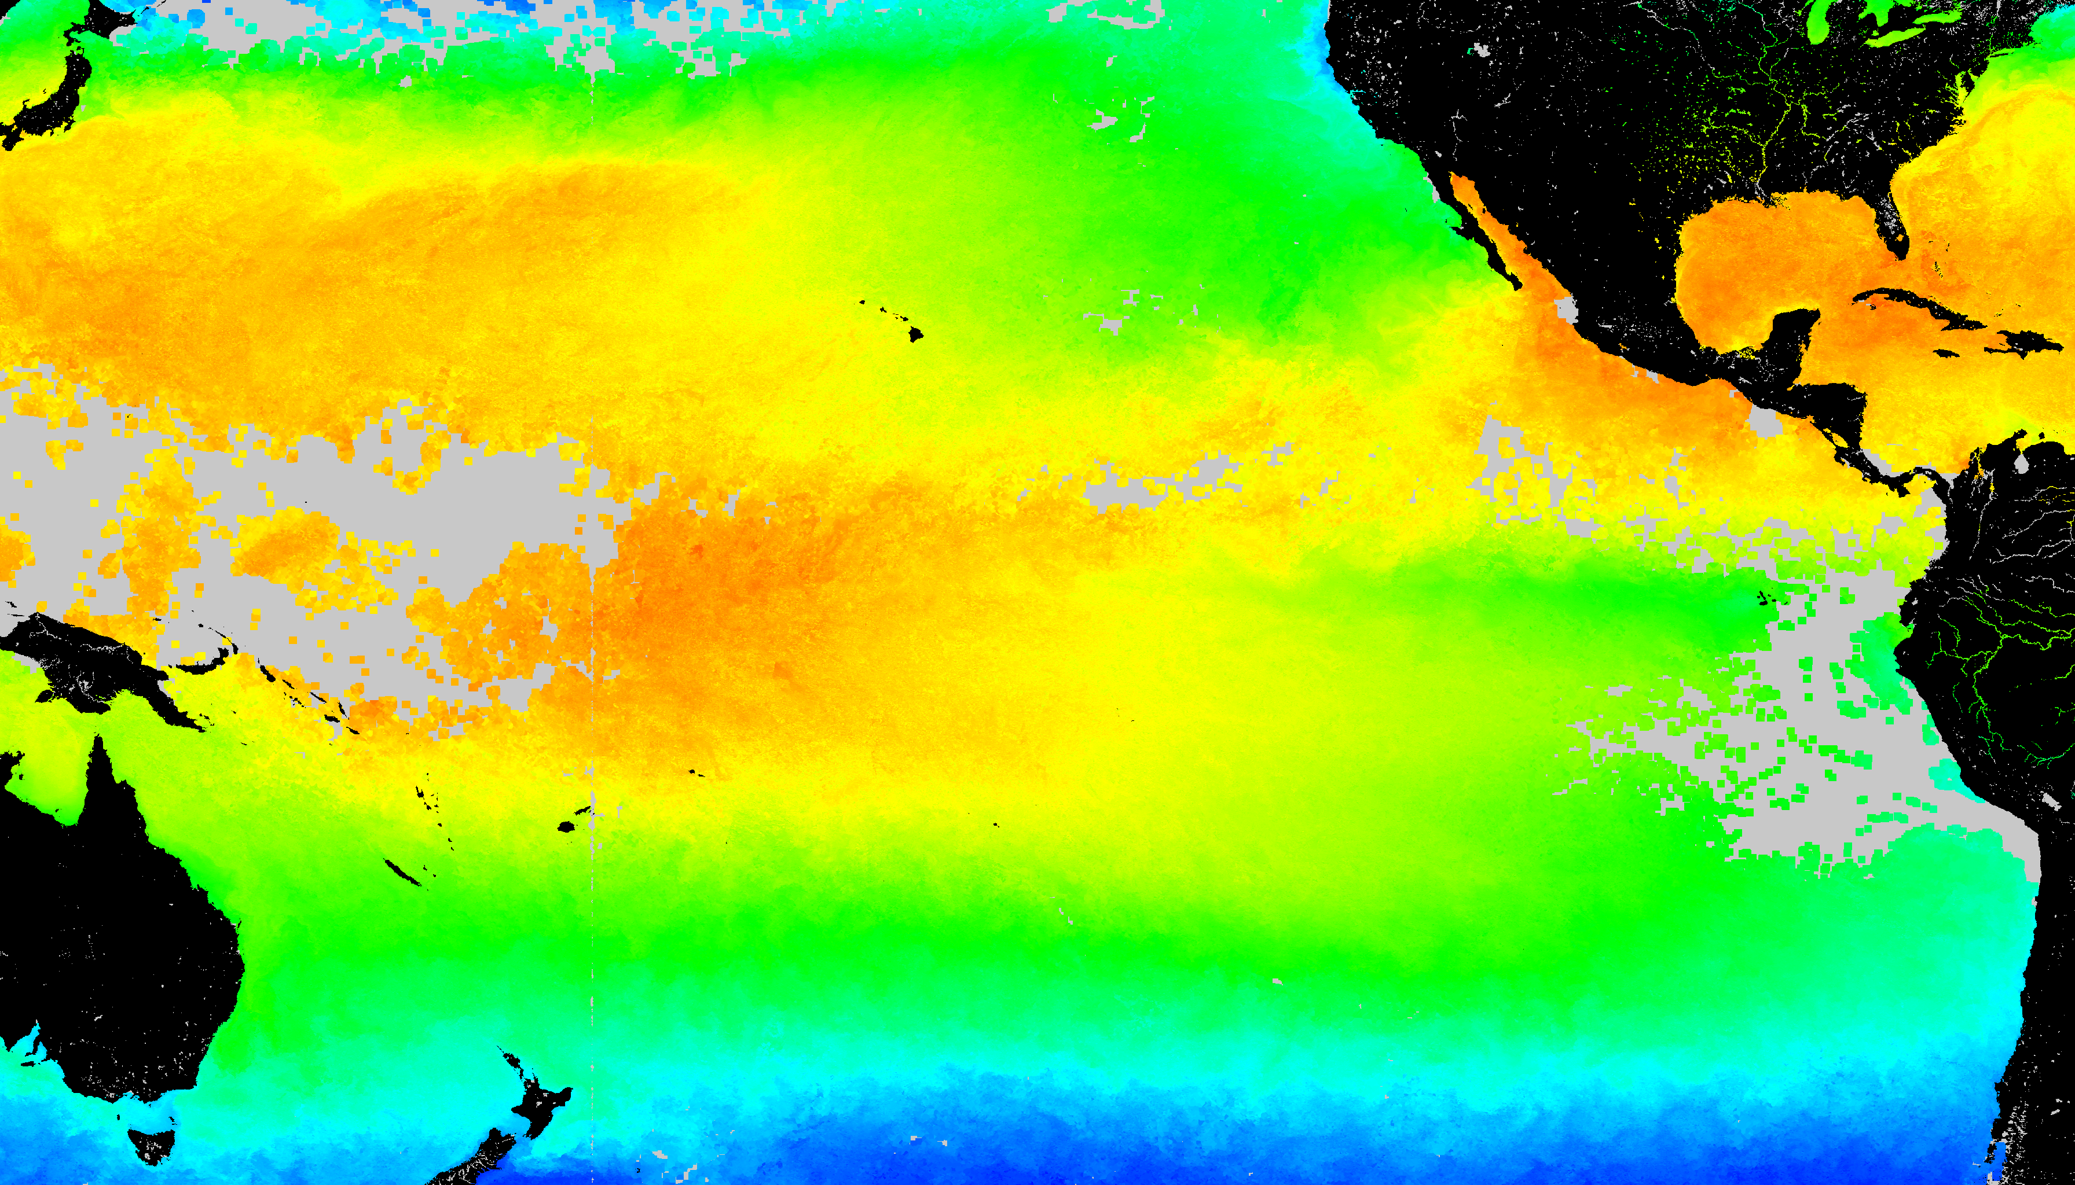
SST Coverage (August 10 2002)
With Gap
Temporal gap filling (≤ 30d)
Spatial gap filling (≤ 50 km)
Temporal + spatial gap filling

Slide 10
5-km Resolution Global CRW Products based on:
Climatology: 4-km AVHRR Global Pathfinder – completed April 2014
Data: 5-km Operational Blended
  Polar-orbiters (2) + Geostationary (4)
  Up to 28-100 scenes/day
  5th geostationary coming
http://coralreefwatch.noaa.gov/satellite/bleaching5km/index.php

Slide 11
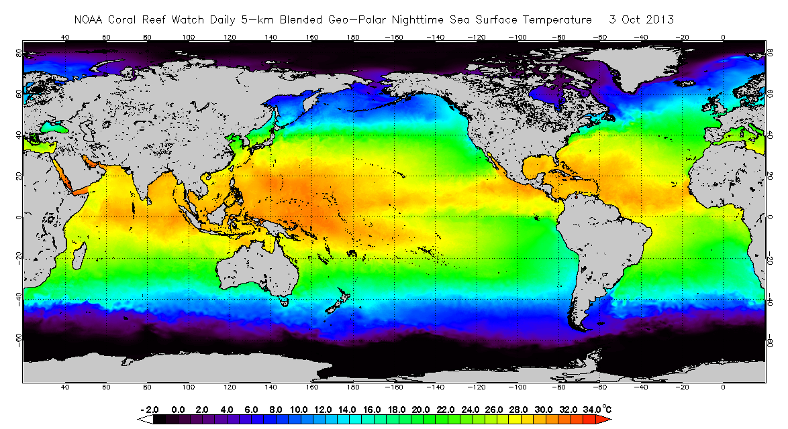
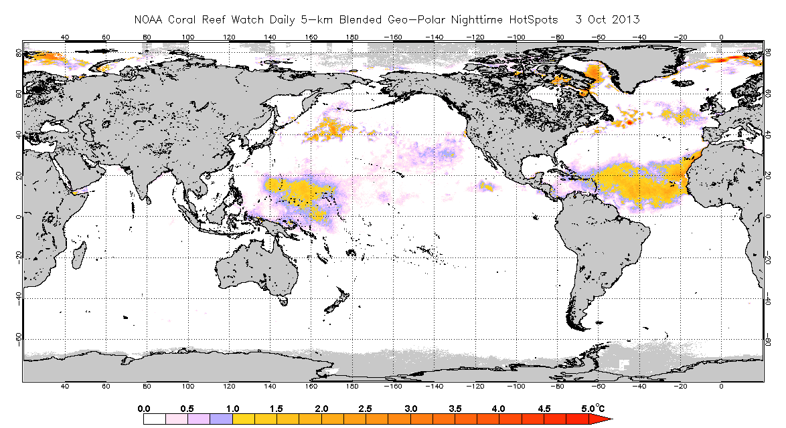
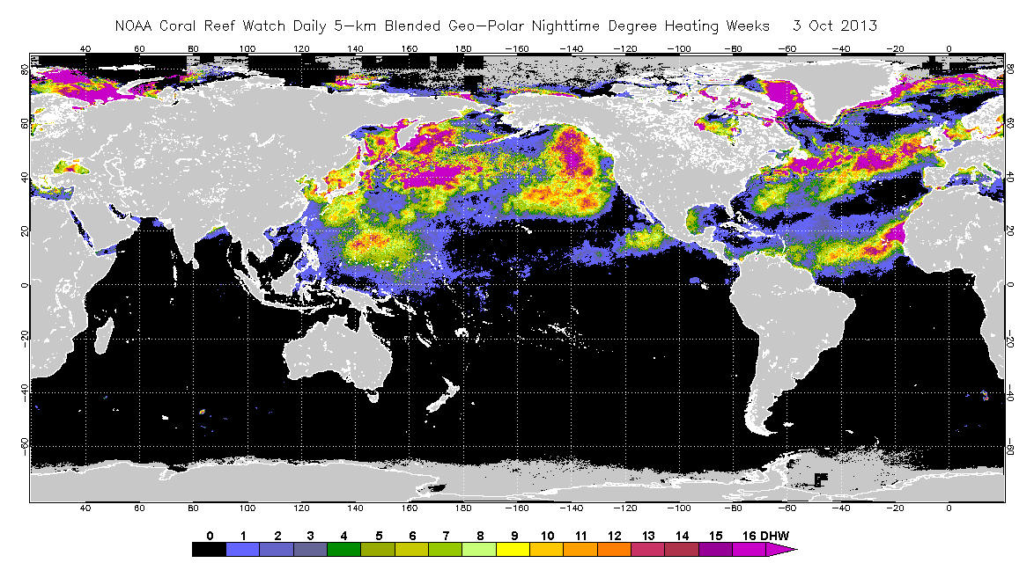
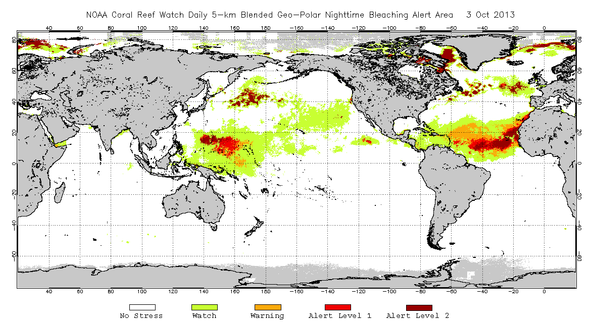
5 km – Resolution, Global Coral Thermal Stress Products – Now Live
Based on NOAA Operational GOES-POES SST, 10/03/13
SST
HotSpot
DHW
Bleaching Alert Areas
http://coralreefwatch.noaa.gov/satellite/bleaching5km/index.php
11

Slide 12
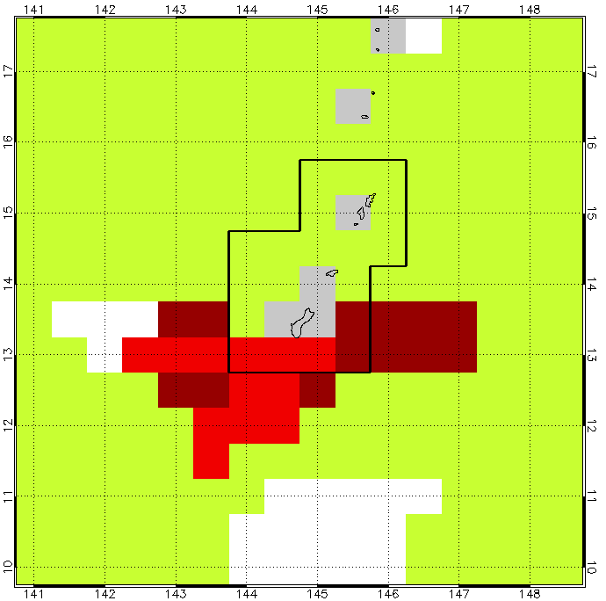
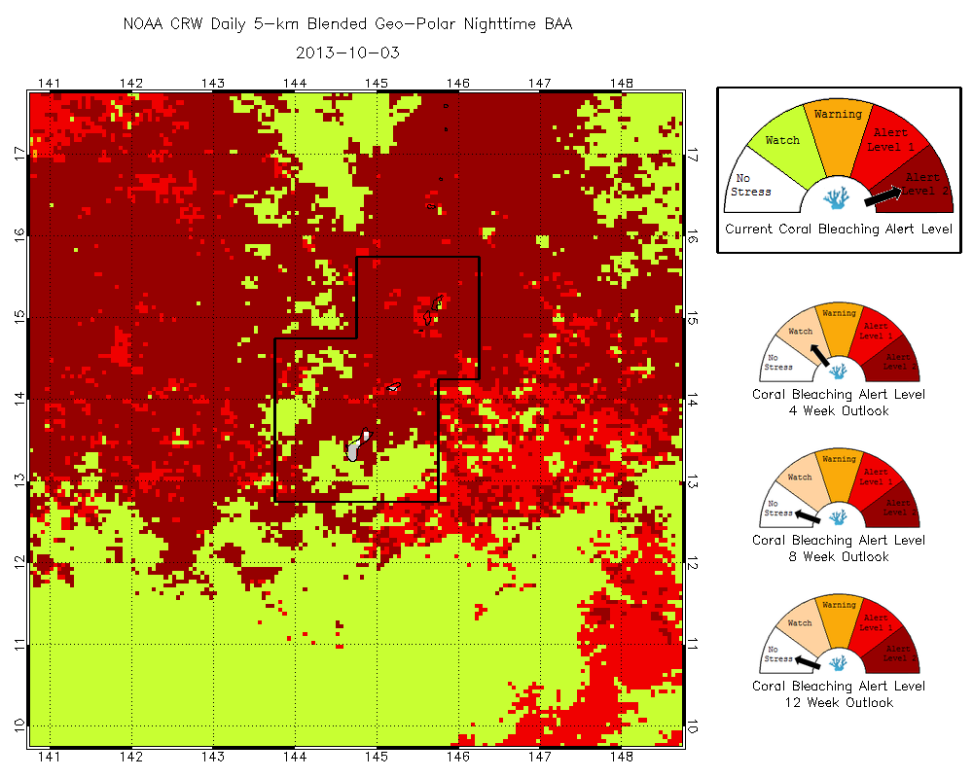
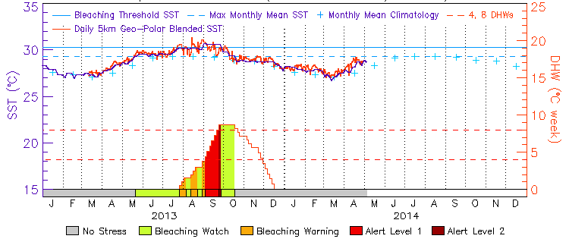
Prototype Regional Alert Products for Guam and Marianas Islands
50-km, 3 Oct 2013
5-km Bleaching Alert 3 Oct 2013

Slide 13
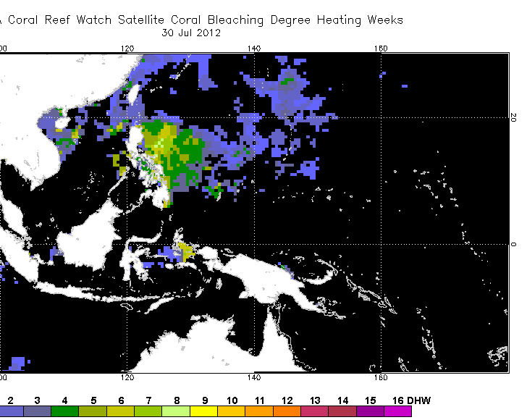
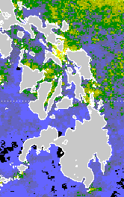
NOAA Coral Reef Watch
5-km Degree Heating Weeks Product
50 km
5 km
http://coralreefwatch.noaa.gov/satellite/bleaching5km/index.php

Slide 14
1-km Prototype Products based on:
4 km AVHRR Global Pathfinder
  Climatology
1 km MODIS and AVHRR
  Test area: Florida Keys National Marine Sanctuary
  Being operationalized by CONABIO
http://imars.marine.usf.edu/crw-dss/crw-dss-description

Slide 15
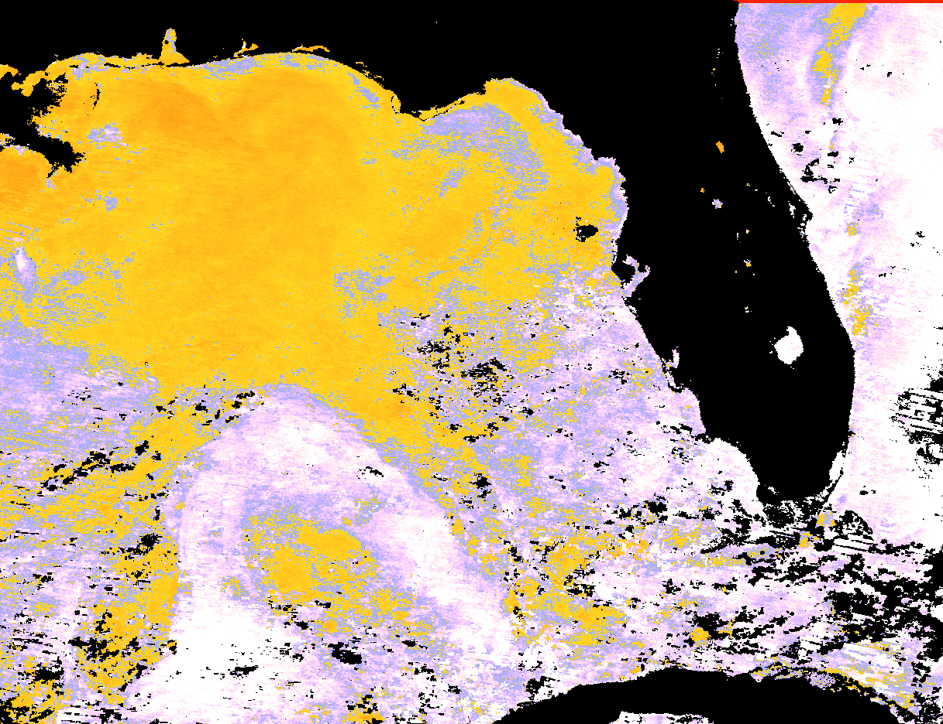
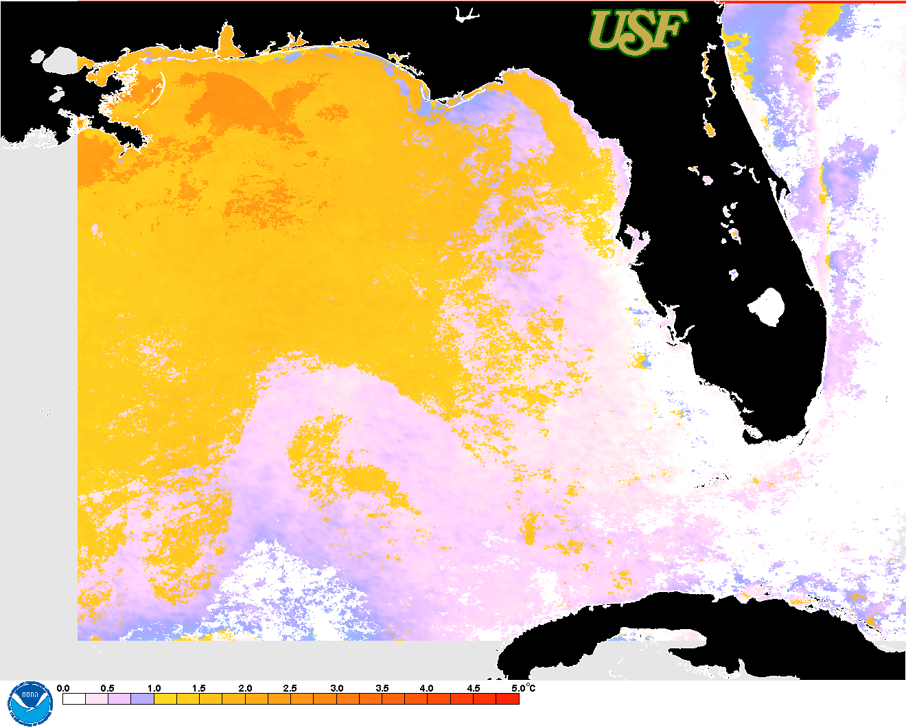
USF 1-km HotSpot products for the West Florida Shelf
(August 29, 2011)
NASA MODIS HotSpot
Climatology from Pathfinder 4km MMM
USF AVHRR HotSpot
Climatology from Pathfinder 4km MMM
http://imars.marine.usf.edu/crw-dss/crw-dss-description

Slide 16


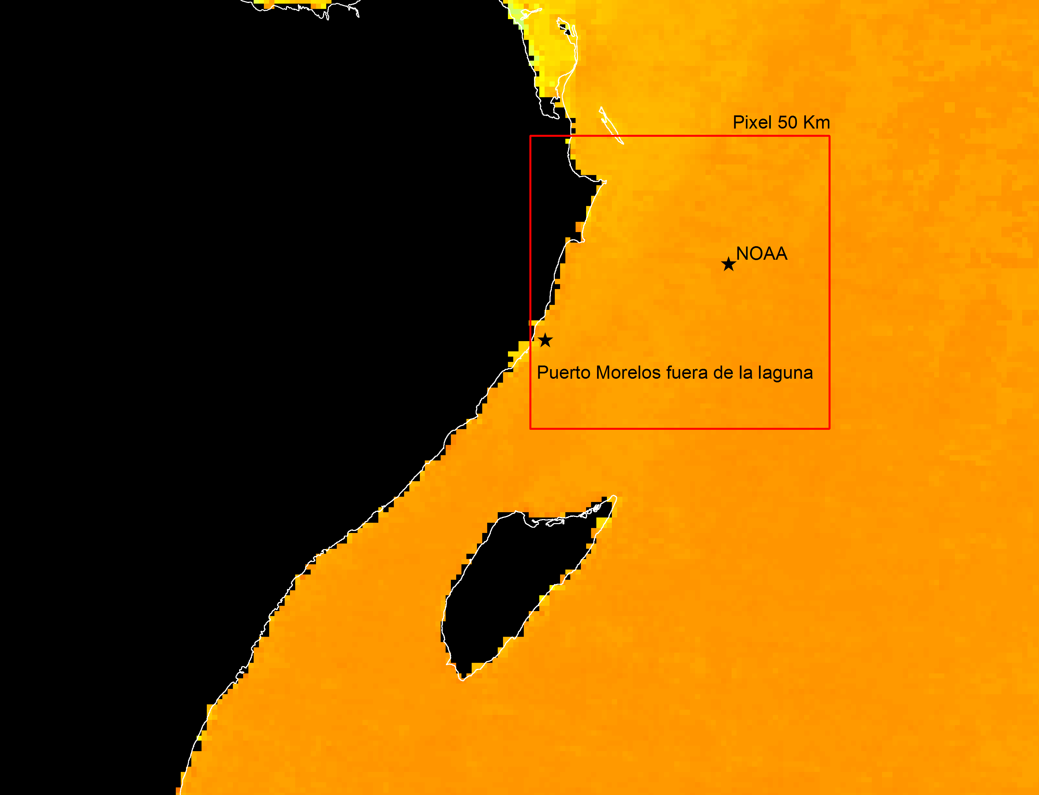
Satellite-derived Bleaching Coral Reef Early Warning System (SATcoral)
Comparable products being produced and distributed by CONABIO (Mexico)
1-km products from
MODIS/Aqua
Yucatan
http://www.biodiversidad.gob.mx/pais/mares/satmo/

Slide 17
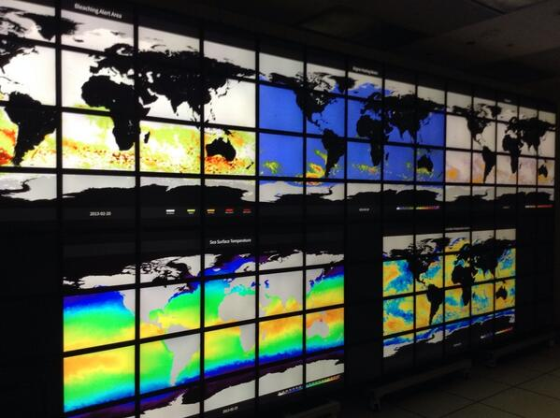
Display and Testing on Hyperwall
CRW-DSS Team
examines data on
Ames Hyperwall
during March 2014 meeting
Planned analysis at Ames August 2014
Talk using mini-Hyperwall
at Ocean Sciences, February 2014

Slide 18
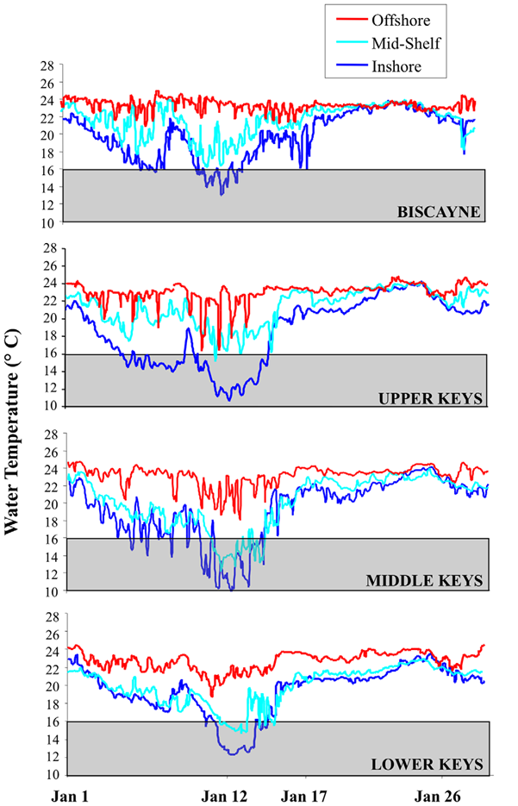
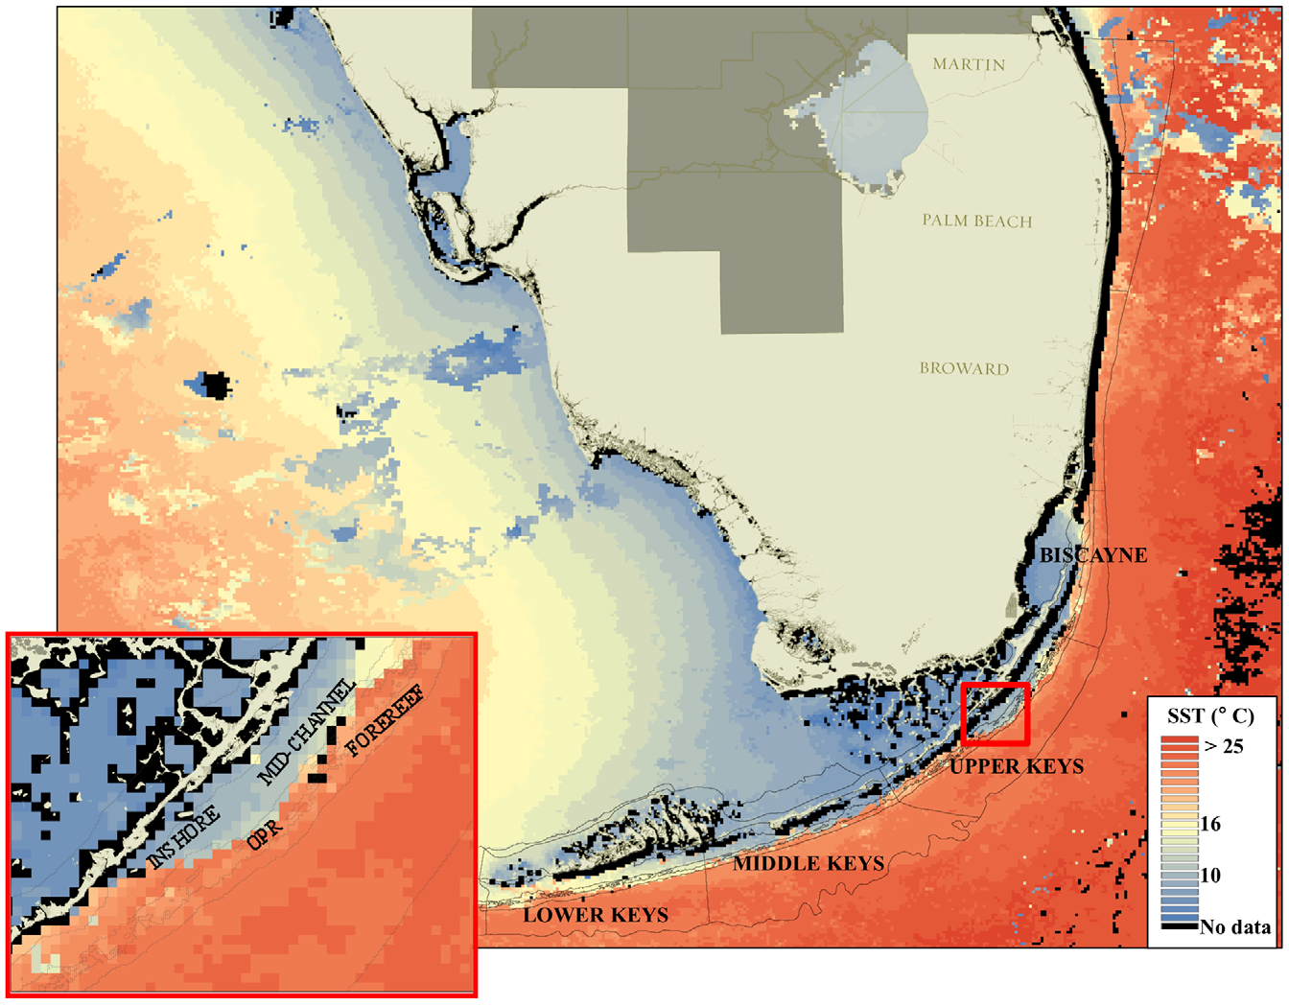
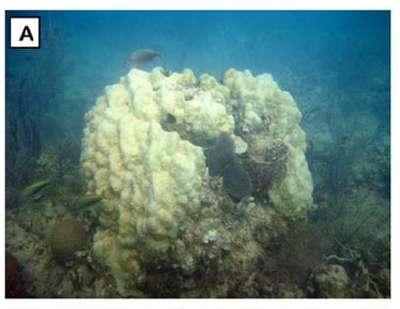
Cold Stress Index
Corals susceptible to low temperature stress and death
January 2010 corals in Florida suffered severe mortality from cold
In situ temperatures

Slide 19
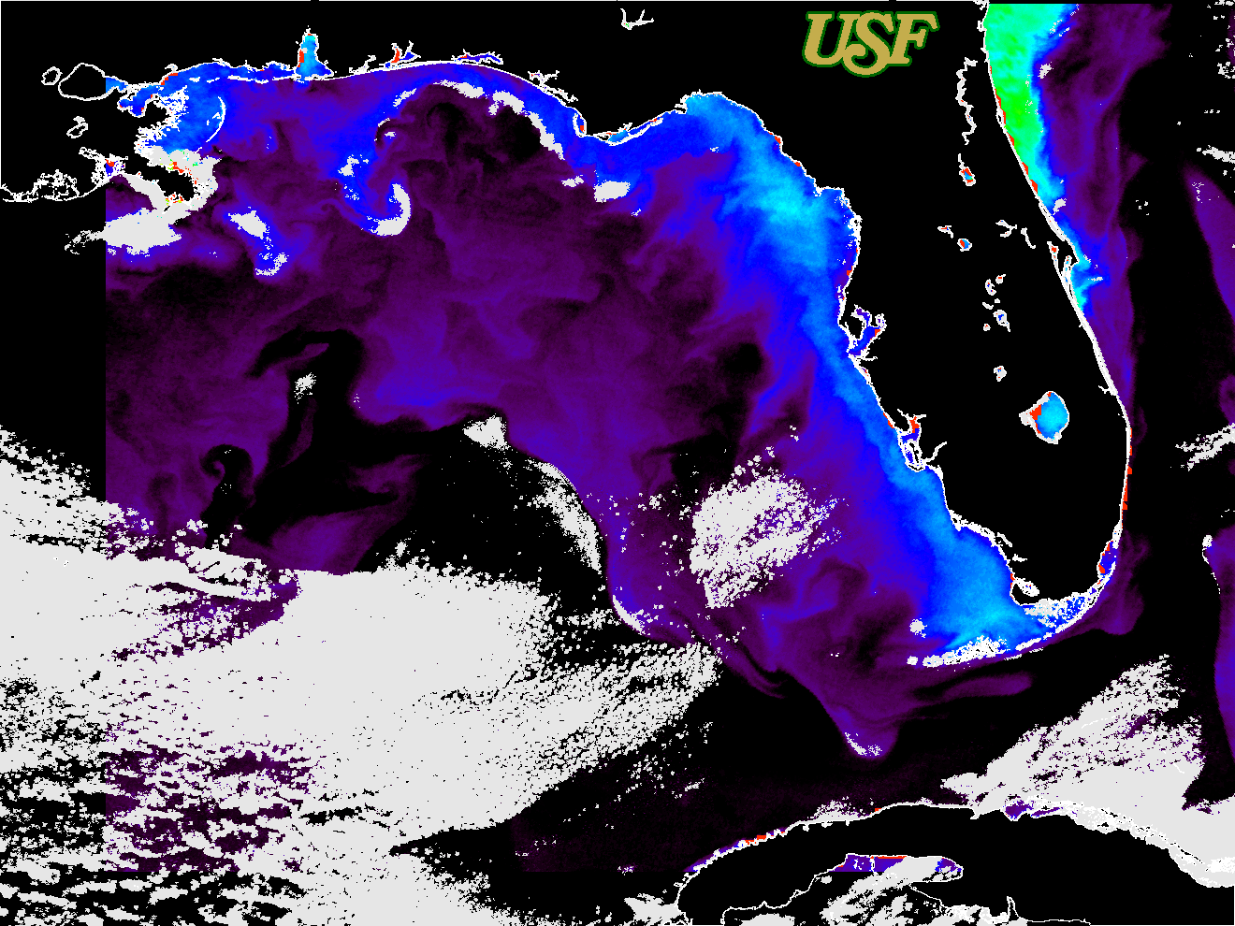
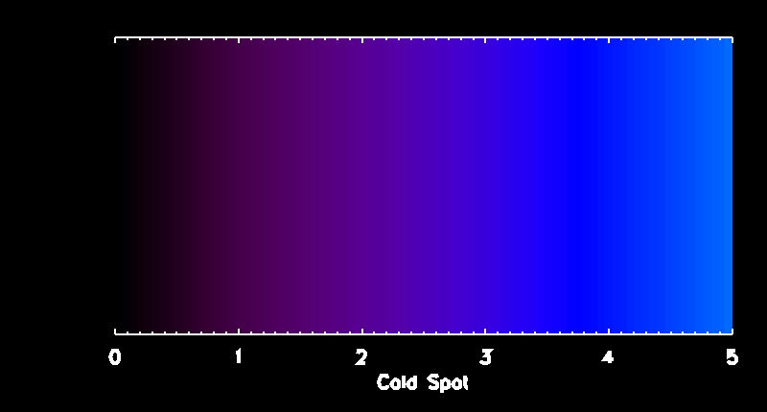
ColdSpot
January 27, 2010
Similar to the Hotspot, except using minimum monthly means of the JAN-MAR seasonal climatology.

Slide 20
‘So what?’
Linking science and management
Goal: To improve our ability to alert reef managers around the world of bleaching-level stress, so they can take appropriate actions.
In the Florida Keys, the CRW products have helped:
  Guide Rapid Response efforts to assess reef conditions (BleachWatch)
  Inform the public about what may be happening on the reef when corals are visibly stressed
  Restrict access to a reef during thermal stress and disease
  Increase confidence in management decisions

Slide 21
‘So what?’
Linking science and management

Slide 22
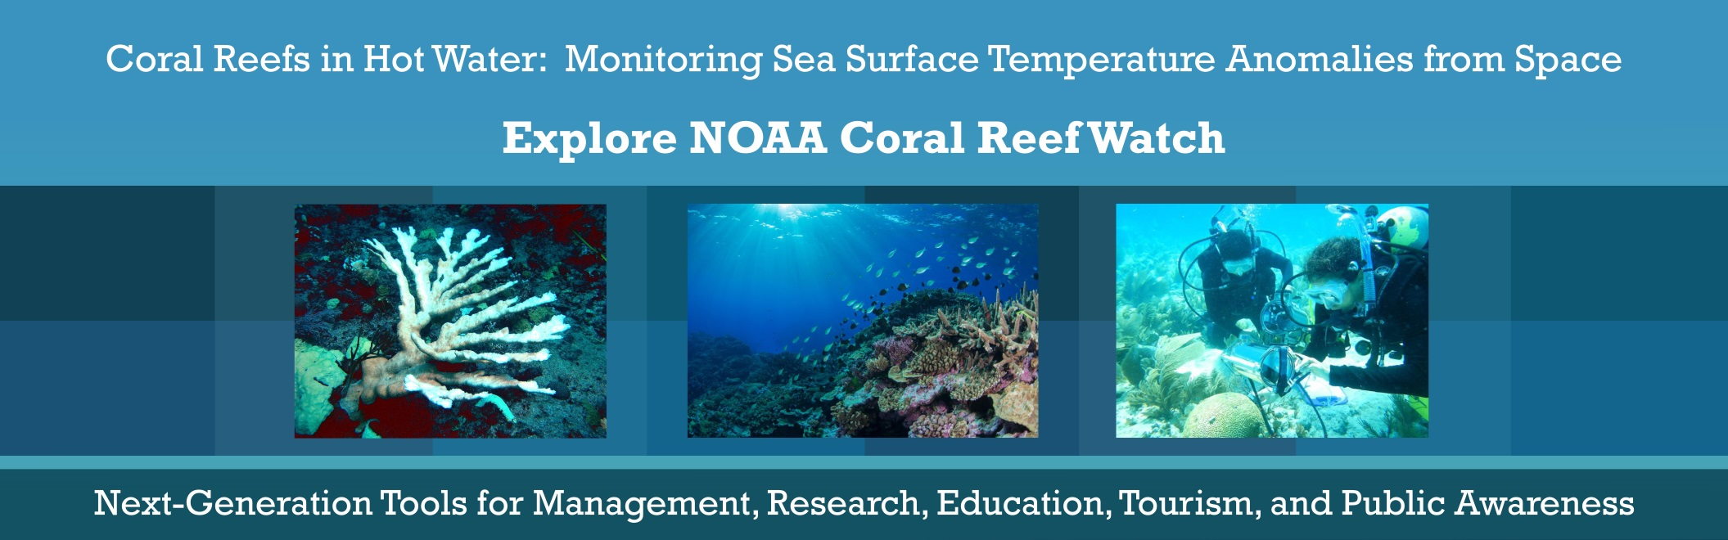
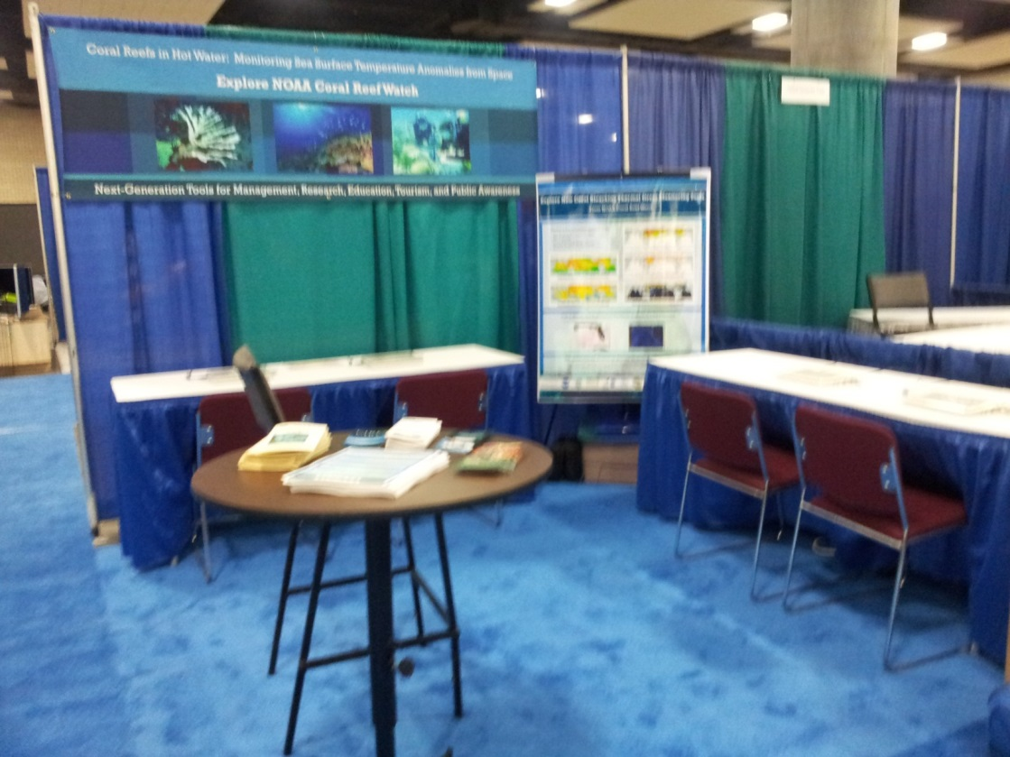
User Evaluation Still Underway
In-person and online interviews continue
Interviews at meetings
  Ocean Sciences Feb 2014
  Florida Marine Science Educators Assoc. April 2014
  National Marine Educators Assoc. July 2014

Slide 23
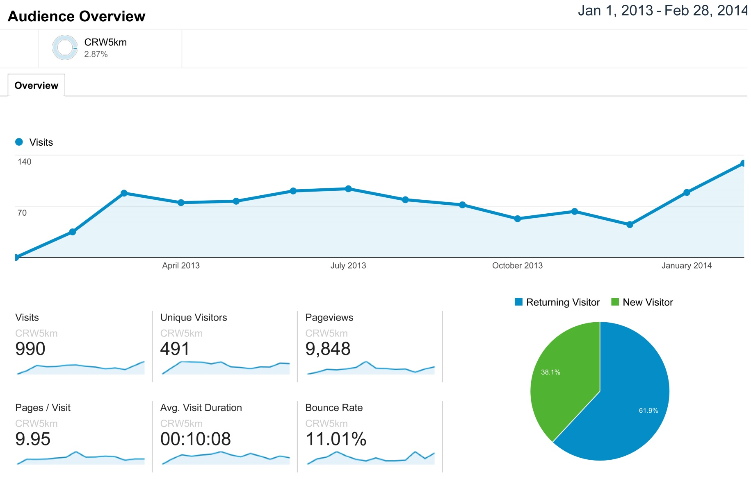
Web Analytics—
NOAA CRW 5 km Products

Slide 24
Ocean Sciences 2014
Interview and Survey Results
User applications of new Coral Reef Watch high resolution products?
Education (students/public)
Monitoring bleaching
Integrating with mapping/modeling
Fish distributions
Ecosystem indicators
Work on coral reef recovery
Forecasting coral disease outbreak risk
Microbial diversity associated with stressed coral communities

Slide 25
Accomplishments: 2010-2014
Visit our Poster for more information
Completed user surveys for NOAA Coral Reef Watch products.
Just completed global high-resolution SST climatology from Pathfinder; final testing and application to 1-5 km products being done in 2014
NOAA deployed 5-km global Coral Reef Watch (CRW) products – Global products now live, regional product under development
USF and CONABIO deployed websites with 1 km Coral Reef Watch (CRW) products for the Gulf of Mexico, Florida Keys and Caribbean Sea using AVHRR and MODIS
Developed prototype cold water stress index (cold spot) for the Florida Keys.
UNEP WCMC integrated the NASA Coral Reef Millennium Map into their online Map servers (http://data.unep-wcmc.org/datasets/13).

Slide 27
Objectives of the Program
Assess and meet needs in coral reef research, management, education
Assess value of high-resolution (1-5 km) data
  (MODIS, AVHRR, Geo-Polar Blended)
Develop higher-resolution decision support tools
  Link to higher-resolution maps
  Satisfy user needs

Slide 28
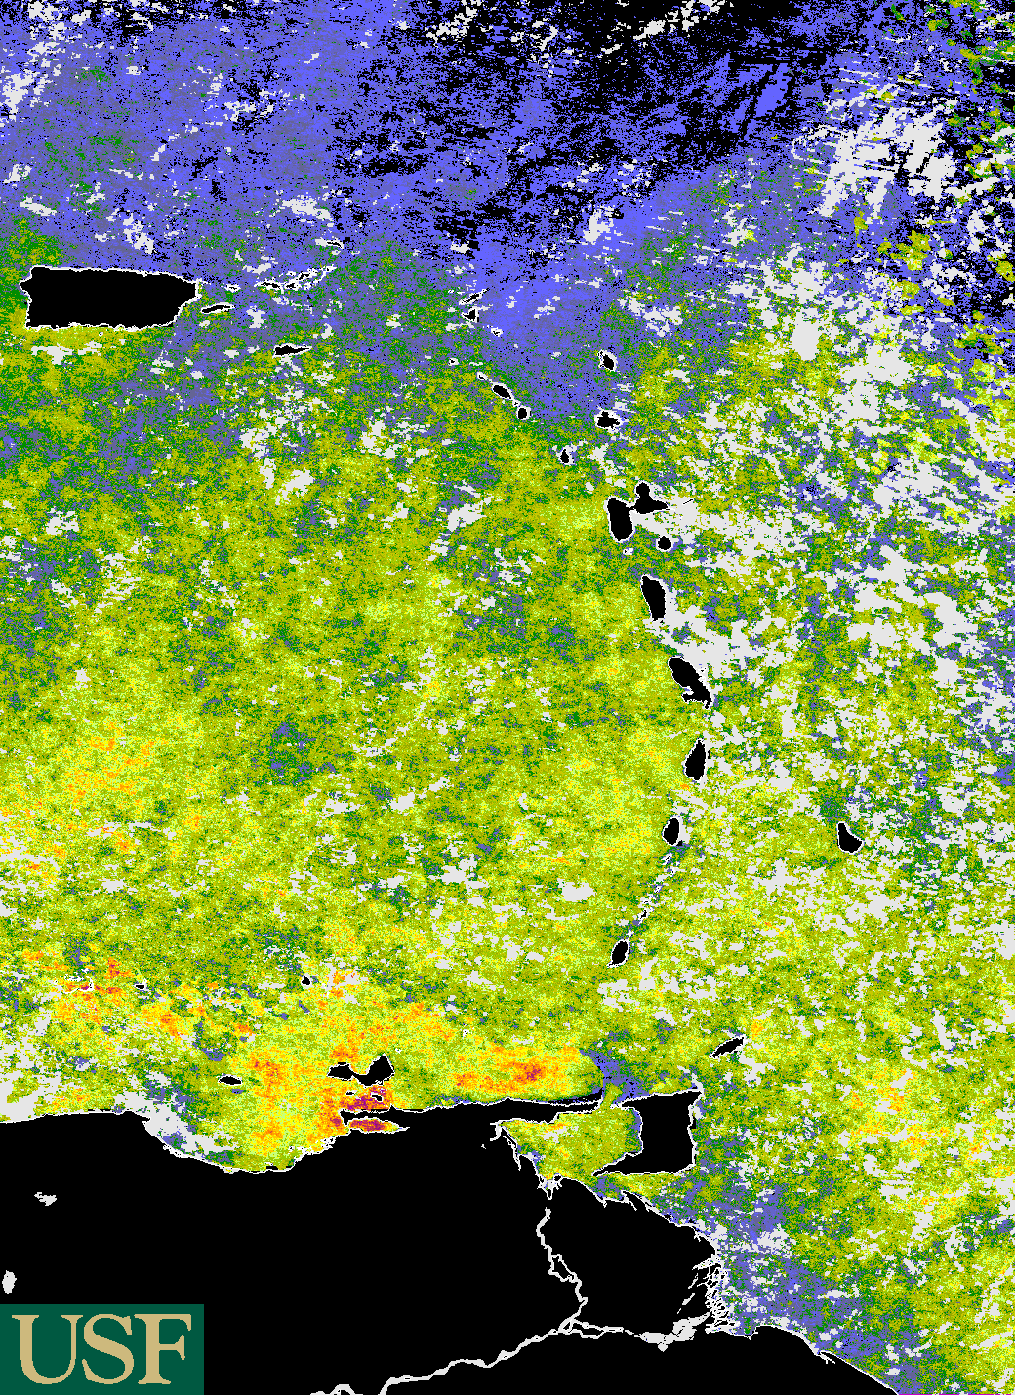
USF 1-km DHW product for the Southern Eastern Caribbean
Based on MODIS Aqua (11um) nighttime only SST & PF (v5.0)
gap-filled climatology
http://imars.marine.usf.edu/crw-dss/crw-dss-description

