Slide 1
Modeling Bowhead Whale Habitat: Integration of Ocean Models with Satellite, Biological Survey and Oceanographic Data
Dan Pendleton, NEAq / NOAA Fisheries
Elizabeth Holmes, NOAA Fisheries
Jinlun Zhang, Univ. Washington
Megan Ferguson, NOAA NMML

Slide 2
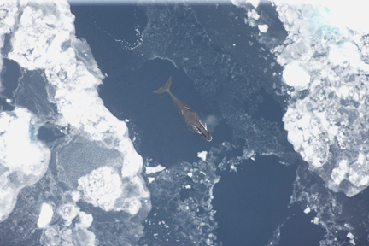
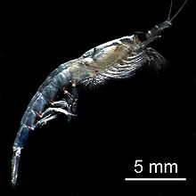
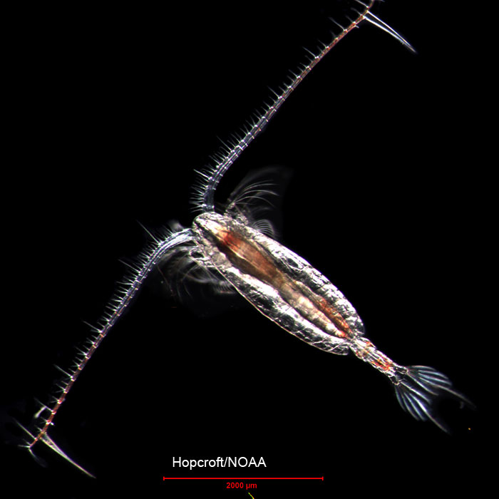
Western Arctic Bowhead Whales
Photo: Hopcroft
Photo: Brenda K. Rone, NOAA/AFSC/NMML

Slide 3
Research Goals
Map bowhead whale potential habitat suitability throughout their summer range
  25 years aerial survey data
  Arctic ocean model output
  Satellite data: Pathfinder, NSIDC-0051: MODIS, SeaWiFS
  P-PA species distribution models
Phase 1: Hindcast from 1988 – 2012
Phase 2: Forecast by forcing ocean model with future climate scenarios
Photo: Brenda K. Rone, NOAA/AFSC/NMML

Slide 4
Hypotheses & Questions
Proof of concept: Can we provide reasonable representations of bowhead whale habitat?
Is the spatial resolution of modeled prey data sufficient?
What are the relative influences
  Sea Ice vs. Prey? Phyto vs. Zoop.
Spatial & temporal model transferability:
  yes or no?
SDM comparison

Slide 5
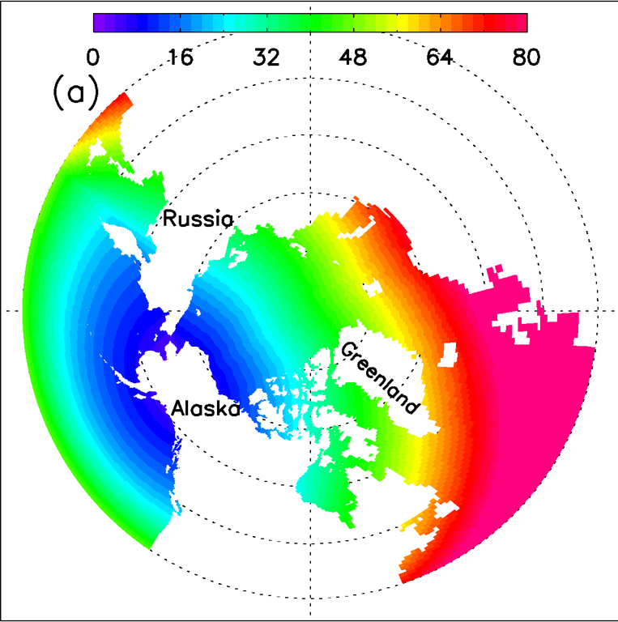
BIOMAS Arctic Ocean Model
Biology/Ice/Ocean Modeling Assimilation System
3D, Pan-Arctic
Highest resolution in Beaufort and Chukchi seas
Hourly estimates from 1988-2013, forecast to 2050
Estimates phytoplankton and zooplankton concentrations
Provides a good representation of inter-annual variability in ice, chl and temperature
Model spatial resolution
Zhang et al., 2010, JGR V 115, C10015

Slide 6
Study region
CHUKCHI
BEAUFORT
Clarke, J.T. et al. (2013) OCS Study BOEM 2013-00117. NMML

Slide 7
Bowhead whale sightings
Data layers
Week 1
Week 2
Week N
t1
SDM algorithm
Habitat
Map 1
t2
Habitat
Map 2
Time
Model
tN
Habitat
Map N
Overlay whale sightings and evaluate habitat maps

Slide 8
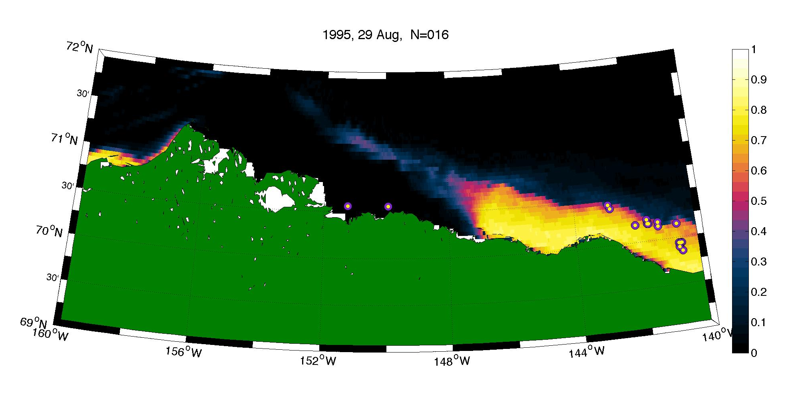
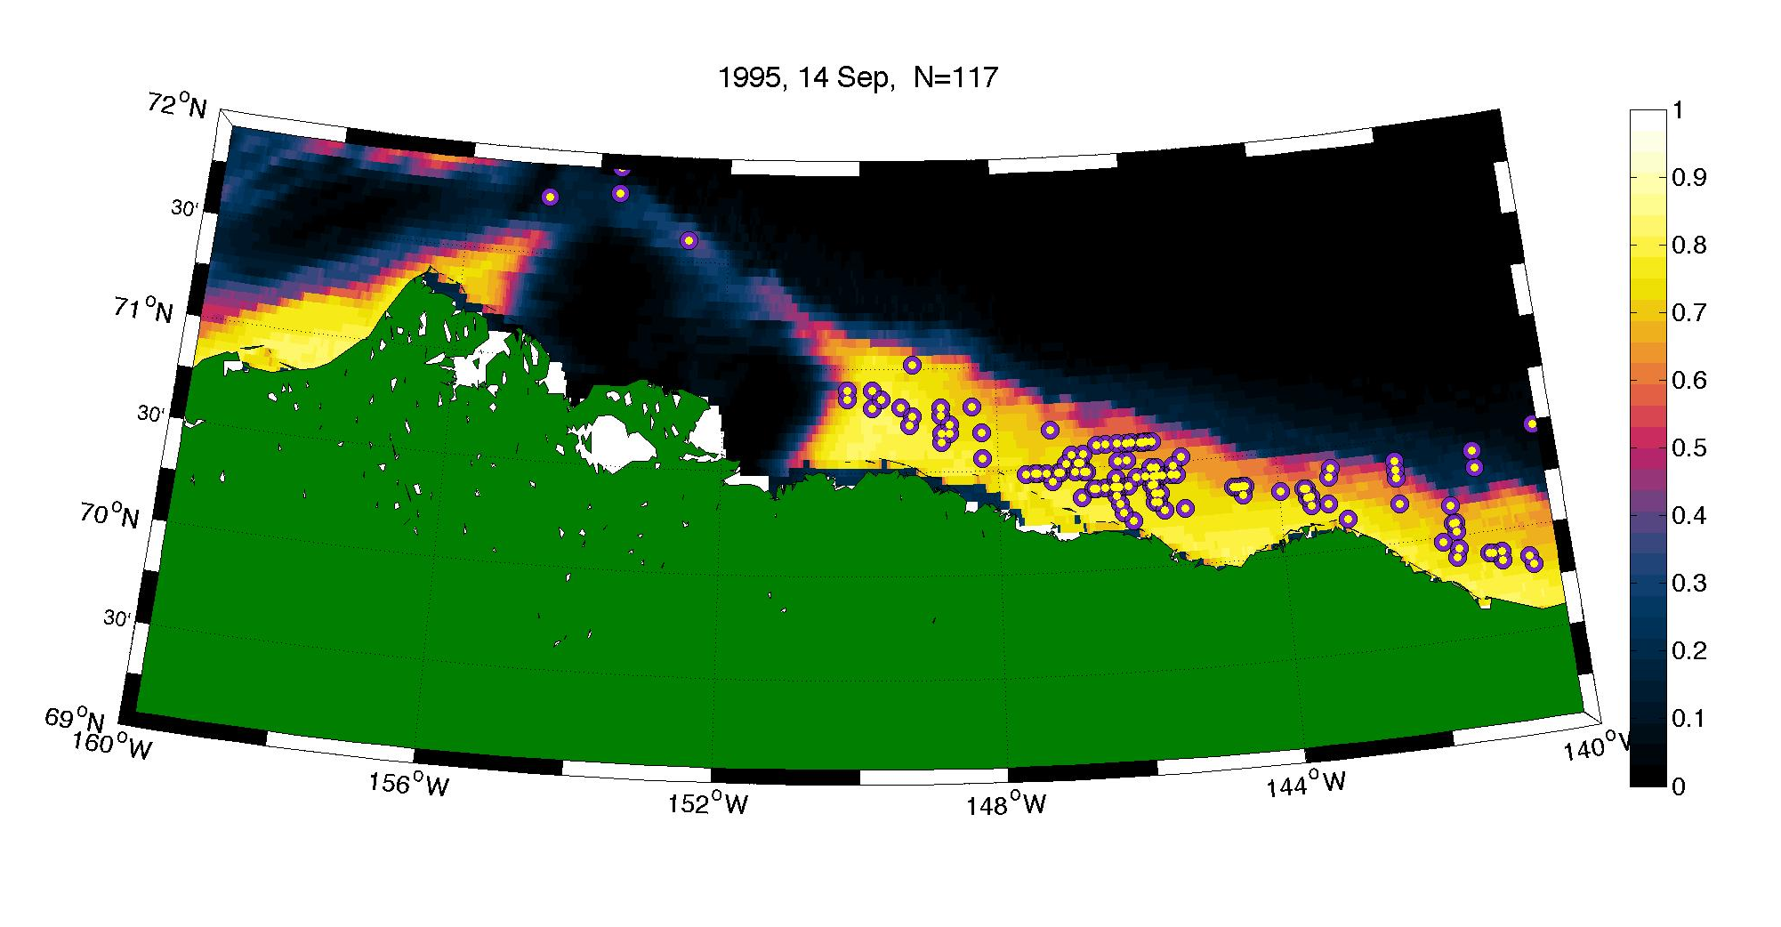
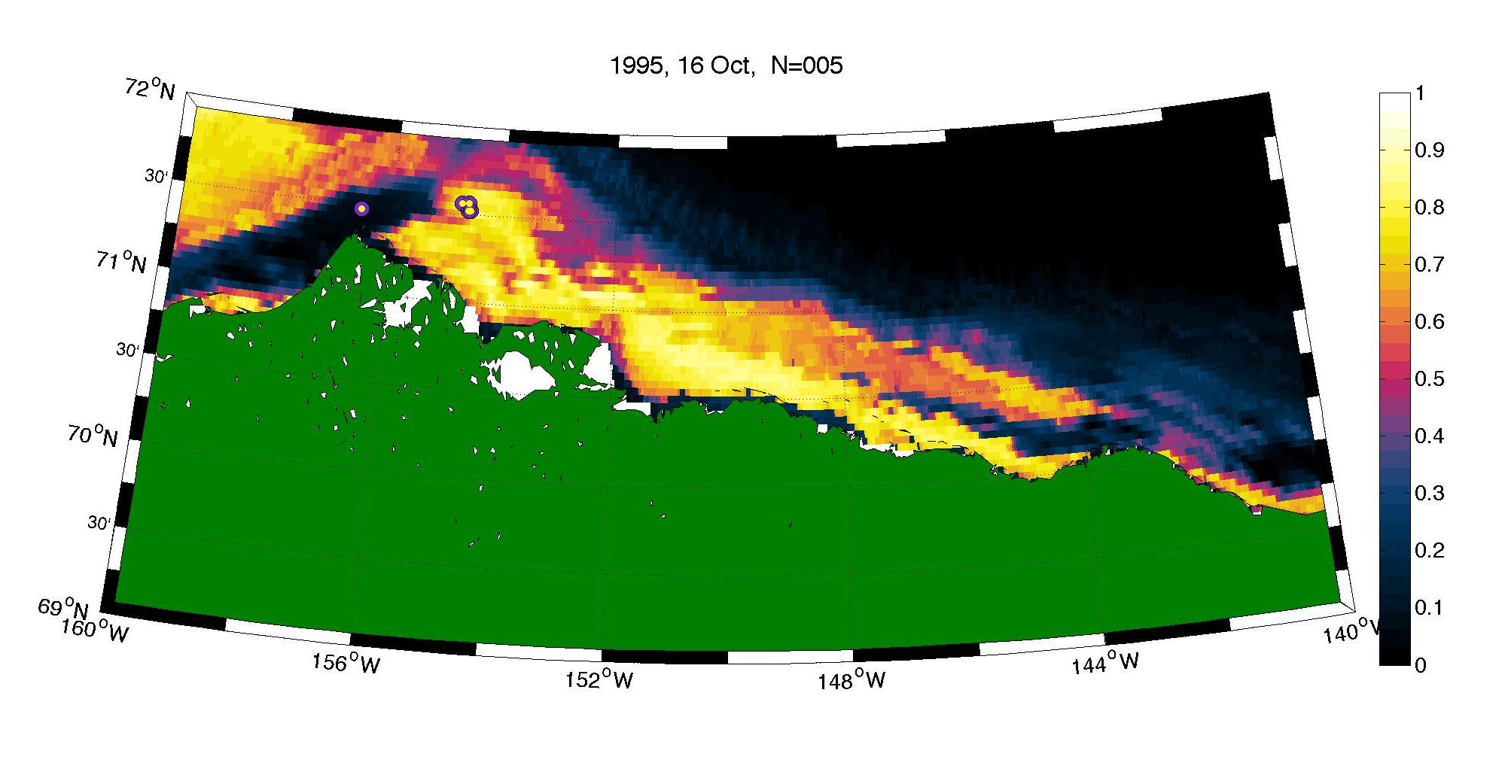
Modeled Potential Habitat
Train with years 1988-1994 & 1996-2012
Tested with independent data from 1995
Based upon
  Depth
  Zooplankton
  Phytoplankton
  Temperature
  Ice
Model performance for all years
AUC

Slide 9
Zooplankton & Bathymetry Most Important
Zooplankton most important time-varying predictor 76% of the time.
Z
Z
Z
?
?
Z
I
I
Z
Z
Z
Z
Z
?
Z
P
Z
Z
Z
Z
Z
Z
Z
Z
Z
Fit model with random subsets of training data
100 replicates
Calculate AUC for each model
Plot 90% CI

Slide 10
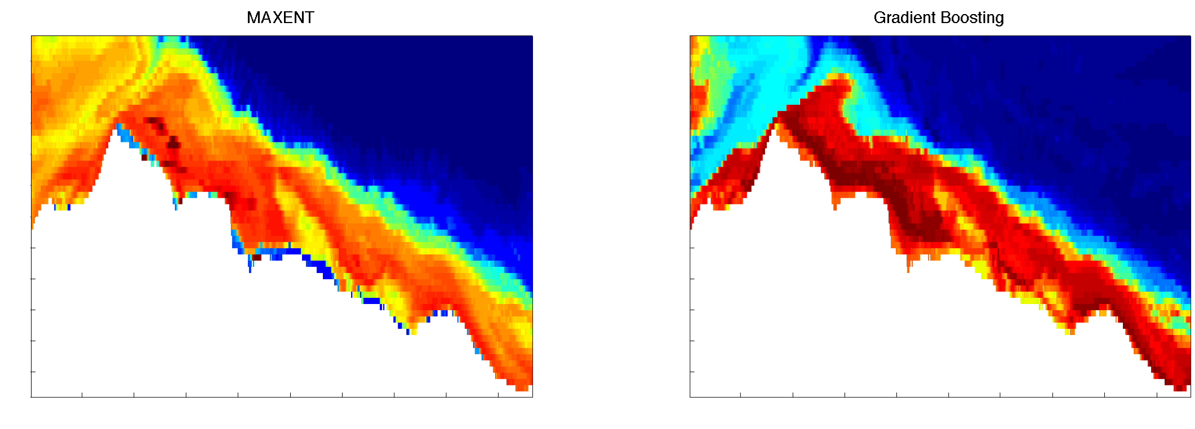
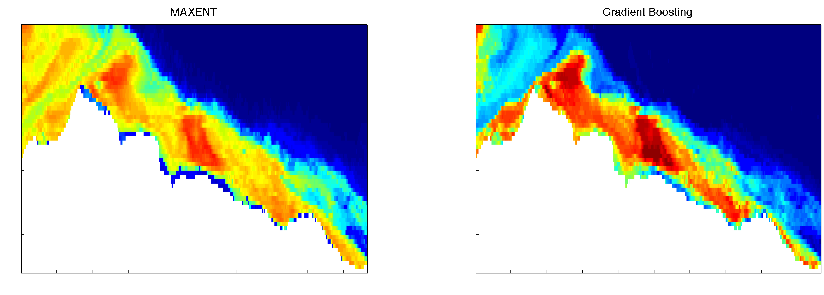
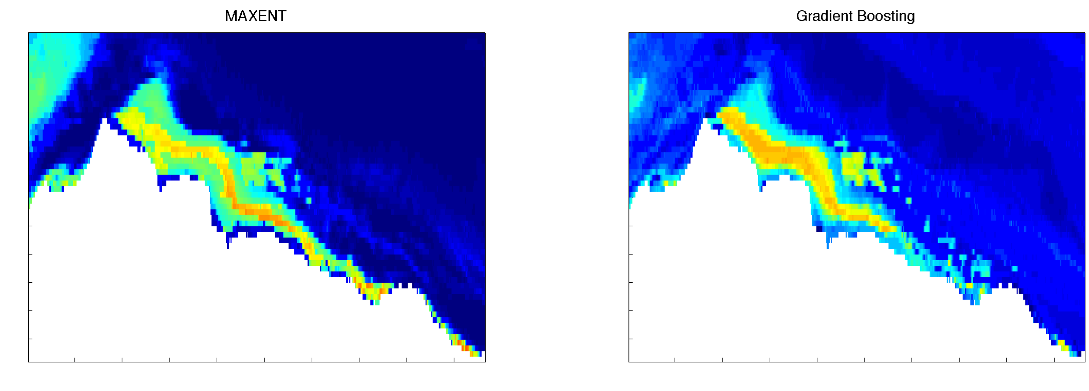
Maxent vs. BRT
Many of the same habitat structures are predicted
Agreement may diverge at the end of the season
BRT less sensitive at high range, more senstive at low range
2011
week 32
2011
week 35
Preliminary comparison of Model performance
2011
week 38
AUC
Becker, et al. MICCAI 2013
Notes:
We’ve also been working to implement additional algorithms.
Here is a comparison of maxent with a boosted regression tree implementation by becker et al.
Gradient boosting implementation by Carlos Becker.
GB and Maxent frequently identify many of the same features.
Relative to Maxent, GB is more generous in predicting good habitat and less generous in predicting poor habitat.
Preliminary analysis indicates that AUC of models is remarkably similar.

Slide 11
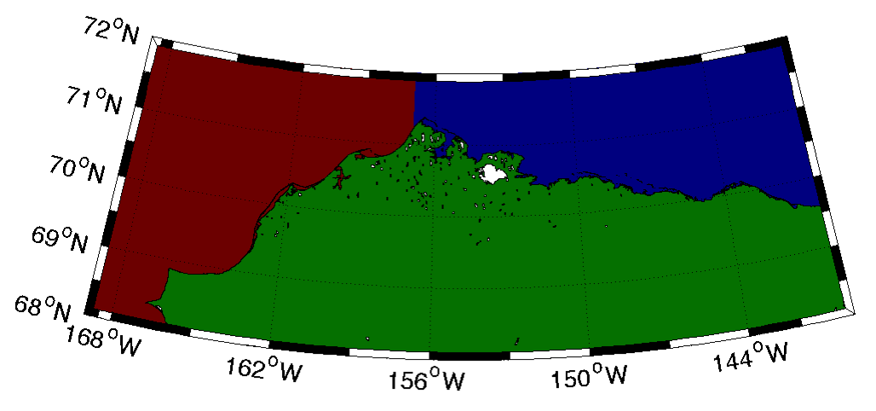
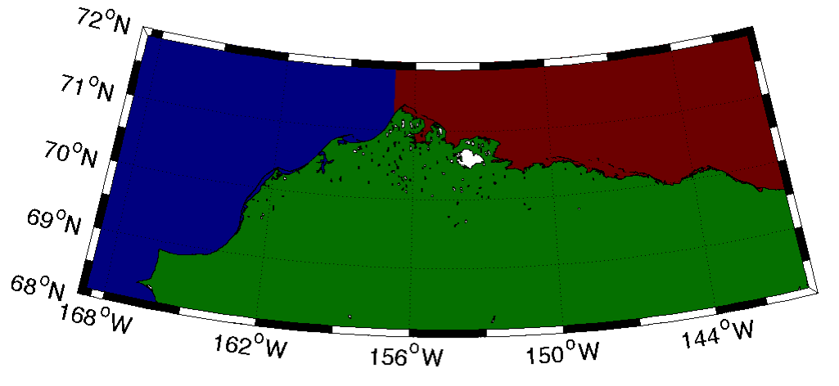
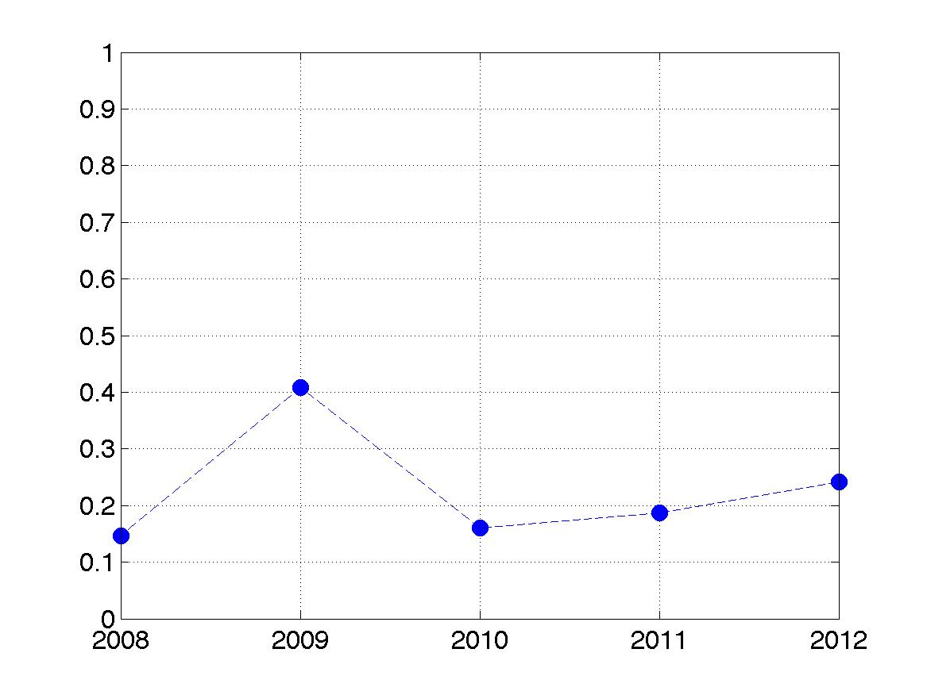
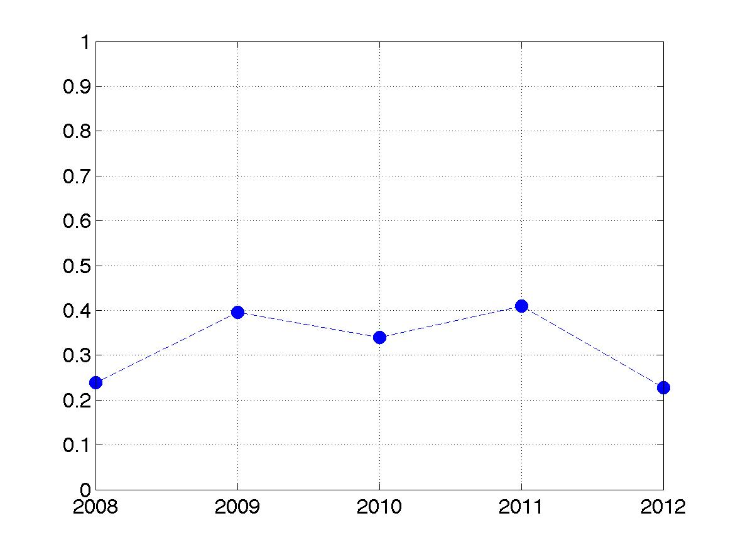
Spatial Transferability
TEST
Chukchi Sea
TRAIN
Beaufort Sea
TRAIN
Chukchi Sea
TEST
Beaufort Sea
ALASKA
ALASKA
Beaufort model tested in Chukchi
Chukchi model tested in Beaufort
AUC
AUC

Slide 12
Conditions associated with bowhead whales: Chukchi relative to Beaufort Sea
biological
physical

Slide 13
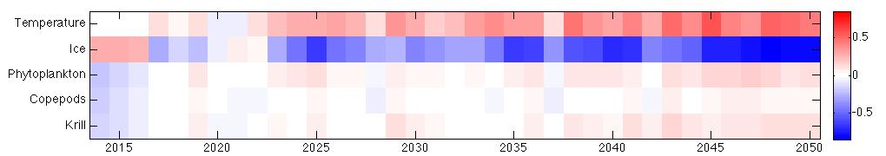
Future work
Utilize acoustics detections
Additional algorithms:
Tune GB/BRT and compare with both RF and maxent
BIOMAS Forecasts to 2050 finished
Anomaly relative to 1988-2012 mean
Zhang et al. 2010. GRL v37 L20505

