Slide 1




Combining Remote Sensing and Biological Data to Predict the
Consequences of Climate Change on Hummingbird Diversity
PIs: Catherine Graham, Susan Wethington, Donald Powers, Pieter Beck, Scott Goetz
Graduate students: Ben Weinstein, Boris Tinoco

Slide 2
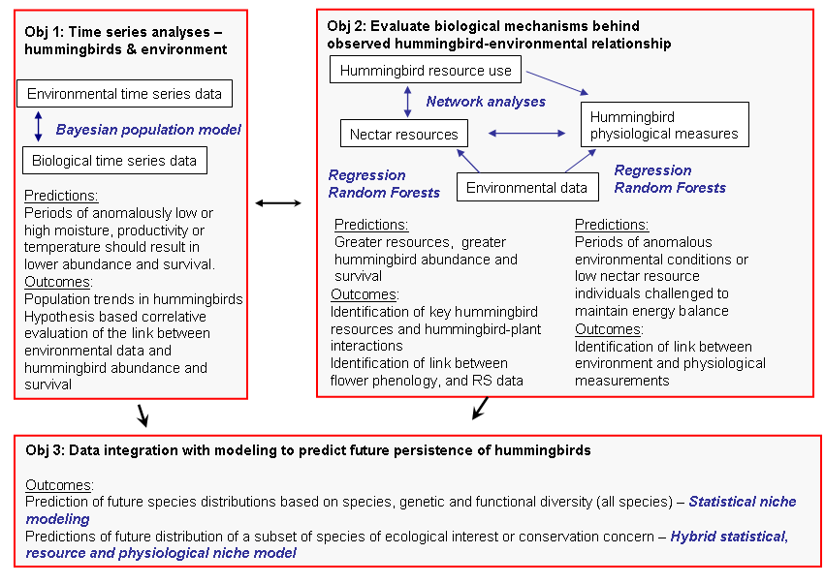
Notes:
Our three main objectives focus on
identifying patterns (objective 1) – i.e., be determining the association between hummingbird abundance, distribution and survival and environmental variables. Specifically we think that periods of anomalously low or high moisture, productivity or temperature should result in changes in abundance, distribution and survival
Evaluating some of the biological mechanisms --- we focus on what we think are the two main mechanisms – nectar resources and physiological response; Nectar is the main food source of hb so understanding what they eat and how their food is distributed has important implications for their survival and distribution, therefore we quantify nectar availability and use across regions and time. Physiological measures provide direct information on hummingbird health and their ability to maintain an energy balance in different environmental (and nectar) conditions.
Finally we will integrate these data into statistical and physiological models.

Slide 3
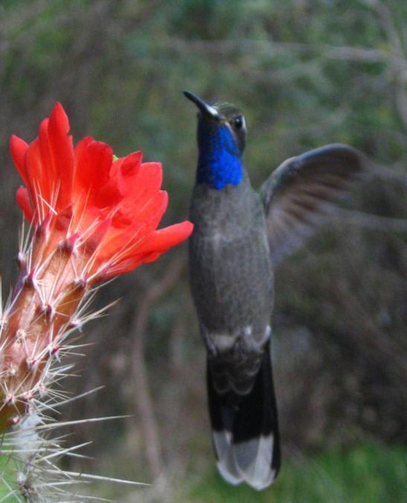
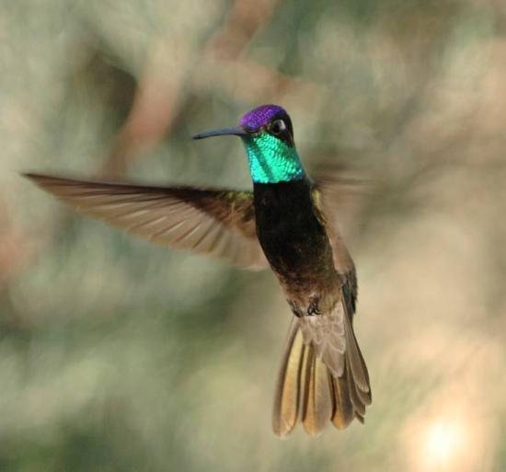
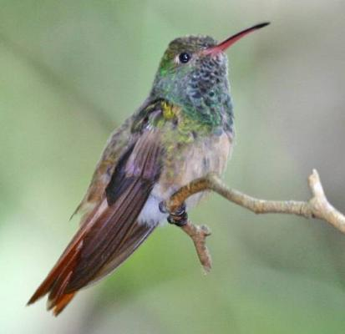
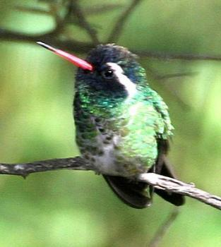
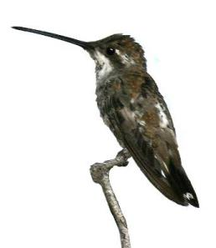
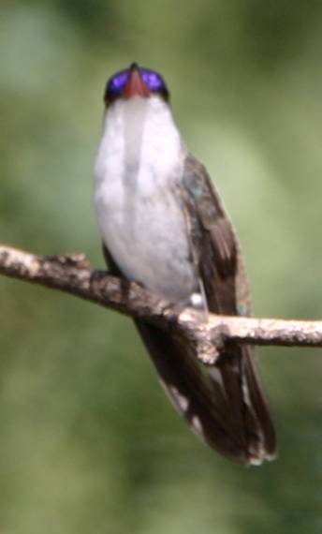
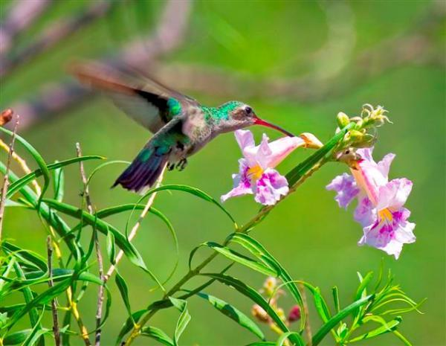
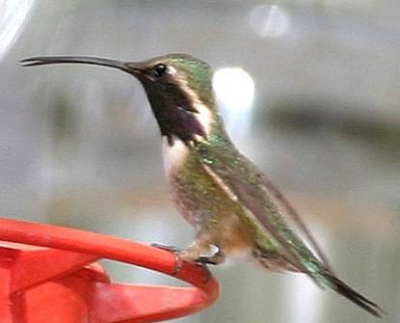
Why Hummingbirds?
They operate at the limits of endothermic physiology. Daily energy requirements are very high.
Climatic changes that reduce energy resources make it more difficult for hummingbirds to meet daily energy demands and drive shifts in their distribution.
Most diversity in the Andes.
North America has 57 species (40% endemic)
Notes:
328 described species of hummingbirds -- live in a variety of environments though about 80% of species are dependent of forest vegetation.
Highest concentration in the northern Andes (109 species; Rahbek & Graves 2000) where up to 35 species co-exist in a local area.
North American has 57 species, of which 40% are endemic and 14% are of high conservation concern
Why hummingbirds?
Because of their small size (many species < 3 g) hummingbirds operate at the limits of endothermic physiology. Daily energy requirements are among the highest measured in vertebrates. Climatic changes that reduce energy resources may make it more difficult for hummingbirds to meet daily energy demands and drive shifts in their distribution
A key plant – animal interaction for ecosystem functioning and diversity maintenance is pollination – if plants/vegetation changes then hummingbird distribution will likely change and likewise pollination services will likely change

Slide 4
Progress on objectives
Objective 1: Time series analyses – hummingbird and environment
Collation and preparation of hummingbird data
Collation and preparation of environmental data
Analyses of hummingbird environment relationships and survival
Combining remote-sensing and climate data with first-principles of physiology to model biological responses to climate change
Objective 2: Evaluate biological mechanisms behind observed environment hummingbird relationships
Hummingbird-plant network quantification
Physiological data collection
Nectar resource – mapping and measuring
Objective 3: Data integration with modeling to predict future persistence of hummingbirds
Statistical modeling
Notes:
***** SUSAN
Data collation: Wethington has spent considerable time cleaning and collating data from hummingbird monitoring network sites.
HMN has samples from about 60 sites that have been monitored an average of 4 years. Twenty sites have been monitored 5 or more years.

Slide 5
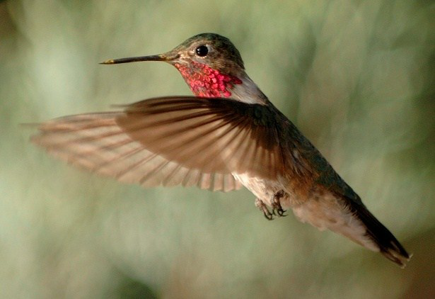
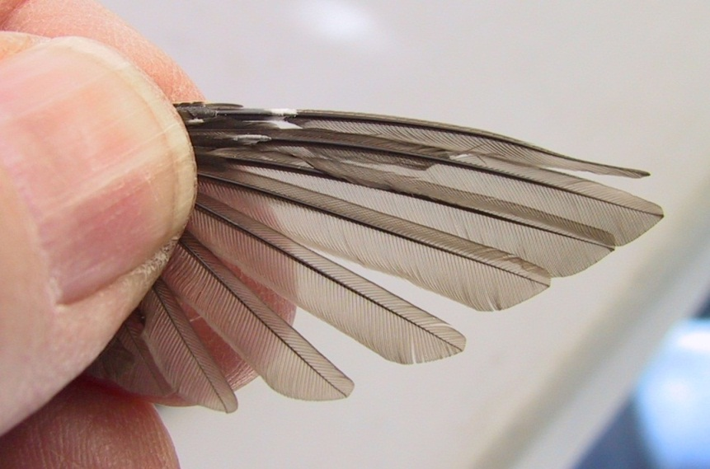
SPRING MIGRATION in SE AZ, 2011
February- record Freeze extending into Mexico
Reports from researchers in Mexico of cold decreasing floral resources
Potential response by Broad-tailed Hummingbirds to extreme climate event on wintering grounds
Increased use of low and mid- elevation sites
More have not completed their winter molt
Notes:
In February 2011, extreme cold weather extended far south into Mexico reaching over-wintering sites of Broad-tailed Hummingbirds, a 3 gram species that breed at high elevations in the western USA. During their 2011 spring migration through Arizona and into Colorado, Broad-tailed Hummingbirds occurred in record numbers at low and mid elevation monitoring sites maintained by the Hummingbird Monitoring Network (HMN) with most birds in the early stages of wing molt, which usually is completed on the wintering grounds.

Slide 6
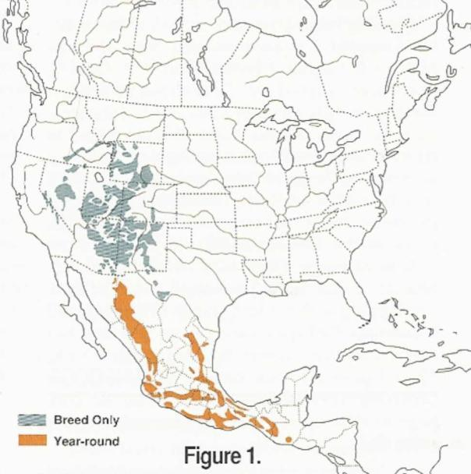
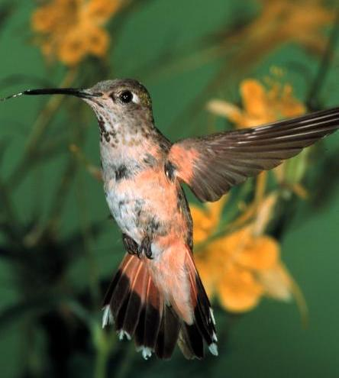
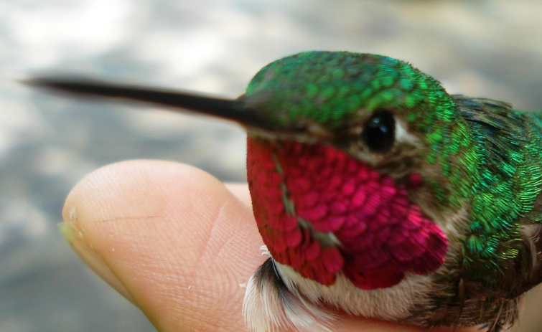
Broad-tailed Hummingbird
(medium sized – 3 grams)
  Latitudinal migratory species that occurs at high elevations on both breeding and wintering grounds
Notes:
High elevation species are likely to be influenced by climate anomalies – have to move down in cold years or when resources are low.

Slide 7
Can we predict both physiological and behavioral attributes of broad-tailed hummingbirds as they migrate to North America based on environmental conditions on their wintering grounds?
Monitoring stations in southern Arizona provide information on hummingbirds as they migrate north
GBIF data provide information of where the birds are on their wintering grounds

Slide 8
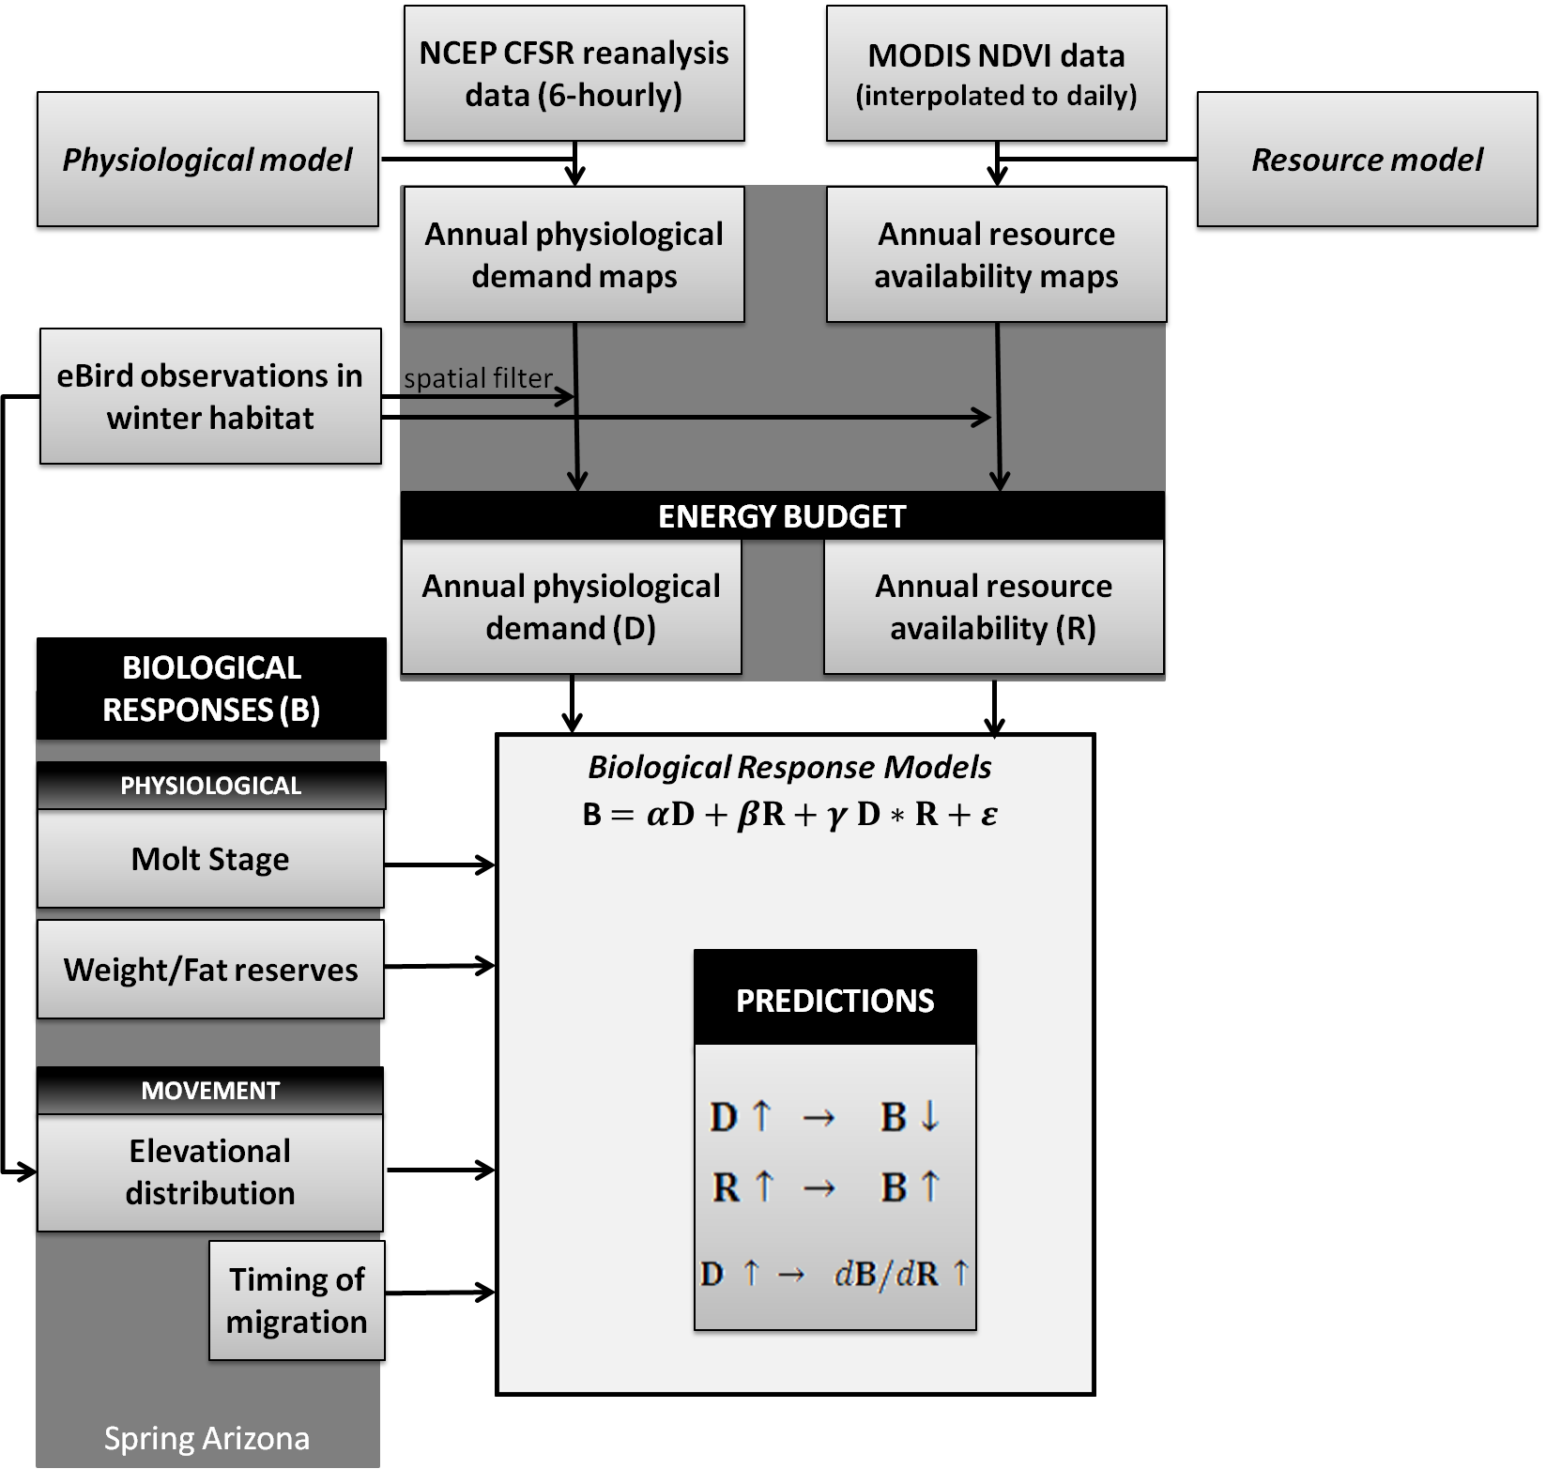
General hypotheses:
As annual physiological demand (D) we will see a negative biological response
As annual resource availability increases (R), we will see a positive biological response

Slide 9
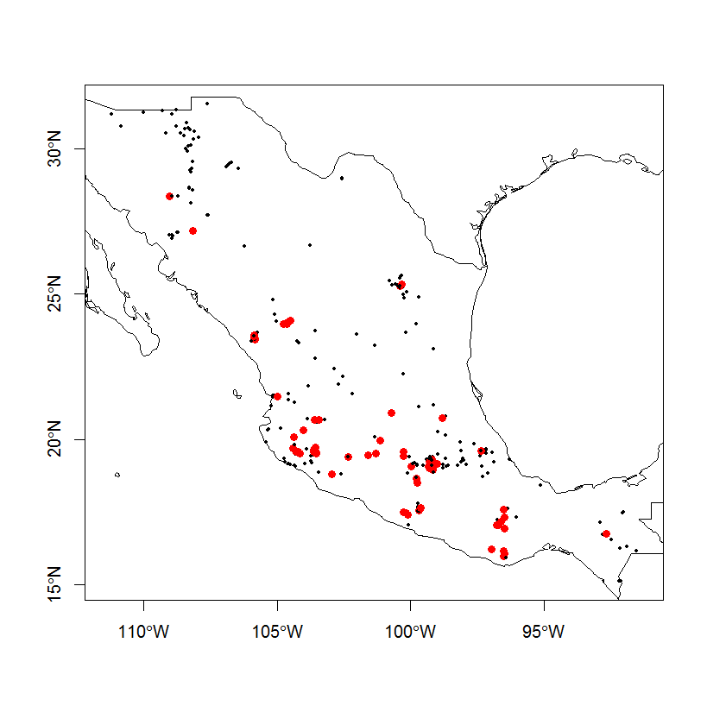
Notes:
he CFSR data are used as input for Ta, obviously, and Rabs (cfsr gives us the gross incoming longwave and shortwave radiation. The latter was partitioned in direct and diffuse radiation because direct shortwave radiation. Combining the gross value for incoming direct shortwave radiation and the bird's albedo gives us the shortwave component of Rabs )

Slide 10
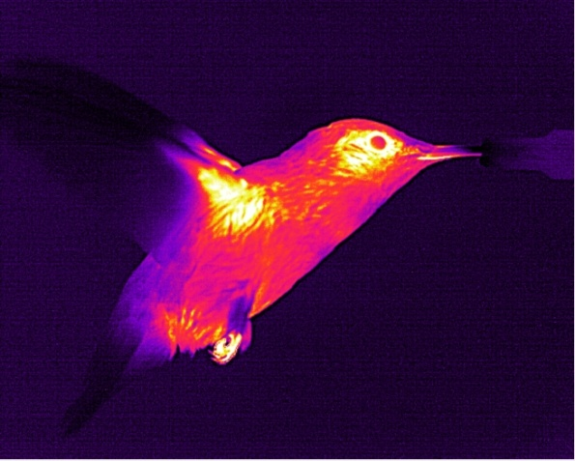
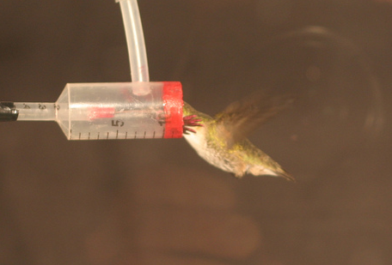
Calculate Operative Temperature (Te)
T_{e} = T_{a} + (R_{abs} – σεT_{a}⁴) / (ρC_{p} / (4σεT_{a}³ + r_{a}))
T_{a} = ambient temperature (°C)
R_{abs} = long wave + short wave radiation absorbed (Wm⁻²)
σ = Stefan-Boltzmann constant (5.67 x 10⁻⁸ Wm⁻² °K⁻⁴)
ε = Emissivity of the bird’s surface (0.95)
ρC_{p} = product of density and specific heat capacity of air (1200 Jm⁻³ °K⁻¹)
r_{a} = aerodynamic resistance to convective heat transfer (s m⁻¹).

Slide 11
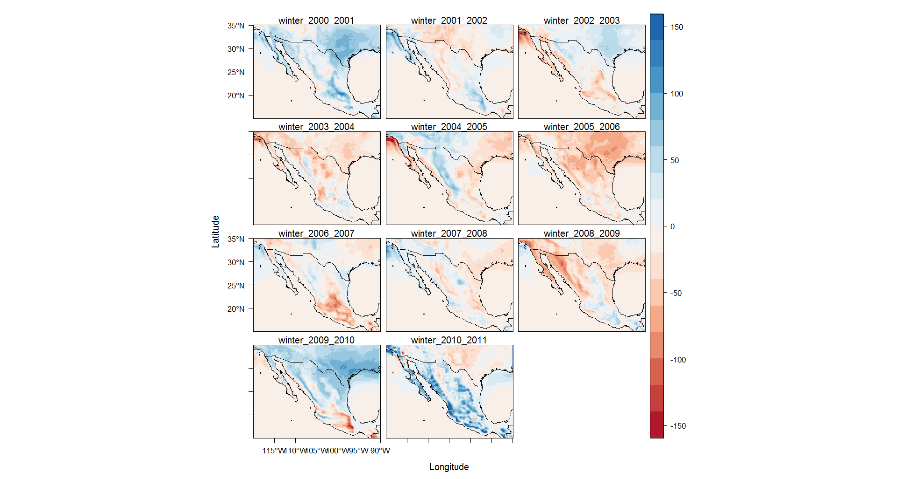
Yearly climate anomalies from mean
6 hr periods where Te(min) < 12.2 C
The NCEP Climate Forecast System Version 2
(http://cfs.ncep.noaa.gov)
Saha et al.
Notes:
Maps of Annual physiological demand and resource availability.
This map shows yearly anomalies from the mean in the nr of 6hr periods observed with Tmin < 12.2C.
Each map depicts a period running from August to July of the next year.
The winter_2010_2011 map reveals how the period August 2010 to July 2011 saw in many high altitude regions of Mexico >150 6-hour periods with Tmin <12.2C more than in an average year.
120 6-hour periods is equivalent to ~1 month.

Slide 12
To better understand this link we are:
Relating in situ sensing of vegetation using in IR cameras with nectar production and
Exploring collaboration with USGS phenology network.

Slide 13
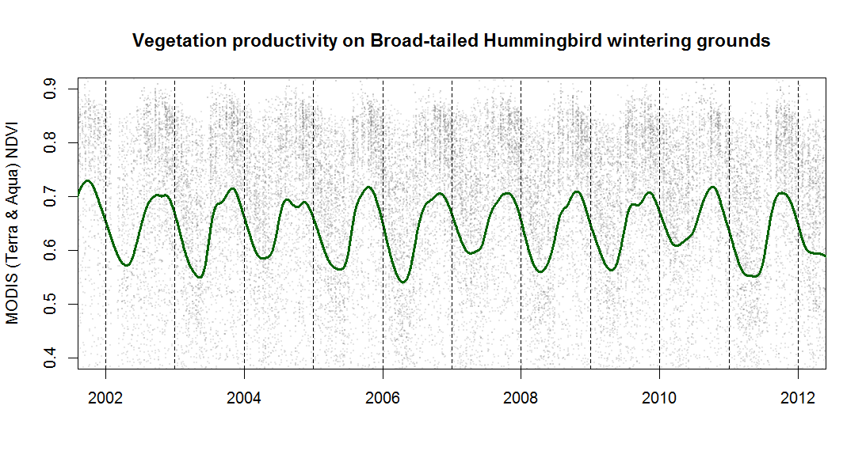
Gray dots – raw NDVI values
Green line – best-fitting interpolated NDVI time series
Notes:
Vertical dashed lines indicate January 1. Highlight the sustained low NDVI values at the beginning of 2011. (This is very difficult to show in a map, hence this figure). Grey dots in the background show ‘raw’ NDVI values. Green line shows the best-fitting interpolated NDVI time series.

Slide 14
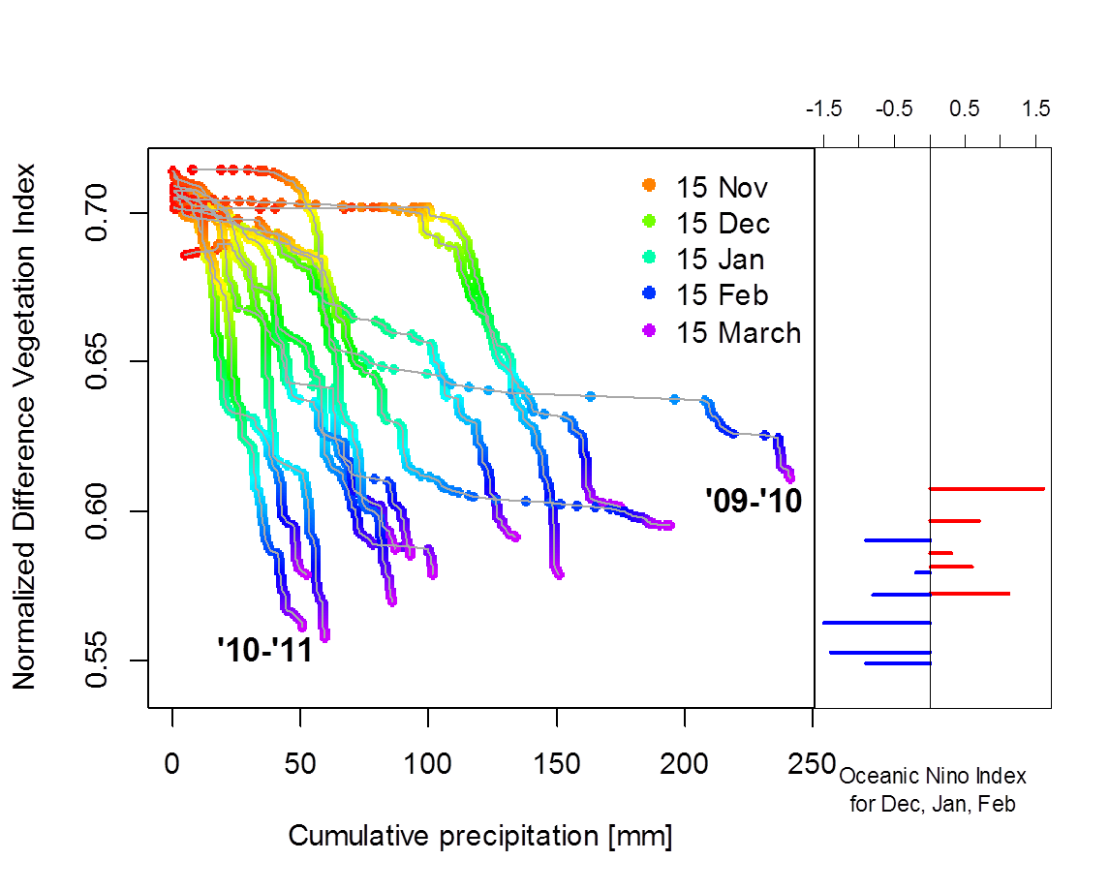
NDVI goes down through the winter, but more quickly if there is little precipitation
La Nina
El Nino
Notes:
Red is

Slide 15
Resource and Demand are not correlated
Resource (NDVI at the end of the winter
Demand (% days with minimum Te < 283K)

Slide 16
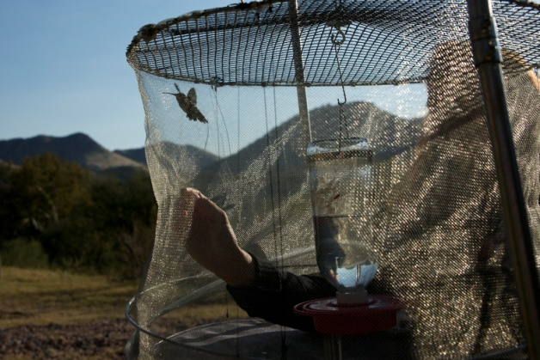
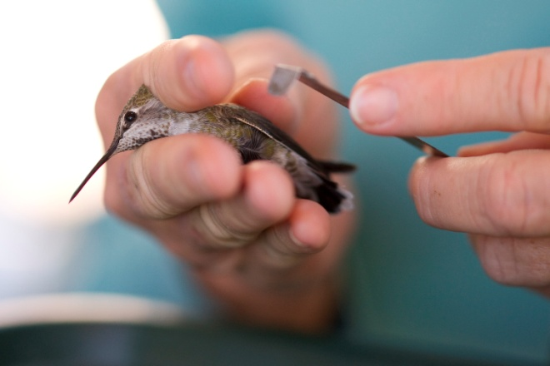

Slide 17
In years with high physiological demand and low resource availability birds should:
Arrive without having completed molt
Weigh less and have lower fat reserves
Arrive later

Slide 18
Predictions based on organismal biology
Take home messages (AICc results)
For molt, full model fit the data best…..
Generate biological layers at fine temporal resolutions
Earlier molt stages are observed in years of high physiological demand, indicating that the birds delayed their molt
Later molt stages are observed in years of higher resource availability, indicating that the birds advance their molt.
The molt response to resource availability is stronger in years of high physiological demand.
Test with long term monitoring data
Predict consequences of future climate change
Notes:
Take home messages:
Earlier molt stages are observed in years of high demand, indicating that the birds delayed their molt
Later molt stages are observed in years of higher resource availability, indicating that the birds advance their molt.
The molt response to resource availability is stronger in years of high physiological demand.
Birds arrive earlier when resource availability is high. The effect of resources on timing of arrival is even greater when physiological demand is high.

Slide 19
Predictions based on organismal biology
Take home messages (AICc results)
For weight and fat model results were in opposite directions and generally uninformative
Generate biological layers at fine temporal resolutions
These variables are likely influenced by the timing of the last meal and the conditions encountered during migration.
Test with long term monitoring data
Predict consequences of future climate change
Notes:
Take home messages:
Earlier molt stages are observed in years of high demand, indicating that the birds delayed their molt
Later molt stages are observed in years of higher resource availability, indicating that the birds advance their molt.
The molt response to resource availability is stronger in years of high physiological demand.
Birds arrive earlier when resource availability is high. The effect of resources on timing of arrival is even greater when physiological demand is high.

Slide 20
Predictions based on organismal biology
Take home messages (AICc results)
For arrival time, full model fit the data best…..
Generate biological layers at fine temporal resolutions
Birds arrive earlier when resource availability is high.
The effect of resources (NDVI) on timing of arrival is even greater when physiological demand is high. logical demand.
Test with long term monitoring data
Predict consequences of future climate change
Notes:
Take home messages:
Earlier molt stages are observed in years of high demand, indicating that the birds delayed their molt
Later molt stages are observed in years of higher resource availability, indicating that the birds advance their molt.
The molt response to resource availability is stronger in years of high physiological demand.
Birds arrive earlier when resource availability is high. The effect of resources on timing of arrival is even greater when physiological demand is high.

Slide 21
Next steps (on-going)
Extend our framework to multiple species and different response variables (i.e., abundance, survival).
Field research to better define our hypotheses and evaluate underlying mechanisms.
Targeted physiological measures

Slide 22
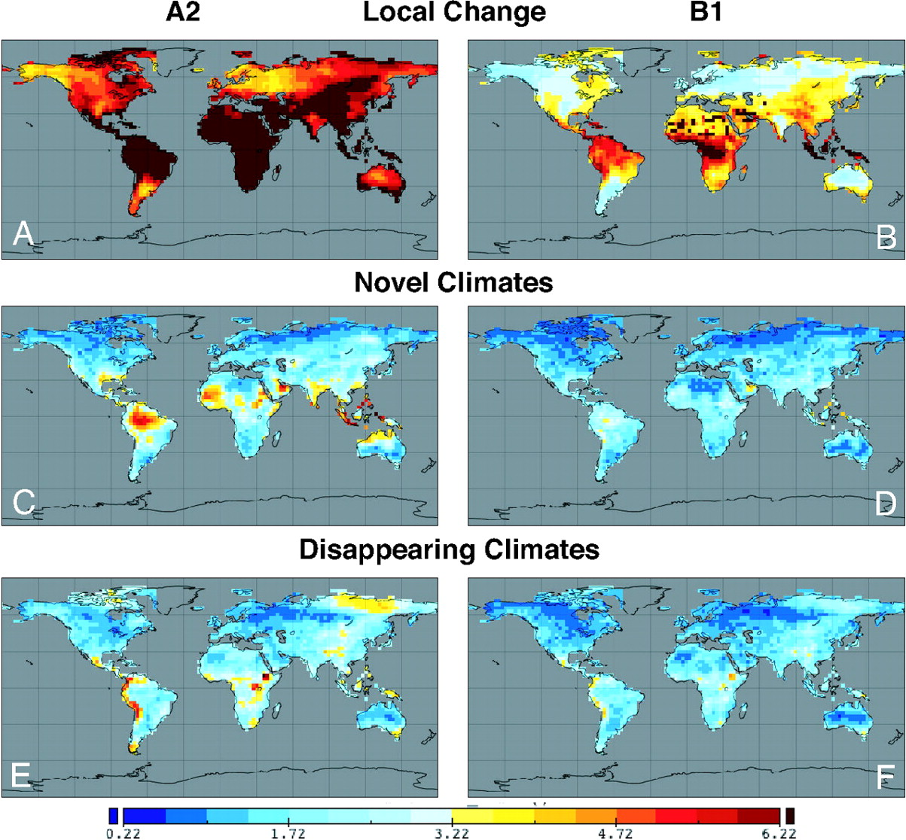
Mapped indices of climate change risk for local climate change (A and B), novel 21st-century climates (C and D), and disappearing 20th-century climates (E and F).
Williams J W et al. PNAS 2007;104:5738-5742
Notes:
Mapped indices of climate change risk for local climate change (A and B), novel 21st-century climates (C and D), and disappearing 20th-century climates (E and F). (A) Local climatic change for the A2 scenario, represented by the SED between the 20th- and 21st-century climate realizations for each gridpoint. The color bar is scaled so that SED→SEDt (see Materials and Methods) are yellow to red. (B) As in A but for the B1 scenario. Locally high values over the Sahara, Arabian Peninsula, and southwestern Asia are an artifact of zero precipitation and precipitation variance simulated by the MRI–CGCM2.3.2 and CCSM3 models. In other models, the SED scores for these locations are similar to those of neighboring gridpoints. (C) Maps of the SEDmin between the 21st-century realization for each gridpoint and the set of 20th-century climate realizations (A2 scenario). High dissimilarities indicate risk of novel climates. (D) As in C but for the B1 scenario. (E) Maps of the SEDmin between the 20th-century realization for each gridpoint and the set of 21st-century climate realizations (A2 scenario). High dissimilarities indicate risk of disappearing climates. (F) As in E but for the B1 scenario. (C–F) The pool of potential climatic analogs is global.

Slide 23
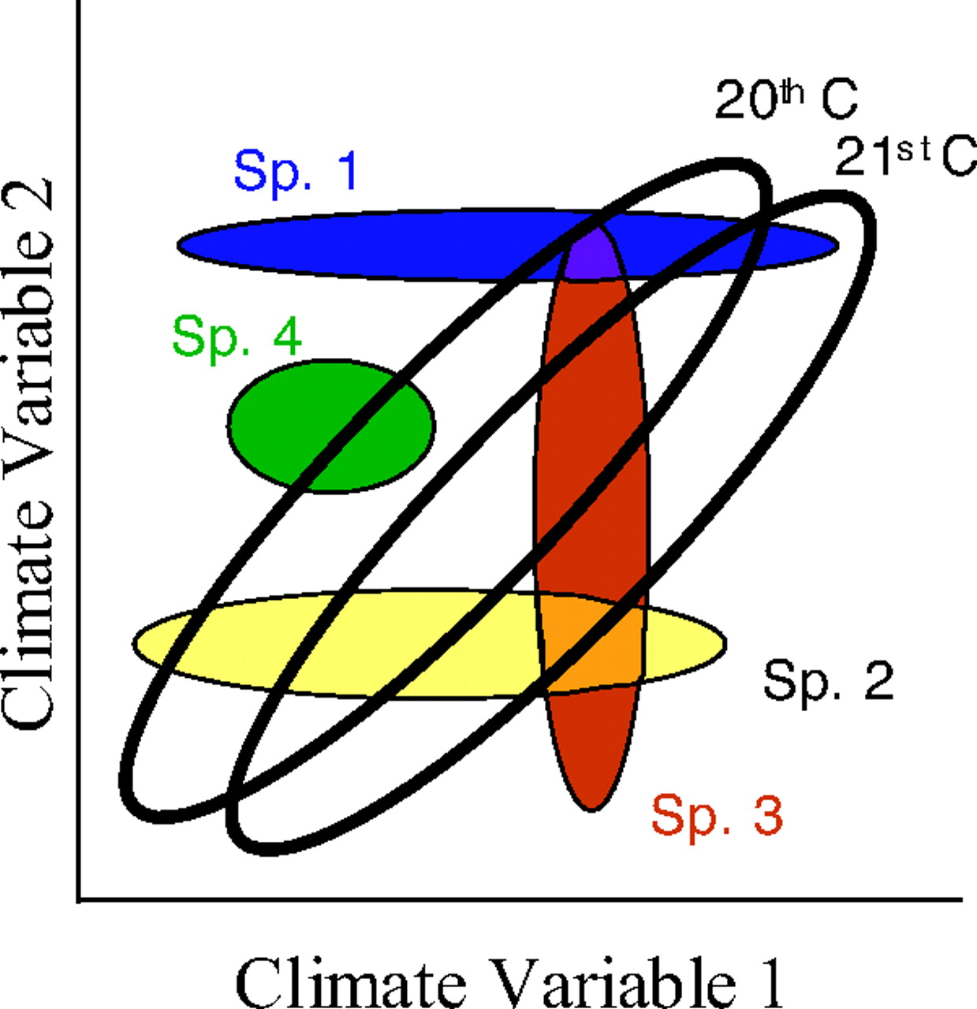
Williams J W et al. PNAS 2007;104:5738-5742
Notes:
Conceptual diagram showing the intersection among the fundamental niches for four species (Sp.; colored ellipses) and climatic envelopes for hypothetical 20th- and 21st-century climates (black-bordered ellipses) (8). Novel climates are the portions of the 21st-century envelope that do not overlap 20th-century climates, and disappearing climates are the portions of the 20th-century envelope that do not overlap 21st-century climates. Species cooccur only if their fundamental niches simultaneously intersect with each other and the current climatic space. Future climate change may cause a variety of ecological responses, including shifts in species distributions (species 1–3), community disaggregation (species 1 and 3), new communities forming (species 2 and 3), and extinction (species 4). This conceptual model assumes fixed niches, i.e., that climate change will outpace evolutionary adaptation (8).

Slide 24
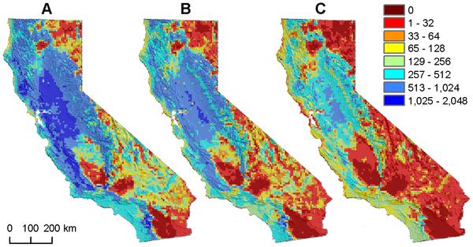
Figure 1. Number of modern analogs for predicted future bird communities across scales.
Stralberg et al. 2009 PLoS ONE 4(9): e6825.

Slide 25
Create assemblage lists in current and future climate
Calculate between time betadiversity
Identify non-analog communities

Slide 26
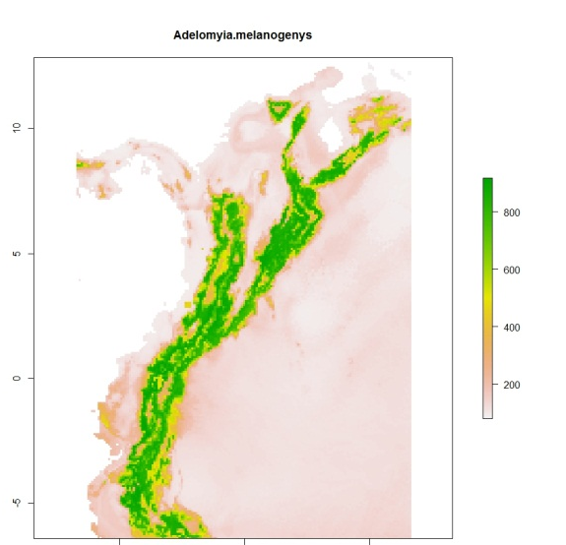
Create assemblage lists
Species Localities (112/180 sp.)
Ensemble niche models (BIOMOD2)
Reviewed and cleaned according to published range maps, expert opinion, grey literature
Maxent, Generalized Linear Models, Boosted Regression Trees
All models with ROC > .75 are combined
Current Climate
Aggregate to .1 degree cells (~10km2)
Future Climate (IPCC 5)
30 sec WorldClim Bioclim: Mean Annual Temp, Annual Precip, Temp Diurnal Range, Precipitation Seasonality
GCM: MICROC, Year: 2070, emission: rcp_85

Slide 27
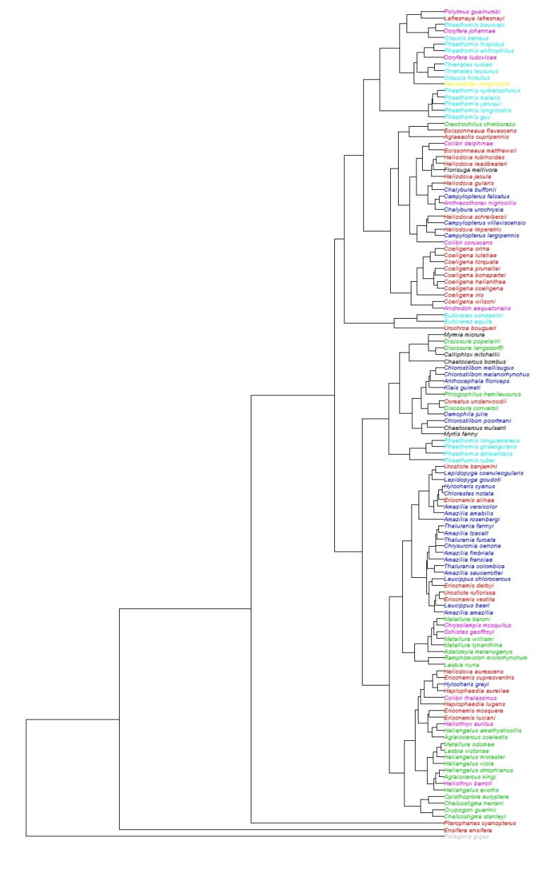
Calculate between time betadiversity
Taxonomic Betadiversity
Phylogenetic Betadiversity
Bray Curtis Dissimilarity
McGuire (2008) 170 taxa
Trait Betadiversity
Hclust of three ecological important traits: body size, wing chord, and bill length
126 taxa Graham (2012)
Betasim metric -> 1- (shared branch lengths/unique branch lengths * shared branch lengths)
Accounts for richness

Slide 28
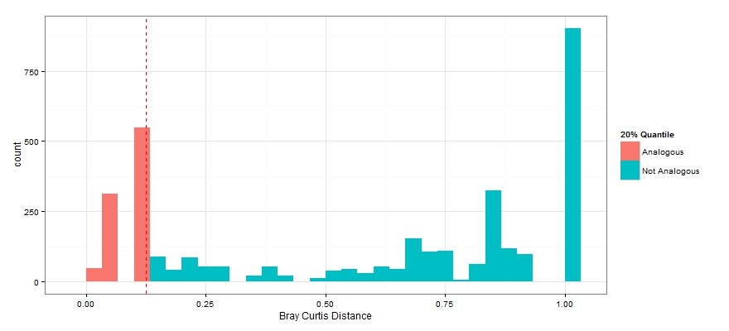
Identify non-analog communities
Future
i
Current Cell_{i} compared to all future cells
Current
Between time betadiversity matrix
Arbitrary threshold (.2) of difference
Future Cell_{i} compared to all future cells
The number of future analogs of current assemblage i

Slide 29
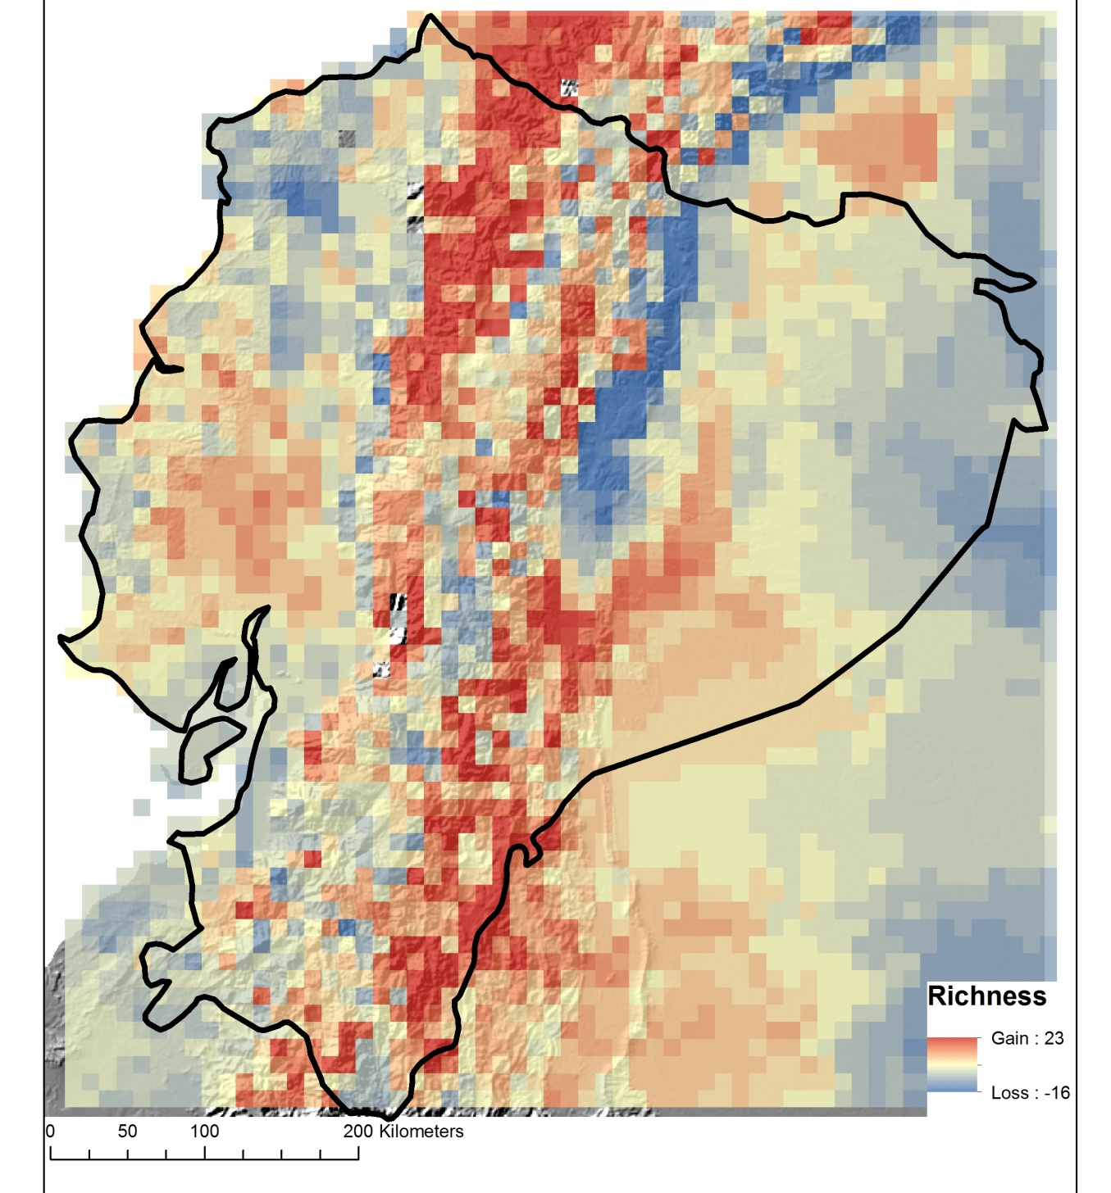
Change in Alpha Richness

Slide 30
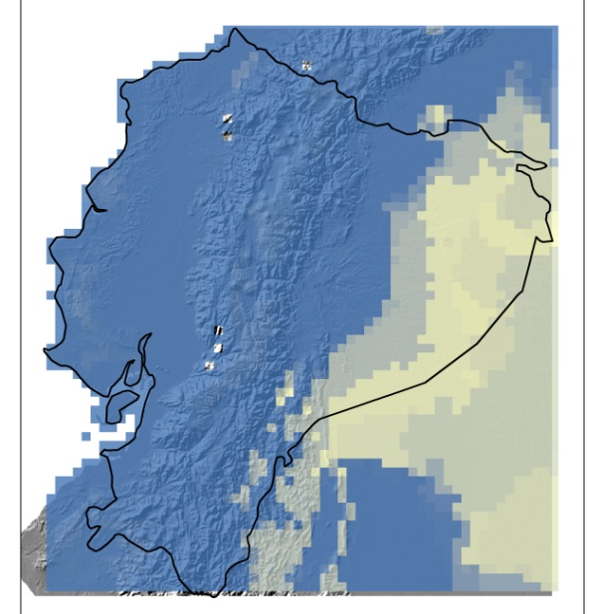
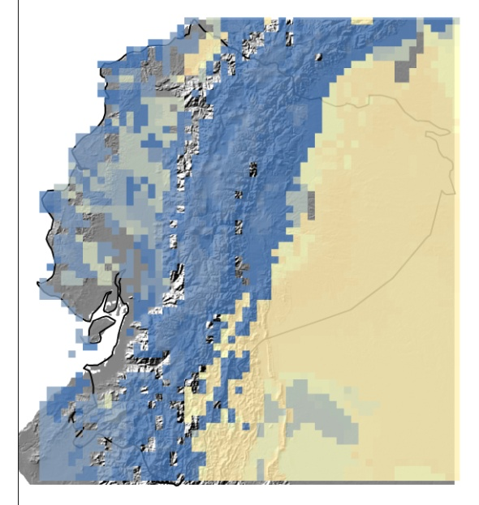
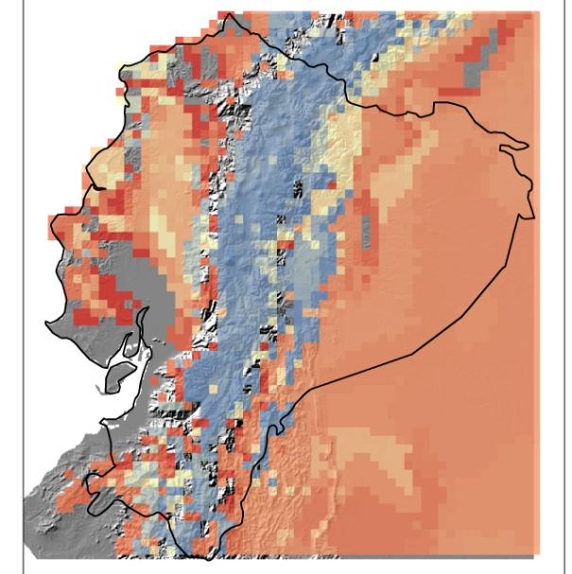

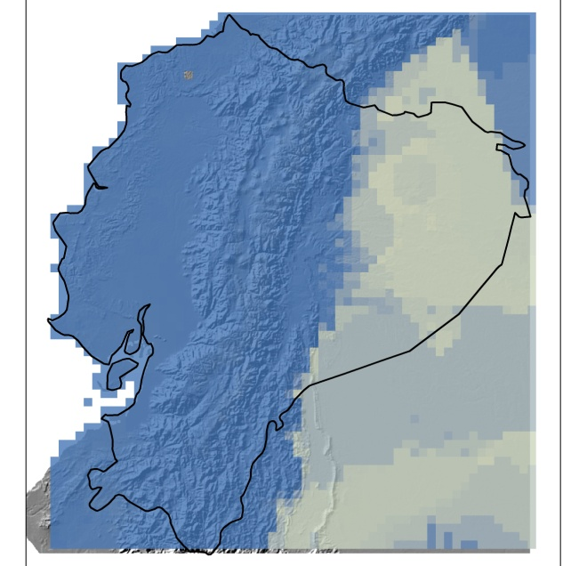
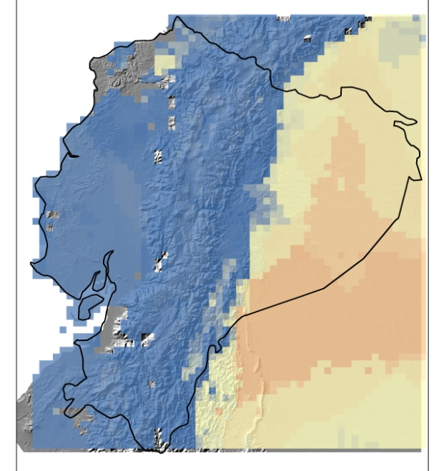
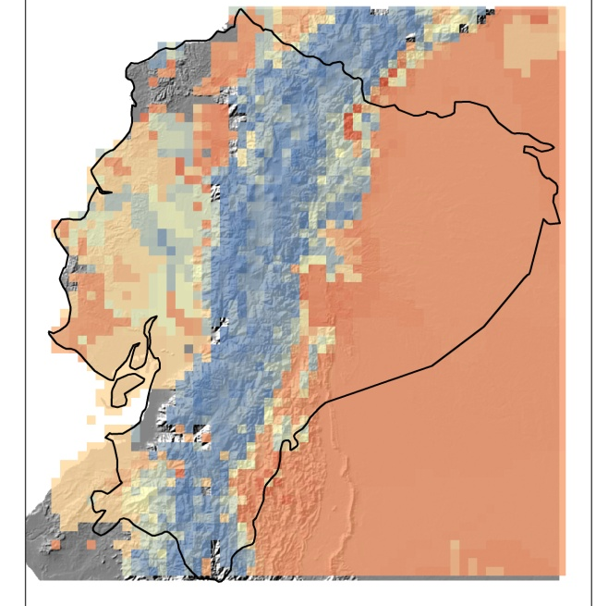
Novel
Taxonomic
Phylogenetic
Trait
Disappearing

Slide 31
Outline
Combining remote-sensing and climate data with first-principles of physiology to model biological responses to climate change
Evaluating the consequences of climate change across different diversity dimensions
Network analyses
Population monitoring
Physiological measurements

Slide 32
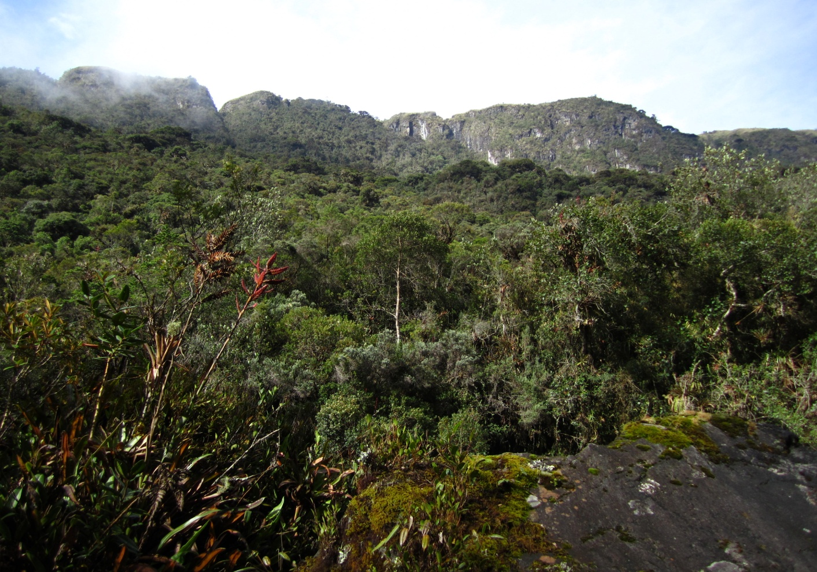
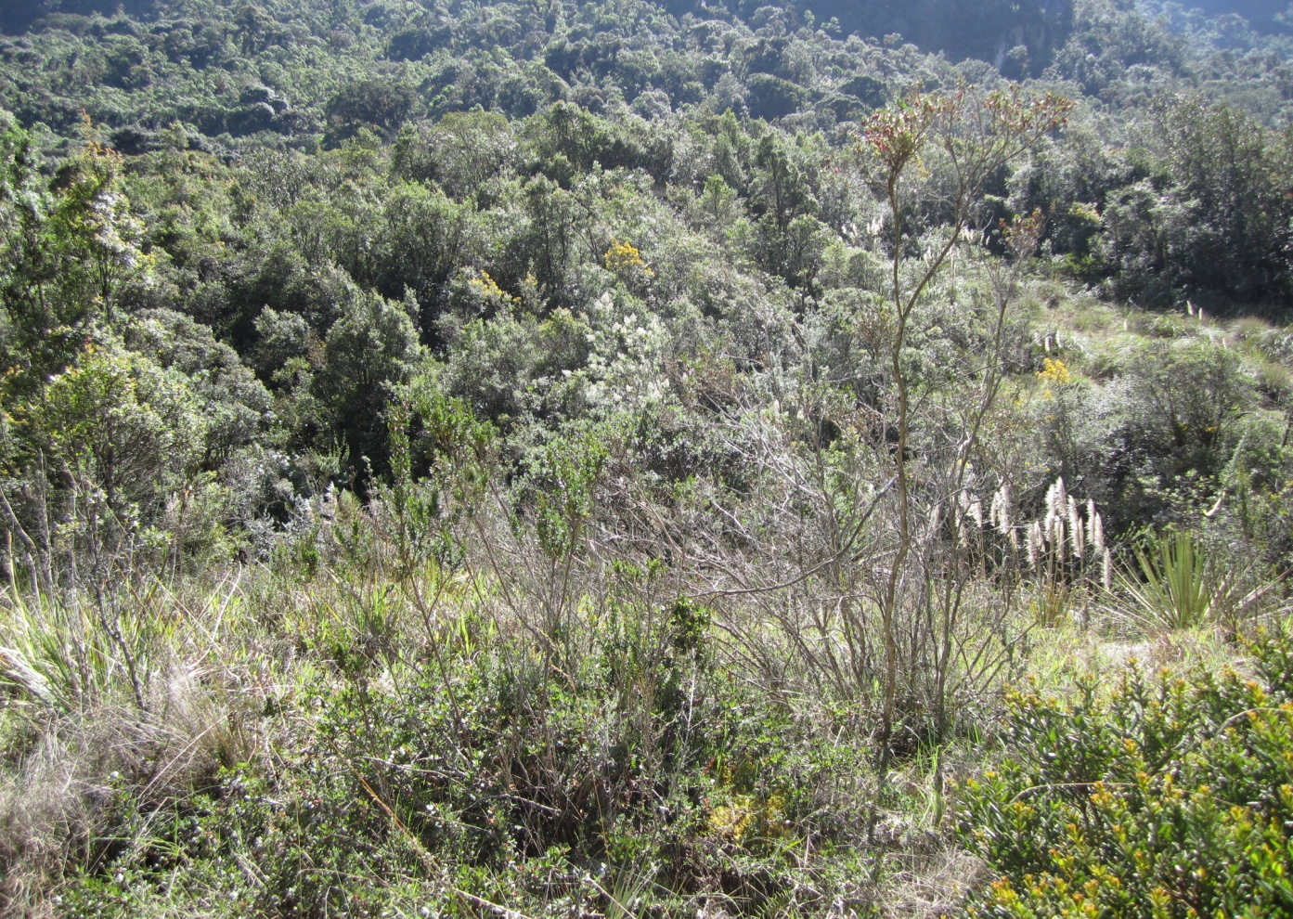
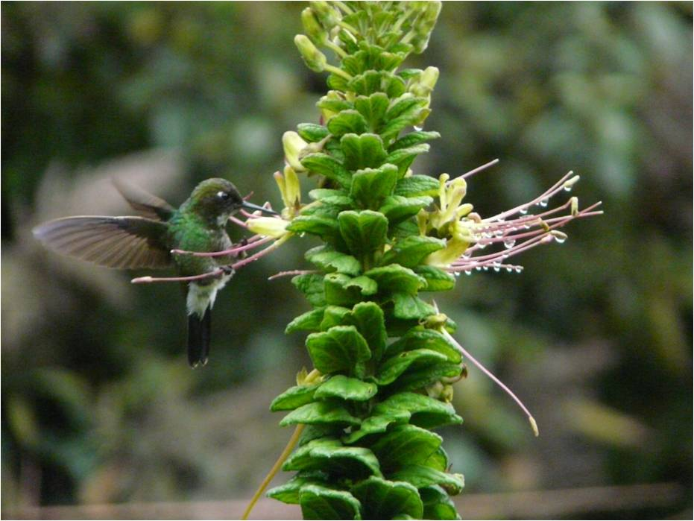
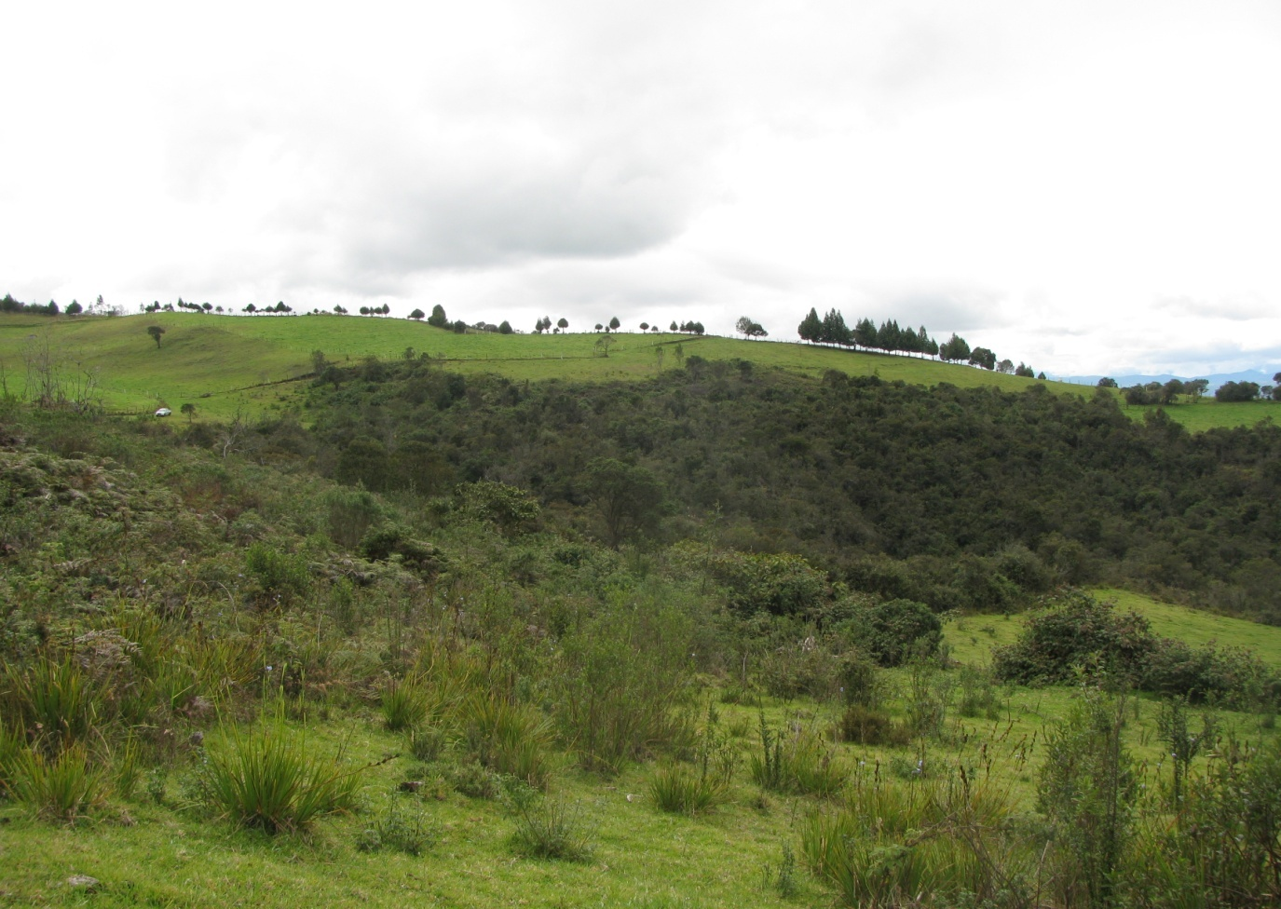
Objective 2: Hummingbird networks in Ecuador (also to be developed in NA)
PREDICTION: Disturbance of natural habitats promotes generalization over specialization
“Old” second growth
Disturbance gradient
Shrubs without cattle
Data collection for networks:
Thirty 10x5 meter plots
All flowers identified
Each plot observed for 30 minutes
Shrubs with cattle
Notes:
The development of network analysis has allowed the incorporation of community level interactions to explore the stability and dynamic of pollination systems.
The responses of species to habitat alterations has been associated with the degree of specialization of the network. Disturbance of natural habitats would promote generalization over specialization.
Cajas National Park – Ecuador. Elevation: 3100 m
Three habitats with varying levels of alteration
1) Second growth forest (GF)
2) Shrubs without grazers (SG)
3) Shrubs with cattle grazers (SC)
We placed three 200 x 5 m plots on each habitat, separated by at least 500 m. These plots were divided in twenty 10 x 5 m subplots. Flowers located within each subplot were observed for hummingbird visits for 30 min. Observation were gathered between February and August 2011.

Slide 33
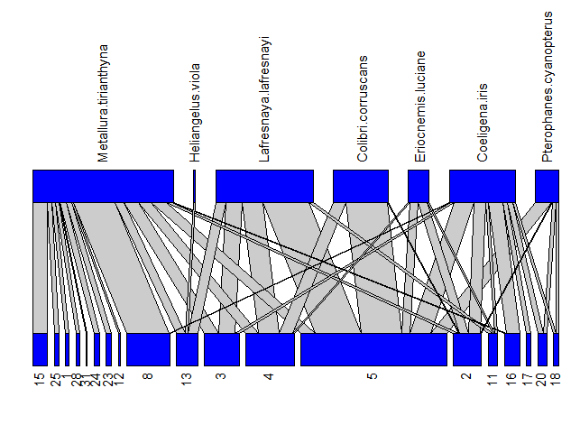
Objective 2: Hummingbird networks in Ecuador
Habitat | Total Interactions | Hummingbirds | Plants
Second growth | 442 | 7 | 19
Shrub no grazing | 1412 | 10 | 16
Shrub grazing | 884 | 7 | 17
Data from February and August 2011. Collection on-going
Interaction networks of hummingbirds and plants.
The lines between the two levels represent interactions and the thickness depends on the frequency of a given interaction.
Hummingbird species
Plant species

Slide 34
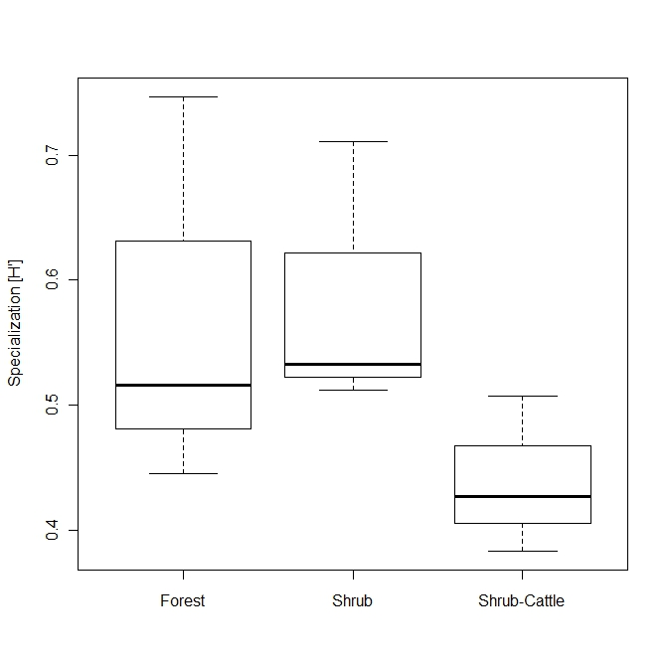
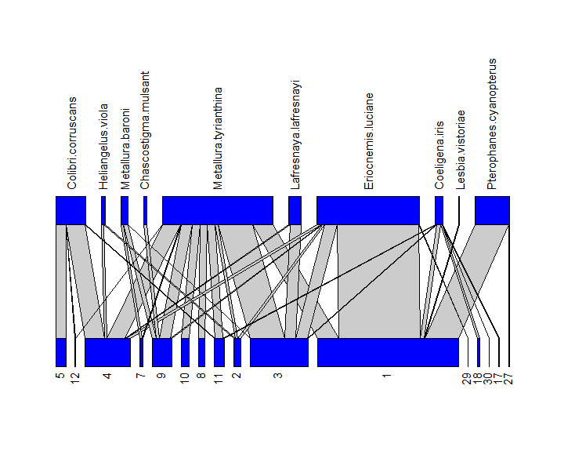
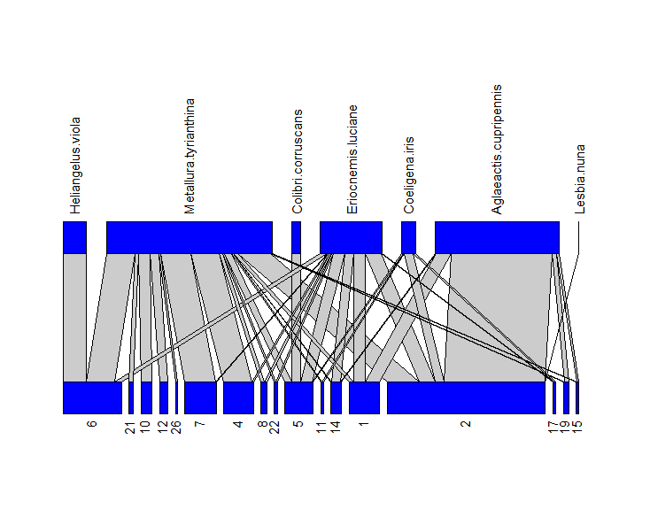
Objective 2: Hummingbird networks in Ecuador
Degree of specialization of the network
“Old” second growth
Specialization
Shrubs without cattle
Second
Growth
Shrub
Shrub cattle
Shrubs with cattle
As predicted cattle grazing decreases specialization

Slide 35
Outline
Combining remote-sensing and climate data with first-principles of physiology to model biological responses to climate change
Evaluating the consequences of climate change across different diversity dimensions
Network analyses
Population monitoring
Physiological measurements

Slide 36
Could put Ecuador here
I GOT TO HERE

Slide 37
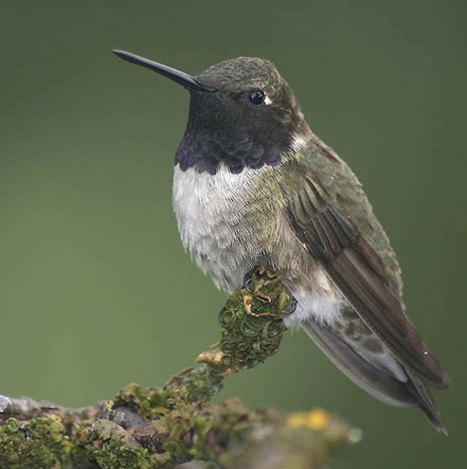
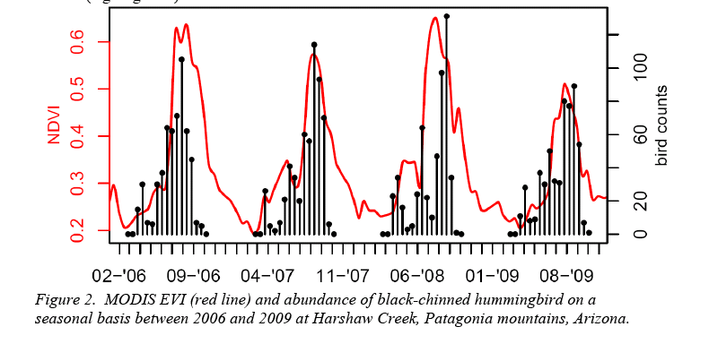
Objective 1: Time series analyses – hummingbirds and environment
Seasonal hummingbird abundance patterns correspond to vegetation activity
Notes:
Preliminary analyses suggest a strong correspondence between environmental factors (EVI) and abundance patterns of the black-chinned hummingbird

Slide 38
Abundance of southbound migrant
Hatch Year Birds
Estimated abundance
(Harsh winter)
Notes:
This graph indicates the percentage of Hatch Year birds captured at HMN sites during southbound migration. The decrease in percentage of hatch year birds in summer of 2006 suggest that breeding success of multiple hummingbird species in western USA respond similarly to adverse environmental variables. One potential result of BTLH models is that climate during the winter of 2005-2006 was a “stress” year

Slide 39
Progress on objectives
Objective 1: Time series analyses – hummingbird and environment
Collation and cleaning of hummingbird data
Collation and cleaning of environmental data
Initial analyses of hummingbird environment relationships and survival
Distribution changes of Broad-tailed Hummingbirds tied to climate anomalies
Objective 2: Evaluate biological mechanisms behind observed environment hummingbird relationships
Hummingbird networks in Ecuador
Plans for physiological data collection
Objective 3: Data integration with modeling to predict future persistence of hummingbirds – nothing to report

Slide 40
PERCENTAGE OF INDIVIDUALS IN MOLT STAGES
COMPARISON OF NUMBER OF BROAD-TAILED AT se ARIZONA MONITORING SITES IN SPRING
YEAR | SITES | MAR | APR | MAY
2003-10 (avg per year) | 9 (avg per year) | 12 | 26 | 66
2011 | 9 | 20 | 305 | 269
YEAR | SITES | Fresh plumage/ End of wing molt | Worn plumage/ beginning wing molt
2003-10 (avg per year) | 9 (avg per year) | 93% | 7%
2011 | 9 | 67% | 33%
Notes:
These tables summarizes the increased abundance of Broad-tailed at Low and Mid- elevation monitoring sites in Arizona and also the increased percentage of birds with delayed or arrested molt. These data motivated our study that will model physiological response to extreme climate events.
Using gridded time series of meteorological data in conjunction with metabolic and digestive physiological data, we will identify the temperature conditions under which Broad-tailed Hummingbirds will likely be stressed; then we will identify years in the past decade that meet these climatic conditions and use HMN monitoring data to test the predictions of the models.
In a follow on project, we will ask whether the climatic conditions that cause stress in individual Broad-tailed hummingbirds also cause population level changes such as a decrease in survivorship.

Slide 41
Progress on objectives
Objective 1: Time series analyses – hummingbird and environment
Collation and cleaning of hummingbird data
Collation and cleaning of environmental data
Initial analyses of hummingbird environment relationships and survival
Distribution changes of Broad-tailed Hummingbirds tied to climate anomalies
Objective 2: Evaluate biological mechanisms behind observed environment hummingbird relationships
Hummingbird networks in Ecuador
Plans for physiological data collection
Objective 3: Data integration with modeling to predict future persistence of hummingbirds – nothing to report

Slide 42
Objective 2: Hummingbird networks in Ecuador (also to be developed in NA)
PREDICTION: Disturbance of natural habitats promotes generalization over specialization
“Old” second growth
Disturbance gradient
Shrubs without cattle
Data collection for networks:
Thirty 10x5 meter plots
All flowers identified
Each plot observed for 30 minutes
Shrubs with cattle
Notes:
The development of network analysis has allowed the incorporation of community level interactions to explore the stability and dynamic of pollination systems.
The responses of species to habitat alterations has been associated with the degree of specialization of the network. Disturbance of natural habitats would promote generalization over specialization.
Cajas National Park – Ecuador. Elevation: 3100 m
Three habitats with varying levels of alteration
1) Second growth forest (GF)
2) Shrubs without grazers (SG)
3) Shrubs with cattle grazers (SC)
We placed three 200 x 5 m plots on each habitat, separated by at least 500 m. These plots were divided in twenty 10 x 5 m subplots. Flowers located within each subplot were observed for hummingbird visits for 30 min. Observation were gathered between February and August 2011.

Slide 43
Objective 2: Hummingbird networks in Ecuador
Habitat | Total Interactions | Hummingbirds | Plants
Second growth | 442 | 7 | 19
Shrub no grazing | 1412 | 10 | 16
Shrub grazing | 884 | 7 | 17
Data from February and August 2011. Collection on-going
Interaction networks of hummingbirds and plants.
The lines between the two levels represent interactions and the thickness depends on the frequency of a given interaction.
Hummingbird species
Plant species

Slide 44
Objective 2: Hummingbird networks in Ecuador
Degree of specialization of the network
“Old” second growth
Specialization
Shrubs without cattle
Second
Growth
Shrub
Shrub cattle
Shrubs with cattle
As predicted cattle grazing decreases specialization

Slide 45
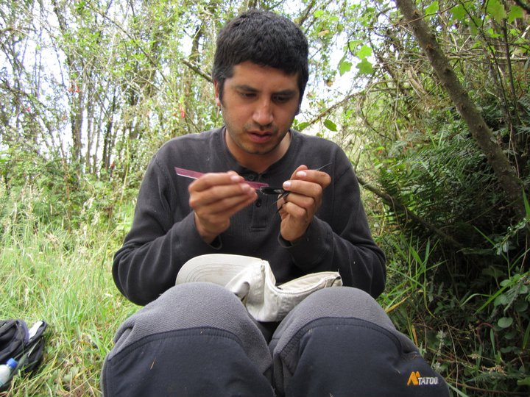
Objective 2: Hummingbird networks in Ecuador
Next steps:
Calculate hummingbird survival using Mark-recapture (as with NA data) based on 8 yrs of mist-net data
Evaluate relationship between survival & RS data
Evaluate relationship between flower resources, RS & hummingbird behavior (specialization etc.) from hummingbird – plant network
Work done by Boris Tinoco, PhD student

Slide 46
Progress on objectives
Objective 1: Time series analyses – hummingbird and environment
Collation and cleaning of hummingbird data
Collation and cleaning of environmental data
Initial analyses of hummingbird environment relationships and survival
Distribution changes of Broad-tailed Hummingbirds tied to climate anomalies
Objective 2: Evaluate biological mechanisms behind observed environment hummingbird relationships
Hummingbird networks in Ecuador
Plans for physiological data collection
Objective 3: Data integration with modeling to predict future persistence of hummingbirds – nothing to report

Slide 47

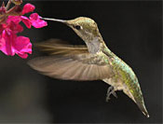
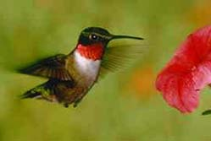
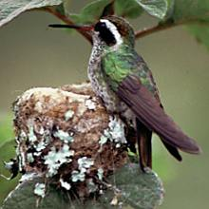



Physiology
Colibríes: fisiología, comportamiento
© R. A. Tyrell
High metabolic rate
High energetic needs
Use of torpor
Nectarivores
Activity patterns
Movement patterns

Slide 48



Objective 2: Plans for physiological data collection
Measure field metabolic rate of 6 hummingbird species at 5 locations using doubly-labeled water (DLW). The 5 locations provide both thermal and elevational variation. The 6 species provide maximum size and phylogeneitc variation for North American hummingbirds.
Lampornis clemenciae; 8 g
DLW Theory
Archilochus alexandri; 3 g
Notes:
1. Measure field metabolic rate of 6 hummingbird species at 5 locations using doubly-labeled water (DLW). The 5 locations provide both thermal and elevational variation. The 6 species provide maximum size and phylogeneitc variation for North American hummingbirds. The plan will be to collect DLW data during Susan's bimonthly banding sessions. This will allow for each site to be sampled 5-7 times this summer yielding a bucket load of energetic data. I still have no idea when the isotope analyzer will be delivered but that will not stop us from collecting samples.
2. Make measurements of environmental operative temperature (Te), a measure of thermal conditions where ambient temperature (Ta) is integrated with environmental radiation to predict radiant load on an organism, and wind speed over a series of days where mean Ta varies. Te and wind speed will be used to calculate standard operative temperature (Tes) which is Te corrected for the effects of convection. The ultimate goal of this experiment is to construct a predictive model of estimate Tes from readily available measures of Ta and wind speed (note I've left a bunch of steps out here and gone straight to the punch line). If this works it will make modeling physiological response really easy.
3. Measure basal/resting metabolism in broad-tail, broad-billed, and violet-crowed hummingbirds. Measurements on broad-tailed hummingbirds will be part of the cold-tolerance paper. These measurements on all three listed species will provide data on thermoregulatory costs that will help us understand how much of their daily energy expenditure must be committed to thermoregulation (an obligatory cost) as opposed to such things as molt or reproduction (optional costs). We will not make these measurements on the other three species since they are available in the literature.
4. Measurement of the rate of heat dissipation using infrared thermography. This is a new experiment that I thought about while in Arizona. We will use the IR camera to film hummingbirds coming to feeders over a broad range of Tes. This should give us sufficient data to construct some sort of index of heat dissipation that will allow us to perhaps identify some critical Tes past which maintaining body temperature becomes a challenge. This, along with future measurements of torpor frequency, could provide some wonderful insight on energy management strategies.
And if time allows:
5. Measurement of resource importance using stable isotopes. We will analyze deuterium levels in free-living hummingbirds to determine the relative importance of feeders in their diet. This will be done by measuring the isotope signature of blooming wildflowers, insects being consumed by hummingbirds, and deuterium-spiked feeders. Because the deuterium signature of hummingbird body water should respond quickly to changes in the deuterium signature of their food resource this should work well. The beauty of this method is that we might be able to gain some good insight into temporal variation in feeding behavior as resources shift. This could add another level of interpretation to the energetic data.

Slide 49


Objective 2: Plans for physiological data collection
Make measurements of standard operative temperature (T_{es}), a measure of thermal conditions where ambient temperature (T_{a}) is integrated with environmental radiation and wind speed to predict radiant load on an organism. Measurements will be made over a range of thermal conditions and used to model the impact of thermal conditions on daily energy costs.
Notes:
These are standard diagrams illustrating all the variables that impact thermal load in an organism. The diagram on the left shows energy gains/losses from various sources of radiation, conduction, and convection (Mugaas & King 1981). The diagram on the left illustrates how significant thermal load can be in determining the real “temperature” an organism experiences (e.g. shade vs. sun)(Mahoney 1976). One thing to keep in mind is that we are fortunate in that hummingbirds experience a relatively simple thermal environment in that they are in a tree/shrub or in the air. Thus modeling their thermal environment should be relatively simple.

Slide 50


Objective 2: Plans for physiological data collection
Measure basal/resting metabolism in broad-tail, broad-billed, and violet-crowed hummingbirds. Measurements on broad-tailed hummingbirds will be part of a cold-tolerance analysis.
Normothermy
Torpor
Notes:
This is a standard Scholander curve measuring metabolic rate under basal metabolic conditions as a function of temperature for Magnificent hummingbirds (Lasiewski & Lasiewski 1967). Below 33 C metabolic rate increases as temperature decreases. The slope of this relationship is an estimate of the rate of heat loss. Seasonal changes in this slope is evidence of seasonal acclimatization (e.g. changes in insulation, etc.). Also, the temperature at which torpor is initiated could also be an indicator of seasonal acclimatization if it shifts. These data will help us understand 1) if broad-tails undergo any sort of seasonal acclimatization to temperature, and 2) costs of thermoregulation in all species measured.

Slide 51

Objective 2: Plans for physiological data collection
Measurement of the rate of heat dissipation using infrared thermography. These data will be used to assess the effects of thermal load and to better understand body-temperature regulation in hummingbirds.
Hovering
Forward Flight
Notes:
These images illustrate how average surface temperature in a 3 g hummingbird is higher during hovering than during forward flight (in this case 12 m/s). The key point is that increased convective heat transfer during forward flight reduced the physiological effort (i.e. evaporative cooling) required to dissipate endogenous heat produce by metabolism and activity. Similar measurements on birds in a variety of thermal environments could tell us a great deal about how hummingbirds will cope energetically with climate change.

Slide 52
Goals for field season and next year
Measure energetic requirements and rate of heat dissipation at field sites in Arizona.
Determine cold temperature tolerance of Broad-taileds to better understand empirical changes in distribution during winter and summer conditions from laboratory measurements
Analyses of demographic data and remote-sensing in South Western North American hummingbirds
Analyses of how migration timing is influenced (predicted) by environmental factors
Determine survival rates as a function of variation in environment (RS data) habitat type and elevation in Ecuadorian hummingbirds
Notes:
If we can do all this then we can write the papers on the next page…

Slide 53
Ambitious plans for publications..
Variation in survival rates as a function of habitat type/vegetation structure/elevation (Arizona) – in prep.
Breading season conditions influence intra- and inter-annual survival rates – in prep
Migration timing influenced (predicted) by environmental factors – in prep
Extreme events influence hummingbird molt, survival, physiological responses and movement behavior: A case study of the Broad-tailed hummingbird – Manuscript complete
Variation in survival rates as a function of habitat type/vegetation structure/elevation Ecuador - Manuscript complete
Changes in plant-animal networks across a disturbance gradient in Ecuador – in prep
Don - preliminary physiology methods – presenting the idea of feeders to the group in more detail

