Slide 1
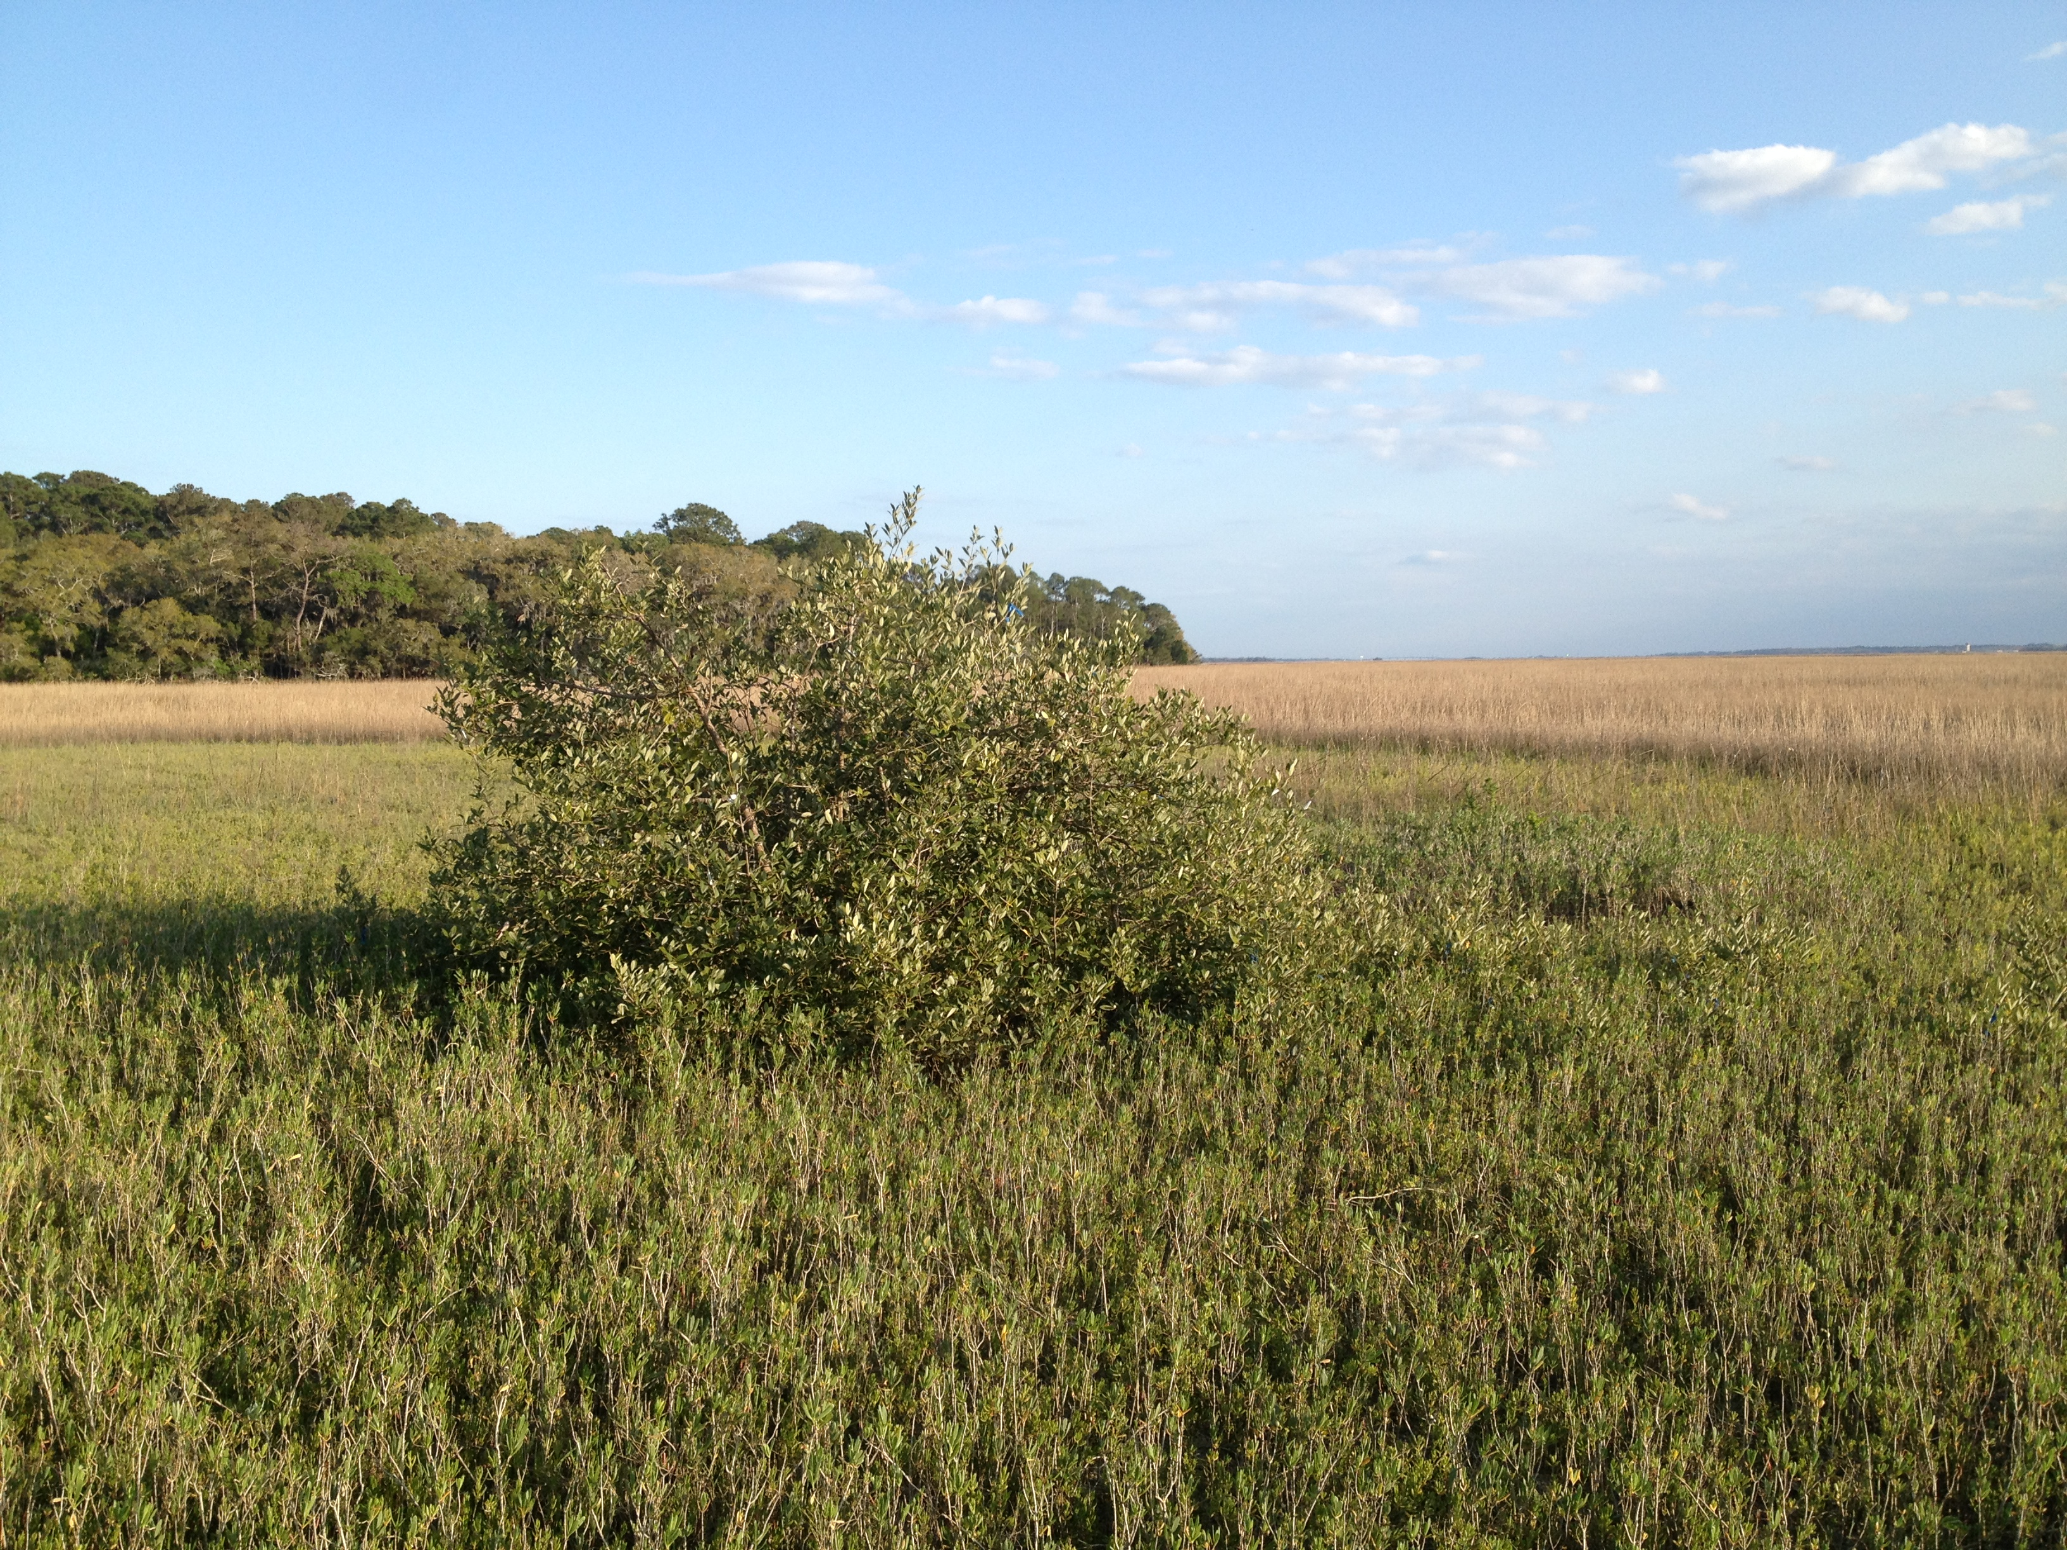


Sensitivity of Coastal Zone Ecosystems to Climate Change
Candy Feller, Kyle Cavanaugh, Jim Kellner, John Parker, Susan Cook-Patton, Rick Osman, Dan Gruner, Wilfrid Rodriguez

Slide 2
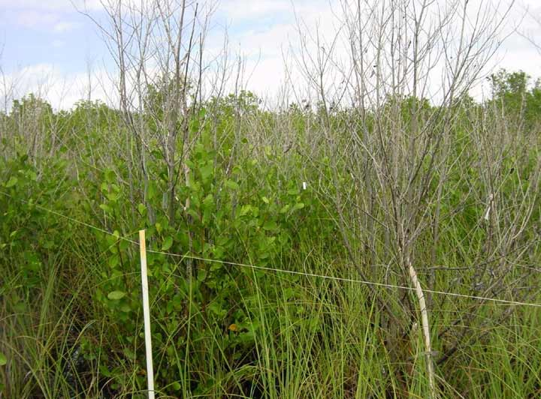
Mangrove die-back from freezing temps

Slide 3
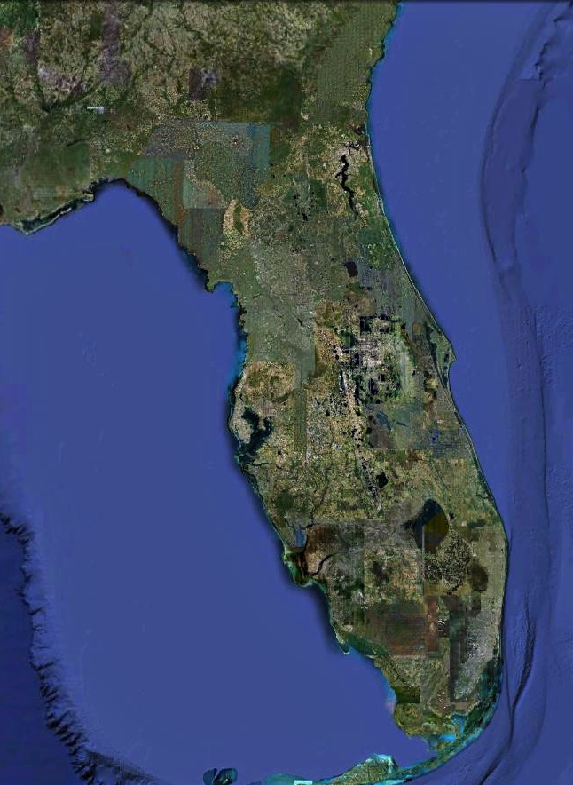
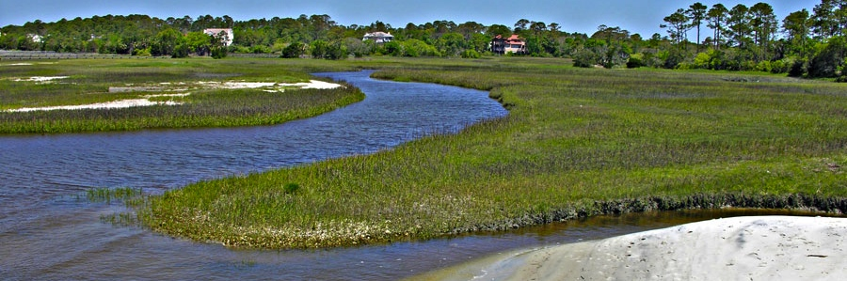
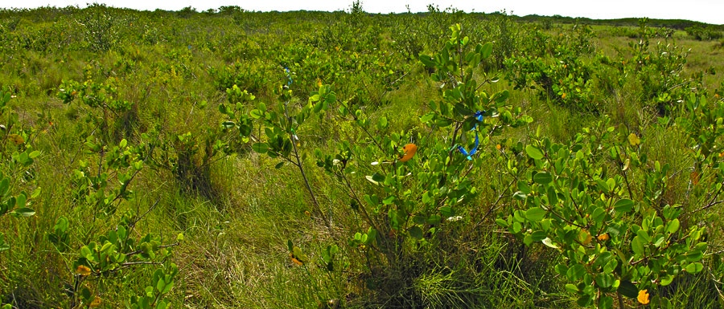
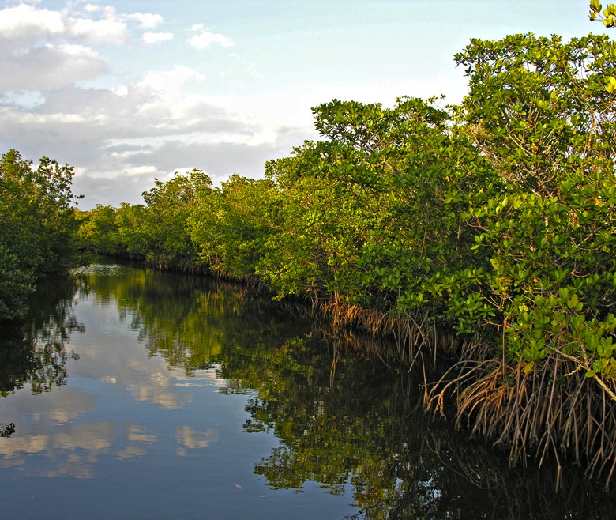
Pure Saltmarsh
St. Augustine
Mangrove-Saltmarsh Ecotone
Cocoa Beach
Pure Mangrove
Notes:
The mangrove x saltmarsh ecotone along the Atlantic coast of Florida currently occurs between St Augustine and Cocoa Beach.
In this ~~2 deg latitude, mangroves and saltmarsh species co-occur.
To the south of Cocoa Beach, mangrove forests dominate. Saltmarsh species still occur in small isolated pockets, but extensive saltmarsh does not occur.
North of the ecotone, coastal wetlands are dominated by saltmarshes.

Slide 4
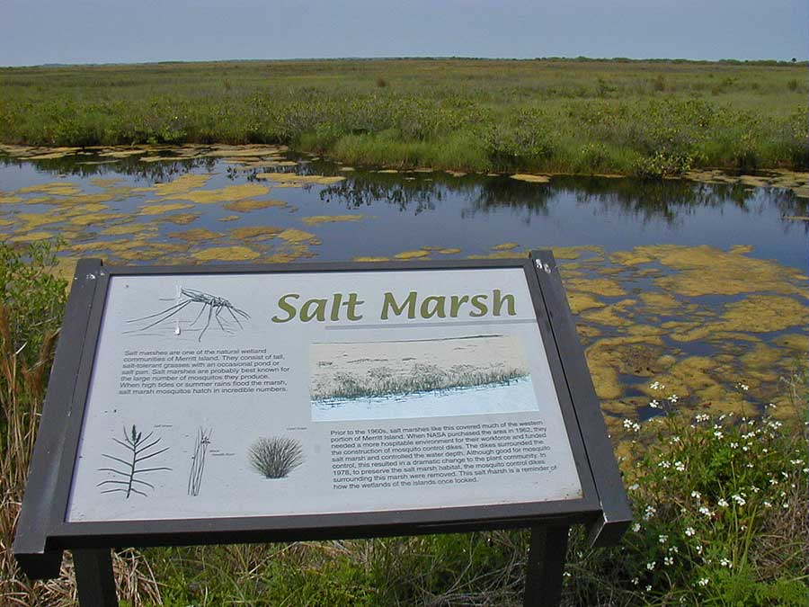
…28°40′ N, Merritt Island National Wildlife Refuge
Notes:
The Merritt Island National Wildlife Refuge is in the current mangrove/salt marsh ecotone.
Here is one of the signs along Black Point Drive through the Refuge. The sign describes this area as a salt marsh and says that the plant species that occur here are salt tolerant grasses.
This system is still a coastal wetland, but it has changed since the sign was put out.
A close look shows that mangroves have invaded since the sign was set up… here mainly Avicennia has become established in this wetland. There is now as much mangrove as there is salt marsh.

Slide 5
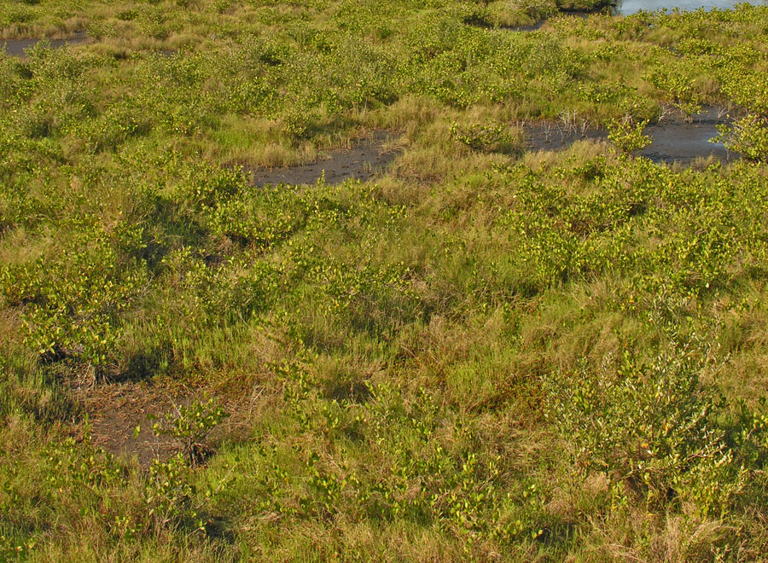
…28°40′ N, Merritt Island National Wildlife Refuge
Notes:
The Merritt Island National Wildlife Refuge is in the current mangrove/salt marsh ecotone.
Here is one of the signs along Black Point Drive through the Refuge. The sign describes this area as a salt marsh and says that the plant species that occur here are salt tolerant grasses.
This system is still a coastal wetland, but it has changed since the sign was put out.
A close look shows that mangroves have invaded since the sign was set up… here mainly Avicennia has become established in this wetland. There is now as much mangrove as there is salt marsh.

Slide 6
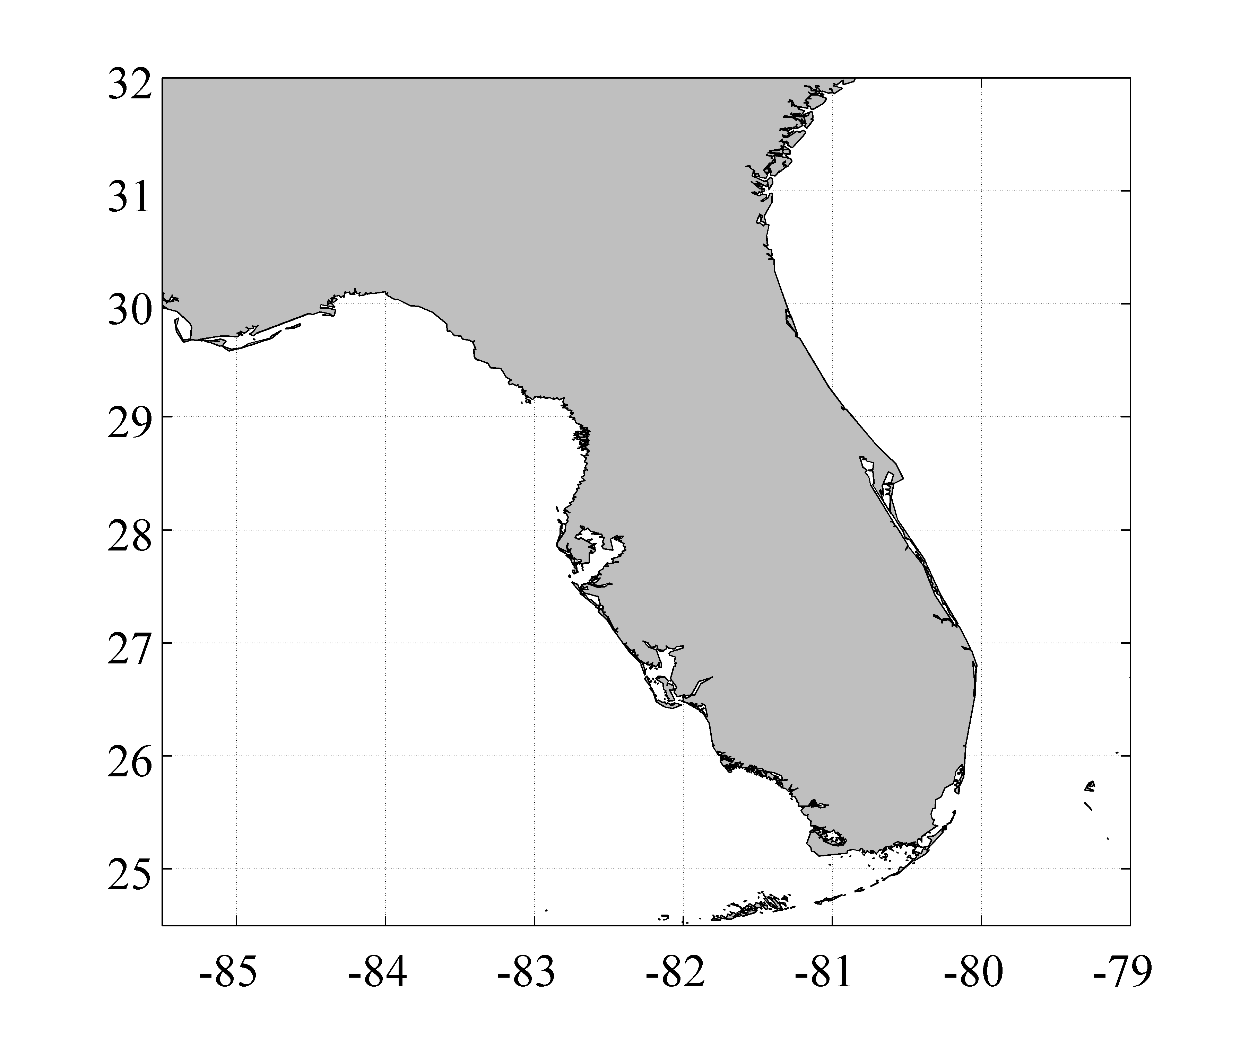
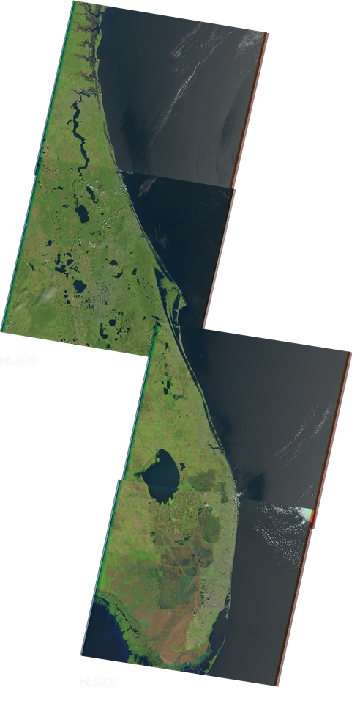
Landsat Imagery
4 Landsat scenes to cover area from Biscayne Bay to Jacksonville
30 m resolution
for each scene: 1 cloud free image per year from 1984-2011
images selected between April-July
Notes:
Combining local obs/experiments with aerial and satellite imagery
Preliminary results from new tool
Spalding etl al.
We aren’t making thematic mangrove cover maps

Slide 7
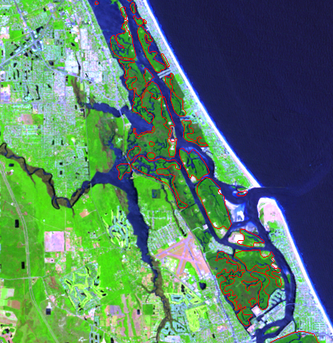
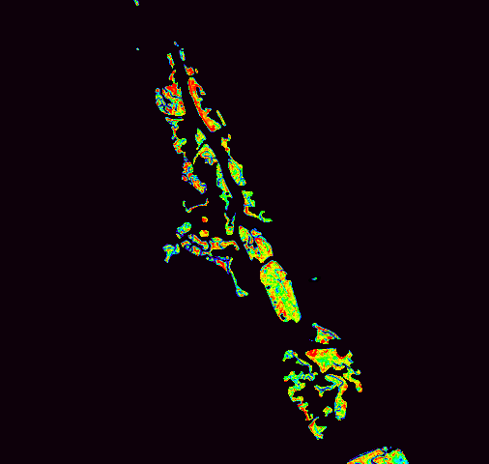

We extracted mangrove areas from published mangrove maps (Spalding et al. 2010) and calculated the fraction of each pixel covered by mangrove
Landsat 5,4,3 image
Mangrove fraction image
Mangrove shapefile
(Spalding et al. 2010)
0.25
0.75
Notes:
-used spectral mixture analysis
-each year from 1985-2011

Slide 8
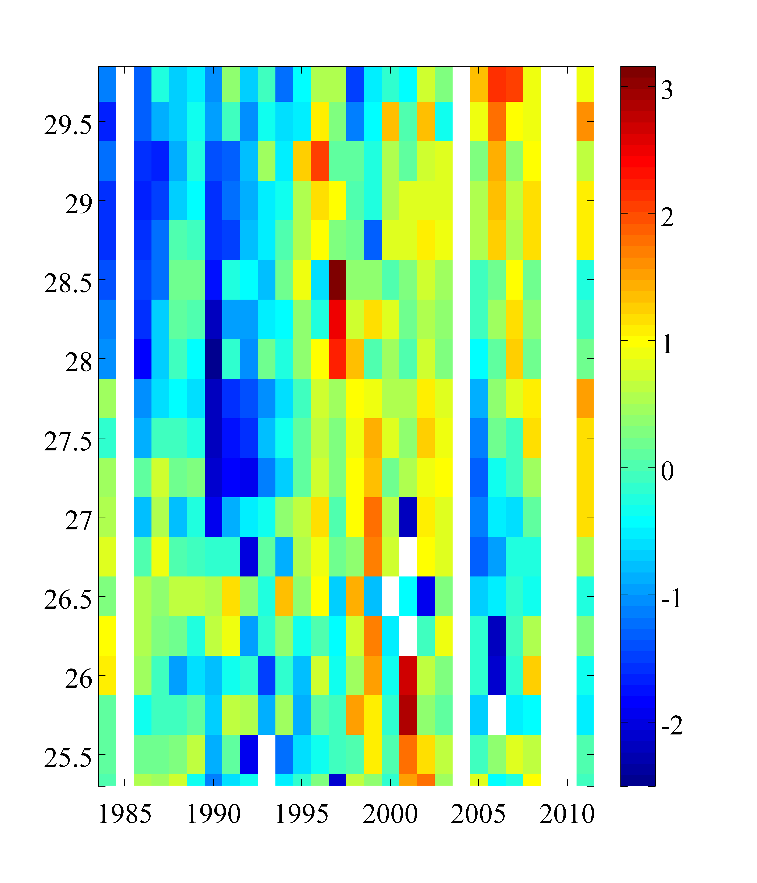
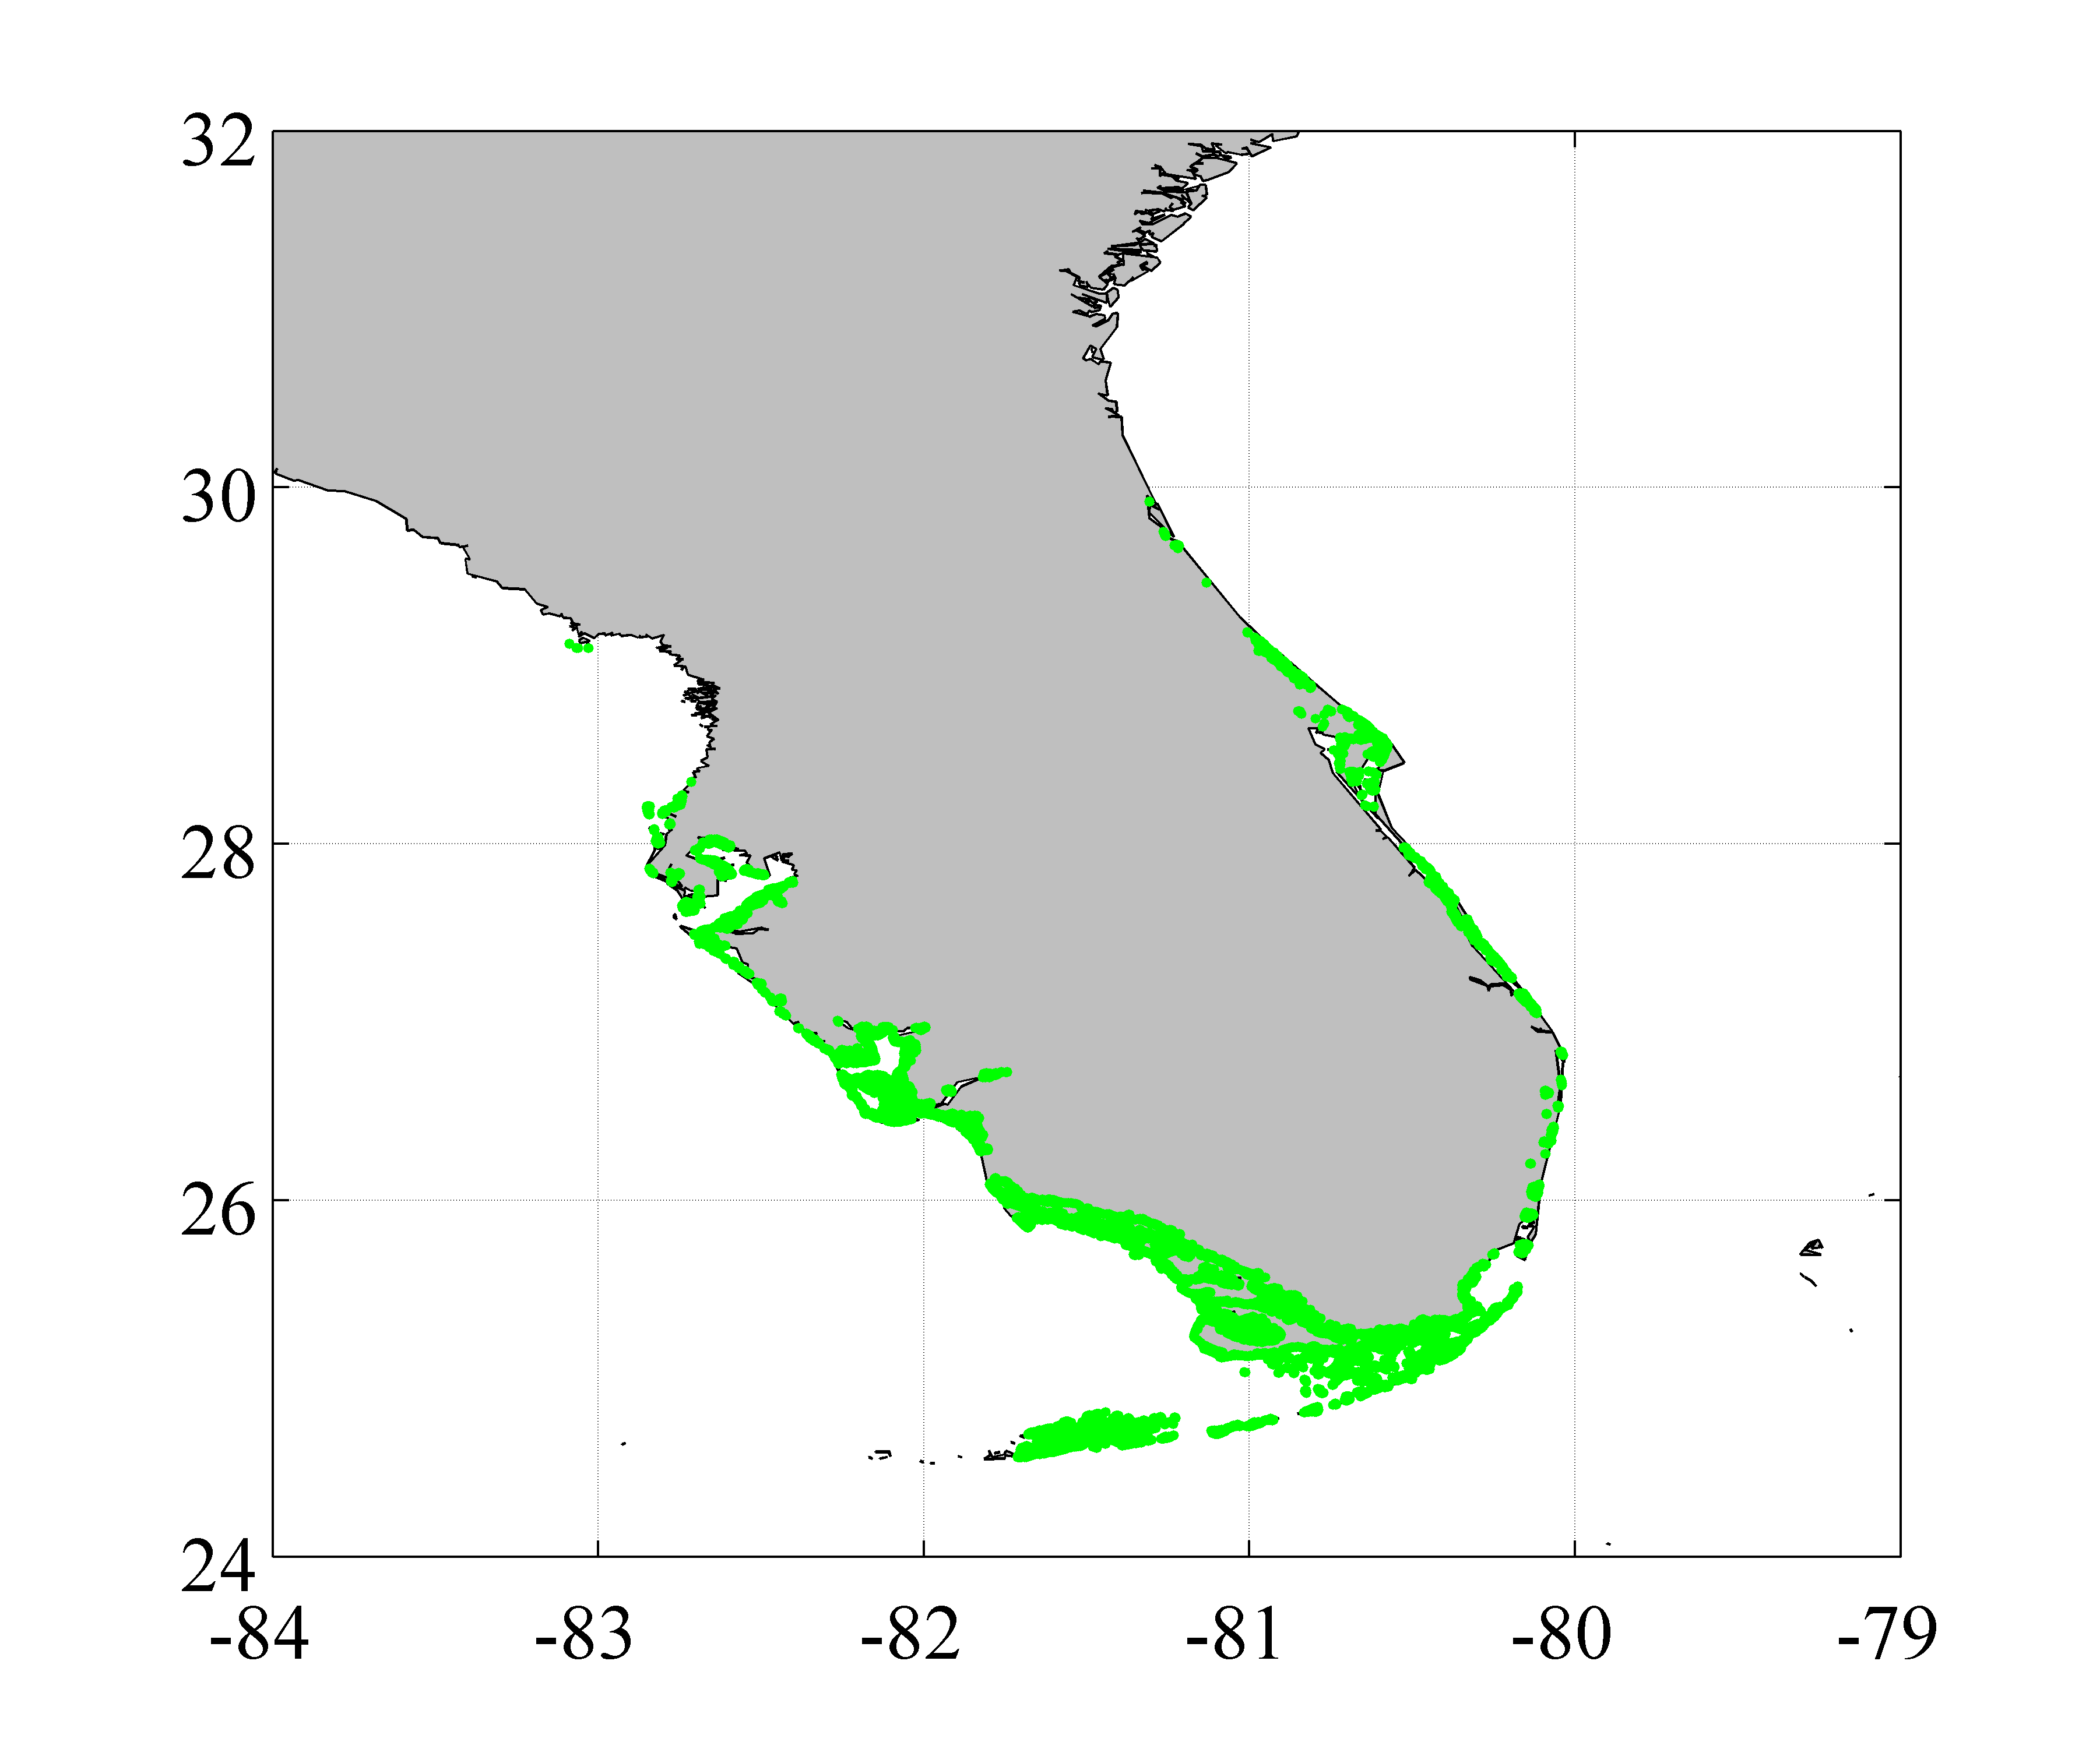
Time series of mangrove cover from 1984-2011 separated into 0.25°latitudinal bins
normalized mangrove area
mangrove
(from Spalding et. al. 2010)
Year
Notes:
-left hand fig: study area
-right hand fig: time series of mangrove cover grouped into 0.25 degree bins. For this figure each latitudinal bin was normalized, so blues represent years with low cover and oranges and reds are years with high cover.

Slide 9
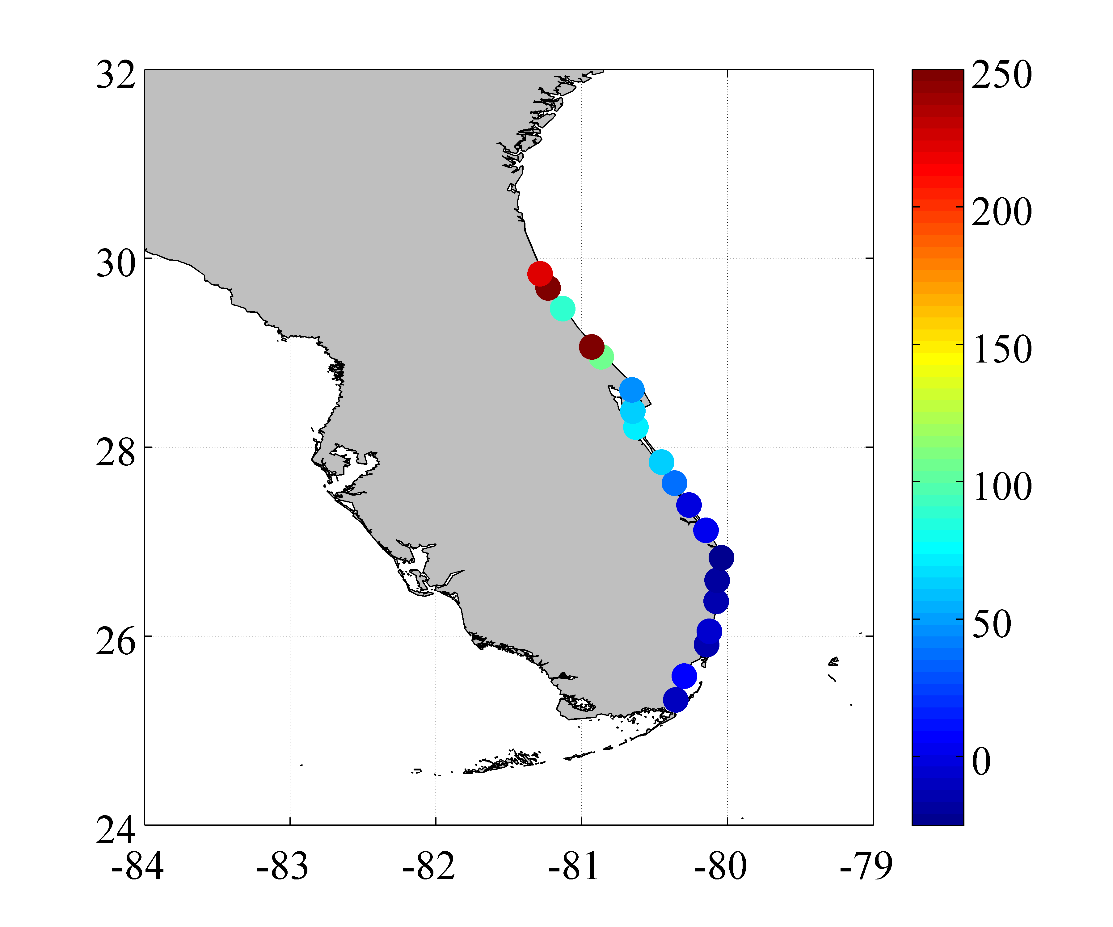
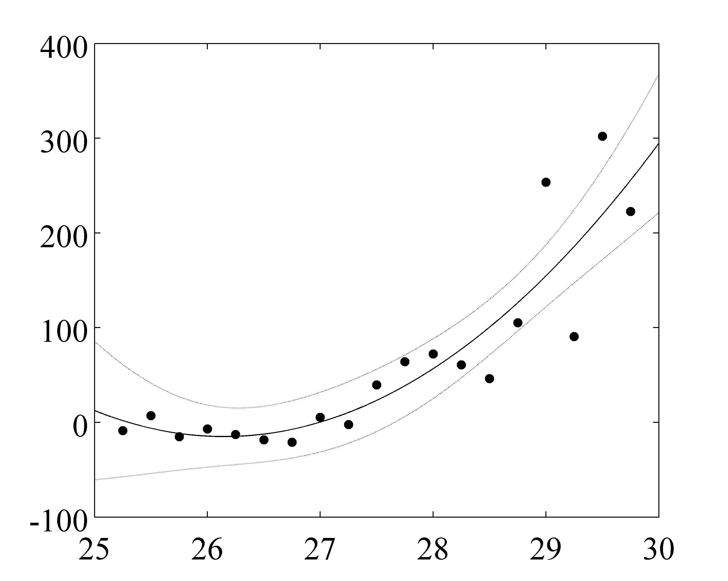
There is a strong relationship between latitude and the magnitude of increase in mangrove cover
r² = 0.78
p < 0.001
Δ mangrove area (%)
1985-2011
Δ mangrove area (%)
1985-2011
Latitude
Notes:
Figures show long-term change in mangrove cover as a function of latitude
- How we calculated long-term change
Left: long-term change displayed as color on a map of Florida. Ecotone shows large increases
Right: figure shows a plot of the strong quadratic relationship between latitude and change in mangrove cover. Again, this increases are really occurring at the northern parts of the range.

Slide 10
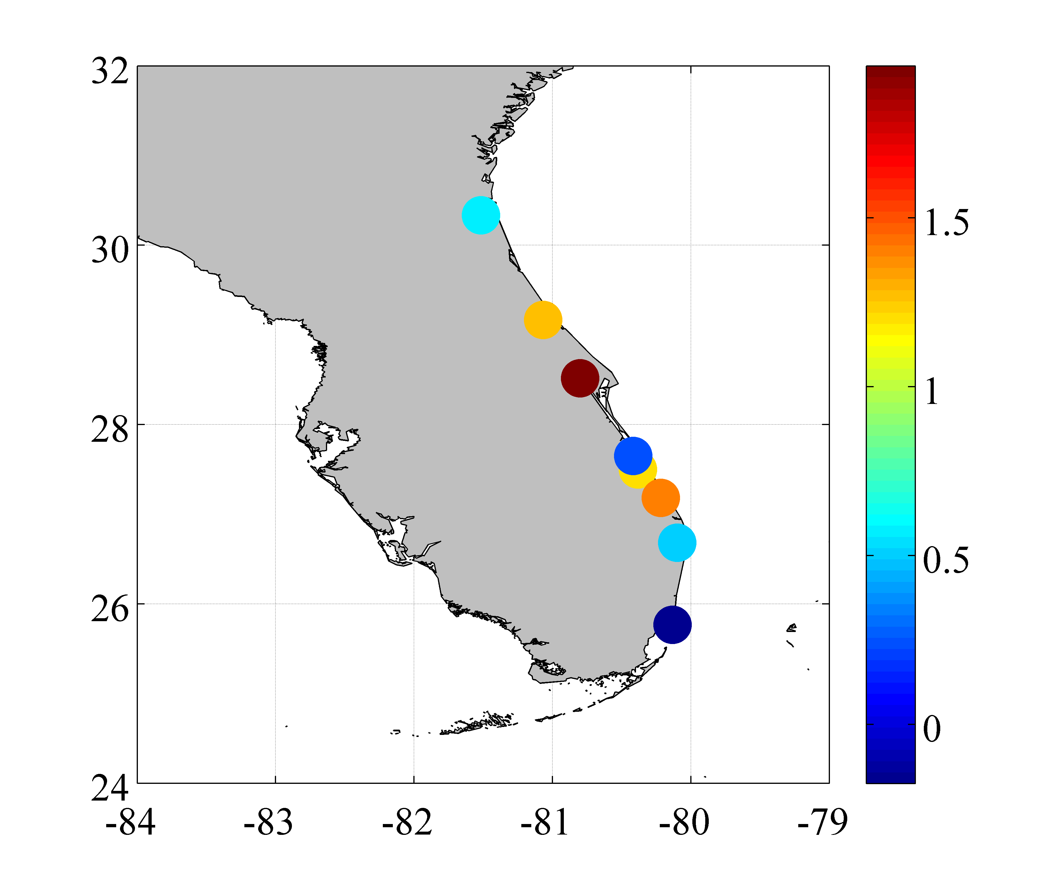
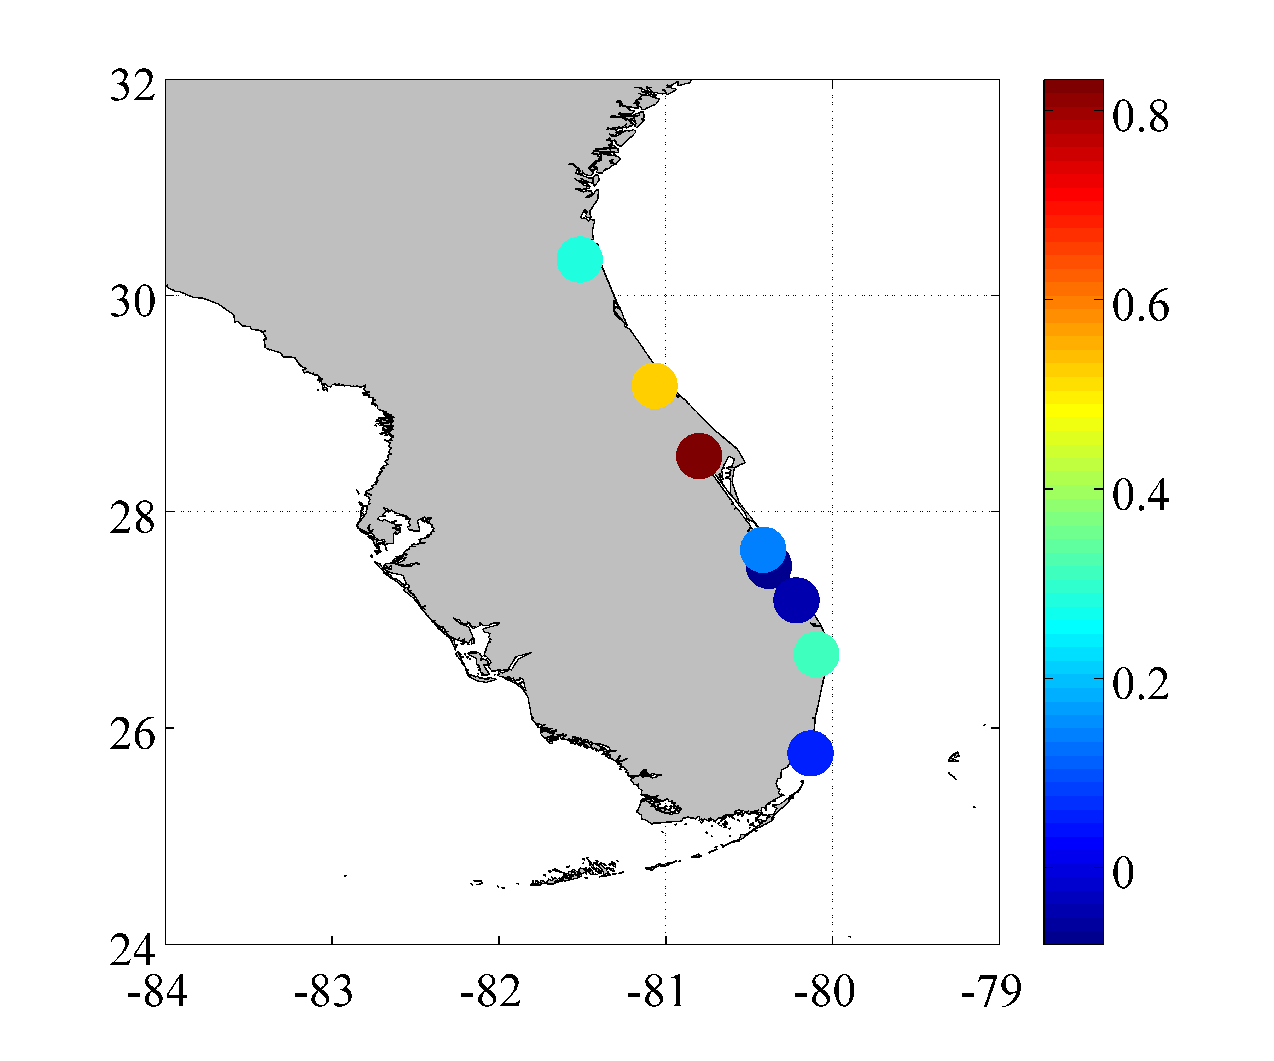
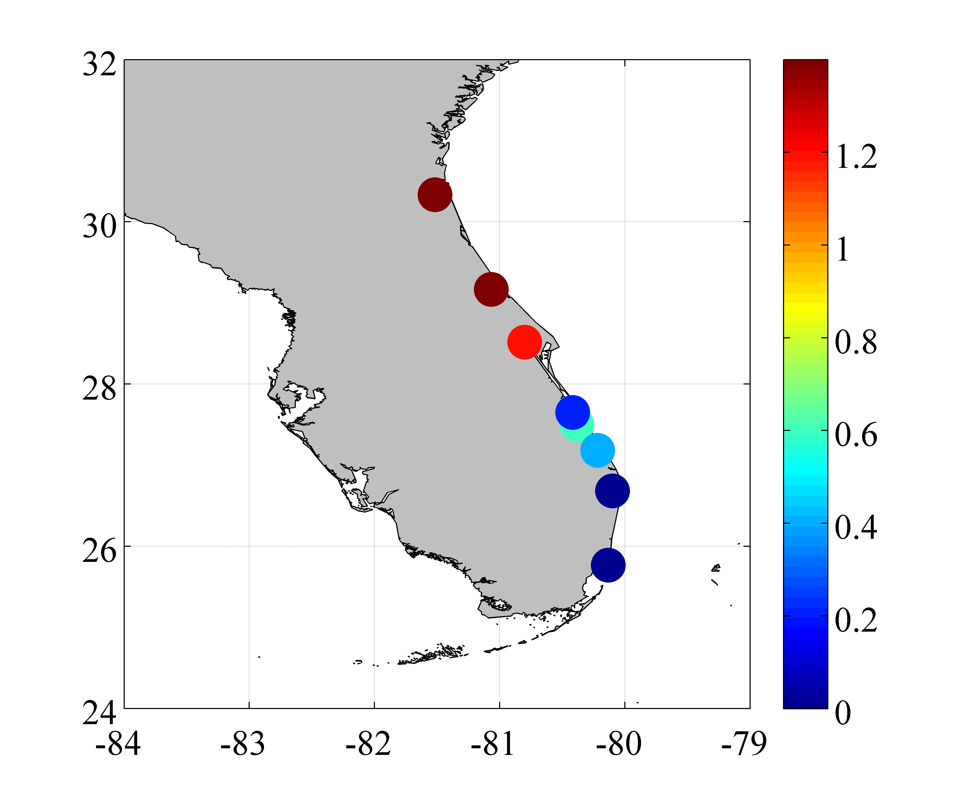
NWS station data provides detailed daily temperature data for 8 sites in our study area
Δ winter mean temp
1985-2011
Δ annual mean temp
1985-2011
°C
°C
reduction in # days below -4 °C
1985-2011
# of days
Notes:
-Wanted to identify drivers of this pole-ward expansion, started with temperature data
-For this preliminary analysis used station data – currently analyzing satellite based gridded climate data
-Top two figures show changes in the mean winter and mean annual temperature. Both increasing
-Bottom figure shows the reduction in the number of days below -4 degrees C. This threshold was chosen because it is thought to represent the frost tolerance of mangroves.
-Southern areas almost never reach this threshold.

Slide 11
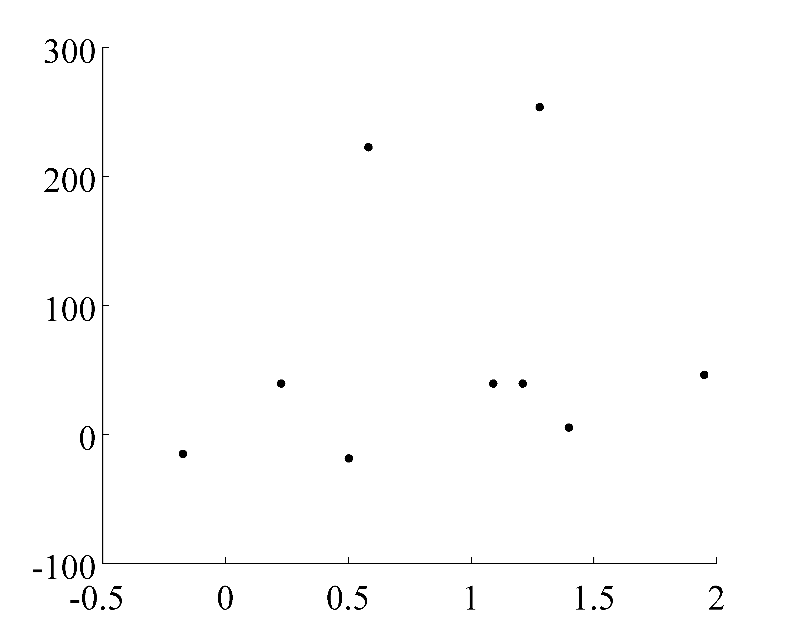
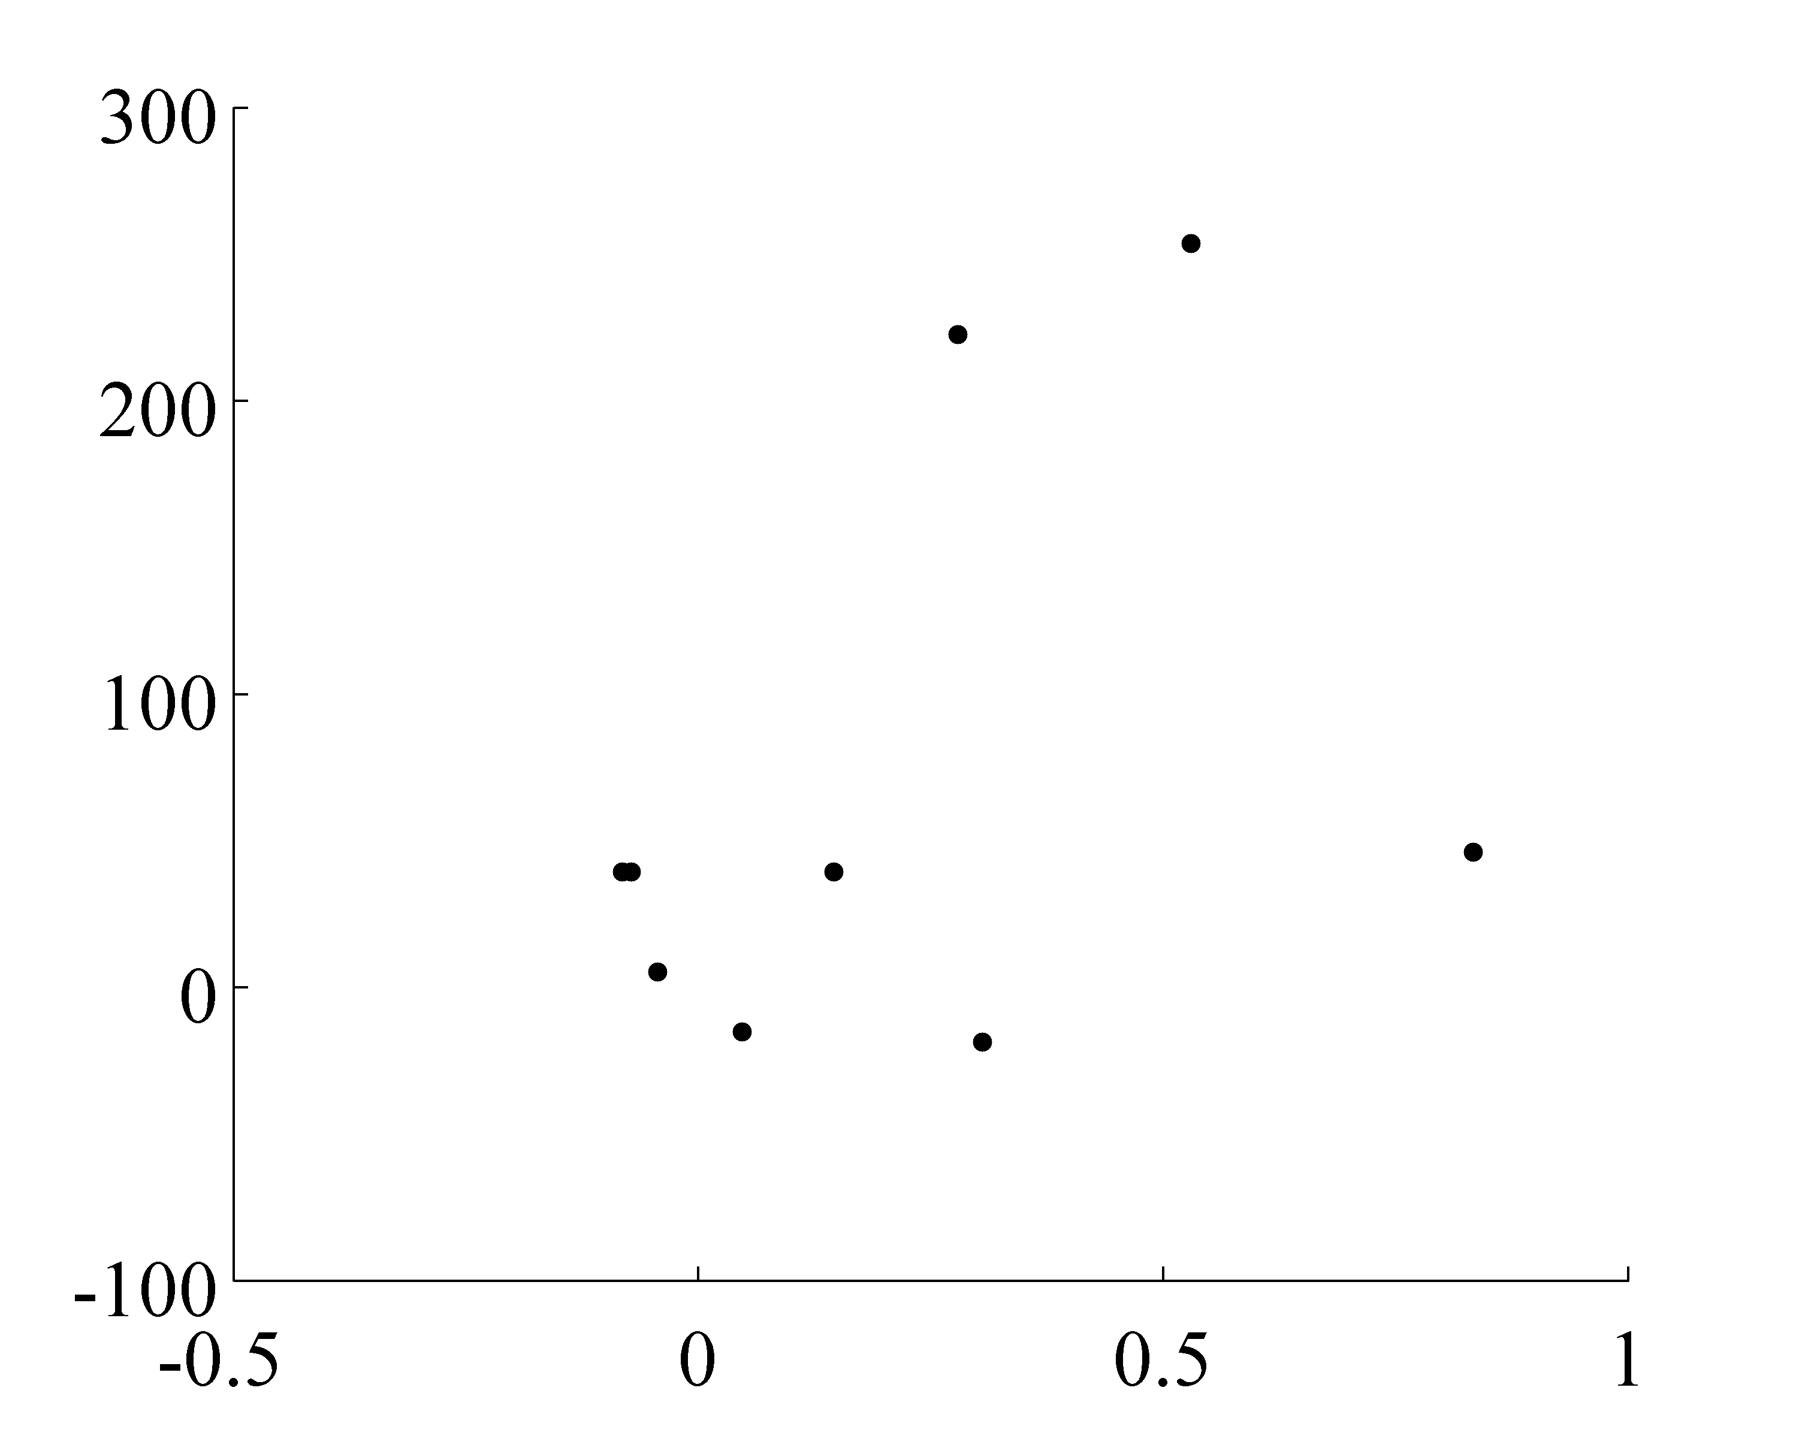
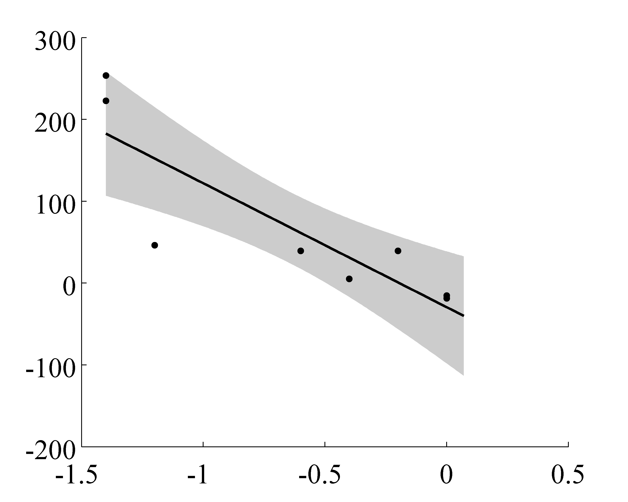
Strong relationship between change in mangrove cover and the change in the # days below -4 °C each year
Δ mangrove area (%)
Δ winter monthly min. temp 1985-2011
Δ annual mean temp
1985-2011
Δ mangrove area (%)
r² = 0.73
p = 0.003
Δ # days below -4 °C
1985-2011
Notes:
-strong relationship between the change in mangrove cover and the reduction in the # of days below freezing
-decrease in number of extreme cold events -> poleward expansion of mangroves in Florida

Slide 12
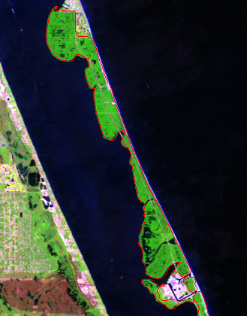
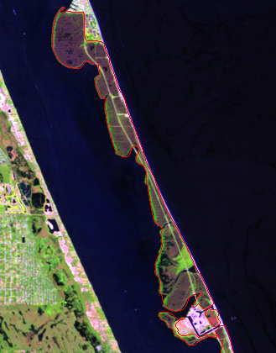
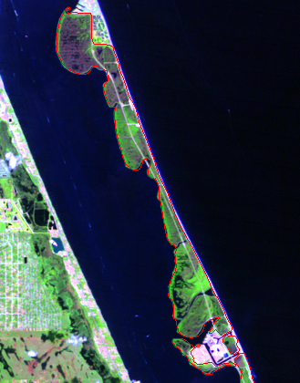
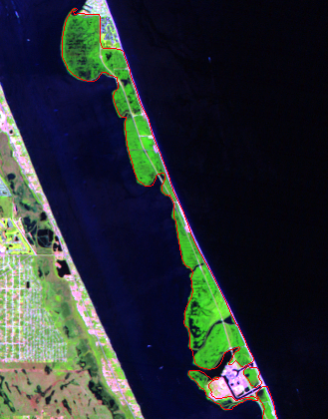
1989 Freeze
normalized mangrove area
1988
1991
1993
1997
Notes:
-examining the impact of extreme cold events more directly both with this dataset and with experimental investigations
-another interesting pattern: large decrease in cover around 1989-1990
-currently looking into how mangroves responded to and recovered from this major disturbance event

Slide 13
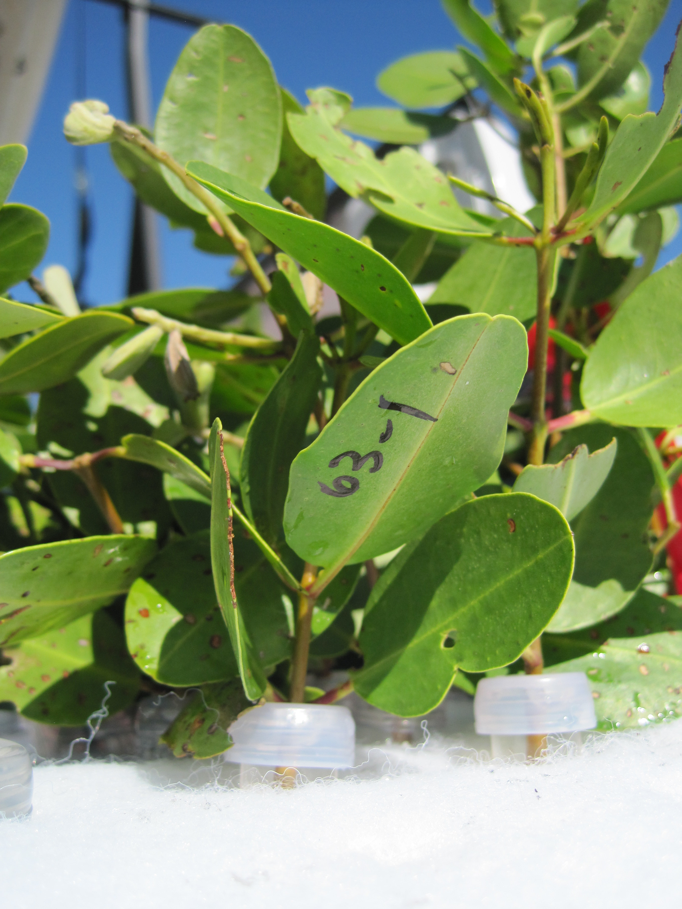
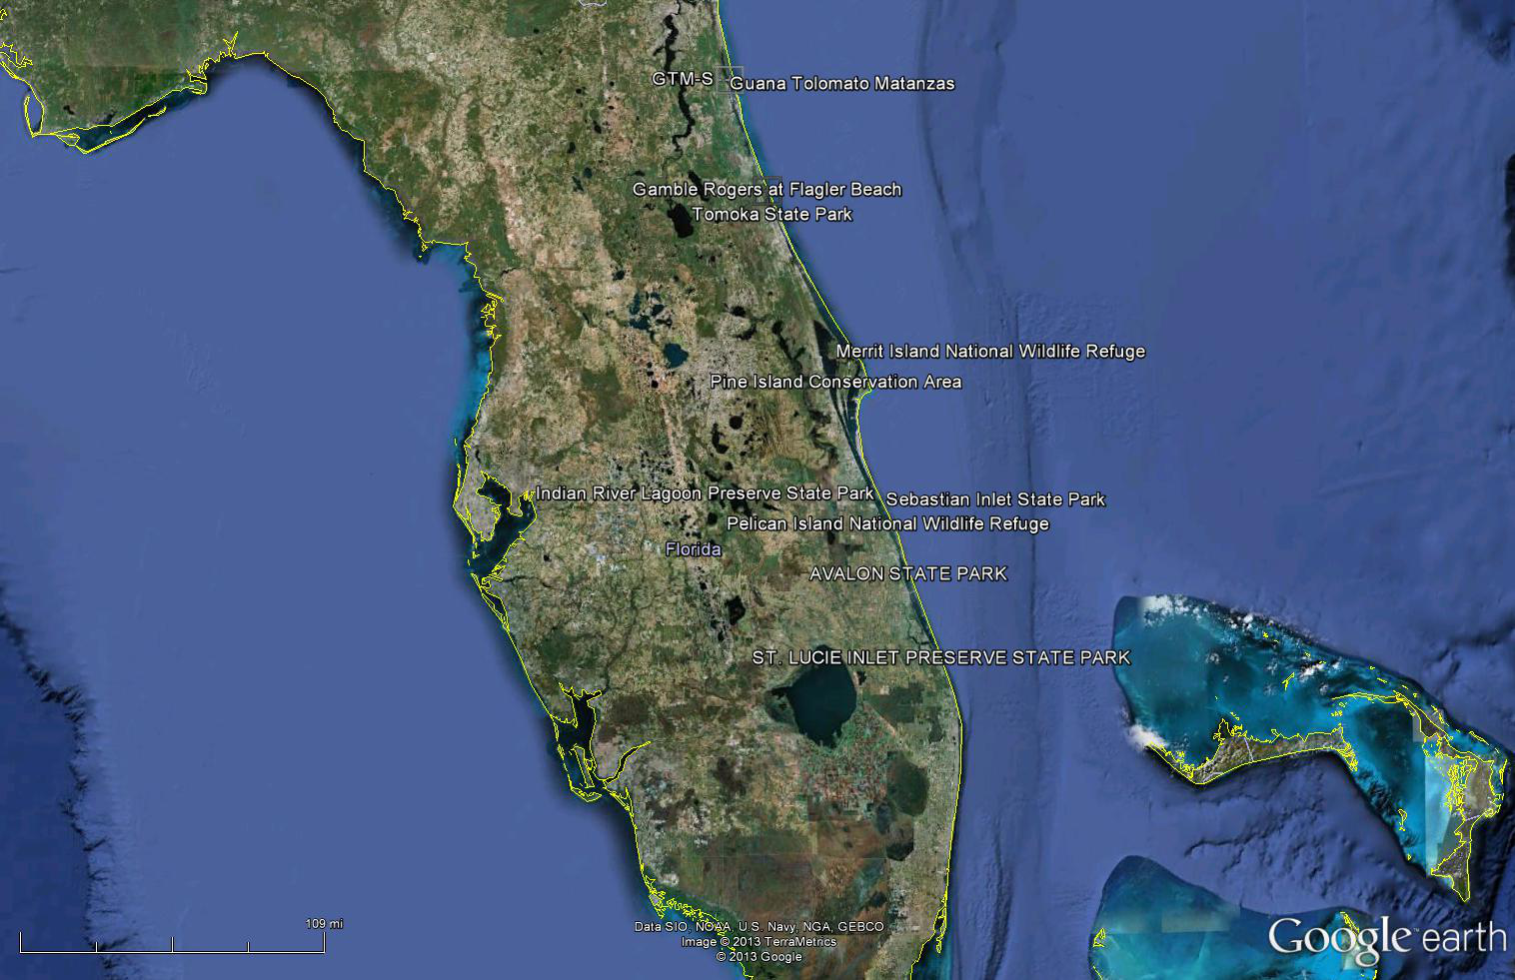
Experimental investigations of frost tolerance
Do mangrove species differ in their frost tolerance?
Are the trees in the north more frost tolerant than the trees in the south?
Is frost tolerance passed to offspring?
Notes:
-last summer started experimental investigations of frost tolerance
-3 mangrove species in FL
-We collected samples from adult trees of each species spanning a 200km gradient of the Florida's eastern shore
-collected paired branches that were fully exposed to sunlight and separated the branches into the control and the freeze treatment
-These were returned to the lab where we measured initial leaf fluorescence.

Slide 14
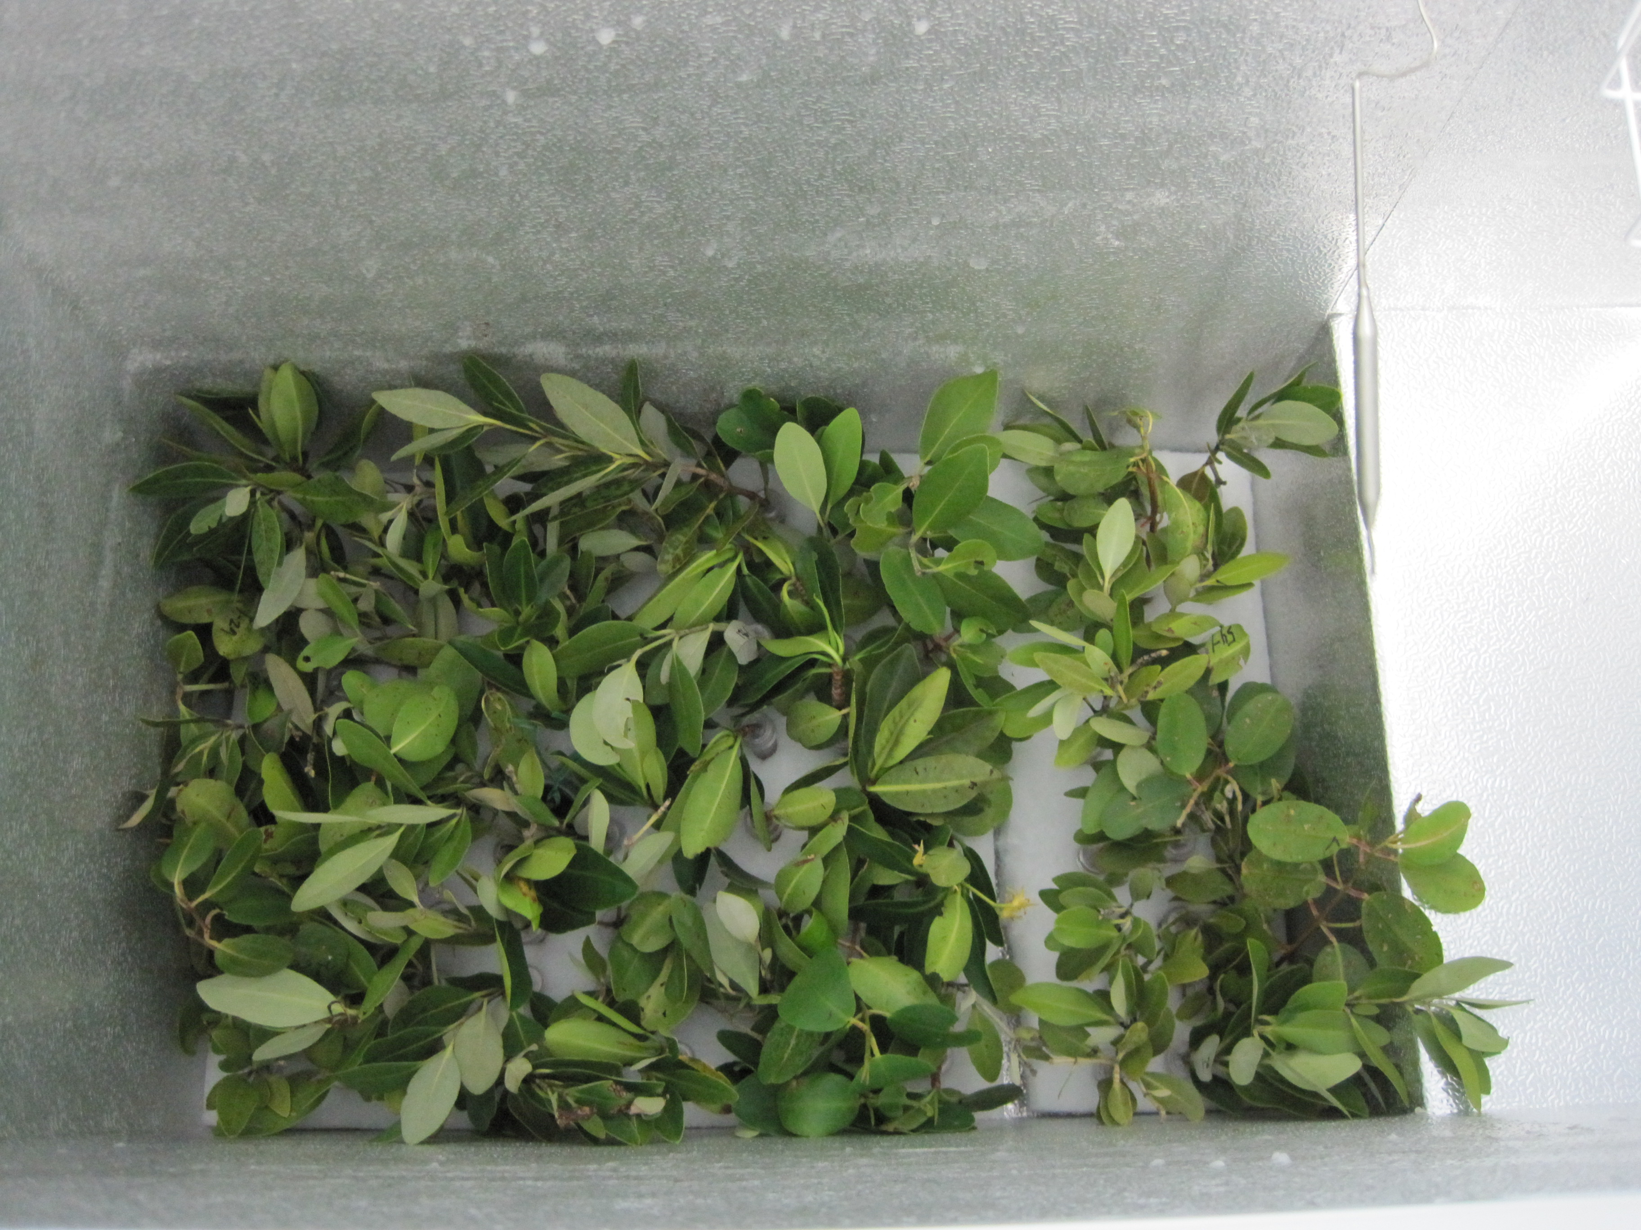
Frost treatment: 4 hrs @ 28F
-Northern part of range: 5 frosts/year
-Miami: frosts are rare
Notes:
-control branches sat on counter, freeze branches placed in freezer for 4 hours at 28 F

Slide 15

Notes:
-removed the freeze branches and then remeasured leaf fluorescence. The change in fluorescence assesses leaf damage.
-This is the mini-PAM just as the leaf is being hit with light.

Slide 16
Black mangroves are more frost tolerant, but trees in the north do not appear to be any more or less tolerant
Less cold tolerant ,← → More cold tolerant
Notes:
-We do see significant variability among species
-pattern matches the pattern of latitudinal distribution among the three species
-However we did not find a latitudinal pattern in frost tolerance. Within species, mangroves from the north did not appear to be more adapted to frost.

Slide 17
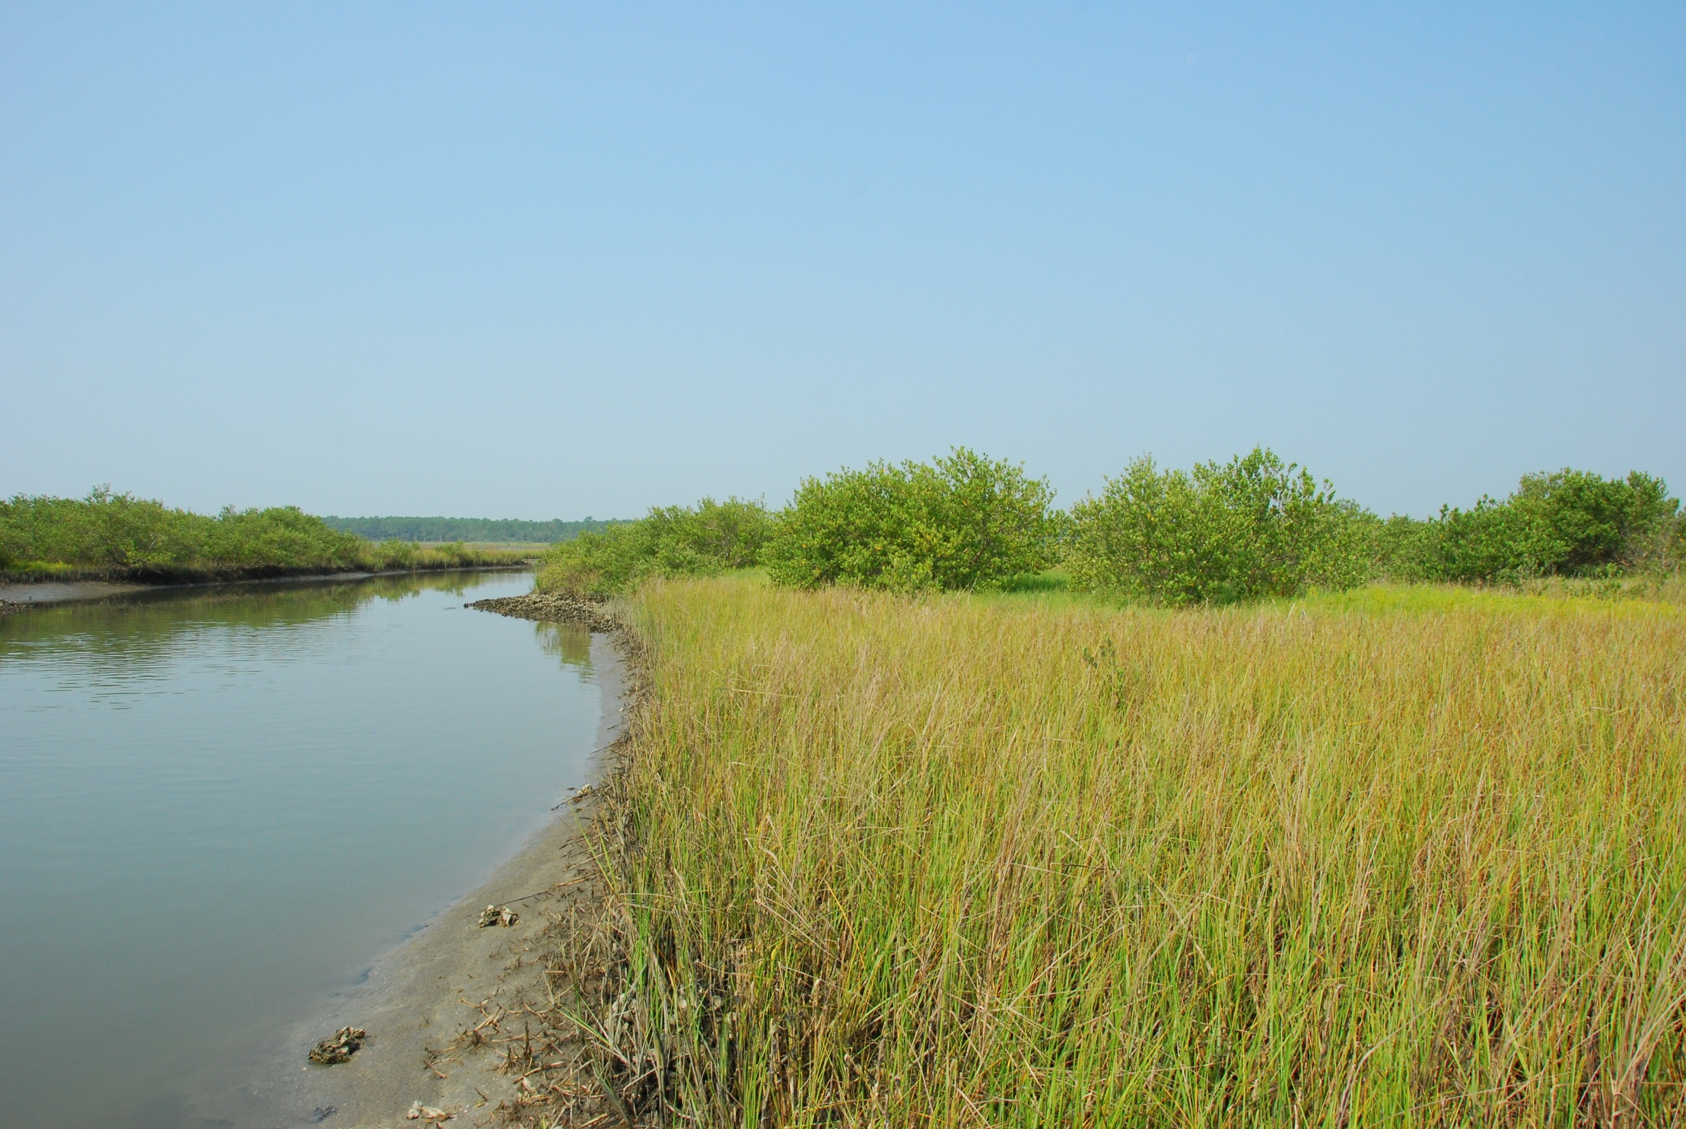
FUTURE PLANS
-frost tolerance mechanisms (e.g. osmolyte concentrations)
-freeze tolerance in Belize/Panama as ‘out group’?
-positive feedbacks of thermal windows (hobo monitoring/reciprocal transplants, GTM)
WARMER?
COLDER?
Notes:
-identify functional traits that may confer frost tolerance
-mangroves may trap long-wave radiation -> micro-climate effects -> higher minimum temps overnight -> aid poleward spread

Slide 18
Modeling response of mangroves to climate change on landscape scales
Climate
(air temp, SST, sea level, etc.)
Land-use
Mangrove species composition
Escape from natural enemies
tipping points??
∆ in mangrove cover
∆ in ecosystem processes
Notes:
-We are currently working on integrating our satellite data with these experimental results in order to model the response of mangroves to climate change
-temporal resolution valuable
-limitation of many species distribution models is they are parameterized with static data. Don’t capture the dynamics of the range shifts.

Slide 19
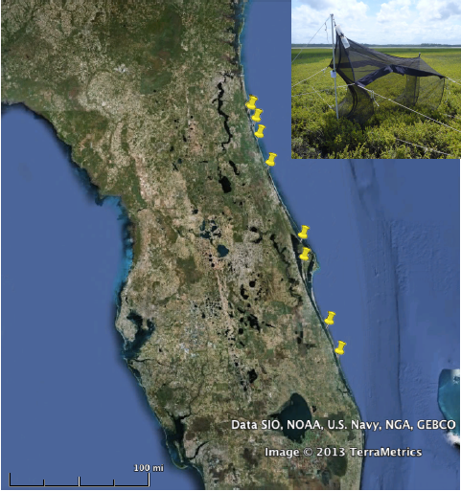
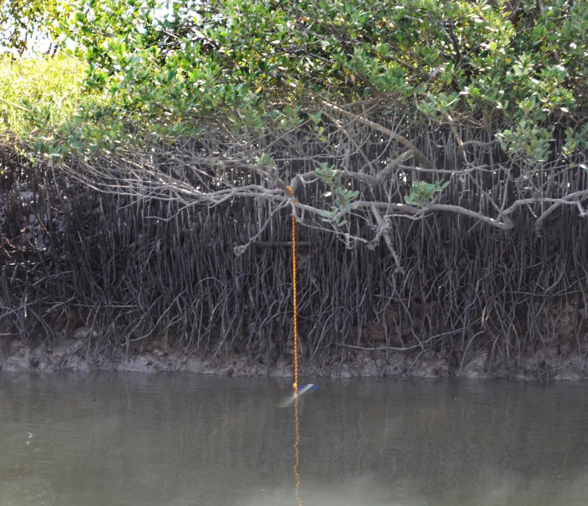
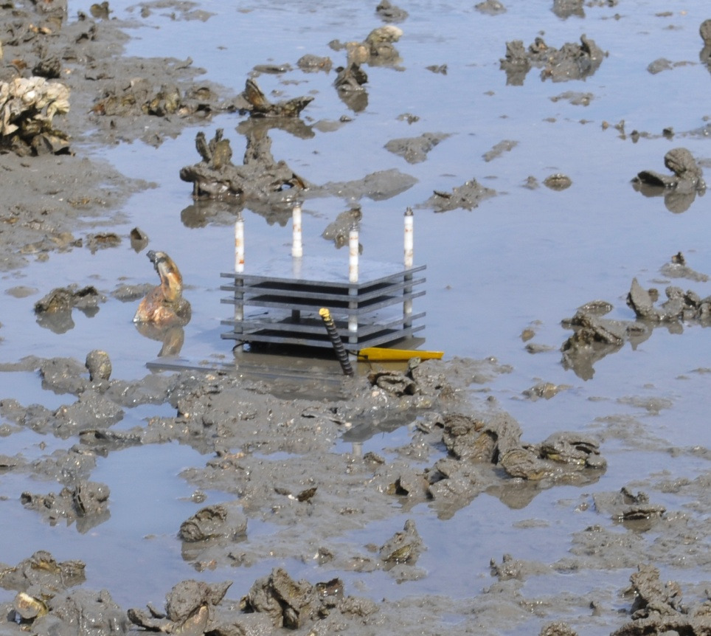
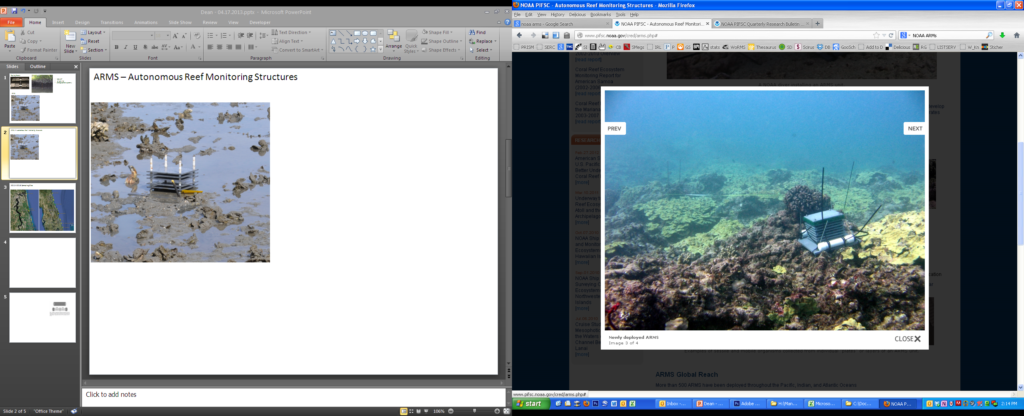
How do ecosystem processes and community structure vary between salt marshes and mangrove forests?
Sampling of food web structure in terrestrial and marine communities
Field sampling of structural complexity
C & N flows from stable isotope analysis
Observations of decomposition rates
Nutrient sampling of soils, sediments, and seawater
Notes:
-how this transition changes community structure and ecosystem functions such as nutrient cycling, decomposition, C storage, etc.
-last summer we started conducting a large amount of field sampling in sites that range from pure mangrove to pure salt-marsh.
-We are sampling community structure in both marine and terrestrial food webs, C & N flows using stable isotope analysis, nutrient concentrations, and decomposition rates.

Slide 20
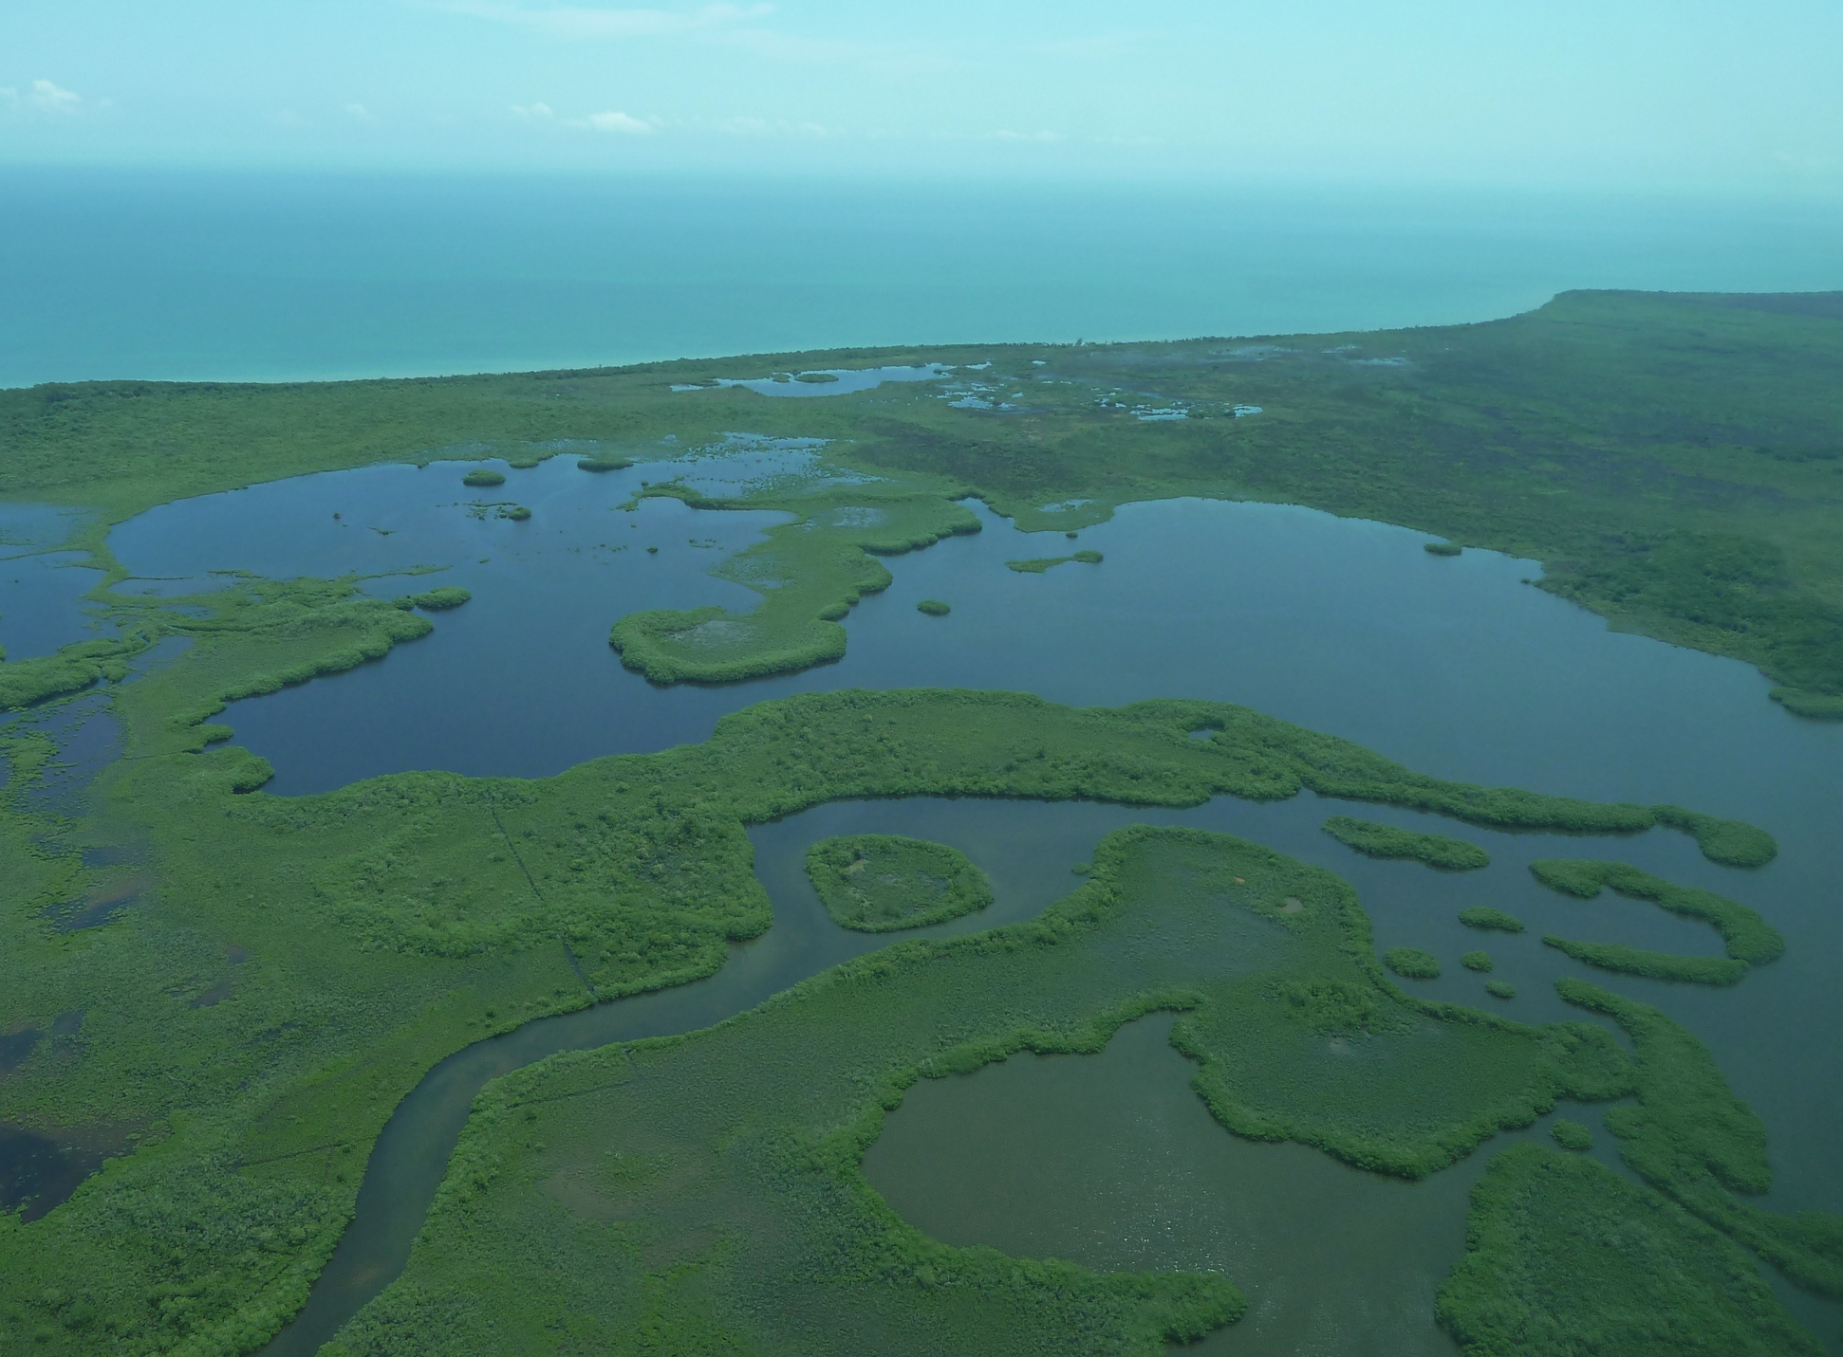
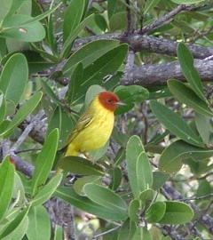
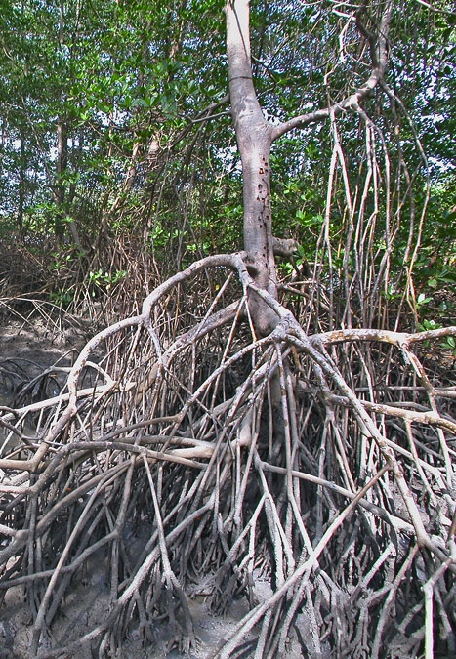

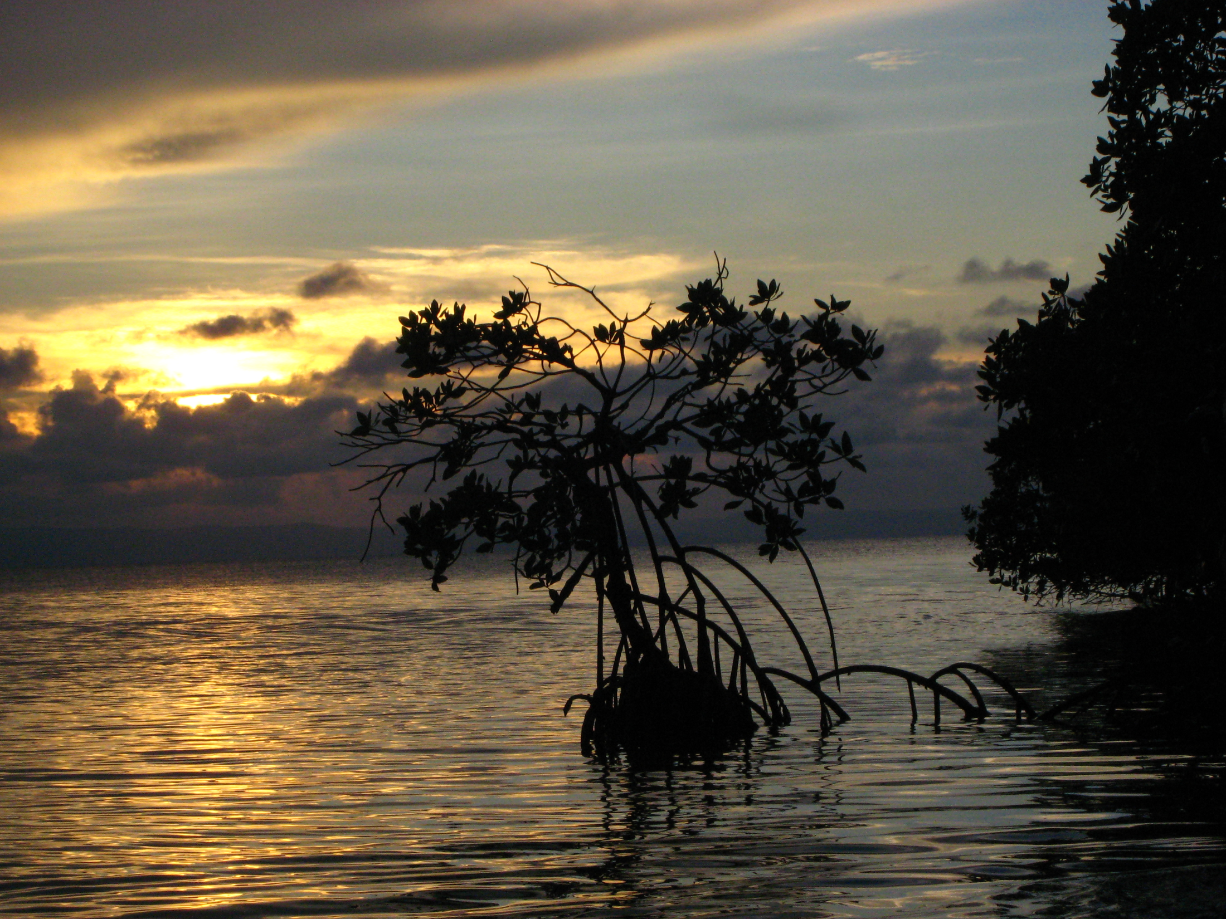
Thank you!
Acknowledgements
NASA Biodiversity and Ecosystem Forecasting Program
NASA DEVELOP Program
UMD and Smithsonian field scientists
Guana Tolomato Matanzas National Estuarine Research Reserve
Thank you

