Slide 1
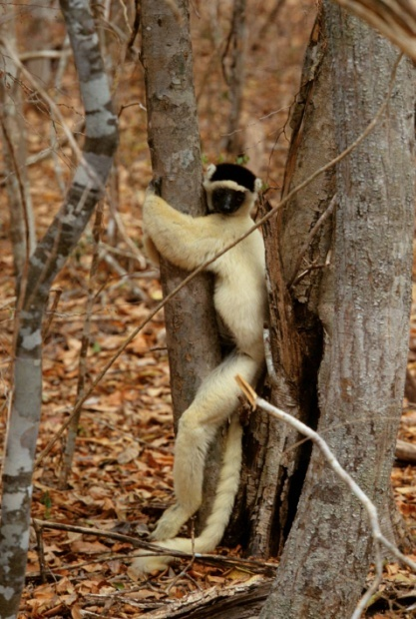

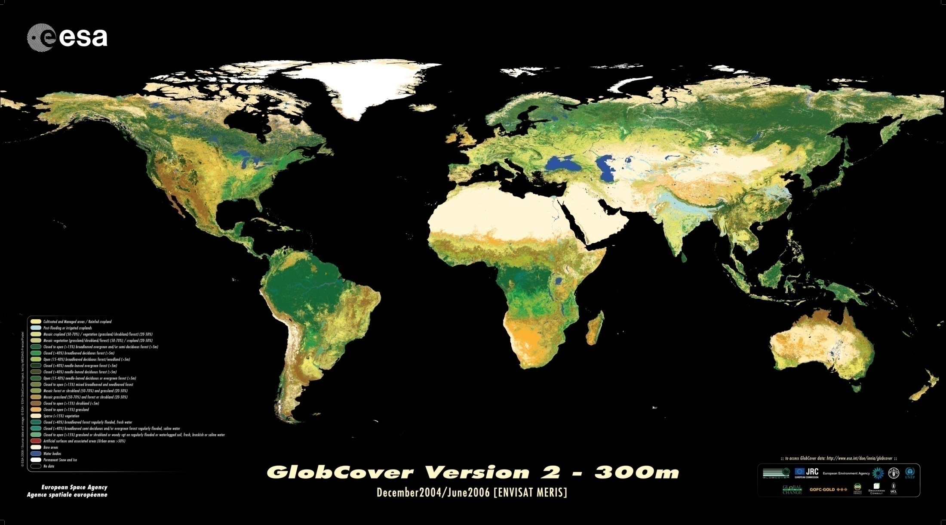
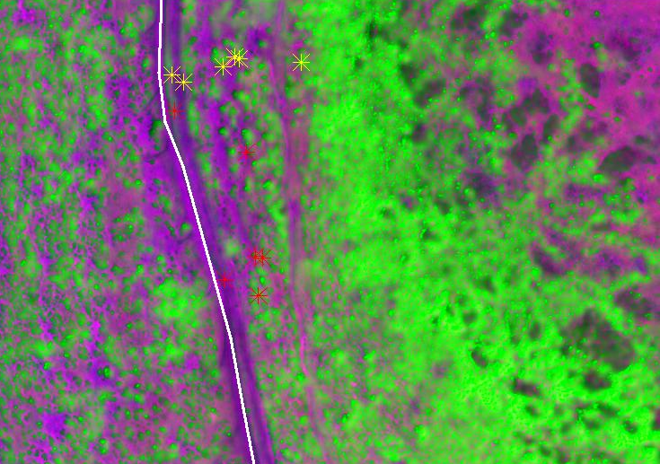

Integrating global species distributions, remote sensing and climate data to model change in species distributions

Slide 2





Integrating global species distributions, remote sensing and climate data to model change in species distributions
PIs:
Walter Jetz (Yale U), Rob Guralnick (CU Boulder, Brian McGill (U Maine), Rama Nemani (NASA Ames), Forrest Melton (NASA Ames)
Postdocs,
Students:
Dr. Mao-Ning Tuanmu (Yale U, NASA-funded), Dr. Adam Wilson (Yale U, YCEI-funded), Dr. Benoit Parmentier (NCEAS, iPlant-funded), Natalie Robinson (CU Boulder, NASA-funded), George Cooper (U Maine, NASA-funded)
Dr. Jim Regetz (NCEAS), Dr. Mark Schildhauer (NCEAS), Martha Narro (iPlant), Dave Thau (Google), Jeremy Malczyk (Yale U)
Others:
YCEI

Slide 3
Predictions
Quality Control
Map of Life
Hierarchical Bayesian models
Global 1km environmental layers
Global spatial biodiversity data
Models
Inference
Environment
Topography: 90m global DEM
Land cover type: Consensus
Habitat Heterogeneity
Net primary productivity
Change in:
Species niches
Species distributions
Climate
Temperature: in progress
Cloud cover: close!
Precipitation: in progress
Bioclimatic variables
Extreme events
1972-92 vs.
1992-12

Slide 4
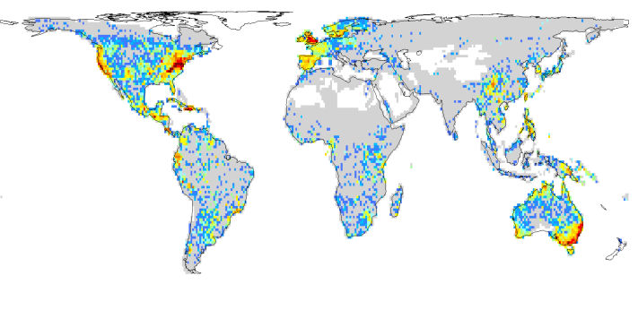
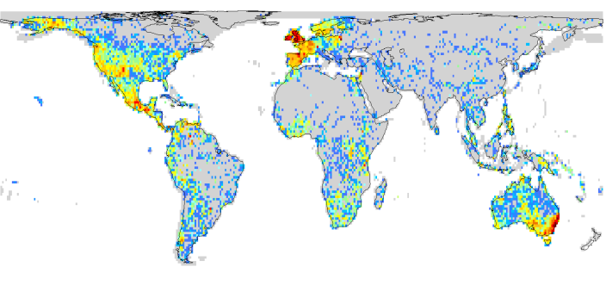
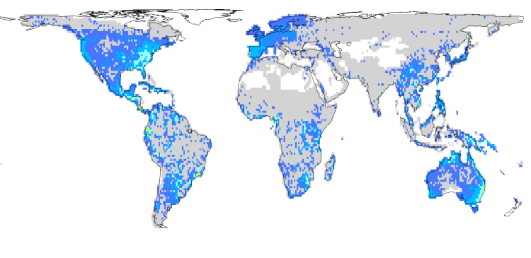
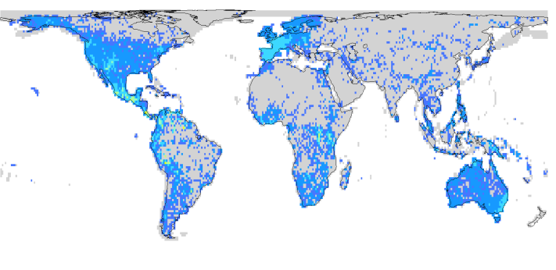
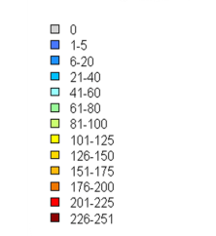
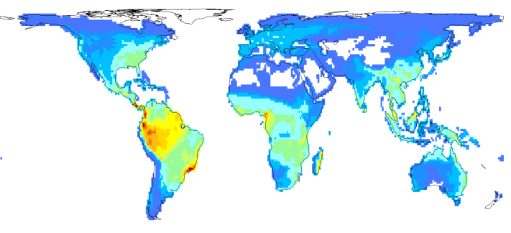
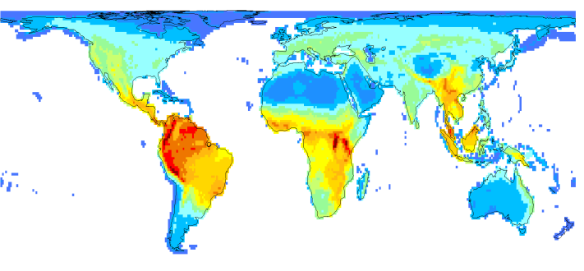
Amphibians
Mammals
GBIF record count
GBIF species richness
Expert species richness
Meyer, Guralnick, Kreft & Jetz in prep.

Slide 5
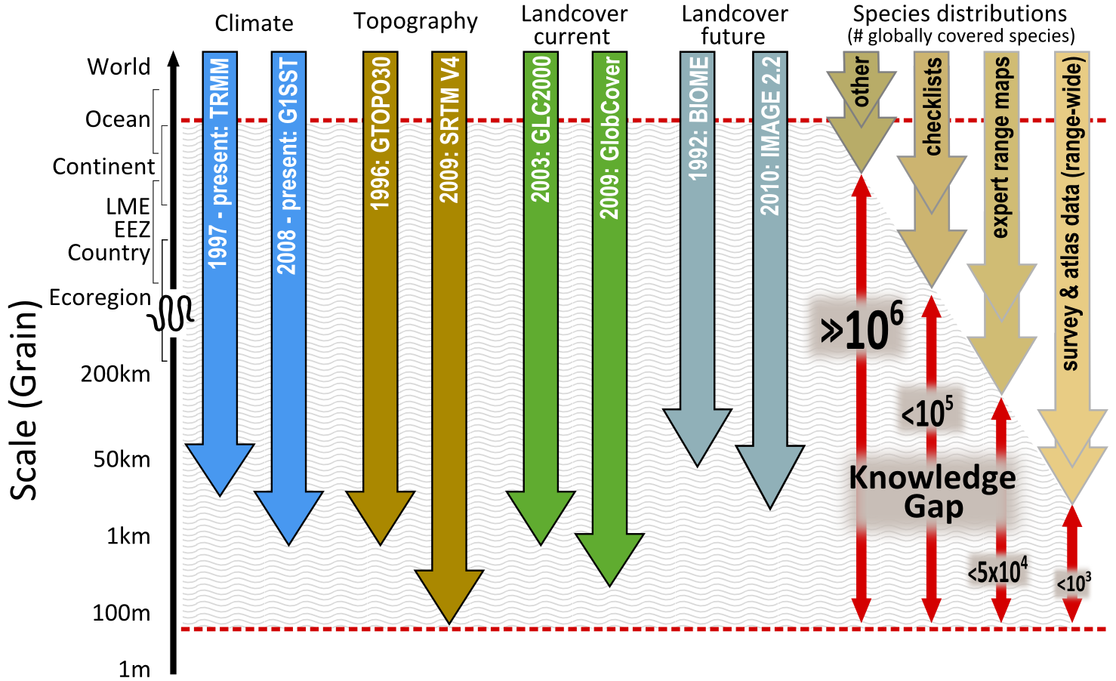
Spatial biodiversity data
Hurlbert and Jetz (PNAS 2007)
Jetz et al. (Conservation Biology 2008)

Slide 6
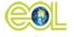
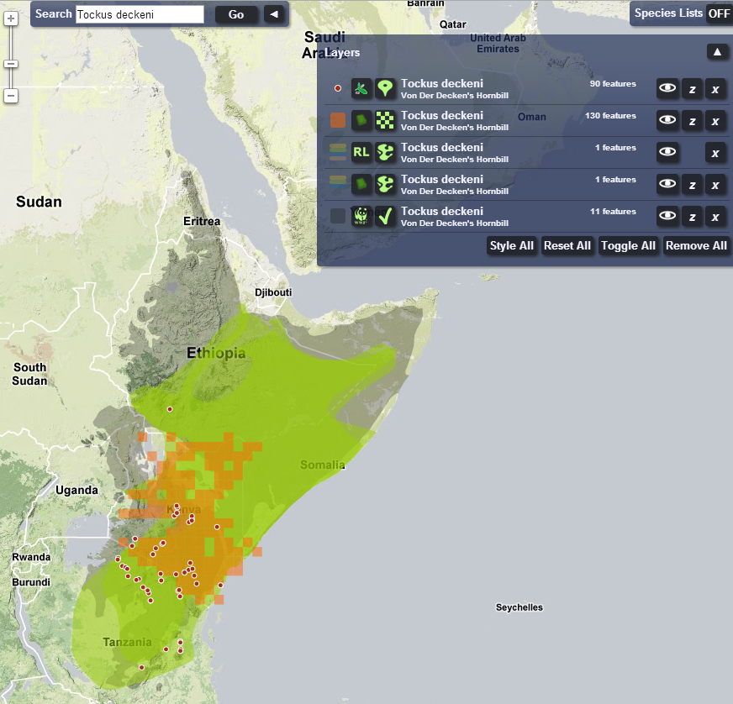



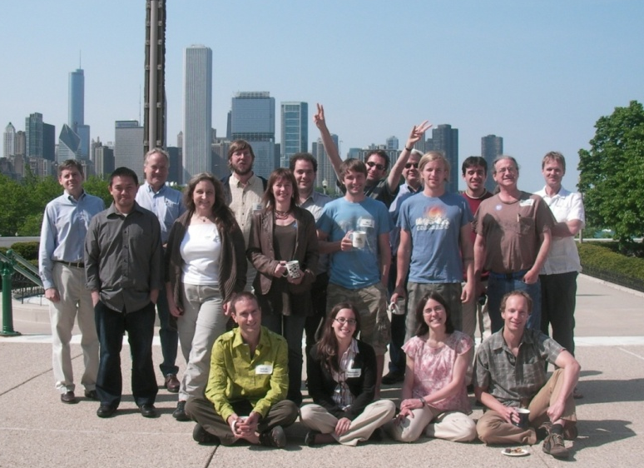
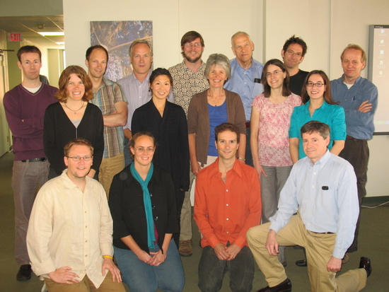


Map of Life - An infrastructure for integrating and analyzing global species distribution knowledge
mappinglife.org
Jetz et al. 2012, TREE
Notes:
The “Wallacean shortfall”, i.e. the geographic bias and coarseness of our species distribution knowledge is a (the?) major impediment for biodiversity science and our understanding of global change impacts on biodiversity
Narrowing the knowledge gap:
Data mobilization (Museums, NGOs, GBIF)
Focused sampling
Model-based data integration
‘Crowd-sourcing

Slide 7
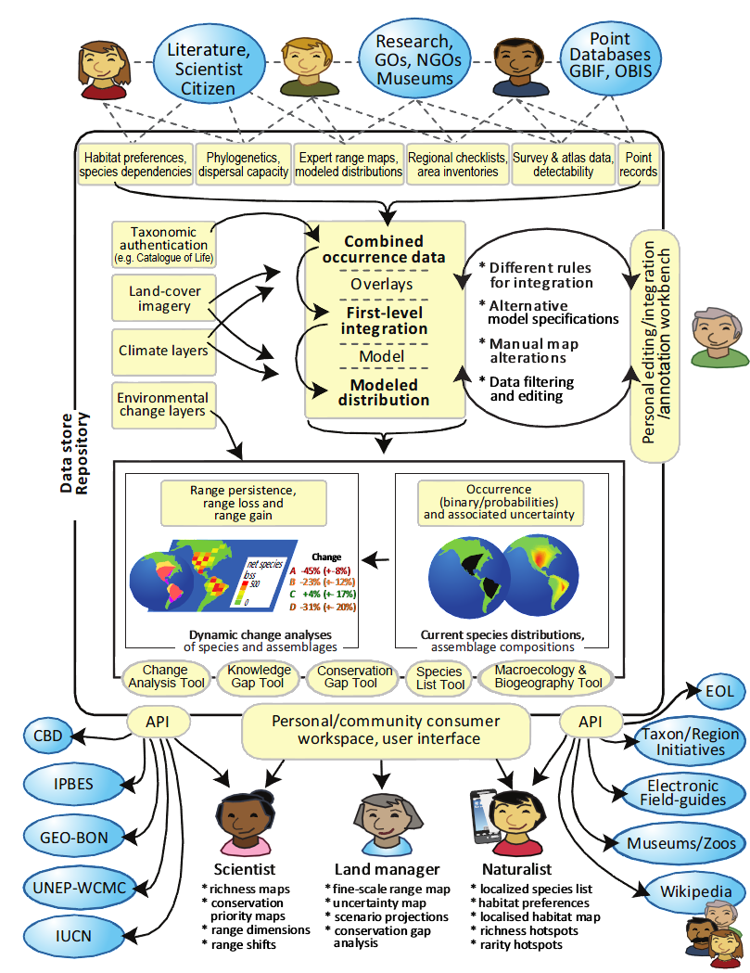
Map of Life
An online workbench and knowledgebase to dynamically document, integrate, validate, advance, analyze the disparate sources of global biodiversity distribution knowledge
Tools and products:
  Aquatic and terrestrial global biodiversity layers
  Species lists for user-defined regions, on mobile devices
  Dynamically-updated threat assessments
Jetz et al. 2012, TREE
Notes:
An online workbench and knowledgebase which dynamically documents, integrates, validates, advances, analyses all of the disparate sources of global biodiversity distribution knowledge.
Tools to annotate and edit maps in order to enhance map quality.
Modeled, uncertainty-assessed, high-resolution geographic range maps for tens of thousands of terrestrial and aquatic plant and animal species.
Tools and products:
Aquatic and terrestrial global biodiversity layers
Species lists for user-defined locations,
Dynamically-updated threat and conservation assessments
Mobile device-based species lists for naturalists.
To establish an infrastructure that encourages and supports community inolvement in biodiversity surveys and species range assessments.

Slide 8
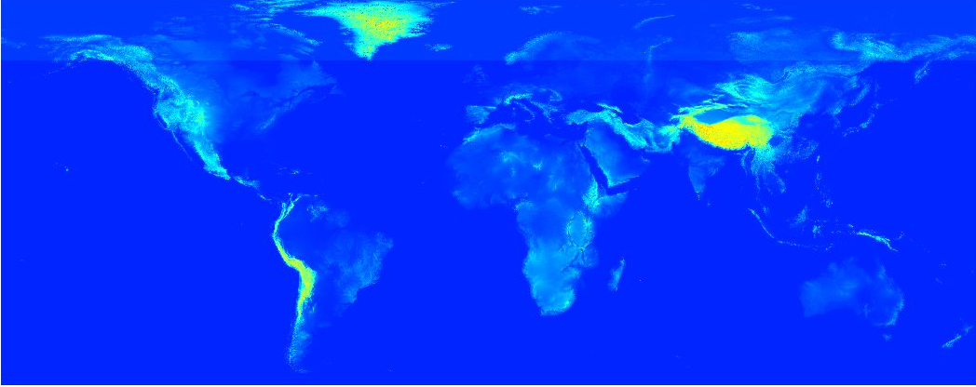
1. Full global-extent 90m DEM
ASTER GDEM V2
Blended, void-filled, multi-scale smoothed
SRTM V4
For global derivation of terrain variables and distribution modeling
Robinson et al (MS)

Slide 9
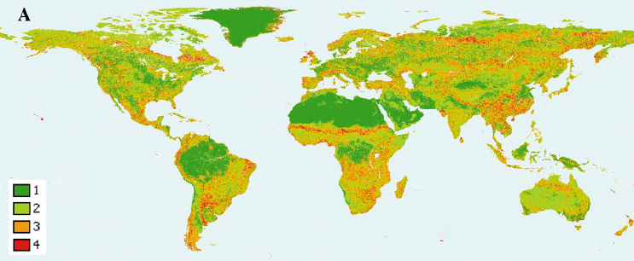
Limitations of Existing Products
2. Global consensus land cover
Classification errors
Among-product disagreements
IGBP DISCover, U of Maryland, GLC2000 and MODIS; Herold et al. 2008

Slide 10
Limitations of Existing Products
2. Global consensus land cover
Classification errors
Among-product disagreements
Categorical data – False absences of minor land cover classes

Slide 11
Goal
2. Global consensus land cover
Generate a harmonized set of 1-km resolution land cover product that provides scale-integrated and accuracy-weighted consensus land cover information on a continuous scale.
Example use in biodiversity modeling: Minimize false absences and improve accuracy of species distribution models

Slide 12
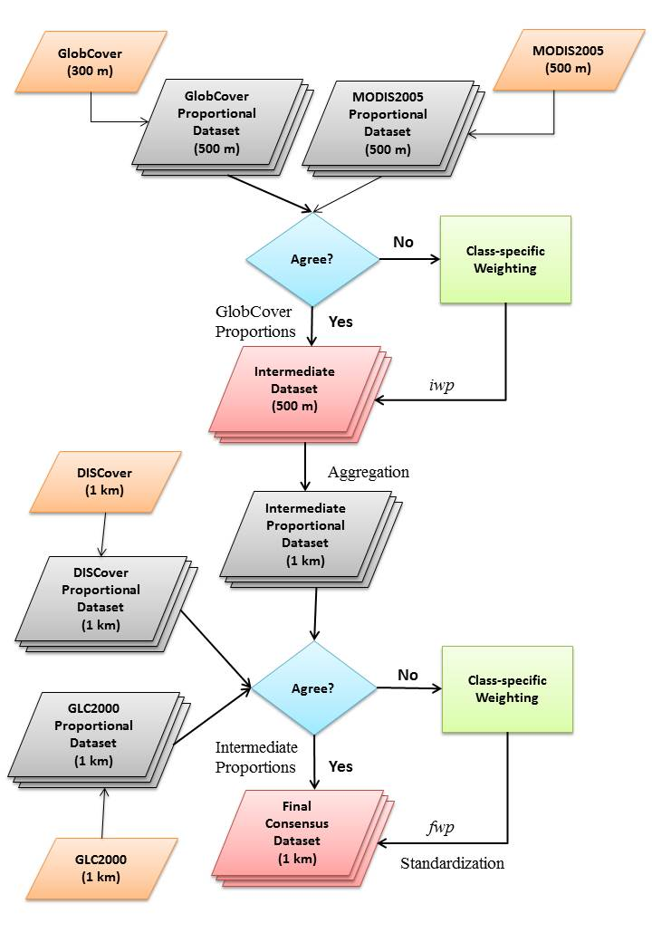
2. Global consensus land cover

Slide 13
2. Global consensus land cover
1km Land Cover Prevalence

Slide 14

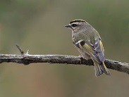
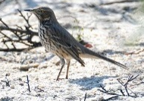
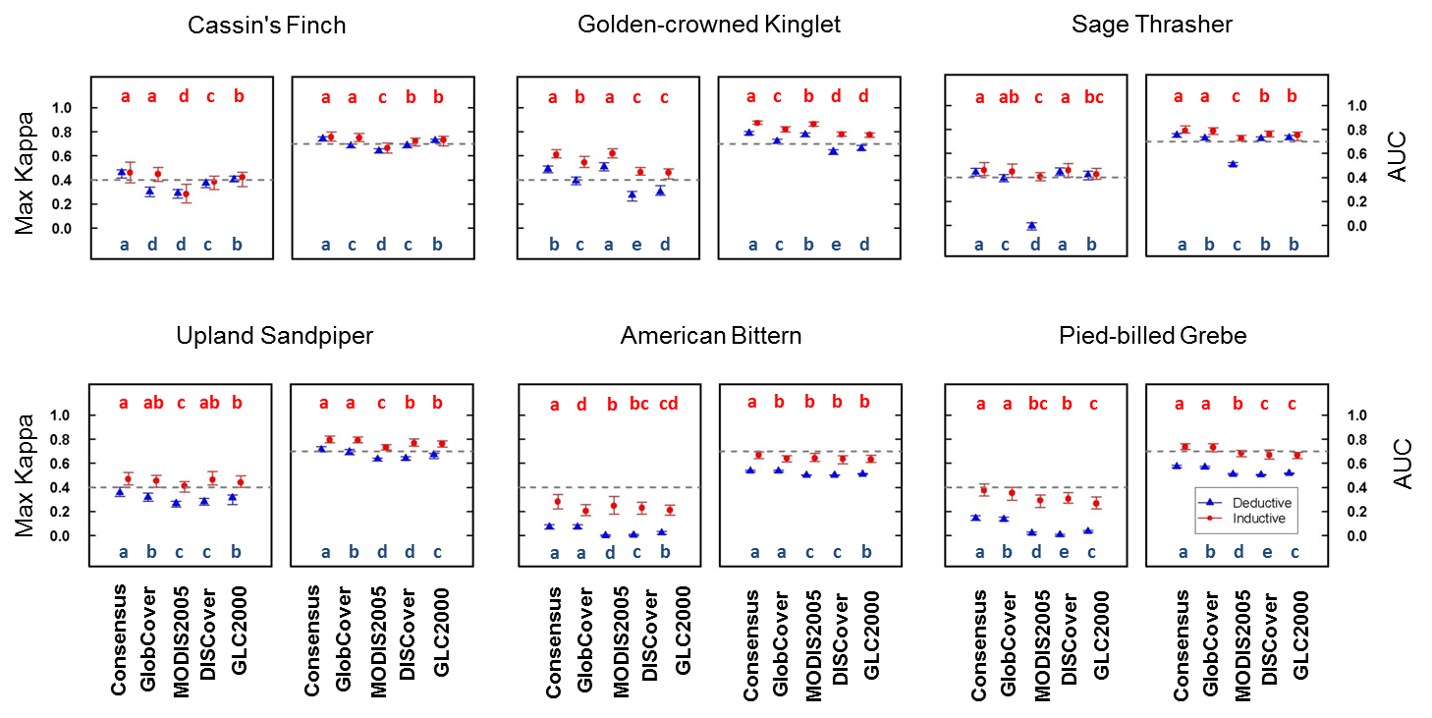
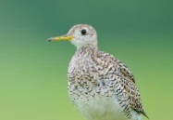
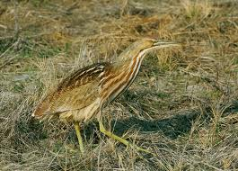

Improvements to model accuracy
2. Global consensus land cover
Better
Tuanmu & Jetz (Global Ecology & Biogeography, in review)

Slide 15
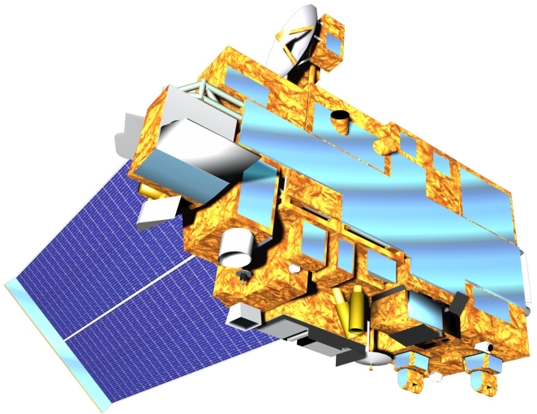
Satellite-Station Data Fusion
3. Global temp. & prec. layers
Goal: Develop daily 1km surfaces of tmax, tmin, and ppt with MODIS and climate station data (1970-2011).
Climate-aided interpolation
Monthly climatologies (2000-2011) from MODIS and station means
Interpolate daily station anomalies (including pre 2000)

Slide 16
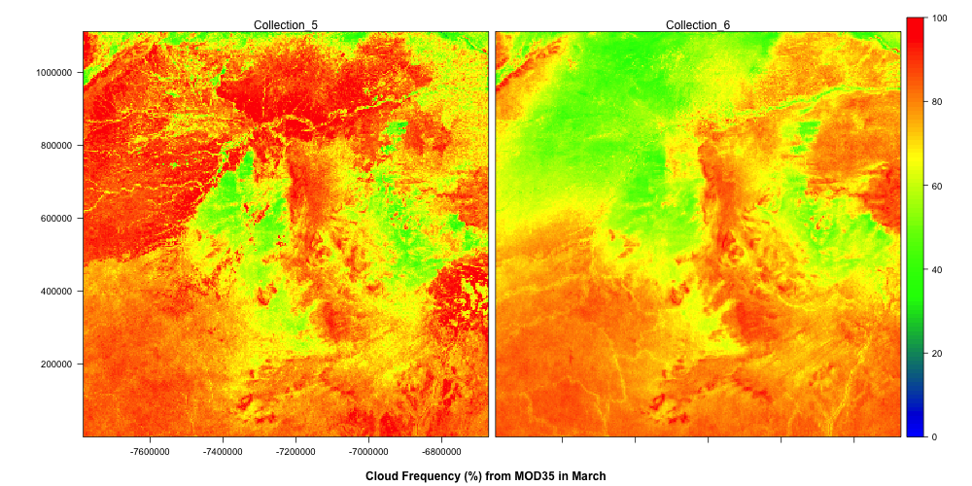
Satellite Weather Products
3. Global temp. & prec. layers
Temperature:
MODIS LST (MOD11A1)
Precipitation:
MODIS Cloud Product (MOD06)

Slide 17
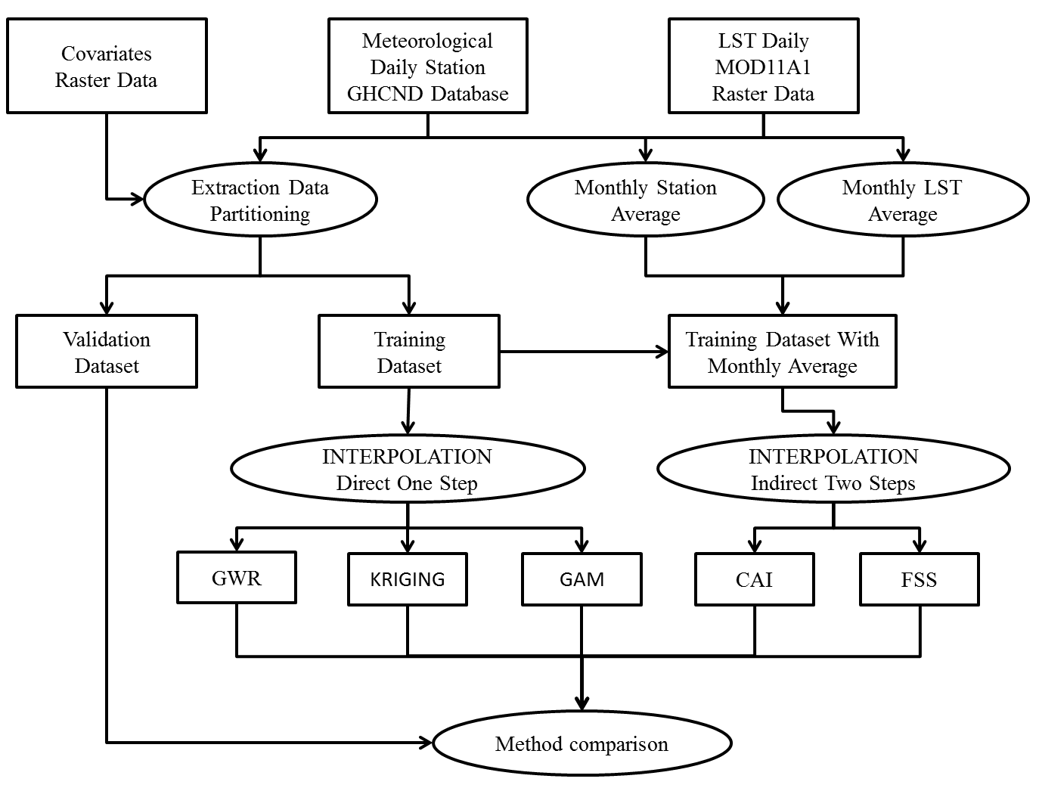
3. Global temp. & prec. layers
CLIMATE INTERPOLATION WORKFLOW
All the steps are implemented in Open Source GIS combining
Linux Shell script, PostGres, R, Python, GRASS and GDAL.

Slide 18
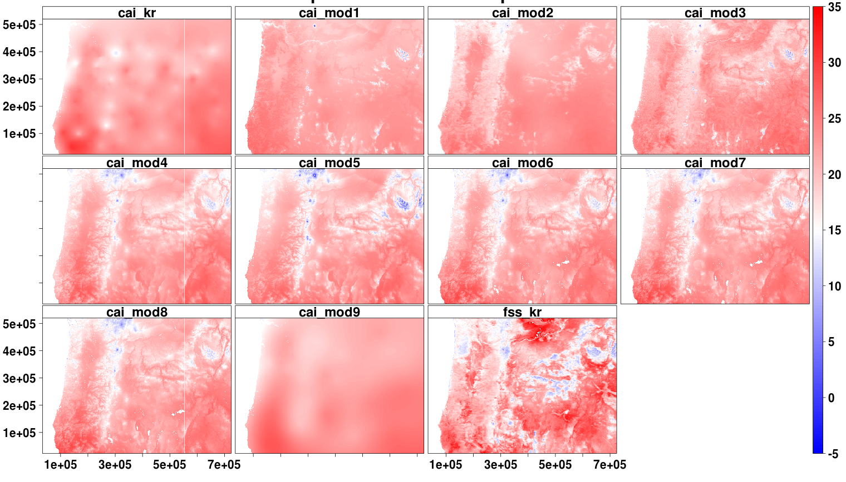
3. Global temp. & prec. layers
Temperature (deg Celsius)
cai_mod1 | TMax~ f(elev)
caii_mod2 | TMax~ f(LST)
cai_mod3 | TMax~ f(elev, LST)
cai_mod4 | TMax~ f(lat) + f(lon) + f(elev)
cai_mod5 | TMax~ f(lat, lon, elev)
cai_mod6 | TMax~ f(lat, lon) + f(elev) + f(N_w, E_w) + f(LST)
cai_mod7 | TMax~ f(lat, lon) + f(elev) + f(N_w, E_w) + f(LST) + f(LC1)
cai_mod8 | TMax~ f(lat, lon) + f(elev) + f(N_w, E_w) + f(LST) + f(LC3)
cai_mod9 | TMax~ f(x)+f(y)
cai_kr | CAI_kr: y_var ~ tmax
Max. temperature, 1 Sep. 2010
Climate aided interpolation
Comparison of models

Slide 19
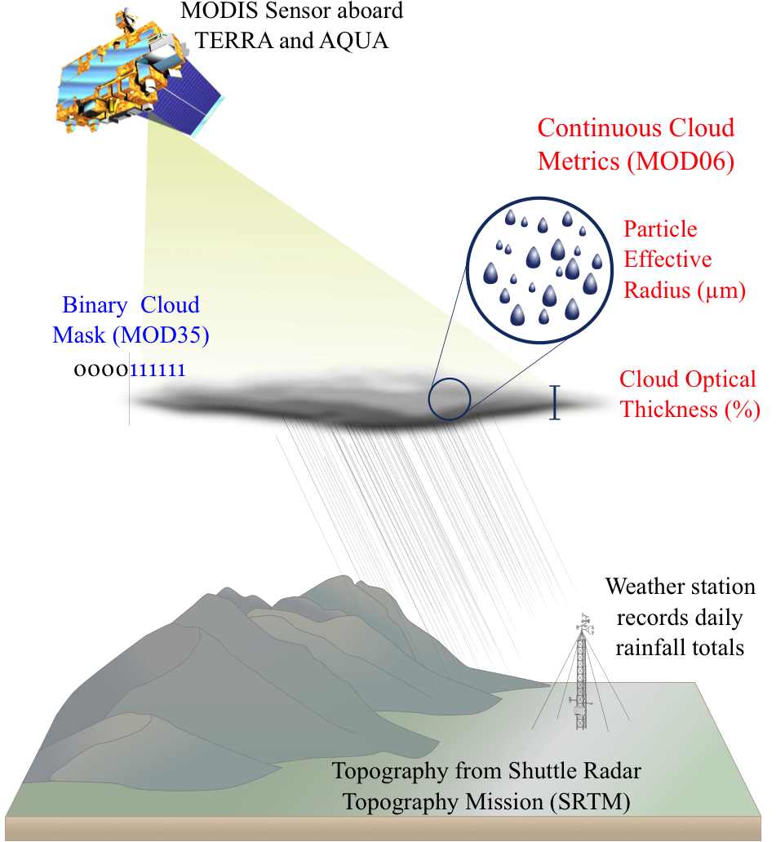
3. Global temp. & prec. layers

Slide 20
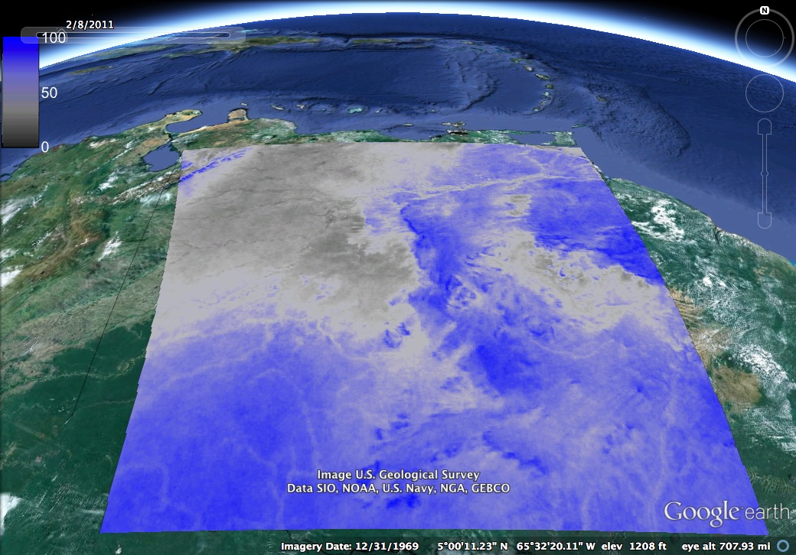
MOD35 Cloud Frequency (%) in February
3. Global temp. & prec. layers
Venezuela
(MODIS tile h11v08)
Notes:
Map of mean 2000-2012 Cloud Frequency (%) from Collection 6 MOD35 for tile h11v08 in February. Colors range from dark grey (rarely cloudy) to dark blue (usually cloudy). Note spatial detail. Red box is area shown in following slides.

Slide 21
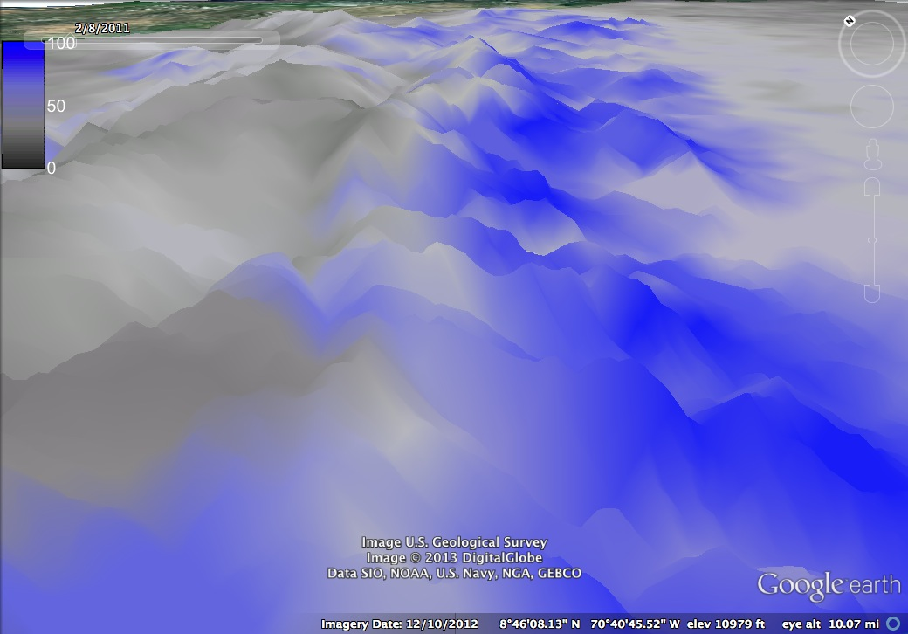

MOD35 Cloud Frequency (%) in February
3. Global temp. & prec. layers
Notes:
Similar to before, but cropped to northern andes and draped over elevation. Note that MOD35 is able to capture orographic clouds on the eastern (but not western slopes).

Slide 22
Cloud data improves interpolation accuracy
3. Global temp. & prec. layers
Notes:
Don’t want to spend too much time here, but we’ve done model comparison using various spatial models and those in blue and red (which use MODIS cloud data) consistently improve the predictive accuracy.

Slide 23
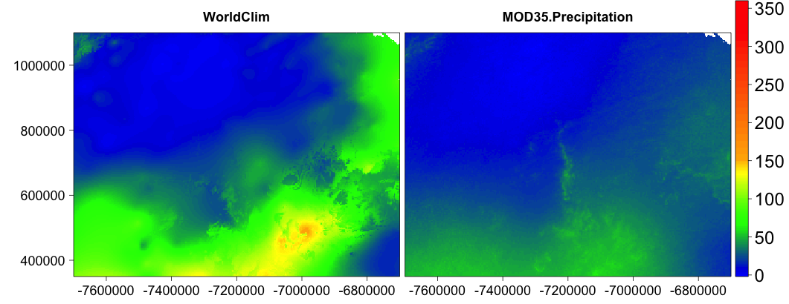
Comparison of WorldClim and MOD35-informed mean monthly interpolation (February)
3. Global temp. & prec. layers
mm
Worldclim
MOD35-Informed
Mean monthly precipitation (mm) from WorldClim [lppt~s(y,x)+s(dem)] and MOD35-informed interpolation [lppt~s(y,x)+s(dem)+cld+cot+cer20 ]

Slide 24
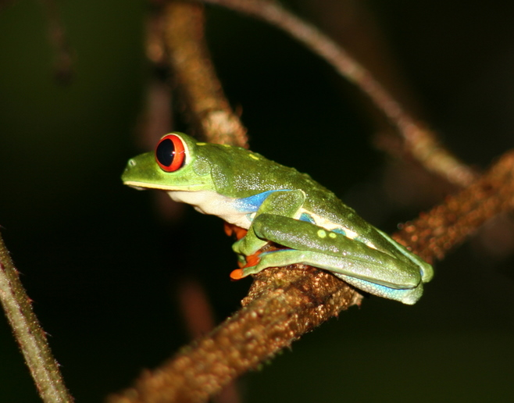
Thanks!

Slide 25
Landcover Bias in Collection 5 (MOD35) Cloud Data
MOD35 Collection 5
MOD35 Collection 6
100
80
Non-Forest
60
40
20
0
Cloud Frequency (%) in March
The current (C5) MODIS Cloud mask has more frequent
“cloudy” days over non-forest
The updated (C6) mask less biased by land cover
Notes:
Comparing C5 and C6 cloud frequency for Venezuela tile h11v08. Note the northwestern corner is 80-90% cloudy in C5, but only ~40% in C6 due to changes in the identification of low-vegetation areas (and associated processing path).

Slide 26
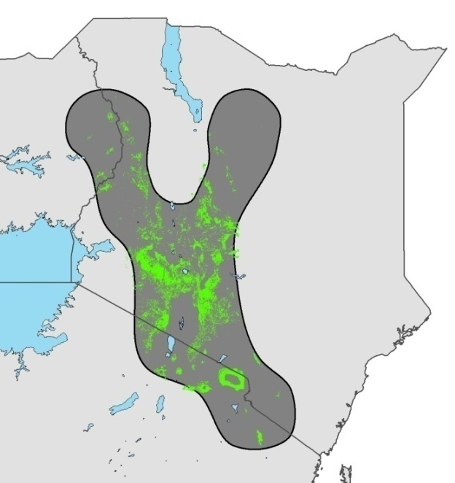
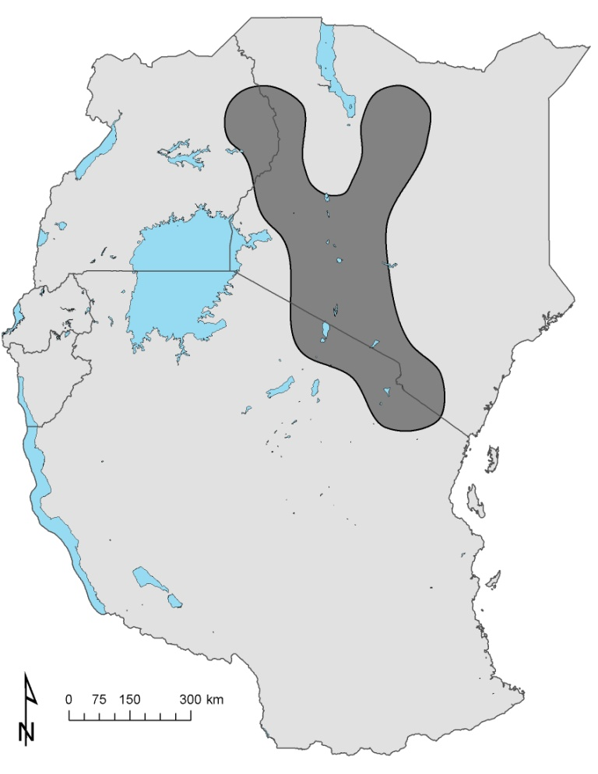
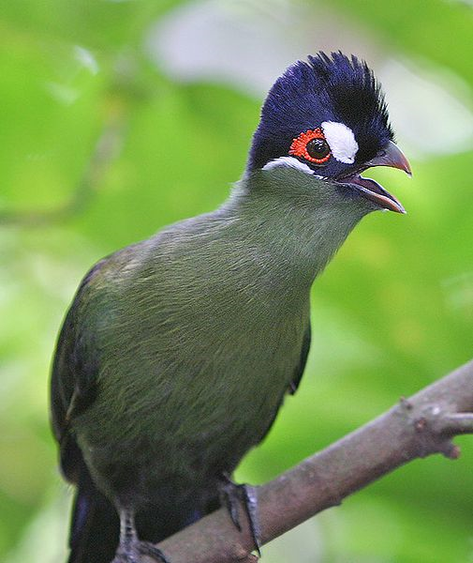
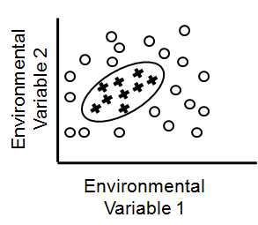
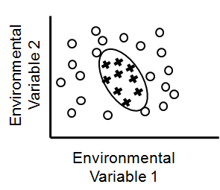
Range Refinement
Expert range size: 180,000km²
180,000km²
23,000km²
MODIS Landcover 2001-2012
Hartlaub’s Turaco: forest specialist, >1500m elevation
Expert range
Suitable 2012

