Slide 1
Synergistic Analyses of Data from Active and Passive Sensors to Assess Relationships between Spatial Heterogeneity of Tropical Forest Structure and Biodiversity Dynamics
Jordan Muss¹, Naikoa Aguilar-Amuchastegui², Geoffrey Henebry¹
¹South Dakota State University & ²World Wildlife Fund, US

Slide 2
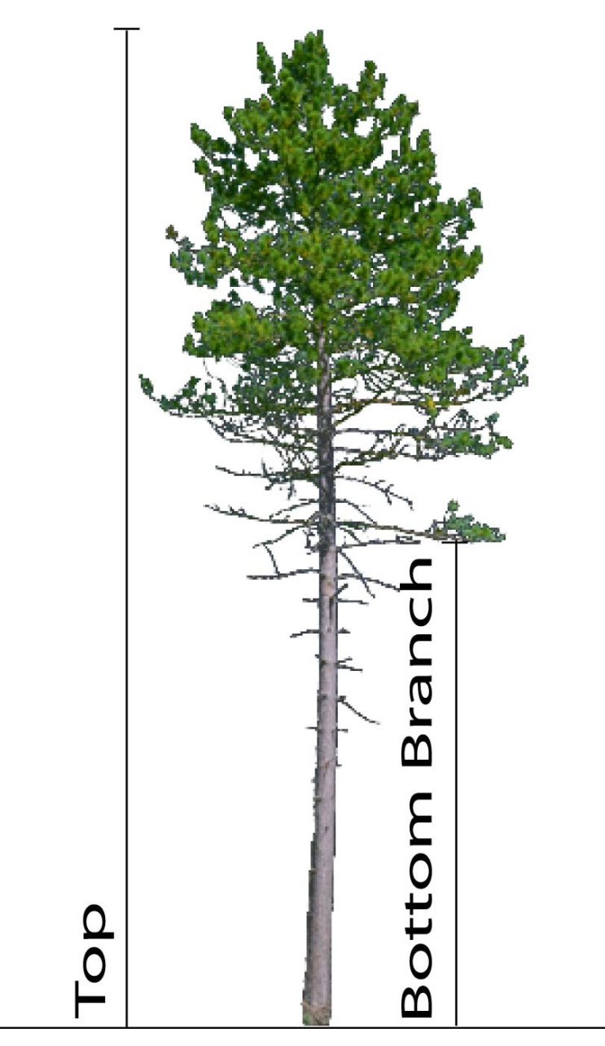
Biodiversity conservation through the sustainable management of tropical forests:
Forest structural heterogeneity as a potential indicator of sustainable forest management
Relationships between forest management & biodiversity indicators
Forest structural heterogeneity linked to habitat availability:
birds (e.g. Barbaro et al. 2006; Goetz et al. 2007; Clawges et al. 2008)
mammals (e.g. Carey & Wilson 2001)
beetles (e.g. Aguilar-Amuchastegui & Henebry 2006, 2007; Barbaro et al. 2006)

Slide 3
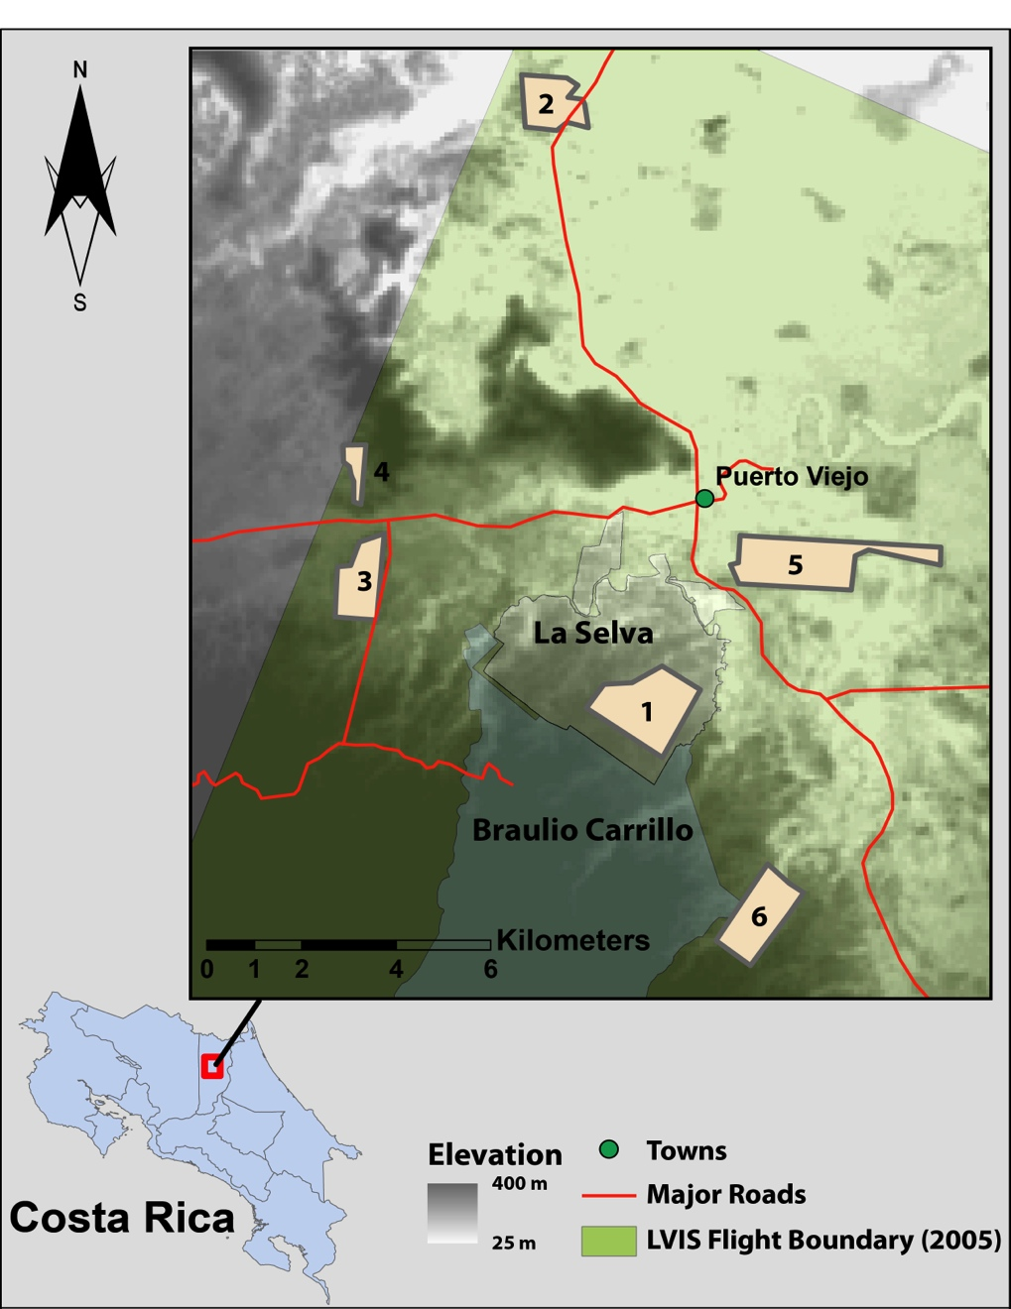
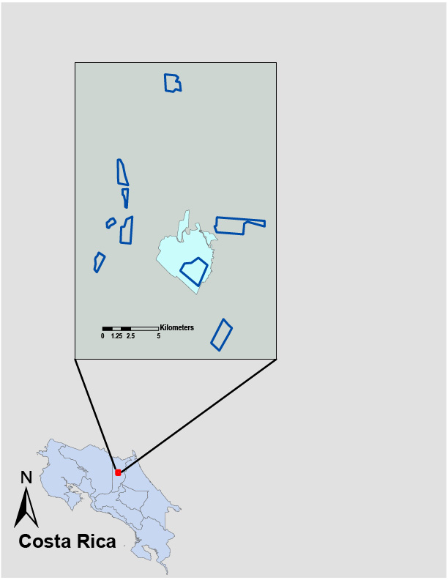
Study Area
9 forested sites
3 natural reference
1 natural & intact
2 natural but fragmented
6 managed units
5 primary
1 old secondary

Slide 4
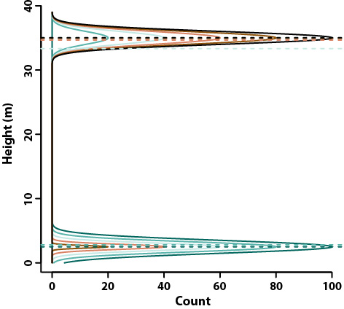
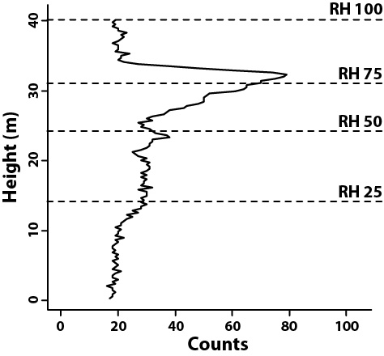
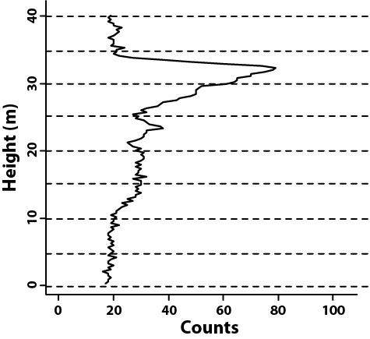
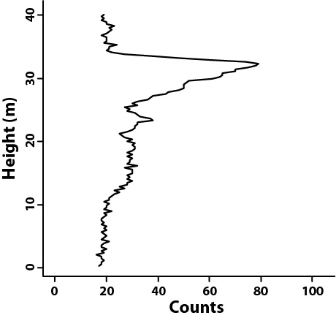
Quantiles
Why do we need more lidar metrics?
Fixed-width Slicing
Gaussian Deconvolution

Slide 5
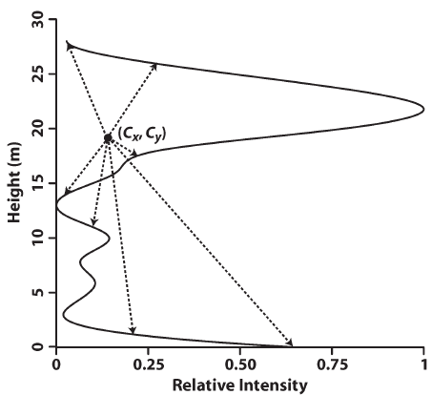
Alternative Approach
Shape-based metrics
Centroid (C_{x}, C_{y})
$$C=\frac{\int{f\left(x,y\right)dA}}{\int{dA}}$$
Balance point of waveform
Relates to canopy height
Radius of Gyration (RG)
$$RG=\sqrt{\frac{\sum{{\left(x_{i}−C_{x}\right)}^{2}}+\sum{{\left(y_{i}−C_{y}\right)}^{2}}}{n}}$$
root mean square distance between the centroid and waveform edge
Relates to 3D structure of canopy
Muss et al. (2012) Geoscience & Remote Sensing Letters

Slide 6
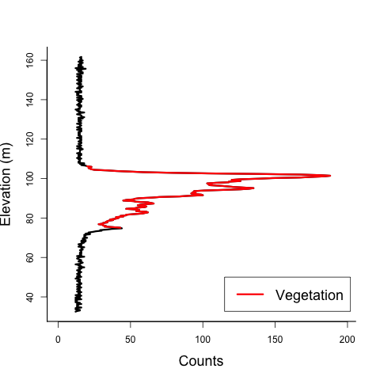
Are we missing signal?

Slide 7
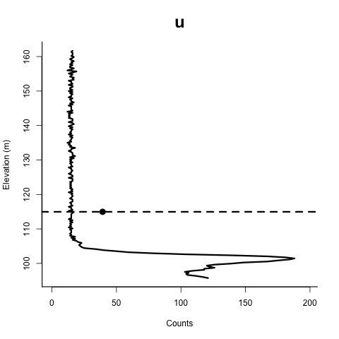
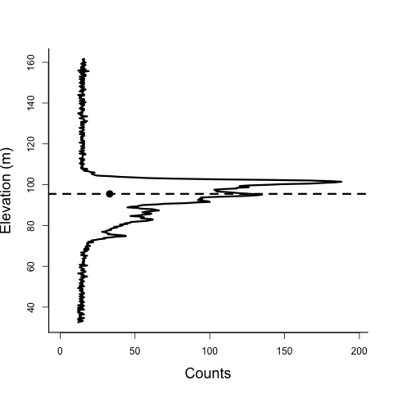
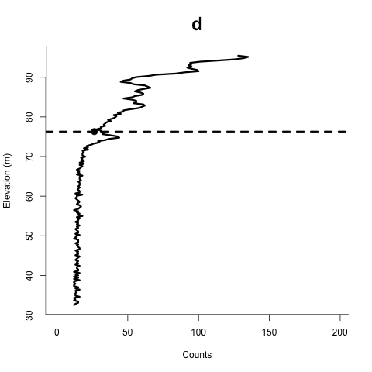
Recursive slicing
Bounds detection using C and normalized RG
Measuring wave complexity using RG

Slide 8
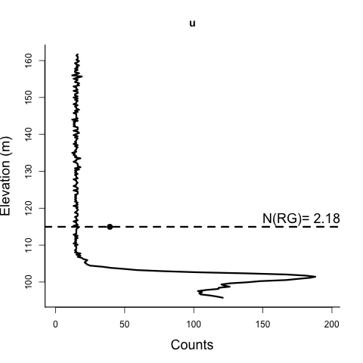
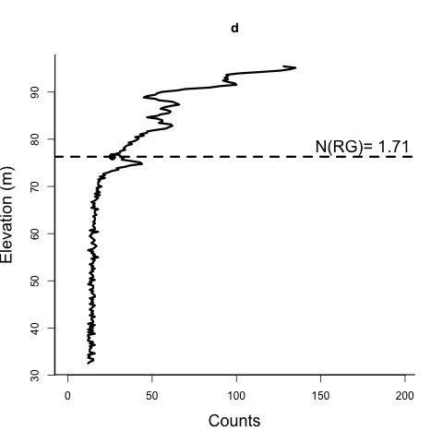
Automated Bounds Detection
Multi-pass rule-based recursive slicing:
Slice waveform
Find & remove slices with symmetry around C_{slice} :
N(Rg_{up}) ~ N(RG_{down})
Repeat until:
N(Rg_{up}) ≠ N(RG_{down})
Or the slices are too small to process

Slide 9
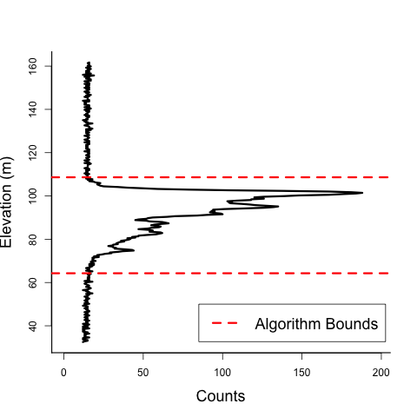
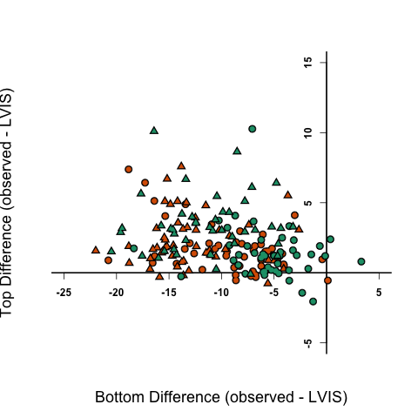
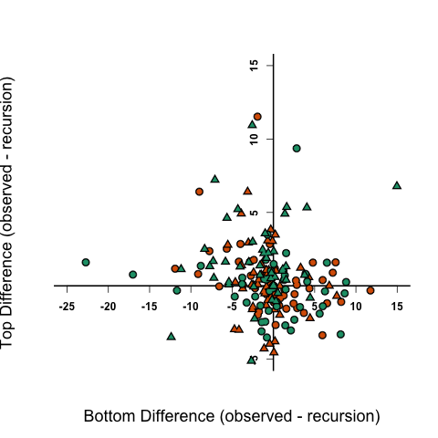
Orange = Pasture
Green = Forest
Circle = Flat site
Triangle = Sloped site

Slide 10
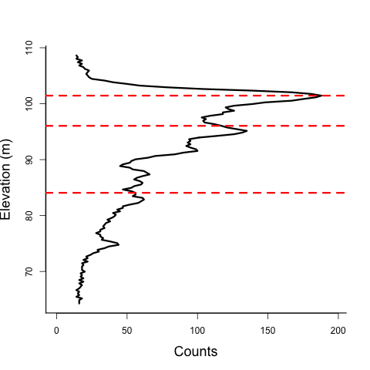
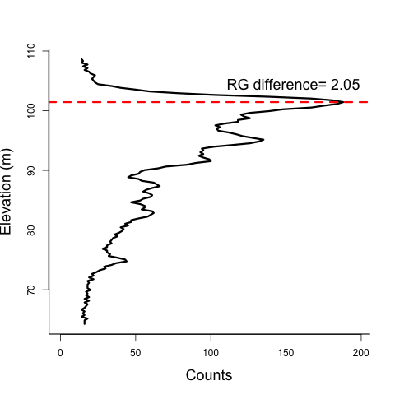
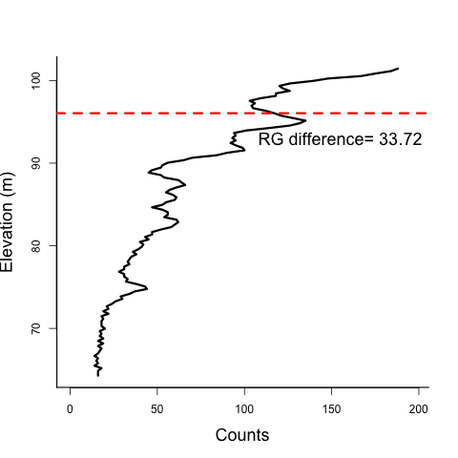
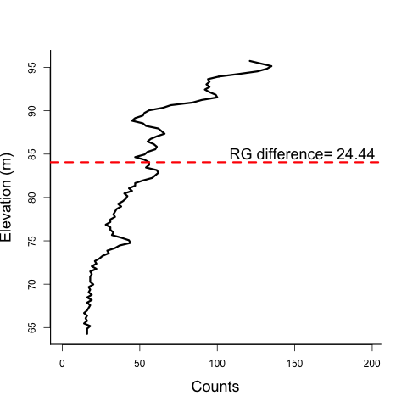
Slicing Using the Radius of Gyration
Multi-pass recursive slicing:
Minimize RG differences between slices
Slice wave at height where minimum difference occurs
Repeat for upper &lower portions until wave can’t be sliced any further

Slide 11
Slicing Using the Radius of Gyration

Slide 12
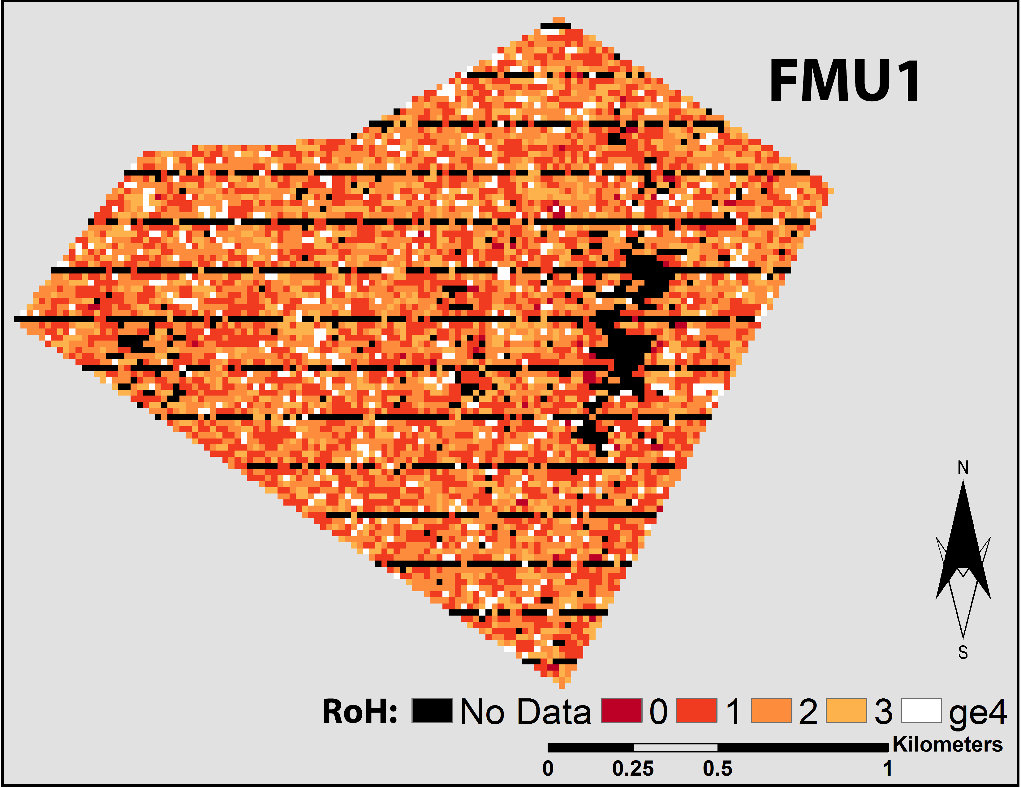
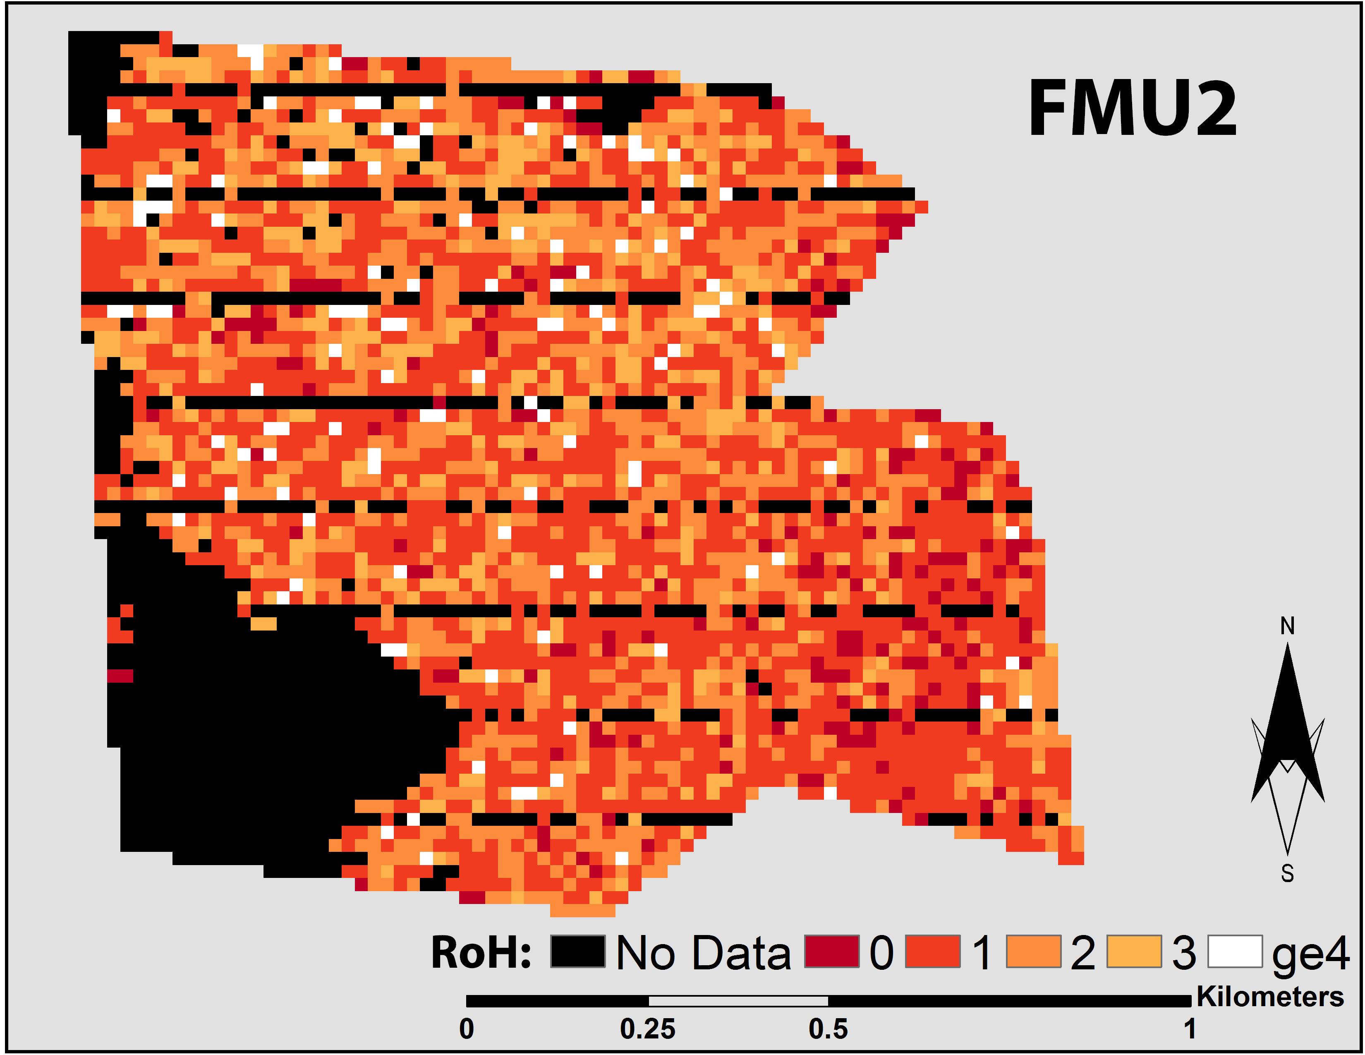
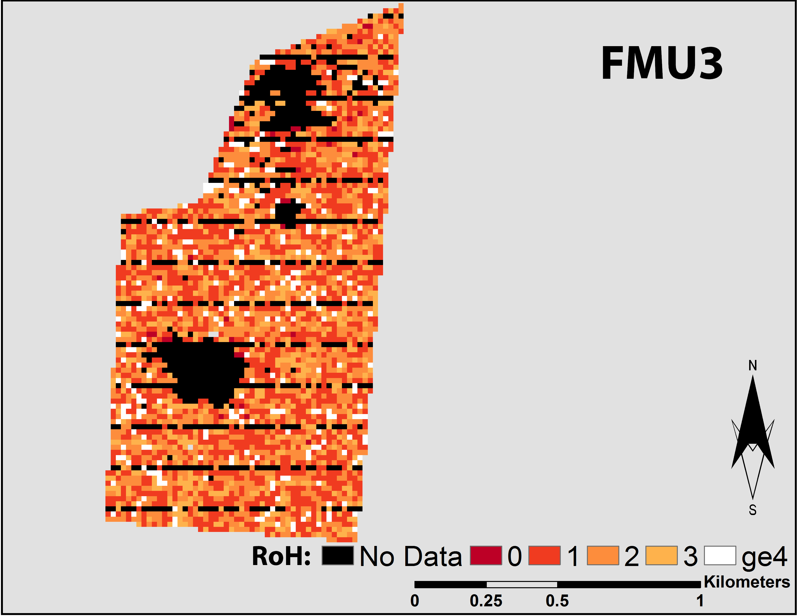
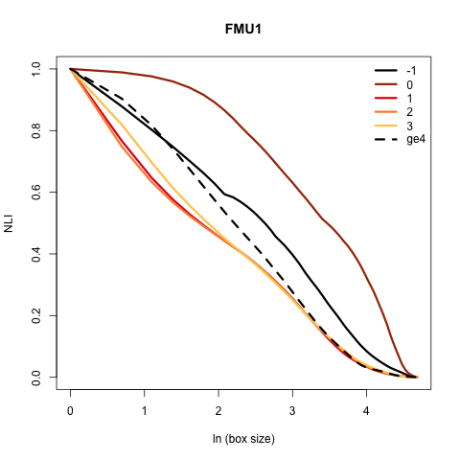
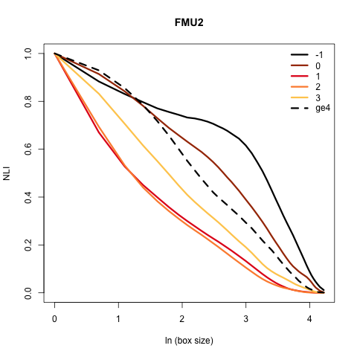
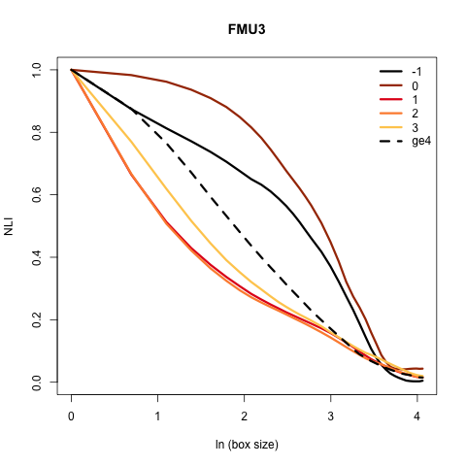

Slide 13
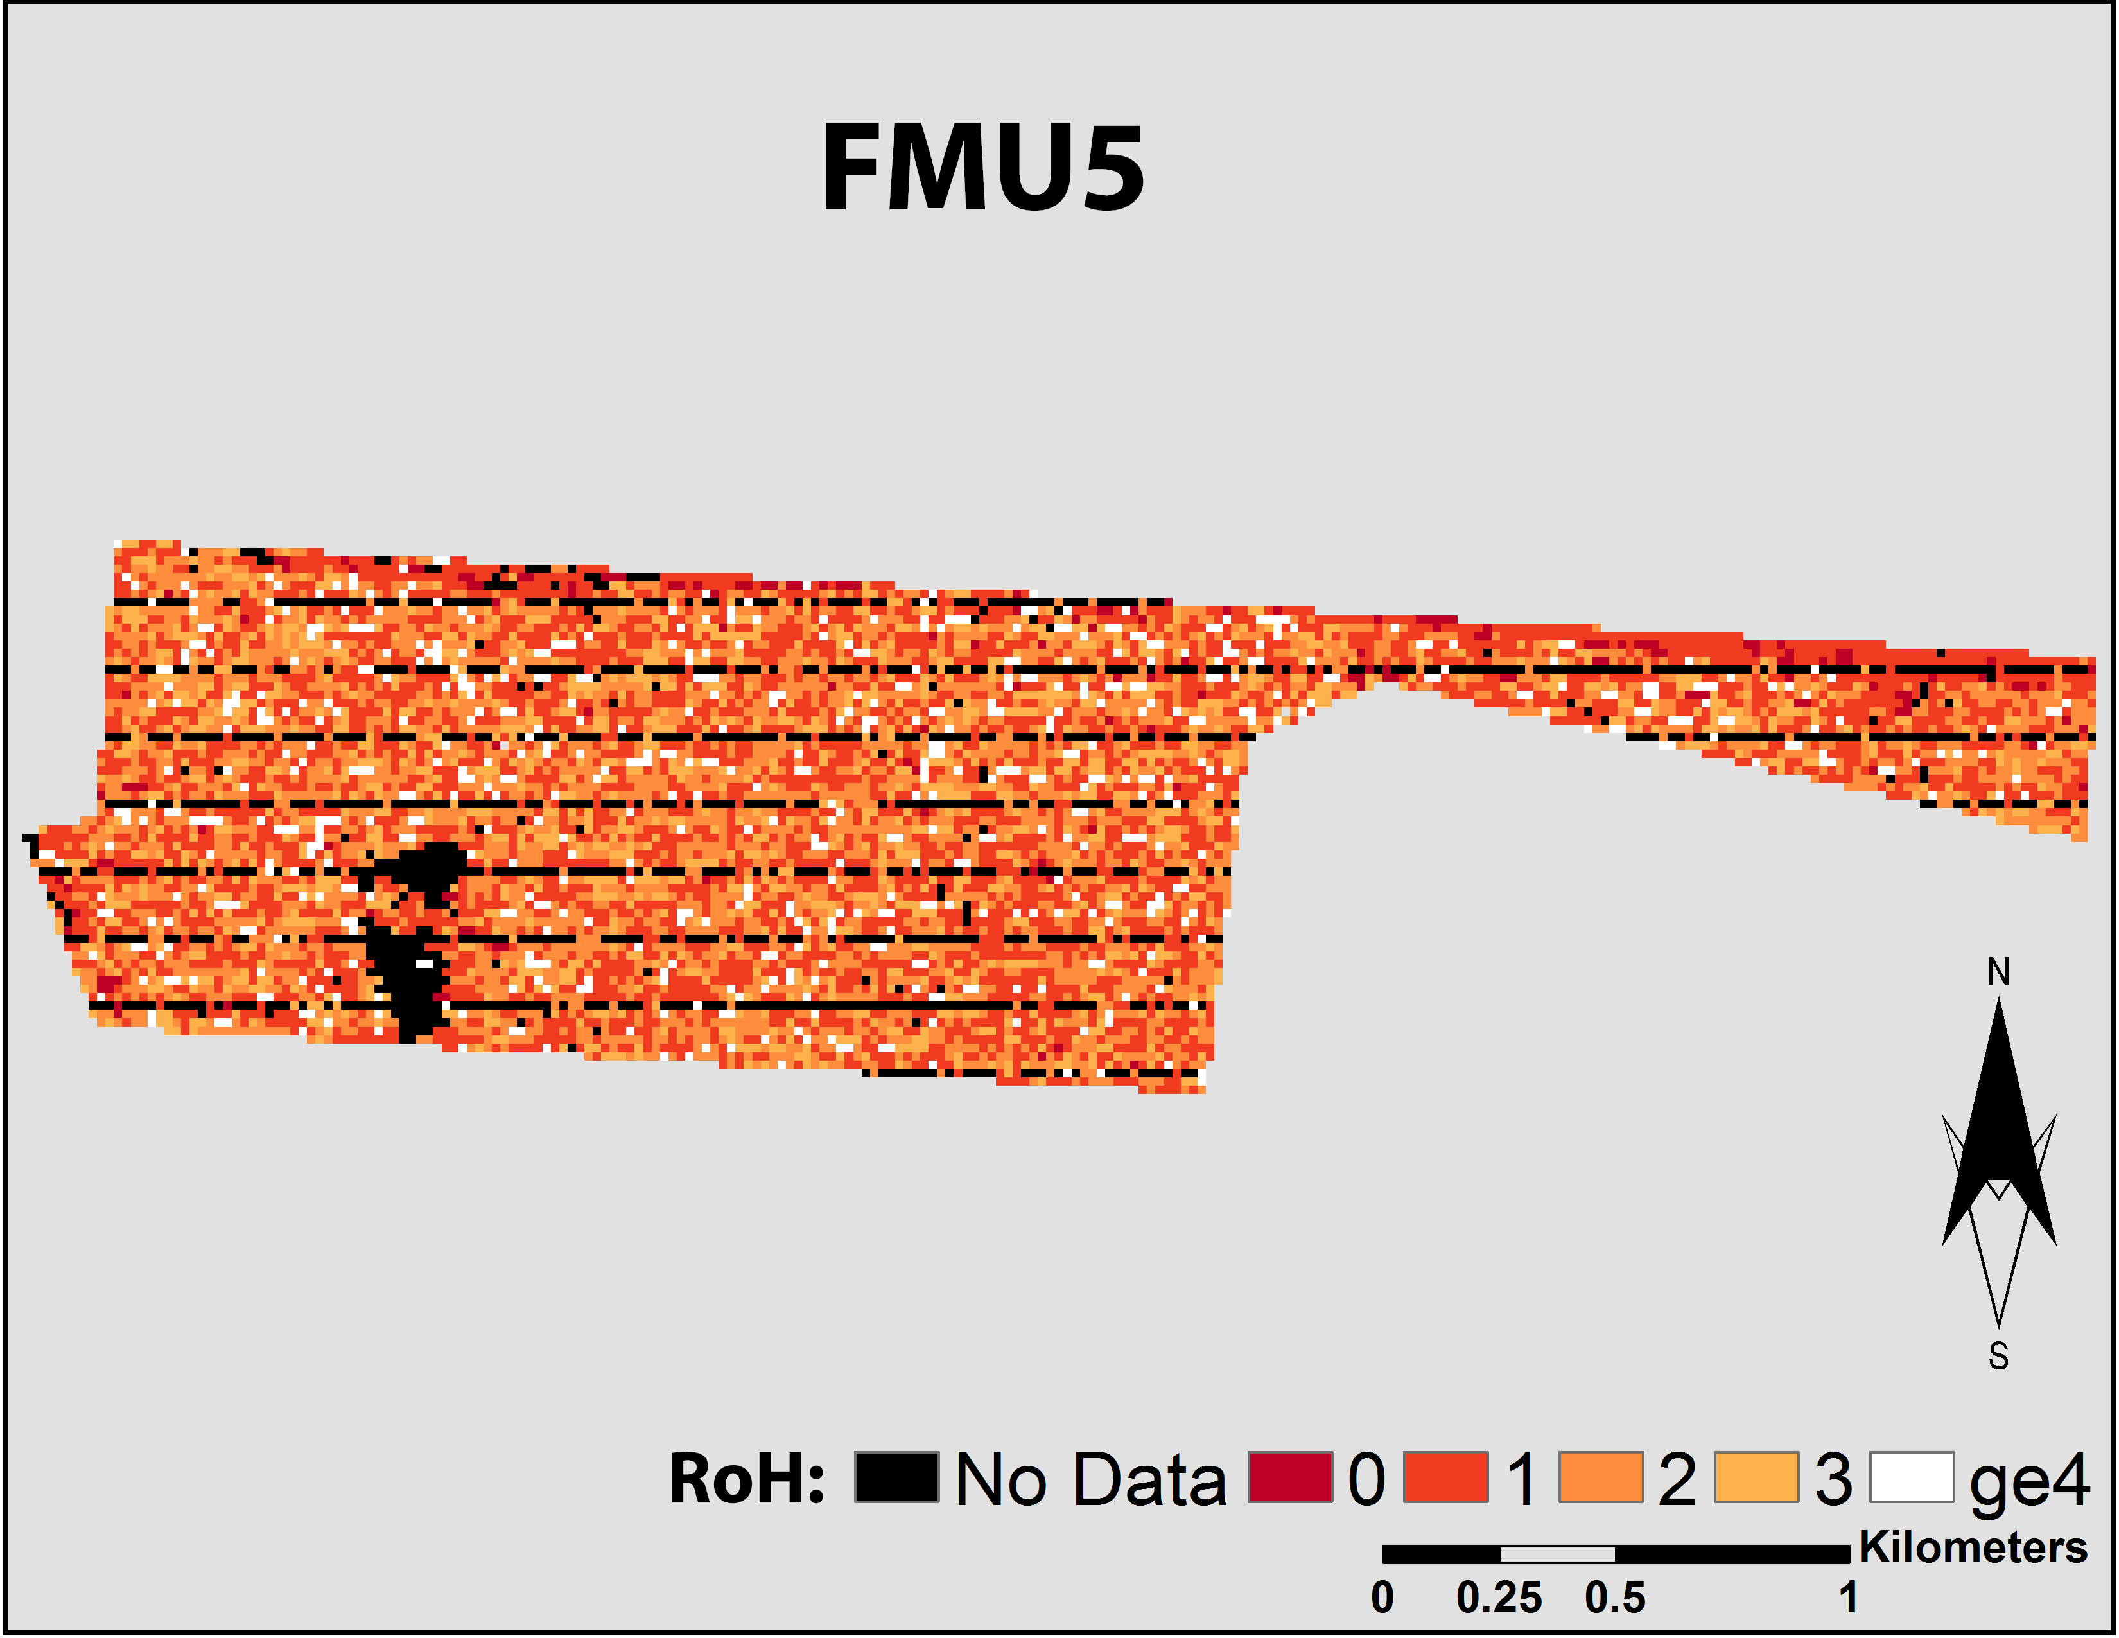
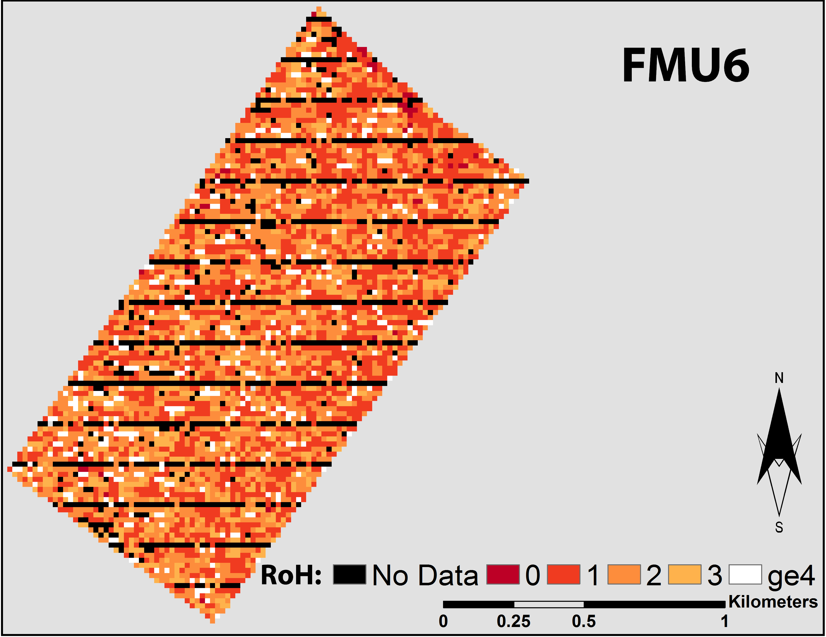
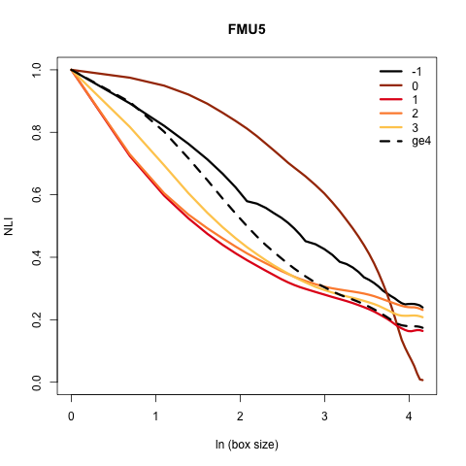
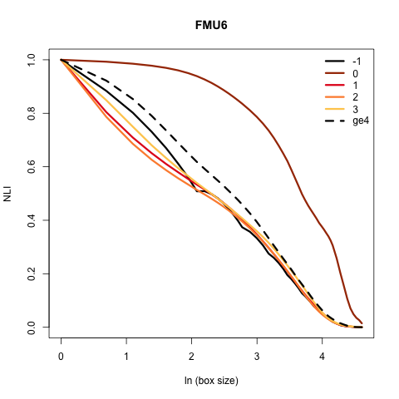

Slide 14
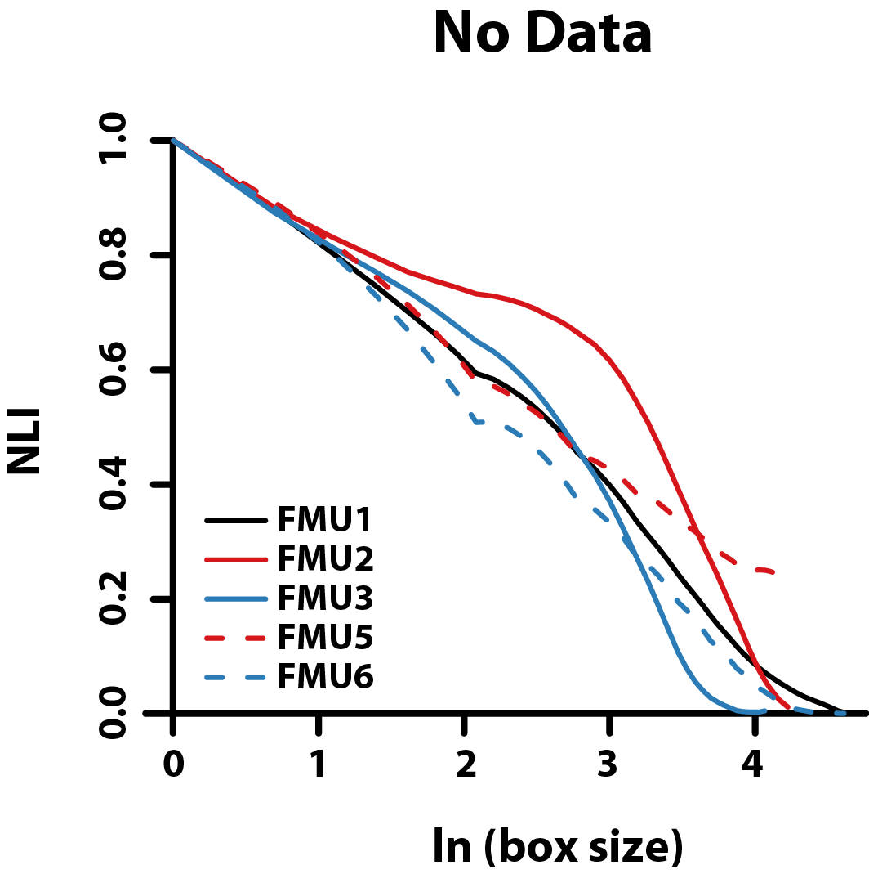
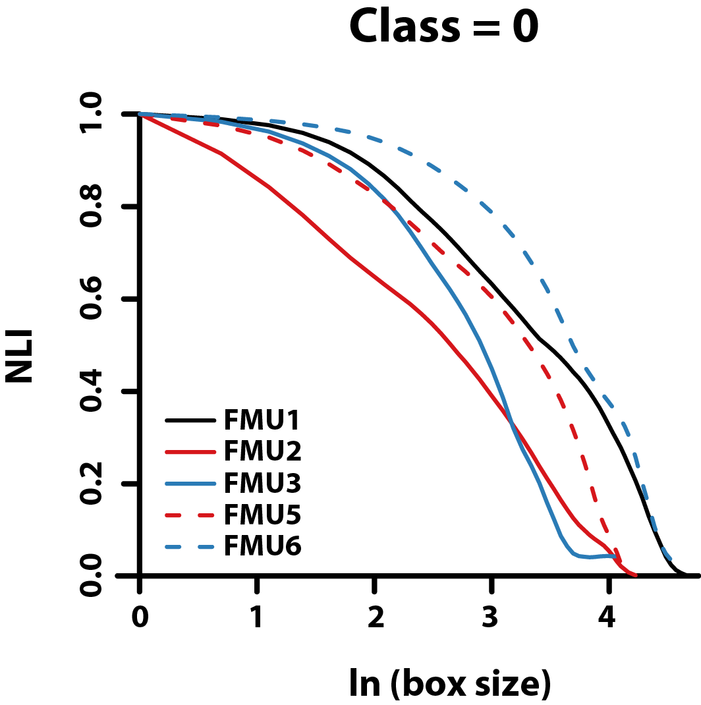
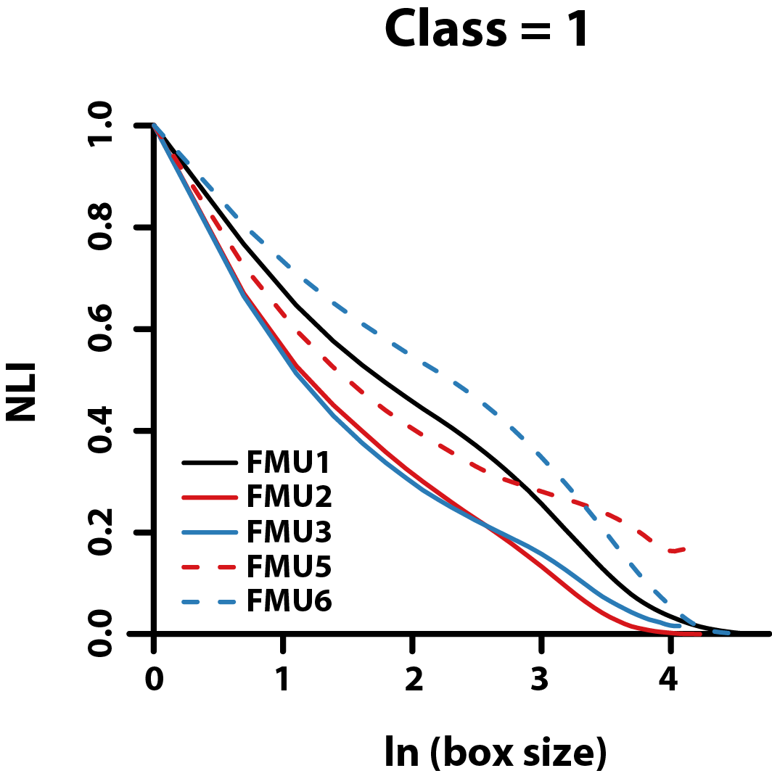
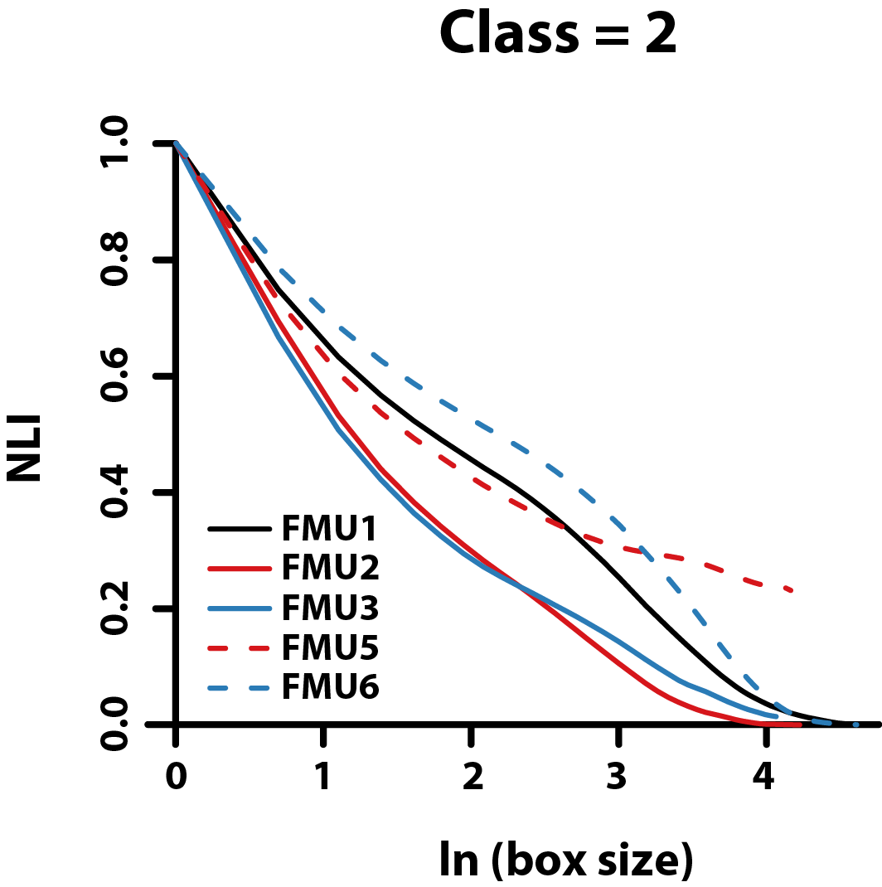
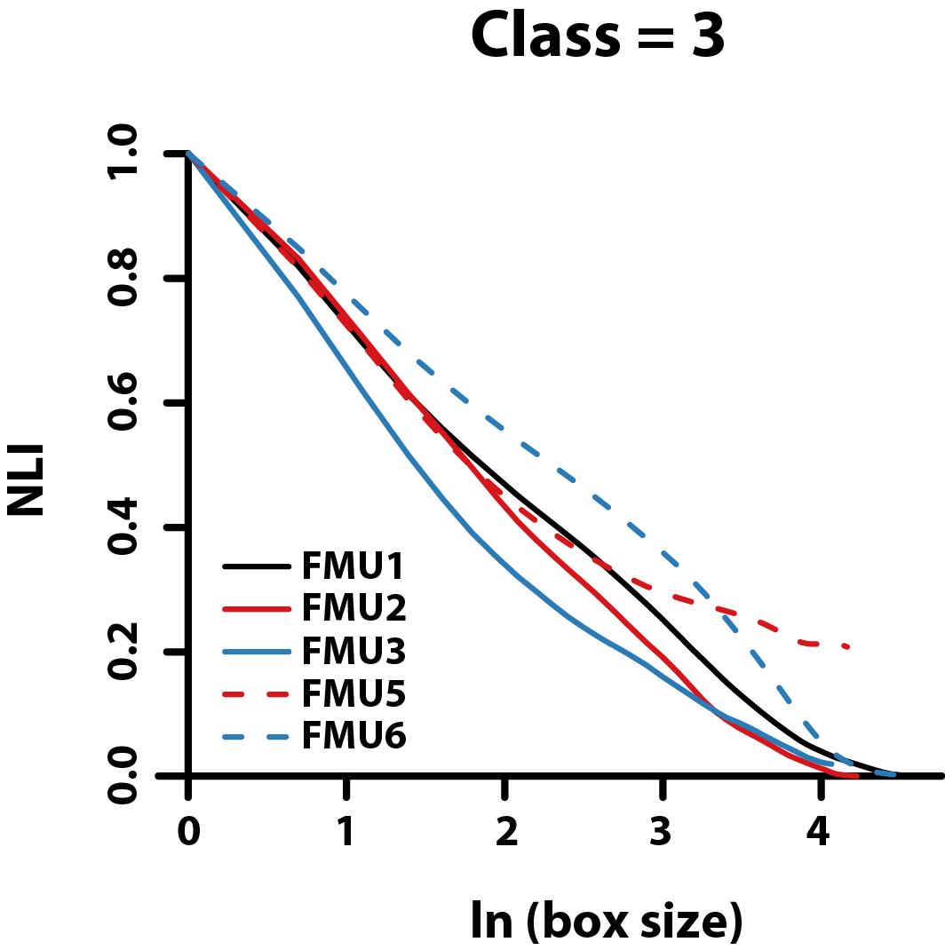
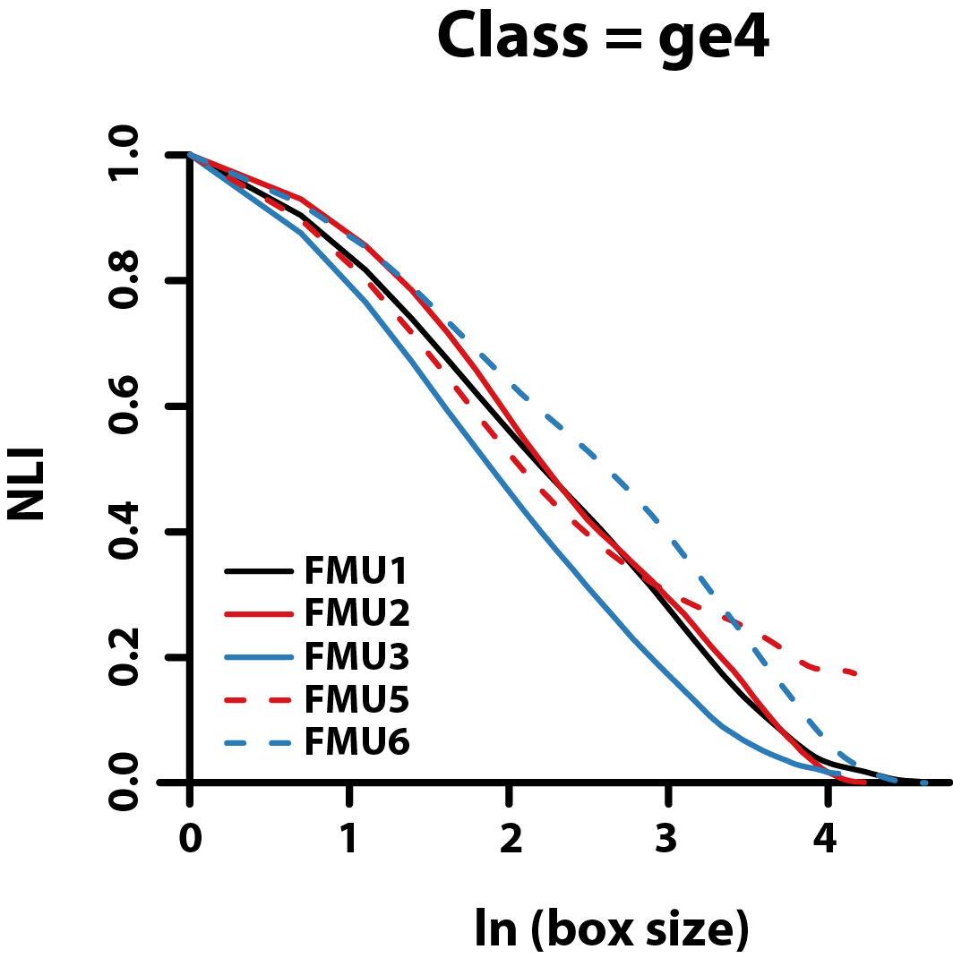

Slide 15
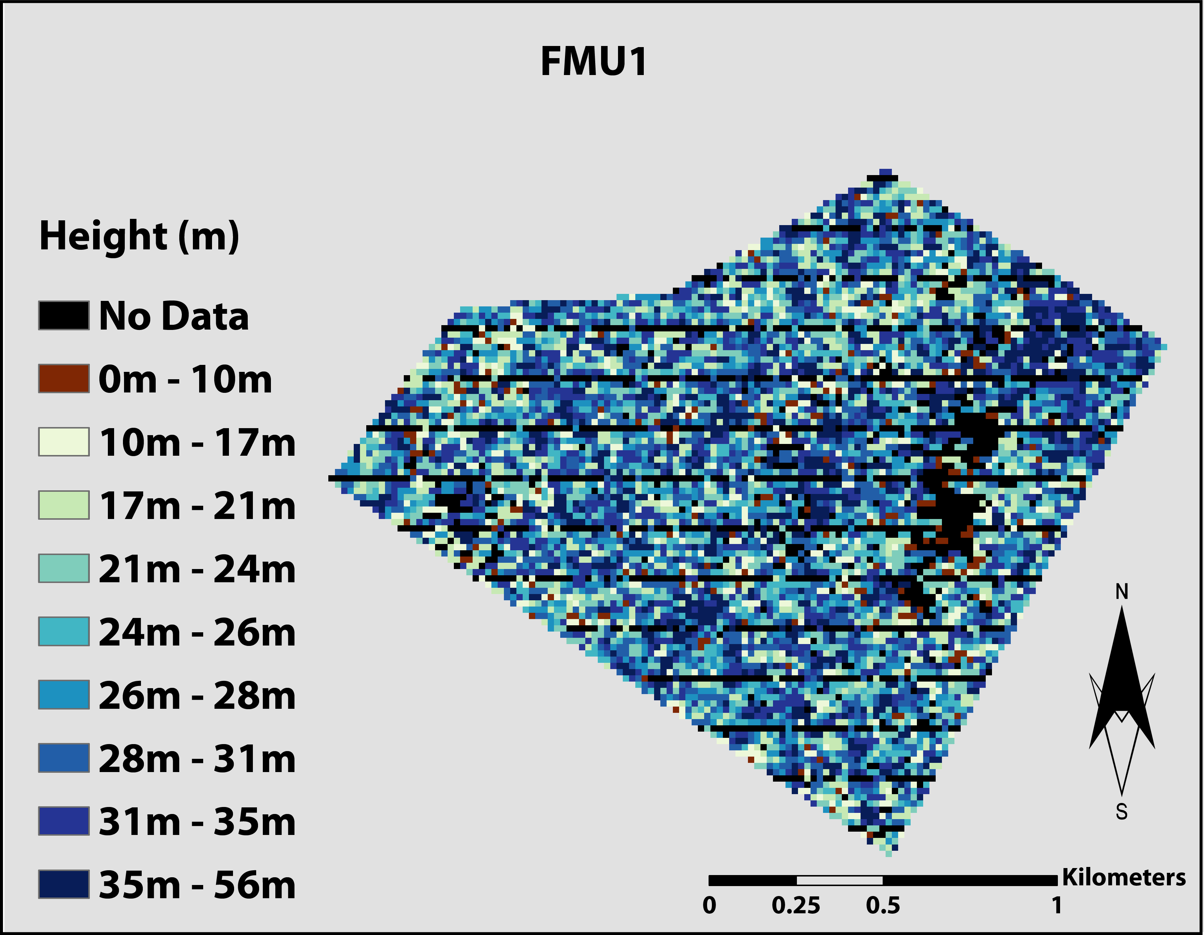
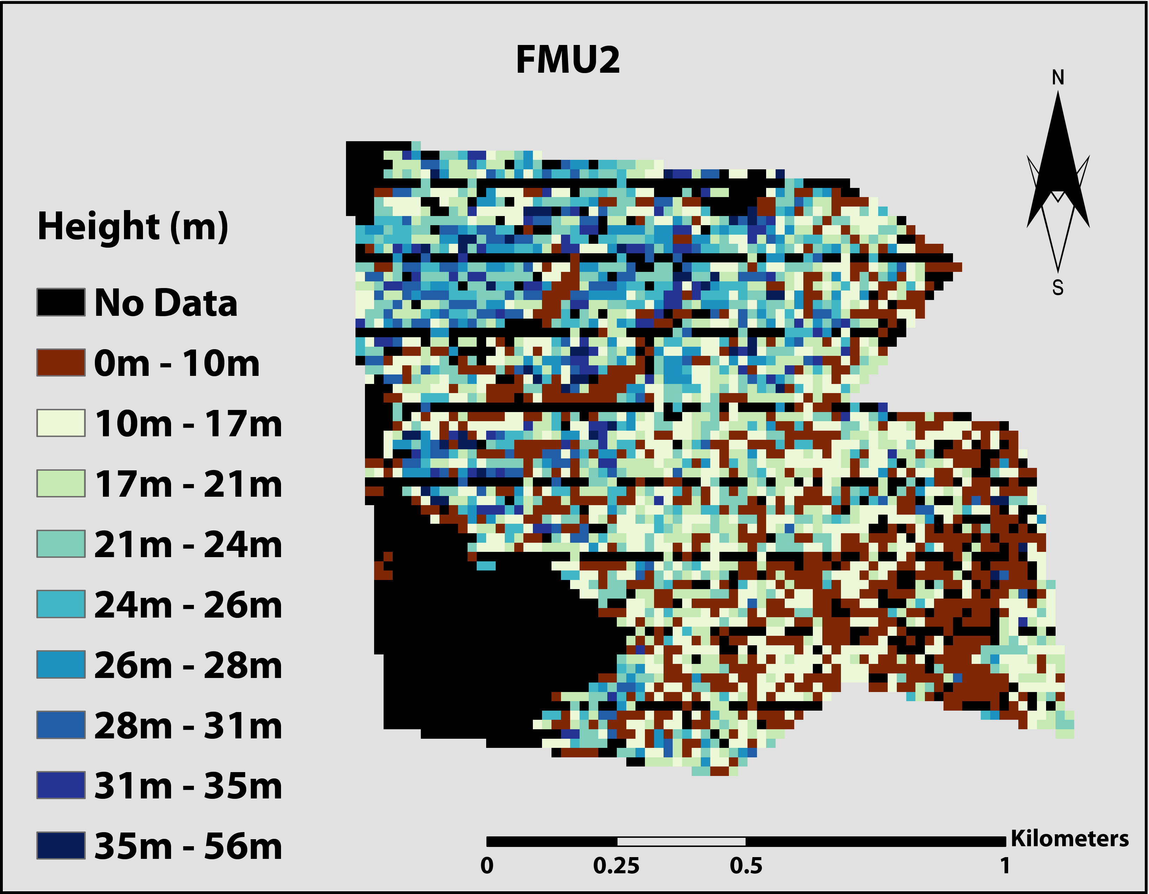
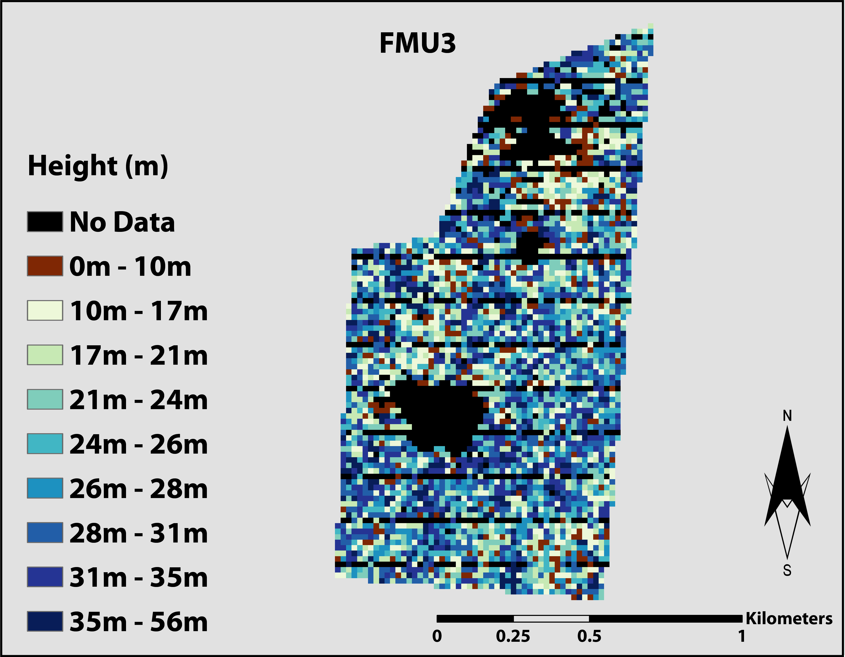
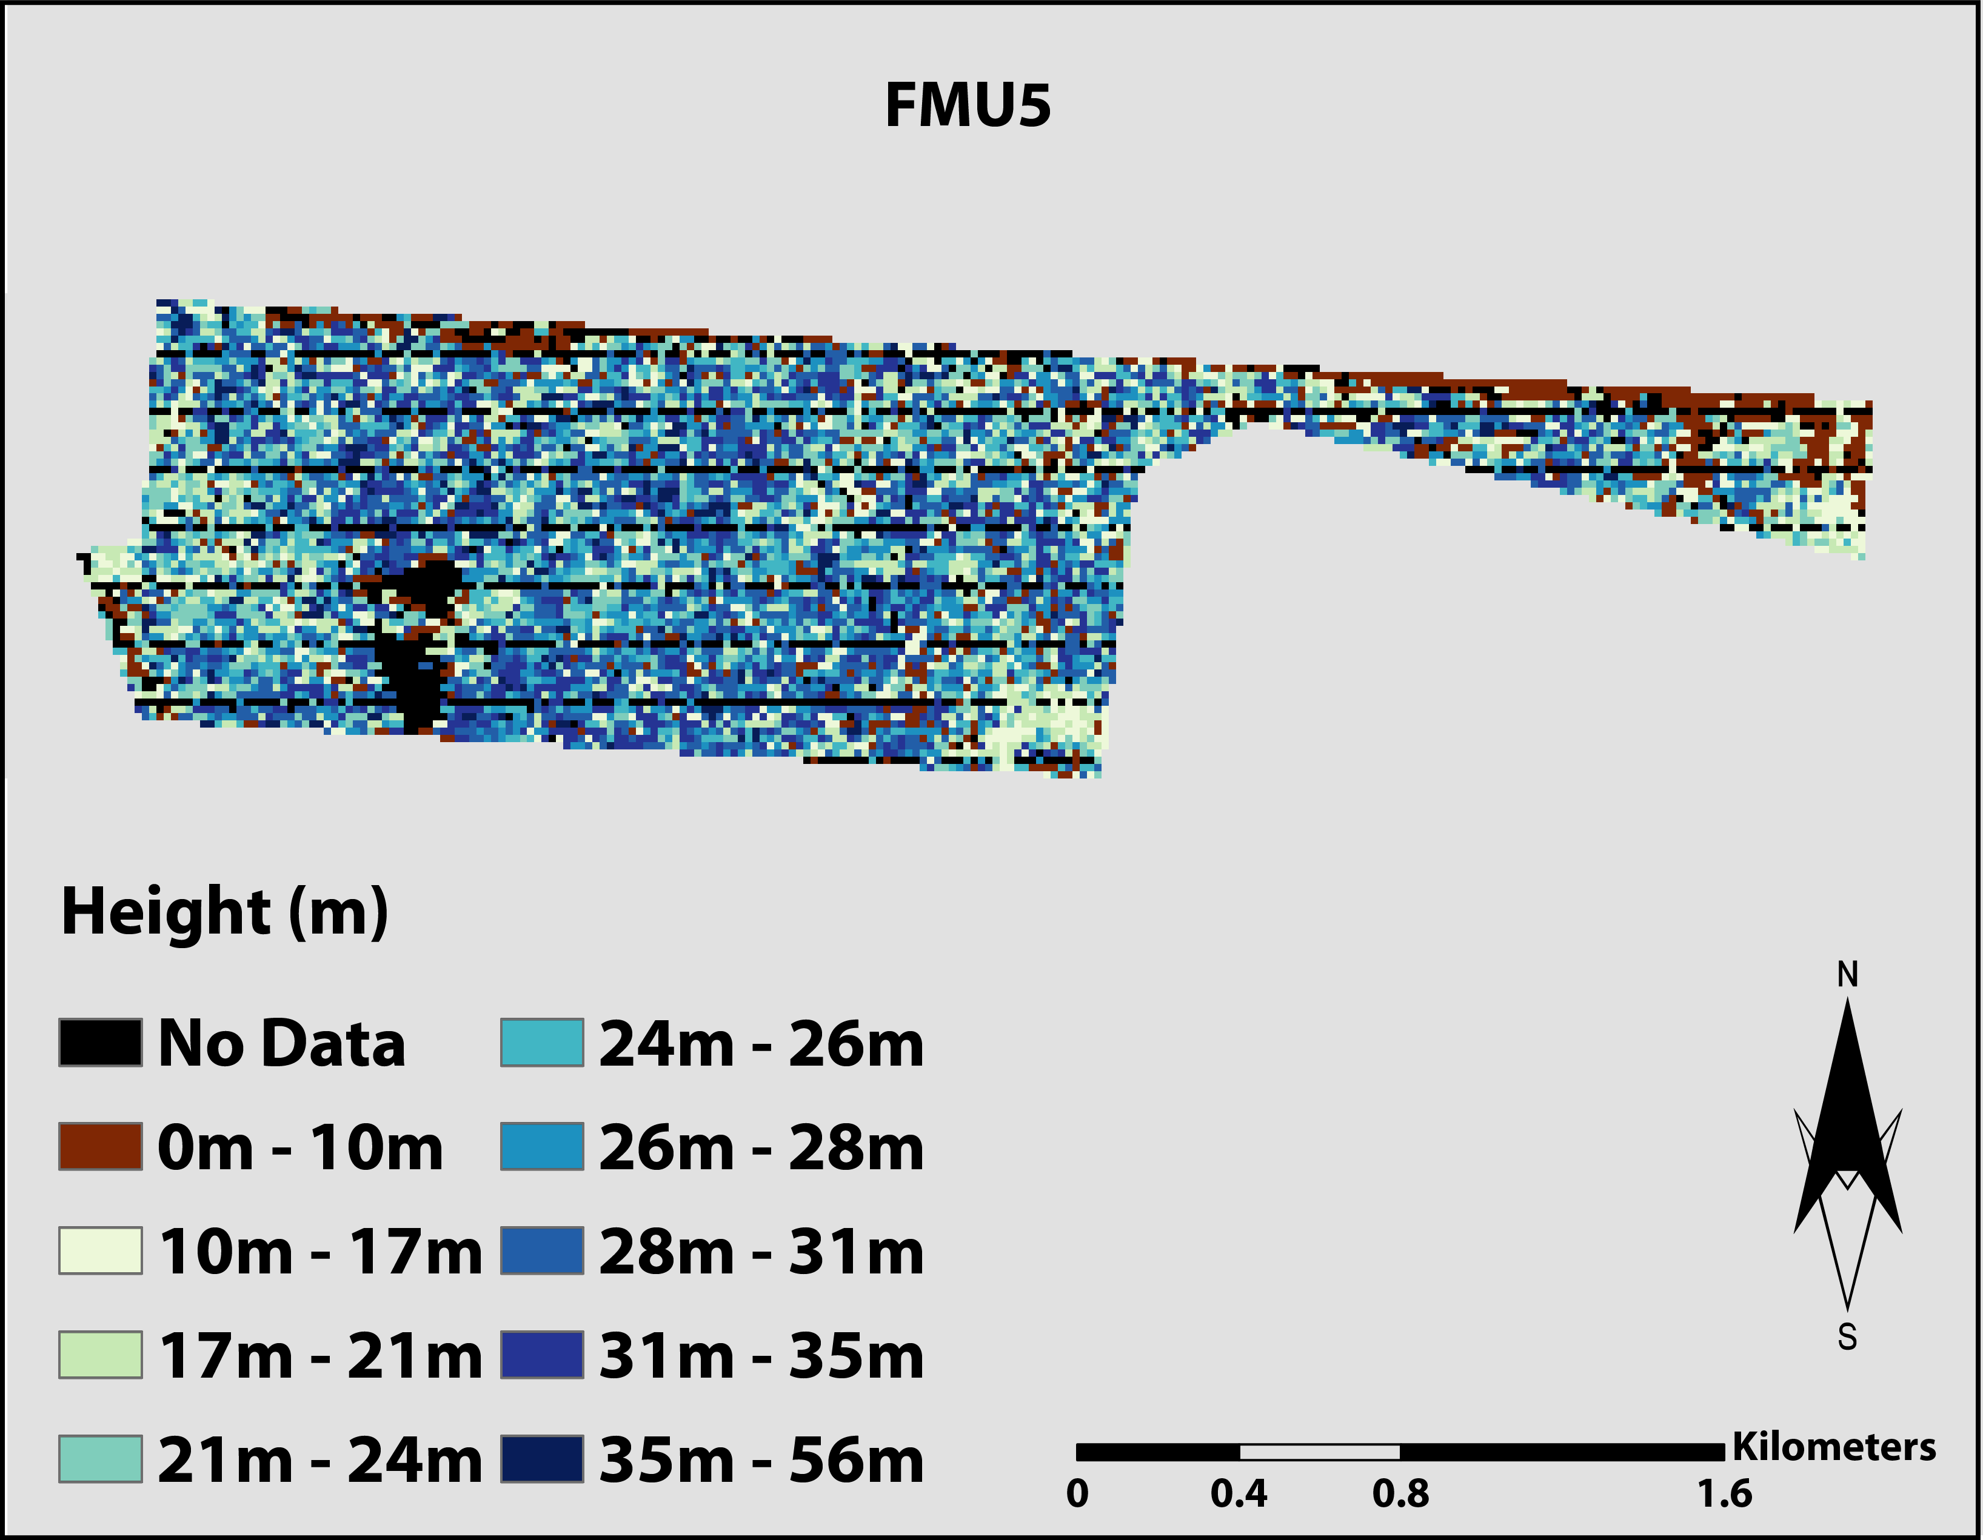
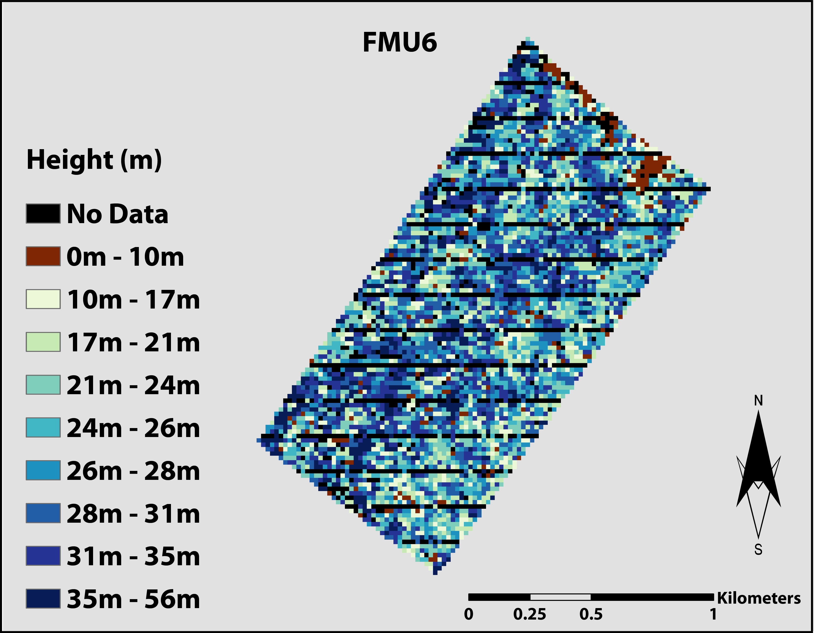
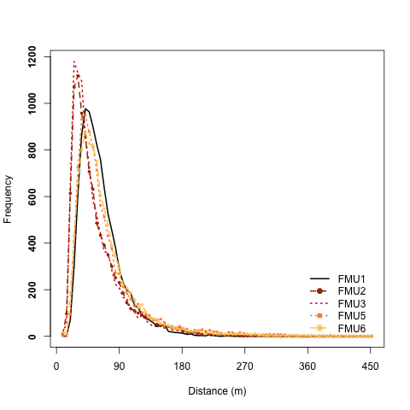

Slide 16
Summary:
Shape-based metrics can be used to process lidar waveforms & identify waveform complexity
Differences in waveform complexity appear to be related to forest management practices
Future Directions:
Lacunarity analysis of UAVSAR data for sites
Incorporate scale of fluctuation from passive optical data
Incorporate biodiversity data with spatial patterns of lidar metrics & spectral indices

Slide 17
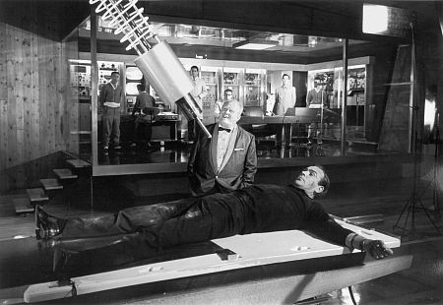
“A solution looking for a problem.”
Thanks to:
Adriana Tovar, Prof. Manuel Spinola, Eric Salas, Debolin Sinha
Lidar data were provided by the Laser Vegetation and Ice Sensor (LVIS) team in the Laser Remote Sensing Branch at NASA Goddard Space Flight Center with support from the University of Maryland, College Park.
Funding Source:
NASA Biodiversity program

