Slide 1
USING LIDAR TO ASSESS THE ROLES OF CLIMATE AND LAND-COVER DYNAMICS AS DRIVERS OF CHANGES IN BIODIVERSITY
PIs: Giorgos Mountrakis, Colin Beier, Bill Porter⁺, Benjamin Zuckerberg^, Lianjun Zhang, Bryan Blair*
PhD Students: Huiran Jin, Wei Zhuang, John Wiley, Marta A. Jarzyna⁺
SUNY College of Environmental Science & Forestry
⁺Michigan State University
^University of Wisconsin at Madison
*NASA Goddard Space Flight Center

Slide 2
Project Components
GOAL: Assess the roles of climate and land-use change on biodiversity dynamics
Remote sensing: Vegetation heights extraction from LiDAR
Successional vegetation modeling: Markov chain transition model
Biodiversity modeling: Avian community turnover in relation to climate change and land cover change

Slide 3
Remote Sensing Vegetation height extraction using LiDAR LVIS

Slide 4
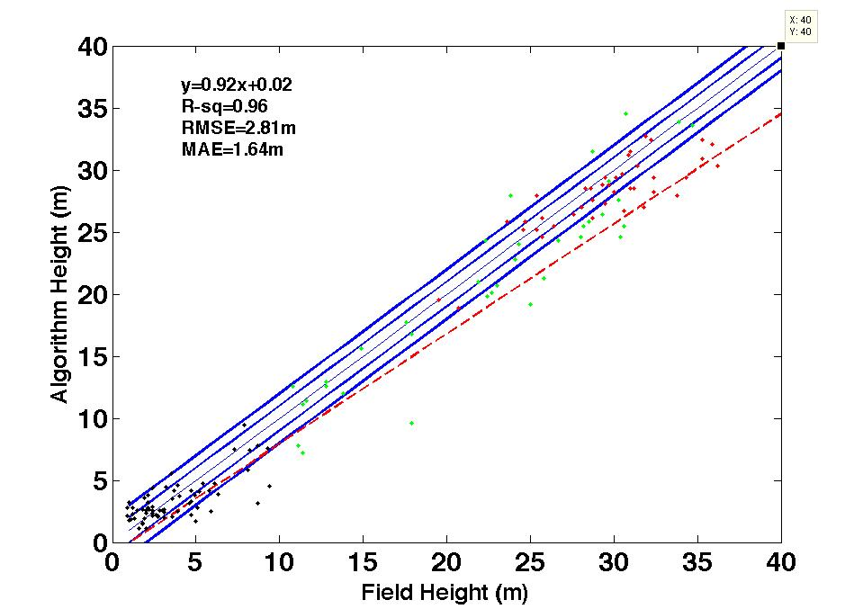
Vegetation Height Extraction Using LiDAR LVIS
Good results but relatively low accuracy in low heights (shrubs)
Remote Sensing Vegetation Model Biodiversity Model
Notes:
The three colors correspond to the type of the plot. Black = shrub, red= coniferous, green = deciduous. The red dashed line is the best linear fit.

Slide 5
Error Sources (<3m)
Slope
Limited shrub presence
Time discrepancy between fieldwork and LVIS
Limitation of LVIS signal
Limitation of signal processing
Remote Sensing Vegetation Model Biodiversity Model
Notes:
It is mostly the first reason – slope.

Slide 6
Remote Sensing
Vegetation height extraction using LiDAR LVIS
New York State 2010 Landsat Product
Remote Sensing Vegetation Model Biodiversity Model
Notes:
The LVIS data was used in conjunction with high resolution imagery (aerial photographs) to create the reference dataset. That reference dataset was combined only with Landsat data to produce the NYS maps. So no LVIS data were used in the classification, LVIS just assisted a bit to create groundtruth information to train our Landsat-based algorithms.

Slide 7
Leaf Off/On Scenes
(19 in total)
2009.04.10
2010.04.13
2009.04.19
2009.03.23
2009.04.17
2010.04.04
2009.04.10
2010.04.13
2008.04.16
2009.04.19
Path 12 Row 31
2010.03.07
2011.03.17
2011.04.18
2009.03.23
2010.04.04
2009.04.26
2008.04.16
For the footprints where one clear scene cannot be found, like path 15 row 29, two scenes were used.
2010.03.07
2011.03.17
Remote Sensing Vegetation Model Biodiversity Model
Notes:
Use Landsat scenes from both leaf-on and leaf-off as that increased accuracy, especially for the vegetation classes.

Slide 8
New York State 2010
Accuracy of shrub class ~70%
NLCD 2006 accuracy <30%
Remote Sensing Vegetation Model Biodiversity Model
Notes:
Major improvement over NLCD – shrub dynamics are not that high to justify the time difference (2006 to 2010) as a significant source of error for the NLCD. Our classifier is significantly better, especially for the shrub class that we are interested in.

Slide 9
Vegetation Model A new approach

Slide 10
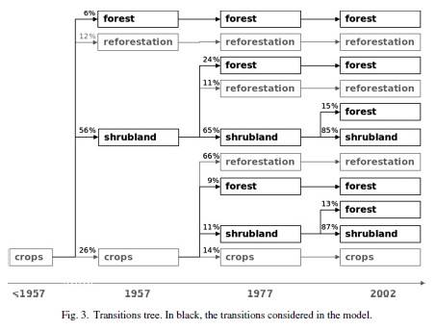
Vegetation Model – A New Approach
Markov Chain Transition model:
View vegetation at individual times as discrete states (i.e., habitat types: grass, shrub, forest)
Model derived from matrix of transition probabilities from one state to another
Pueyo, Y., and S. Beguer. 2007. Modelling the rate of secondary succession after farmland abandonment in a Mediterranean mountain area. Landscape and Urban Planning 83:245–254.
Remote Sensing Vegetation Model Biodiversity Model

Slide 11
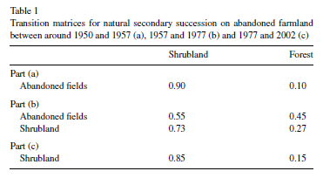
Transition Probabilities
Building on the training data methods for the habitat classification already produced
Use identical training locations with historical imagery and field verification to determine past states at thousands of locations
Pueyo, Y., and S. Beguera. 2007. Modelling the rate of secondary succession after farmland abandonment in a Mediterranean mountain area. Landscape and Urban Planning 83:245–254.
Remote Sensing Vegetation Model Biodiversity Model

Slide 12
Markov Model
Can provide insight into agricultural and urban/suburban land use changes and provide predictive output
Generally assumes stationarity of transition probabilities
However, logistic regression incorporating spatial variation can lead to more robust non-stationary estimates of transition probabilities (i.e., higher transition probability from field to urban near population centers)
Model outputs are derived from Monte Carlo simulation frequency distributions of transition frequency trials
Remote Sensing Vegetation Model Biodiversity Model

Slide 13
Biodiversity Model Community turnover

Slide 14
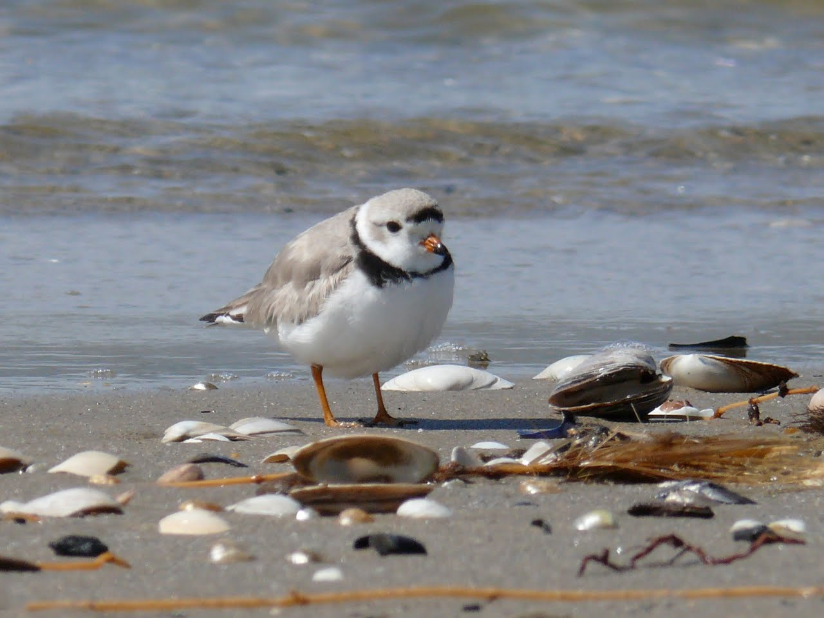
Background
Majority of research on responses of individual species
Aggregation of individual species responses to reflect community responses
Important that communities are evaluated as a stand alone entity
Turnover (temporal β-diversity) - one way of looking at biodiversity dynamics
Remote Sensing Vegetation Model Biodiversity Model

Slide 15
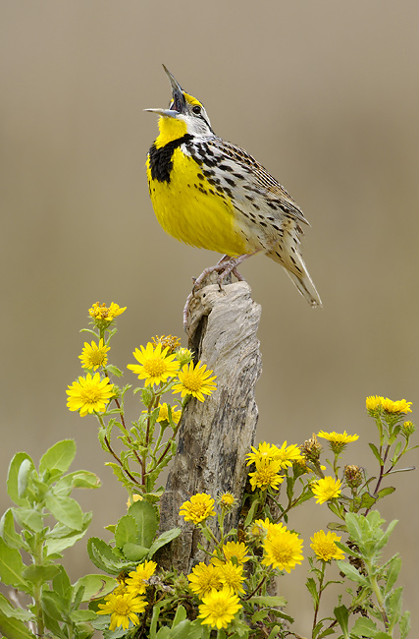
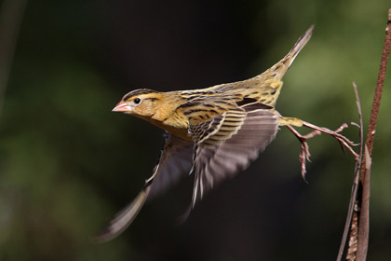
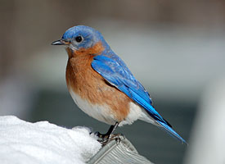
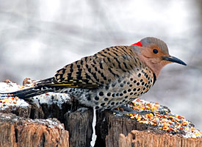
Goals and Hypotheses
Goal: Investigate community turnover and its drivers.
Hypotheses:
H1: High turnover is related to climate change.
H2: Land cover interacts with climate change in shaping responses of communities to environmental change.
H3: Birds with different migratory strategies
exhibit different responses.
Photos courtesy of David Speiser, Christopher Taylor, and Cape May Bird Observatory
Remote Sensing Vegetation Model Biodiversity Model

Slide 16
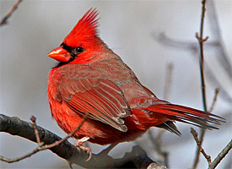
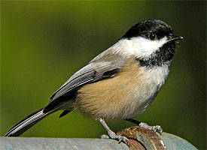
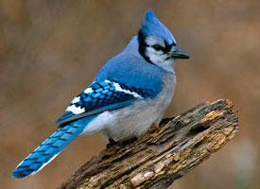
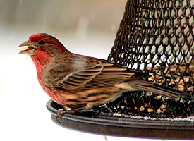
Preliminary Methods
Datasets: NYS Breeding Bird Atlas (1980s
and 2000s), PRISM, NLCD
Response variable:
-Community turnover – Sorensen Index
(BBA)
Predictor variables:
-Trends in climatic factors (Tmax, Tmin, Precip;
PRISM)
-Habitat disturbance (% developed land; NLCD)
-Change in survey effort
Remote Sensing Vegetation Model Biodiversity Model

Slide 17
Community Turnover
Community turnover index – Sorensen Index:
S = 2P/(E+C+P)
where P is number of species common to both times, E is the number of species that went extinct in the block, C is the number of species that colonized the block.
High
Similarity
Low
Turnover
Large S
Community turnover index – Sorensen Index for each migratory group:
Long-Distance Migrants: S_{L} = 2P_{L}/(E_{L}+C_{L}+P_{L})
Short-Distance Migrants: S_{S} = 2P_{S}/(E_{S}+C_{S}+P_{S})
Resident Species: S_{R} = 2P_{R}/(E_{R}+C_{R}+P_{R})
Remote Sensing Vegetation Model Biodiversity Model

Slide 18
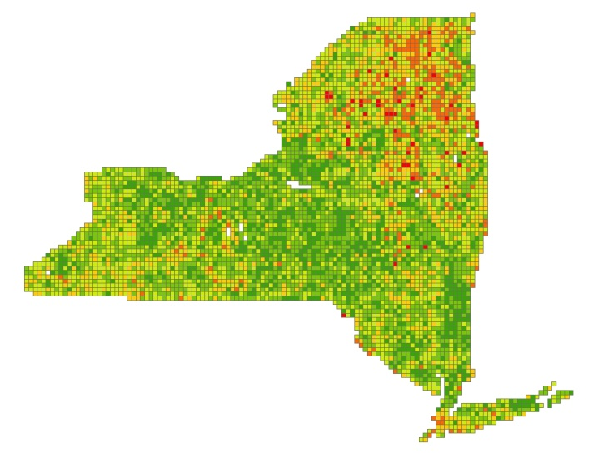
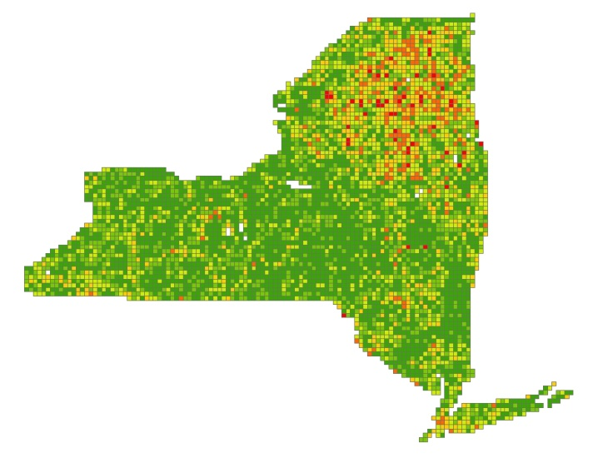
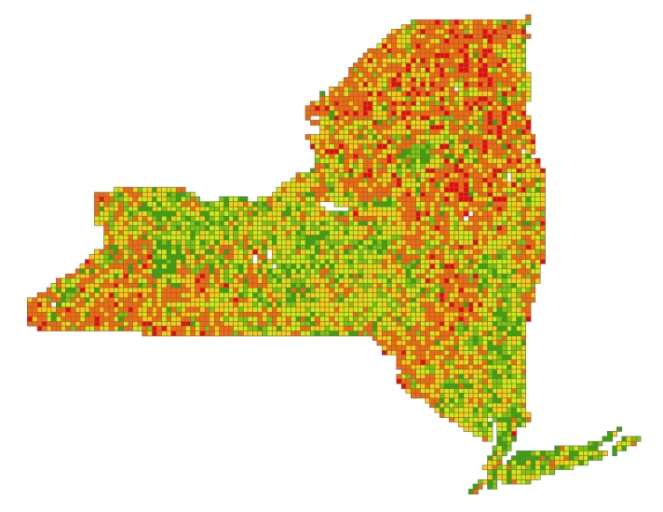
Community Turnover
All Migratory
Groups
Long-Distance
Migrants
Short-Distance
Migrants
Resident
Species
Remote Sensing Vegetation Model Biodiversity Model

Slide 19
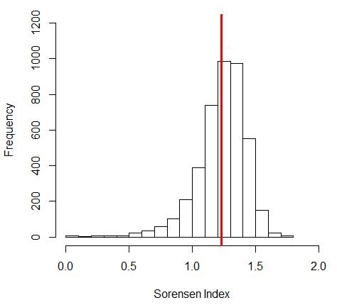
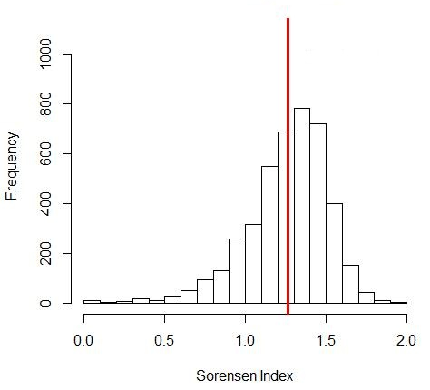
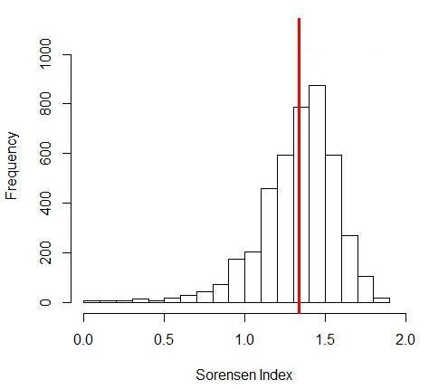
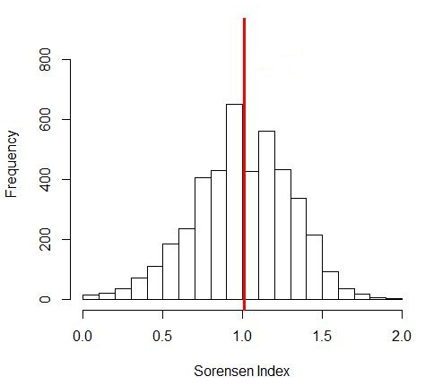
Community Turnover
All Migratory
Groups
Long-Distance
Migrants
mean = 1.23
mean = 1.27
38%
change
36%
change
Short-Distance
Migrants
Resident
Species
mean = 1.34
mean = 1.0
33%
change
50%
change
Remote Sensing Vegetation Model Biodiversity Model

Slide 20
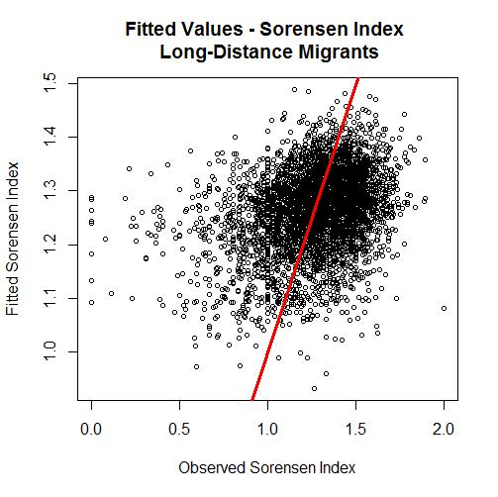
Preliminary Results
Long-Distance Migrants
Best Model:
S_{L} = α + β₁·Devel + β₂·TMAX
+ β₃·TMAX·Devel + β₄·TMIN
+ β₅·TMIN·Devel + β₆·PRECIP
+ β₇·PRECIP·Devel + β₈·EFF
ΔBIC: 16.645
SE: 0.235
Remote Sensing Vegetation Model Biodiversity Model

Slide 21
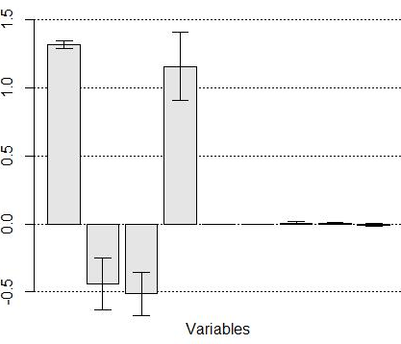
Preliminary Results
Long-Distance Migrants
Tmax = -0.4434: Higher community turnover in locations where Tmax increased most
*
*
Tmin = -0.5130: Higher community turnover in locations where Tmin increased most
TMAX:DEVEL
TMIN:DEVEL
PRECIP:DEVEL
INTERCEPT
*
*
*
*
TMAX
PRECIP
DEVEL
EFFORT
TMIN
Precip = 1.1573: Higher community turnover in locations where Precip decreased most
Devel and Effort: Significant but very small
Remote Sensing Vegetation Model Biodiversity Model

Slide 22
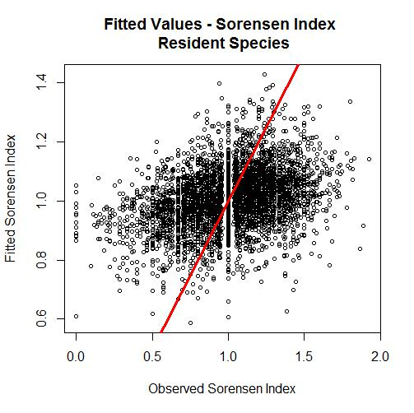
Preliminary Results
Resident Species
Best Model:
S_{R} = α + β₁·Devel + β₂·TMAX
+ β₃·TMAX·Devel + β₄·TMIN
+ β₅·TMIN·Devel + β₆·PRECIP
+ β₇·PRECIP·Devel + β₈·EFF
ΔBIC: 21.306
SE: 0.282
Remote Sensing Vegetation Model Biodiversity Model

Slide 23
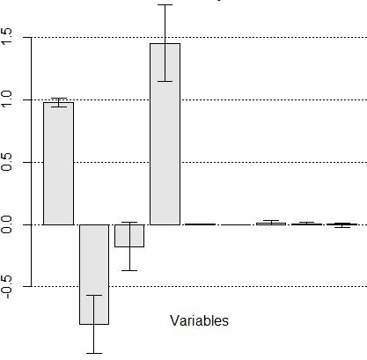
Preliminary Results
Resident Species
Tmax = -0.8002: Higher community turnover in locations where Tmax increased most
*
*
Precip = 1.4542: Higher community turnover in locations where Precip decreased most
TMAX:DEVEL
TMIN:DEVEL
PRECIP:DEVEL
INTERCEPT
*
*
*
TMAX
PRECIP
DEVEL
EFFORT
TMIN
Devel and Effort: Significant but very small
Remote Sensing Vegetation Model Biodiversity Model

Slide 24
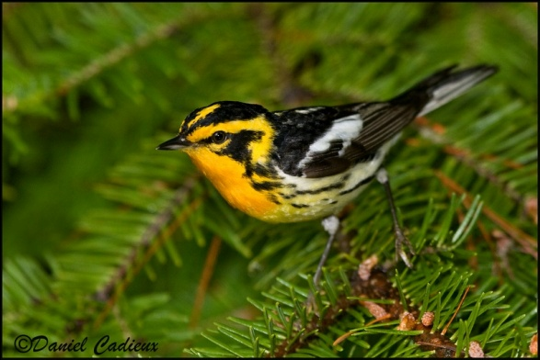
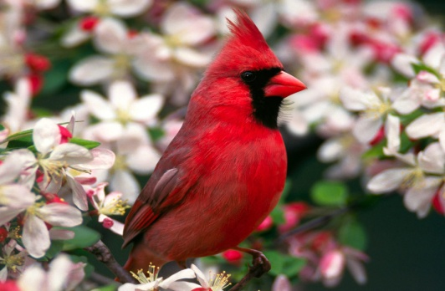
Preliminary Results
Long-Distance Migrants vs Resident Species
Parameter | Long-Distance | Relationship of the absolute coefficient value | Resident
Tmax | -0.4434 | < | -0.8002
Tmin | -0.5130 | > | -0.1774
Precip | 1.1573 | < | 1.4542
Remote Sensing Vegetation Model Biodiversity Model

Slide 25
Preliminary Conclusions
H1: High community turnover is related to climate change.
Conclusion: YES
H2: Land cover interacts with climate change in shaping responses of communities to environmental change.
Conclusion: NO EVIDENCE
H3: Birds with different migratory strategies exhibit
different responses to environmental change.
Conclusion: POSSIBLY
Remote Sensing Vegetation Model Biodiversity Model

Slide 26
Next Steps for Biodiversity Modeling
What causes resident species to have higher turnover?
What’s the remaining variation?
Appropriate habitat fragmentation metrics
Incorporate successional vegetation model
Responses to climate/land-cover are often heterogeneous or non-linear within a species geographic range
Spatially-varying coefficients models in Bayesian framework
Remote Sensing Vegetation Model Biodiversity Model

Slide 27
Anticipated Timeline
Remote sensing:
-Close to completion
Successional vegetation modeling:
-Final backcast and forecast by October 1, 2013
Biodiversity modeling:
-Final model (explanatory and forecasting) by November 1,
2013
Delivery date: January 1, 2014

Slide 28
Acknowledgements
Funding
-National Aeronautics and Space Administration (NASA)
-NYS Department of Environmental Conservation
-Boone and Crockett Club
Technical Support
-Brian A. Maurer, Andrew O. Finley
-Quantitative Wildlife Laboratory, Michigan State University
-Volunteers who participated in both New York State
Breeding Bird Atlases
Citations available upon request, contact Marta Jarzyna at jarzynam@msu.edu

Slide 29
Questions?

