Slide 1
Extending the Terrestrial Observation and Prediction System (TOPS) to Suomi-NPP Applications
Sangram Ganguly, Forrest Melton
Jennifer Dungan, Ramakrishna Nemani
Ecological Forecasting Lab
NASA Ames Research Center
http://nex.nasa.gov
April 23-25
NASA Biodiversity and Ecological Forecasting Team Meeting 2013

Slide 2
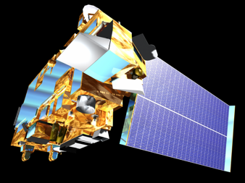

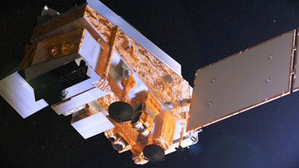

Motivation
Terra MODIS
Continuity of satellite observations is a primary concern for many Applied Science Program (ASP) projects and their partners
Many Applied Science projects currently rely on MODIS data as inputs to models or Decision Support Systems
Suomi NPP VIIRS
Credit: NASA/Reto Stöckli
Credit: NASA/NOAA/GSFC/Suomi NPP/VIIRS/Norman Kuring
Notes:
Now that the MODIS instruments have been up over a decade, we now have the long-planned successor to MODIS in the form of Suomi NPP VIIRS

Slide 3
Objectives
Terra MODIS
Understand any errors and uncertainties associated with the transition from MODIS to VIIRS with reference to ASP projects
Integrate Suomi/NPP data and products into existing applications → must address differences in sensor characteristics, algorithms, & data distribution systems
Leverage TOPS and NEX to engage federal, state and local partners in the Suomi/NPP mission by providing a platform for creating high-level products and rapid prototyping of applications
Suomi NPP VIIRS
Credit: NASA/Reto Stöckli
Credit: NASA/NOAA/GSFC/Suomi NPP/VIIRS/Norman Kuring

Slide 4
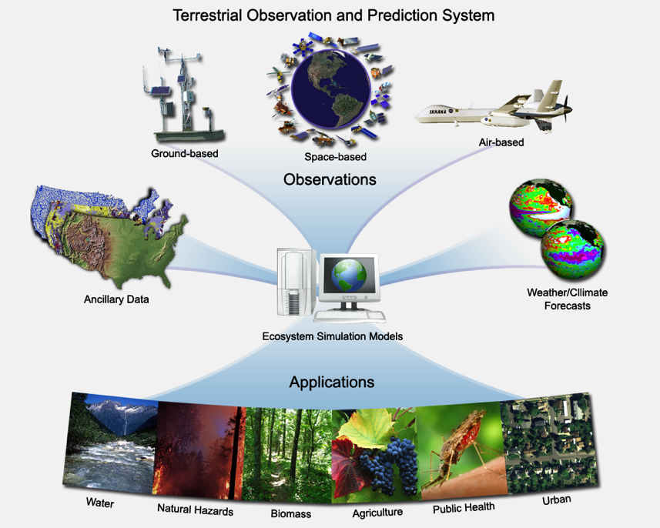
Terrestrial Observation and Prediction System (TOPS)
Partner | Application
NOAA NMFS | Forecasting river temperatures for management of endangered fish species (PI: E Danner, NOAA)
National Park Service | Monitoring and forecasting park ecosystem conditions (PI: A Hansen, Montana State Univ.)
CA Dept. of Water Resources / Western Growers | Mapping crop canopy conditions and crop water requirements (PI: F Melton, NASA Ames / ARC-CREST)
USGS / CA DWR | Mapping fallow area extent (PI: J Verdin, USGS)
Notes:
Data products from the TOPS modeling framework have been applied in more than a dozen ASP projects. While we are focusing on four of these projects because members of our team collaborate or lead them, our findings should be relevant to most of them.

Slide 5
Key findings from
January 2013 NPP Science Team Meeting
Broad consensus that Suomi NPP instruments are working well
Equally broad consensus that there are serious problems with algorithms and QA processing as implemented in the NOAA IDPS
Major issues with algorithm documentation from Northrop-Grumman, especially on QA handling
As a result, VIIRS data products from IDPS frequently do not agree with concurrent MODIS data products; however, VIIRS data from Land PEATE (which is running algorithms comparable to MODIS Collection 6 algorithms) do agree well with MODIS data products
Notes:
Our progress with the project has been driven by the pace of VIIRS data production both on the NOAA side, with their IDPS, and on the NASA side, with the evaluation of those products being done by the PEATEs.

Slide 6
Key findings from
January 2013 NPP Science Team Meeting
(continued)
The NASA NPP Science Team is working with NOAA but is experiencing long delays (>3-6 months) in implementing algorithm changes
The NOAA IDPS / CLASS system is viewed as the primary data provider for near real-time operational uses (including NASA ASP)
IDPS is not planning to provide capability for reprocessing
IDPS is not planning to provide gridded Level 3 products

Slide 7
MODIS-VIIRS Transition Issues
VIIRS vs. MODIS Corresponding Spectral Bands
Spectral characteristics:
MODIS and VIIRS bands used for land products have similar spectral characteristics
Tungsten oxide contamination is a potential problem for VIIRS bands I2 and M7
Spatial characteristics:
Improved spatial resolution at swath edge for VIIRS vs. MODIS
375m vs. 250m resolution limits utility for some ag & ecosystem monitoring applications
Algorithms:
Algorithm changes from MODIS to VIIRS for some standard products
Different compositing periods
Data processing and distribution:
MODIS data pool vs. NOAA CLASS
Lack of reprocessing of standard products may limit VIIRS utility for detection of anomalies / long-term trends
VIIRS Band | Spectral Range (μm) | Nadir HSR (m) | MODIS Band(s) | Spectral Range (μm) | Nadir HSR (m)
DNB | 0.500 – 0.900
M1 | 0.402 – 0.422 | 750 | 8 | 0.405 – 0.420 | 1000
M2 | 0.436 – 0.454 | 750 | 9 | 0.438 – 0.448 | 1000
M3 | 0.478 – 0.498 | 750 | 3 10 | 0.459 – 0.479 0.483 – 0.493 | 500 10000
M4 | 0.545 – 0.565 | 750 | 4 12 | 0.545 – 0.565 0.546 – 0.556 | 500 1000
I1 | 0.600 – 0.680 | 375 | 1 | 0.620 – 0.670 | 250
M5 | 0.662 – 0.682 | 750 | 13 14 | 0.662 – 0.672 0.673 – 0.683 | 1000 1000
M6 | 0.739 – 0.754 | 750 | 15 | 0.743 – 0.753 | 1000
I2 | 0.846 – 0.885 | 375 | 2 | 0.841 – 0.876 | 250
M7 | 0.846 – 0.885 | 750 | 16 2 | 0.862 – 0.877 0.841 – 0.876 | 1000 250
M8 | 1.230 – 1.250 | 750 | 5 | SAME | 500
M9 | 1.371 – 1.386 | 750 | 26 | 1.360 – 1.390 | 1000
I3 | 1.580 – 1.640 | 375 | 6 | 1.628 – 1.652 | 500
M10 | 1.580 – 1.640 | 750 | 6 | 1.628 – 1.652 | 500
M11 | 2.225 – 2.275 | 750 | 7 | 2.105 – 2.155 | 500
I4 | 3.550 – 3.930 | 375 | 20 | 3.660 – 3.840 | 1000
M12 | 3.660 – 3.840 | 750 | 20 | SAME | 1000
M13 | 3.973 – 4.128 | 750 | 21 22 | 3.929 – 3.989 3.929 – 3.989 | 1000 1000
M14 | 8.400 – 8.700 | 750 | 29 | SAME | 1000
M15 | 10.263 -- 11.263 | 750 | 31 | 10.780 – 11.280 | 1000
I5 | 10.500 – 12.400 | 375 | 31 32 | 10.780 – 11.280 11.770 – 12.270 | 1000 1000
M16 | 11.538 – 12.488 | 750 | 32 | 11.770 – 12.270 | 1000

Slide 8
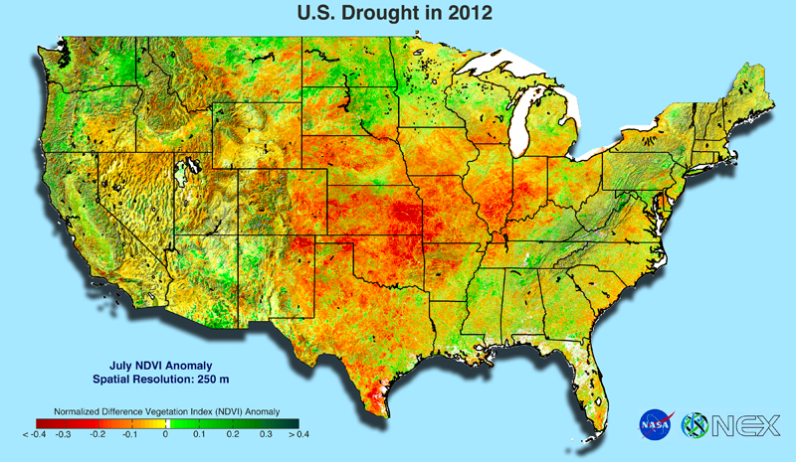
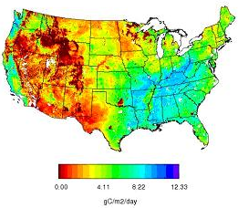
Workflow
NEX
Datapool
VIIRS Data Acquisition
MODIS/ VIIRS Consistency
Climatology/Anomaly Workflow
LAI/ FPAR Processing
Inter-compare MODIS & VIIRS SSR Products
QA filtering/ analysis
Time-series comparison
VI consistency adjustment
MODIS Climatology/Anomaly Workflow Engine
Compositing Routines
Reprojection/Mosaicking Routines
VIIRS Climatologies/
Anomalies
Test with MODIS
Reproduce known trends
BU LAI/FPAR Team
Inputs from consistency check
Aid in LUT development
TOPS
VIIRS-
Derived Products
MODIS- Derived Products
Verification/ Validation
Ancillary Data

Slide 9
Data Acquisition
VIIRS Surface Reflectance Products
Data obtained from VIIRS Land PEATE Team (Early December, 2012)
Data for U.S. from June, 2012 to September 2012 used for initial consistency testing with MODIS
Surface Reflectance and associated QA at 1-km resolution and SZA files obtained
MODIS Surface Reflectance/ Vegetation Index Products
All MODIS Surface Reflectance/ Vegetation Index Collection 6 Products from 2000 onwards are available in the NEX datapool

Slide 10


NASA Earth Exchange (NEX) http://nex.nasa.gov
Notes:
NEX is providing a platform for testing and analysis of VIIRS data products as well as running TOPS.

Slide 11
VIIRS QA Flags
Bit 0 (missing OZ input data) | Bit 1 (missing SP input data) | Bit 2 (quality of M1 SR data) | Bit 3 (quality of M2 SR data) | Bit 4 (quality of M3 SR data) | Bit 5 (quality of M4 SR data) | Bit 6 (quality of M5 SR data) | Bit 7 (quality of M7 SR data)
0 – no 1 – yes | 0 – no 1 – yes | 0 – bad 1 – good | 0 – bad 1 – good | 0 – bad 1 – good | 0 – bad 1 – good | 0 – bad 1 – good | 0 – bad 1 – good
Band 5 & 7 QA
(Land_Quality_Flags_b05_1)
Bit 0-1 (cloud mask quality) | Bit 2-3 (cloud detection & confidence) | Bit 4 (day/ night) | Bit 5 (low sun mask) | Bit 6-7 (sun glint)
00 – poor 01 – low 10 –medium 11 – high | 00 – confident clear 01 – probably clear 10 – probably cloudy 11 – confident cloudy | 0 – day 1 – night | 0 – high 1 – low | 00 – none 01 – geometry based 10 – wind speed based 11 – geometry and wind speed based
Cloud Flags
(Land_Quality_Flags_b01_1)
Bit 0-2 (land/ water background) | Bit 3 (shadow mask) | Bit 4 (heavy aerosol mask) | Bit 6 (thin cirrus reflective) | Bit 7 (thin cirrus emissive)
000 – land and desert 001 – land no desert 010 – inland water 011 – sea water 101 – coastal | 0 – no cloud shadow 1 – shadow | 0 – no heavy aerosol 1 – heavy aerosol | 0 – none 1 – yes | 0 – none 1 – yes
Aerosol Flags
(Land_Quality_Flags_b02_1)
Notes:
QA Filtering should produce comparable datasets

Slide 12
MODIS QA
MOD13A2 VI Quality
Bit 0-1 (MODLAND QA) | Bit 6-7 (Aerosol Quantity) | Bit 8 (Adjacent Cloud Detected) | Bit 9 (Atmospheric BRDF correction) | Bit 10 (Mixed Clouds) | Bit 14 (Possible snow/ ice) | Bit 15 (Possible Shadow)
00 – VI produced, good quality 01 – VI produced, check other QA 10 – Pixel most probably cloudy 11 – pixel not produced | 00 – Climatology 01 – Low 10 – Average 11 - High | 0 – No 1 – Yes | 0 – No 1 – Yes | 0 – No 1 – Yes | 0 – No 1 – Yes | 0 – No 1 – Yes
Notes:
Additional flags corresponding to pixel reliability and VI usefulness also used, however caution needs to be taken

Slide 13
QA Processing, Compositing and Inter-Comparison
MODIS 1km SSR/ VI 16-day products are screened for pixels with atmospheric effects (clouds, aerosols, shadows) – this is also done in the present climatology/anomaly module
VIIRS 1km (~750m) daily products are screened for pixels with atmospheric effects and a 16-day compositing is performed based on Maximum NDVI (from corresponding Red and NIR values)
QA consistency test is mandatory to establish similar contaminated pixels from MODIS and VIIRS
Compare QA screened pixels and form adjustment equations to generate consistent SSR/VI products

Slide 14
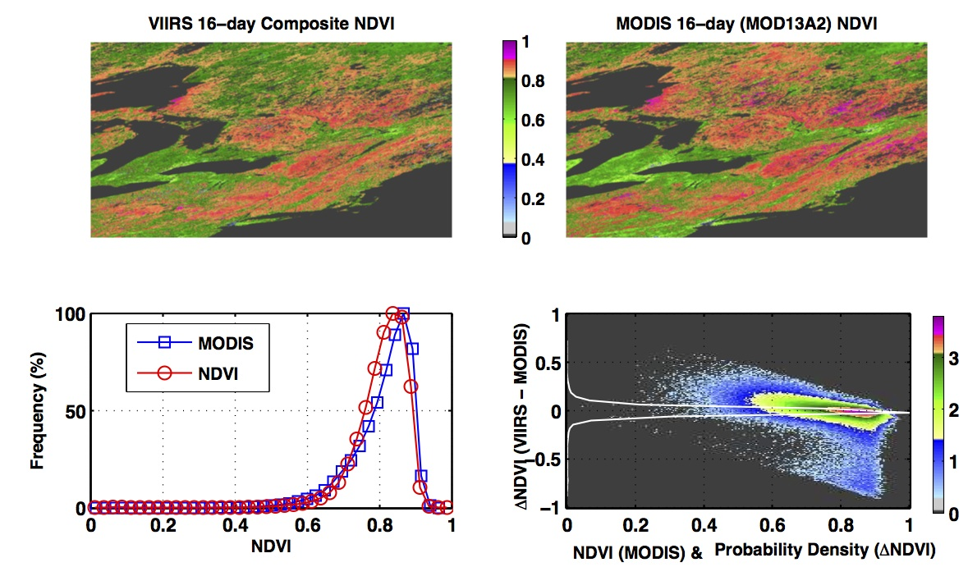
Results
Tile: h12v04 DOY 177-192
The 16-day VIIRS NDVI composites were created from QA/QC filtered (cloud/aerosol filtered) daily VIIRS surface reflectance data.
The MOD13A2 1km 16-day standard product is also QA filtered.
VIIRS

Slide 15
Results (cont.)
Tile: h12v04 DOY 177-192
The cross plots consist of pixels representing Broadleaf Deciduous Forests (as delineated from the MODIS MCD12Q1 Land Cover Product).
Composite DOY varies (depends on compositing scheme, e.g. MODIS uses a combined scheme that incorporates max value compositing with pixels with nadir view). View angle filter can result in patchiness.

Slide 16
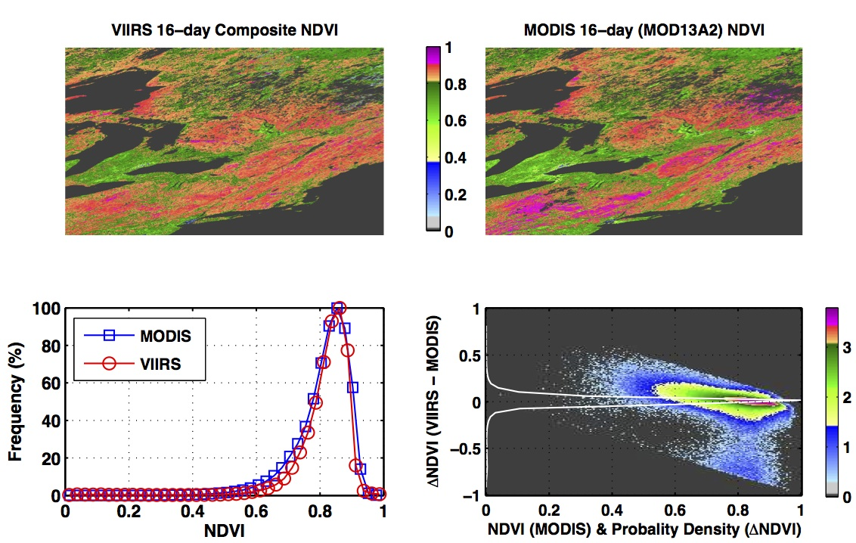
Results (cont.)
Tile: h12v04 DOY 193-208
The 16-day VIIRS NDVI composites were created from QA/QC filtered (cloud/aerosol filtered) daily VIIRS surface reflectance data.
The MOD13A2 1km 16-day standard product is also QA filtered.

Slide 17
Results (cont.)
Tile: h12v04 DOY 193-208
The cross plots consist of pixels representing Broadleaf Deciduous Forest (as delineated from the MODIS MCD12Q1 Land Cover Product).
Composite DOY varies (depends on compositing scheme, e.g. MODIS uses a combined scheme that incorporates max value compositing with pixels with nadir view). View angle filter can result in patchiness.

Slide 18
Results (cont.)
Tile: h12v04
A phenology plot over the first growing season of data shows VIIRS mean values just slightly lower than MODIS, but with higher spatial variance (as would be expected with 750m native HSR).

Slide 19
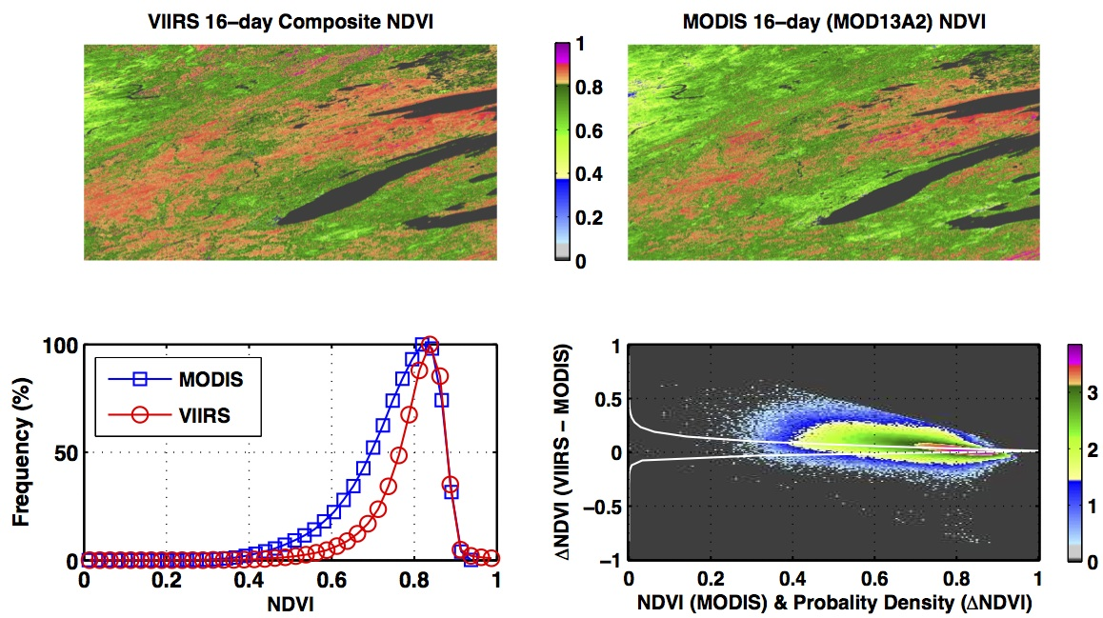
Results (cont.)
Tile: h11v04 DOY 193-208
The 16-day VIIRS NDVI composites were created from QA/QC filtered (cloud/aerosol filtered) daily VIIRS surface reflectance data.
The MOD13A2 1km 16-day standard product is also QA filtered.

Slide 20
Results (cont.)
Tile: h11v04 DOY 193-208
The cross plots consist of pixels representing Broadleaf Deciduous Crops (as delineated from the MODIS MCD12Q1 Land Cover Product).
Composite DOY varies (depends on compositing scheme, e.g. MODIS uses a combined scheme that incorporates max value compositing with pixels with nadir view). View angle filter can result in patchiness.

Slide 21
Plans for the Remainder of the Project
VIIRS Data Acquisition
Update current version of SSR data and acquire other SDRs from NOAA CLASS and Land PEATE Team
Consistency Testing
Develop SSR adjustments between MODIS and VIIRS for consistency in upper level products (e.g. VIs and LAI) in collaboration with Miura and Boston U. team
Cross-check anomalies between MODIS and VIIRS
Applications
Implement TOPS with VIIRS data to assess differences in results and implications for existing applications
Notes:
(e.g. using MODIS climatologies, VIIRS data forward can be used to generate anomalies).

Slide 22
Acronyms
ASP - Applied Science Program
CLASS – Comprehensive Large Array Data Stewardship System
HSR – Horizontal Spatial Resolution
IDPS - Interface Data Processing Segment
LUT - Look Up Table
GPP - Gross Primary Production
NDVI – Normalized Difference Vegetation Index
NPP - National Polar-orbiting Partnership
PEATE - Product Evaluation and Test Element
QA – Quality Assurance
SDR – Sensor Data Record
SSR - Surface Spectral Reflectance
SZA – Solar Zenith Angle
VI - Vegetation Index
VIIRS - Visible Infrared Imager Radiometer Suite

