Slide 1


A Decision Support System for Ecosystem-Based Management of
Tropical Coral Reef Environments
F. Muller-Karger, M. Eakin, J. Li,
L. Guild, S. Lynds, M. Vega-Rodriguez, R. Nemani, C. Hu, G. Quiles – Perez, T. Christensen, L. Wood, C. Fitzgerald

Slide 2

A Partnership
NOAA NESDIS/CRW (M. Eakin, J. Li, G. Liu, T. Christensen)
NOAA AOML / ICON/CREWS (J. Hendee, L. Gramer)
NASA Ames (L. Guild, R. Nemani)
UNEP-WCMC (L. Wood, C. Ravilious, C. Fitzgerald)
U. South Florida (F. Muller-Karger, C. Hu, M. Vega, B. Barnes)
U. Colorado-CIRES (S. Lynds)
NOAA NESDIS/CRW-Australia (W. Skirving, S. Heron / NOAA)

Slide 3
Acknowledgements
  NASA Applied Sciences Program
    Woody Turner
    2008 Ecological Forecasting application area
    4-year program (2009-2013)
  NOAA
    Coral Reef Conservation Program
  UNEP WCMC (World Conservation Monitoring Centre)

Slide 4
Objectives
Operational:
  Improve present NOAA NESDIS Coral Reef Watch (CRW) products using NASA technologies
  Use higher-resolution (1, 5 km ) satellite data
    (MODIS, AVHRR, other)
  Assess value of product / understand user needs
Science:
  Understand long-term change in the Caribbean and Gulf of Mexico
  Test hypotheses on biodiversity and coral reef resilience in the Florida Keys National Marine Sanctuary

Slide 5
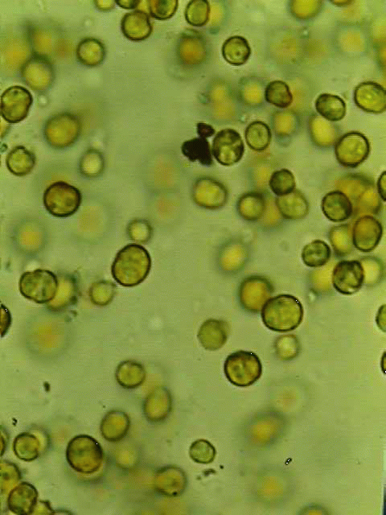
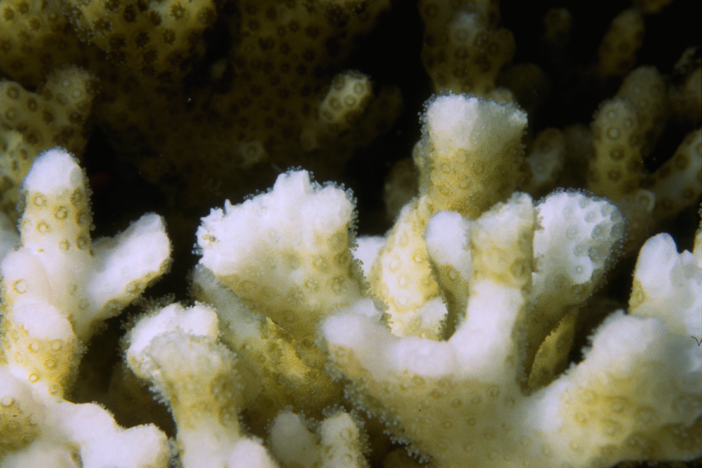
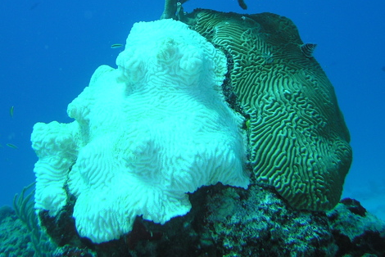
Coral Bleaching:
Impact of Climate Change
Most of corals’ food comes from photosynthesis
Scott R. Santos
Corals exposed to high temperatures and/or high light become stressed
Corals eject their algae; coral appears “bleached
If stress is mild or brief, corals recover, otherwise they die
zooxanthellae
Symbiotic algae
Mass bleaching covers 100-1000’s km2

Slide 6
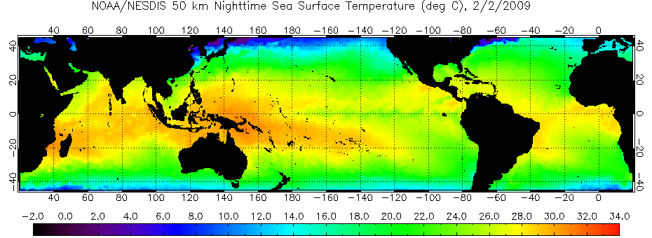
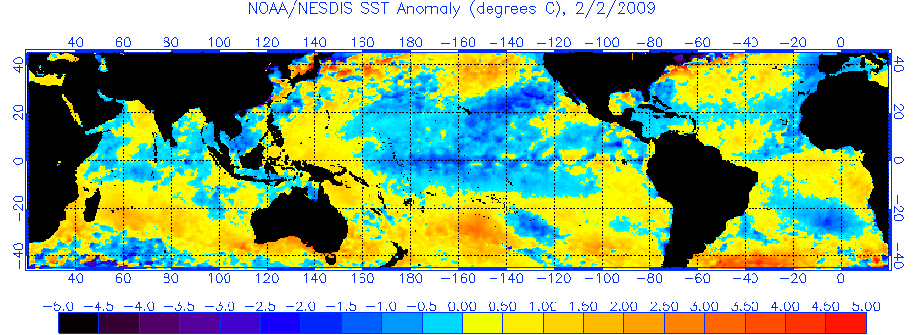
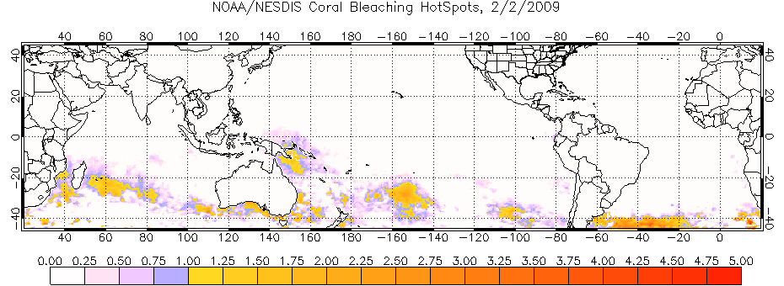
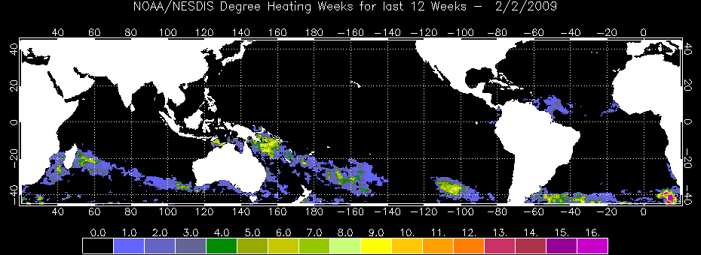
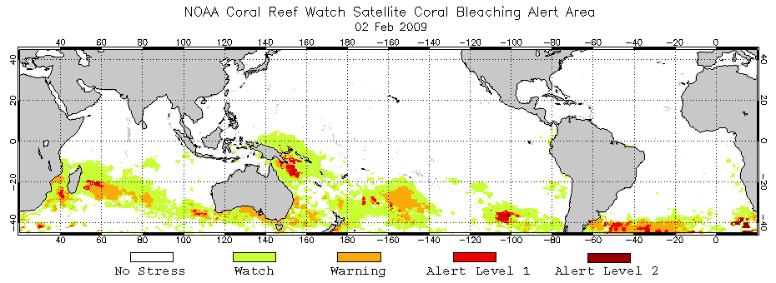
Coral Reef Watch
Satellite-Based Products
Primary Products: SST-based
50km Nighttime Sea Surface Temperature (SST)
Coral –
specific
SST Anomaly
HotSpot
Degree Heating Week
Bleaching Alert Areas

Slide 7
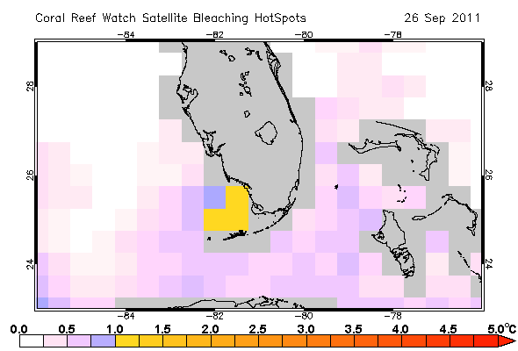
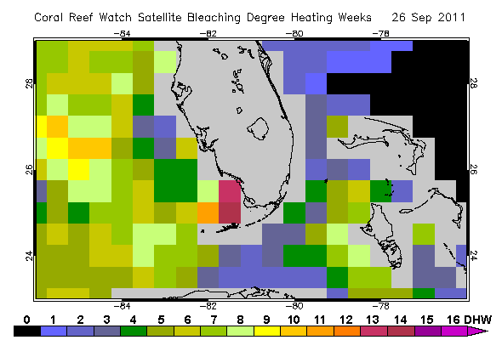
Global
Coral Thermal Stress Products
-produced at 50 km resolution
HotSpot
DHW
7

Slide 8
New products:
Night-time MODIS SST (1km)
    2003-2010 climatology
    CRW products
Night-time 4 km AVHRR Global Pathfinder
  1985-2006
  Gap – filled climatology
  CRW products (1 km regional, 5 km global)
Test area: Florida Keys

Slide 9
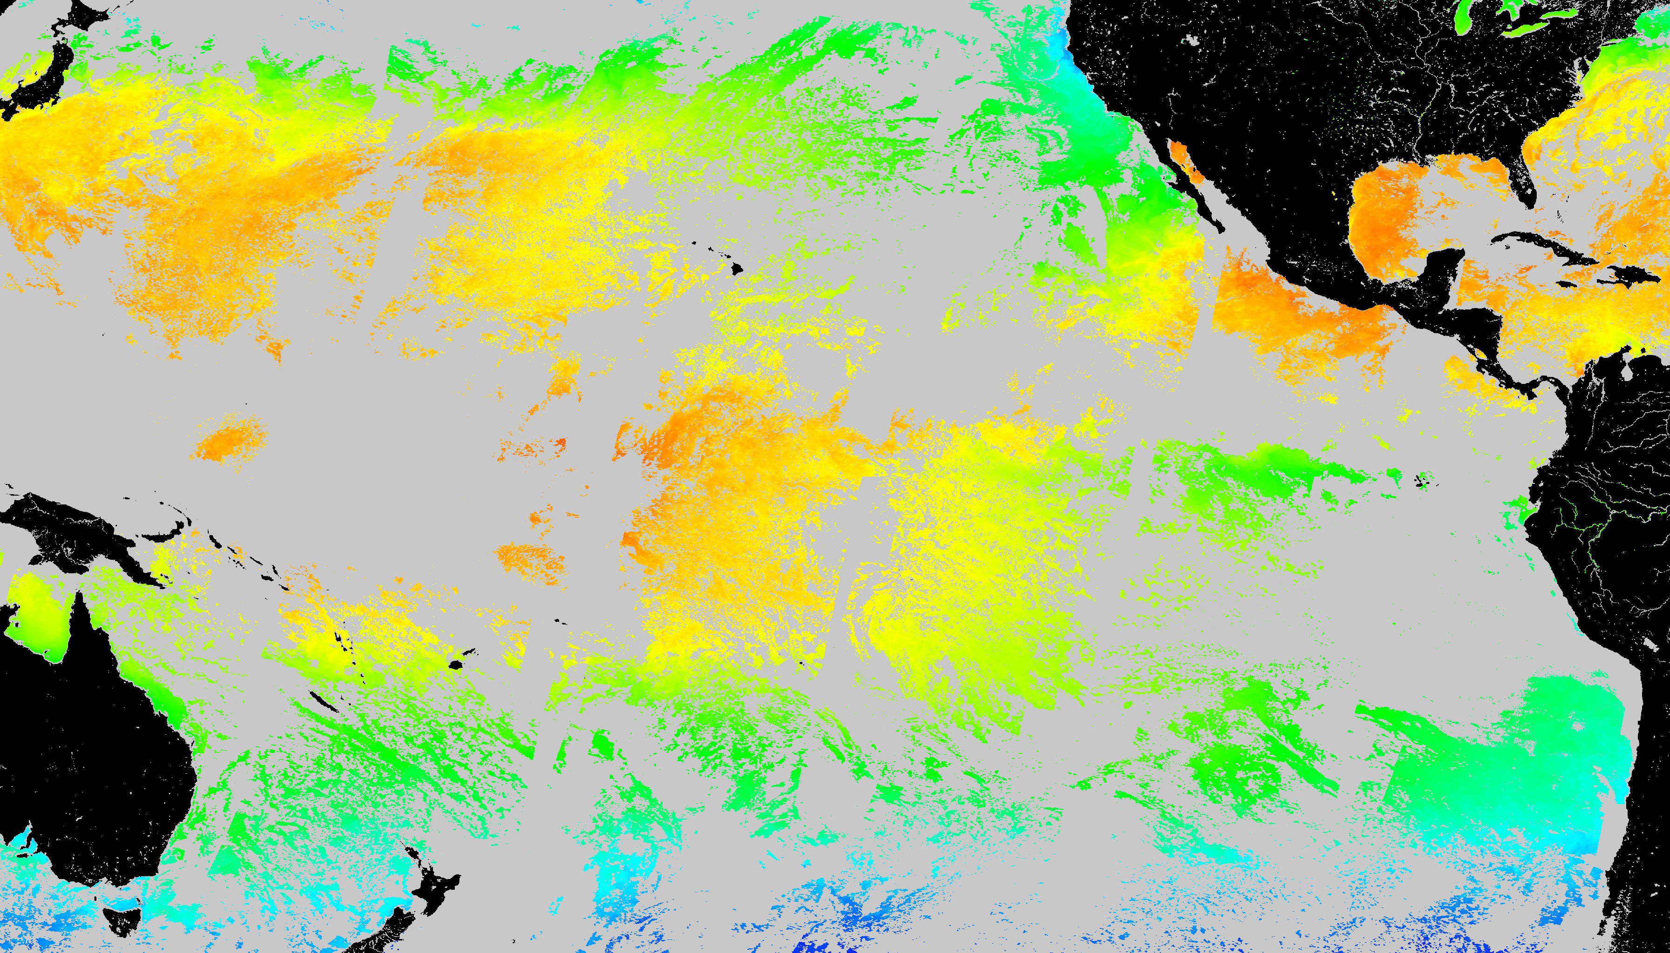
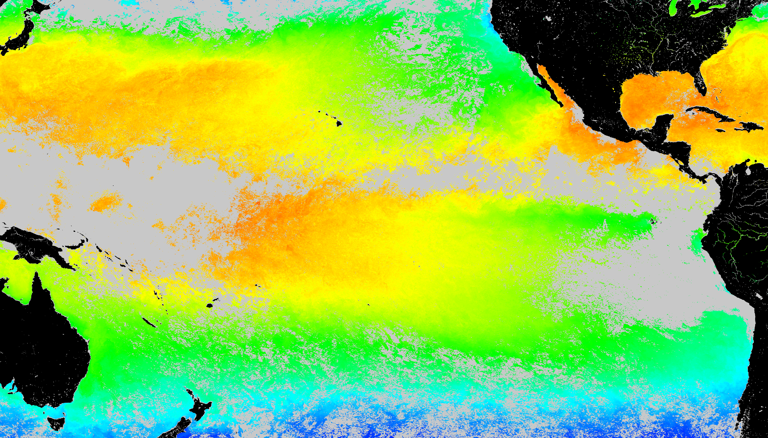
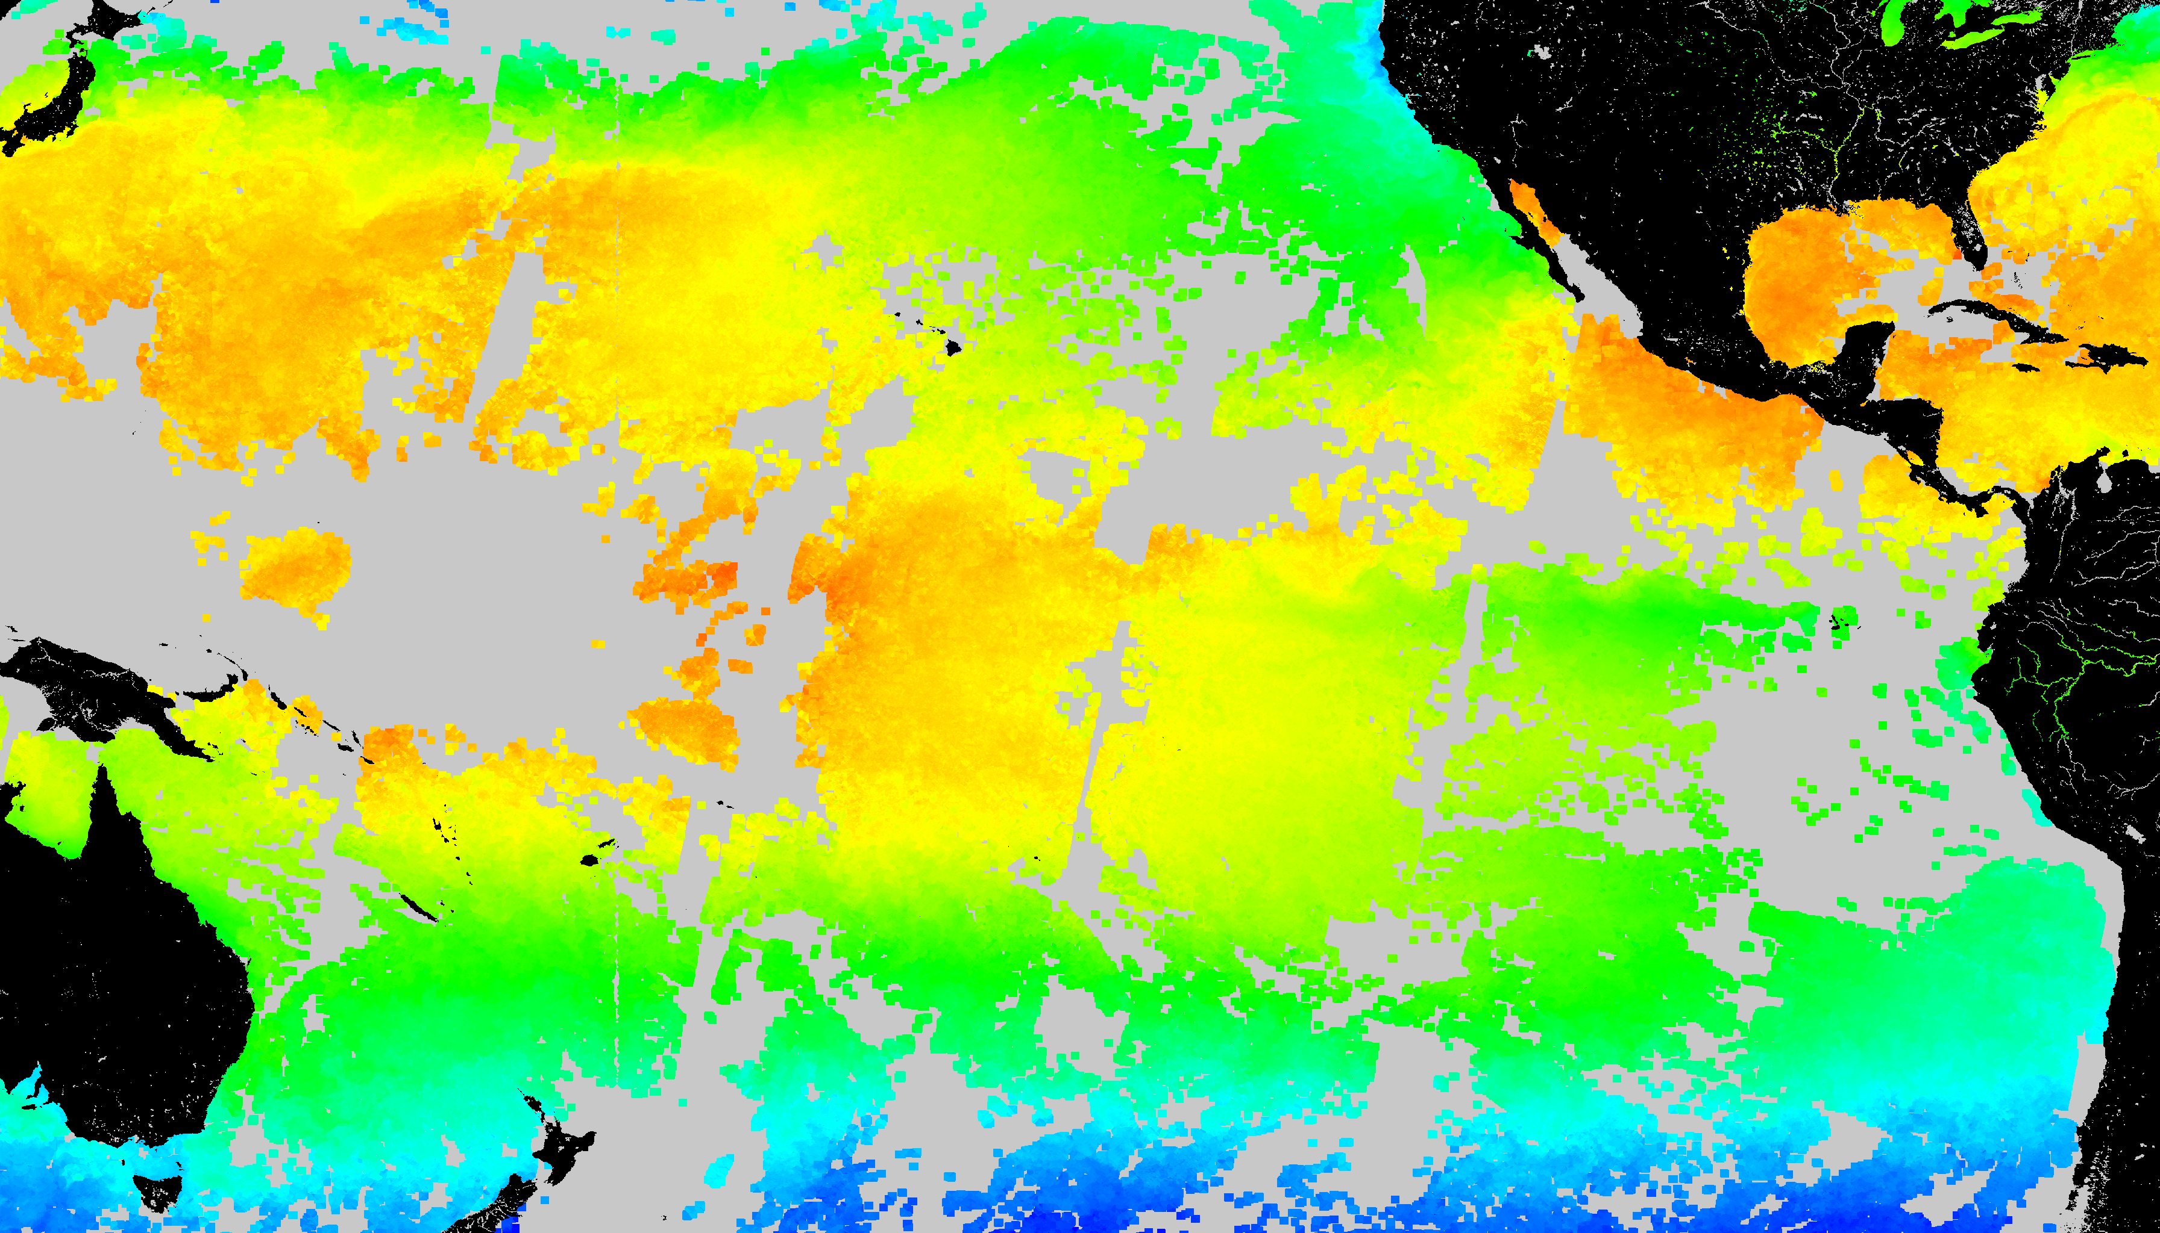
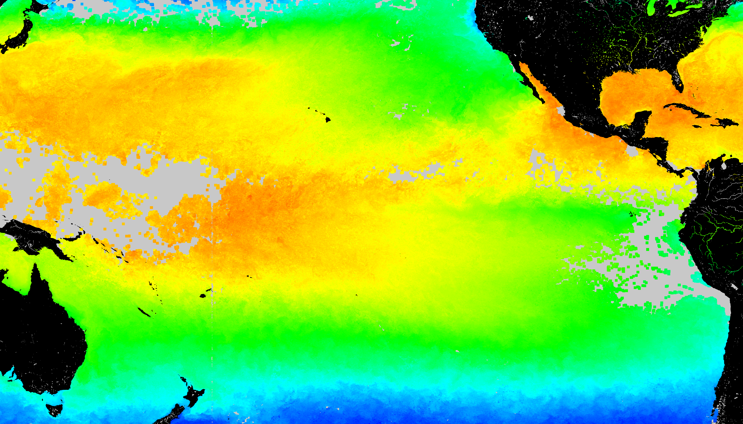
SST Coverage (August 10 2002)
With Gap
Temporal gap filling (≤ 30d)
Spatial gap filling (≤ 50 km)
Temporal + spatial gap filling

Slide 10
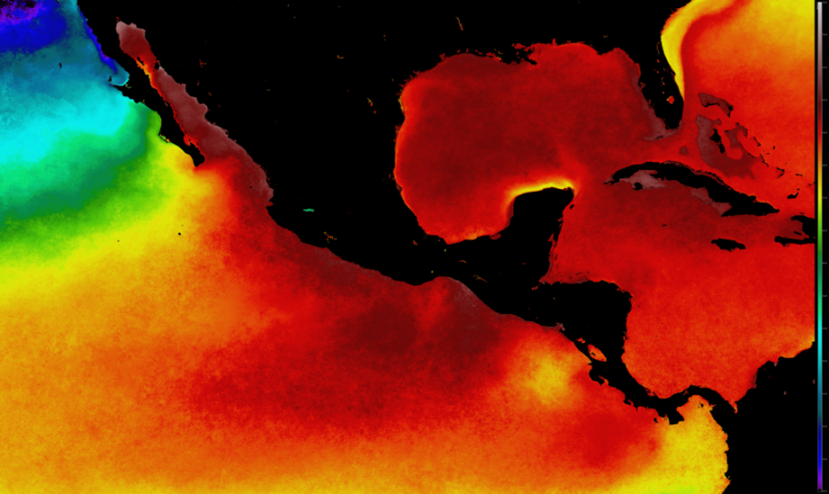
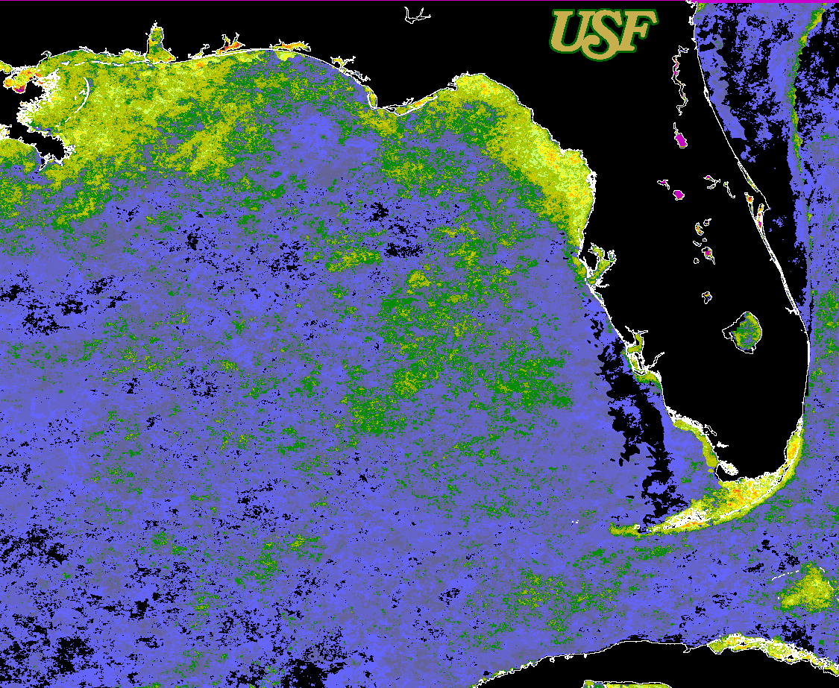
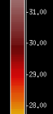

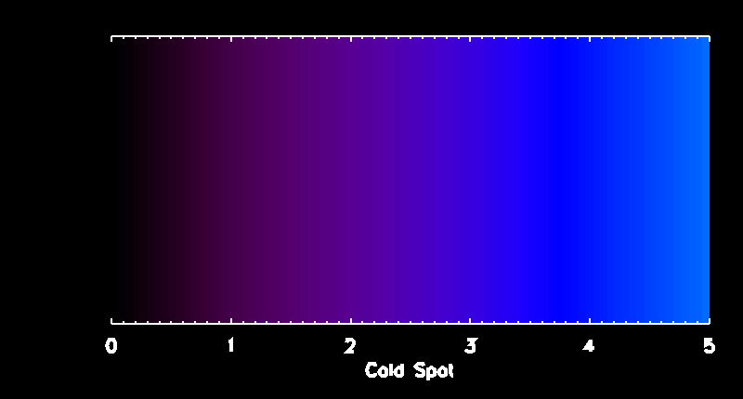
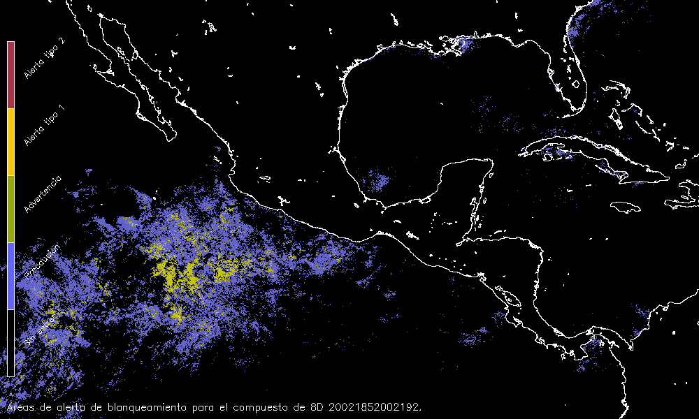
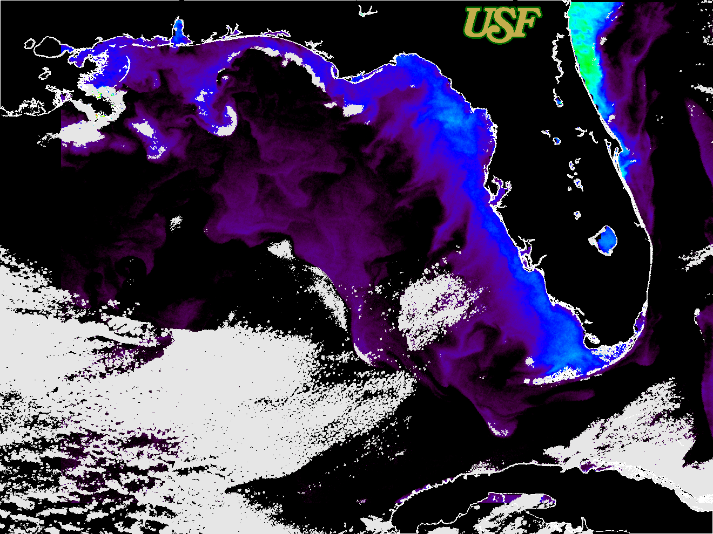
Sample 1 km CRW Products
MODIS products
Aug 19, 2010
USF Degree-Heating Week index (AVHRR 1 km LAC and Pathfinder v 5.0 Monthly Mean (MMM) SST Climatology)
Maximum of the Monthly Mean (MMM)
MODIS SST Climatology (1 km regional MODIS)
Jan 27, 2010
Bleaching Alert Area: 2002 week Julday 185-192
(1 km regional MODIS)
USF Cold-Snap prototype
(AVHRR 1 km LAC)

Slide 11
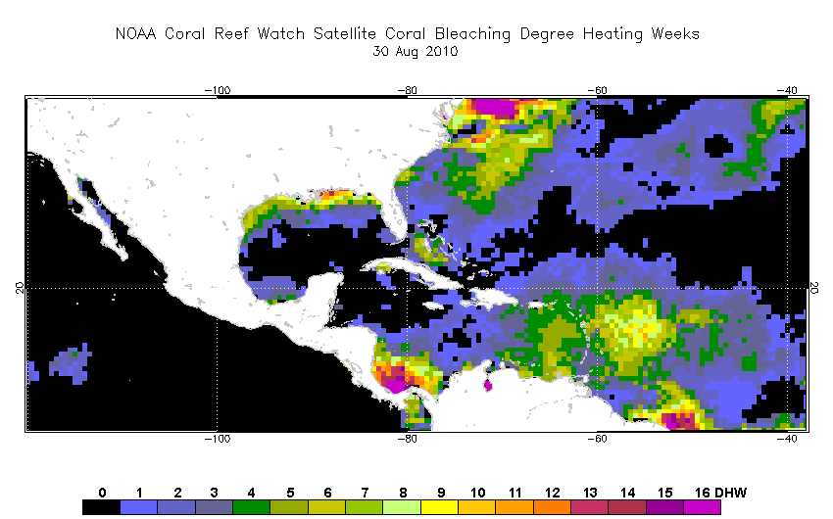

Slide 12
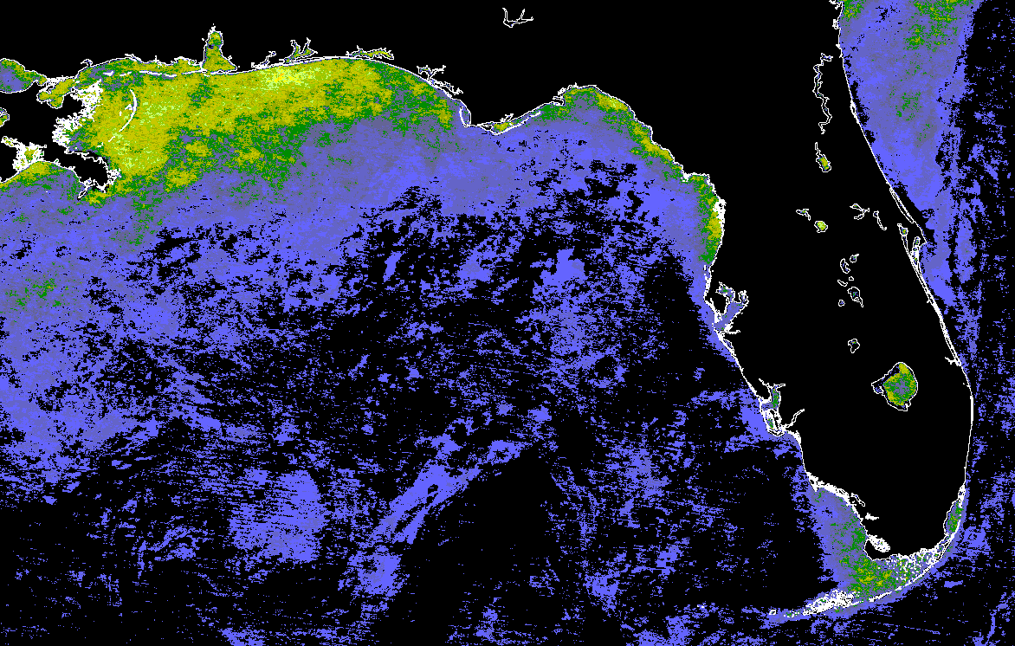
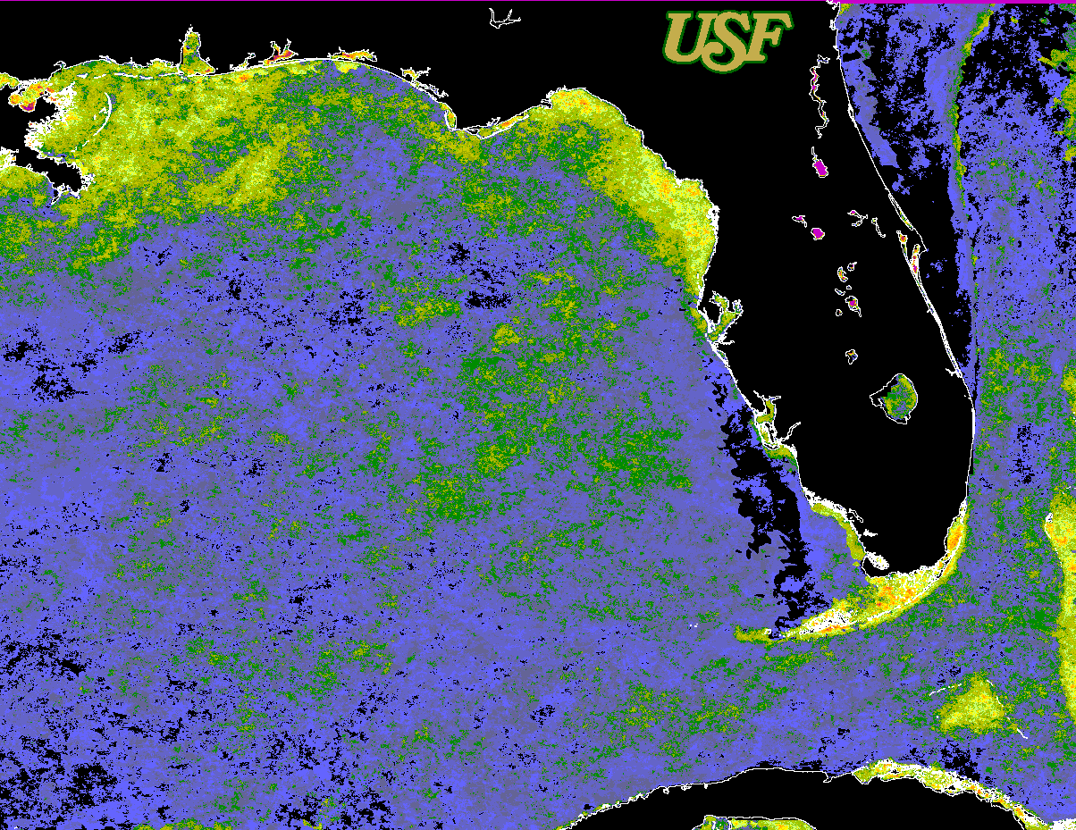
August 30, 2010
MODIS Aqua 4 µm SST
(night-time only)
Derived from a MODIS Aqua 4 µm SST climatology from 2003 - 2010
AVHRR SST (night-time only)
Derived from a AVHRR Pathfinder
(v 5.0) night-time only gap-filled SST climatology from 1985 – 2006.

Slide 13
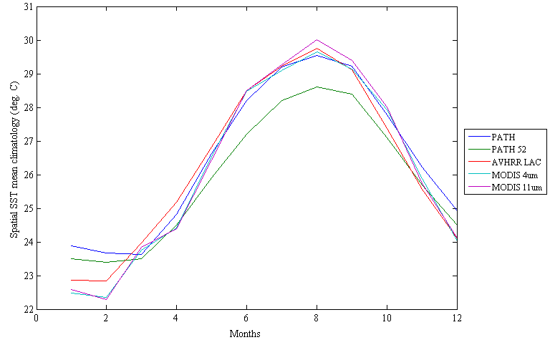
SST “climatologies” for the Florida Keys region

Slide 14
Issues
Regional CRW products generated with MODIS show less “stress” during both summer and winter than products generated with AVHRR pathfinder
  Pathfinder v5.2 climatology is cooler in summer and warmer in winter than MODIS SST climatology
We will need to adjust one dataset against the other if we want to have products that “look” similar

Slide 15
Case study in biodiversity:
FL Keys National Marine Sanctuary
Coral cover in the Florida Keys National Marine Sanctuary declined >50% between 1996 and 2010
Hypothesis: Sea surface temperature (SST) variability and warm events have an impact on the coral reef diversity
Data: 1996-2010
  Coral Reef Evaluation and Monitoring Project (CREMP)
  MODIS and AVHRR temperature and CRW products
  In situ temperature

Slide 16
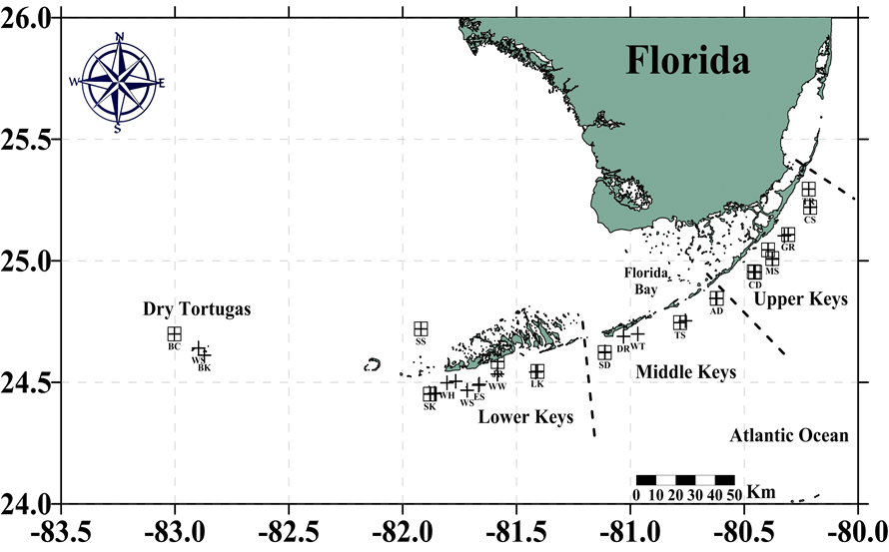
Boxes with crosses are stations with satellite SST, in situ temperature and CREMP surveys (33 stations)

Slide 17
Tests
Coral species richness and Shannon diversity index
Annual SST variances categorized in 3 levels:
  low (< 7 °C^2), intermediate (7 – 10.9 °C^2), high (≥ 11 °C^2).
Difference between summer and winter monthly regional means
Impact of “HotSpots” and “Degree Heating Weeks (DHW’s)”.

Slide 18
Degree-heating Weeks FL Keys
Regional maximum DHW means: 1996-2010
Upper Keys (UK), Middle Keys (MK), Lower Keys (LK)
and Dry Tortugas (DT)

Slide 19
a
b
Figure 1. Time series of (a) H’ and (b) mean species richness for the UK, MK and LK. Standard errors are represented with one-sided error bars.

Slide 20
Findings
Intermediate (7 – 10.9 °C) /high (≥ 11 °C) SST variability leads to apparent stability in coral reef diversity and benthic cover.
Despite exposure to three bleaching events since 1996, reefs in the Middle Keys experienced significant losses in diversity due to warm thermal anomalies only in 2009-2010, when extremely low winter temperatures were followed by an extremely high summer

Slide 21
User surveys (S. Lynds / CIRES)
Web statistics started on February 10, 2013. Images show baseline for visitation levels. We will monitor visitation as we market the products
March 2013
March 2013

Slide 22
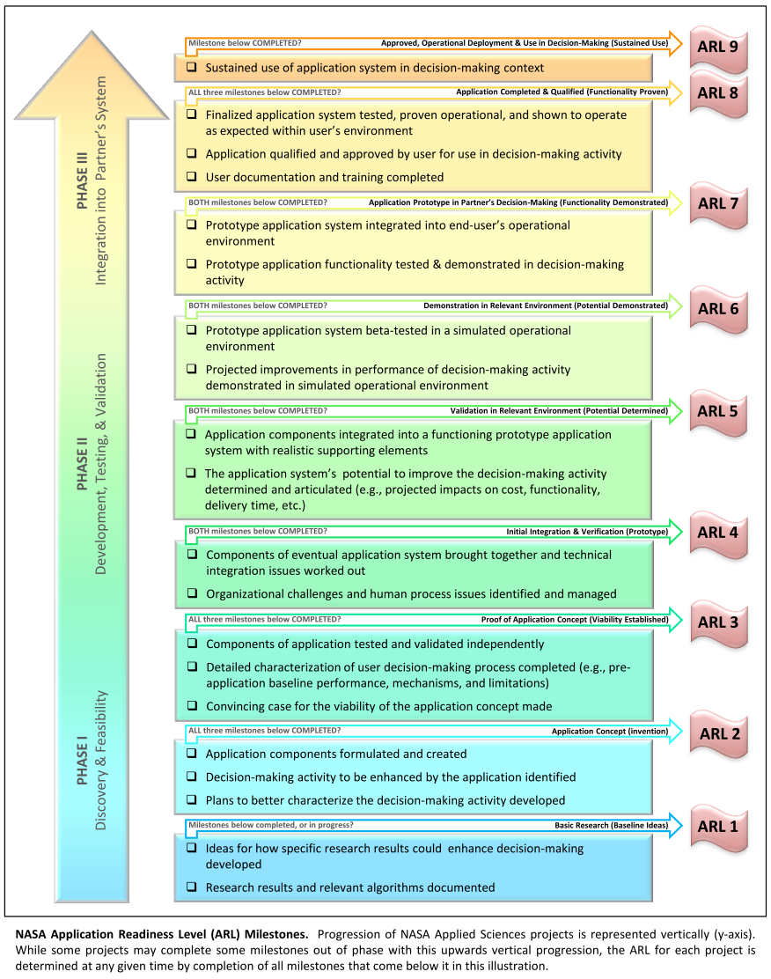
Start of project ARL = 2 (12/2009)
Current ARL = 7
Final ARL expected = 8 or 9
  NOAA has deployed and is testing high resolution CRW products from GOES
  Mexico and USF working on 1 km MODIS products
  New NASA products will be deployed through two DSS, one in the USA (NOAA) and one in Mexico (CONABIO)
|‌ 22

Slide 23
Summary: 2012-2013
Finished 1km MODIS SST climatology for the Caribbean, Gulf of Mexico, and adjacent regions (2003-2010)
Completed initial assessment f impacts of temperature variability on coral reef biodiversity in the FL Keys National Marine Sanctuary
Advanced prototype of global, 4-km resolution Sea Surface Temperature climatology (AVHRR Pathfinder , 1985-2006) using NEX at Ames
Deployed new website at CONABIO (Mexico) with regional 1 km Coral Reef Watch products (MODIS)
Collaboration and training of CONABIO scientist (Dr. S. Cerdeira at USF, Oct-Dec 2012)
Deployed website at USF with 1 km Coral Reef Watch products (AVHRR)
  Heat stress and new cold stress products
Deployed new 5 km heat stress product suite at Coral Reef Watch website (NOAA)
Started to develop NASA Ames Hyperwall program on CRW products
Analyzed user surveys done during AGU/ASLO/TOS Ocean Sciences meetings
Established Google Analytics tool at NOAA CRW
Advanced graduate training of PhD student engaged in program (Maria Vega, minority student from Puerto Rico)

