Slide 1
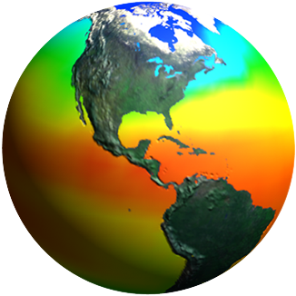
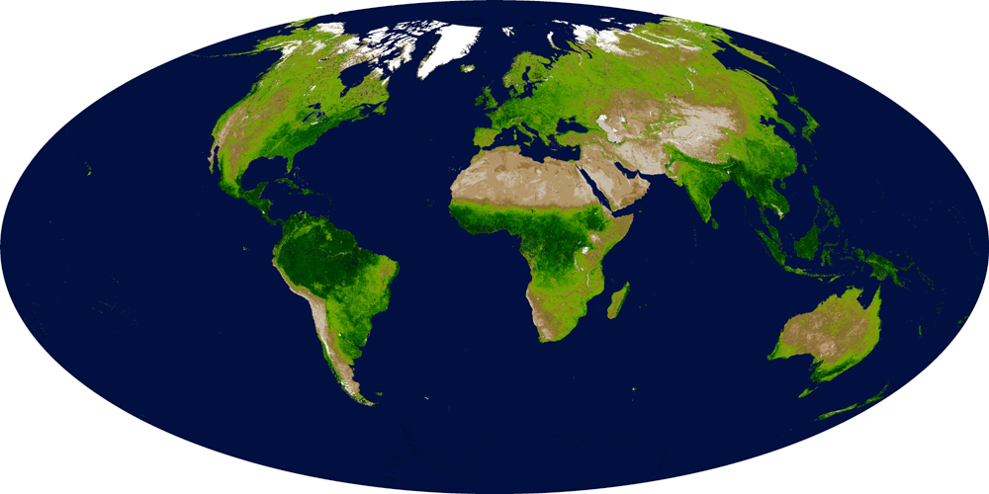
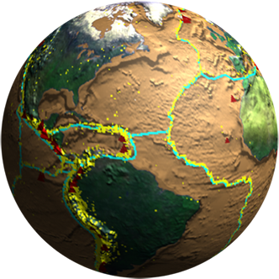
Biodiversity and Ecological Forecasting Team Meeting
Waterview Conference Center, Arlington, VA
Issues, Needs, Directions
(Insights into the Programs)
Woody Turner
Earth Science Division, NASA Headquarters
April 23, 2013

Slide 2
What’s Limiting Progress?*
Observations
Models
Sensors
Products
Policy
*in terms of NASA’s improving (a) our understanding of biodiversity globally and how it’s changing and (b) our application of this understanding to management

Slide 3
One More Thing
Try to consider the issues, needs, and suggested directions in this presentation within the context of:
- What if NASA—and indeed the entire space effort—were to go away?
- Would there be an impact to (a) our understanding of biodiversity globally and how it’s changing and (b) our application of this understanding to management?

Slide 4
Issue: Observations Are Limiting
We need more time series of biological observations.
We need to link observations across spatial and temporal scales.

Slide 5
Some Possible Directions
Citizen science for crowdsourcing observations
Better integration of existing databases
Link satellite data networks with networks of in situ sensors (e.g., camera traps, sound recorders, reported sitings, movement tracking data)
Facilitate global (e.g., GEO BON) and regional (e.g., U.S. marine BON) biodiversity observation networks

Slide 6
Issue: Models Are Limiting
We need models that can talk to each other.
We need a global framework(s) for general ecosystem models.
We need better distribution models that incorporate physiological (process) and bioclimate (correlative) designs.
We need species/group abundance models that use RS inputs.

Slide 7
Some Possible Directions
A model web for model-to-model interoperability
A DAAC(s) for models?
Workshops on general ecosystem modeling and better distribution and abundance modeling
Support model downscaling efforts—or just push for higher resolution global models
Find more CPUs

Slide 8
Issue: Sensors Are Limiting
We need satellite sensors that capture the most ecologically-relevant parameters (e.g., proxies for ecosystem composition, function, and structure).

Slide 9
Some Possible Directions
Launch VSWIR spectrometer + blue-green/NIR lidar(s) + Thermal IR scanner
Initiate international airborne campaigns to bring together observations from spectrometers, lidars, TIR, and radars over sites with well-characterized biodiversity and/or management needs
Remain in touch with user communities (e.g., conservation, land/fisheries managers) to ascertain evolving needs

Slide 10
Issue: Products Are Limiting
We need a consistent, global, repeatable (every 5 years?), continuous fields or discrete classes land cover classification product derived from ~30m resolution imagery, e.g., Landsat.
We need a consistent, global, repeatable (every 7 days?) phytoplankton functional type product derived from x?m resolution imagery.

Slide 11
Some Possible Directions
Global land cover product developed through international consortium under the auspices of GEO, CEOS, and GTOS GOFC-GOLD
Complete “MODIS-ization” of Landsat
Identify key product for marine/coastal community (PACE?)

Slide 12
Issue: Policy Is Limiting
We need national space agency satellite data products to be free and open.

Slide 13
Some Possible Directions
Work through CEOS and GEO to foster open data policies for satellite imagery
Pay attention to Europe where decision on Sentinel 2 data policy will have a large impact on our ability to develop global landscape scale products

Slide 14
Intriguing Topics
The Biogeography of Small Things
Aerobiology: life in the sea above us
Leverages NASA expertise in aerosols/clouds, atmospheric chemistry and dynamics
Aerosols analogous to the plankton? ACE the ideal sensor
Movement Ecology
Both of the above address Connectivity
Climate and Biological Response
DeExtinction

Slide 15
And Now a Word About Costing
Sequestration at NASA: ~8% reduction
ESD Plan: For R&A/ASP becomes ~5% grant reduction: highly uncosted projects
We are tracking uncosted levels more vigorously and high levels could lead to reductions in your project funding that you may not get back in out years
Please spend and then cost/invoice your spending as soon as possible

