Slide 1

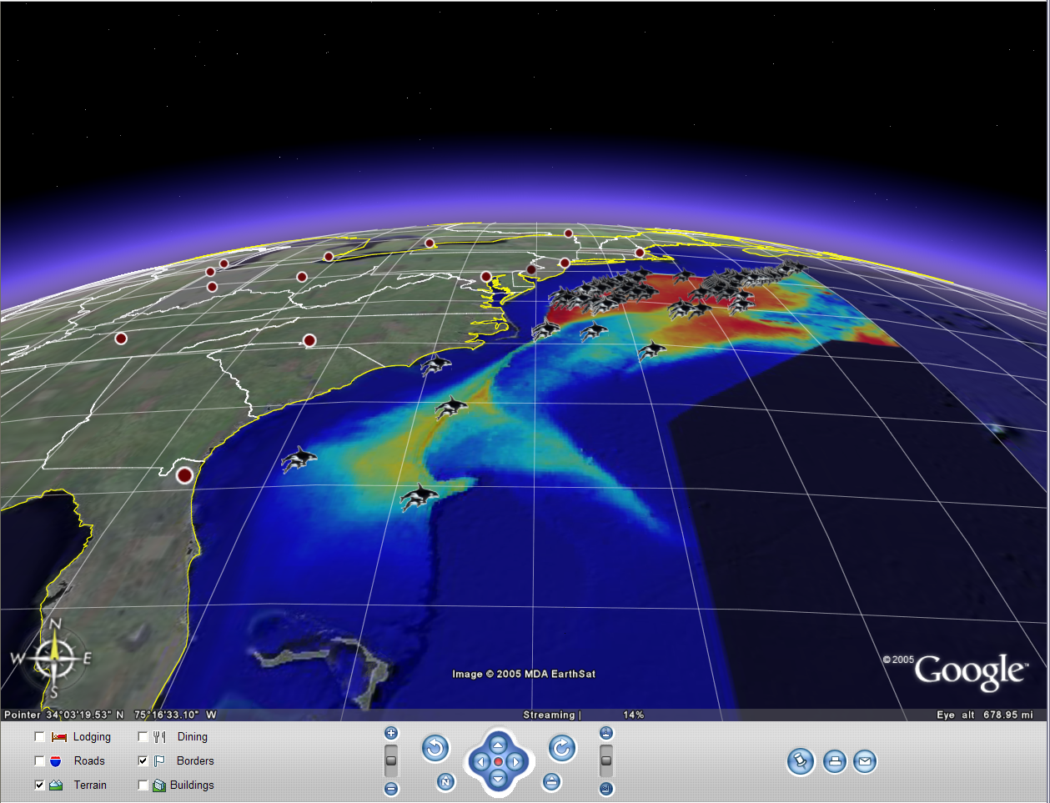


Integrating Ocean Observing Data to Enhance
Protected Species Spatial Decision Support Systems
PI Pat Halpin, Duke University
Co-PI Karin Forney, NOAA
NASA Grant / Cooperative Agreement NNX08AK73G
Atlantic Team: Ben Best³, Ei Fujioka³, Pat Halpin³, and Jason Roberts³
Pacific Team: Elizabeth Becker¹, Karin Forney¹, Dave Foley^{1,2}, Jay Barlow¹, Lisa Ballance¹, Steven Bograd¹, Daniel Palacios^{1,2} , Jessica Redfern¹
¹Southwest Fisheries Science Center, NOAA - National Marine Fisheries Service
²Joint Institute for Marine and Atmospheric Research, University of Hawai`i at Manoa
³Marine Geospatial Ecology Lab, Nicholas School of the Environment, Duke University

Slide 2
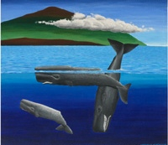
Outline:
Protected species forecasting problem
Density forecasting models
Spatial Decision Support System (SDSS)
Remote Sensing Geoprocessing Tools (MGET)
Remote Sensing products
New applications
Next steps

Slide 3
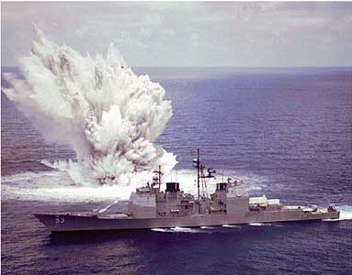
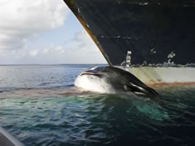
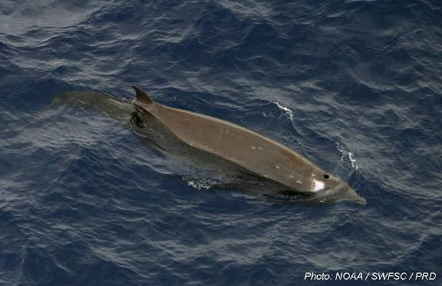
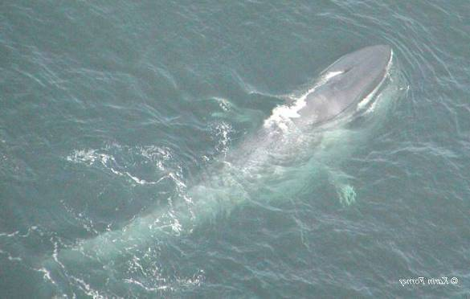
Cetaceans (whales, dolphins and porpoises)
and anthropogenic threats
Threats include
Ship strikes
Fishery bycatch
Naval activities
Anthropogenic sound
Cetaceans protected by US laws
MMPA
ESA

Slide 4
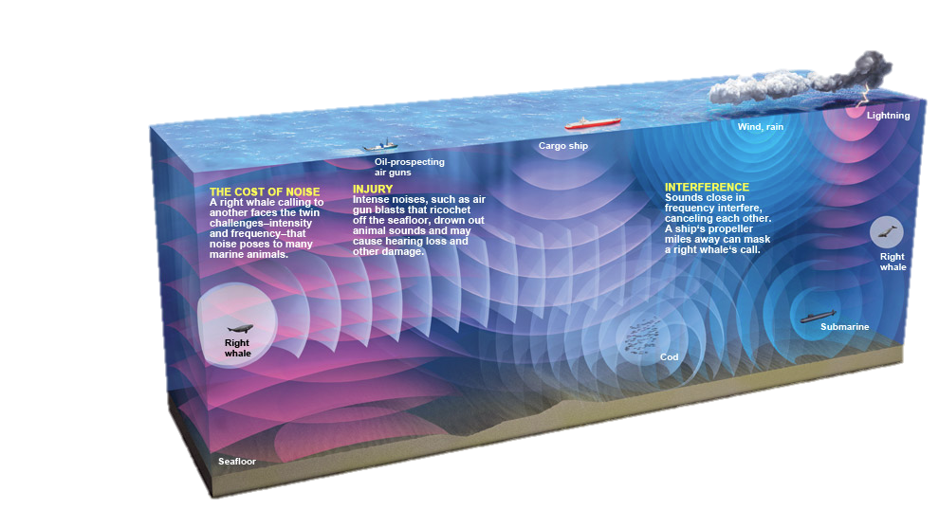


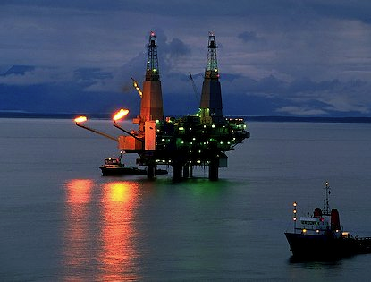
Cetaceans, sound exposure
&
Marine Spatial Planning
Credit:National Geographic
Offshore energy development
Chronic
Event
Notes:
Comprehensive marine spatial planning requires mapping chronic background noise levels arising from offshore human activities over scales relevant to long-term, regional-scale decision-making. For example, predicted average annual noise contributions from merchant shipping to low-frequency noise levels can be integrated with other human-induced marine environmental stressors to evaluate potential cumulative impacts associated with proposed use scenarios (e.g., siting new offshore energy installations, creating new marine protected areas, shifting commercial vessel traffic patterns). Predicted average annual noise contributions from merchant shipping to low-frequency noise levels also provide a background for understanding the acoustic influence of localized proposed activities, such as off the coast of the Northeastern U.S. Frequency: 50 Hz; Duration: average annual Leq; Depth: 5 m; Grid size: 1oNx1oW (Figure 1A), ~10km x 10km (Figure 1B); Source Data: U.S. Voluntary Observing Ship (VOS) reporting data 2004-5. Based on source level of “Merchant Vessel” ship-type at 6 m depth (Renner, W. W. (1986). Ambient Noise Directionality Estimation System (ANDES) Technical Description, Science Applications Int. Corp, SAIC-86/1645).
Propagation Modeling Parameters: Kraken Normal Modes (Porter and Reiss, 1984, 1985; Porter, 1991).
Environmental Variables: Bathymetry from SRTM30 (David T. Sandwell, Walter H. F. Smith, and Joseph J. Becker, 2008) and ETOPO2 (U.S. Geological Survey, 2004); Sea surface roughness based on 10-knot wind speed; Seabed from NCEAS conversion of dbSEABED into “hard” and “soft” bottom types (Halpern et al. 2008); Sound-speed profiles from WOA “Annual Average” (World Ocean Database 2005. S. Levitus, Ed., NOAA Atlas NESDIS 60, U.S. Government Printing Office, Washington, D.C.).
Cumulative impact assessment of short-term but relatively high-intensity acoustic events often fall short of including the full suite of sources that were active during operations. Here, predicted noise levels due to three concurrent geophysical seismic exploration surveys in the Beaufort Sea allow managers to better approximate the result- ing sound field experienced by seasonally resident species.
In a January 19, 2010 letter to the President’s Council on Environmental Quality, NOAA Administrator Dr. Jane Lubchenco committed to improving the tools used by the agency to evaluate the impacts of underwater noise on cetacean species. As a result, two product-driven working groups were convened in January 2011: the Underwater Sound-field Mapping Working Group and the Cetacean Density and Distribution Mapping Group.
Frequency: broadband 10Hz-1kHz; Total sound exposure level (SEL) over full pulse duration (summed for all sources); Max Level over Depth (2 m to local ocean depth); Grid size: ~2.5 km x 2.5 km; Source Data: Public comprehensive reports on 2008 season activities.
For more information see:
Harrison et al. (2011) “The NOAA Cetacean Density and Distribution Mapping Working Group: Developing Comprehensive Geospatial Tools to Assist Management in Impact Analyses of Cetaceans in US EEZ Waters.” Poster Presentation, Biennial Meeting Society for Marine Mammalogy; and http://www.st.nmfs.noaa.gov/cetsound
Propagation Modeling Parameters: RAM Parabolic Equation (Collins, 1993) with complex density seafloor interface approximation (Zhang and Tindle (1995)). Environmental Variables: Bathymetry from GINA database; Sound Speed Profile from GDEM database (Teague et al., 1990); Seabed properties from JASVO technical references.
Tier 1: Habitat-based Density Models - Abundance predicted heterogeneously across a surface of cells based on environmental covariates. Probability of detection is accounted for as a function of distance from the line transect to the observed species. Abundance is derived from the predicted encounter rate along the effective strip width and school size, one or both of which may vary based on the environment.
Tier 2: Stratified Density Models - Abundance predicted homogeneously across a large area. Probability of detection is accounted for as a function of distance from the line transect to the observed species. Abundance is derived from the encounter rate, effective strip width, average school size, and an assumed or estimated value for the trackline detection probability.
Tier 3: Probability of Occurrence - probability of encountering the species predicted heterogeneously across a surface of cells based on environmental covariates.
Tier 4: Observations - Presence-only observations. Principally these observations were collated at OBIS-SEAMAP based on visual observations aboard ships or aircraft on scientific surveys. Acoustic observations and other opportunistic visual observations have also been included. The observations have not been corrected for heterogeneity in survey effort or detection probabilities across the study area.
Tier 5: Records Exist - Observation records are known to exist in published literature but are not yet included the CetMap data system.
** We also include a qualifier that can pertain to Tiers 1-5, "valid time period extended based on expert recommendation"
Tier 6: Expert Knowledge Present/Absent/Rare/Unknown - Species status [present/absent] is known in a given region. This is how we include information from the regional species lists generated by CetMap experts and others.
Tier 7: No Data - No models, data, or expert knowledge about a given species in a given region.
Additional Contextual Information / Important Areas - Areas identified by experts as biologically important for certain species for feeding, breeding, calving, small resident population, etc.

Slide 5
Societal need: We need to minimize risk to protected species from potentially harmful marine interactions (e.g. ship strikes, seismic surveys, oil drilling noise, Navy sonar training exercises.)
NASA project response: Duke University and NOAA’s Southwest Fisheries Science Center (SWFSC) teamed up to develop an online Spatial Decision Support System (SDSS) that provides spatiotemporally-explicit, quantitative predictions of the density and probability of occurrence of marine mammals.
Role of Remote Sensing: This project works to enhance and improve our protected species modeling capabilities through improved remote sensing data development.

Slide 6
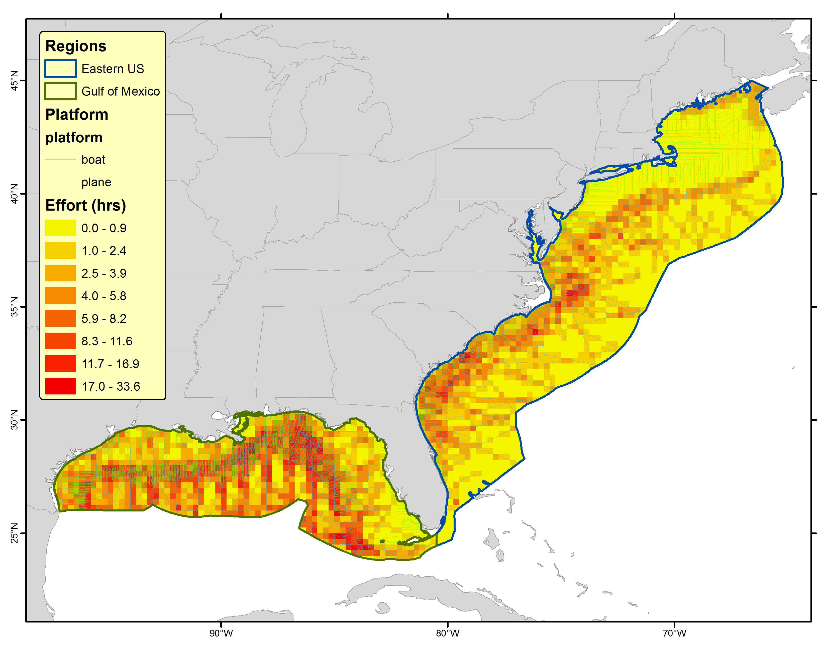
Integrating Ocean Observing Data to Enhance
Protected Species Spatial Decision Support Systems
Joint Academic & Federal Agency Team
Pacific: NOAA - SWFSC
Atlantic & Gulf of Mexico: Duke University
Density of protected species ship & aircraft surveys

Slide 7
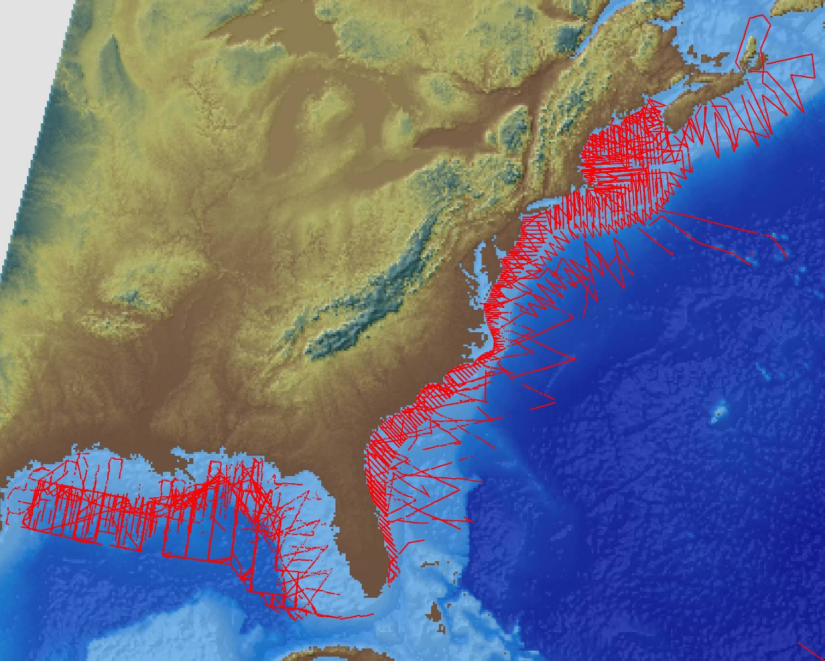
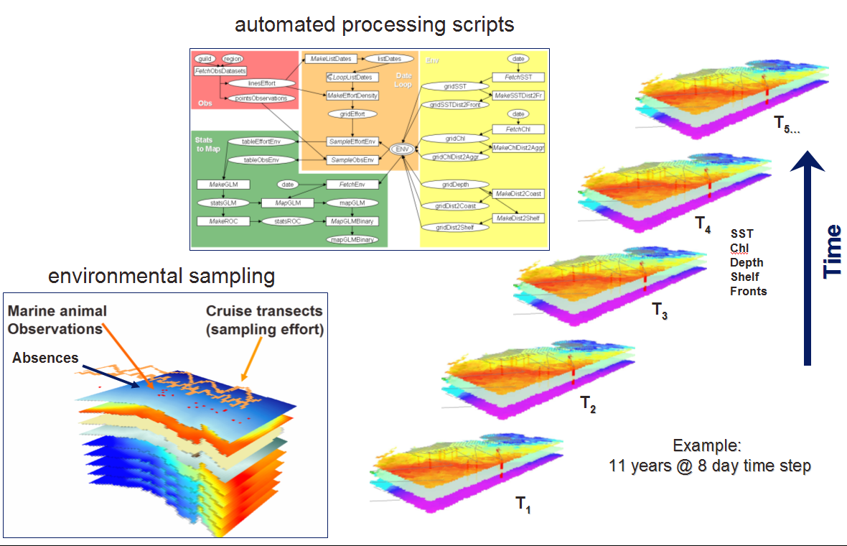
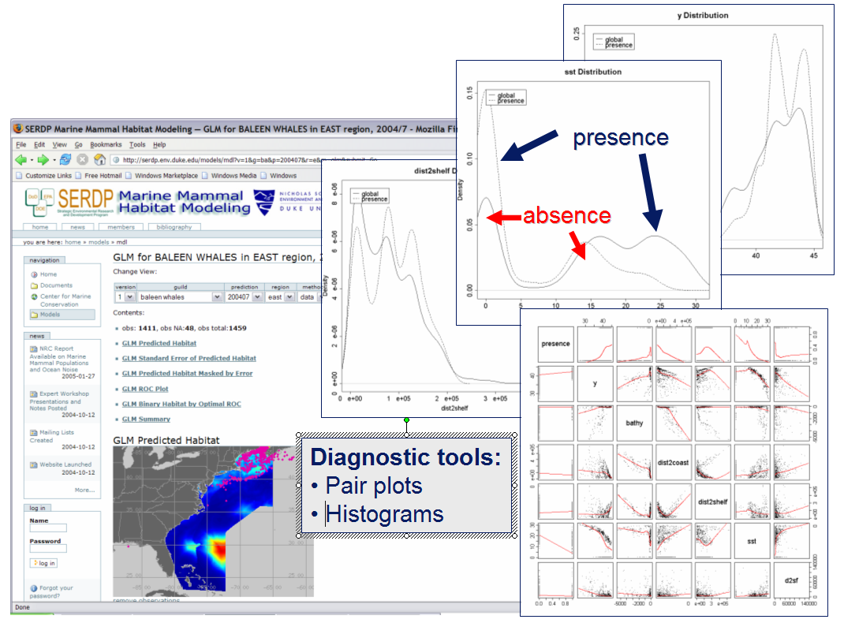
Modeling Workflow
(1) animal observation data
(2) ocean observation data
Temporally matched covariates
Data
(4) spatial decision support system
GAM models of density
&
habitat
Information
(3) statistical analysis & modeling

Slide 8
Forecasting model & SDSS improvements
  Incorporating a wider range of remotely-sensed ocean observations, including new geographic areas.
  Deriving more ecologically-important model parameters from the ocean observations.
  Exploring the implementation of near-real-time now-cast and forecast capabilities.
  Publishing key algorithms in a free, GIS-integrated toolbox.

Slide 9
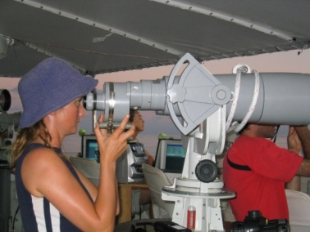





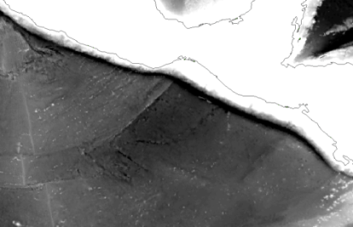
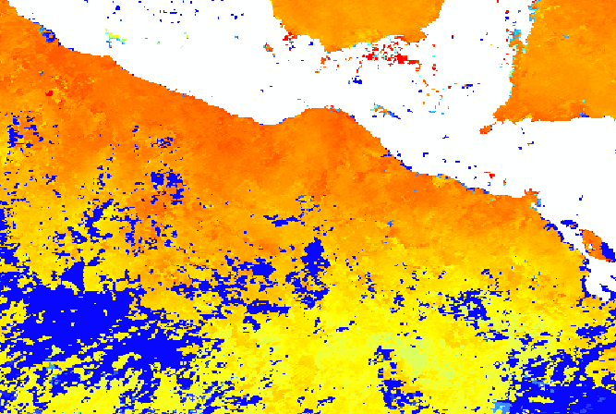

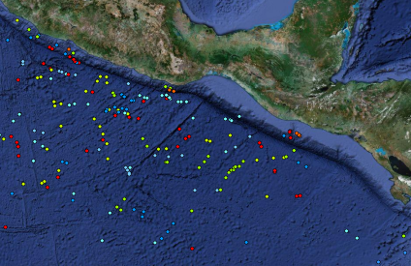
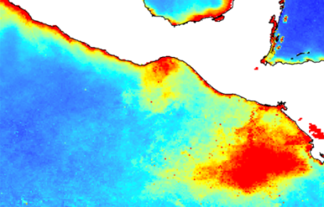

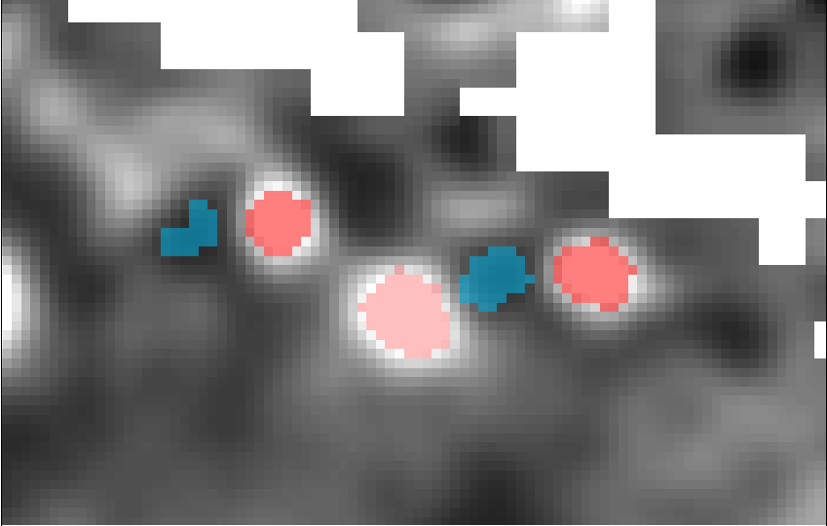
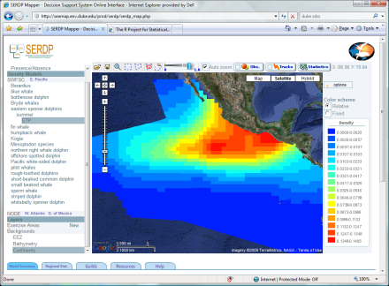
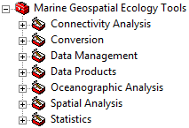
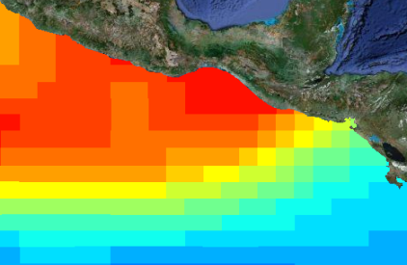
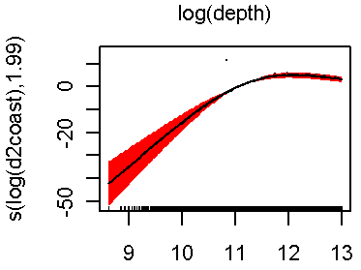
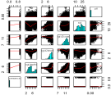
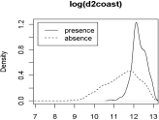
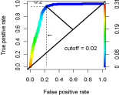
Species data providers
Ocean data providers
NASA project enhancements
Protected Species
Decision
Support
System
Ocean
observations
More
Species observations
Algorithms
Statistical models
Ecologically-important parameters
GIS Tools
Predicted distributions
Summary plots
SDSS website

Slide 10
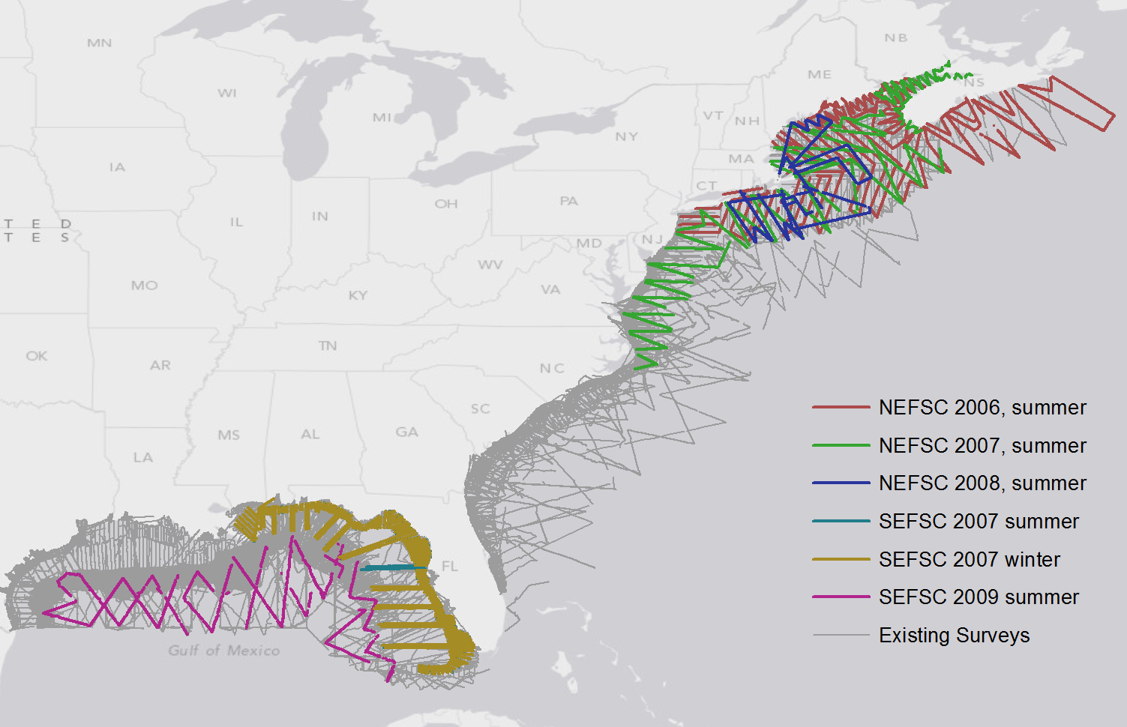
New Density Models In Progress
New Atlantic datasets now processed for producing updated cetacean density surface models. Models are being built in two stages.
1) Using similar methods to Pacific for a comparative similar product
2) Using novel methods
Unstructured grid with finer resolution closer to coast
New covariates
Time of year as a circular statistic
Oceanographic model outputs, including mixed layer depth
Dynamics: fronts, eddies, Lagrangian coherent structures…

Slide 11
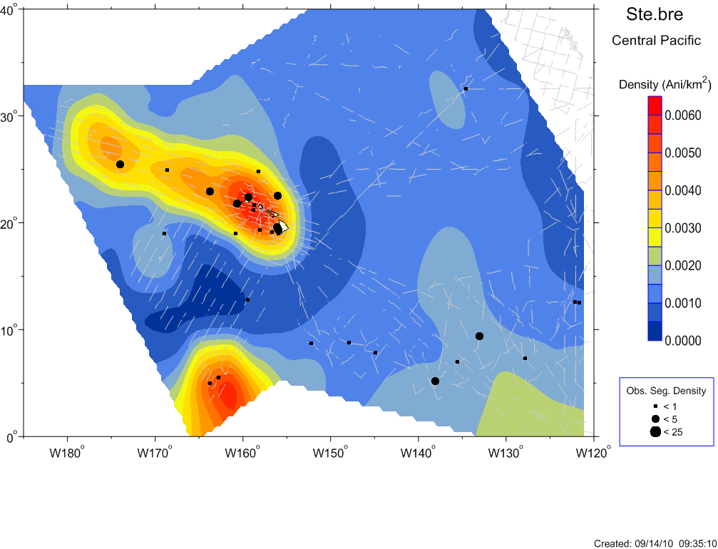
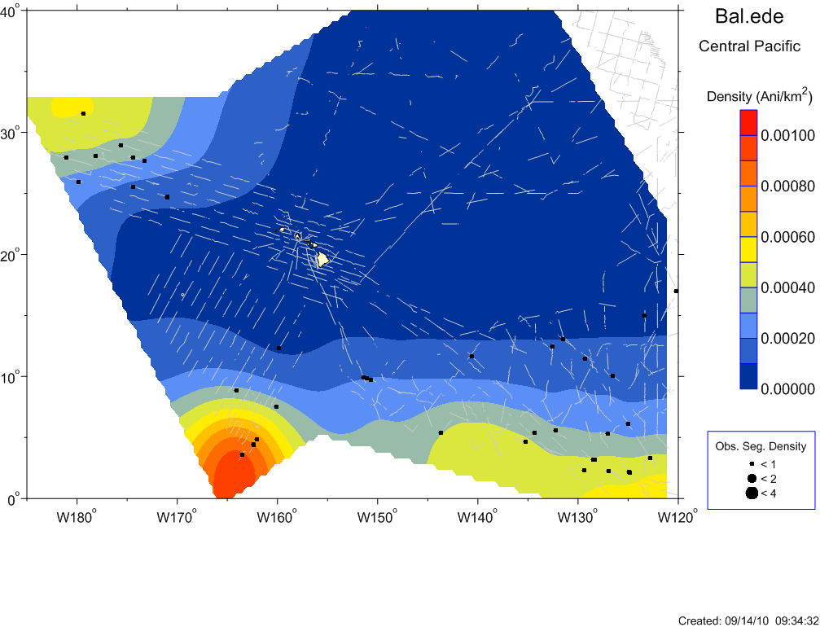
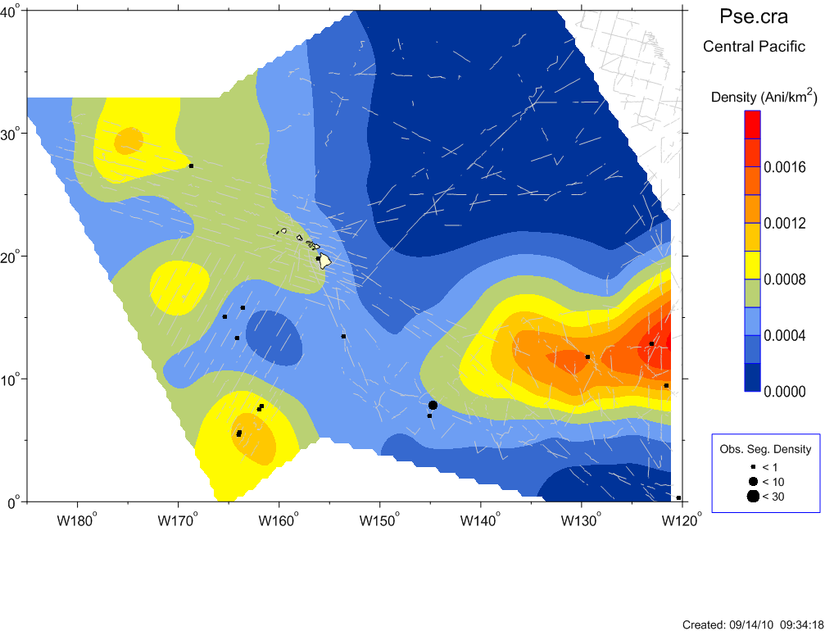
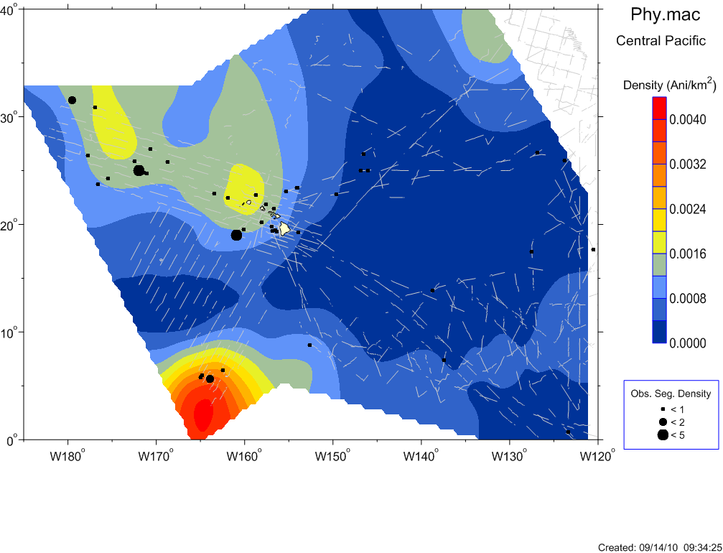
Improved density models (animals per km²) for select cetacean species, based on satellite-derived input variables
The addition of more specific RS covariates is improving model fit & specificity.
Rough-toothed dolphin
Steno bredanensis
Bryde’s whale
Balaenoptera edeni
False killer whale
Pseudorca crassidens
Sperm whale
Physeter macrocephalus

Slide 12
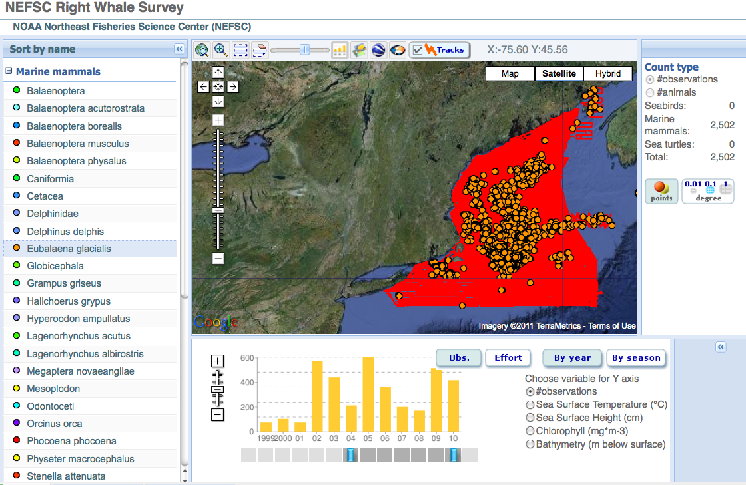
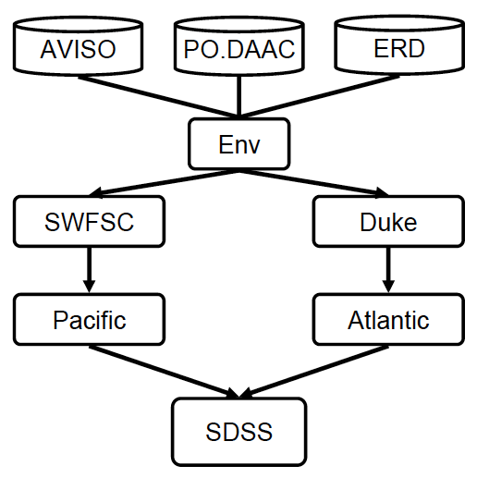
Spatial Decision Support System
SDSS Provides:
Density models
Links to data
Links to metadata
Links to variables
Visualization by time
Observations and survey effort of North Atlantic right whale dataset hosted on SEAMAP since 2004 when HYCOM data is available.
Initial development: Strategic Environmental Research and Development Program
SERDP projects SI-1390 at Duke University and SI-1391 at NOAA-SWFSC

Slide 13
Outline:
Protected species forecasting problem
Density forecasting models
Spatial Decision Support System (SDSS)
Remote Sensing Geoprocessing Tools (MGET)
Remote Sensing products
New applications
Next steps

Slide 14
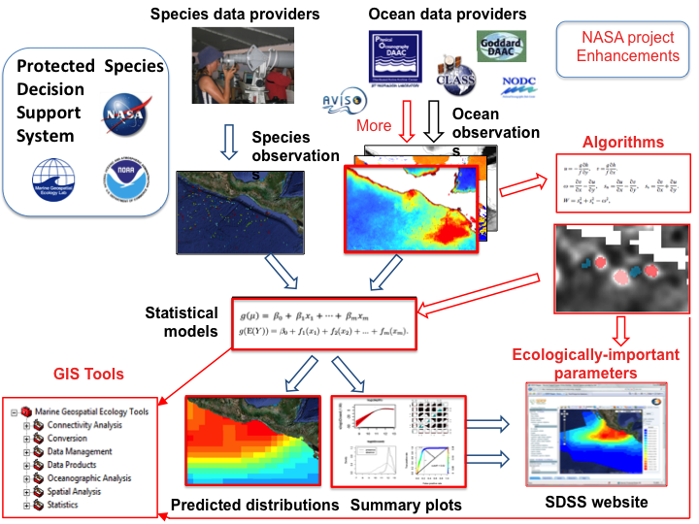
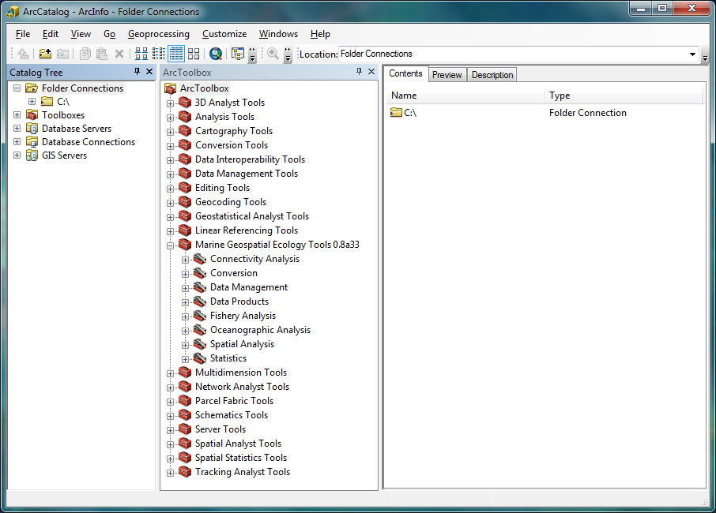
Tools & Algorithm Products:
Marine Geospatial Ecology Toolbox (MGET)
MGET
A free plug-in tool set for the popular ArcGIS Geographic Information System

Slide 15
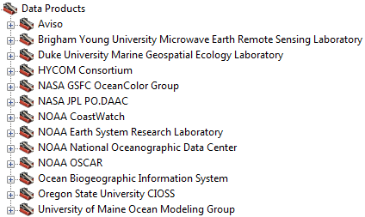
MGET directly facilitates increased usage of NASA remote sensing products and applications
More than 200 GIS/RS tools & scripts made freely available

Slide 16
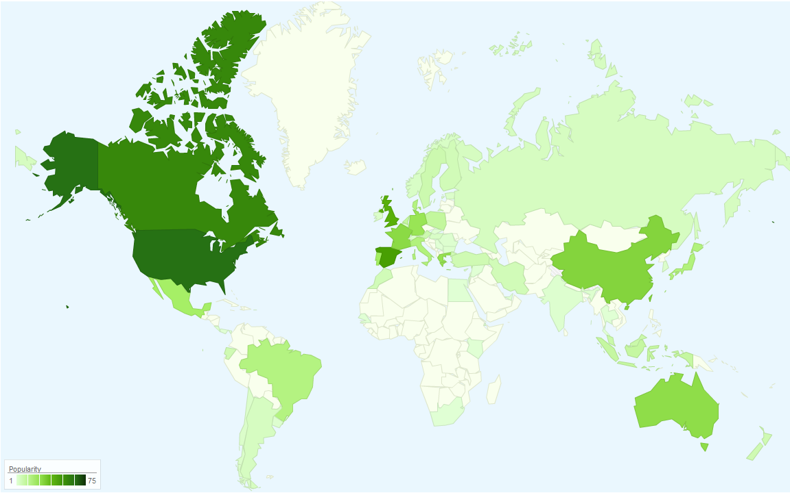
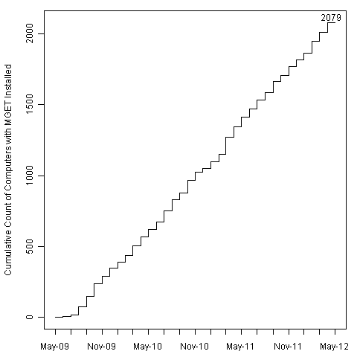

MGET tool use is growing worldwide
> 2000 installations since August 2009
>2079 unique
users 2009 - 2012
77 Countries
http://code.nicholas.duke.edu/projects/mget/

Slide 17

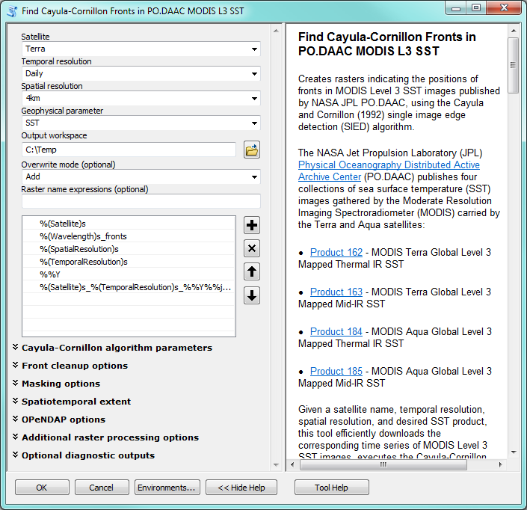

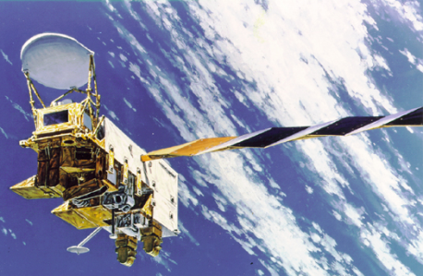
NASA MODIS SST products
MGET Tools & Algorithms
MGET provides tools that detect oceanographic features in remote sensing images
These are some of the most popular tools in MGET
Terra
Aqua

Slide 18

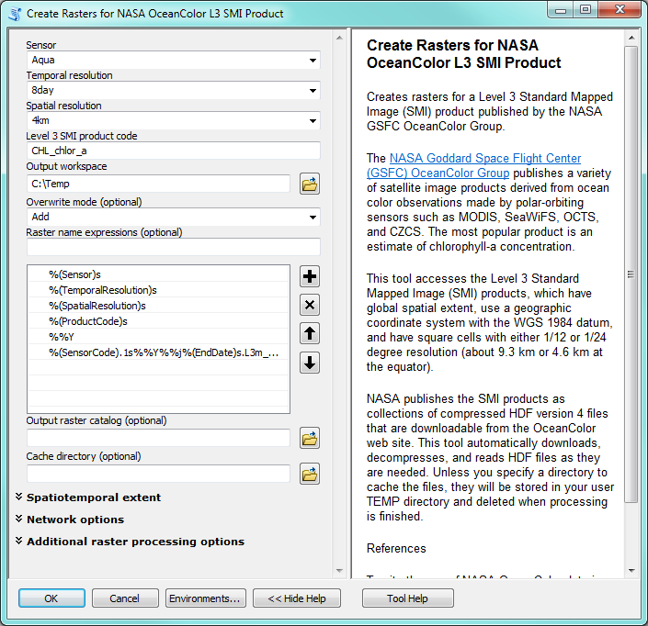
NASA Ocean Color products
MGET Tools & Algorithms
MGET provides customized tools for each data product that it supports
The tool shown here is a simple one: it downloads ocean color data in a GIS-compatible format
This may seem trivial but GIS users regularly cite data import as 80% of the work of any project

Slide 19
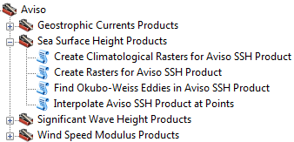
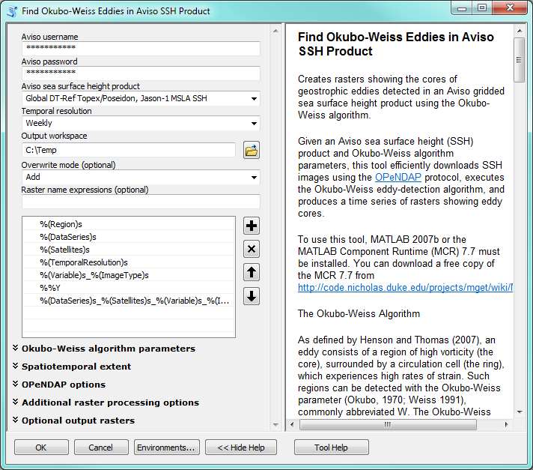
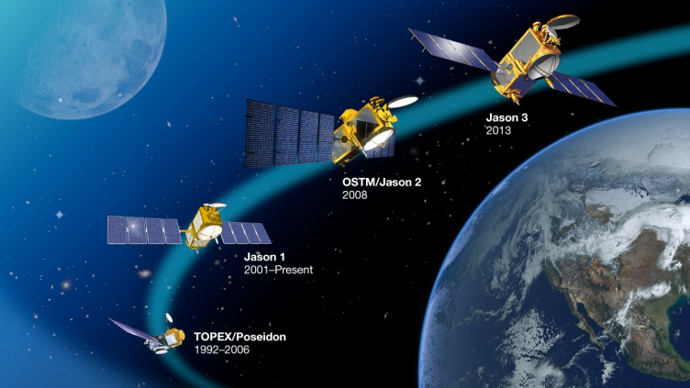
NASA/CNES altimetry products
MGET Tools & Algorithms
This tool detects eddies in SSH images collected by NASA/CNES radar altimeters

Slide 20
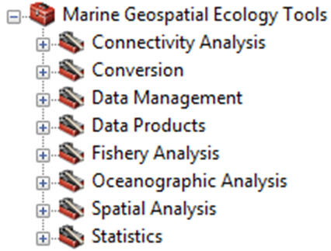
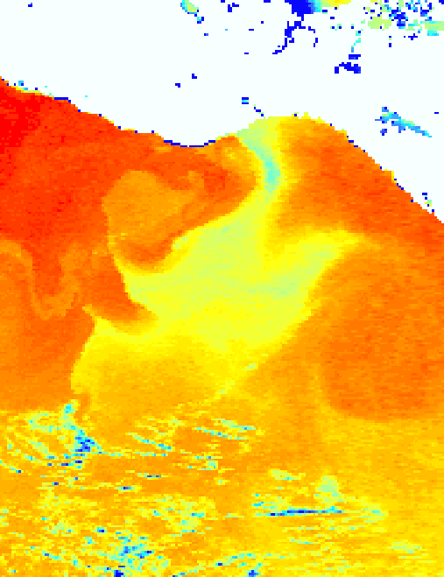
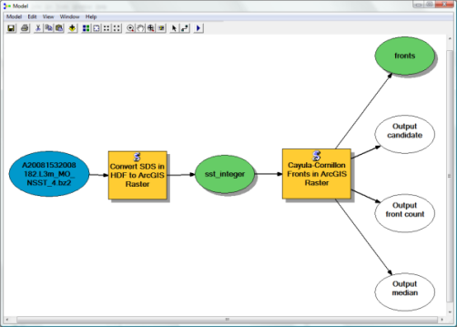
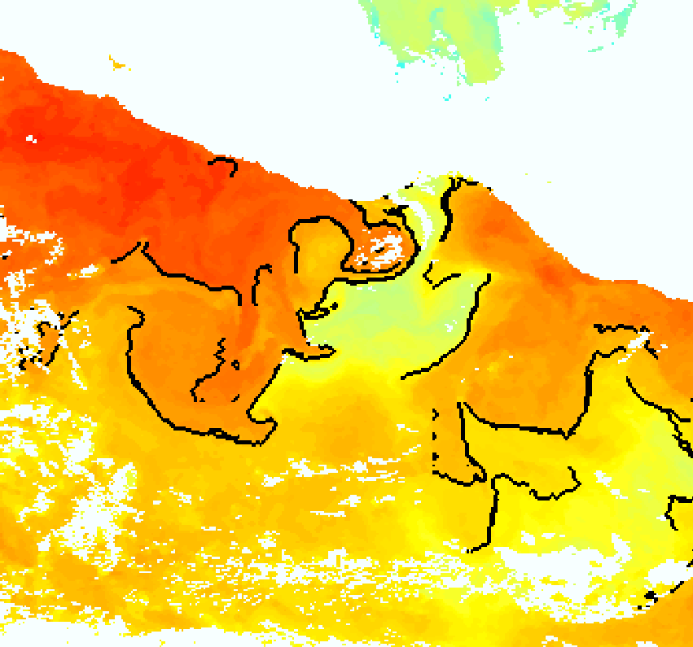
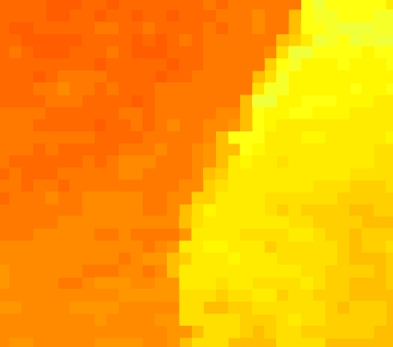

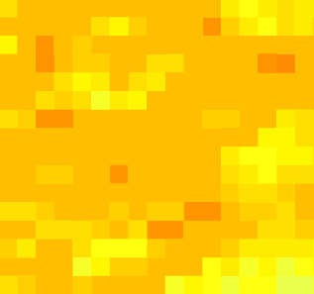
Identify fronts in SST images
MGET Tools & Algorithms
AVHRR Daytime SST 03-Jan-2005
Cayula and Cornillion (1992) edge detection algorithm
Step 1: Histogram analysis
ArcGIS model
Mexico
Bimodal
Optimal break 27.0 °C
Frequency
Temperature
Example output
Step 2: Spatial cohesion test
Mexico
28.0 °C
Front
25.8 °C
Strong cohesion → front present
Weak cohesion → no front
~120 km

Slide 21
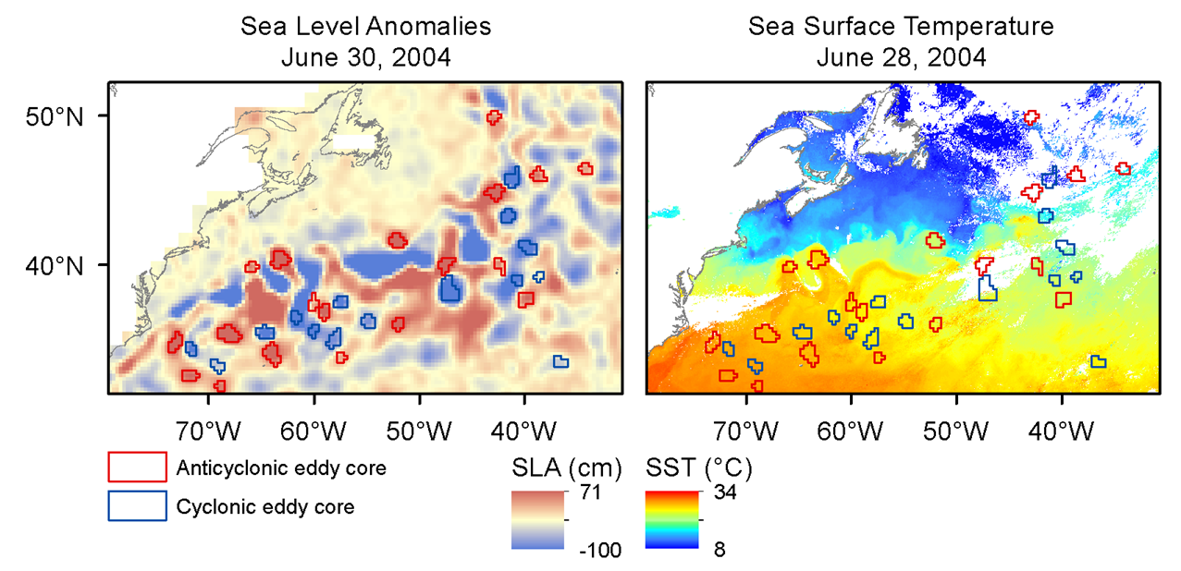


Detecting sea height anomalies & eddys
MGET Tools & Algorithms
SSH anomaly
Okubo-Weiss Detection algorithm
Derived eddy features
Aviso DT-MSLA 27-Jan-1993
Red: Anticyclonic Blue: Cyclonic

Slide 22



Access to global eddy databases
MGET Tools & Algorithms
MGET also includes tools that provide easy access to data products published by other NASA grantees
By improving access to these products from GIS, we hope to increase use by ecologists
Chelton, DB, MG Schlax, and RM Samelson (2011). Global observations of nonlinear mesoscale eddies. Progress in Oceanography 91: 167-216.

Slide 23
MGET tools to be featured at ESRI 2012 User Conference
The Marine Geospatial Ecology Lab & the MGET tool system were selected to be featured in the “Environment Showcase” for the 2012 ESRI User Conference to be held in San Diego July 2012
~12,000 ArcGIS users attend.

Slide 24
Outline:
Protected species forecasting problem
Density forecasting models
Spatial Decision Support System (SDSS)
Remote Sensing Geoprocessing Tools (MGET)
Remote Sensing products
New applications
Next steps

Slide 25

New Application: Offshore Energy
www.MarineCadastre.gov
Purpose: spatial information for determining environmental compliance for siting offshore wind farms and oil exploration.
Provided: predictive density models of cetaceans and turtles by season for US Atlantic and Pacific waters.

Slide 26


New Application: Cetacean Mapping & Sound
Sound field mapping
GAP analysis of cetacean forecasting models in space & time
Providing forecasting models for the assessment of potential interactions of cetaceans and sound. Workshop to be held: May 22-24 2012 Washington DC > 200 participants

Slide 27



New Application: fisheries ecology
Are tuna and swordfish catches in the northwest Atlantic correlated with eddies?
Eddies
Hsu, A, AM Boustany, JJ Roberts, and PN Halpin (submitted). Effects of mesoscale eddies on CPUE of four fish species in the western north Atlantic. Fisheries Oceanography.

Slide 28

New Application: Commercial sector
NASA funded private sector application
Now using MGET tools
NOAA Spring Scientific
Larvae survey cruise
In the Gulf of Mexico
and Caribbean
NASA Forecasting Team interactions

Slide 29
New Application: Enforcement Forecasting (USCG / NGA)
US Coast Guard now investigating our methods to help forecast fishing areas for more efficient enforcement.
A current USCG officer is developing a graduate thesis project to develop pilot applications 2012-2013.

Slide 30
Outline:
Protected species forecasting problem
Density forecasting models
Spatial Decision Support System (SDSS)
Remote Sensing Geoprocessing Tools (MGET)
Remote Sensing products
New applications
Next steps

Slide 31

Forecasting Climate Change and its Effect on the Abundance and Distribution of Cetaceans using Downscaled Output of IPCC-class Earth System Models
Cetacean SDSS
GFDL TOPAZ model
Submitted to NASA ROSES Ecological Forecasting 10-BIOCLIM10-0079
Deferred until a user needs assessment can be conducted

Slide 32

Evaluating User Needs for Models and Decision Tools to Predict the Impacts of Climate Change on the Marine Environment
(A user-needs assessment in reference to a submitted proposal to NASA-ROSES 10-BIOCLIM10-0079)
Research question: What remote sensing and downscaling forecasting model products will federal agency users require for the management of migratory pelagic species under changing climates?
Approach: A user needs evaluation for new models and decision support tools to forecast potential changes in marine environments and habitats under future climate change scenarios.
  Structured user needs questionnaires;
  A series of webinars and video meetings;
  An end-user workshop.
Other key elements: Expand the applications from cetacean species to also include other migratory marine species, including pelagic fisheries species, to broaden the societal value of these efforts.
Webinars & end-user workshop summer / fall 2012

