Slide 1
The effects of extreme climate events on avian demographics: the role of habitat refugia in mitigating climate change
Pat Heglund, A. M. Pidgeon, R. Akcakaya, W. Thogmartin, T. P. Albright, S. J. Vavrus, C. H. Flather, B. Bateman, J. Gorzo,
V. Radeloff

Slide 2
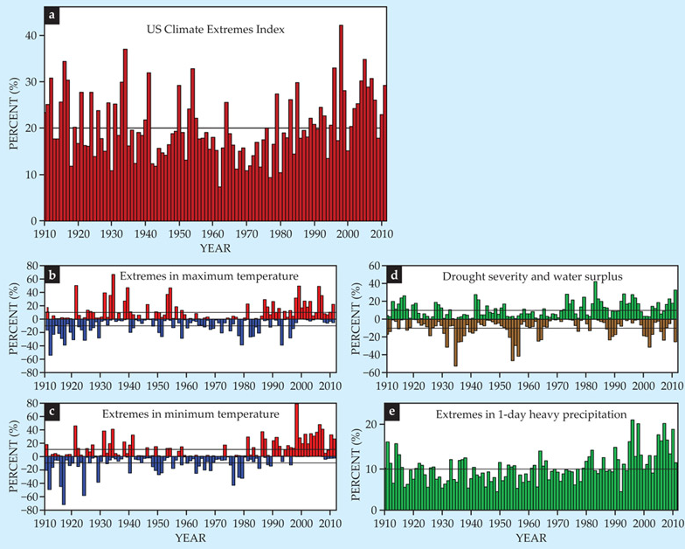
It’s getting weirder

Slide 3
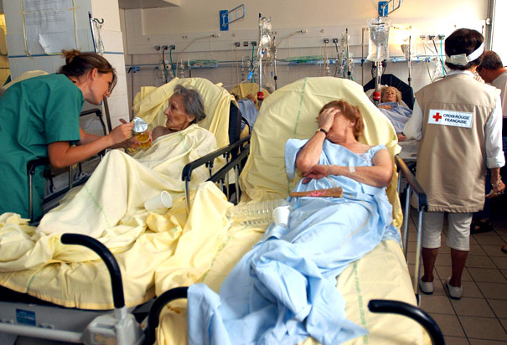
It’s getting weirder
2003 Heat wave in France

Slide 4
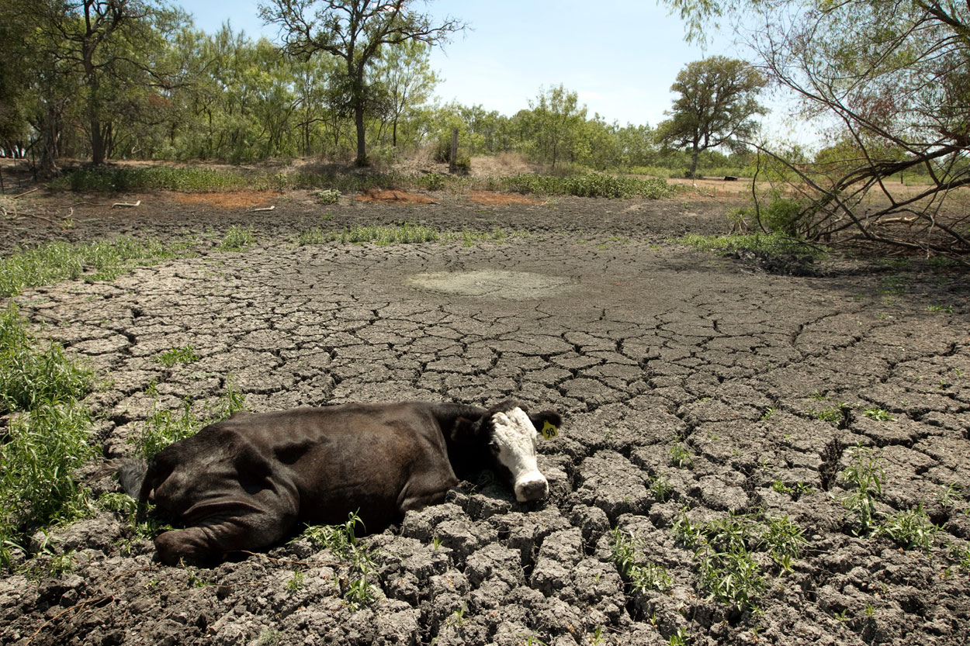
It’s getting weirder
2011 Drought in Texas

Slide 5
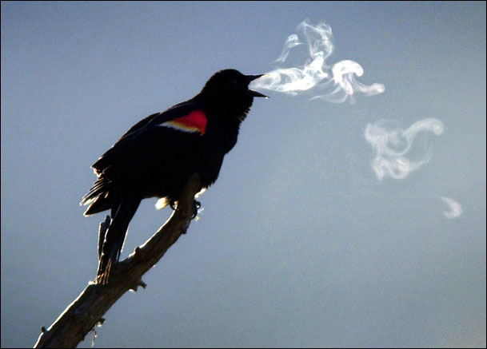
It’s getting weirder
Spring cold snap

Slide 6
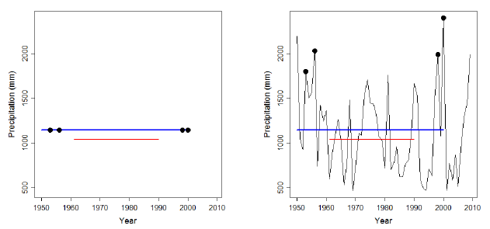
Climate versus weather

Slide 7
Climate versus weather

Slide 8
Climate versus weather

Slide 9
Climate versus weather
Precipitation change by late 20th Century
Ensemble prediction of 20 global climate models

Slide 10
Declines in landbird abundance following drought/heat events
Extreme weather and birds
Nesting period
Post-fledging period
Modeled response to a 100-year event
[Albright et al., 2010 Ecosphere]
Notes:
12 out of 17 ecoregions had significant declines following events in at least one of the two periods.
Desert saw 25% declines in avian abundance.

Slide 11
Ground nesting species particularly affected
Extreme weather and birds
Nesting period
Post-fledging period
Modeled response to a 100-year event
[Albright et al., 2010 Ecosphere]
Notes:
12 out of 17 ecoregions had significant declines following events in at least one of the two periods.
Desert saw 25% declines in avian abundance.

Slide 12
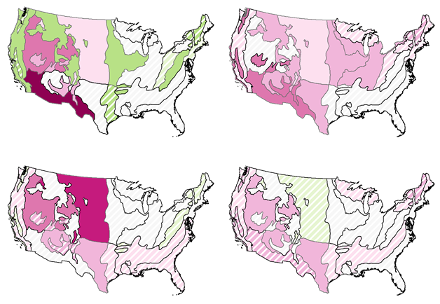
Extreme weather and birds
Nesting period
Post-fledging period
Short distance
migrants
Neotropical
migrants
Modeled response to a 100-year event
[Albright et al., 2010 Ecosphere]

Slide 13
Research Question
Bird abundance typically declines after extreme weather
Why exactly?

Slide 14
Research Question
Bird abundance typically declines after extreme weather
Why exactly?
Lower recruitment? Adult mortality? Long-distance dispersal? Concentration in refugia?

Slide 15
Research Question
Bird abundance typically declines after extreme weather
Why exactly?
Lower recruitment? Adult mortality? Long-distance dispersal? Concentration in refugia?
And what can we do about it?

Slide 16
1st Goal
Basic science: Predict the effects of droughts, heat waves, and cold snaps,
on bird demographics, especially waterfowl and forest birds.

Slide 17
1st Goal
Test four alternative hypotheses to explain abundance declines: (1) the lower recruitment hypothesis, (2) the adult mortality hypothesis, (3) the long-distance dispersal hypothesis, and (4) the refugia hypothesis.

Slide 18
2nd Goal
Applied science:
Quantify the role of National Wildlife Refuges and National Forests as refugia for waterfowl and forest birds during extreme events, and identify management actions to enhance this function.

Slide 19
1st Goal - Approach
Extreme events data
Droughts
NDVI (MODIS, AVHRR), SPI
Heat Waves
MODIS LST, PRISM
Spring Cold Snaps
MODIS snow cover, AMSR Freeze/Thaw

Slide 20
1st Goal - Approach
Bird data
Waterfowl
FWS breeding population and habitat survey
FWS waterfowl banding program
FWS Mid-winter waterfowl counts
Refuge weekly waterfowl counts

Slide 21
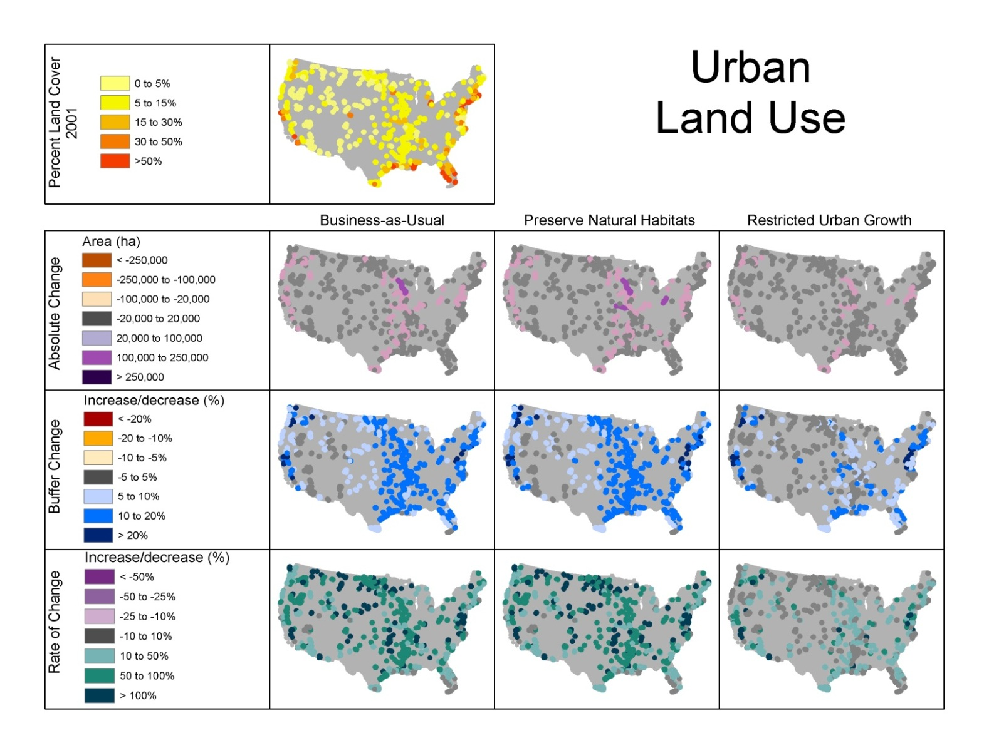
1st Goal - Approach
C. Hamilton, UW-Madison SILVIS lab

Slide 22
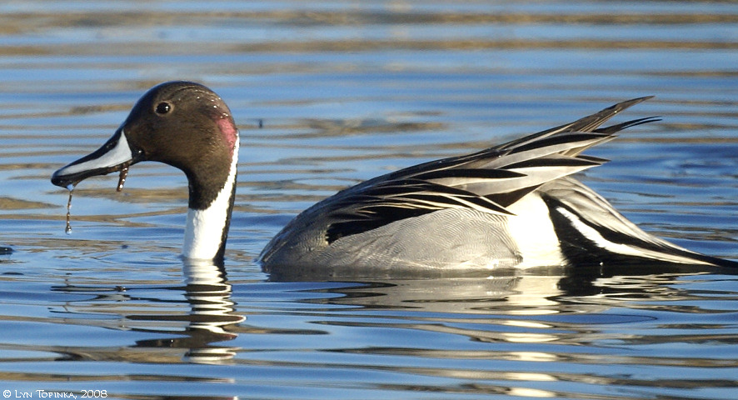
1st Goal - Approach
Notes:
End presentation here

Slide 23
1st Goal - Approach

Slide 24
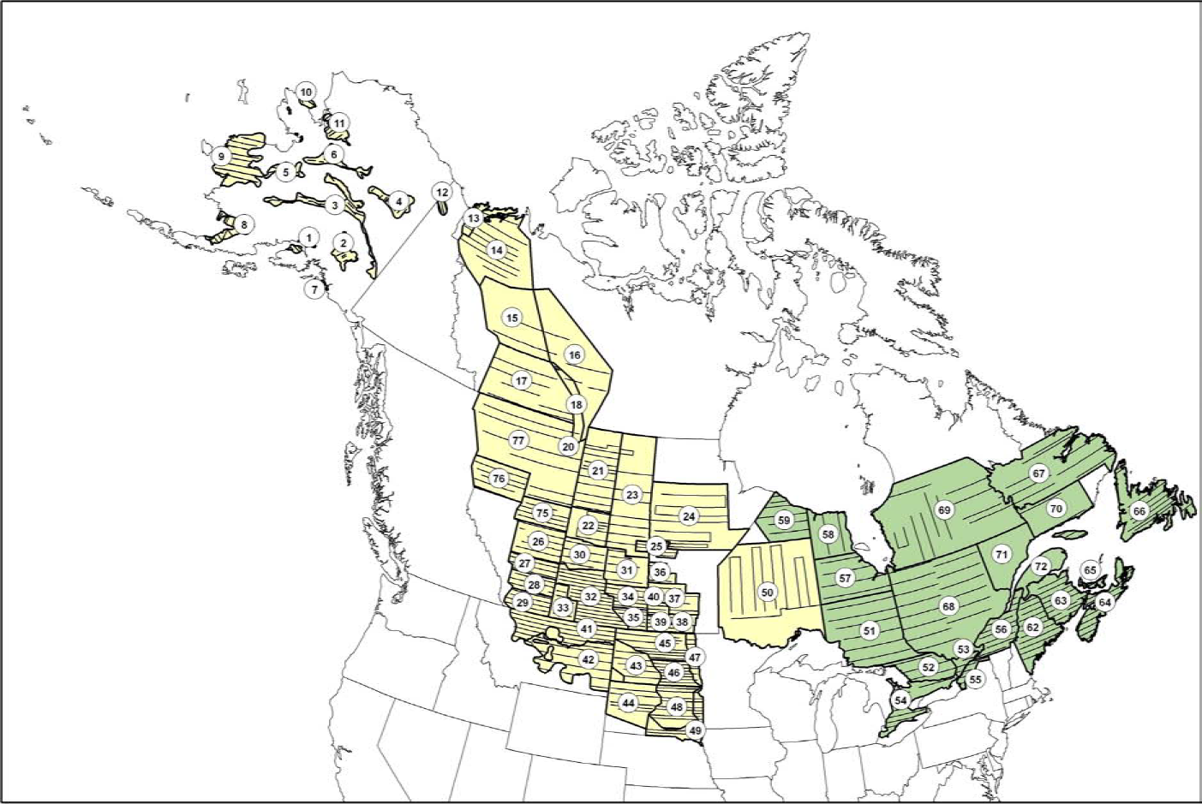
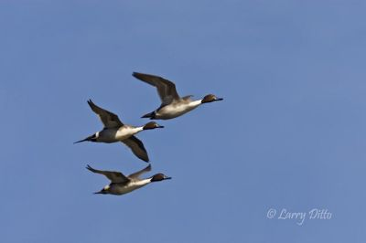
1st Goal - Approach

Slide 25
1st Goal - Approach
Bird data
Waterfowl
FWS breeding population and habitat survey
FWS waterfowl banding program
FWS Mid-winter waterfowl counts
Refuge weekly waterfowl counts
Forest birds
USGS BBS
IBP MAPS data
USGS Banding lab data
GBIF
eBird

Slide 26
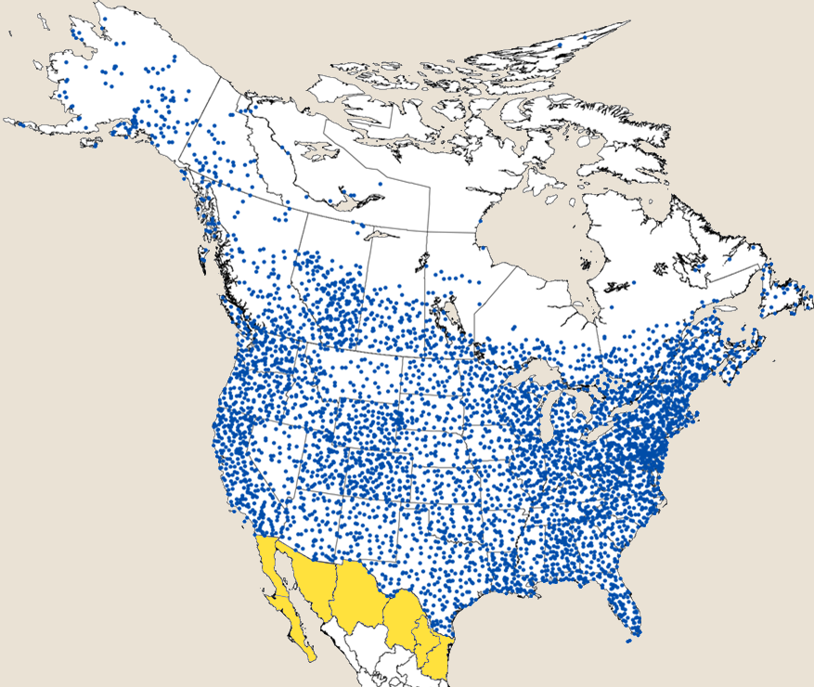
1st Goal - Approach

Slide 27
1st Goal - Approach
NWR totals
BBS totals
Hypotheses 1 and 2
Hypotheses 3 and 4
USGS banding data
MAPS data
NWR counts
BBS routes
Hypothesis 1: Lower recruitment
Hypothesis 2: Adult mortality
Hypothesis 3:
Out-migration
Hypothesis 4: Concentration

Slide 28
2nd Goal
Future predictions climate change
NARCCAP data
Population simulations of past extremes
RAMAS-GIS with six species
Counterfactual removing NWRs and NFs
Simulation of conservation actions
Transitioning to USFWS and USFS

Slide 29
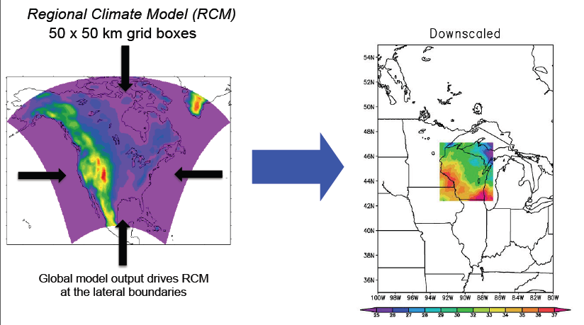
2nd Goal - Approach

Slide 30
2nd Goal - Approach

Slide 31
Birds and weather stability
Birds and weather stability
Species distribution modeling with GBIF data
Climate versus weather modeling for U.S.
Identify species most affected by extreme events

Slide 32
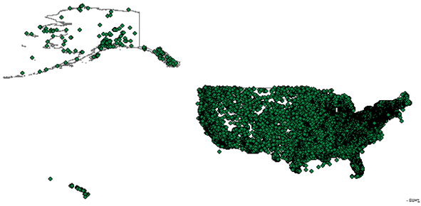
Birds and weather stability
GBIF
~ 400 US Bird species
Over 230,000 records
1890s to 2010, most after 1990

Slide 33
Birds and weather stability
BIOCLIM
Global 1 km
1950-2000

Slide 34
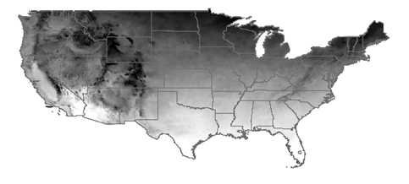
Birds and weather stability
PRISM data
Monthly precip, tmin, tmax
Derived 8 BIOCLIM variables
1905-2011 monthly grid

Slide 35
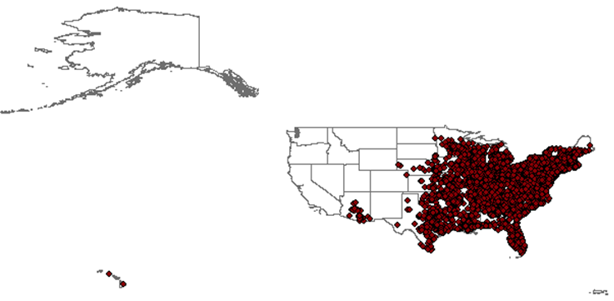
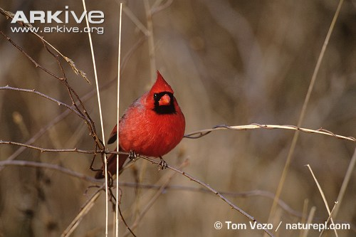
Birds and weather stability
Nearly 10,0000 records, 1912-2009, majority post-1990

Slide 36
Birds and weather stability
Climate Suitability

Slide 37
Birds and weather stability
Northern Cardinal suitable weather space 1950 -2009

Slide 38
Birds and weather stability
Climate Suitability
Weather stability

Slide 39
Birds and weather stability
Models for 389 bird species in the conterminous U.S.

Slide 40
Conclusions
Weather matters – maybe even more than climate
Extreme events push species to their physiological limits
Addressing extreme events is key for mitigating climate change effects on biodiversity conservation

Slide 41
Conclusions
Goal 1: Predict the effects of extreme events on birds
Process of (1) lower recruitment, (2) adult mortality, (3) dispersal, or (4) refugia
Goal 2: Quantify and enhance the role of refuges and national forests as refugia

Slide 44
Deliverables
Develop a tool and a modeling framework to predict species responses to future extreme climate and weather events by integrating RAMAS-GIS with NARCCAP
test four hypotheses about the effects of extreme events on bird patterns and bird demographics in the case of droughts, heat waves, and spring cold snaps, and for a range of bird species with different migratory and foraging habits
assess which MODIS products best capture those extreme events that are most important to explain bird demographics
make recommendations for NASA for future of biodiversity-relevant data products and satellite missions
train 2 PhD students and 2 postdoctoral fellows to build capacity;
deepen collaboration among team members, and between the U.S. Fish and Wildlife Service, the U.S. Geological Survey, and the U.S. Forest Service; and
publish at least 12 peer-reviewed journal articles in journals such as Remote Sensing of Environment, Global Change Biology, Conservation Biology, and Ecological Applications.

Slide 45
Derived Variables
Annual Mean Temperature
Temperature Seasonality
Max Temperature of Warmest Month
Min Temperature of Coldest Month
Annual Precipitation
Precipitation Seasonality
Precipitation of Wettest Quarter
Precipitation of Driest Quarter
NLCD, MODIS, GRACE drought, SPI… and other data sets will be assessed

