Slide 1
Combining Remote Sensing and Biological Data to Predict the Consequences of Climate Change on Hummingbird Diversity
Catherine Graham, Susan Wethington, Donald Powers, Pieter Beck, Scott Goetz

Slide 2
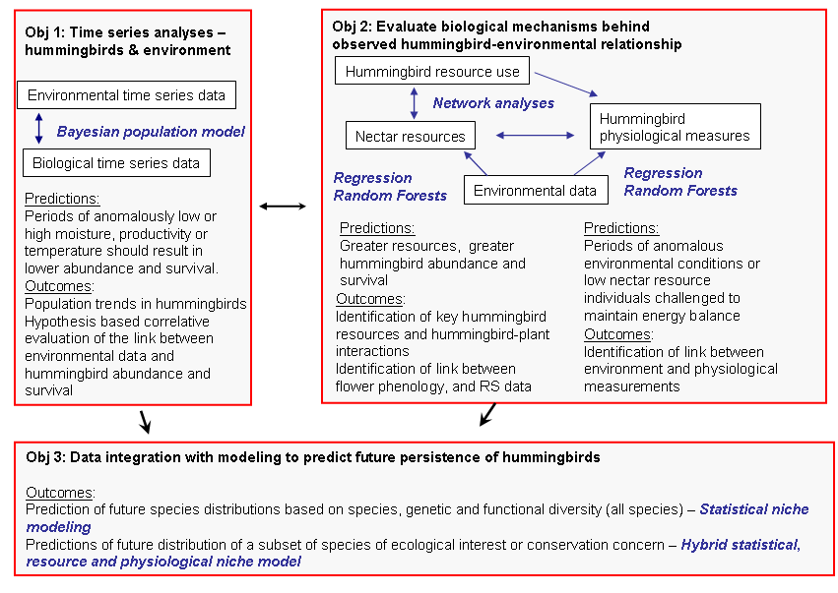
Notes:
Our three main objectives focus on
identifying patterns (objective 1) – i.e., be determining the association between hummingbird abundance, distribution and survival and environmental variables. Specifically we think that periods of anomalously low or high moisture, productivity or temperature should result in changes in abundance, distribution and survival
Evaluating some of the biological mechanisms --- we focus on what we think are the two main mechanisms – nectar resources and physiological response; Nectar is the main food source of hb so understanding what they eat and how their food is distributed has important implications for their survival and distribution, therefore we quantify nectar availability and use across regions and time. Physiological measures provide direct information on hummingbird health and their ability to maintain an energy balance in different environmental (and nectar) conditions.
Finally we will integrate these data into statistical and physiological models.

Slide 3
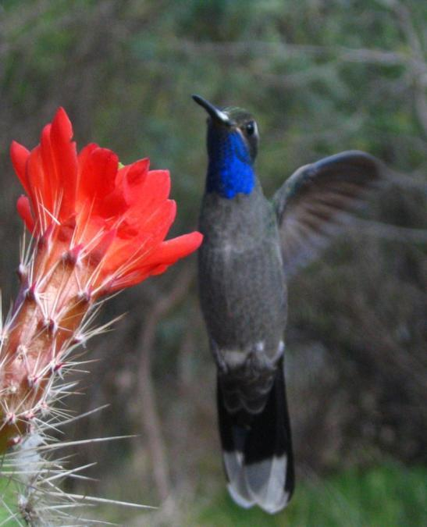
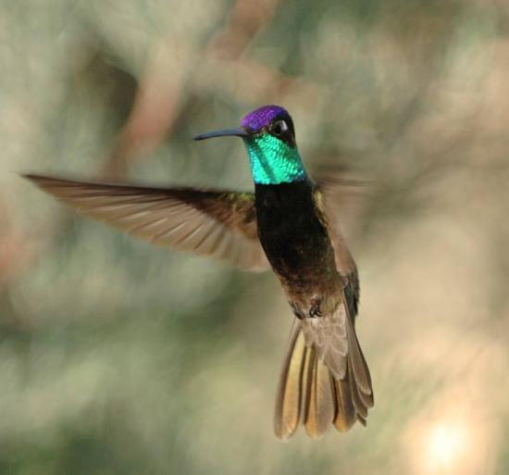
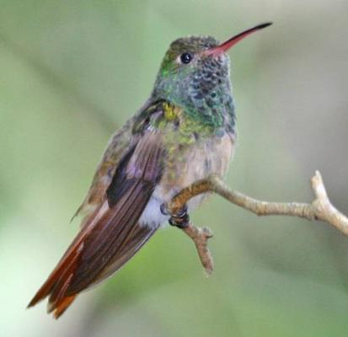
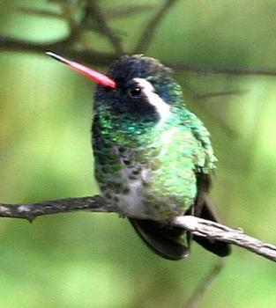
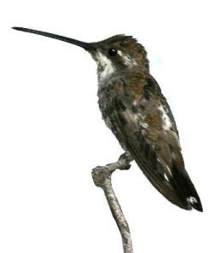
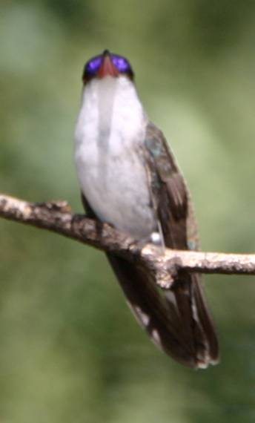
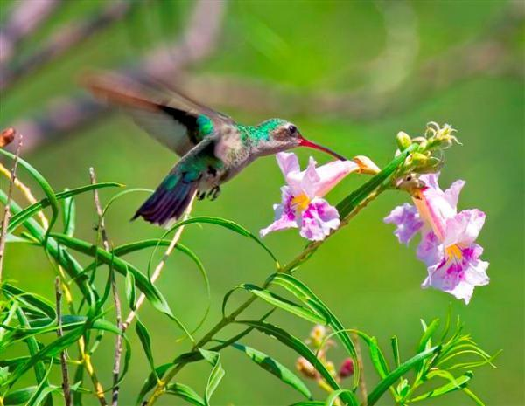
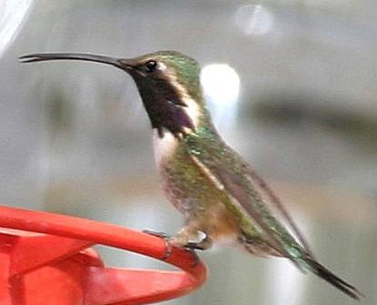
Why Hummingbirds?
They operate at the limits of endothermic physiology. Daily energy requirements are very high.
Climatic changes that reduce energy resources make it more difficult for hummingbirds to meet daily energy demands and drive shifts in their distribution.
Most diversity in the Andes.
US has 57 species (40% endemic)
Notes:
328 described species of hummingbirds -- live in a variety of environments though about 80% of species are dependent of forest vegetation.
Highest concentration in the northern Andes (109 species; Rahbek & Graves 2000) where up to 35 species co-exist in a local area.
North American has 57 species, of which 40% are endemic and 14% are of high conservation concern
Why hummingbirds?
Because of their small size (many species < 3 g) hummingbirds operate at the limits of endothermic physiology. Daily energy requirements are among the highest measured in vertebrates. Climatic changes that reduce energy resources may make it more difficult for hummingbirds to meet daily energy demands and drive shifts in their distribution
A key plant – animal interaction for ecosystem functioning and diversity maintenance is pollination – if plants/vegetation changes then hummingbird distribution will likely change and likewise pollination services will likely change

Slide 4
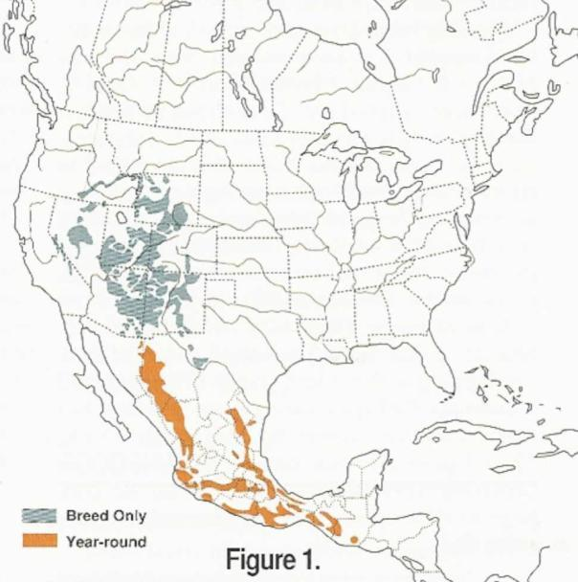
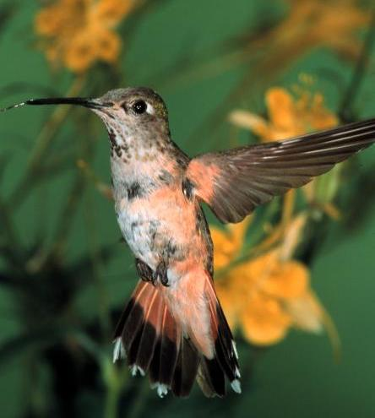
Broad-tailed Hummingbird
(medium sized)
Longest Longevity
Record in N. America
12 yr 3 mos
RMBL, CO
Three long distance recaptures between the Chiricahua Mountains, AZ and Rocky Mountain NP, CO
Notes:
North american species… not sure you want all these and you might want them later…? Or just the Broad-tailed for now???
The series of species slides relate to the species that Don and I chose for initial physiological measurements. Three medium sized species –Broad-tailed, Black-chinned, and Broad-billed. Two large species: Blue-throated and Magnificent. The small species’ distributions differ in elevation and latitude. The larger species differ in their foraging behaviors. Blue-throated is highly territorial and Magnificent is more often viewed as a trap-lining species.

Slide 5
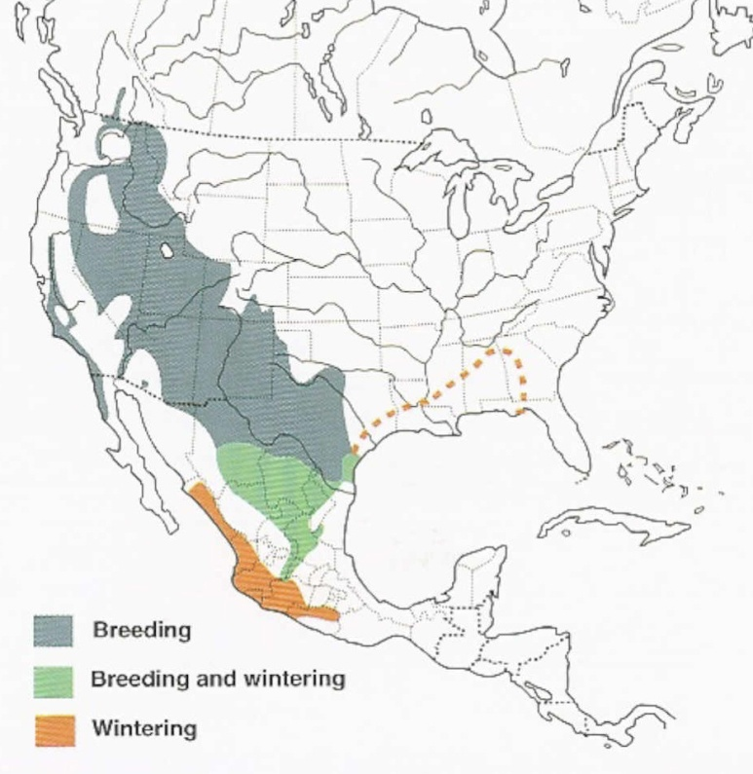
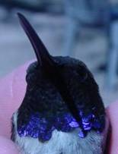
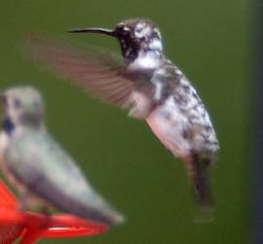
Black-chinned Hummingbird

Slide 6
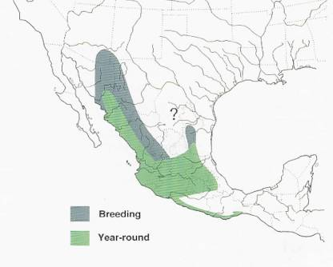
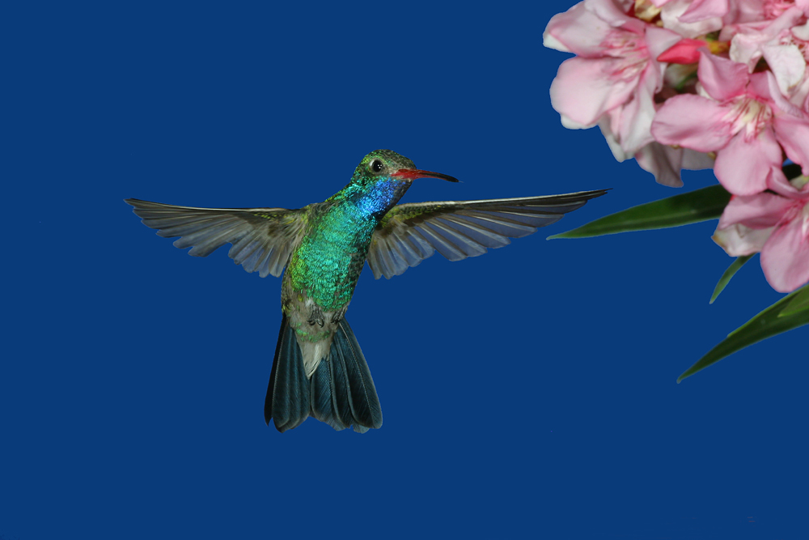
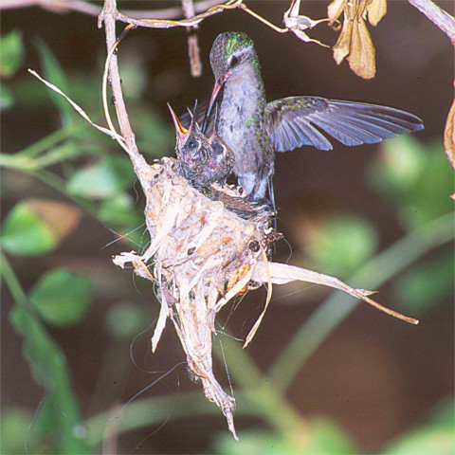
Broad-billed Hummingbird
Migrant populations at northern edge of range
Restricted to riparian zones
In spring returns earlier than other migrant species
has strong site fidelity

Slide 7
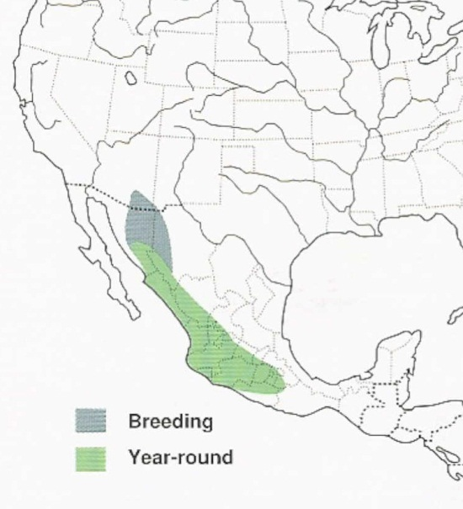
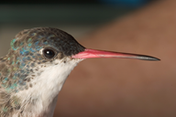
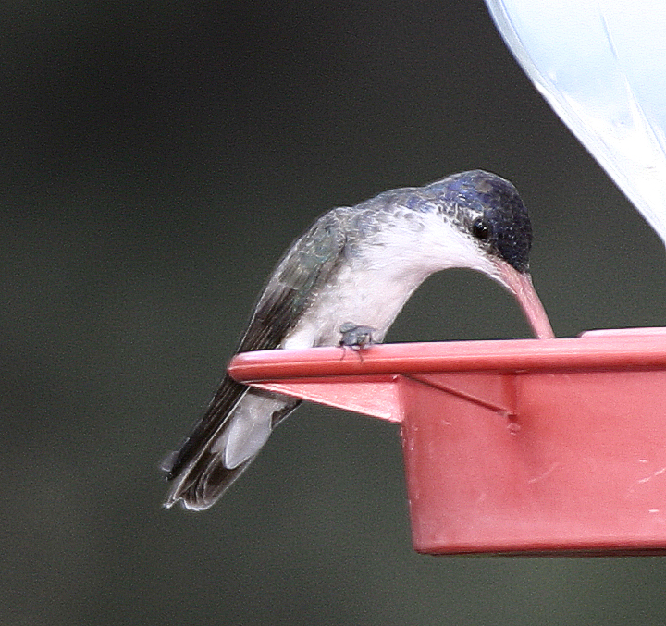
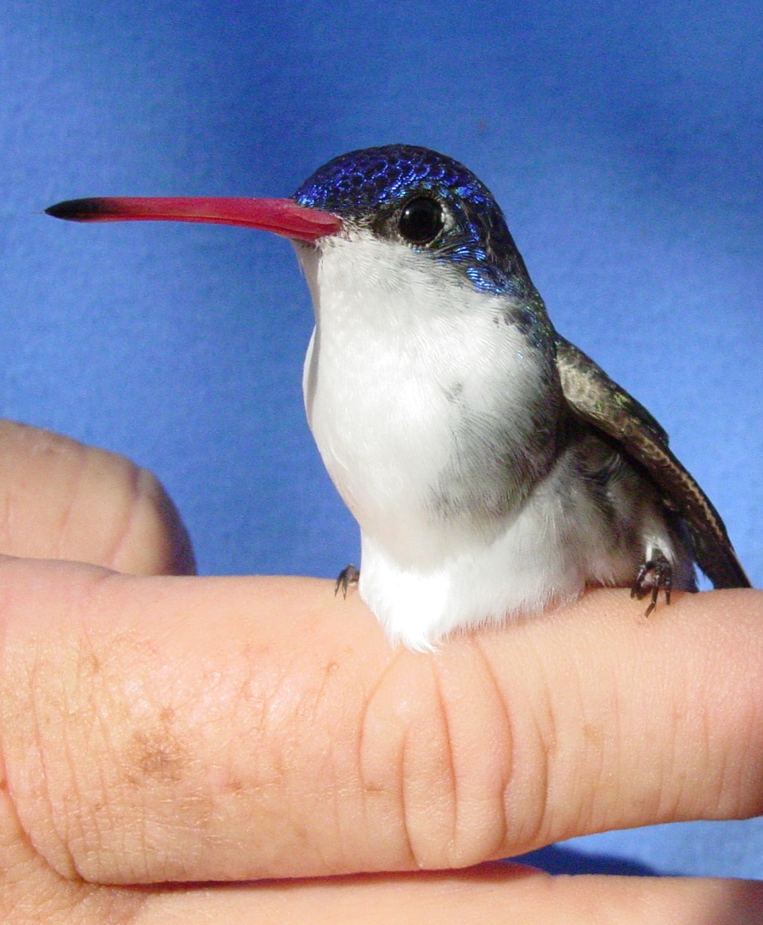
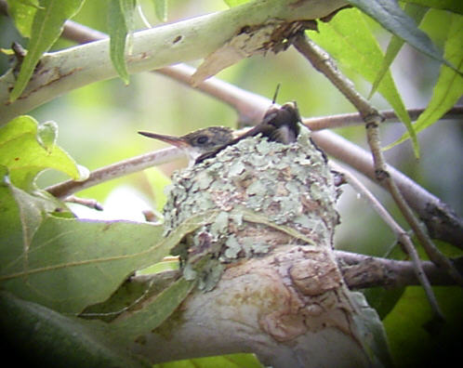
Violet-crowned
Hummingbird
(small)

Slide 8
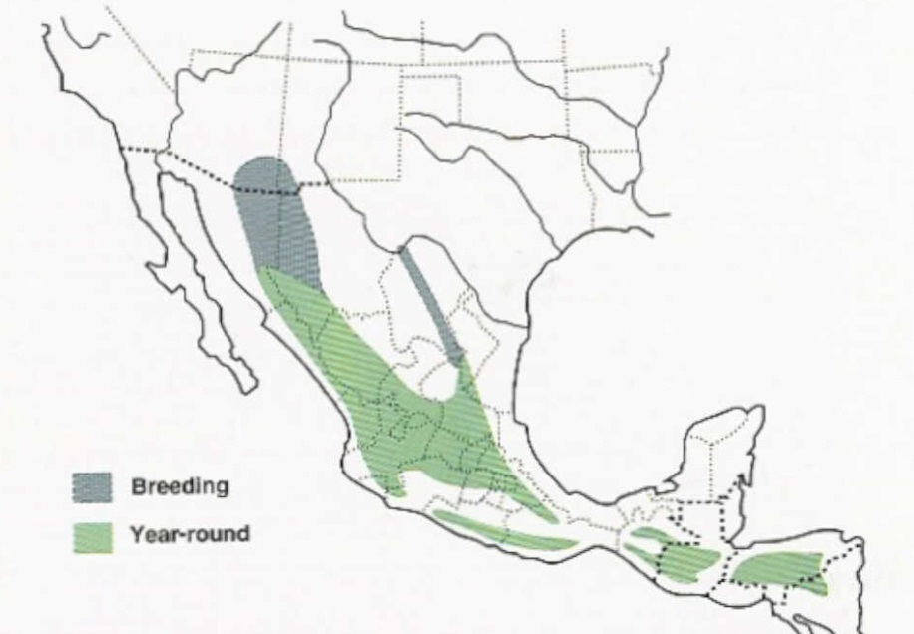
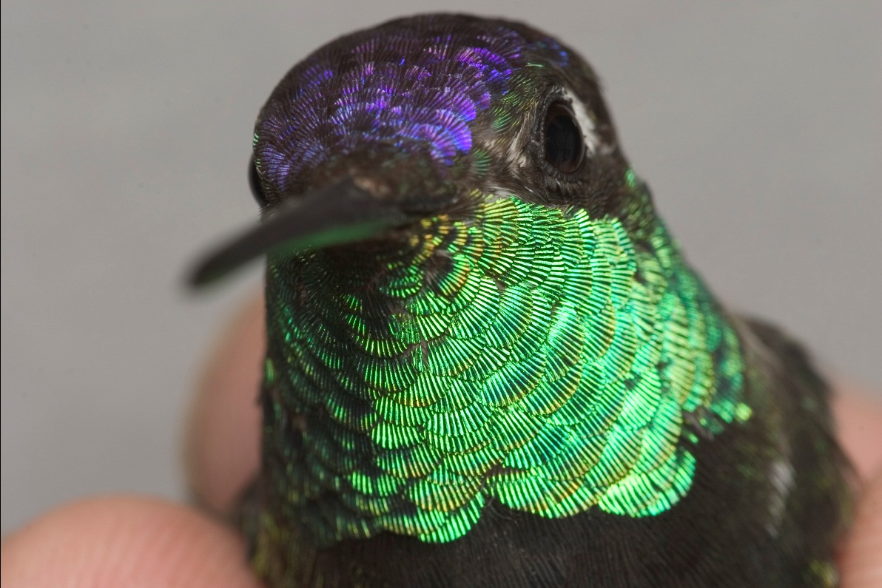
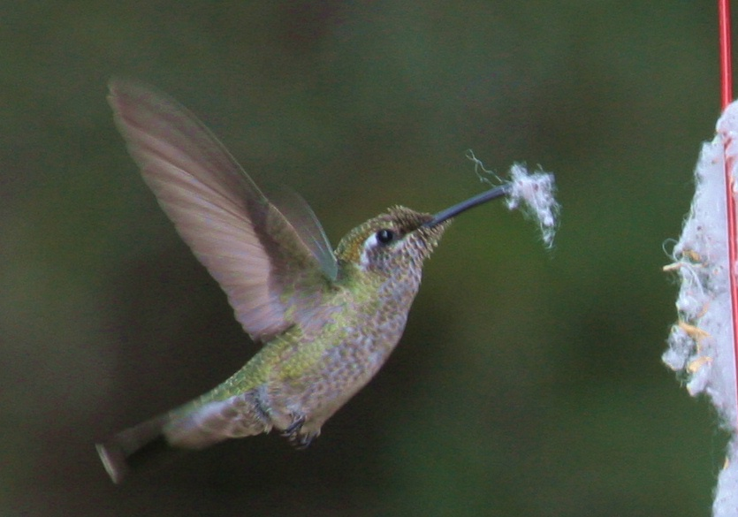
Magnificent Hummingbird
Relatively large, longevity record
11 years

Slide 9
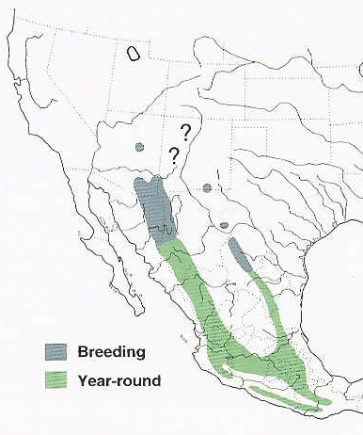
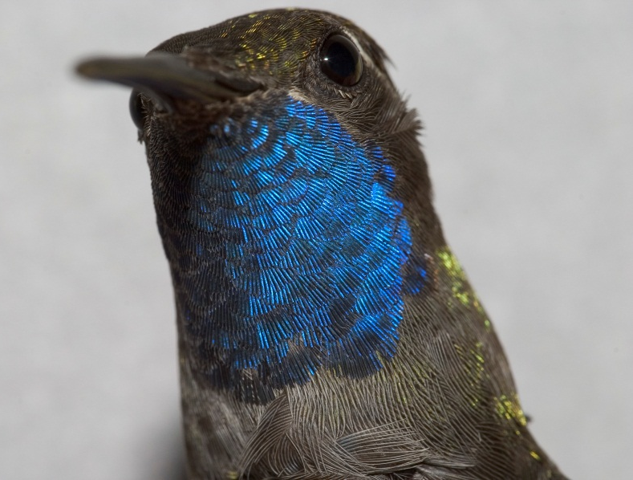
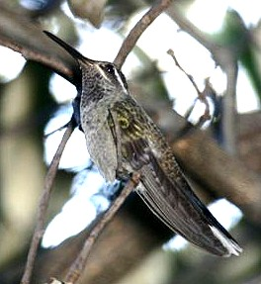
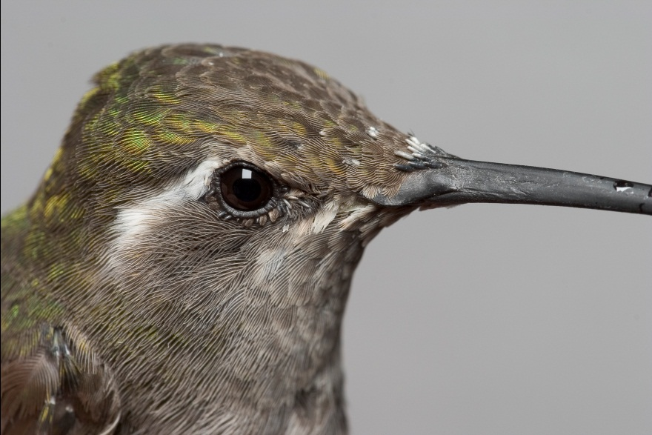
Blue-throated Hummingbird
(relatively large, highly territorial)

Slide 10
Hummingbird Monitoring Network
Co-PI Wethington operates the HMN
Samples from about 60 sites have been monitored an average of 4 years.
Twenty sites have been monitored 5 or more years.
Notes:
***** SUSAN
Data collation: Wethington has spent considerable time cleaning and collating data from hummingbird monitoring network sites.
HMN has samples from about 60 sites that have been monitored an average of 4 years. Twenty sites have been monitored 5 or more years.

Slide 11
Progress on objectives
Objective 1: Time series analyses – hummingbird and environment
Collation and preparation of hummingbird data
Collation and preparation of environmental data
Initial analyses of hummingbird environment relationships and survival
Distribution changes of Broad-tailed Hummingbirds tied to climate anomalies
Objective 2: Evaluate biological mechanisms behind observed environment hummingbird relationships
Hummingbird networks in Ecuador
Plans for physiological data collection
Objective 3: Data integration with modeling to predict future persistence of hummingbirds – nothing to report
Notes:
***** SUSAN
Data collation: Wethington has spent considerable time cleaning and collating data from hummingbird monitoring network sites.
HMN has samples from about 60 sites that have been monitored an average of 4 years. Twenty sites have been monitored 5 or more years.

Slide 12
Objective 1: Data
Hummingbird:
Hummingbird Monitoring Network (North America) –
Sampling occurs at two week intervals from March to October (i.e., breeding and migration) in British Columbia, California, Arizona and southwestern Colorado.
Ecuador –
3 sites in high Andes (~3000 meters), monitored 8 years, 3 times a year.
Colombia (data not fully prepped yet) –
8 sites (various elevations), monitored ~5-10 years, 12x / year.
Environmental data:
Various remote sensing data sets compiled (MODIS, Landsat, some higher res optical, GLAS metrics, etc..)
Suites of other data sets including climate, topo, etc..
Notes:
NEEDS ENVIRONMENTAL DATA.

Slide 13
Progress on objectives
Objective 1: Time series analyses – hummingbird and environment
Collation and cleaning of hummingbird data
Collation and cleaning of environmental data
Initial analyses of hummingbird environment relationships and survival
Distribution changes of Broad-tailed Hummingbirds tied to climate anomalies
Objective 2: Evaluate biological mechanisms behind observed environment hummingbird relationships
Hummingbird networks in Ecuador
Plans for physiological data collection
Objective 3: Data integration with modeling to predict future persistence of hummingbirds – nothing to report

Slide 14
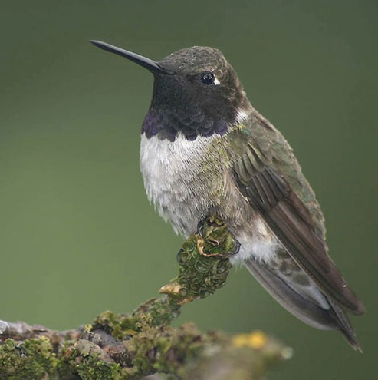
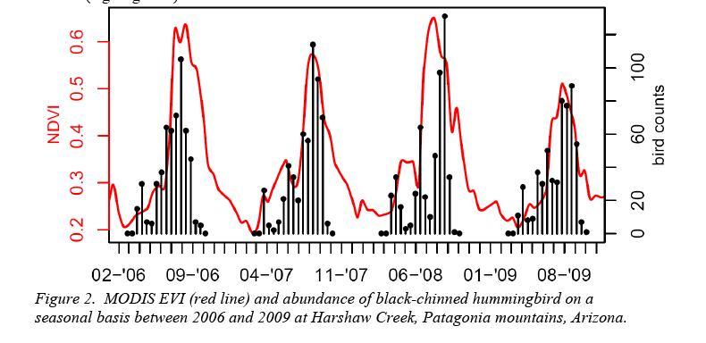
Objective 1: Time series analyses – hummingbirds and environment
Seasonal hummingbird abundance patterns correspond to vegetation activity
Notes:
Preliminary analyses suggest a strong correspondence between environmental factors (EVI) and abundance patterns of the black-chinned hummingbird

Slide 15
Abundance of southbound migrant Hatch Year Birds
Estimated abundance
(Harsh winter)
Notes:
This graph indicates the percentage of Hatch Year birds captured at HMN sites during southbound migration. The decrease in percentage of hatch year birds in summer of 2006 suggest that breeding success of multiple hummingbird species in western USA respond similarly to adverse environmental variables. One potential result of BTLH models is that climate during the winter of 2005-2006 was a “stress” year

Slide 16
Progress on objectives
Objective 1: Time series analyses – hummingbird and environment
Collation and cleaning of hummingbird data
Collation and cleaning of environmental data
Initial analyses of hummingbird environment relationships and survival
Distribution changes of Broad-tailed Hummingbirds tied to climate anomalies
Objective 2: Evaluate biological mechanisms behind observed environment hummingbird relationships
Hummingbird networks in Ecuador
Plans for physiological data collection
Objective 3: Data integration with modeling to predict future persistence of hummingbirds – nothing to report

Slide 17
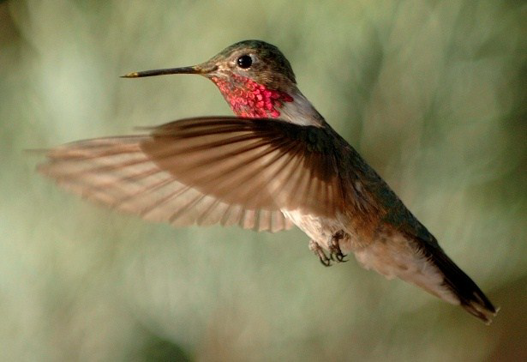
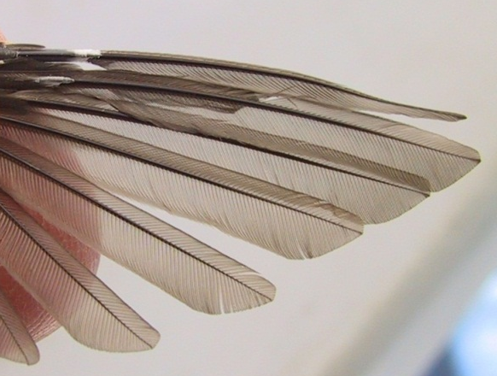
SPRING MIGRATION in SE AZ, 2011
February- Record Freeze extending into Mexico
AZ Winter Drought
Reports from researchers in Mexico of cold decreasing floral resources
Potential response by Broad-tailed Hummingbirds to extreme climate event on wintering grounds
Increased use of low and mid- elevation sites
More individuals at sites
More have not completed their winter molt
Notes:
In February 2011, extreme cold weather extended far south into Mexico reaching over-wintering sites of Broad-tailed Hummingbirds, a 3 gram species that breed at high elevations in the western USA. During their 2011 spring migration through Arizona and into Colorado, Broad-tailed Hummingbirds occurred in record numbers at low and mid elevation monitoring sites maintained by the Hummingbird Monitoring Network (HMN) with most birds in the early stages of wing molt, which usually is completed on the wintering grounds.

Slide 18
PERCENTAGE OF INDIVIDUALS IN MOLT STAGES
COMPARISON OF NUMBER OF BROAD-TAILED AT se ARIZONA MONITORING SITES IN SPRING
YEAR | SITES | MAR | APR | MAY
2003-10 (avg per year) | 9 (avg per year) | 12 | 26 | 66
2011 | 9 | 20 | 305 | 269
YEAR | SITES | Fresh plumage/ End of wing molt | Worn plumage/ beginning wing molt
2003-10 (avg per year) | 9 (avg per year) | 93% | 7%
2011 | 9 | 67% | 33%
Notes:
These tables summarizes the increased abundance of Broad-tailed at Low and Mid- elevation monitoring sites in Arizona and also the increased percentage of birds with delayed or arrested molt. These data motivated our study that will model physiological response to extreme climate events.
Using gridded time series of meteorological data in conjunction with metabolic and digestive physiological data, we will identify the temperature conditions under which Broad-tailed Hummingbirds will likely be stressed; then we will identify years in the past decade that meet these climatic conditions and use HMN monitoring data to test the predictions of the models.
In a follow on project, we will ask whether the climatic conditions that cause stress in individual Broad-tailed hummingbirds also cause population level changes such as a decrease in survivorship.

Slide 19
Progress on objectives
Objective 1: Time series analyses – hummingbird and environment
Collation and cleaning of hummingbird data
Collation and cleaning of environmental data
Initial analyses of hummingbird environment relationships and survival
Distribution changes of Broad-tailed Hummingbirds tied to climate anomalies
Objective 2: Evaluate biological mechanisms behind observed environment hummingbird relationships
Hummingbird networks in Ecuador
Plans for physiological data collection
Objective 3: Data integration with modeling to predict future persistence of hummingbirds – nothing to report

Slide 20
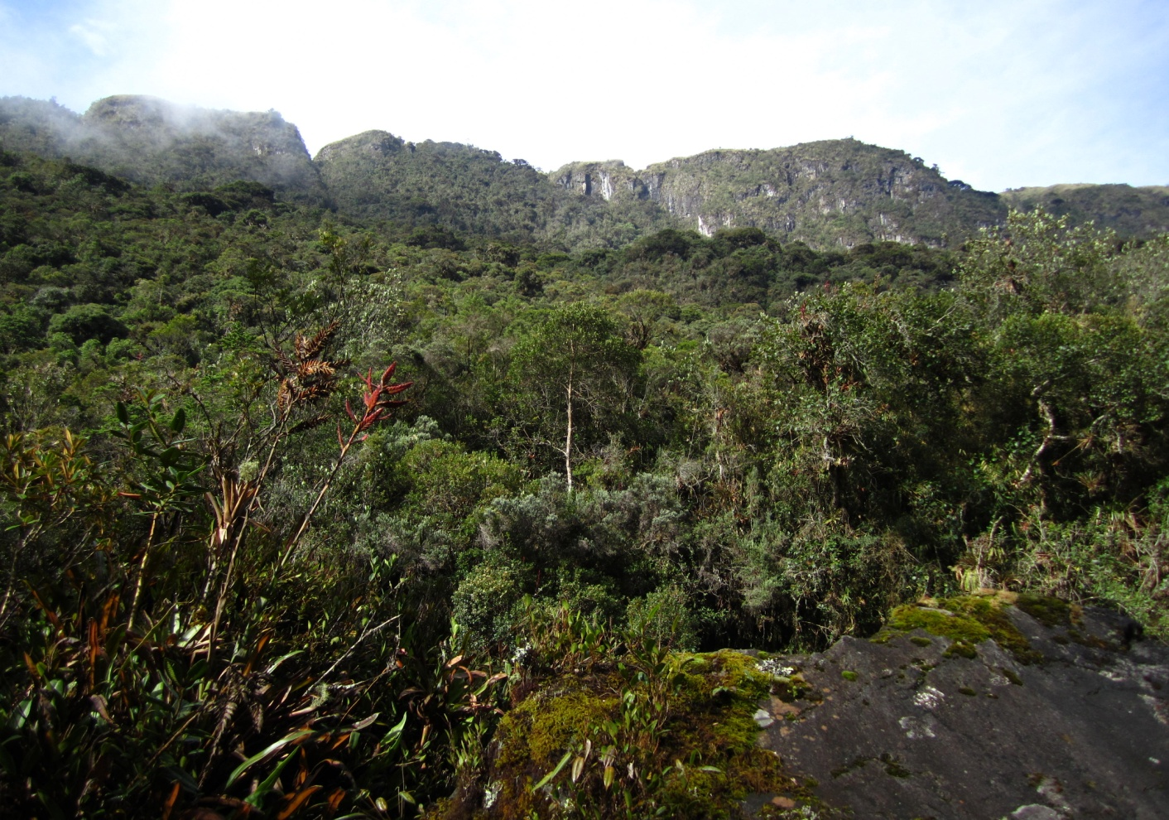
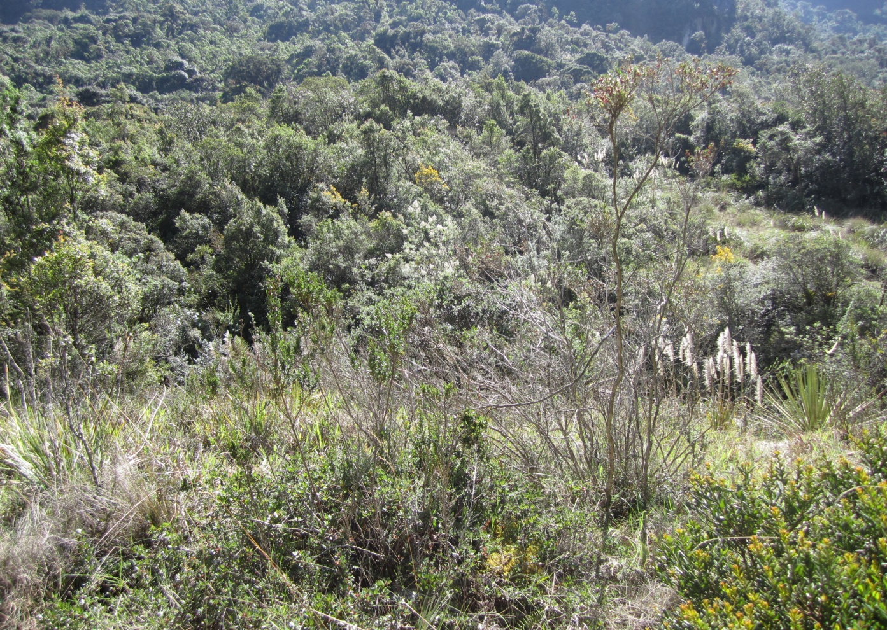
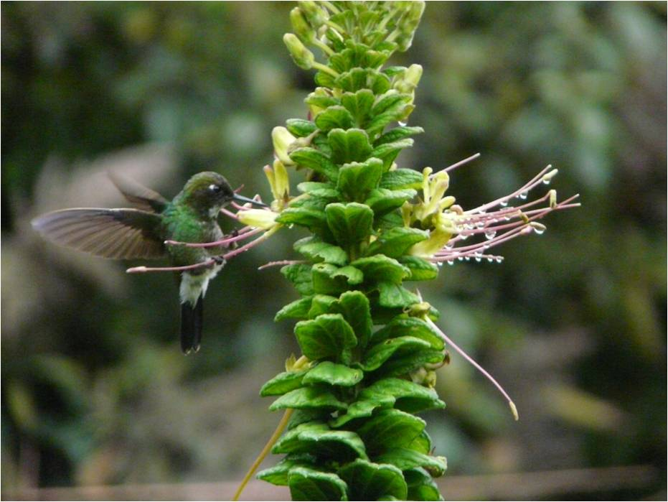
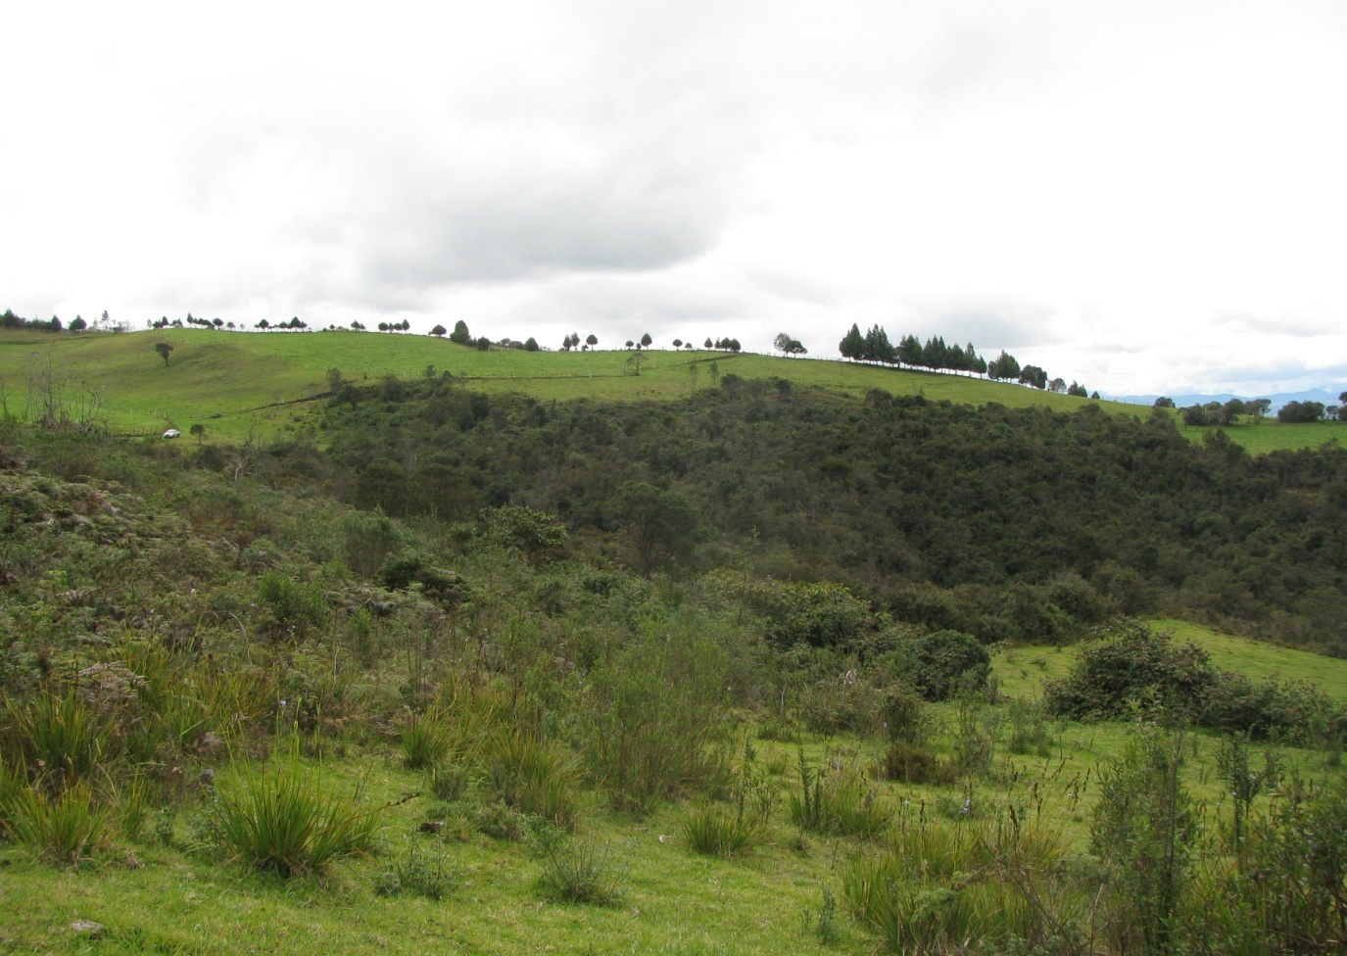
Objective 2: Hummingbird networks in Ecuador (also to be developed in NA)
PREDICTION: Disturbance of natural habitats promotes generalization over specialization
“Old” second growth
Disturbance gradient
Shrubs without cattle
Data collection for networks:
Thirty 10x5 meter plots
All flowers identified
Each plot observed for 30 minutes
Shrubs with cattle
Notes:
The development of network analysis has allowed the incorporation of community level interactions to explore the stability and dynamic of pollination systems.
The responses of species to habitat alterations has been associated with the degree of specialization of the network. Disturbance of natural habitats would promote generalization over specialization.
Cajas National Park – Ecuador. Elevation: 3100 m
Three habitats with varying levels of alteration
1) Second growth forest (GF)
2) Shrubs without grazers (SG)
3) Shrubs with cattle grazers (SC)
We placed three 200 x 5 m plots on each habitat, separated by at least 500 m. These plots were divided in twenty 10 x 5 m subplots. Flowers located within each subplot were observed for hummingbird visits for 30 min. Observation were gathered between February and August 2011.

Slide 21
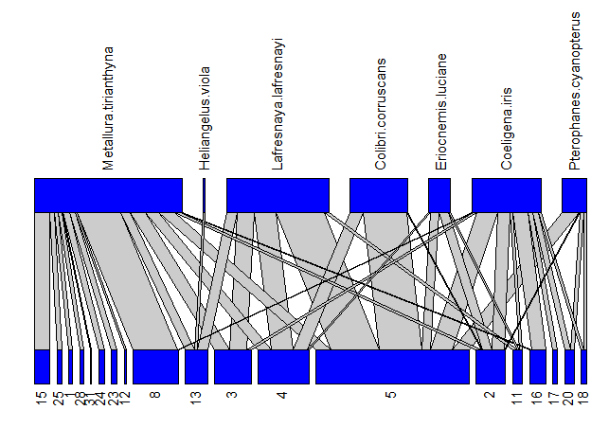
Objective 2: Hummingbird networks in Ecuador
Habitat | Total Interactions | Hummingbirds | Plants
Second growth | 442 | 7 | 19
Shrub no grazing | 1412 | 10 | 16
Shrub grazing | 884 | 7 | 17
Data from February and August 2011. Collection on-going
Interaction networks of hummingbirds and plants.
The lines between the two levels represent interactions and the thickness depends on the frequency of a given interaction.
Hummingbird species
Plant species

Slide 22
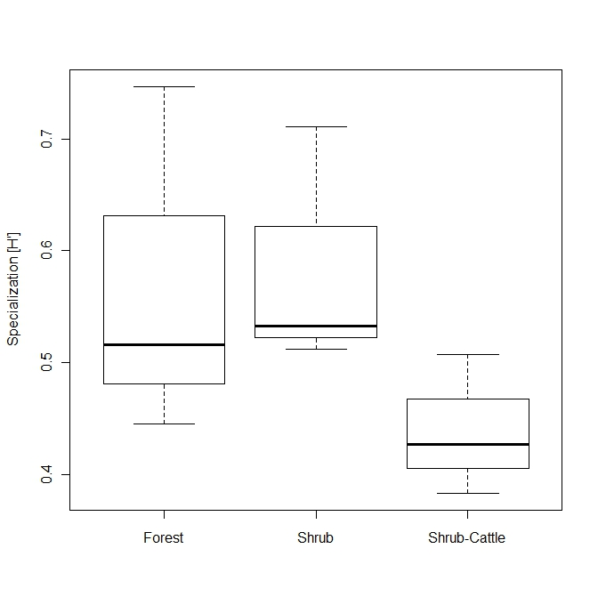
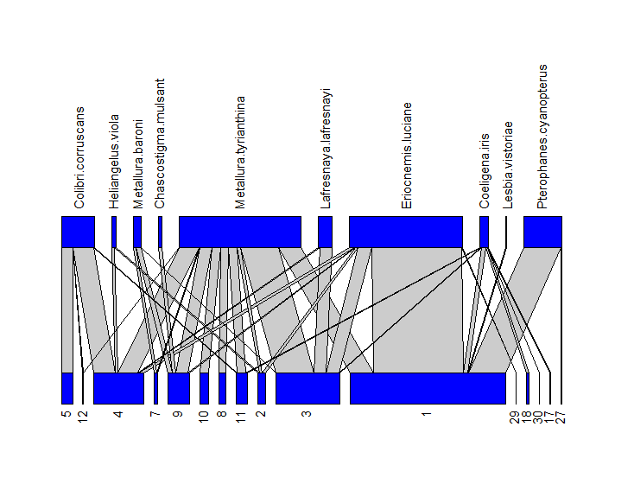
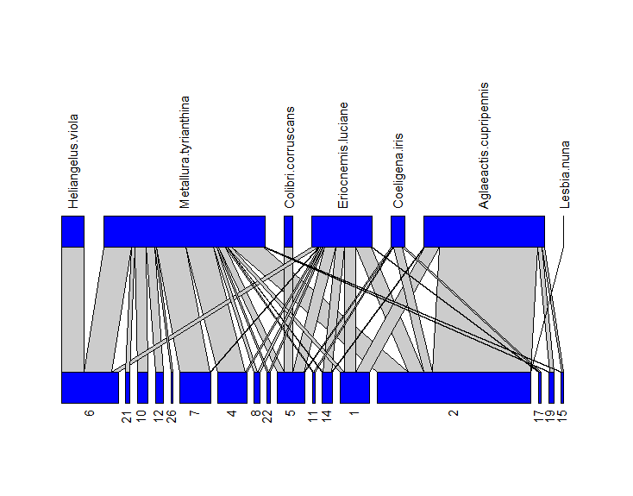
Objective 2: Hummingbird networks in Ecuador
Degree of specialization of the network
“Old” second growth
Specialization
Shrubs without cattle
Second
Growth
Shrub
Shrub cattle
Shrubs with cattle
As predicted cattle grazing decreases specialization

Slide 23
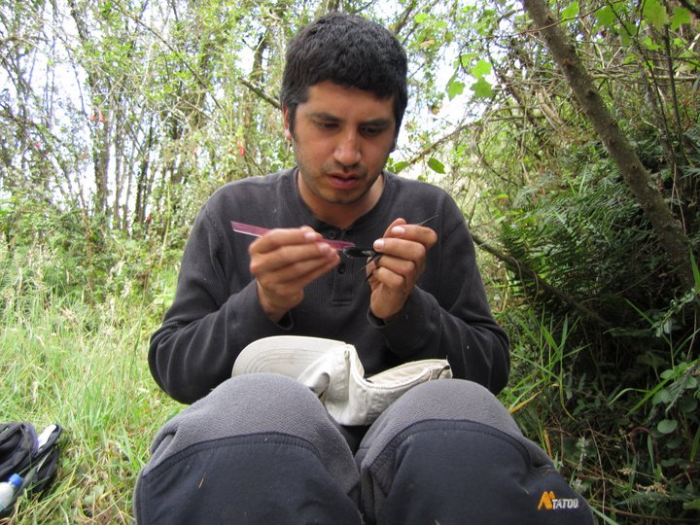
Objective 2: Hummingbird networks in Ecuador
Next steps:
Calculate hummingbird survival using Mark-recapture (as with NA data) based on 8 yrs of mist-net data
Evaluate relationship between survival & RS data
Evaluate relationship between flower resources, RS & hummingbird behavior (specialization etc.) from hummingbird – plant network
Work done by Boris Tinoco, PhD student

Slide 24
Progress on objectives
Objective 1: Time series analyses – hummingbird and environment
Collation and cleaning of hummingbird data
Collation and cleaning of environmental data
Initial analyses of hummingbird environment relationships and survival
Distribution changes of Broad-tailed Hummingbirds tied to climate anomalies
Objective 2: Evaluate biological mechanisms behind observed environment hummingbird relationships
Hummingbird networks in Ecuador
Plans for physiological data collection
Objective 3: Data integration with modeling to predict future persistence of hummingbirds – nothing to report

Slide 25
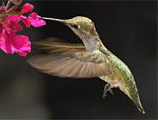
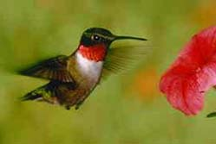
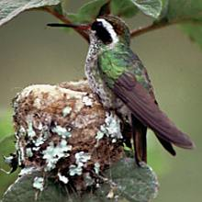
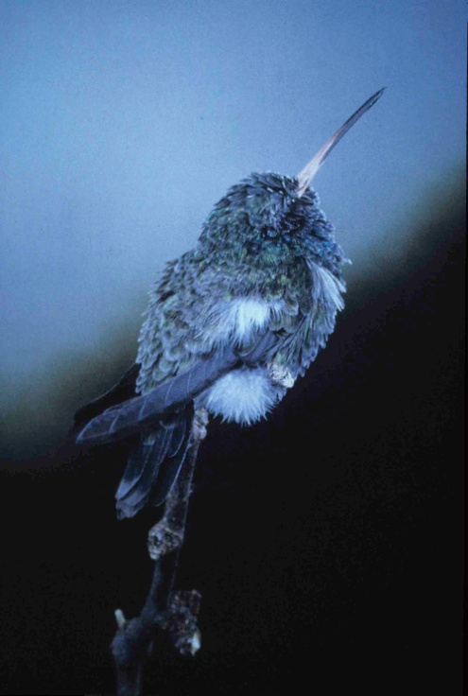
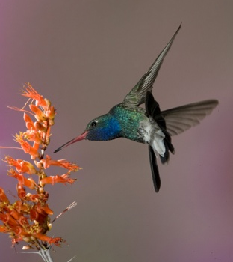
Physiology
Colibríes: fisiología, comportamiento
© R. A. Tyrell
High metabolic rate
High energetic needs
Use of torpor
Nectarivores
Activity patterns
Movement patterns

Slide 26
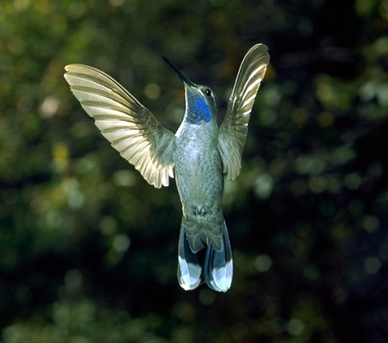
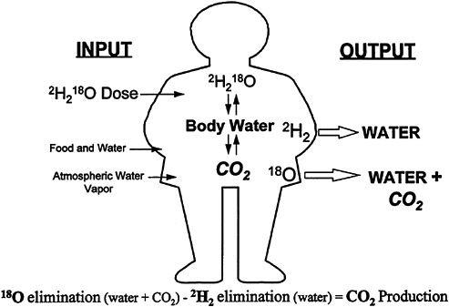
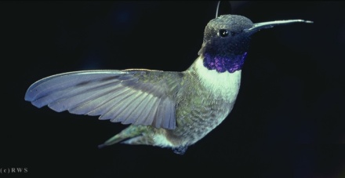
Objective 2: Plans for physiological data collection
Measure field metabolic rate of 6 hummingbird species at 5 locations using doubly-labeled water (DLW). The 5 locations provide both thermal and elevational variation. The 6 species provide maximum size and phylogeneitc variation for North American hummingbirds.
Lampornis clemenciae; 8 g
DLW Theory
Archilochus alexandri; 3 g
Notes:
1. Measure field metabolic rate of 6 hummingbird species at 5 locations using doubly-labeled water (DLW). The 5 locations provide both thermal and elevational variation. The 6 species provide maximum size and phylogeneitc variation for North American hummingbirds. The plan will be to collect DLW data during Susan's bimonthly banding sessions. This will allow for each site to be sampled 5-7 times this summer yielding a bucket load of energetic data. I still have no idea when the isotope analyzer will be delivered but that will not stop us from collecting samples. 2. Make measurements of environmental operative temperature (Te), a measure of thermal conditions where ambient temperature (Ta) is integrated with environmental radiation to predict radiant load on an organism, and wind speed over a series of days where mean Ta varies. Te and wind speed will be used to calculate standard operative temperature (Tes) which is Te corrected for the effects of convection. The ultimate goal of this experiment is to construct a predictive model of estimate Tes from readily available measures of Ta and wind speed (note I've left a bunch of steps out here and gone straight to the punch line). If this works it will make modeling physiological response really easy. 3. Measure basal/resting metabolism in broad-tail, broad-billed, and violet-crowed hummingbirds. Measurements on broad-tailed hummingbirds will be part of the cold-tolerance paper. These measurements on all three listed species will provide data on thermoregulatory costs that will help us understand how much of their daily energy expenditure must be committed to thermoregulation (an obligatory cost) as opposed to such things as molt or reproduction (optional costs). We will not make these measurements on the other three species since they are available in the literature. 4. Measurement of the rate of heat dissipation using infrared thermography. This is a new experiment that I thought about while in Arizona. We will use the IR camera to film hummingbirds coming to feeders over a broad range of Tes. This should give us sufficient data to construct some sort of index of heat dissipation that will allow us to perhaps identify some critical Tes past which maintaining body temperature becomes a challenge. This, along with future measurements of torpor frequency, could provide some wonderful insight on energy management strategies. And if time allows: 5. Measurement of resource importance using stable isotopes. We will analyze deuterium levels in free-living hummingbirds to determine the relative importance of feeders in their diet. This will be done by measuring the isotope signature of blooming wildflowers, insects being consumed by hummingbirds, and deuterium-spiked feeders. Because the deuterium signature of hummingbird body water should respond quickly to changes in the deuterium signature of their food resource this should work well. The beauty of this method is that we might be able to gain some good insight into temporal variation in feeding behavior as resources shift. This could add another level of interpretation to the energetic data.

Slide 27
Objective 2: Plans for physiological data collection
Make measurements of standard operative temperature (T_{es}), a measure of thermal conditions where ambient temperature (T_{a}) is integrated with environmental radiation and wind speed to predict radiant load on an organism. Measurements will be made over a range of thermal conditions and used to model the impact of thermal conditions on daily energy costs.
Notes:
These are standard diagrams illustrating all the variables that impact thermal load in an organism. The diagram on the left shows energy gains/losses from various sources of radiation, conduction, and convection (Mugaas & King 1981). The diagram on the left illustrates how significant thermal load can be in determining the real “temperature” an organism experiences (e.g. shade vs. sun)(Mahoney 1976). One thing to keep in mind is that we are fortunate in that hummingbirds experience a relatively simple thermal environment in that they are in a tree/shrub or in the air. Thus modeling their thermal environment should be relatively simple.

Slide 28
Objective 2: Plans for physiological data collection
Measure basal/resting metabolism in broad-tail, broad-billed, and violet-crowed hummingbirds. Measurements on broad-tailed hummingbirds will be part of a cold-tolerance analysis.
Normothermy
Torpor
Notes:
This is a standard Scholander curve measuring metabolic rate under basal metabolic conditions as a function of temperature for Magnificent hummingbirds (Lasiewski & Lasiewski 1967). Below 33 C metabolic rate increases as temperature decreases. The slope of this relationship is an estimate of the rate of heat loss. Seasonal changes in this slope is evidence of seasonal acclimatization (e.g. changes in insulation, etc.). Also, the temperature at which torpor is initiated could also be an indicator of seasonal acclimatization if it shifts. These data will help us understand 1) if broad-tails undergo any sort of seasonal acclimatization to temperature, and 2) costs of thermoregulation in all species measured.

Slide 29
Objective 2: Plans for physiological data collection
Measurement of the rate of heat dissipation using infrared thermography. These data will be used to assess the effects of thermal load and to better understand body-temperature regulation in hummingbirds.
Hovering
Forward Flight
Notes:
These images illustrate how average surface temperature in a 3 g hummingbird is higher during hovering than during forward flight (in this case 12 m/s). The key point is that increased convective heat transfer during forward flight reduced the physiological effort (i.e. evaporative cooling) required to dissipate endogenous heat produce by metabolism and activity. Similar measurements on birds in a variety of thermal environments could tell us a great deal about how hummingbirds will cope energetically with climate change.

Slide 30
Goals for field season and next year
Measure energetic requirements and rate of heat dissipation at field sites in Arizona.
Determine cold temperature tolerance of Broad-taileds to better understand empirical changes in distribution during winter and summer conditions from laboratory measurements
Analyses of demographic data and remote-sensing in South Western North American hummingbirds
Analyses of how migration timing is influenced (predicted) by environmental factors
Determine survival rates as a function of variation in environment (RS data) habitat type and elevation in Ecuadorian hummingbirds
Notes:
If we can do all this then we can write the papers on the next page…

Slide 31
Ambitious plans for publications..
Variation in survival rates as a function of habitat type/vegetation structure/elevation (Arizona).
Breading season conditions influence intra- and inter-annual survival rates
Migration timing influenced (predicted) by environmental factors
Extreme events influence hummingbird molt, survival, physiological responses and movement behavior: A case study of the Broad-tailed hummingbird (to be presented at the American Ornithological Union)
Variation in survival rates as a function of habitat type/vegetation structure/elevation Ecuador
Changes in plant-animal networks across a disturbance gradient in Ecuador (Presented at the Neotropical Ornithological Conference)
Don - preliminary physiology methods – presenting the idea of feeders to the group in more detail

