Slide 1
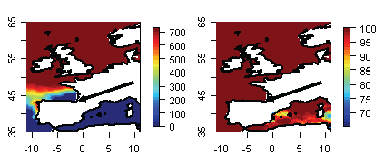
Your institution logo here
Physiological Impacts of Climate Change
Using Remote Sensing David S Wethey/University of South Carolina
How can physiology inform species distribution models?
Approach
Examine difference between lethal vs performance limits
Thermal death vs scope for growth / energy budget
Commercially important shellfish
Extensive physiology, production, biogeography data
Extremely important to find reasons for failure of assumption of niche conservatism in species distribution models that work in one geographic region but fail to make correct predictions elsewhere.
Marine Mussel
Distribution Model
Validated for
US East Coast
Fails utterly in
Europe
Species Distribution Models Based On:
Thermal Tolerance Energy Budget Thermal Tolerance

Slide 2
Transient Event Margin
This is the difference between the upper physiological performance limit Ctmax
of a species and its lethal thermal limit Ltmax
We believe that niche models will be well conserved geographically in species with small TEM, and such models will fail spectacularly when TEM is large.
We are using modeling and experimental measurements of performance to test this idea.
Performance Metrics
Growth rate
Scope for Growth
Reproduction
Feeding rate
Burrowing rate
Heart rate
Respiration rate

Slide 3
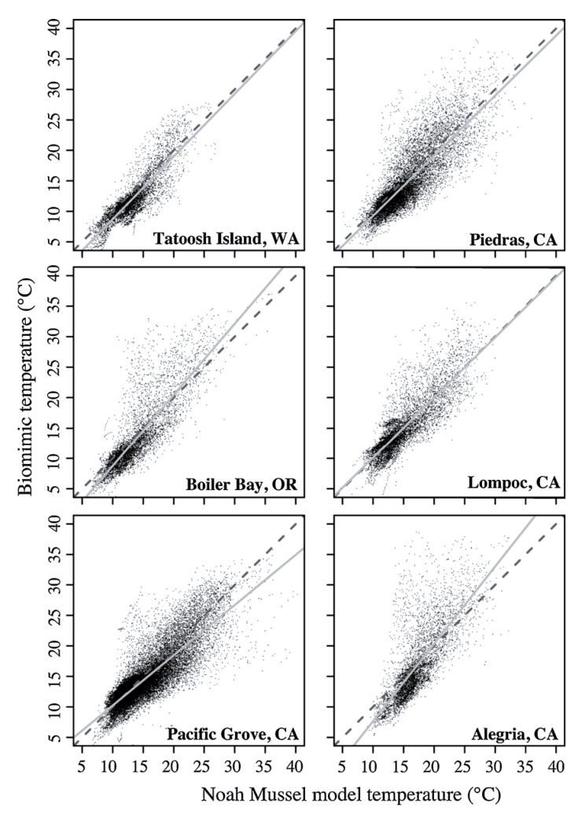
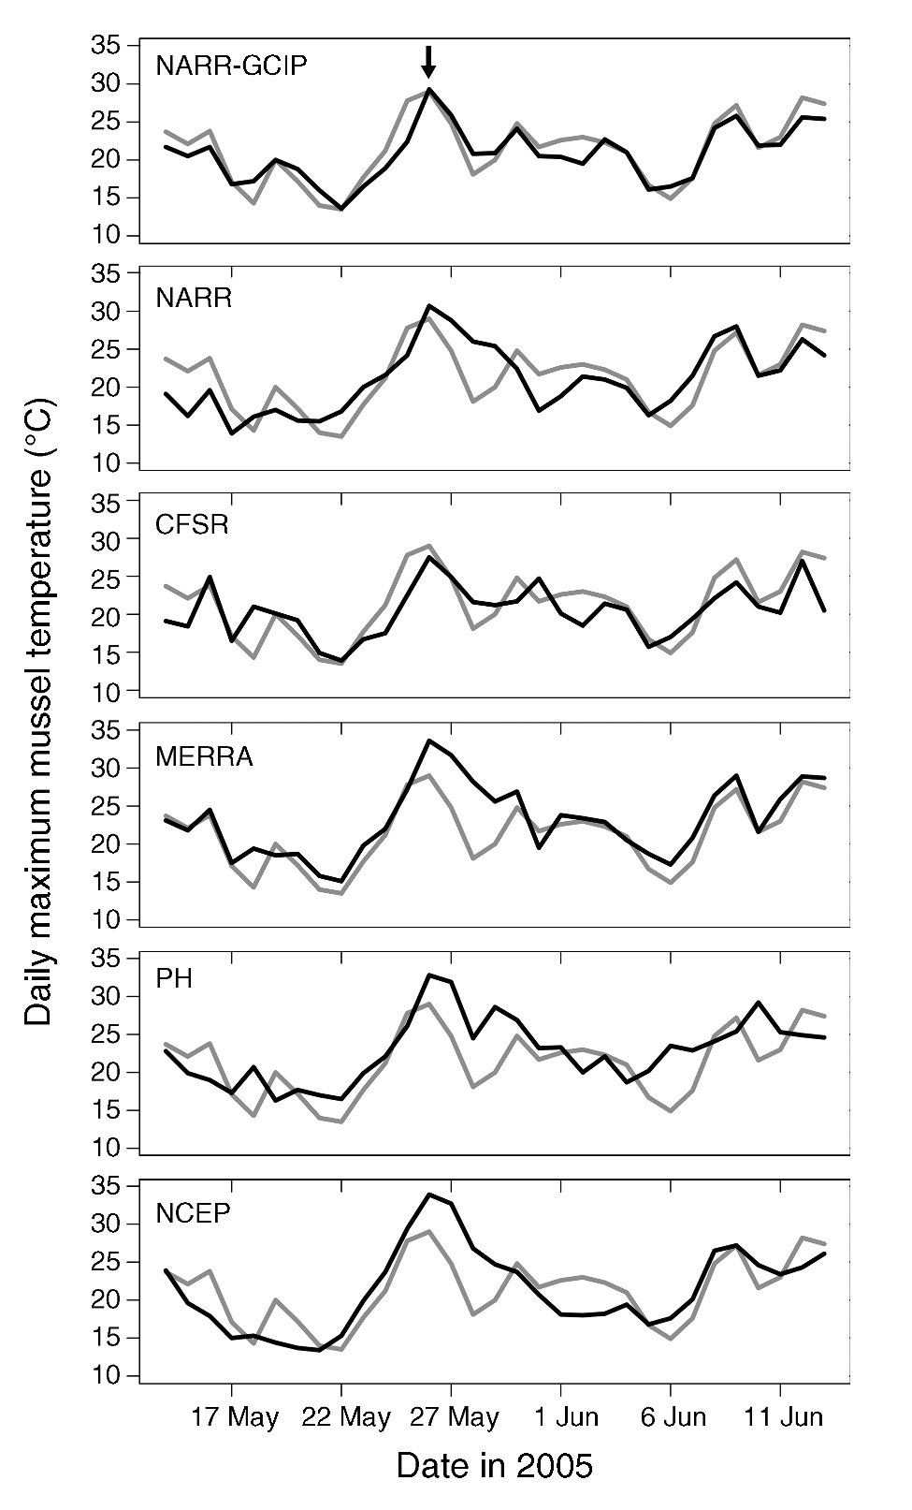
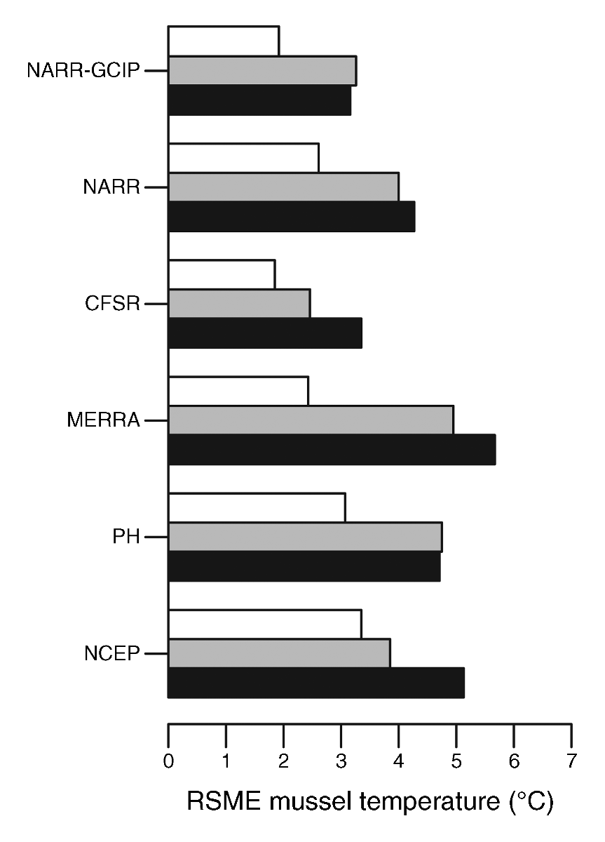
Biophysical Modeling of Intertidal Body Temperatures
NOAH Mussel Model
Good predictor of
Intertidal Body Temps
Gridded climate reanalysis products differ a great deal
in their utility for biophysical modeling . CFSR (global)
and NARR (N America) almost as good as local data.
Wethey et al. 2011. Ecological Modelling 222:3568-3576
Mislan & Wethey 2011. Ecological Applications 21: 2678-2690

Slide 4
Quality of Gridded Remotely Sensed daily SST Relative to in situ Dataloggers
Robolimpets in Europe, Robomussels in Chile
Analysis of daily GHRSST
products.
Bias in R/S SST increases
in upwelling regions and
in upwelling seasons
Chile errors are greater
than elsewhere for this
reason.
Lima, Broitman, Seabra, Wethey

Slide 5
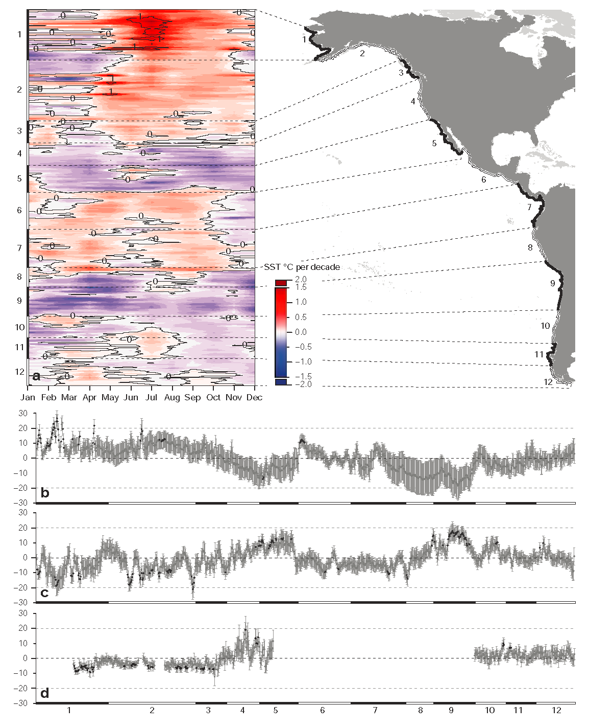
SST reconstructions and forecasts
are essential to our modeling
efforts
Global distribution of seasonal
rates of change of SST from
remote sensing.
71% of coastlines are warming.
46% have decrease in frequency
of extreme cold events.
Hot days are becoming more
common in 38% of coasts.
Warm season is beginning earlier
In the year in 36% of coasts.
http://coastalwarming.com
Change in Hot days (d/decade)
Change in Cold days (d/decade)
Change in timing of warming
Lima & Wethey, 2012. Nature Communications 3:704

Slide 6
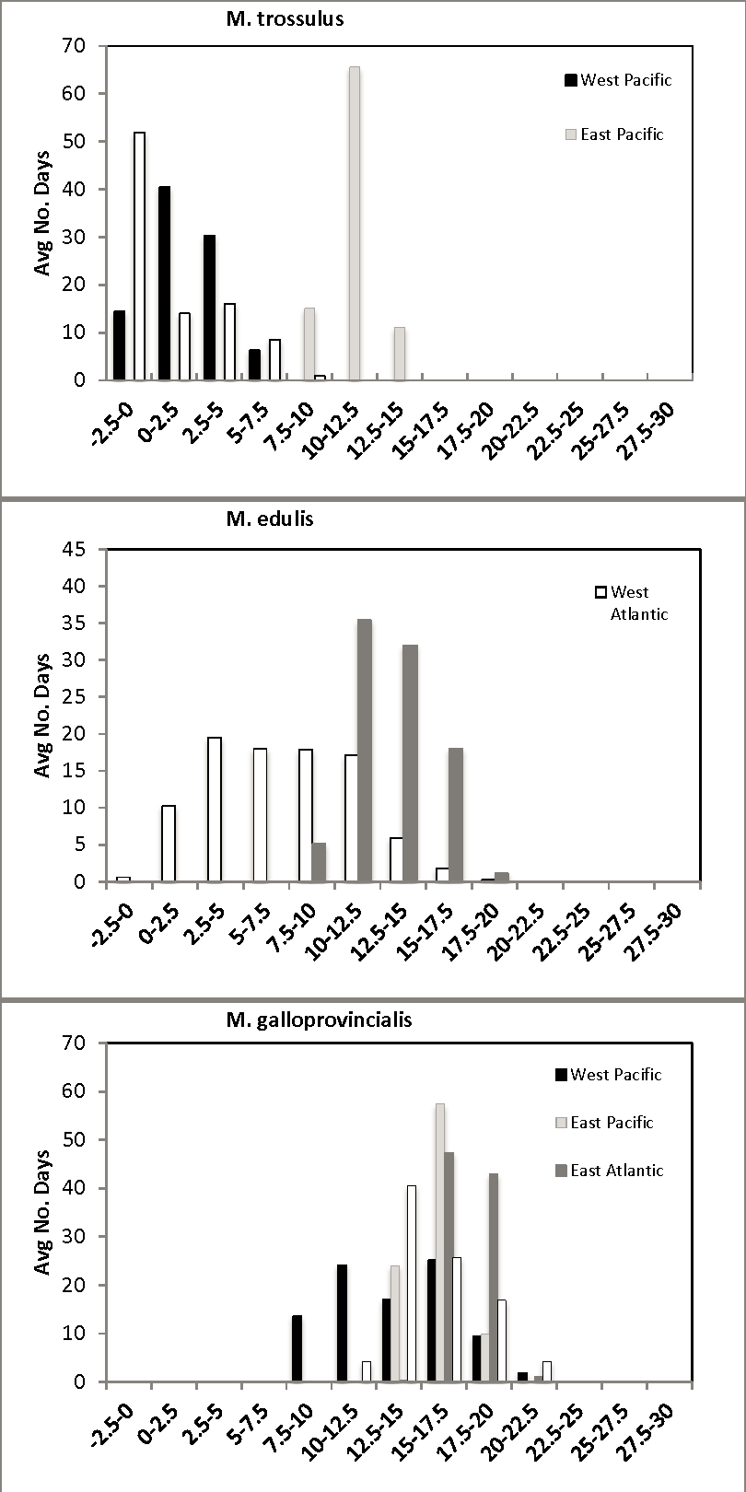
Measures of Physiological Performance
Linked to Biogeography
Scope For Growth (Assimilation – Respiration)
drops below zero at high temperatures in
3 species of mussels
SST rarely exceeds zero SFG threshold
in locations where these species are found
Fly and Hilbish

Slide 7
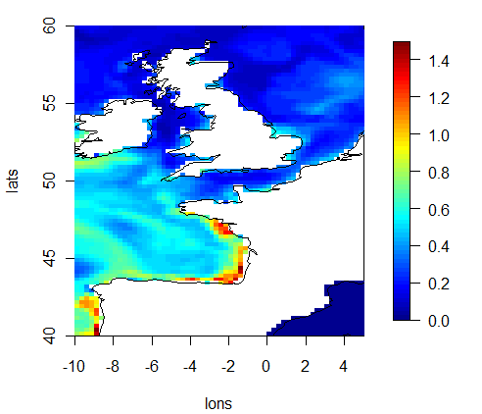
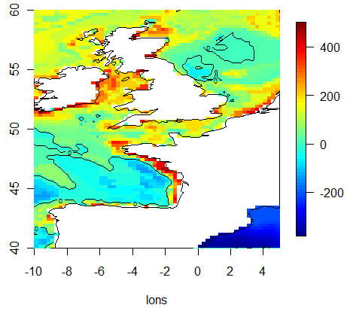
Scope for Growth Models incorporating daily SST and reanalyzed Chlorophyll
Yield the correct southern limit of Mytilus edulis in Europe
Reanalysis Chlorophyll µg/L End of Year body mass via SFG
UKMO Reanalysis
Field measurements of growth rate
underway around UK to validate models
Wethey, Fly, Hilbish

Slide 8
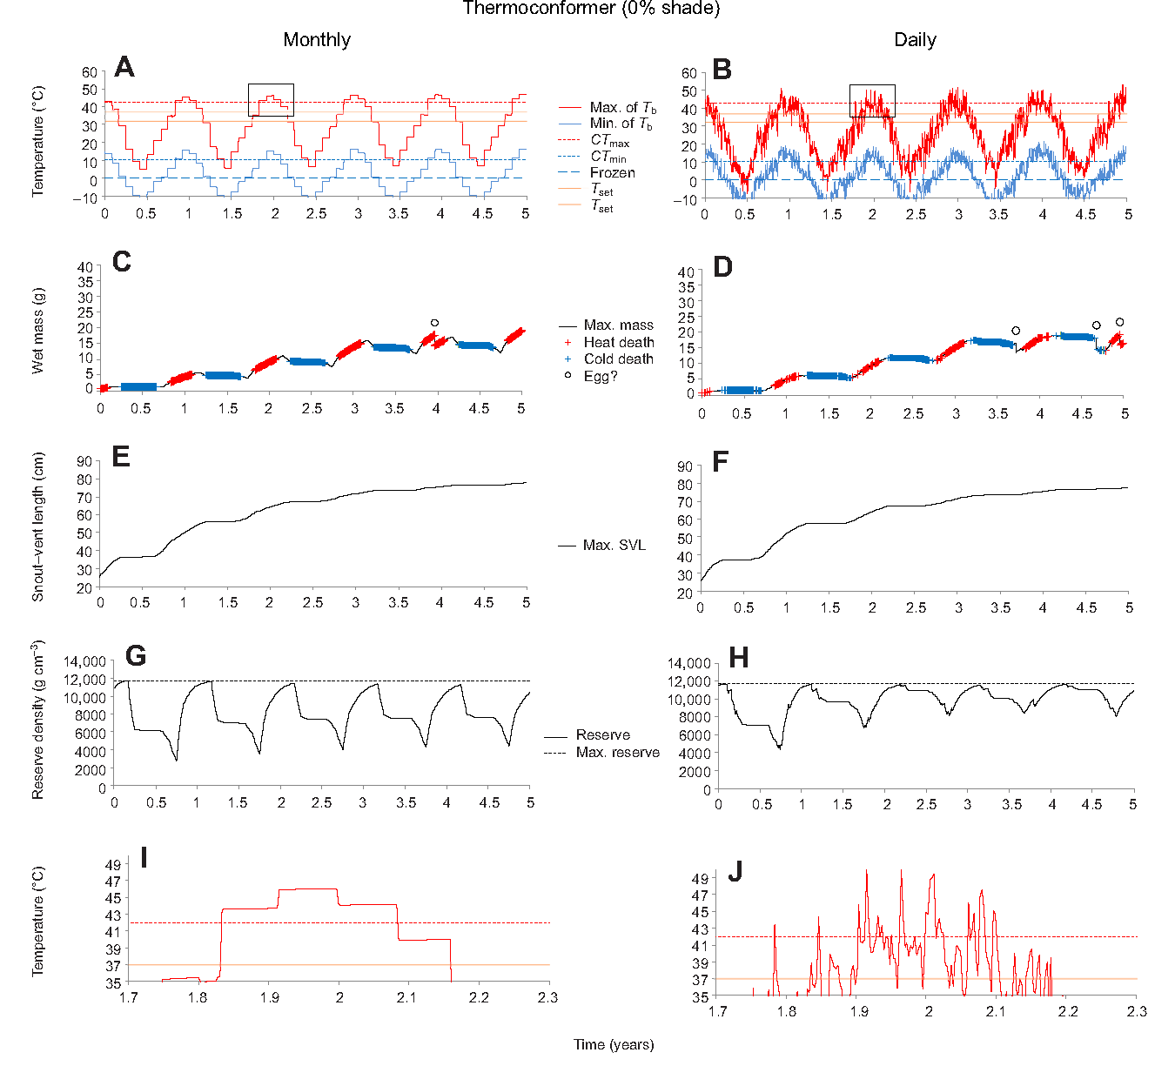
Energy Budget Models are very sensitive to environmental fluctuations:
Daily temperature dynamics influence growth and reproduction
Kearney, Matzelle, Helmuth 2012. J Exp Biology 215:922-933

Slide 9
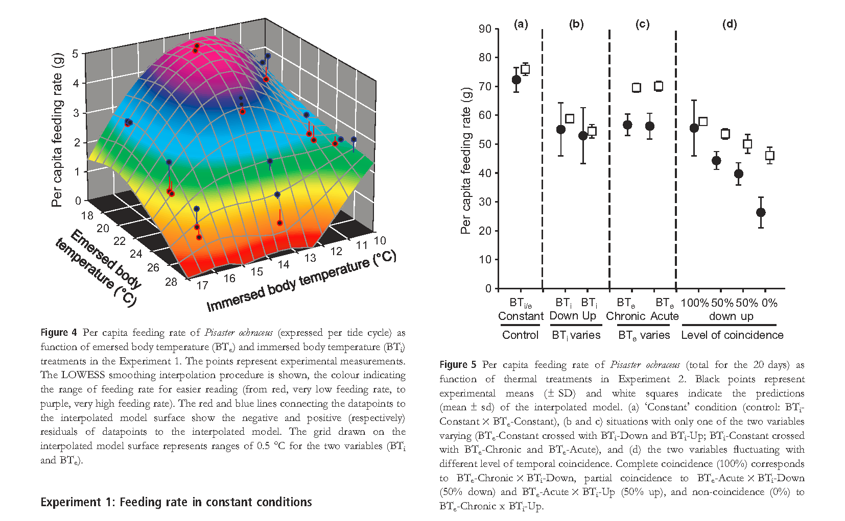
Predator-Prey interactions are affected by daily fluctuations in
environmental conditions – feeding rates of starfish are lower in fluctuating
conditions than in constant conditions
Pincebourde, Sanford, Casas, Helmuth 2012. Ecology Letters

Slide 10
Rapid Large Scale Geographic Change is occurring on intertidal shores
Subtropical mussels in Europe expanding northward 50 km / decade in parallel with warming winters.
Hilbish et al. 2012. J Biogeography 39:676-687
Boreal barnacles on US East coast contracted northward 350 km since 1960 in parallel with increasing frequency of lethal conditions in south
Jones, Southward, Wethey. 2012. Global Ecology & Biogeography in press
Boreal mussels on US East coast contracted northward 350 km since 1960s parallel with increasing frequency of lethal conditions in south
Jones, Lima, Wethey. 2010. J. Biogeography 37:2243-2259
Boreal barnacles on European coast reversed northward contraction after cold winters of 2009-10 and 2010-11 caused increased reproductive output: expansion of up to 200 km in 4 different geographic regions
Wethey et al. 2011. J Exp. Marine Biology & Ecology 400:132-144
Subtropical mussels on US West coast reversed northward expansion during cold phase of Pacific Decadal Oscillation: contraction of 200 km
Hilbish et al. 2010. Journal of Biogeography 37:423-431.

Slide 11
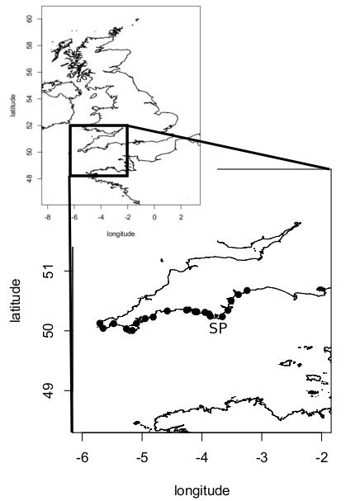
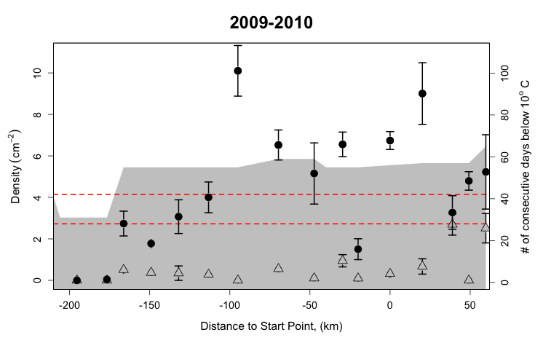
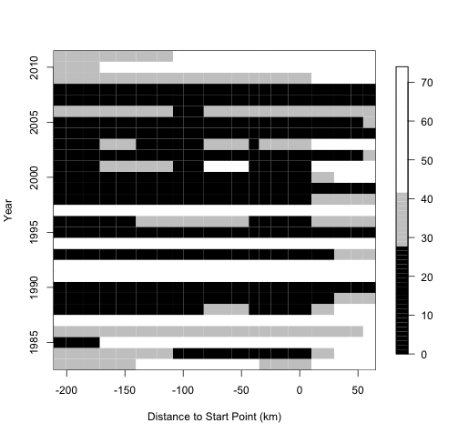
Biogeography controlled by climate and dispersal
The barnacle Semibalanus balanoides does not reproduce
when there are fewer than 30-45 days below 10°C in winter
Several warm decades led to low populations in SW England,
but the winters of 2009-10 and 2010-11 were cold, and there
was rapid expansion of populations in SW England
Days below 10°C
Rognstad, Hilbish, Wethey

Slide 12
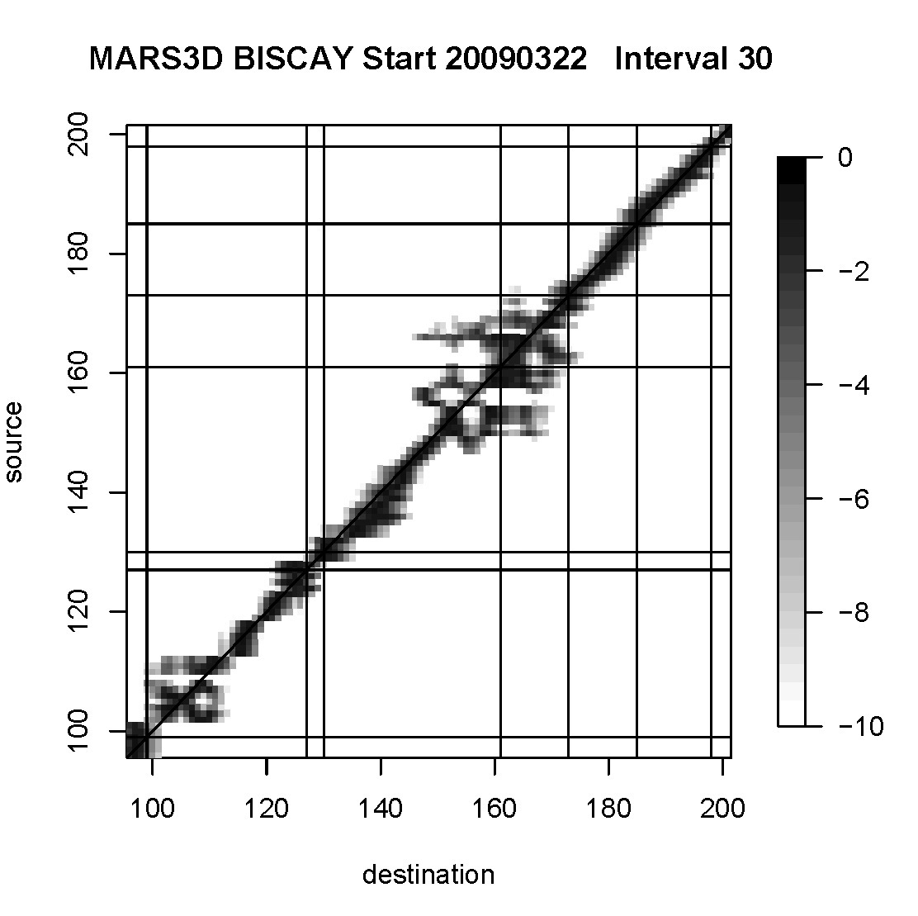
Modeling Larval Dispersal as Lagrangian Particles with Ocean Models as Basis for Biogeographic Metapopulation Models
Cohorts of 50 larvae projected using Euler’s method
Eddy diffusion simulated from Okubo’s 1972
ocean diffusion rates at each time step
Large differences among trajectories of larvae released from same location on same day in simulations using different models:
HYCOM, MARS3D, IBI-NEMO, UKMet-NEMO
Validating surface velocities with GTS
drifter buoy data
Wethey, Rognstad, Oliver, Hilbish

Slide 13
Research Team
David Wethey – PI biogeography and modeling
Sarah Woodin – CoI ecological performance
Jerry Hilbish – CoI scope for growth
Brian Helmuth – CoI dynamic energy budgets
Venkat Lakshmi - CoI ocean color
Postdocs
Fernando Lima (Europe – SST, heart rate )
Nils Volkenborn (USA - performance)
Gonzalo Macho (Europe - performance)
Mackenzie Zippay (USA – heart rate)
Current Grad Students
Rhiannon Rognstad – biogeography UK
Elizabeth Fly – scope for growth
Cristian Monaco – dynamic energy budgets
Nicholas Colvard – energetics
Nicole Kish – biophysical model validation
Jessica Price – ocean color and SST
Rui Seabra (Univ Porto) – biogeography
Overseas Collaborators
Gian-Luca Sara, U Palermo - DEB
Stan Dubois, IFREMER – biogeography
Bernardo Broitman, Chile - SST
Technician
Allison Matzelle – DEB models
Undergrads
Nicholas Burnett – heart rate sensors
Hilde Oliver – larval dispersal models
Shadow Fockler – biophysical models

