Slide 1


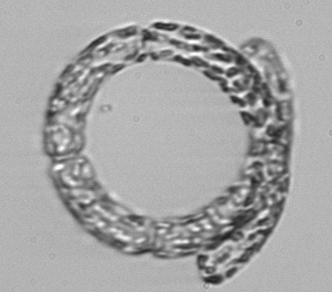


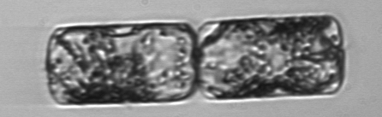
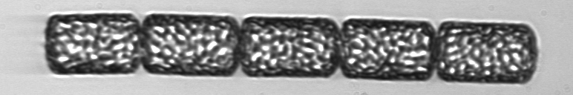
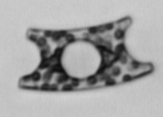
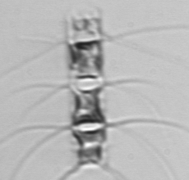

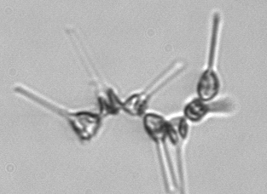
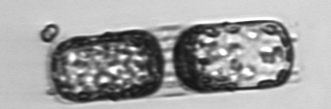
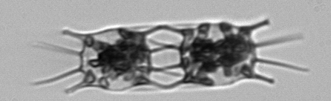
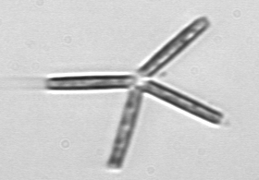

Seasonal to Interannual Variability in
Phytoplankton Biomass and Diversity on the New England Shelf
In Situ Time Series for Validation and Exploration
of Remote Sensing Algorithms
Heidi M. Sosik Hui Feng
Woods Hole
Oceanographic Institution
University of
New Hampshire

Slide 2
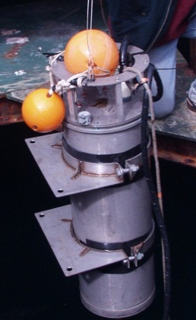
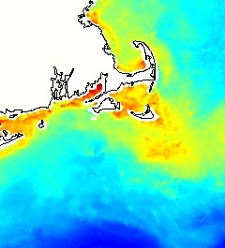


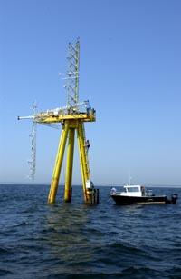


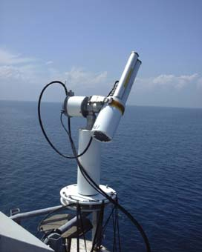
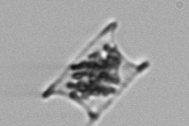


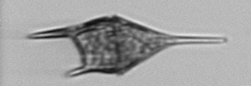
Project Overview
Goal: Use unique time series to evaluate algorithms that extend MODIS ocean color data beyond chlorophyll to functional type or size-class-dependent phytoplankton retrievals
Approach: End-to-end time series observations, with step-by-step algorithm evaluation and error analysis
single cells → phytoplankton community → bulk water optical properties → sea surface optical properties (air and water) → MODIS optical properties
Martha’s Vineyard Coastal Observatory
Tower mounted
AERONET-OC
Submersible Imaging
Flow Cytometry
MODIS products

Slide 3
Talk Overview
Phytoplankton Observations
  Single cells to communities
  Biomass, size- and taxon-resolved
Phytoplankton Algorithms
  Absorption spectral shape → size structure
  Diagnostic pigments → size structure
Next Steps

Slide 4
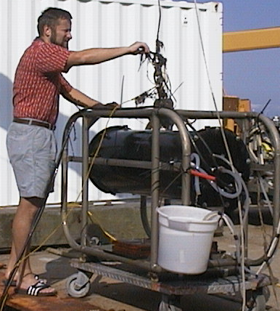
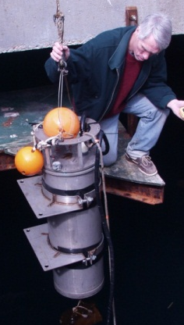
Observing Phytoplankton at MVCO
Martha’s Vineyard Coastal Observatory (MVCO)
Cabled site with power and two-way communications
Picoplankton
Microplankton
Automated features for extended deployment (>6 months)
Enumeration, identification, and cell sizing
Thousands of individual cells every hour
FlowCytobot
Imaging FlowCytobot
Laser-based flow cytometry
Fluorescence and light scattering
Flow cytometry
with video imaging
Olson et al. 2003
Olson & Sosik 2007

Slide 5
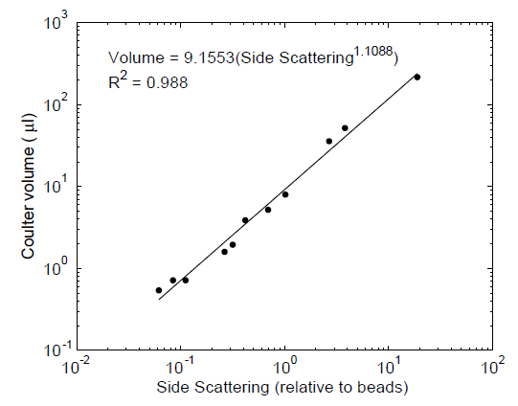
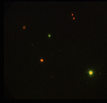
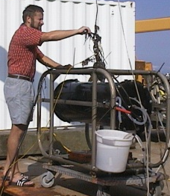
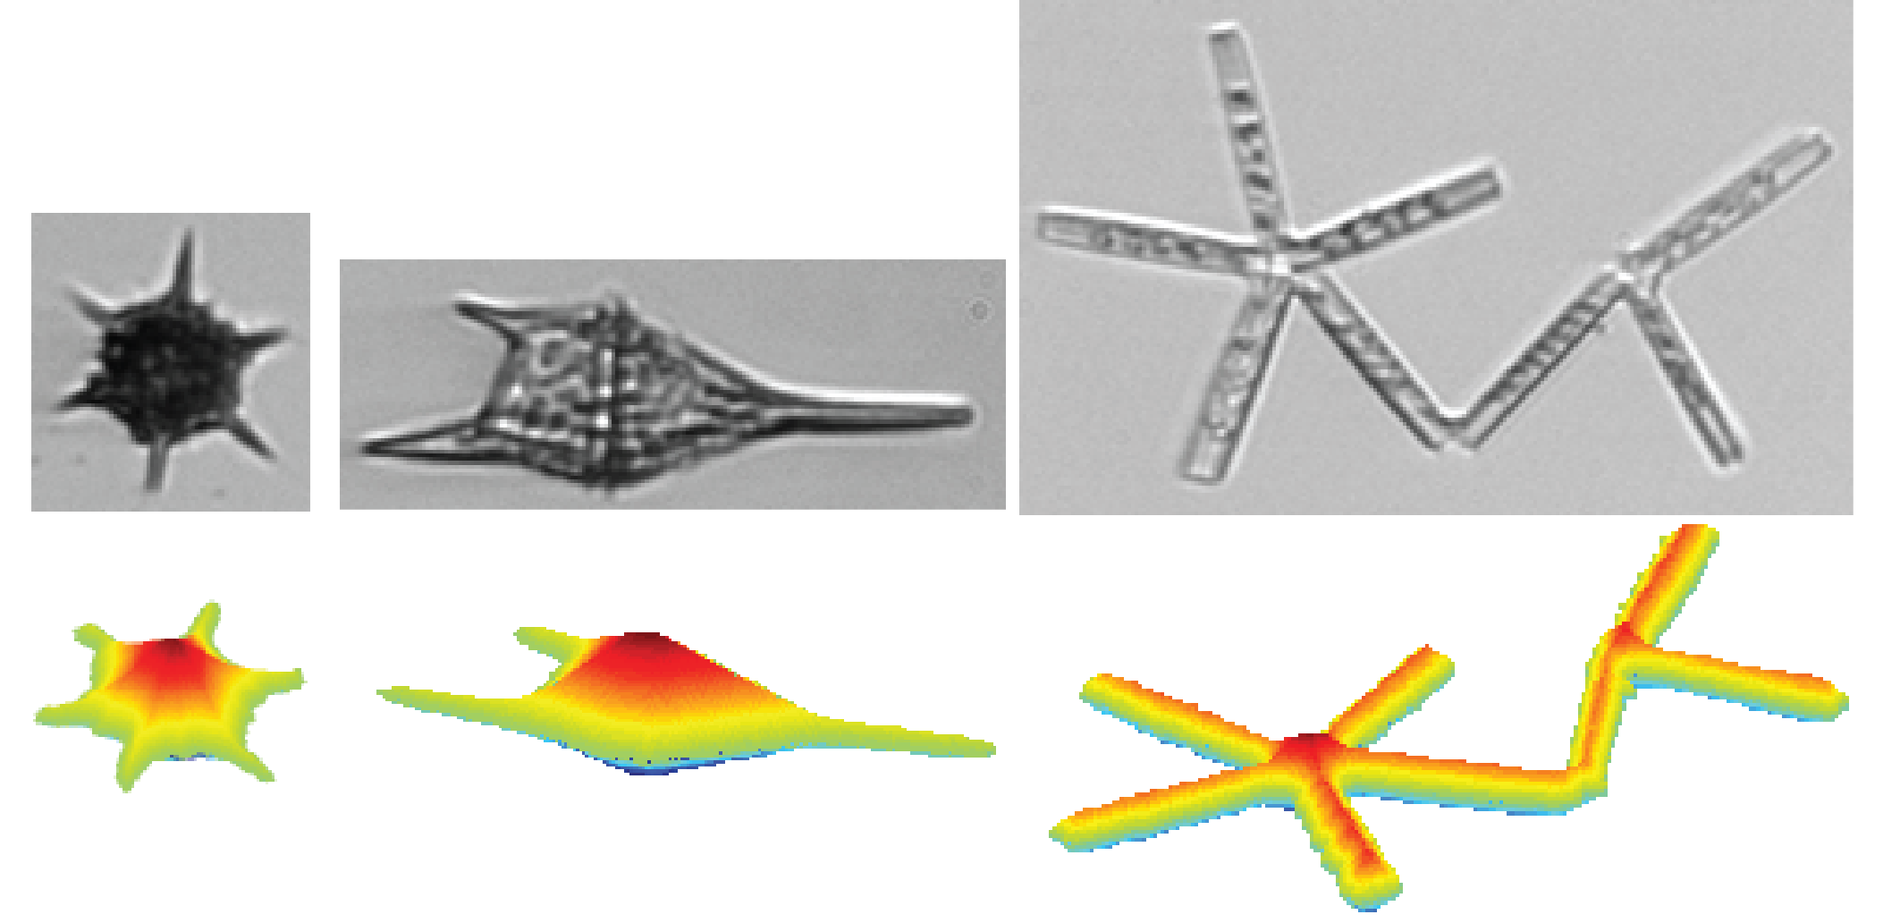


Single Cells to Biomass
Picoplankton
$$Carbon=\sum_{i}{C_{i}}$$
$C_{i}=$ ${f(V}_{i})$
Cell volume (μm³)
Menden-Deuer
and Lessard 2000
FlowCytobot
Light scattering
Volume from laser scattering
Olson et al. 2003
Microplankton
Imaging
FlowCytobot
Volume from image analysis
new “distance map” approach
Sosik and Olson 2007
Moberg & Sosik 2012

Slide 6

Single Cells to Communities
Individual cells → Taxa → Communities
Syn
Individual cells → Size-classes → Communities
Notes:
http://ifcb-data.whoi.edu/mvco/IFCB5_2012_024_204912_02967.png

Slide 7
Phytoplankton Algorithms
Spectral absorption shape → size structure
Ciotti et al. 2002
Ciotti and Bricaud 2006

Slide 8
Phytoplankton Algorithms
Spectral absorption shape → size structure
Ciotti et al. 2002
Ciotti and Bricaud 2006
FCM C-budget

Slide 9
Phytoplankton Algorithms
Diagnostic pigments → size structure
Vidussi et al. 2001
Uitz et al. 2006
Hirata et al. 2008
Devred et al. 2011
Fraction micro = ( P_{1,w} + P_{2,w}) / ∑P_{i,w}
Fraction nano = ( P_{3,w} + P_{4,w} + P_{5,w}) / ∑P_{i,w}
Fraction pico = ( P_{6,w} + P_{7,w}) / ∑P_{i,w}
P₁ = fucoxanthin
P₂ = peridinin
…
Microphytoplankton

Slide 10
Phytoplankton Algorithms
Diagnostic pigments → size structure
Vidussi et al. 2001
Uitz et al. 2006
Hirata et al. 2008
Devred et al. 2011
Fraction micro = ( P_{1,w} + P_{2,w}) / ∑P_{i,w}
Fraction nano = ( P_{3,w} + P_{4,w} + P_{5,w}) / ∑P_{i,w}
Fraction pico = ( P_{6,w} + P_{7,w}) / ∑P_{i,w}
P₁ = fucoxanthin
P₂ = peridinin
…
Picophytoplankton

Slide 11
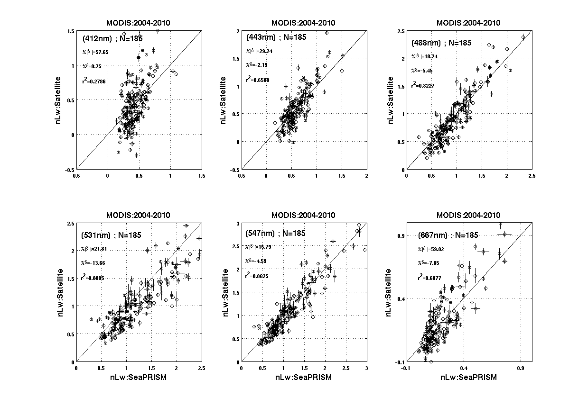
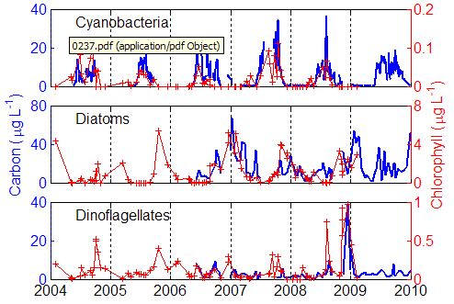
Work in Progress and Next Steps
Water-leaving radiance and aerosol property retrievals
AERONET-OC vs. MODIS
Inherent optical property retrievals
AERONET-OC vs. in situ samples
Diagnostic pigment retrievals
AERONET-OC vs. in situ samples
Phytoplankton carbon retrievals
MODIS vs. cell-based C budgets
Diagnostic pigment algorithm evaluation
HPLC-CHEMTAX vs. cell-based C budgets
Quantification of biases and uncertainties

Slide 12
Phytoplankton Algorithms
Diagnostic pigments → size structure
Vidussi et al. 2001
Uitz et al. 2006
Devred et al. 2011
Hirata et al. 2008
Fraction micro = ( P_{1,w} + P_{2,w}) / ∑P_{i,w}
Fraction nano = ( P_{3,w} + P_{4,w} + P_{5,w}) / ∑P_{i,w}
Fraction pico = ( P_{6,w} + P_{7,w}) / ∑P_{i,w}
P₁ = fucoxanthin
P₂ = peridinin
…
Nanophytoplankton

