Slide 1




Synergistic Analyses of Data from Active and Passive Sensors to Assess Relationships between Spatial Heterogeneity of Tropical Forest Structure and Biodiversity Dynamics:
New Lidar Waveform Metrics & Biodiversity
Geoffrey M. Henebry
Jordan D. Muss
Eric Ariel L. Salas
Geographic Information Science Center of Excellence
South Dakota State University
and
Naikoa Aguilar-Amuchastegui
World Wildlife Fund–US
Seattle: 25 APR 2012
Research supported through the NASA Biodiversity program: NNX09AK23G. Thank you!

Slide 2
Overview
Alternative metrics to characterize waveform lidar data: Cy & RG
Cy & RG in two study areas in Costa Rica: La Selva and Starke
Toward linking Cy & RG to our biodiversity data
Next steps

Slide 3
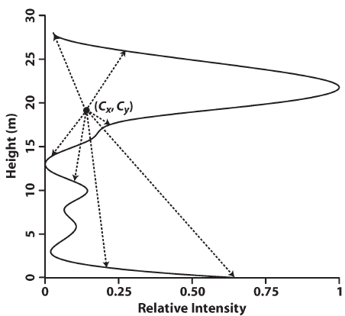
Alternative metrics to characterize waveform lidar data:
Centroid height (Cy) & Radius of Gyration (RG)
Centroid (located at Cx, Cy) is the balance point of the waveform. It is determined by the relationship of the waveform shape to its length.
Centroid height (Cy) component offers an alternative retrieval of canopy height.
Radius of Gyration (RG) is the root mean square of the distances from the centroid to the outer edge of the waveform.
Analysis of Waveform Lidar Data Using Shape-Based Metrics
Jordan D. Muss, Naikoa Aguilar-Amuchastegui, David J. Mladenoff, and Geoffrey M. Henebry
Geoscience & Remote Sensing Letters (in press)

Slide 4
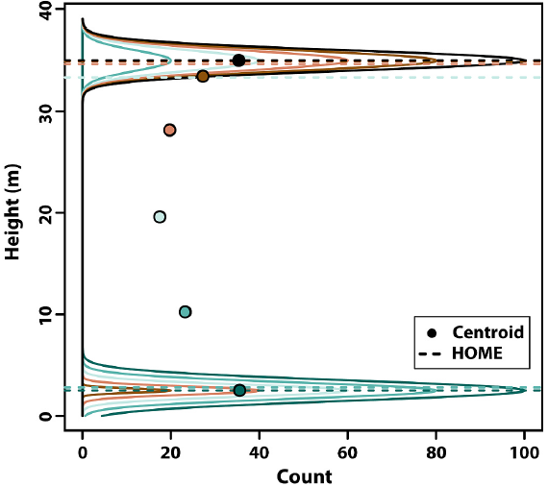
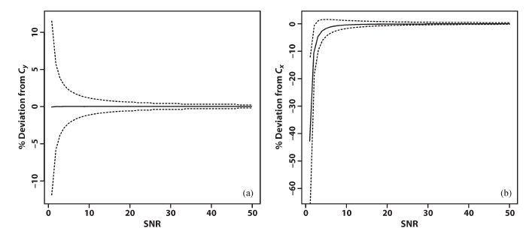
Height Of Median Energy (HOME) is a widely used waveform metric.
⬅Here is the relationship of HOME to the centroid as an artificial waveform shifts from canopy-only to ground-only returns.
HOME does not significantly change until the total energy from the ground and canopy are equal, at which point HOME shifts from canopy to ground.
In contrast, the centroid changes smoothly.
⬅ Centroid coordinates (Cx, Cy) are robust to noise, as is RG, which has a noise resistance pattern very similar to Cx. Very little impact on metrics when SNR > 10.
Cy
Cx

Slide 5
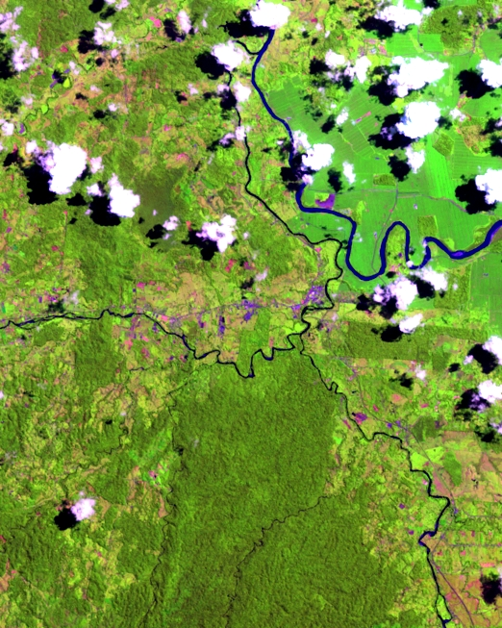
Study Areas
L7 15JUN2001
RGB=543

Slide 6
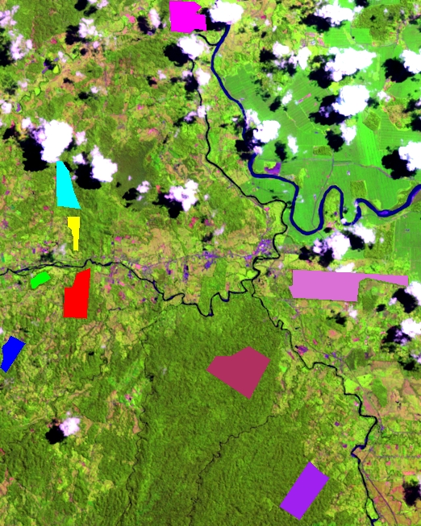
⬅ Rojomaca
⬅ Ecovida
Study Areas
L7 15JUN2001
RGB=543
⬅ Ladrillera 1
⬅ ⬅ Ladrillera 3
⬅ Selva Verde
⬅ Starke
9 forested sites
3 natural reference:
1 natural & intact
2 natural but fragmented
6 managed units:
5 primary
1 old secondary
⬅ Kay Rica
⬅ La Selva
⬅ Tosi

Slide 7
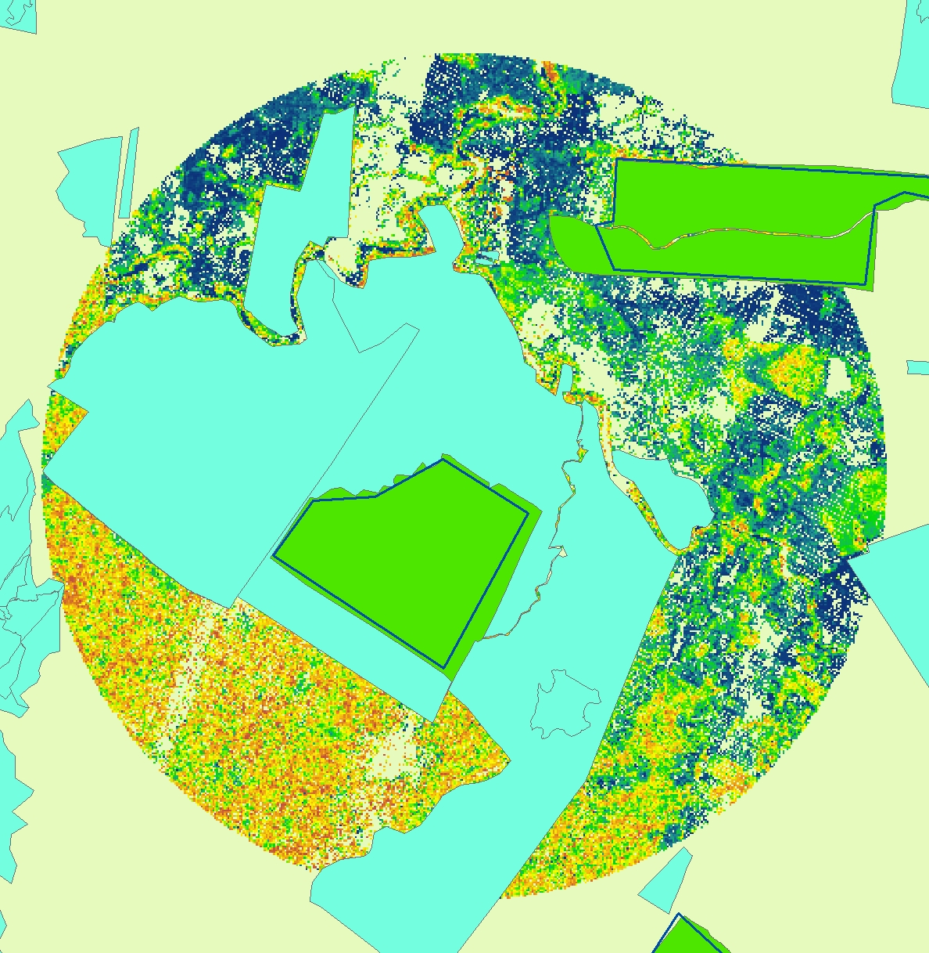
LVIS 2005 data
Starke:
Old
Secondary Growth (OSG)
La Selva:
Primary
Old
Growth (POG)

Slide 8
Starke (OSG): histograms of LVIS standard waveform metrics

Slide 9
Starke (OSG): histograms of LVIS standard waveform metrics &
new waveform metric: centroid height (Cy)
Histogram of Cy looks similar to that of RH50.
What, if anything, is gained?

Slide 10
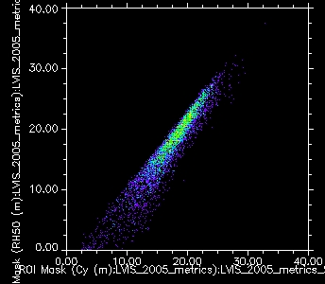
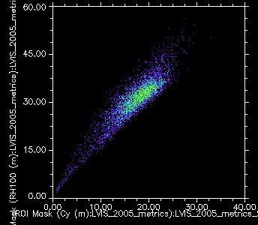
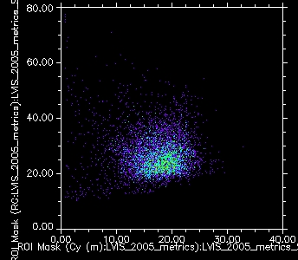
RH50 (m) ➔
RH100 (m) ➔
Cy (m) ➔
Cy (m) ➔
At Starke (Old Secondary Growth):
RH50 shows less specificity than Cy
Strong linearity between RH100 & Cy
RG and Cy appear almost uncorrelated
Radius of Gyration ➔
Cy (m) ➔

Slide 11
La Selva (POG): histograms of LVIS standard waveform metrics

Slide 12
La Selva (POG): histograms of LVIS standard waveform metrics &
new waveform metric: centroid height (Cy)
Histogram of Cy again looks similar to that of RH50.

Slide 13
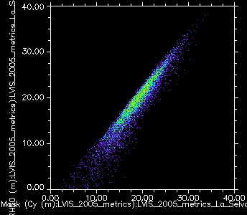
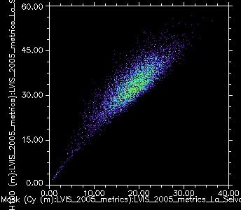
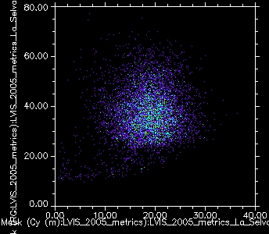
RH50 (m) ➔
RH100 (m) ➔
Cy (m) ➔
Cy (m) ➔
At La Selva (Primary Old Growth):
RH50 shows less specificity than Cy
Strong linearity between RH100 & Cy
RG and Cy appear almost uncorrelated
Radius of Gyration ➔
Similar patterns among metrics between sites
Cy (m) ➔

Slide 14
Metric richness: Each distinct metric value is counted (n)
Metric diversity: SWW diversity is calculated across distinct values (H’)
Cy: comparable richness (n) & diversity (H’) in La Selva (203, 0.090) and in Starke (201, 0.088)
RG: higher richness (n) & diversity (H’) in La Selva (192, 0.098) than in Starke (159, 0.055)

Slide 15
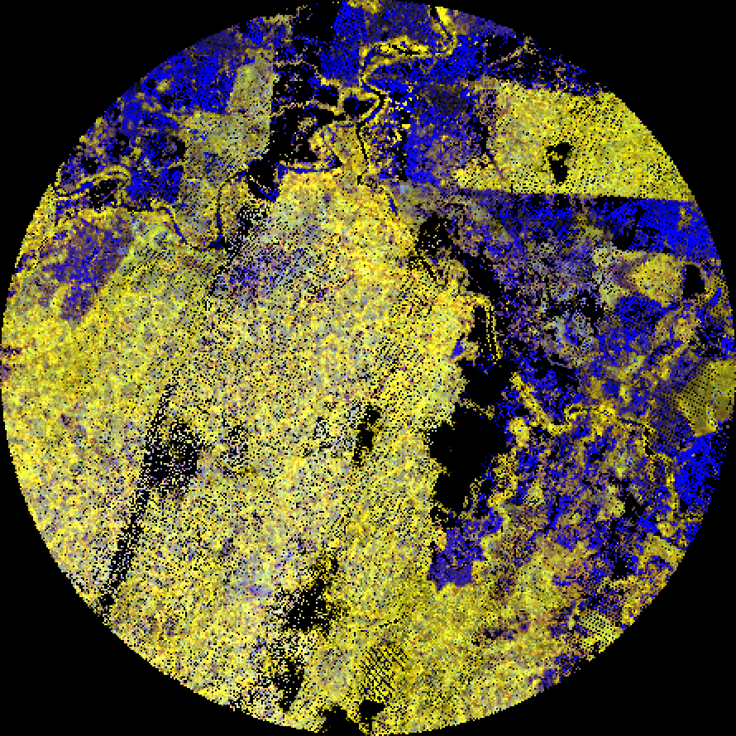
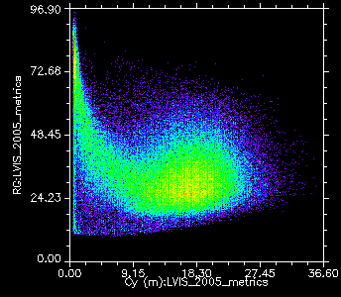
LVIS 2005
R=RH100
G=Cy
B=RG
RG ➔
Cy (m) ➔

Slide 16
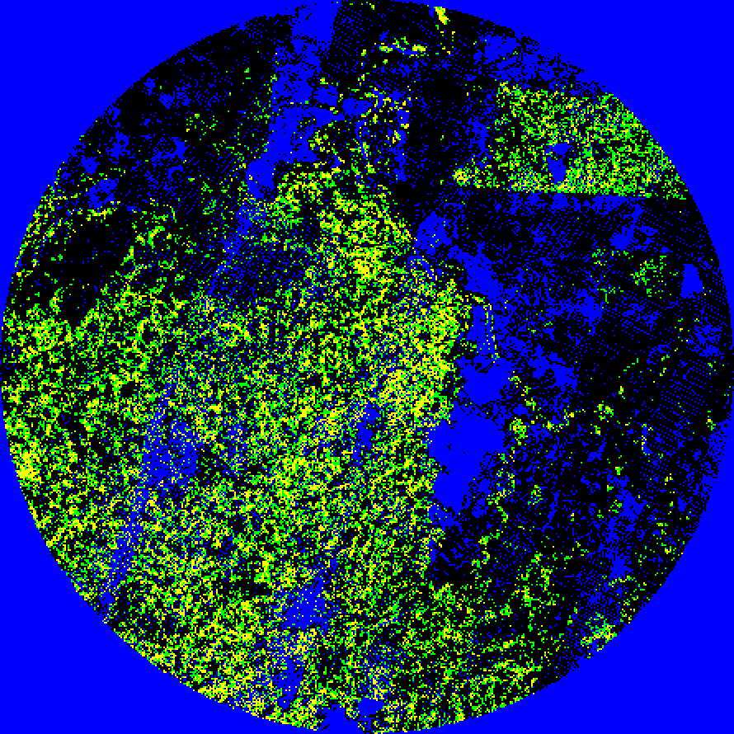
LVIS 2005
R=Cy ge p90
G=Cy ge Q3
B=missing

Slide 17
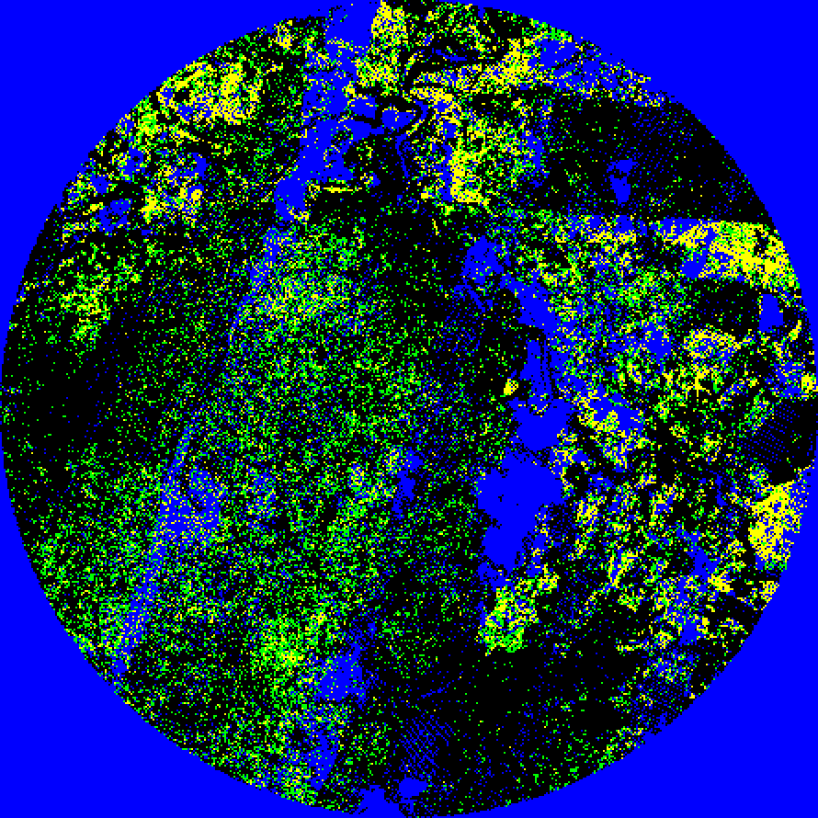
LVIS 2005
R=RG ge p90
G=RG ge Q3
B=missing

Slide 18
How may the new lidar metrics Cy & RG relate to biodiversity?
Cy relates to canopy height; RG relates to 3D canopy structure, but not simply.
More 2005 LVIS data exist, but they have not been processed; we have a processing request in with Bryan Blair.
Early June: field campaign and meeting with collaborators will yield more biodiversity data.
Lacunarity analyses on appropriately sliced Cy & RG images
Surveyed Forests | Estimated Species Richness Dung Birds Mammals Beetles Butterflies
La Selva | 74.6 | 9 | 3.5 | NYA
Starke | 33.0 | 5 | 8.0 | 34

