Slide 1

The Application of Climate Models to Understand and Model Environmental Processes
Marc Kramer
Earth and Planetary Sciences, UCSC
mkramer@es.ucsc.edu

Slide 2
MERCURY
A new modeling system that explicitly
couples biological models with environmental models

Slide 3
MERCURY
Part of an on-going UC Santa Cruz, NASA,USDA and DOD effort to develop a robust, globally relocateable spatially explicit environmental modeling system
Motivated by the application of biological control agent modeling for invasive species
3

Slide 4
Objectives
Develop spatially-explicit simulation capability for USDA plant and insect models by linking with NASA and DOD technology.
Improve existing model accuracy and thus applicability for field decision makers and scientists dealing with invasive species.

Slide 5
NASA Earth Science Results
The Terra, Aqua and QuickSCAT satellites provide vital wind data every 6 hours on upper polar air winds and near-surface sea winds using the MODIS and Seawinds scatterometer sensors.
Use high end computing (HEC) to perform large, memory and cpu intensive climate and environmental model simulations.
New data visualization tools for spatio-temporal data.

Slide 6
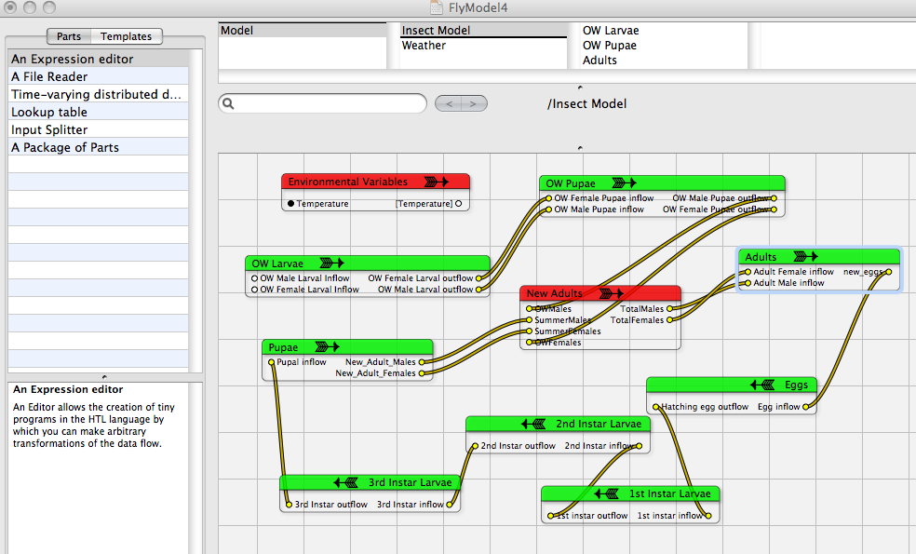
NASA observational data (Terra, Aqua, QUICKscat)
DOD Numerical Weather Prediction System (COAMPS)
Improved
DSS Capability
Spatially explicit
high resolution
environmental
models
Enhanced USDA DSS Model MERCURY
-explicitly coupled to NWP output

Slide 7
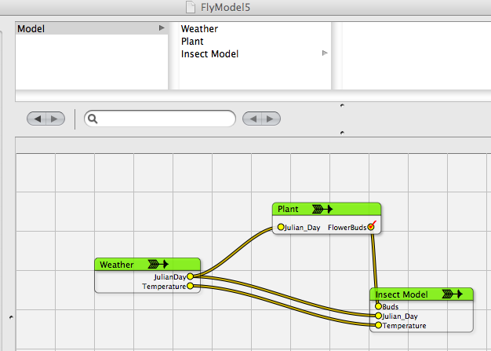
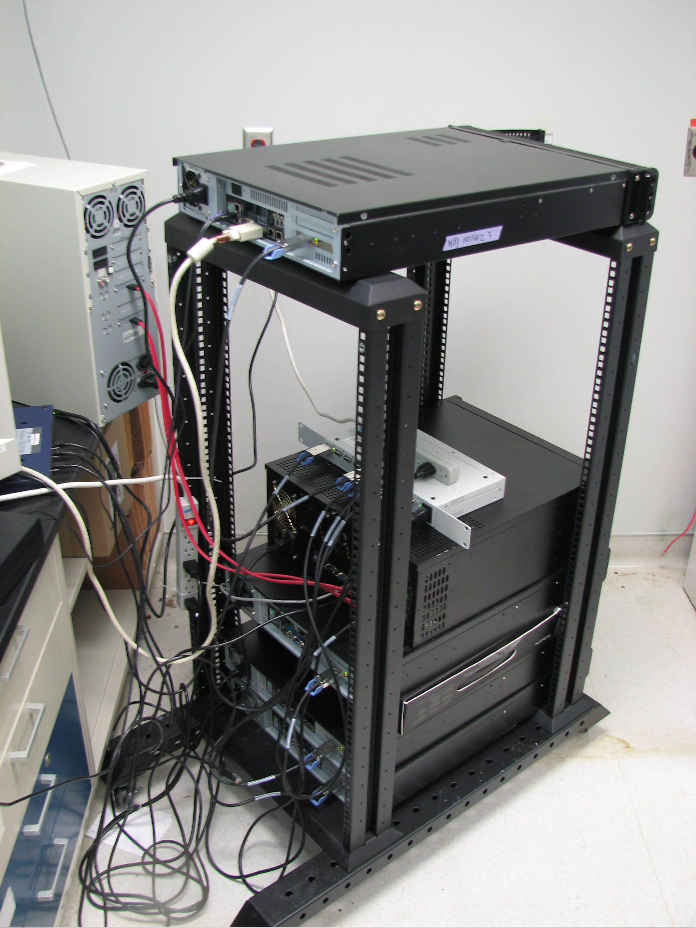
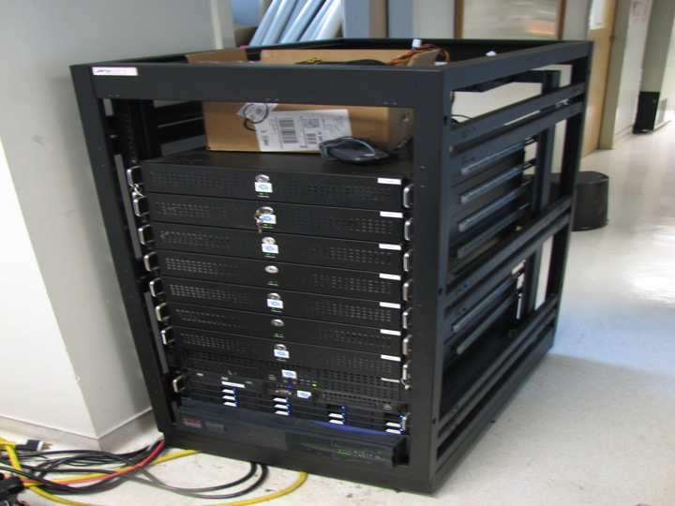
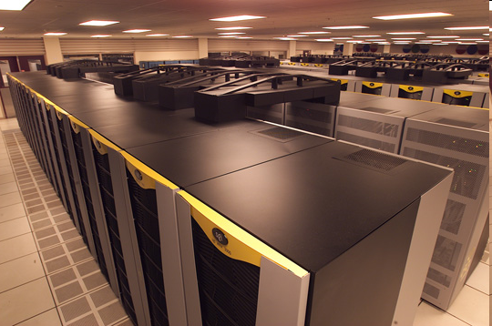
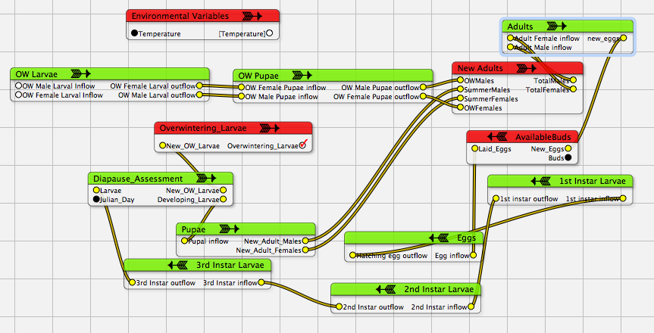
MERCURY Environmental
Modeling System:
Object-oriented
Explicitly linked to COAMPS
Spatially explicit
Capable of running on HEC
platforms in a parallelized
fashion
High Performance Computing

Slide 8
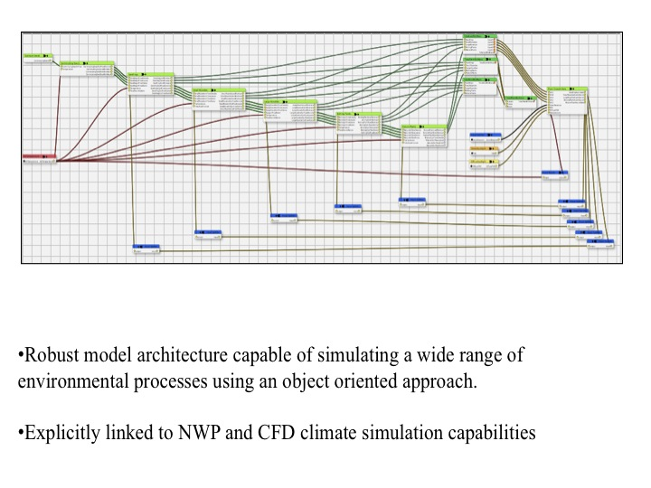

Slide 9
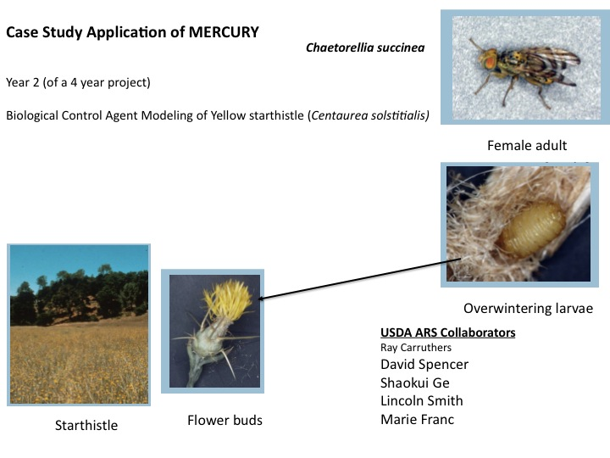
Tephritid fly

Slide 10
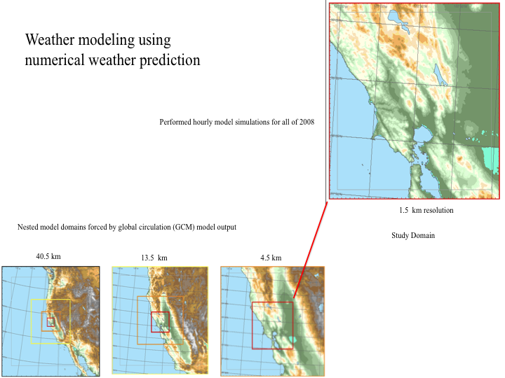

Slide 11
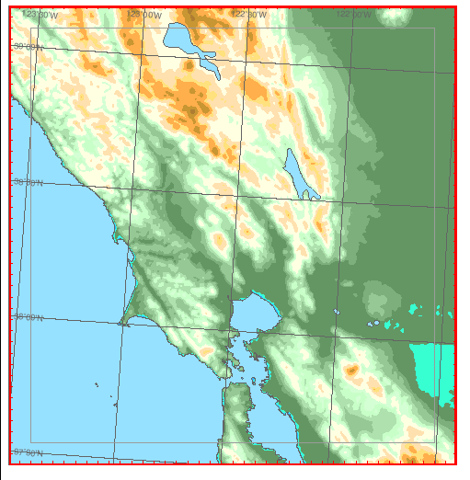
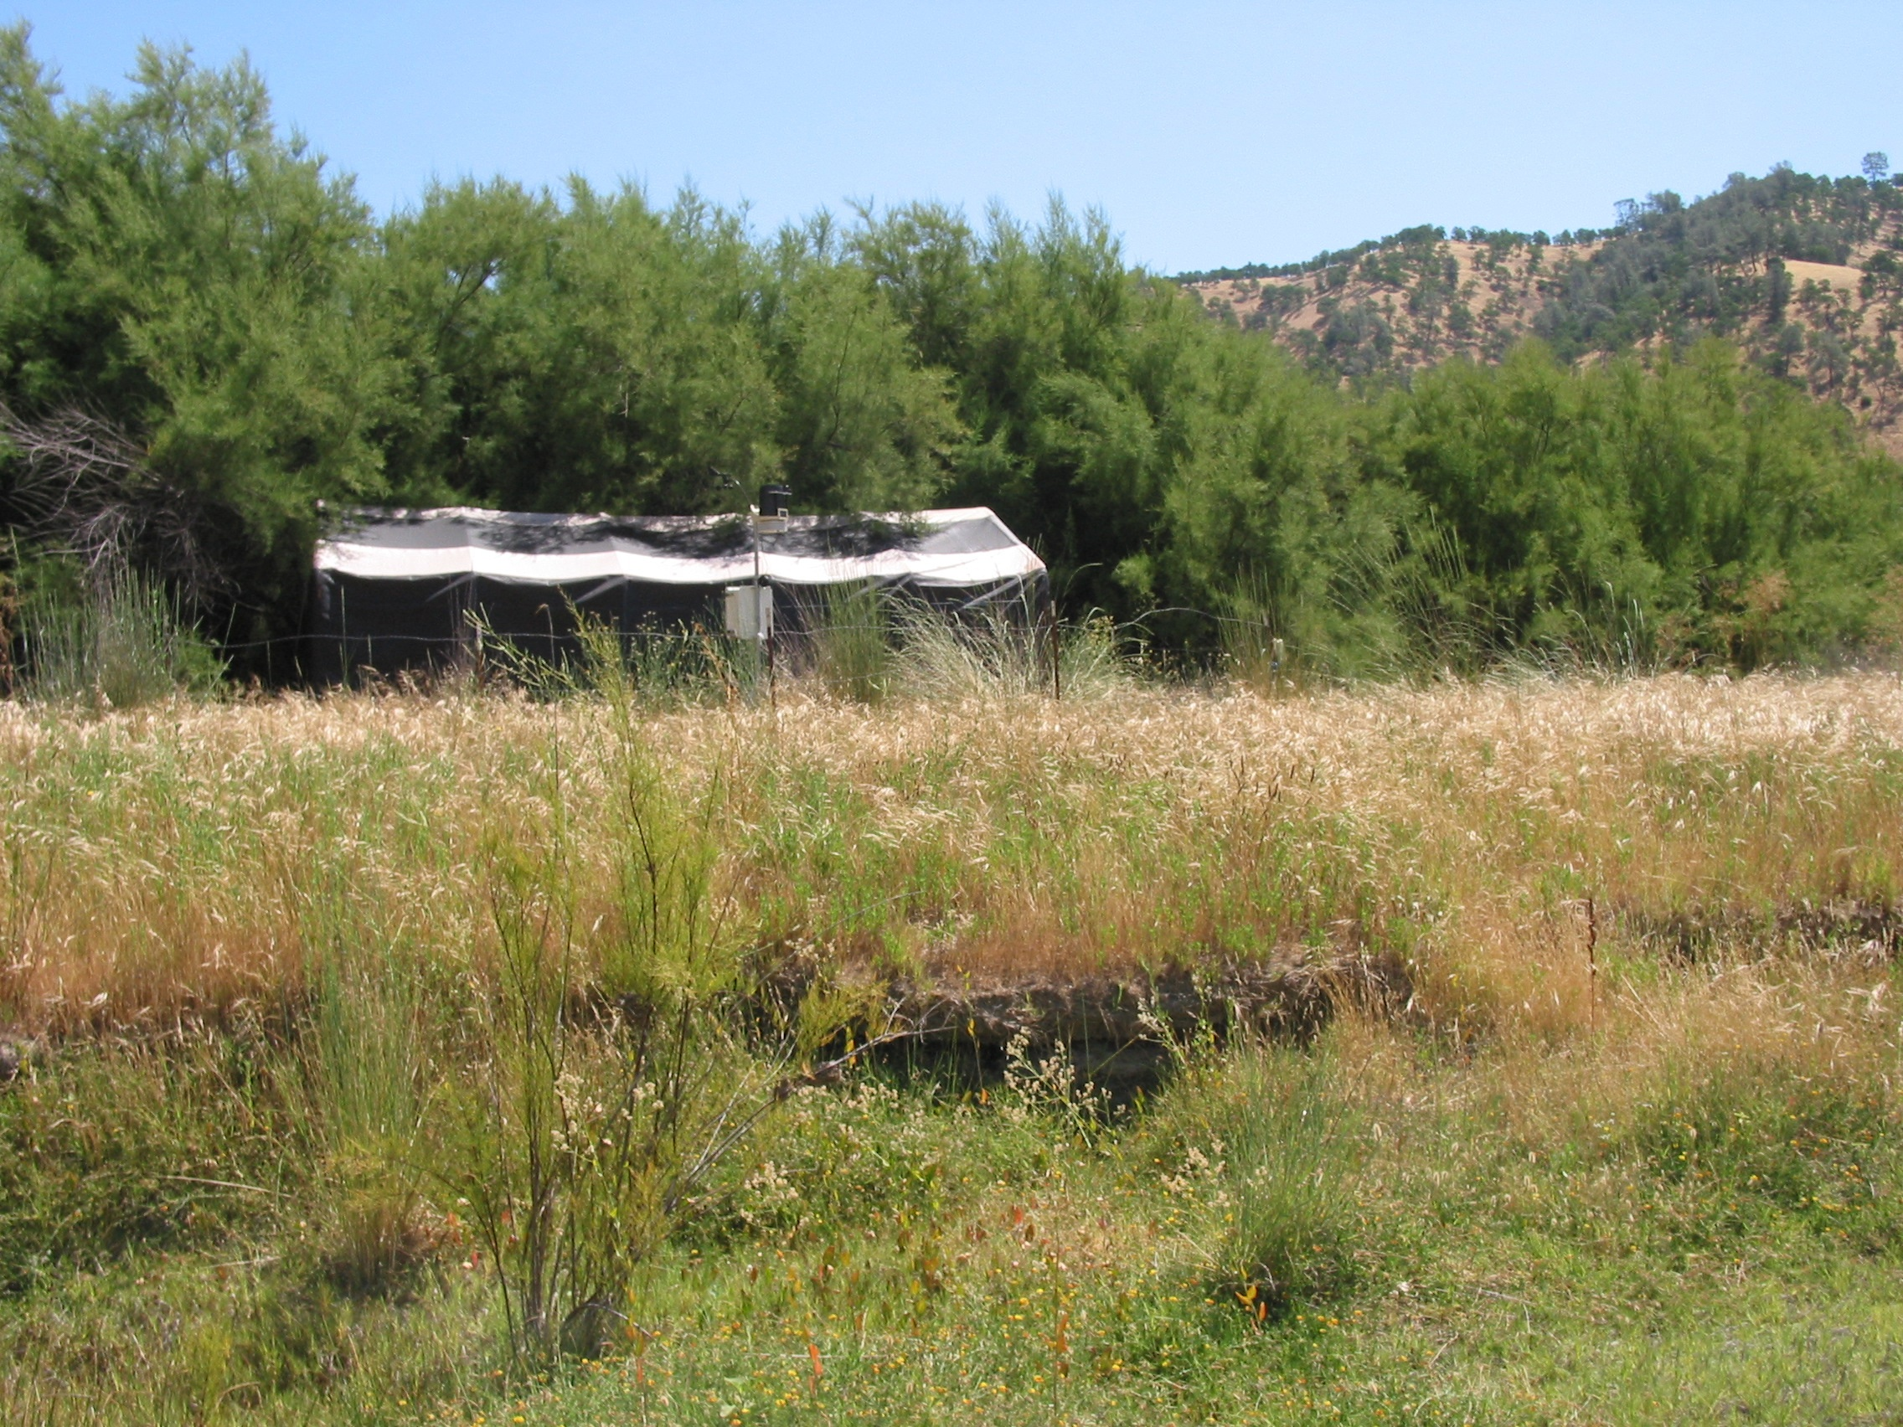
Preliminary validation at 3 USDA research sites
in Cache Creek
Weather station locations

Slide 12
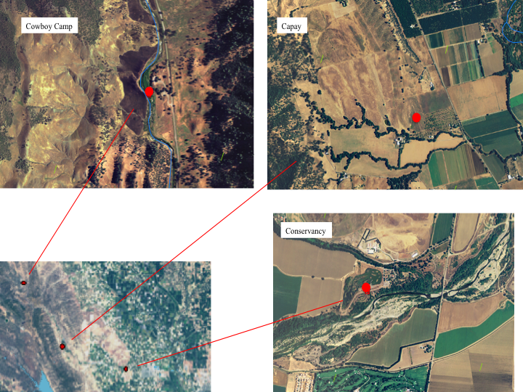

Slide 13
Preliminary Validation
Air Temperature (Deg C)

Slide 14
Preliminary Validation
Air Temperature (Deg C)

Slide 15
Modeled mean annual temperature (MAT) across the study domain for 2008

Slide 16
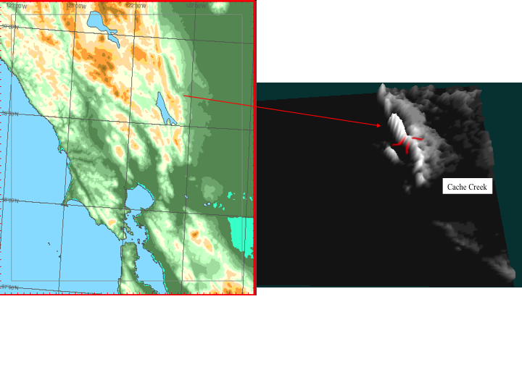

Slide 17
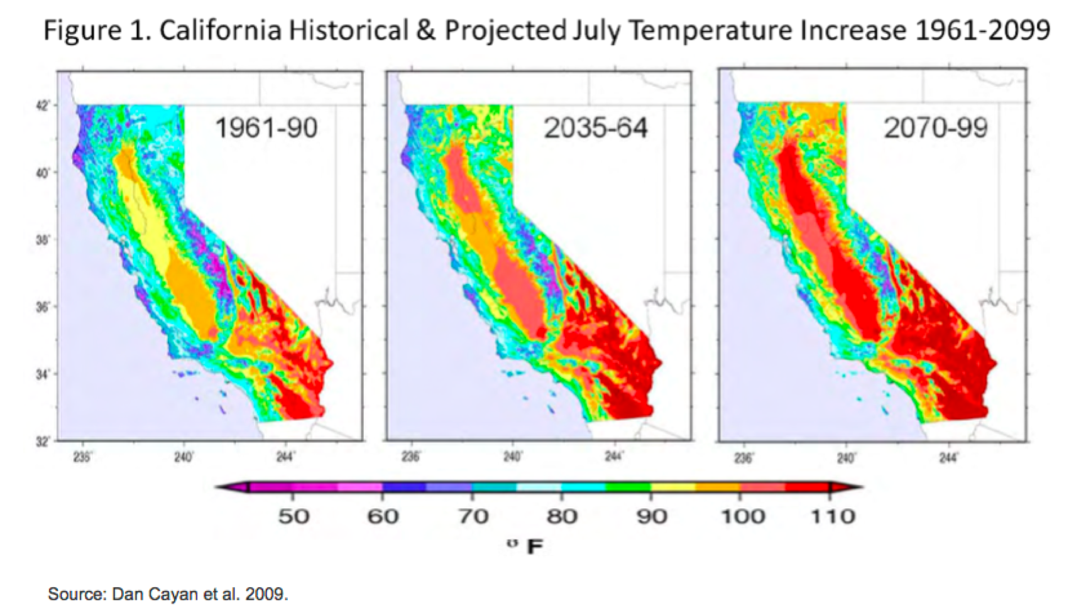

Slide 18
Summer
Air Temperature (Deg C)
Time (hours)
Winter
Air Temperature (Deg C)
Time (hours)

Slide 19
Tephritid fly daily model output driven by hourly air temperature data
Tephritid fly model output
# individuals
Julian day
Other states (not show)
Egg production
1st instar
2nd instar
3rd instar

Slide 20
Air Temperature (Deg C)
Daily Mean Air Temperature (Deg. C)
Julian day
Tephritid fly female adults
# individuals
Julian day

Slide 21
Total number individuals
Julian day
Percent of population (%)
Julian day

Slide 22
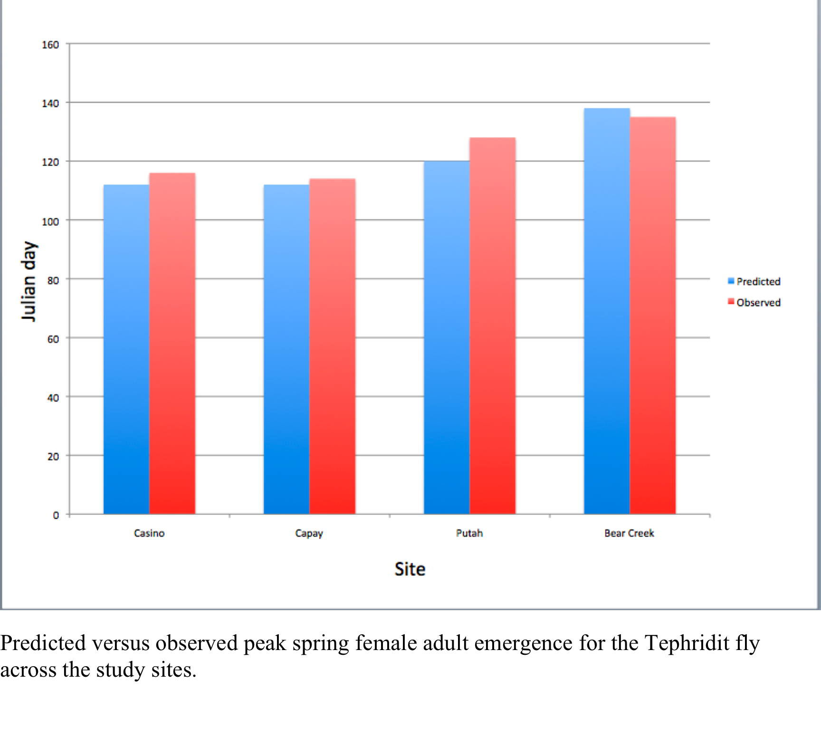

Slide 23
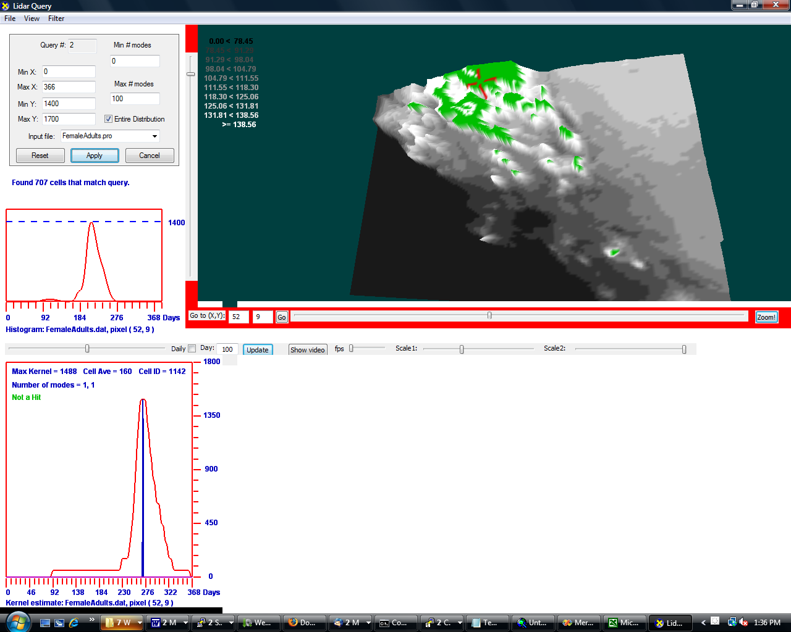
Average number of Tephritid fly female adults across the study domain
Cache Creek
Green =more favorable
microsite
SF Bay Area
Tephritid fly female adults
# individuals
Tephriti
# individuals
Julian day

Slide 24
Next Steps
Starthistle modeling …

Slide 25
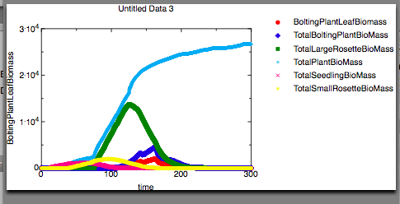
USDA Starthistle Model ( Dr. Raymond Carruthers, Shaoukui Ge, David Spencer)

Slide 26
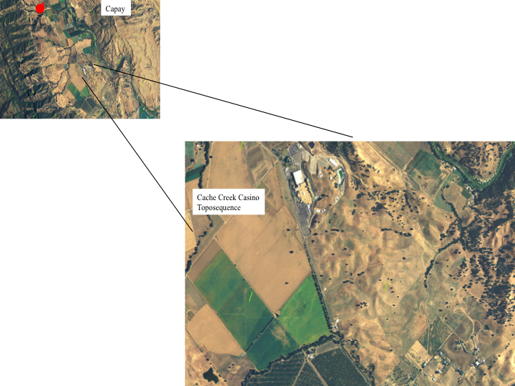

Slide 27
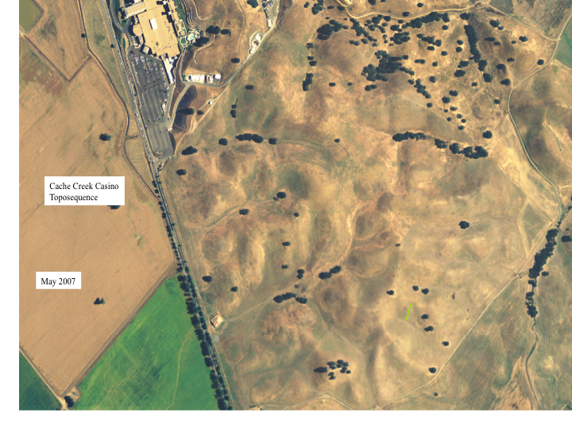

Slide 28
Cache Creek Casino
Toposequence
Shaded relief of modeled hourly
solar radiation (W/m2)
Using high resolution lidar data
( 0.5 m Digital Elevation Model)

Slide 29
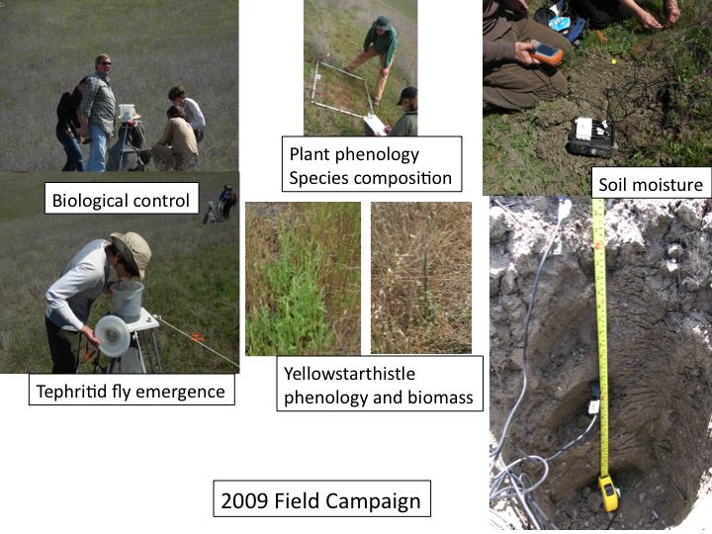

Slide 30
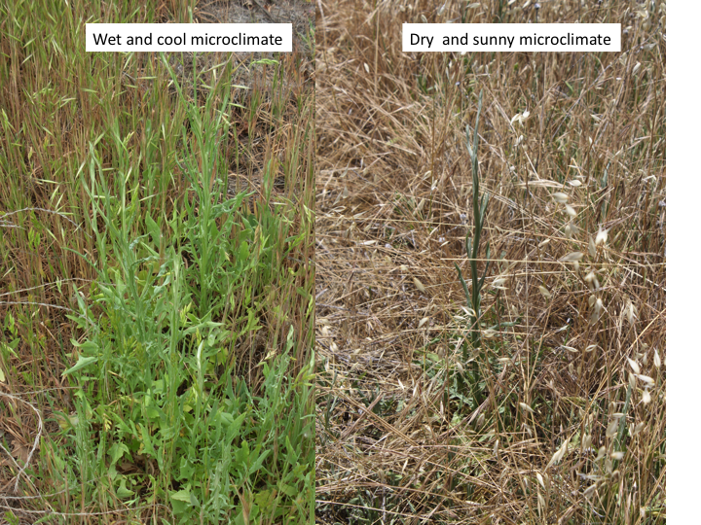
100m apart

Slide 31
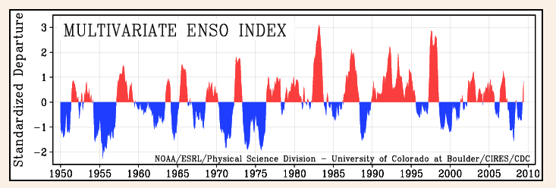
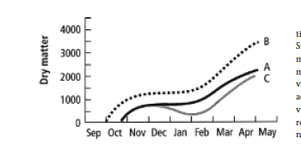
El Nino and La Nina years are key
components to understanding climate change impacts on ecosystems
Warm wet fall
Average year
Valley grassland biomass production curves (kg ha⁻¹ )

Slide 32
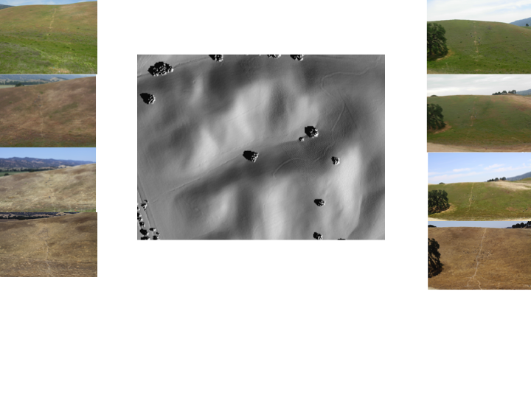
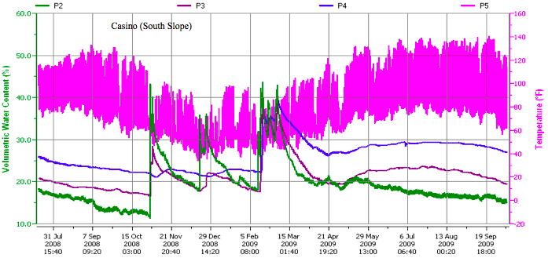
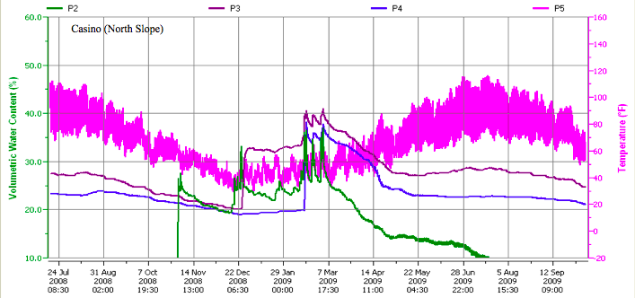
2009
Soil temperature
Soil temperature
Soil moisture
Soil moisture

Slide 33
Next steps …
-El Nino still predicted for Spring 2010-high rainfall
-Simulate and observe timing of annual grass and
YST germination and senescence, biomass production
-Second year of soil moisture observations
-Improved numerical weather prediction
-Build a soil moisture model
-Complete our Yellow starthistle growth model
-Search Greece for similar microclimates for synchronous biological
control agents

Slide 34
Planned activities,
(2010)
1) Parternship and collaboration with NOAA and NCAR.
2) Testing COAMPS model performance with the land surface modeling component (LSM vs NAVDAS vs MVOI).
3) Incorporating solar radiation surface heating algorithms that account for topography in COAMPS.
4) Testing high resolution COAMPS using high resolution global (300m) land cover data sets over the Central valley.
5) Linking with USDA plant and insect models.
6) Soil moisture modeling and observation networks.
7) Evaluating (and comparing) high resolution COAMPS model runs with the use of NASA high resolution global topography datasets (SRTM data).

