Slide 1

Daniel E. Irwin
NASA/Marshall Space Flight Center
National Aeronautics And Space Administration
SERVIR:
A Global Network for Satellite and in situ Environmental Monitoring and Management
www.nasa.gov

Slide 2
What is SERVIR?
SERVIR is the Spanish verb to serve and a Spanish acronym for Regional Visualization and Monitoring System.
A network of centers that use satellite imagery and other data sources for environmental management, disaster preparedness and response, and climate change adaptation.
Primarily supported by NASA and USAID
SERVIR nodes are operated by the host nations who work with NASA/USAID to determine the suite of decision support applications required to meet pressing regional assessment and monitoring needs.
Engages multiple non-traditional partnerships

Slide 3
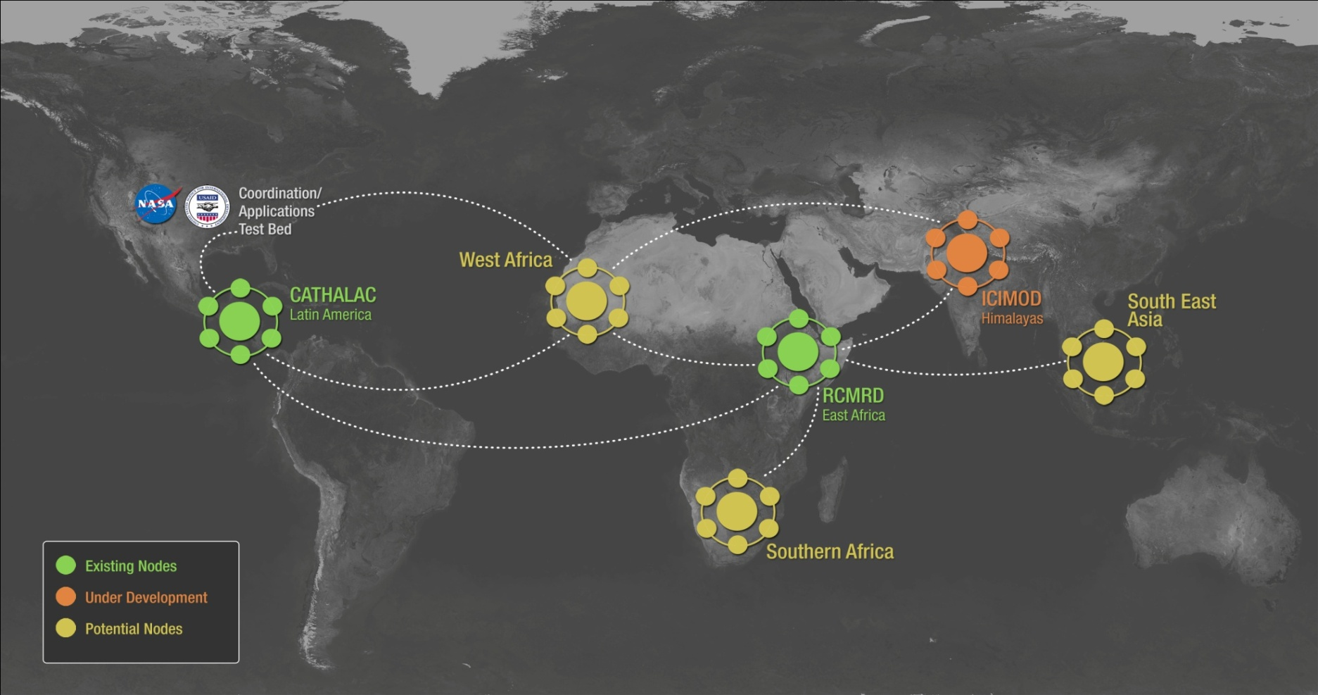
The SERVIR Network

Slide 4
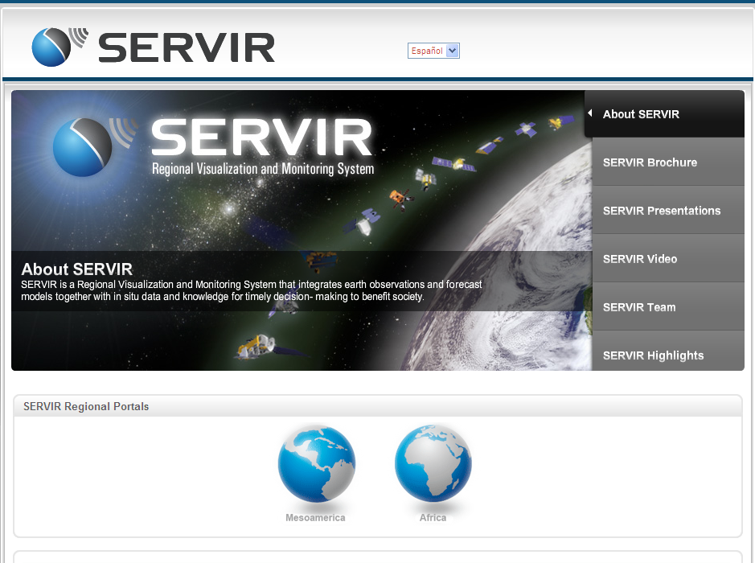
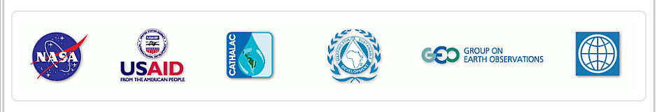
What We Do at SERVIR
A Regional Public Good
Data and Models
Online Maps
Visualizations
Decision Support
Training
Partnerships

Slide 5
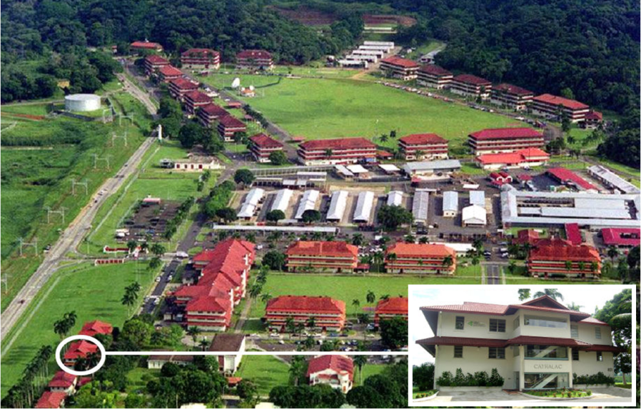
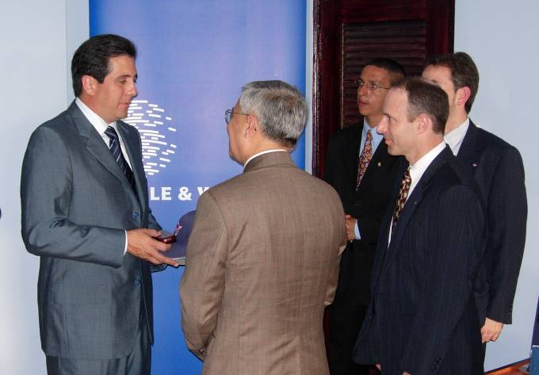
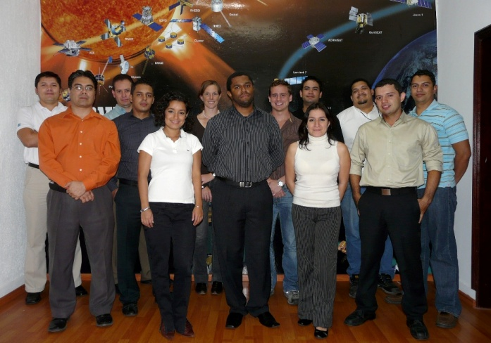
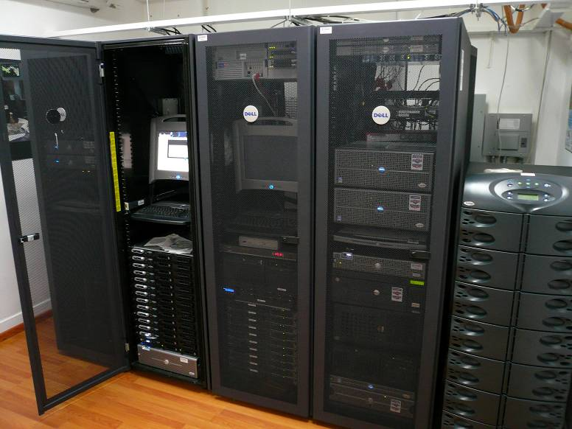
SERVIR @ CATHALAC
City of Knowledge, Panama
Dedicated on February 3, 2005
Notes:
February 3, 2005 – SERVIR Dedication in Panama

Slide 6

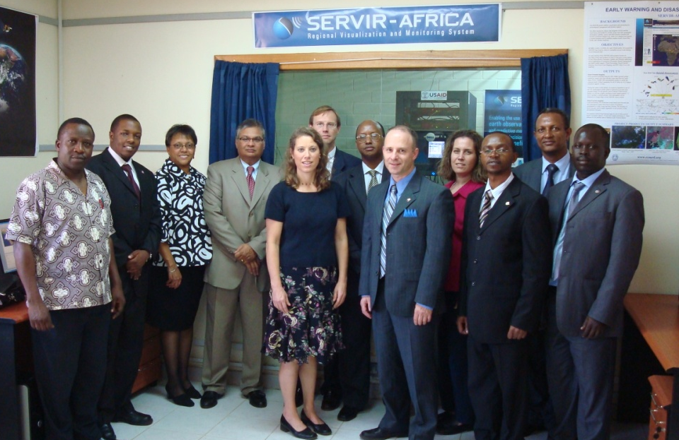
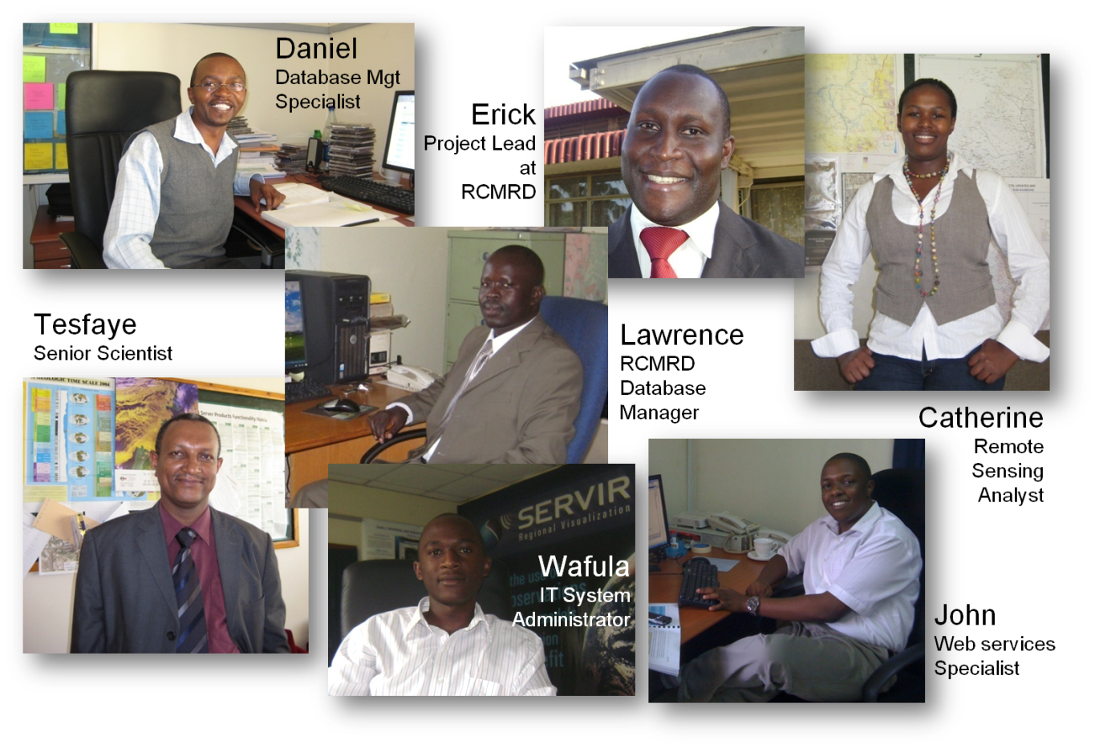
SERVIR-Africa @ RCMRD
Nairobi, Kenya
Dedicated on
November 21, 2008

Slide 7
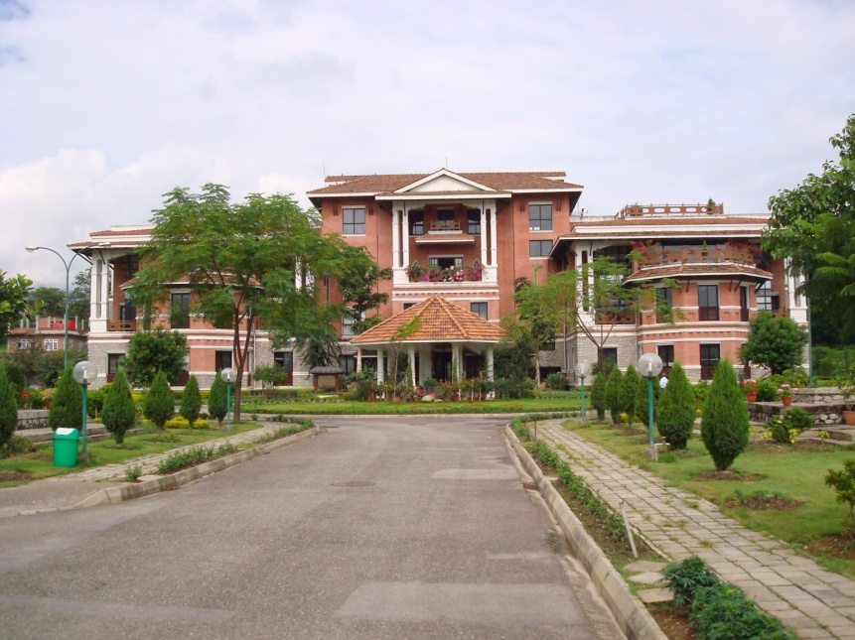
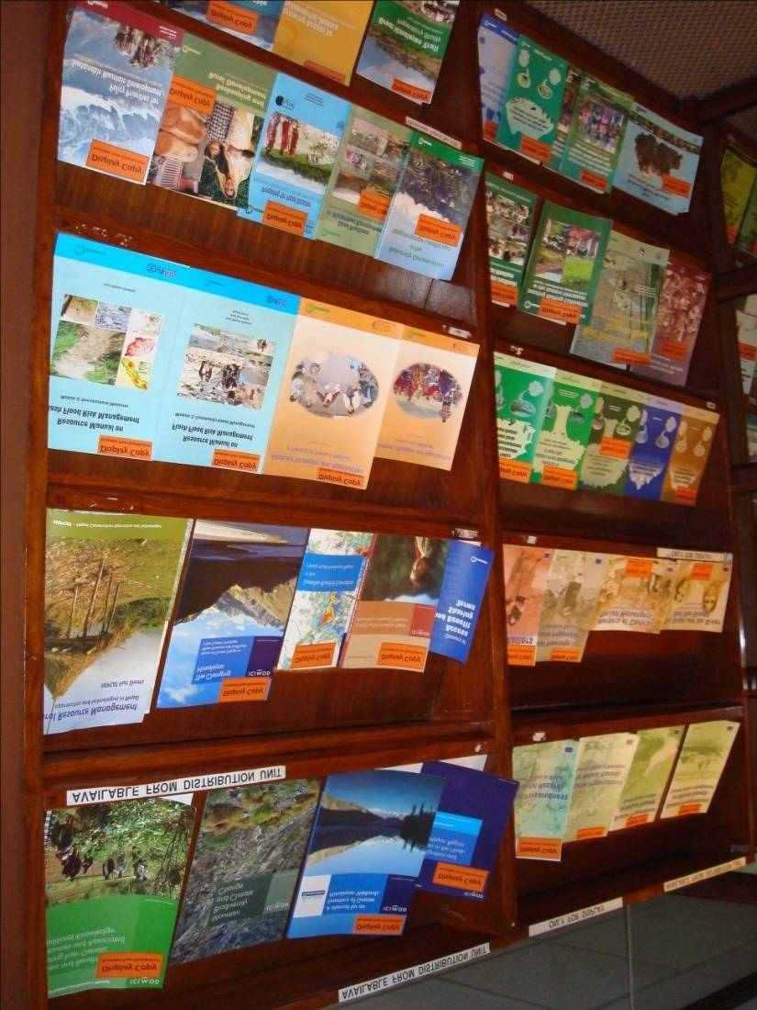
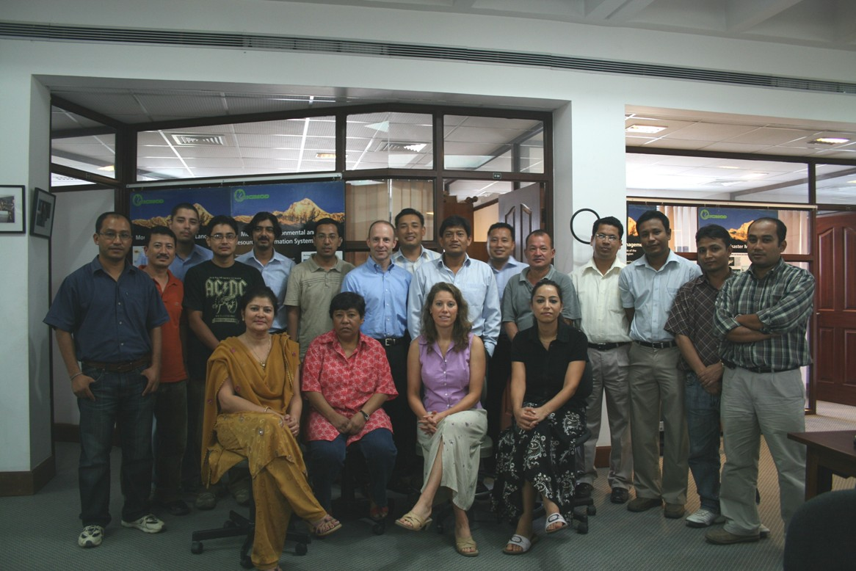
SERVIR-Himalaya @ ICIMOD
Kathmandu, Nepal
Coming…
October 2010

Slide 8
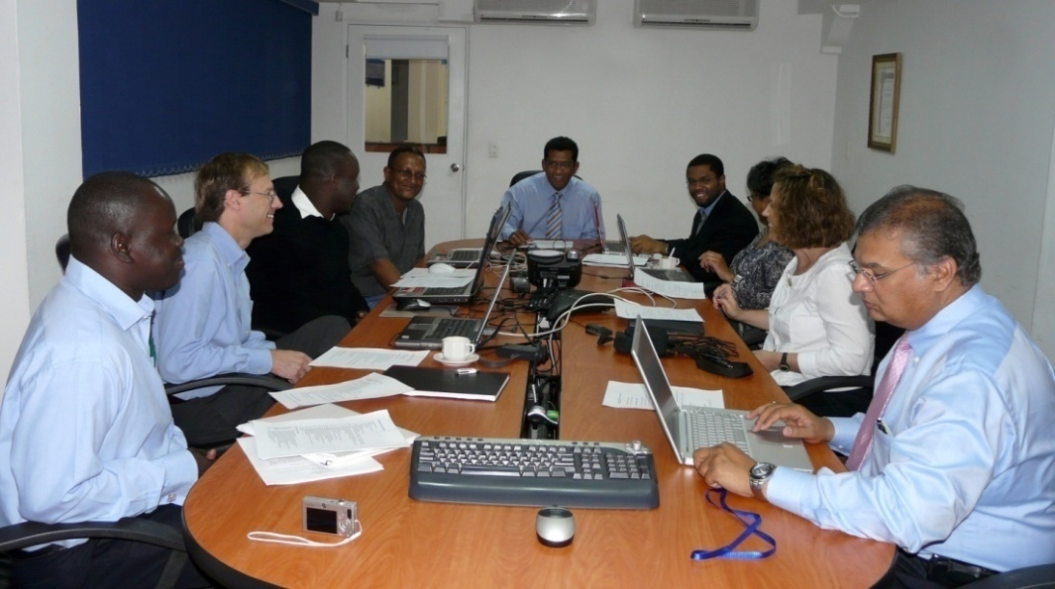
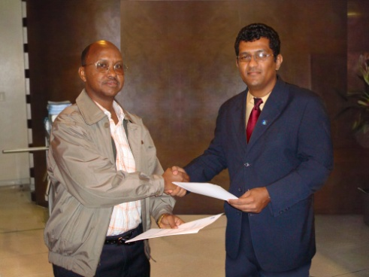
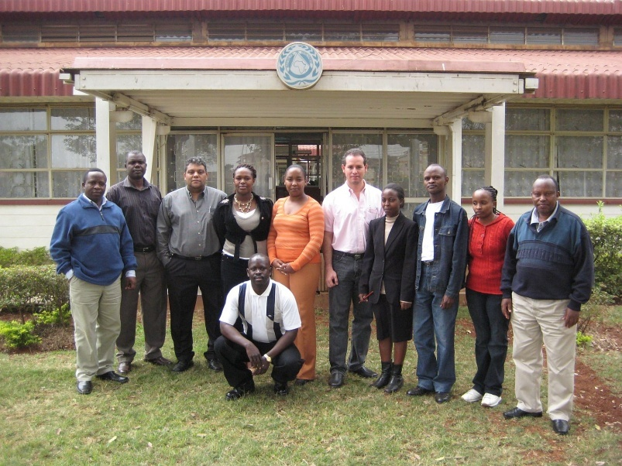
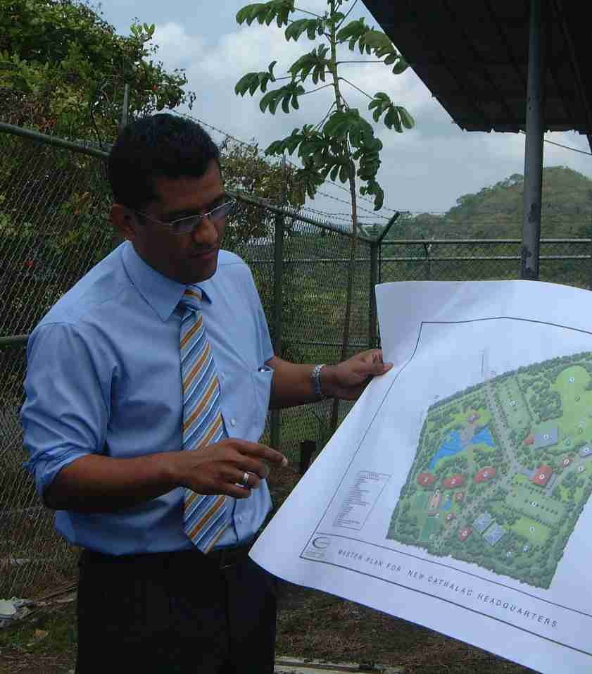
‘South-South’ Collaboration
RCMRD travels to CATHALAC to observe Panama operations
CATHALAC travels to RCMRD
Both centers exchange ideas, share experience

Slide 9
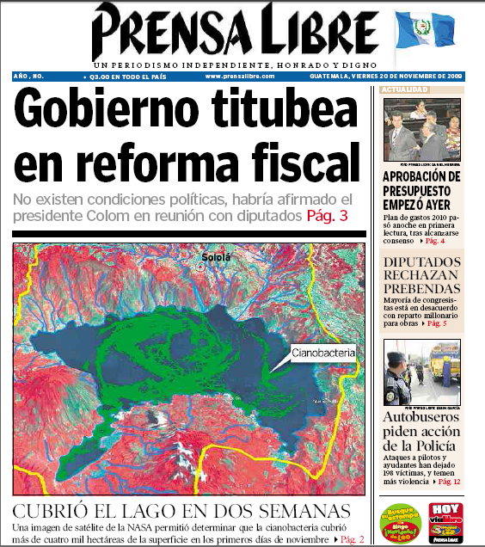
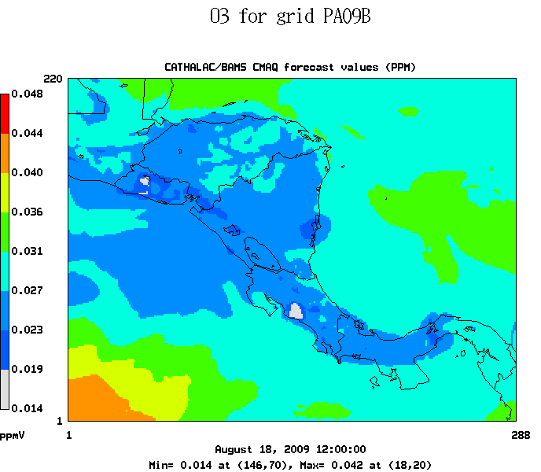
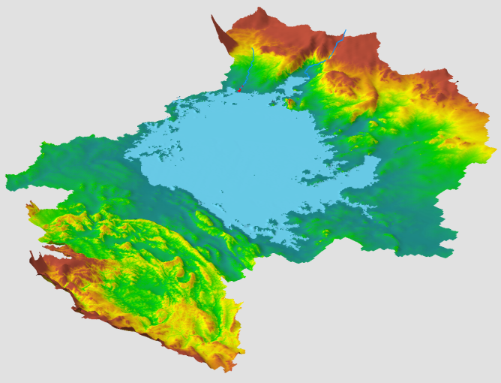
SERVIR Applications
Environmental Monitoring
Disaster Analysis
Air Quality and Public Health
Climate Change and Biodiversity
Mapping Water Quality in Guatemala
Monitoring Air Quality
In Central America
Flood Modeling in the Lake Victoria Basin

Slide 10
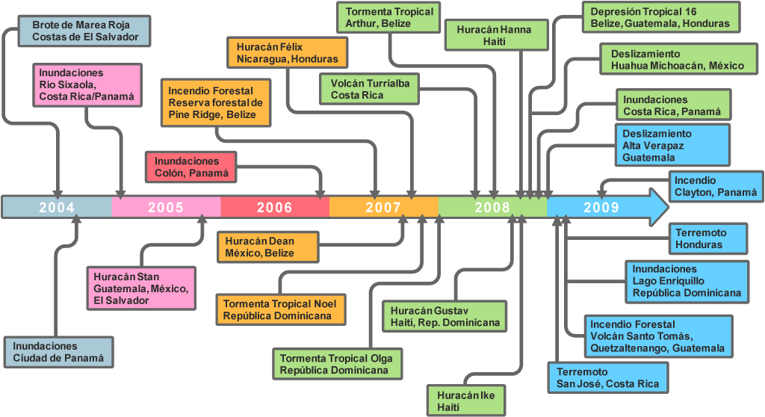
Extreme Events

Slide 11
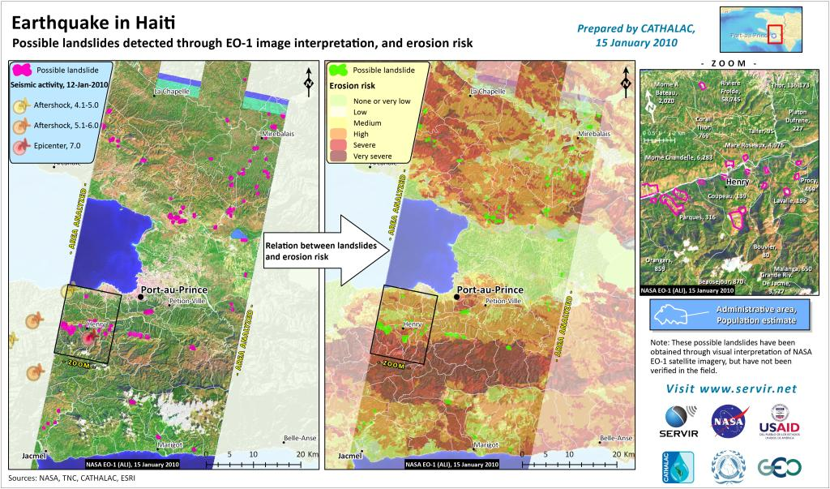
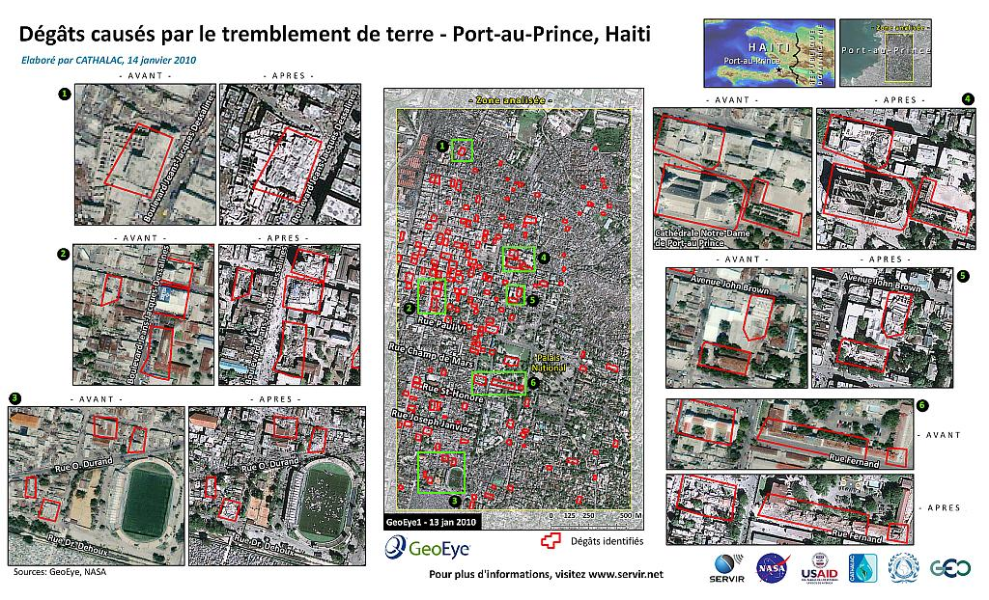
Earthquake in Haiti

Slide 12
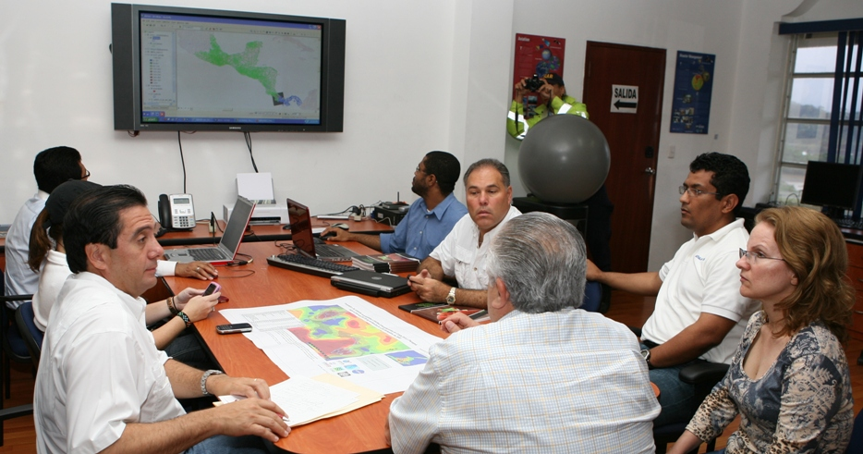
Where did NASA satellite data go? Thanks to USAID and CATHALAC… To the desk of the President of Panama!
SERVIR decision support on the spot (Nov 2008)

Slide 13
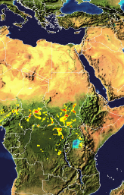
Mapping Flood Potential in Africa
Using a regional/global hydrologic model with near-real time precipitation from the multi-sensor NASA TRMM 3B42 precipitation product to derive flood potential
Provides an estimate of expected depth of flood inundation at a 0.25 degree resolution (approx. 25 km)
Precipitation forecast data can be used with the model to provide longer lead time forecasts
Model
TRMM 3B42 Precipitation
Flood Potential

Slide 14
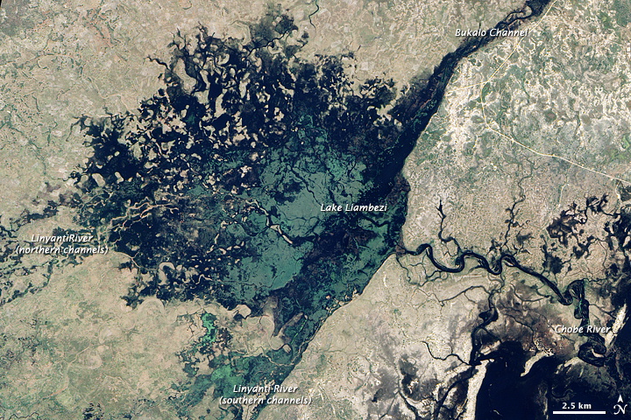
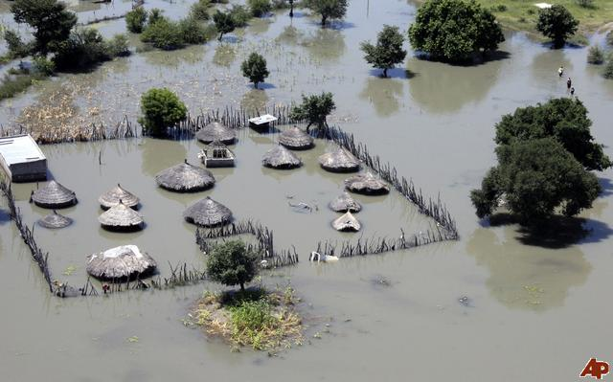
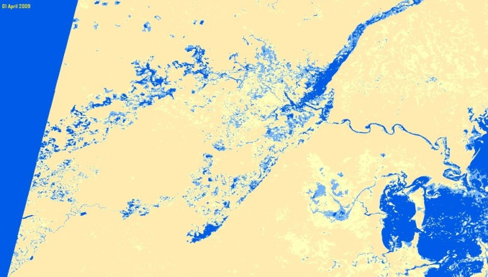
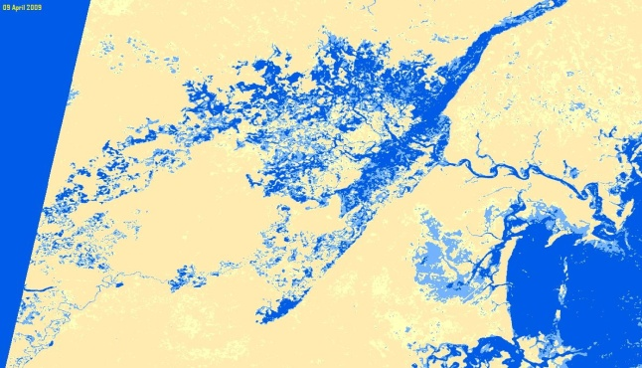
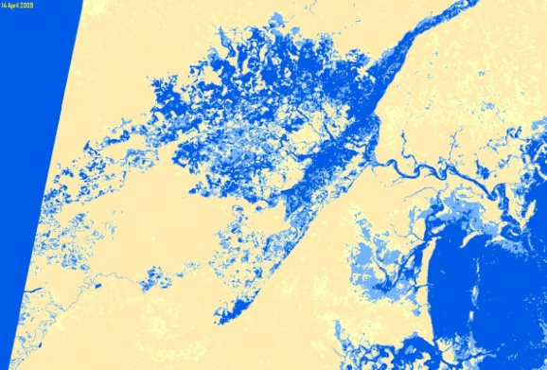
Mapping Floods in Africa
Lake Liambezi Area
LAKE LIAMBEZI AREA – NASA EO1 BAND 6 SCENES FOR 01, 09 and 14 APRIL 2009
(false colours based on preliminary classification without ground verification)

Slide 15
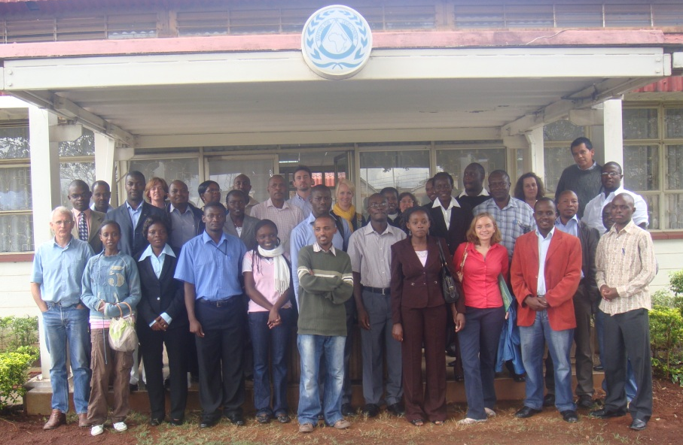
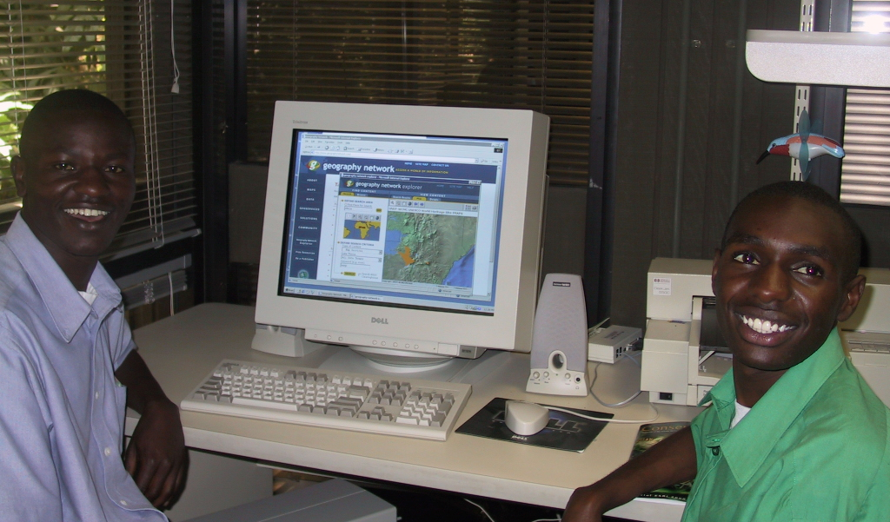







Use: MyCOE-SERVIR Initiative
Building capacity to protect biodiversity using GIS, RS, and geospatial analytical techniques.
Strengthening collaboration amongst universities, government environmental authorities, and NGOs.
Students & mentors competitively selected; both receive modest stipends to conduct 6-month long projects and travel support .
Notes:
15

Slide 16
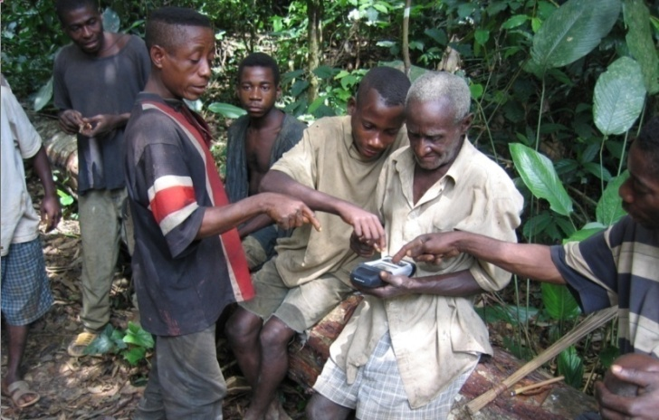
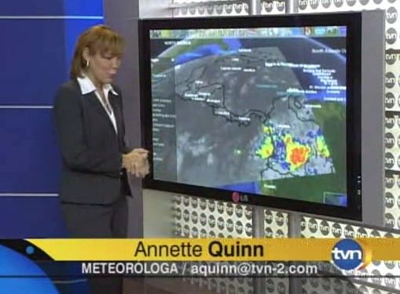
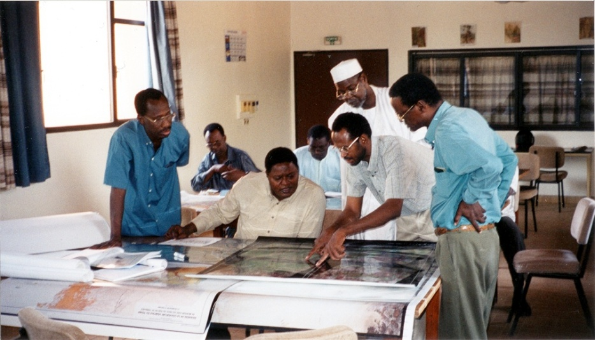
SERVIR Users
Decision makers, media, educators, students, private industry, community groups.

Slide 17
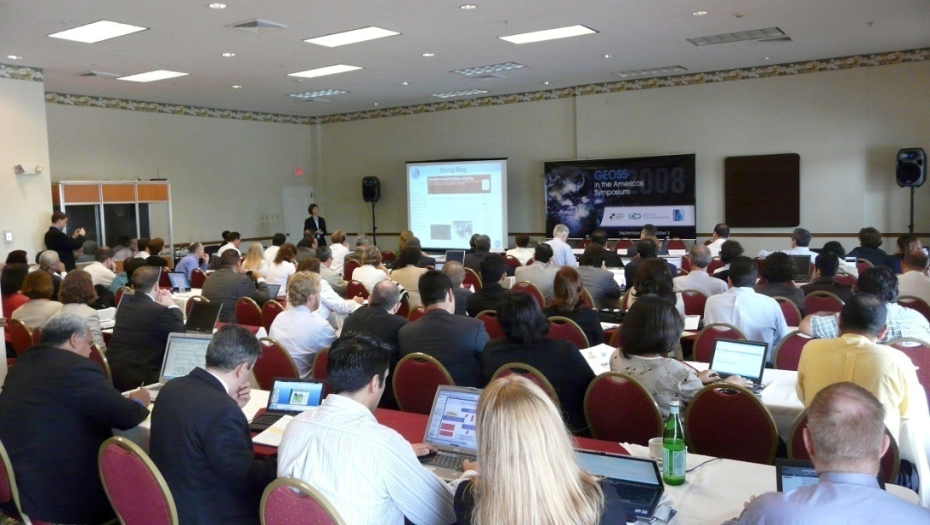
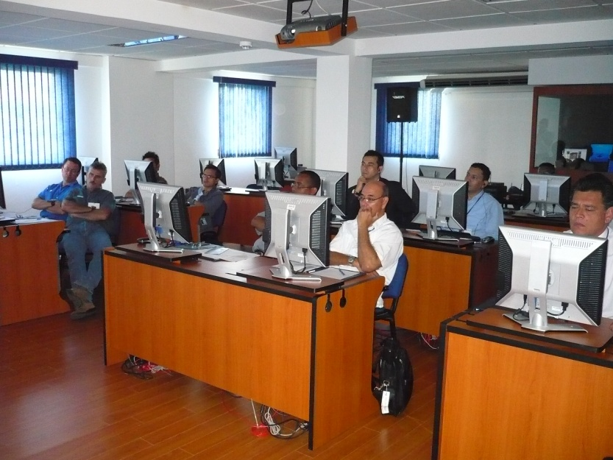
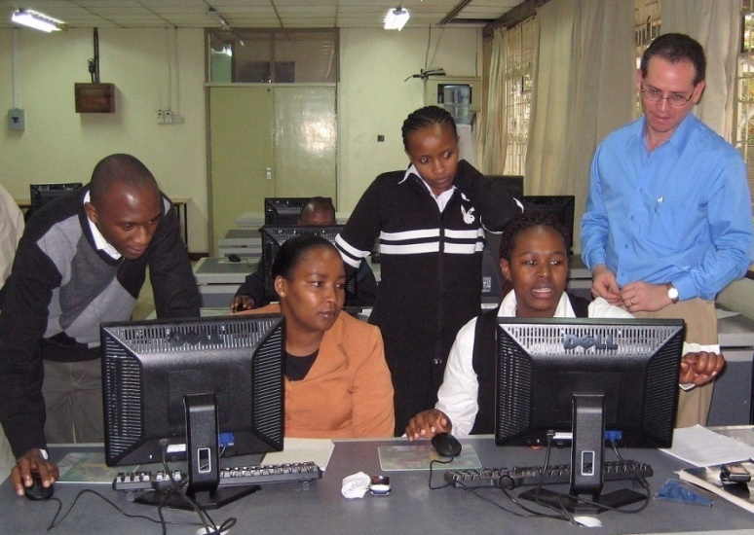
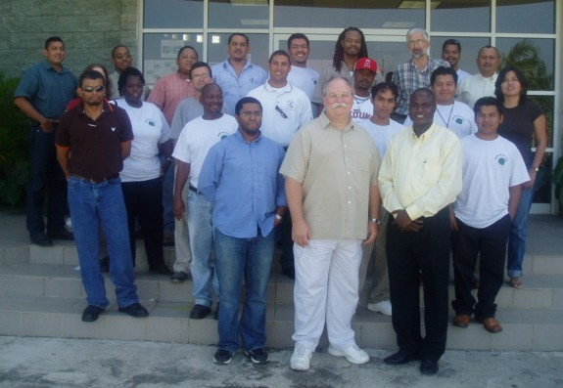
Training & Capacity Building

Slide 18
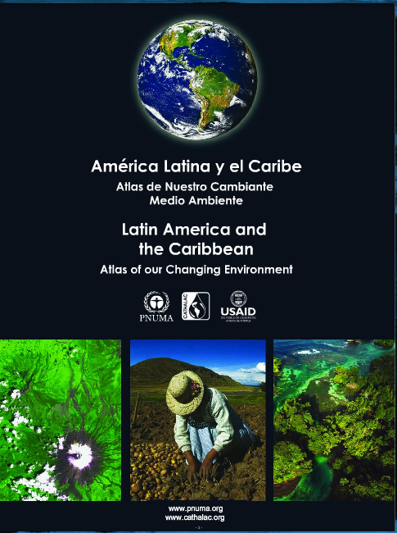

Slide 19
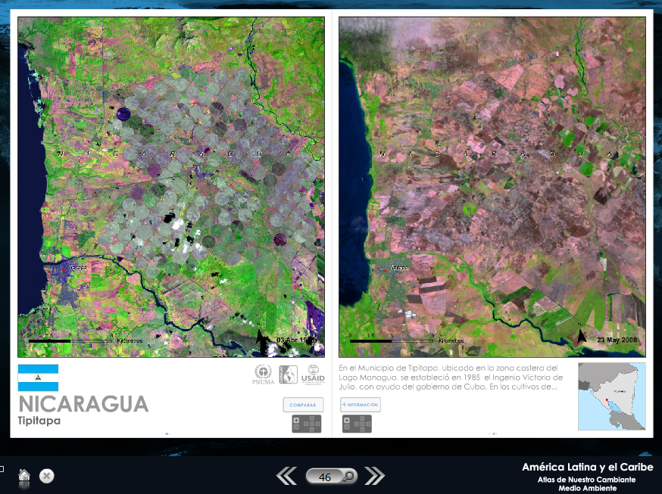
Notes:
Ingenio victoria de julio—cuba, closed in 2000

Slide 20
The Future
Growing SERVIR network
Widening the On-Ramp for Applications
  ROSES calls
  Visiting Scientists
  Pilot Projects
University Campus in Panama
Weather Doppler RADAR in Central America

Slide 21


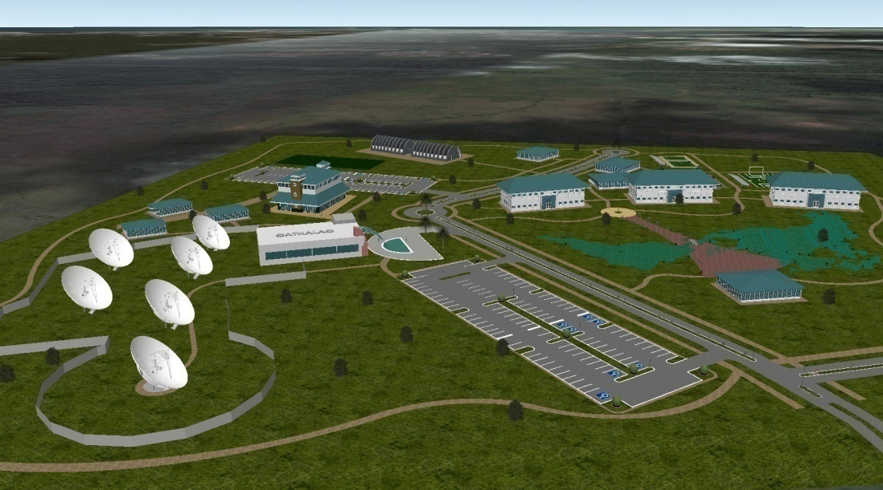
SERVIR and UAHuntsville

