Slide 1
Utilizing remote sensing, modeling and data assimilation to sustain and protect fisheries: ecological forecasting at work
Francisco Chavez, M. Messie
Monterey Bay Aquarium Research Institute
F. Chai (U of Maine), Y. Chao (NASA/JPL),
David Foley (NOAA/NMFS), R. Guevara, M. Niquen (IMARPE) and R.T. Barber (Duke)

Slide 2
Approach
Develop remote sensing products for fisheries decision support systems
Develop strong theoretical basis for forecasting using in situ and satellite data
Develop 20-50 year model hindcasts and test theory
Develop 9 month model forecasts and incorporate into fisheries decision support systems

Slide 3
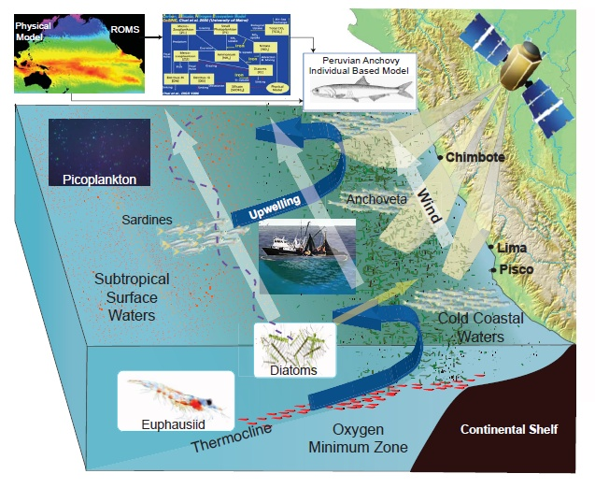
NASA products:
Physical basin-scale model (ROMS) run at 12.5 km resolution and an embedded nutrient-phytoplankton-zooplankton ecosystem
Validated and forced with remote sensing time series:
SST
Winds
Chlorophyll
The ecosystem of the Peruvian anchovy is modulated locally by winds, the depth of the thermocline and oxygen minimum zone. These in turn are perturbed remotely by changes in basin-scale thermal dynamics.
Notes:
I must be prepared to answer and defend any statements about the Earth science products, their use, validation of claims, etc. so please feel free to add details in the PPT notes section

Slide 4
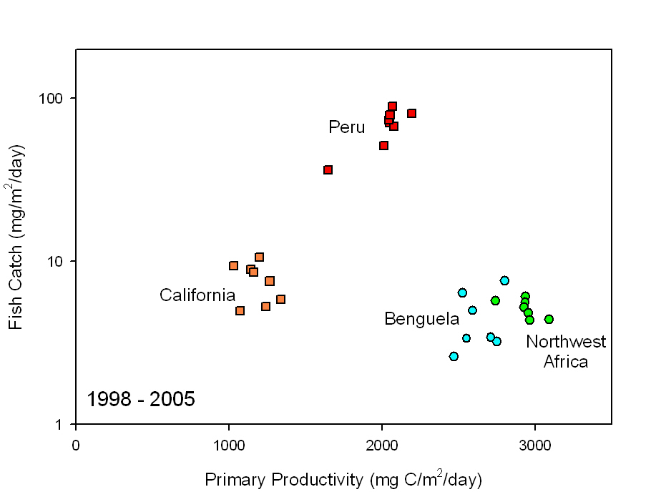
More fish (total and per unit primary production)
than any other place in the world!

Slide 5
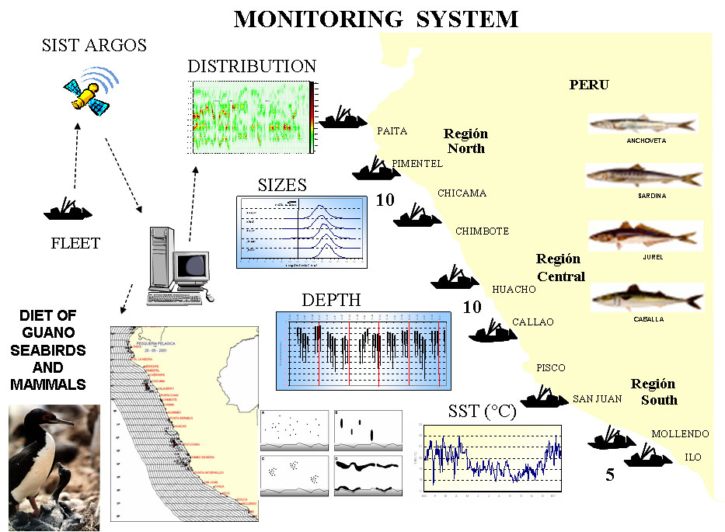

Slide 6
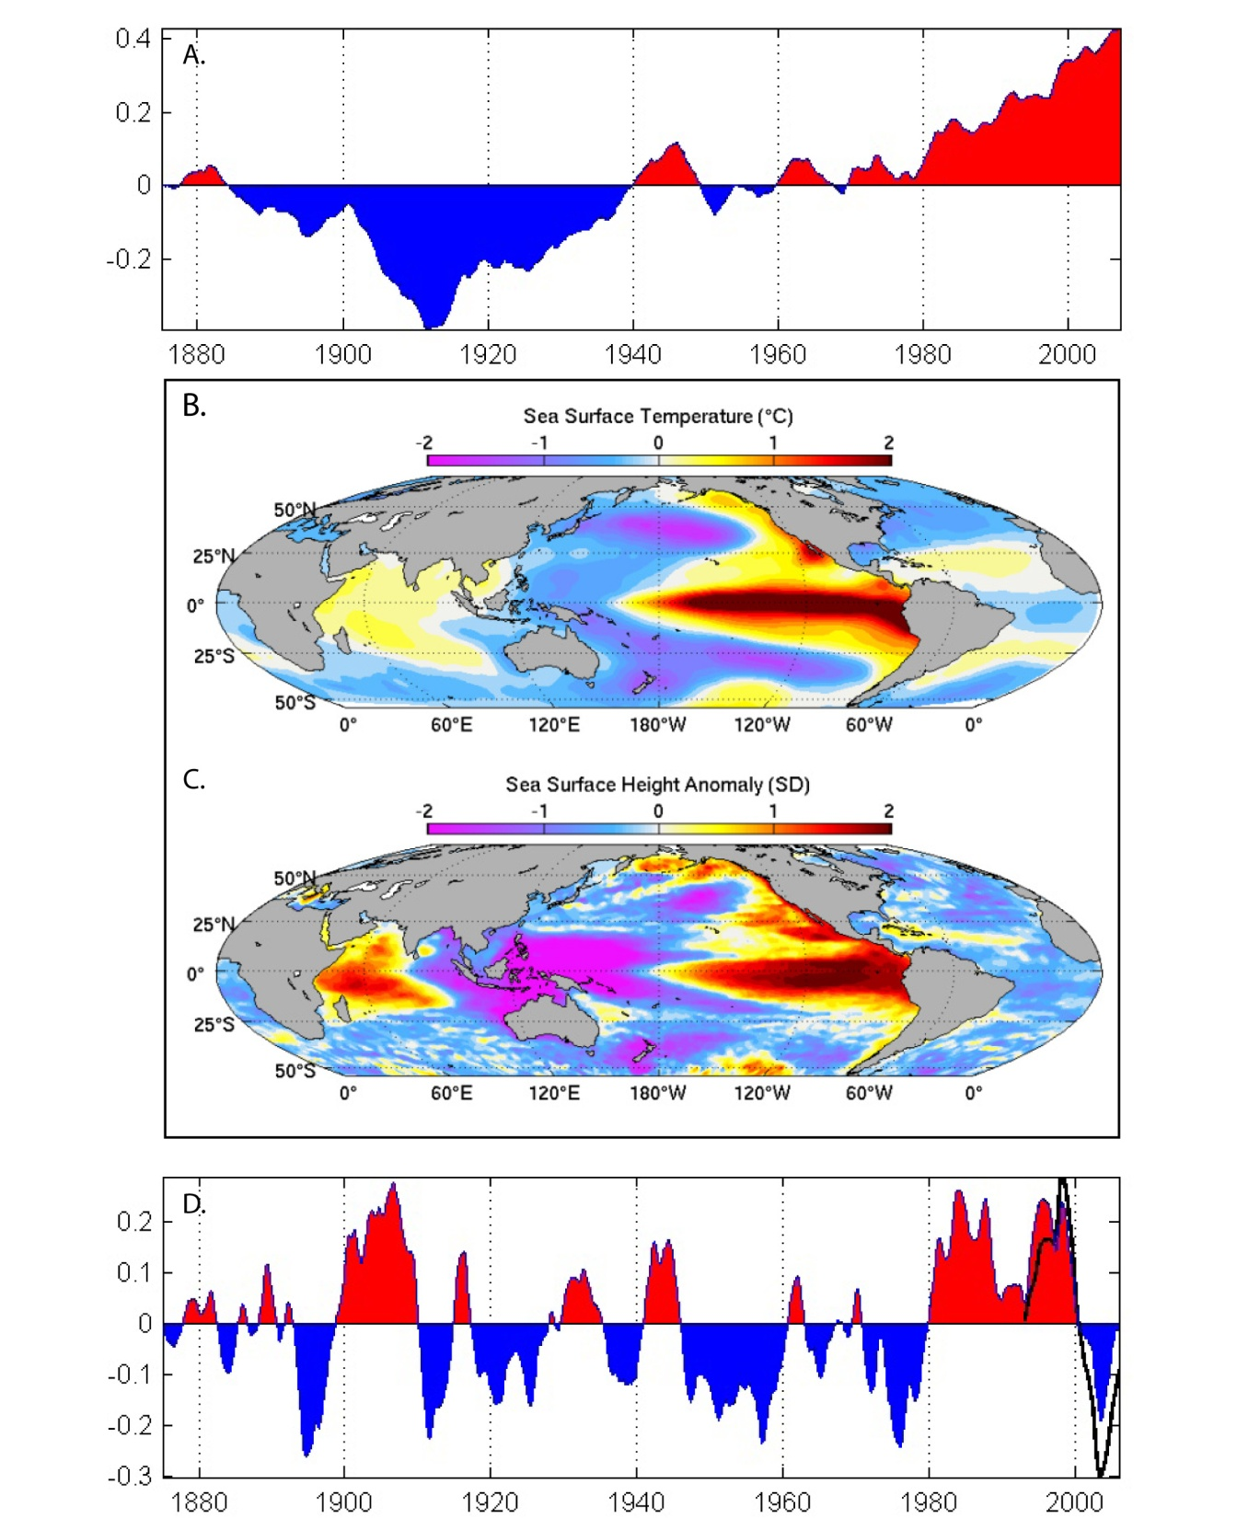
Change?
SST
1880 - 2006
Two
Primary
States
SSH
1983 – 2006
black line
Varia-
bility

Slide 7
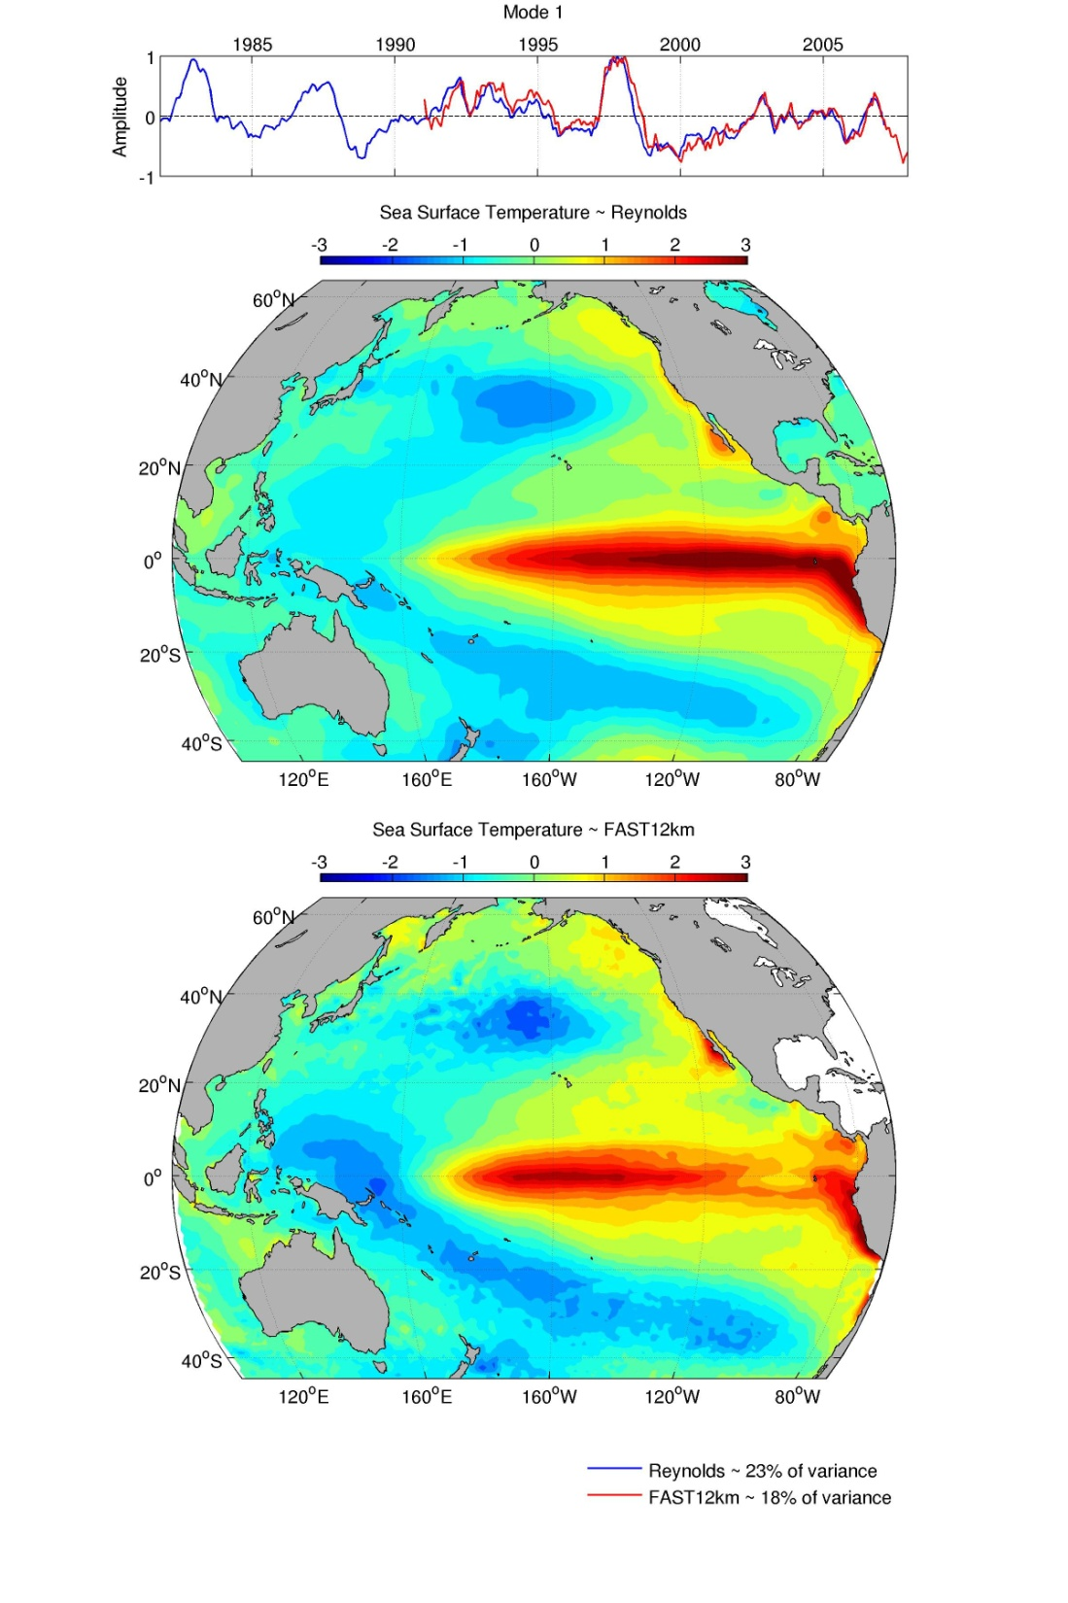
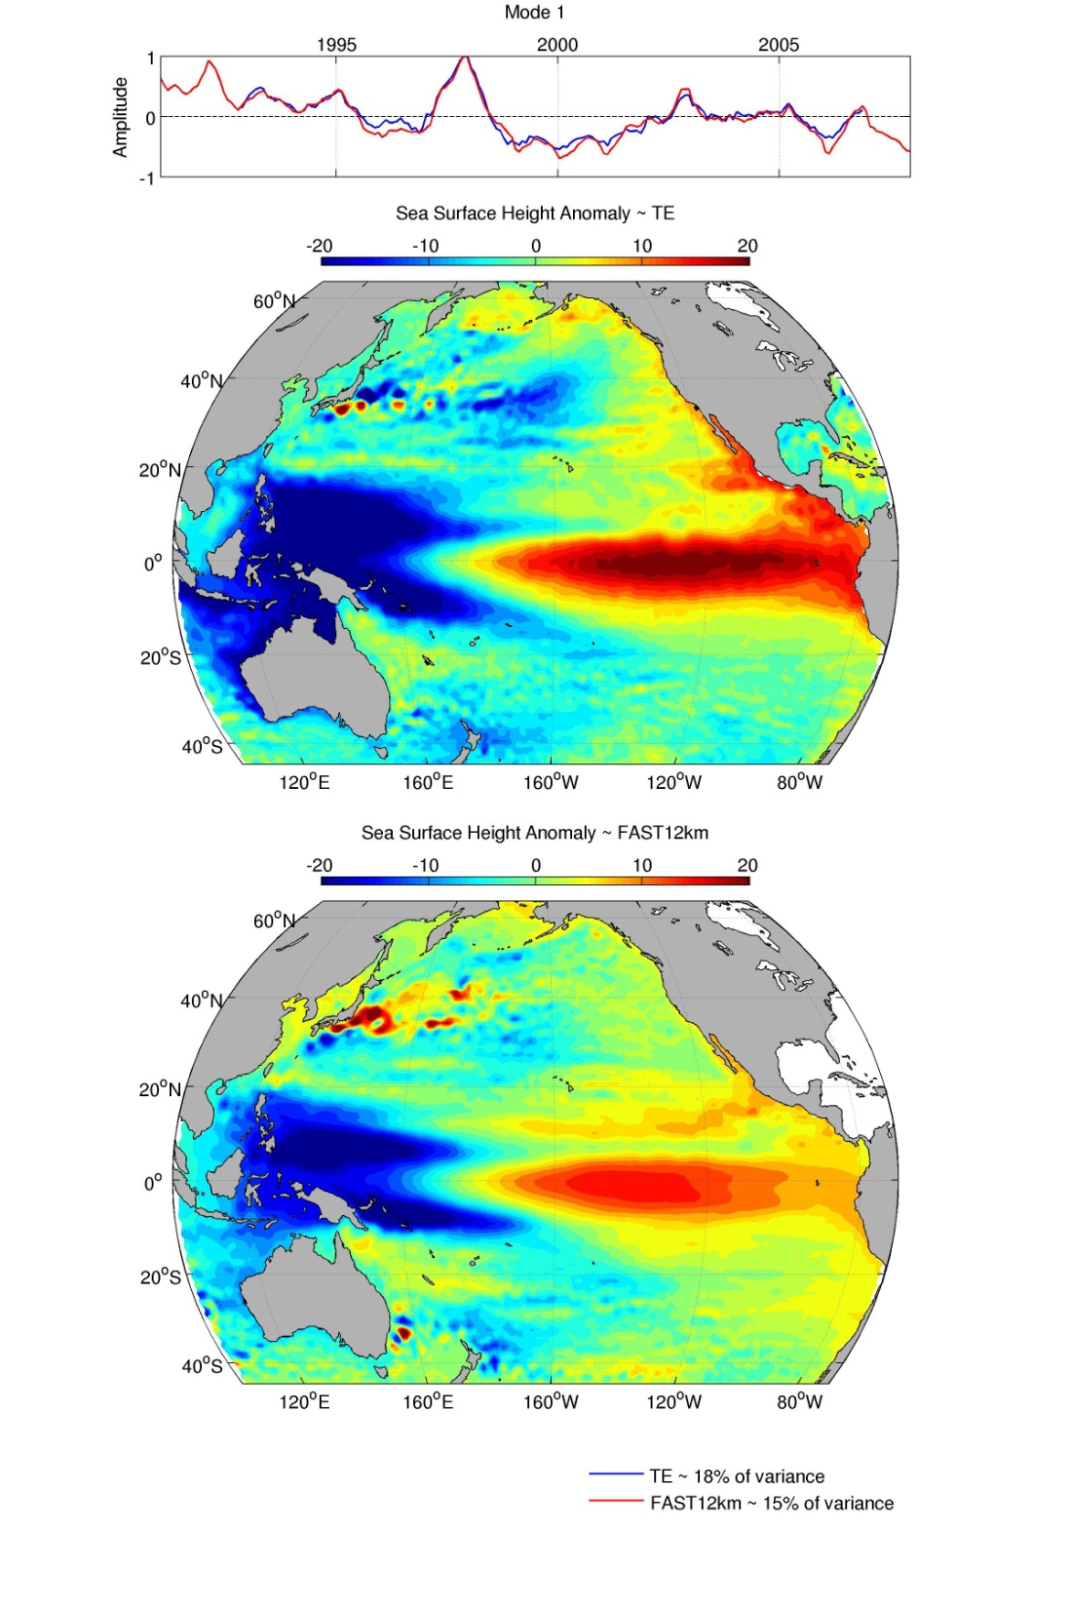
Data
Model
SST
Sea level

Slide 8
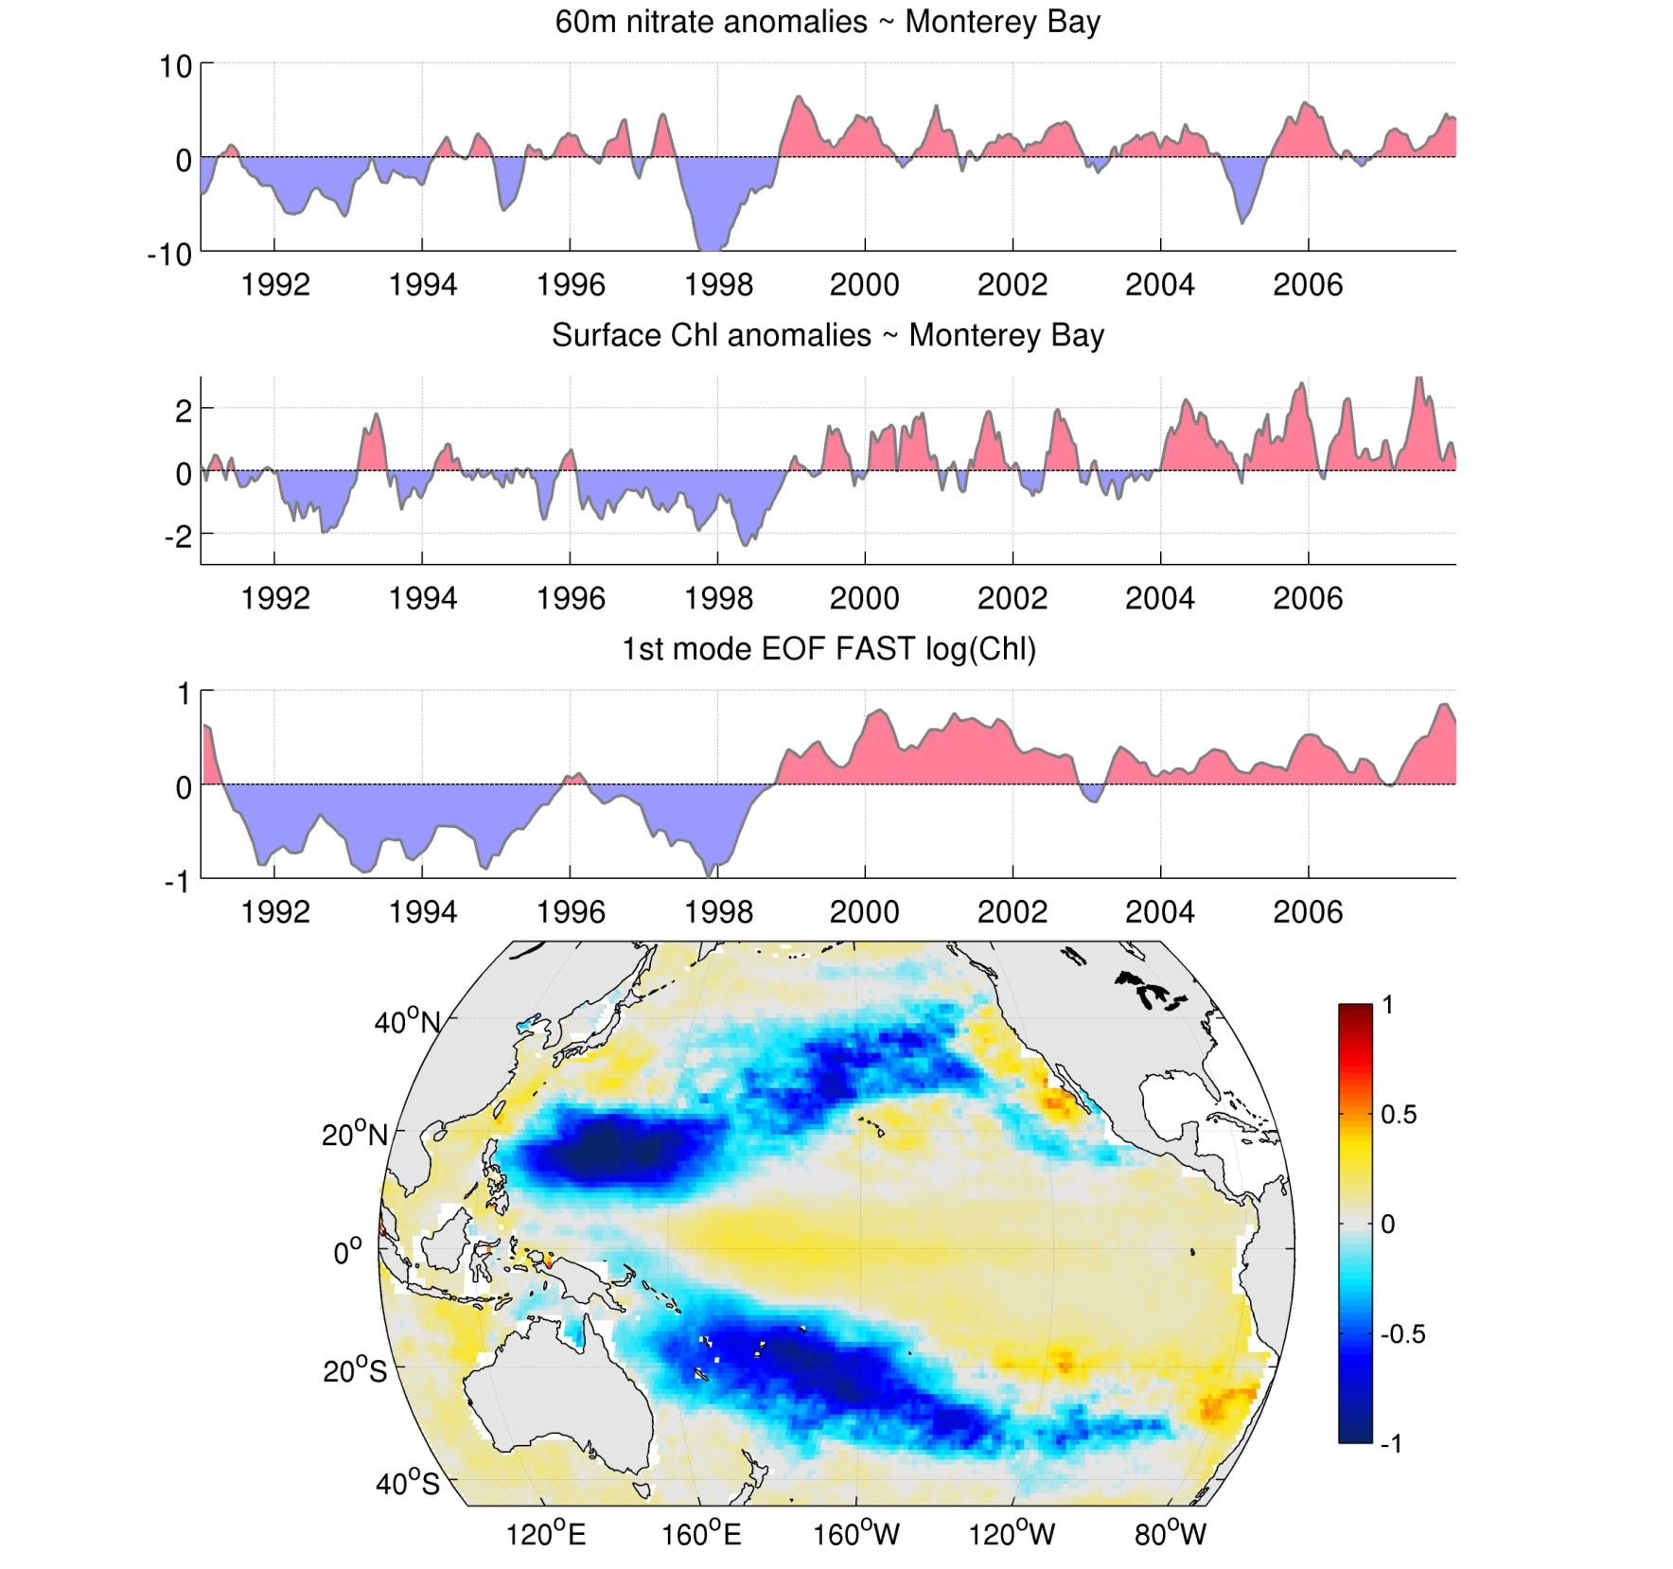

Slide 9
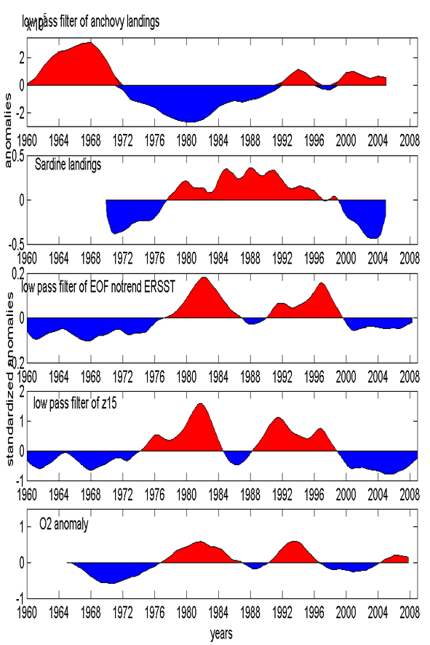
V panel
Anchovy
Sardine
SST
Thermocline
depth
Oxygen

Slide 10
Current status
On 4th year no-cost extension
Working with V panel on the anchoveta
Determining skill of forecast (forcing and ocean)
Improving skill of forecast
Determining and implementing US requirements

Slide 11
Recommendations from V panel
Develop an environmental/biological index that can be used in predictive models (see Wells et al.)
Develop and improve environmental forecasts on time scales of months to decades
Integrate environmental forecasts into upper trophic level and socio-economic models

Slide 12
Global modes of SST variability

Slide 13
Model results
Excellent hindcast agreement between ocean model and observations – meaning solid atmospheric forcing and physics/ecosystem
NCEP atmospheric forecasts at lower resolution – excellent open ocean tropical Pacific skill, poor coastal skill
Ocean forecast skill off Peru good but can be improved by downscaling NCEP forcing – doing this as part of a salmon project (see Wells et al. presentation)

Slide 14
Classical quota is % of biomass from stock assessment
Acoustic Ship Survey or other Stock Assessment
Anchoveta population
Fishery
1
Quota
2
Add environmental information
Environmental Information
3
Ecosystem (fish, mammals, seabirds, etc.)
4
Remote sensing
Add remote sensing
ROMS model forecasts
5
Quota (%B)
Add forecasts
Biomass
No Forecast
With Forecast

Slide 15
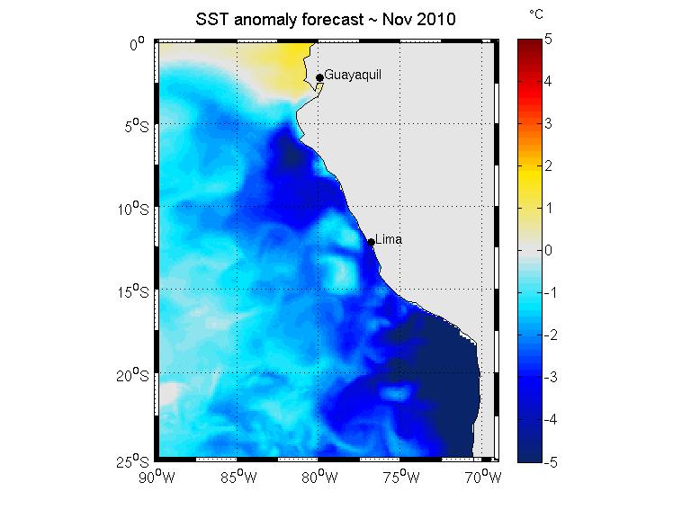
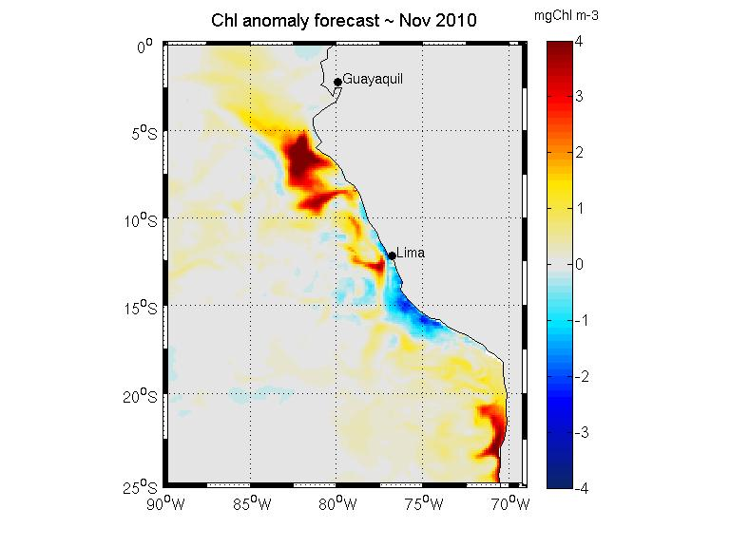
Accomplishments:
- Fishery resource managers are utilizing NASA remote sensing and model forecasts to decide how much fish to catch each season
- Why? If fishery managers know what the environment will be in the future they can maximize fishery profits and maintain the health of the ecosystem at the same time
- Providing scientifically credible information so the managers pay attention
Notes:
I must be prepared to articulate and defend what makes this an accomplishment – should be able to answer this very clearly and succinctly.

