Slide 1
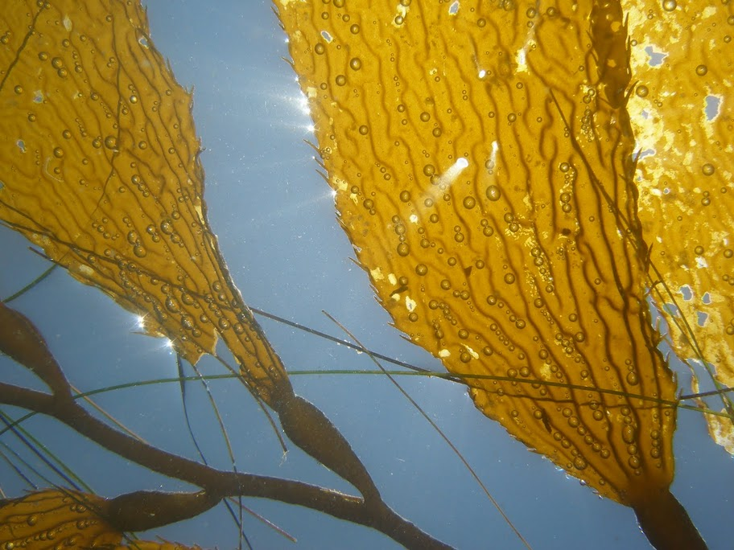


Dynamics of Giant Kelp Forests:
The Engineer of California’s
Nearshore Ecosystems
Dave Siegel, Kyle Cavanaugh, Brian Kinlan, Dan Reed, Phaedon
Kyriakidis, Stephane Maritorena, Steve Gaines
UC Santa Barbara
Dick Zimmerman, Victoria Hill, Bilur Celibi, Tanique Rush
Old Dominion University
Photo: Stuart Halewood
Notes:
LTER

Slide 2
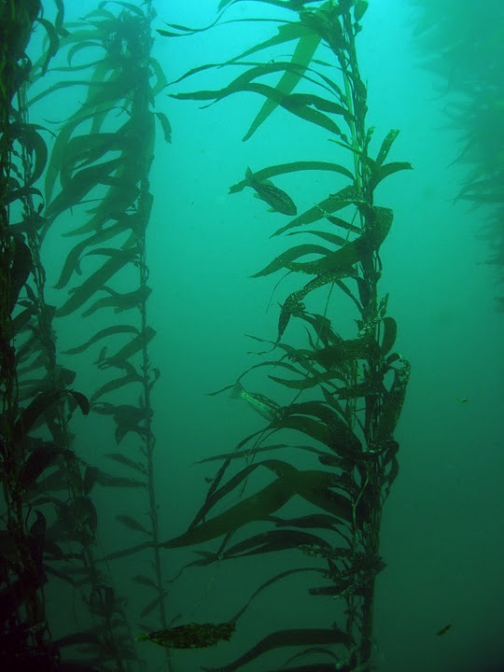
Macrocystis pyrifera – Giant Kelp
High economic & ecological importance
“Ecosystem engineer” of the nearshore ecosystems
Dominant canopy forming macroalga in So Cal
Highly dynamic
  Plant life spans ~ 2.5 years
  Frond life spans ~ 4 months
  Fronds growth can be 0.5 m/day
Notes:
Giant kelp critically important in and of itself
Excellent model for studying variability in primary producers structured by repeated disturbance

Slide 3
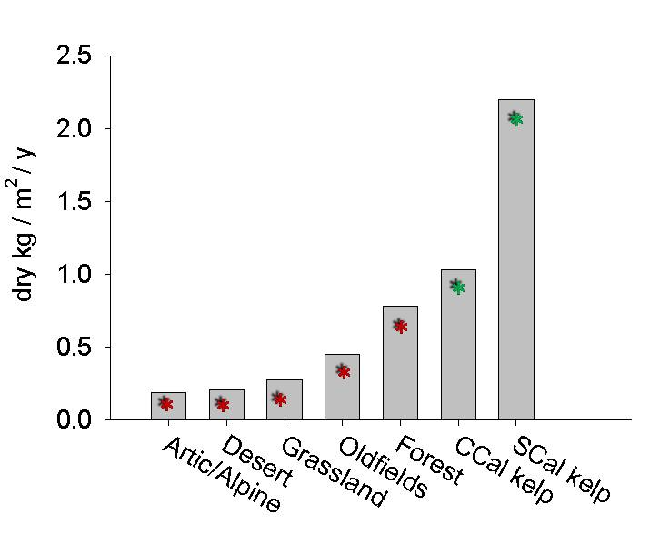
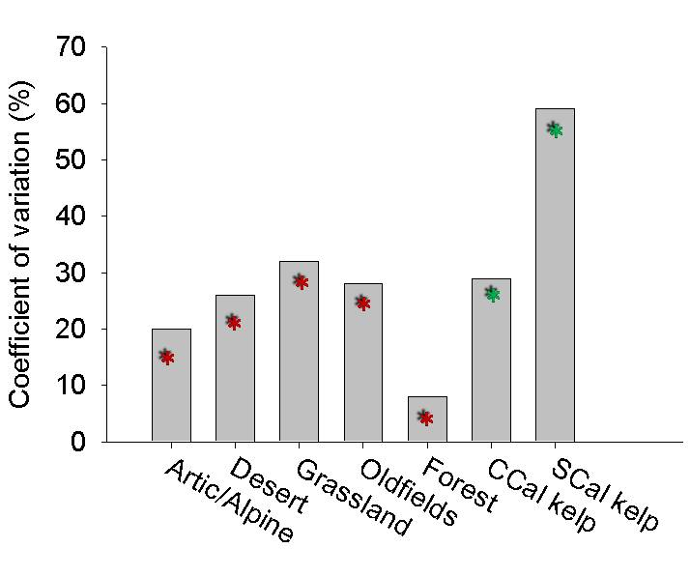
NPP of Southern California kelp is high and variable relative to other systems
Disturbance is behind much of this high variability
NPP (dry kg/m²/yr)
* from SBC-LTER data
* from Knapp and Smith 2001
Notes:
LTER data shows that standing crop at start of growing season explains 63% of that year’s NPP, no correlation was found between growth rate and annual NPP
Disturbance driven system

Slide 4
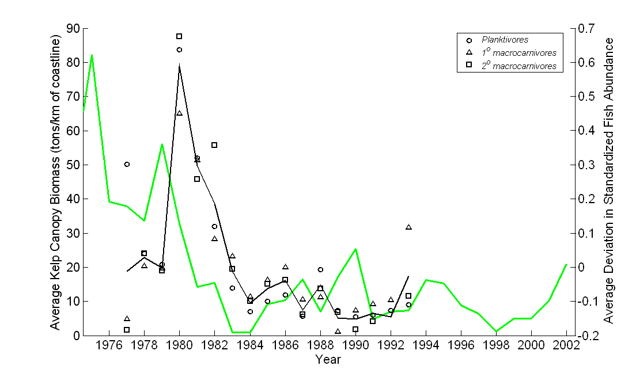
Implications for ecosystem production and biodiversity
Macrocystis and Fish Stocks
PDO shift
El Nino
El Nino
Kelp biomass data from Kelco visual estimates;
Fish observations from Brooks et al 2002

Slide 5
Research Questions
How does kelp vary through space (m’s to 100’s of km) and time (seasonally to decadally) ?
  SBC-LTER diver observations combined with:
  SPOT (2006-2008): spatial scaling and variability
  LANDSAT (1984-2010): temporal variability
Which mechanisms are driving variability across scales?
  Develop statistical models relating growth, mortality, colonization to forcing data (waves, SST, nutrients, substrate, currents, etc.)
Still, our understanding of variability in kelp populations is limited
  Based on local studies

Slide 6
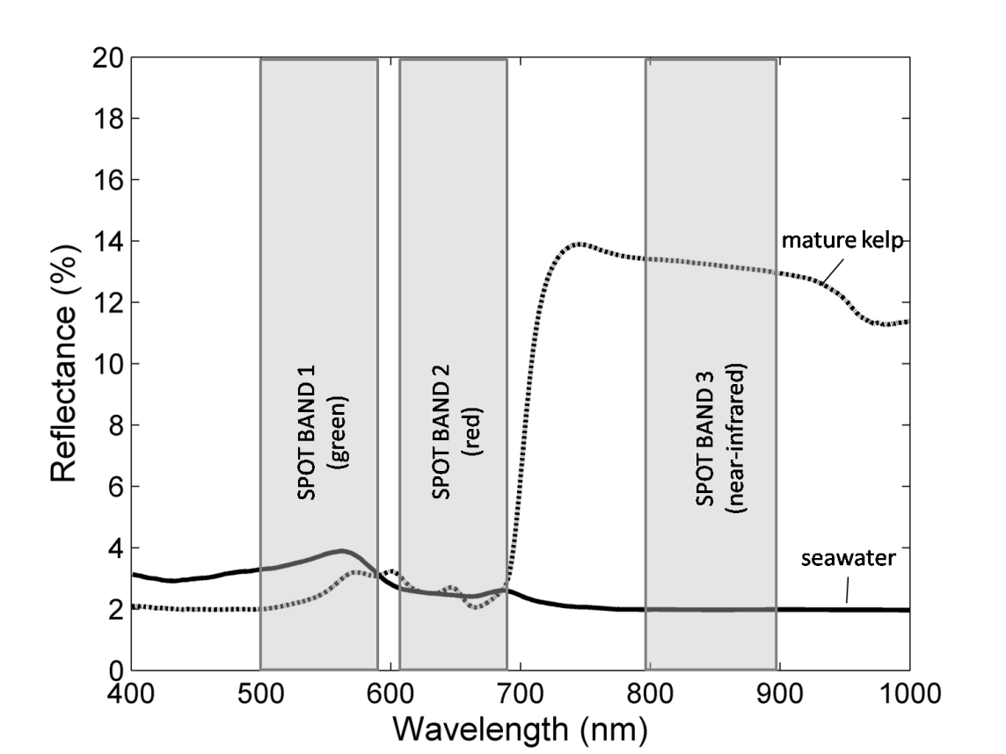
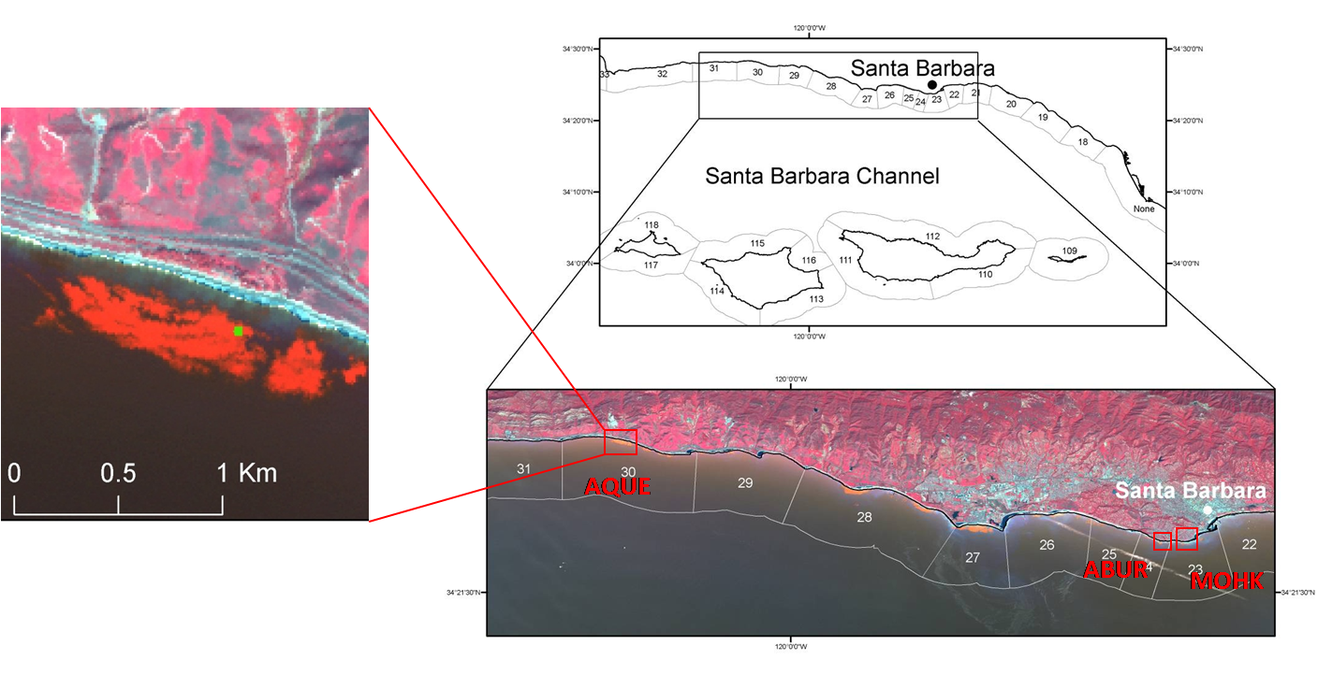
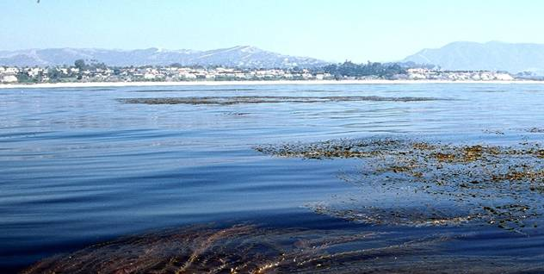
SPOT Satellite Imagery
10 m resolution
Diver transects
imagery acquired approx. every 2 months from 2006-2008
Notes:
Explain SCUBA data

Slide 7
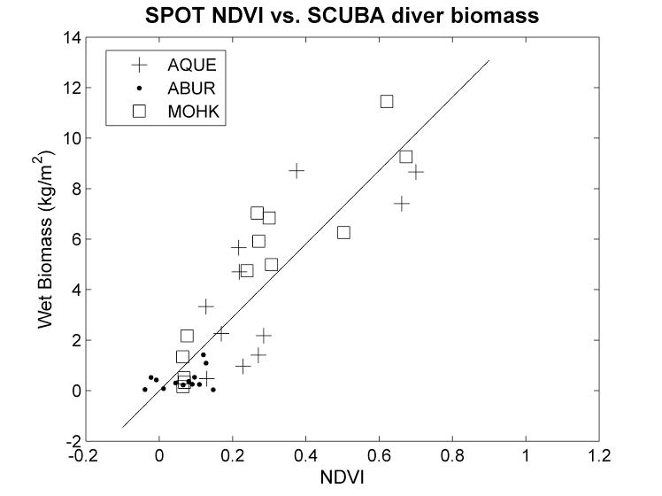
Remote Sensing of Macrocystis
Biomass
r² = 0.71
(Cavanaugh et al. Marine Ecology Progress Series 2010)

Slide 8
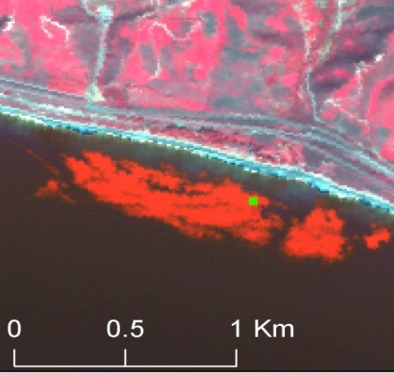

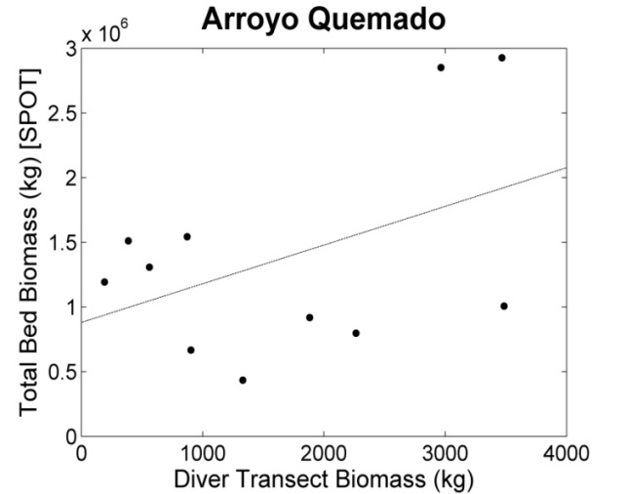
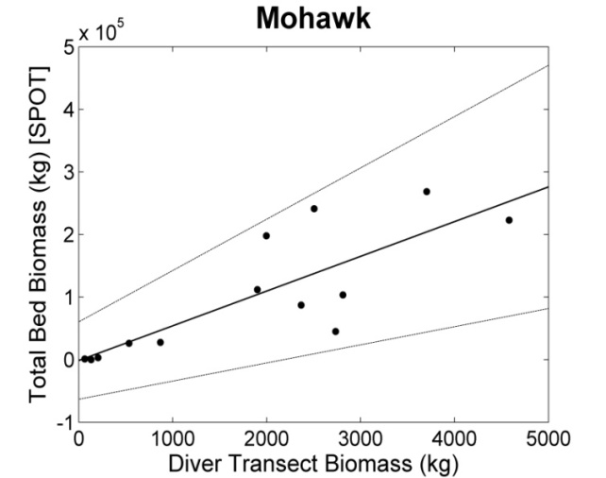
Spatial Scaling with SPOT Imagery
Arroyo Quemado
Mohawk
Larger beds harder to characterize w/ transect scale measurements
r² = 0.20
r² = 0.67*
(Cavanaugh et al. 2010)

Slide 9
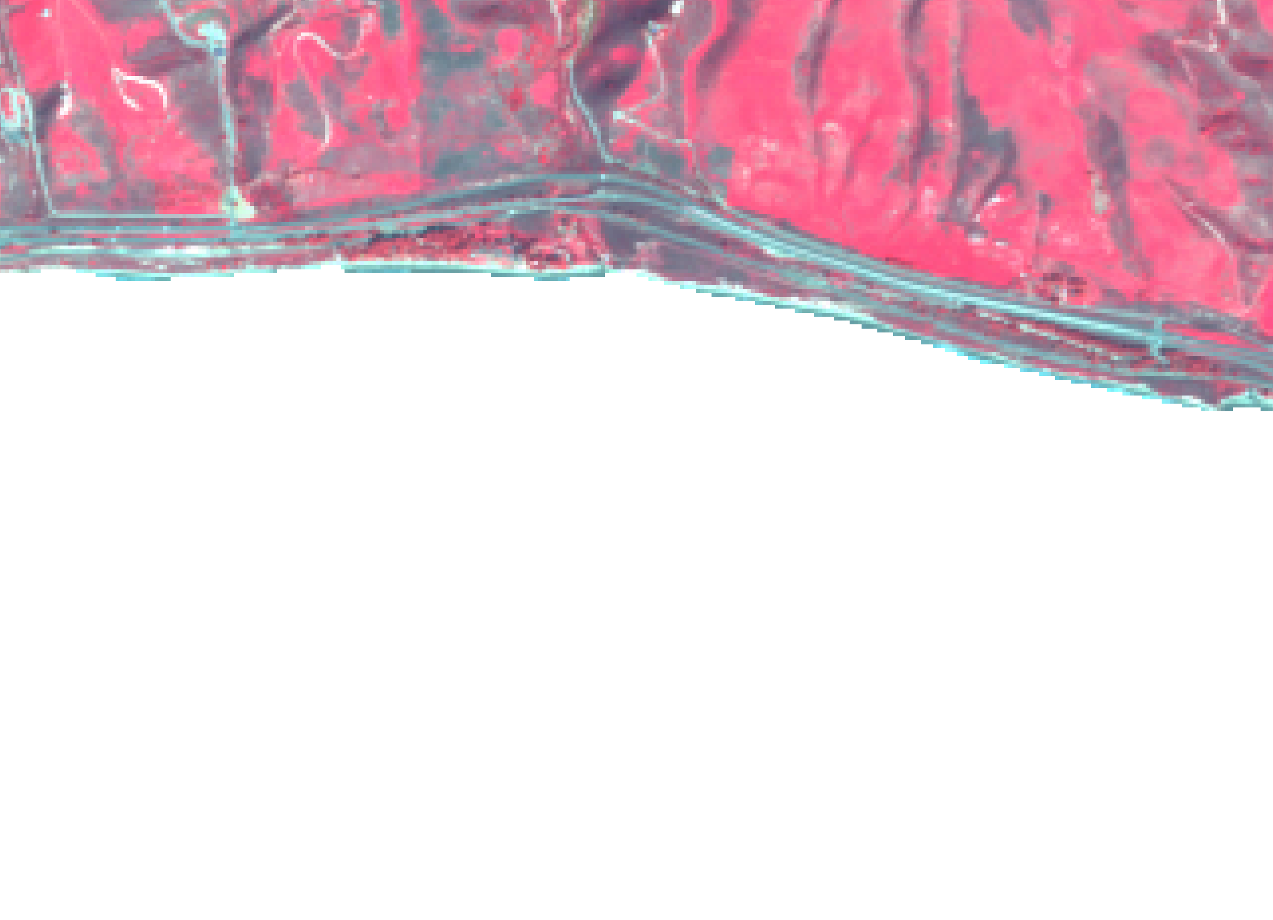
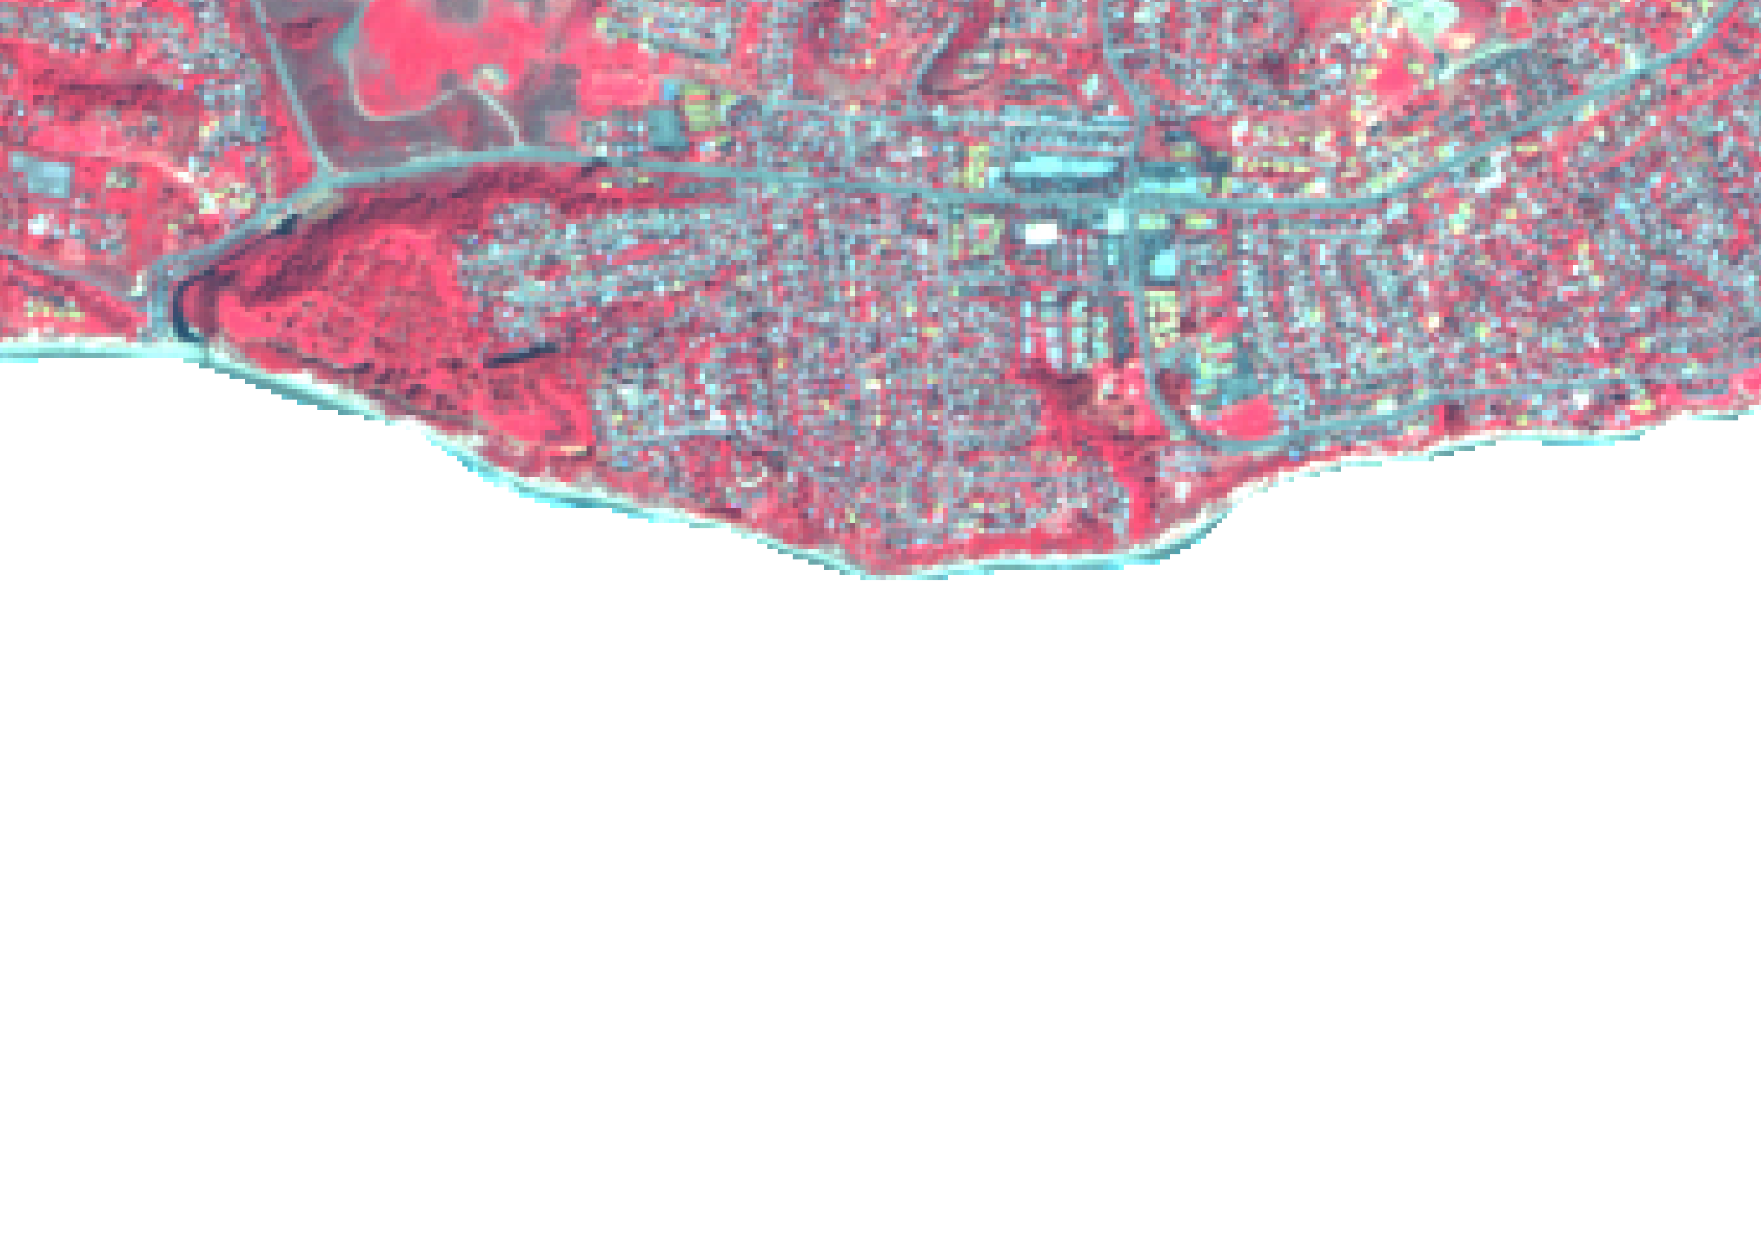
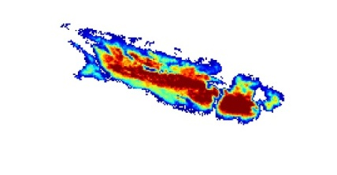

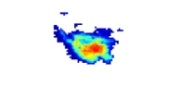
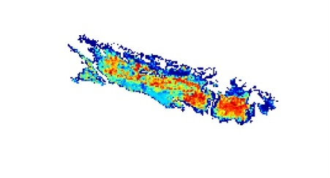


Location Matters Too
Arroyo Quemado
Mohawk
5
5
Mean Biomass (kg/m²)
0
0
1
1
Correlation to Bed Biomass
0.4
0.4
High biomass bed centers are better correlated with bed wide changes

Slide 10
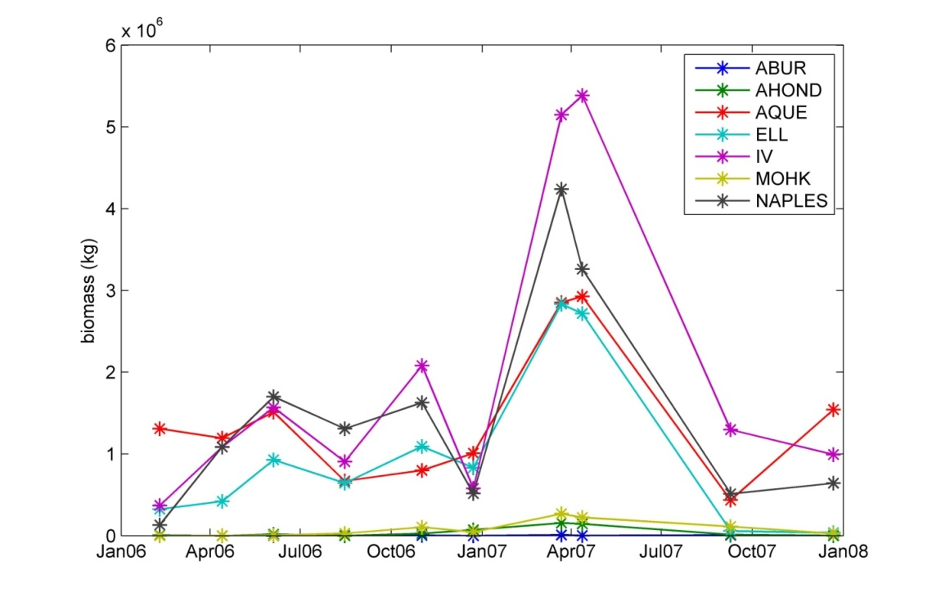
Bed dynamics are similar for this region
Biomass (kg)
Large beds and region as a whole had similar dynamics during 2006-2008
Notes:
Explain how correlations were calculated, 2 year time series: satellite data only
During this time period changes in large beds were well correlated with each other and the region as a whole
Could be different during a El Nino year or as area is expanded

Slide 11
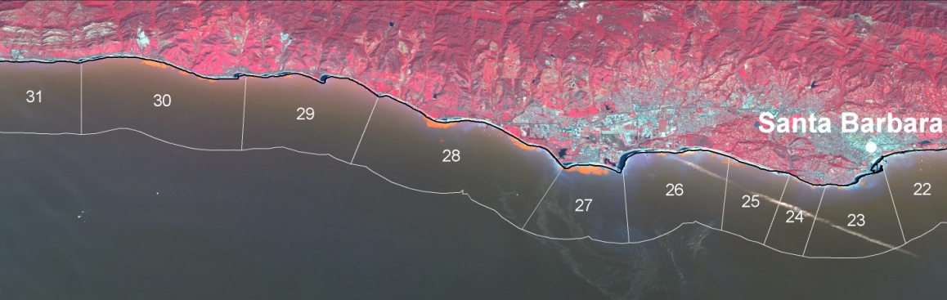
SPOT Summary
We can measure giant kelp biomass from multispectral satellite imagery
The relationship between transect and bed scale measurements depends on the size of the bed and the location of the transect within the bed
Beds in the region had similar dynamics

Slide 12
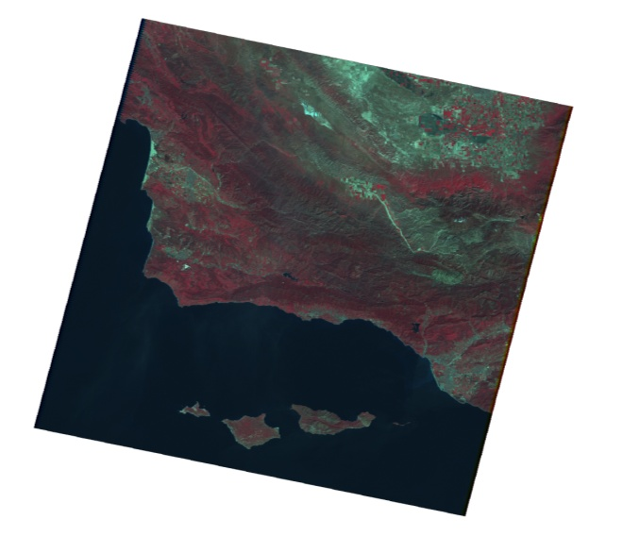
LANDSAT 5
SPOT time series limited (2006-2008)
  Does not allow us to sample winter storm disturbance regime effectively
We now have turned to LANDSAT 5
  Spatial scale is 30 m vs. 10 m BUT…
  Gives us a regularly sampled (clear images every ~1-2 months), 25 year record to work with
Notes:
Time series!!! LDCM

Slide 13
LANDSAT Goals
Can we get biomass from LANDSAT as we did with SPOT?
What is driving temporal variability of giant kelp biomass in the Santa Barbara Channel? How is that affecting NPP?

Slide 14
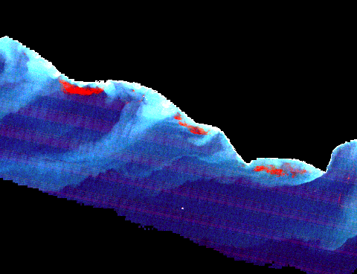
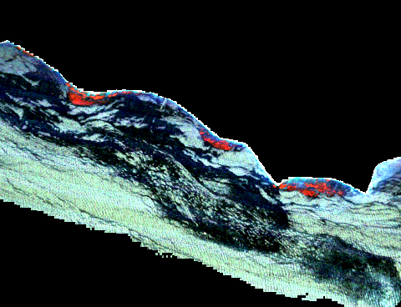
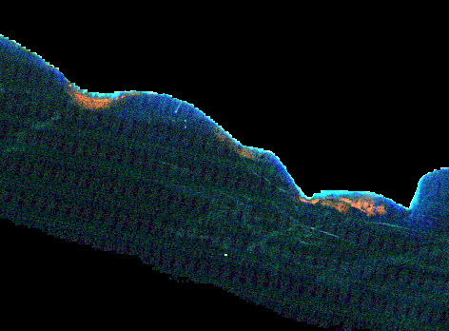
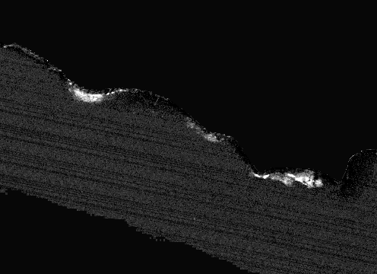
Methods: LANDSAT Spectral Unmixing
Relative atmospheric correction w/ ACORN and empirical line method
Spectral Mixture Analysis
  Single kelp endmember used for all scenes
  30 water members selected from each scene to account for sun glint, sediment runoff, phytoplankton, etc.
  Water endmember allowed to vary for each pixel. Optimal endmember chosen based on minimum RMSE
False color image
Kelp fraction image

Slide 15
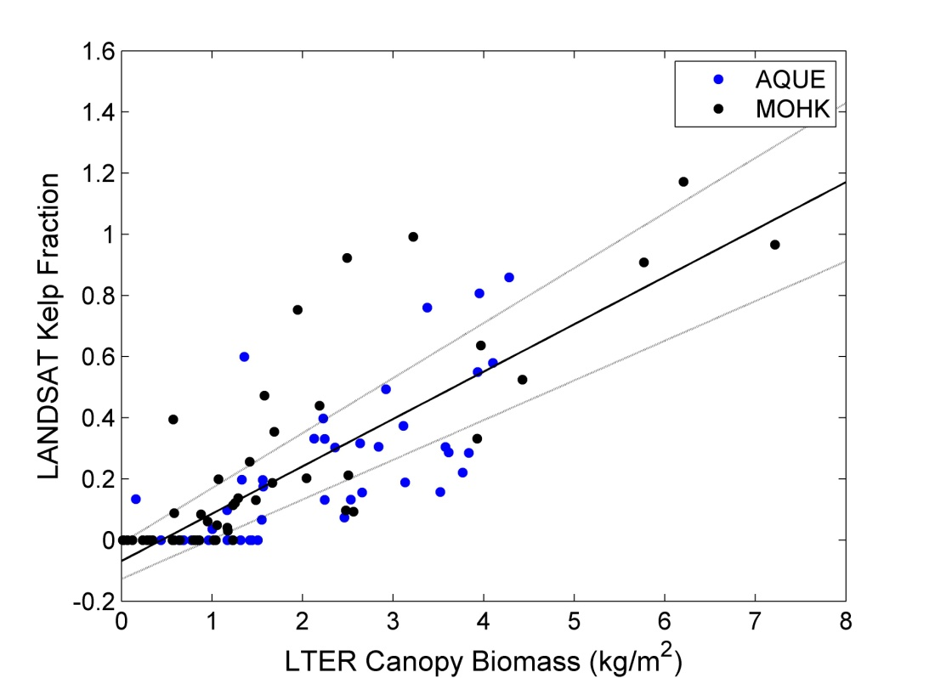
Methods: Biomass from LANDSAT
Strong relationship between kelp fraction and diver measured canopy biomass
r² = 0.62

Slide 16
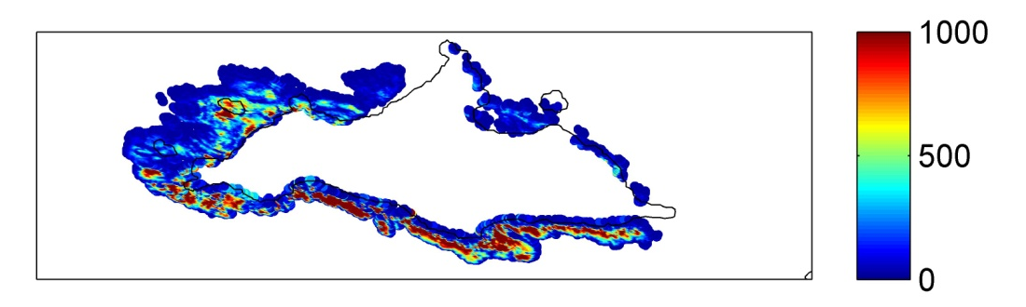
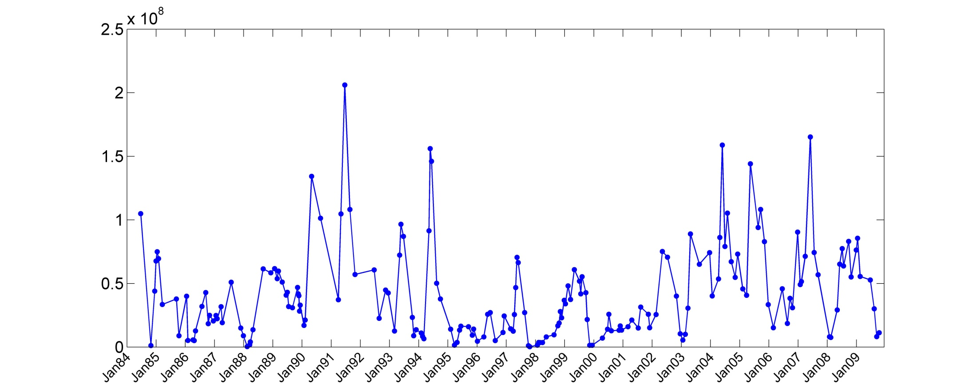
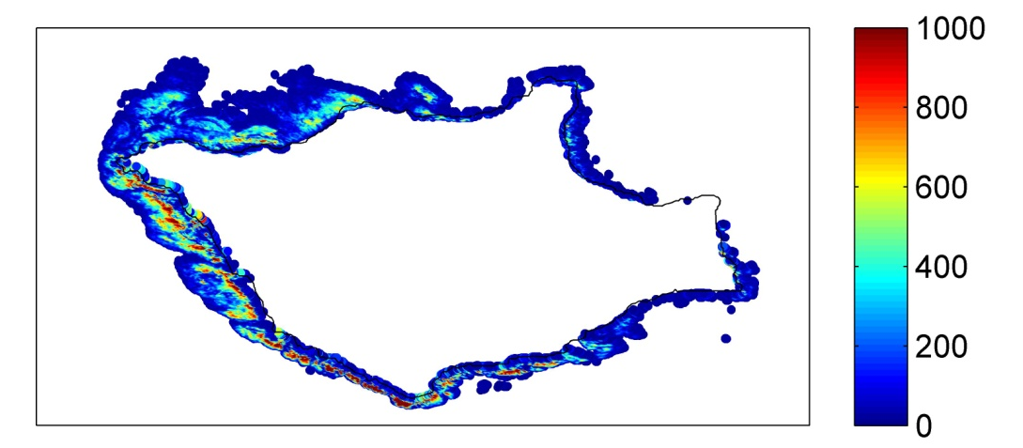
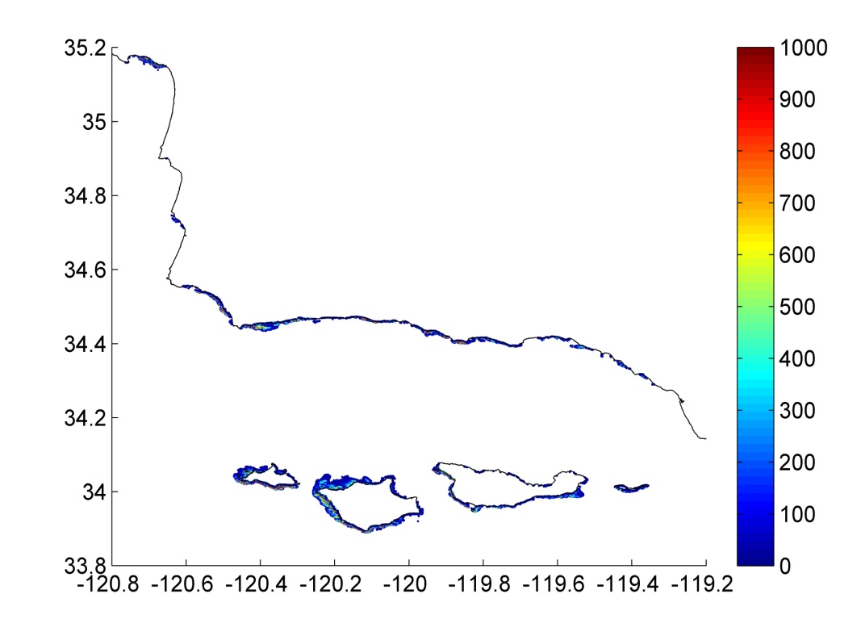
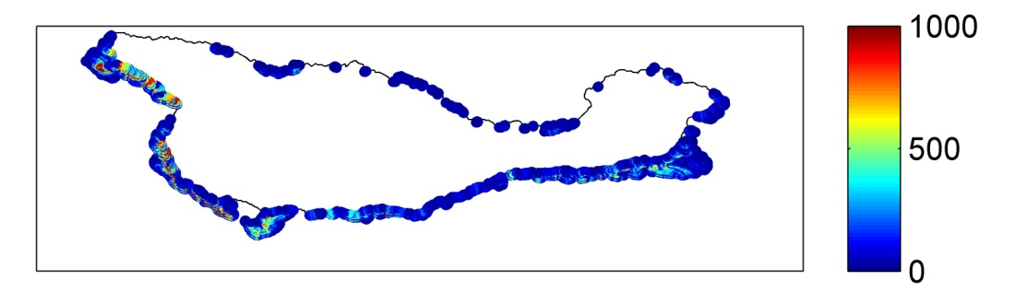
Kelp dynamics in the SB Channel (1984-2009)
Regional Mean: 41500 metric tons of kelp canopy
Regional CV: 87%
Santa Barbara Channel
Mean Biomass (kg)
Biomass (kg)
El Nino
El Nino
mean
Notes:
Years around El Ninos have low means and low variability
Southwest facing coastlines have higher means and higher persistence

Slide 17
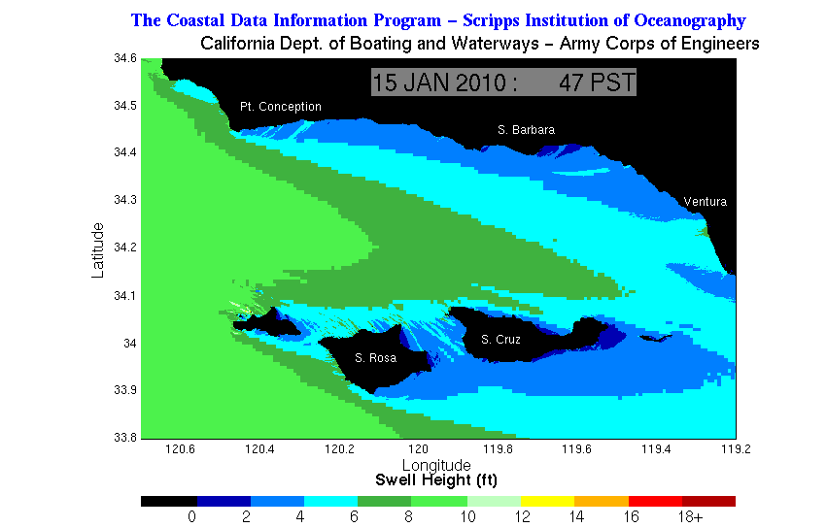
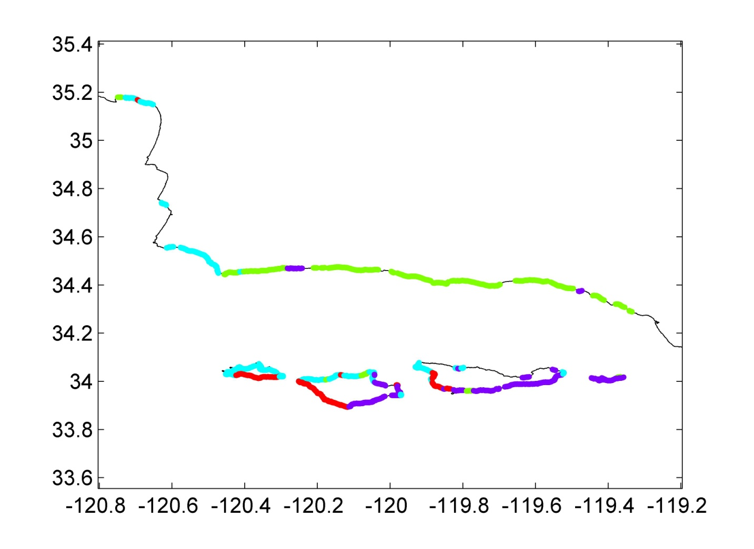
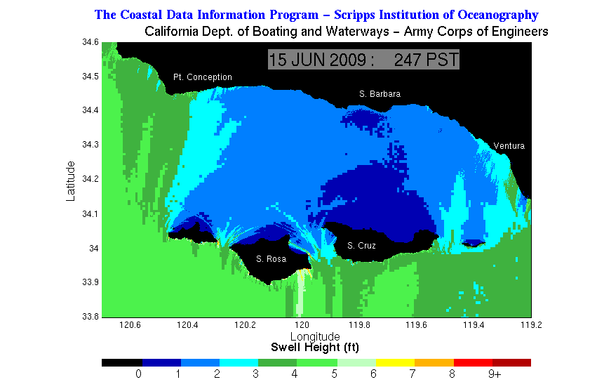
Cluster Analysis
Typical winter swell regime
Typical summer swell regime
At 1 km scale, dynamics are driven by wave disturbance
Notes:
Fits with SPOT finding that beds along SB mainland had similar dynamics

Slide 18
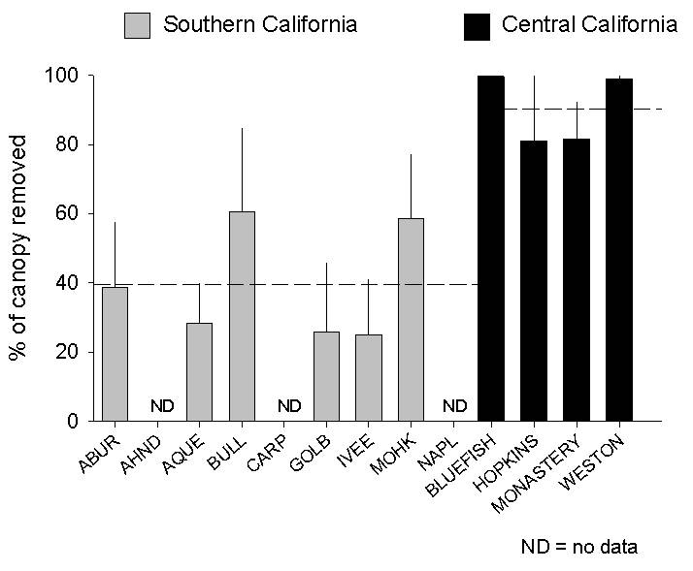
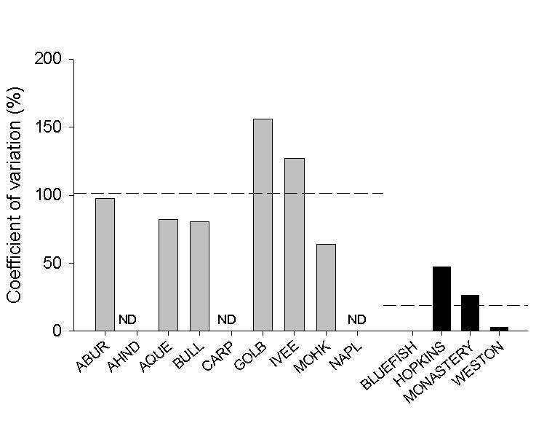
Regional Patterns of Disturbance (using LANDSAT data)
Mean winter kelp loss
Inter-annual variation in kelp loss
mean
(Reed et al. in prep)
Disturbance from winter storms in central California was more than 2X as high, but only about ¼ as variable as southern California

Slide 19
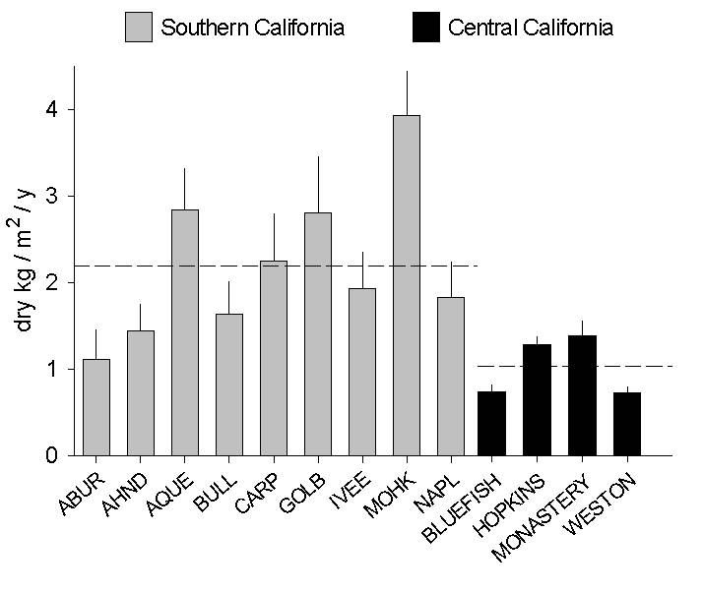
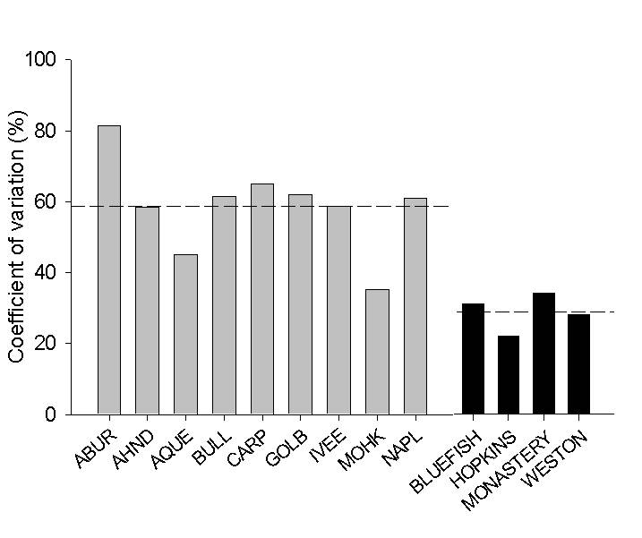
Sub-regional Patterns of NPP (from diver data) are consistent with disturbance patterns
Mean annual NPP
Interannual variation in NPP
Annual NPP by Macrocystis was ~ twice as high and twice as variable in S. California compared to C. California
Notes:
NPP nearly twice as high and twice as variable in southern California
Consistent with predictions of disturbance
Consistent with our assumption that disturbance induced decreases in biomass contribute more to interannual variability in NPP than disturbance induced increases in recruitment and growth
One can ask then, How might these patterns be affected by climate change in California?

Slide 20
Climate Change in California
Winter storm intensity, as measured by residual non-tidal water height, and frequency have increased in California since 1950
(Ruggiero et al. 2010)

Slide 21
LANDSAT Summary
We have created a time series of giant kelp biomass in the Santa Barbara Channel between 1984-2010 with unprecedented spatial and temporal resolution from LANDSAT imagery
Temporal dynamics at the 1 km scale seem to be driven largely by wave exposure
Kelp forests in areas with higher wave exposure have lower and less variable NPP

Slide 22
Next Steps: Gridded Kelp Metapopulation Model
Trophic interactions
f(species)
Growth
f(nutrients, kelp_{i})
Kelp biomass _{j ≠ i}
Kelp biomass _{i}
Wave mortality
f(H_{s}, T, exposure, depth)
Colonization
f(substrate, nutrients, temp, kelp_{j}, kelp_{i})
Senescence
f(time, age, nutrients, temp)
Notes:
statistical model of growth, disturbance, colonization based on correlative analyses

Slide 23
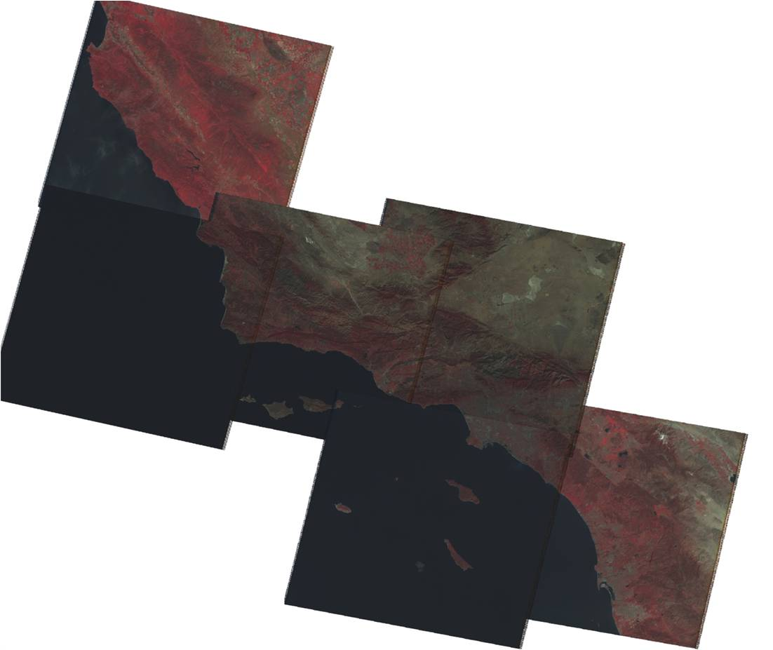
Next Steps: Expansion of Study Area
Monterey
Entire Southern California Bight has excellent LANDSAT 5 coverage (clear images every ~1-2 months from 1984-present)
Allows us to incorporate detailed diver data from Monterey, San Nicolas, Palos Verdes, San Onofre, Pt. Loma
Santa Barbara
Los Angeles
San Diego
Notes:
HYSPIRI

Slide 24
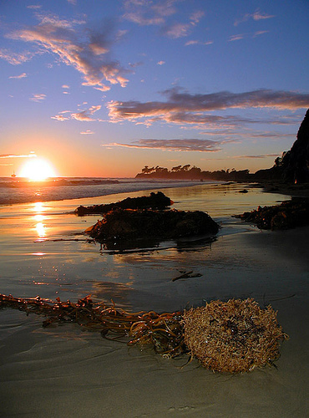
Thank You!!

